Slide 1




Odyssey: A Journey in the Land of Distributed Data Series Similarity Search
Manos Chatzakis, Panagiota Fatourou, Eleftherios Kosmas, Themis Palpanas, Botao Peng
Notes:
Hi everyone, I am Manos Chatzakis from EPFL, and I will present our work on Distributed Data Series Similarity Search.
Odyssey is our framework that succesfully addresses various challenges of distributed Similarity Search, proposing scalable distributed query scheduling and load balancing, while it gracefully navigates the trade-offs between memory limitations and query answering performance.

Slide 2
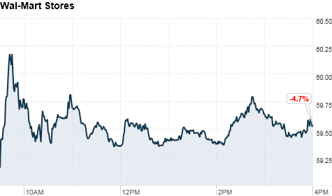
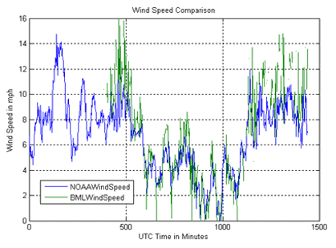
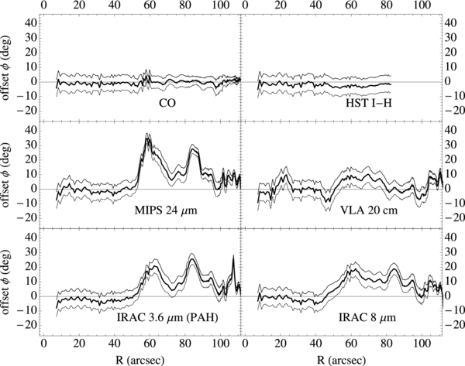
Motivation
Data points ordered along a dimension
Multiple real-world applications
  Seismology (Seismic Stations)
  Astrophysics (Telescopes)
  Neuroscience (fMRI)
Extract knowledge using similarity search
Similarity search is pivotal for data series processing!
Notes:
Data series, defined as data points ordered along a dimension,
have multiple real-world applications,
across virtually every scientific and social domain.
One of the most promising methods to extract knowledge from data series is similarity search,
which, given a query with a data series collection,
is the task of locating the most similar data series to the query in that collection,
and it has a pivotal role for data series processing.
Wind speed
http://bml.ucdavis.edu/boon/wind.html
Astro Data (Whirlpool Survey)
https://arxiv.org/pdf/1304.1801.pdf
Stocks
http://money.cnn.com/2012/04/23/markets/walmart_stock/index.htm

Slide 3
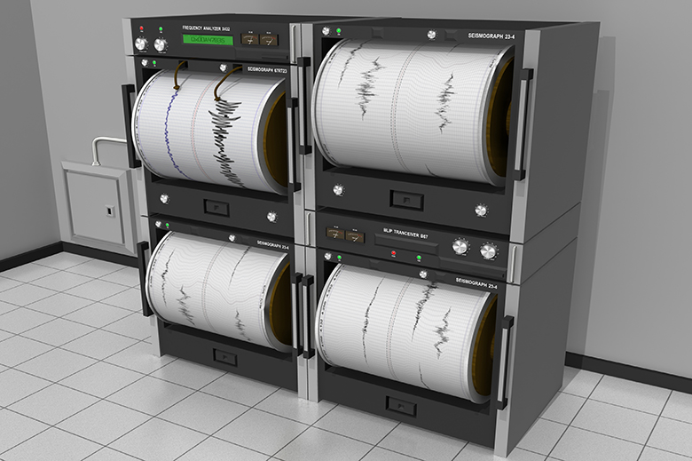
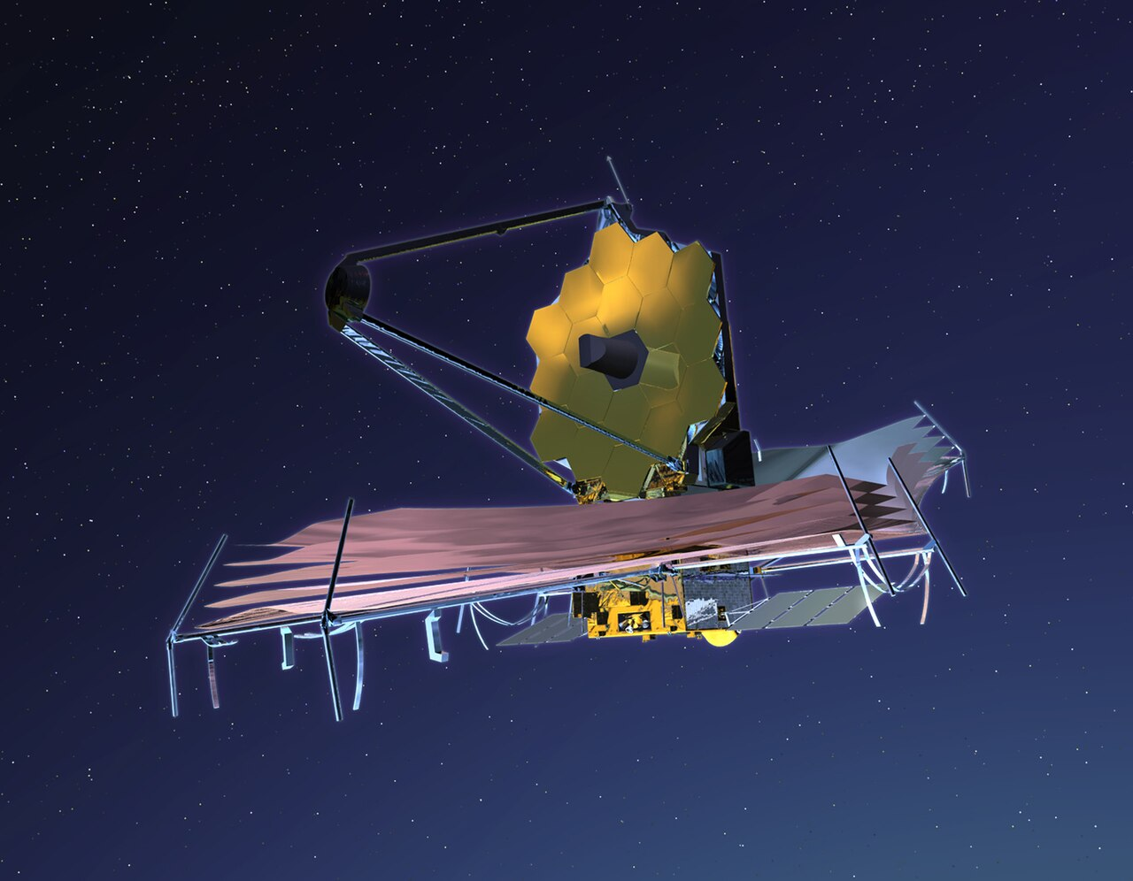
Problems
Extreme Data Growth
  PetaBytes of Data Series daily
  Imbossible to fit in a single node
Applications need fast responses
  Single-node parallelism protocols inadiquate
In-memory processing is fast, but limited by memory size
Shifting to distributed processing is crucial!
Notes:
Nowadays we face critical problems in data series management.
As Petabytes of data series are produced daily, it is impossible to fit big data collections in a single machine, while the limited memory size has made the fast in-memory processing more challenging.
In addition, the increasing need for availability in modern applications sets the single-machine parallelism inadequate.
This is why, shifting to distributed processing is crucial to address these problems.

Slide 4
Challenges
Query Scheduling: Which queries to which nodes?
  Data Replication?
  Hardness Estimations?
Load Balancing: Enable nodes to perform useful and equal work
  Data Distribution?
  Inaccurate Estimations?
  Helping?
Notes:
Unfortunately, distributed processing has challenges that we need to overcome.
The first challenge relates to query scheduling, as we need to decide which queries will be assigned to which nodes of the system.
In order to perform efficient scheduling, the data should be replicated, while we also need estimations about how hard is each query, based on its execution time.
The second challenge is load balancing, because we need all nodes to perform useful and equal work.
We need to create algorithms that distribute the data fairly, distributing the good answers equally over the system.
We also need to handle inaccurate estimations and enable nodes to help each other.

Slide 5
Challenges
Query Scheduling: Which queries to which nodes?
  Query Execution Time estimations
  Flexible Replication Schemes
  Dynamic Scheduling
Load Balancing: Enable nodes to perform useful and equal work
  Data Distribution?
  Inaccurate Estimations?
  Helping?
Notes:
(Odyssey proposes mechanisms that efficiently address those challenges.)
Our framework can generate query hardness estimations and supports flexible data replication schemes that enable scalable dynamic scheduling.

Slide 6
Challenges
Query Scheduling: Which queries to which nodes?
  Query Execution Time estimations
  Flexible Replication Schemes
  Dynamic Scheduling
Load Balancing: Enable nodes to perform useful and equal work
  Density-aware Distribution
  Work-Stealing
  a
Notes:
In addition, Odyssey addresses load balancing by distributing the data in a density-aware manner, ensuring that good answers will be distributed fairly across the system.
Moreover, the framework utilizes a novel single-node similarity search algorithm, that allows efficient query answering and work-stealing opportunities.

Slide 7
Challenges
Query Scheduling: Which queries to which nodes?
  Query Execution Time estimations
  Flexible Replication Schemes
  Dynamic Scheduling
Load Balancing: Enable nodes to perform useful and equal work
  Density-aware Distribution
  Work-Stealing
  a
Odyssey successfully addresses these challenges!
Notes:
Overall, Odyssey utilizes all those methods to succesfully address the distributed challenges!

Slide 8
Odyssey:
Single-node query answering
Load data in-memory and build index
Single traversal to obtain an approximate first answer (1st BSF)
Search all index for exact search
  Use BSF for pruning
  Update BSF when better answers are found
raw data
build index tree
Notes:
To answer a query, each node builds an in-memory index based on its local data,
and performs a traversal over the index to obtain an approximate answer,
which is called 1st BSF.
BSF is later used during exact search, where all index is processed, in order to prune regions of the tree,
while we update BSF everytime we find a better answer.

Slide 9
Odyssey:
Single-node query answering
Distances of data series less than BSF stored in priority queues
  Priority Queues have a size threshold
Split index to subtree batches and process each batch
  We know the origin of each priority queue
root
RS-batch 1
RS-batch 2
RS-batch N
PQ
PQ
PQ
PQ
PQ
PQ
PQ
PQ
PQ
PQ
PQ
PQ
Place leaves in priority queues for processing!
Notes:
Throughout query answering,
the distances of data series less than BSF are stored in priority queues,
which have a size threshold.
When the theshold of a priority queue is reached, we create a new one.
To be able to monitor the origin of each priority queue,
we split the index into subtree batches,
generating the corresponding priority queues according to each batch.
This single-node algorithm design
is crucial to accommodate our work-stealing,
which we will present later.

Slide 10
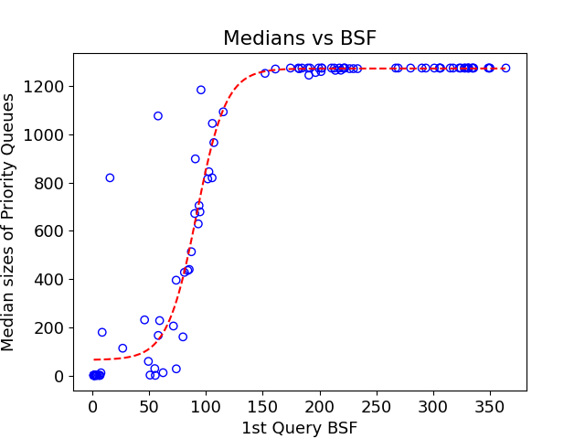
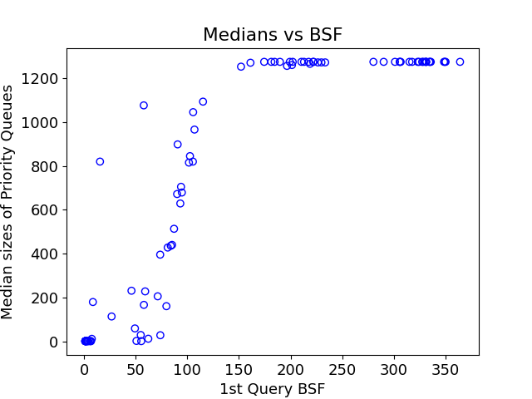
Odyssey:
Single-node query answering
Priority Queue Size Threshold Estimation
  Correlation between 1st BSF and median size of the priority queues of the query
Notes:
To determine the priority-queue threshold for each query,
we noticed that there exists a correlation between the 1st BSF and the median size of the priority queues produced for answering it.

Slide 11
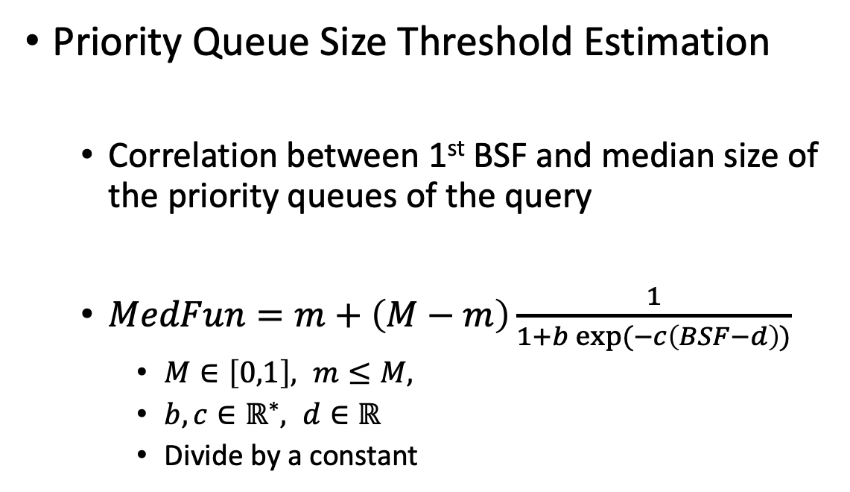
Odyssey:
Single-node query answering
Priority Queue Size Threshold Estimation
  Correlation between 1st BSF and median size of the priority queues of the query
  $MedFun=m+\left(M−m\right)\frac{1}{1+b exp⁡(−c\left(BSF−d\right))}$
    $M∈\left[0,1\right], m≤M,$
    $b,c∈ℝ^{∗}, d∈ℝ$
    Divide by a constant
We determine the threshold using a sigmoid!
Notes:
Thus, we fitted a sigmoid function to our data,
and we use the generated value of sigmoid as our threshold.

Slide 12
Odyssey:
Single-node query answering
Gather the priority queues
Sort based on min element
Start processing and prune or update the BSF
PQ
PQ
PQ
PQ
PQ
PQ
PQ
PQ
PQ
PQ
PQ
PQ
min
max
PQ
PQ
PQ
PQ
PQ
PQ
PQ
PQ
PQ
PQ
PQ
PQ
Most promising queues are processed first!
Notes:
After the priority queues are filled, we sort them in a single array,
in order to bring the most promising priority queues first and be able to do a lot of pruning, and generate a final answer.

Slide 13
Distributed Data Series Similarity Search:
Naïve Solution
sn1
sn2
sn3
sn4
Notes:
So, lets see now what would be a naïve solution to shift to distributed processing.
We begin with 4 system nodes.

Slide 14
Naïve Solution
Dataset
sn1
sn2
sn3
sn4
Dataset
Notes:
And we have a dataset

Slide 15
Naïve Solution:
Equally Split
Dataset
chunk1
chunk2
chunk3
chunk4
sn1
sn2
sn3
sn4
Dataset
Notes:
Which we will split in as many chunks as the available system nodes,

Slide 16
Naïve Solution:
Equally Split
Dataset
chunk1
chunk2
chunk3
chunk4
sn1
sn2
sn3
sn4
Dataset
Notes:
And each system node will be assigned its chunk

Slide 17
Naïve Solution:
Equally Split
Dataset
chunk1
chunk2
chunk3
chunk4
sn1
sn2
sn3
sn4
Dataset
Notes:
In order to build the local index.

Slide 18
Naïve Solution:
Equally Split
sn1
sn2
sn3
sn4
Dataset
Notes:
Then, to answer a query

Slide 19
Naïve Solution:
Equally Split
Queries
sn1
sn2
sn3
sn4
Dataset
Notes:
From a query batch,

Slide 20
Naïve Solution:
Equally Split
Queries
sn1
sn2
sn3
sn4
Dataset
Notes:
We would need to answer the queries one by one,

Slide 21
Naïve Solution:
Equally Split
Queries
sn1
sn2
sn3
sn4
Dataset
Notes:
Forwarding each query to all nodes, in order to search all the dataset.

Slide 22




Naïve Solution:
Equally Split
Queries
sn1
sn2
sn3
sn4
Dataset
Notes:
Each node would process the query based on its local data,

Slide 23
Naïve Solution:
Equally Split
Queries
sn1
sn2
sn3
sn4
Dataset
Notes:
And the answers of all nodes

Slide 24
Naïve Solution:
Equally Split
Queries
sn1
sn2
sn3
sn4
collect partial answers,
compute global answer
Dataset
Notes:
Will be gathered to select the best one.

Slide 25
Problem Solved?
Enables in-memory processing of very large datasets, but:
Chunking Data partitioning leads to imbalances
  Good answers might end up on a single node
Query answering is not scalable
  Nodes store different data subsets: no query scheduling!
  If a node finishes its work early, it will remain idle: cannot help others
Notes:
So did we solve the problem?
Well, although this “equally-split” method enables the in-memory processing of large datasets, it suffers from several shortcomings.
First of all, the naïve chunking-based data partitioning sometimes may lead to imbalances between the workload of the nodes.
Think of a scenario were all good answers are stored in the same chunk.
The node processing this chunk will have a lot work to do, as it will do less pruning, due to the fact that it will need to calculate the distances of all good answers.
In this scenario, all other nodes will remain idle, unable to help.
In addition, this approach does not lead to scalable query answering.
As nodes operate in different subsets, all queries should be forwarded to all nodes, not allowing any scheduling.
Also, since each node stores different data, it is impossible for nodes to help each other in case of imbalances.

Slide 26
Problem Solved?
Enables in-memory processing of very large datasets, but:
Chunking Data partitioning leads to imbalances
  Good answers might end up on a single node
Query answering is not scalable
  Nodes store different data subsets: no query scheduling!
  If a node finishes its work early, it will remain idle: cannot help others
Data Distribution and Replication are crucial for scalable query answering!
Notes:
Thus, sophisticated data distribution and data replication schemes are crucial in order to support scalable query answering!

Slide 27
Odyssey Solution
sn1
sn2
sn3
sn4
Dataset
Notes:
Odyssey tackles the challenges in the following manner: We start from the same system of 4 nodes.

Slide 28
Odyssey Solution
Dataset
sn1
sn2
sn3
sn4
Dataset
Notes:
with the same data series dataset.

Slide 29

Odyssey Solution
Dataset
Density Aware Partitioning
sn1
sn2
sn3
sn4
Dataset
Notes:
The dataset is now preprocessed by our density-aware partitioning algorithm that fairly distributes the data over the system.

Slide 30
Odyssey Solution
Dataset
Density Aware Partitioning
Compute binary summarizations (iSAX) of the Data Series (Shieh et al. Knowl. Dic. Data Mining)
000
001
010
011
100
101
110
111
…
Raw Data Series
Dataset
Notes:
Our algorithm achieves that by calculating binary summarizations of the Data Series, and groups them in buffers according to their summarization code.

Slide 31
Odyssey Solution
Dataset
Density Aware Partitioning
Compute binary summarizations (iSAX) of the Data Series (Shieh et al. Knowl. Dic. Data Mining)
Order the summarizations according to Gray Code (Robert Doran, J. Univers. Comput. Sci.)
000
001
010
011
100
101
110
111
…
000
001
011
010
110
111
101
100
…
Raw Data Series
Dataset
Notes:
Then, it reorders the buffers into an alternative ordering, according to gray code.
We do that because gray code places similar buffers close to one another, enabling us to easily assign their data series to different system nodes in a round-robin fashion.

Slide 32
Odyssey Solution
Dataset
Density Aware Partitioning
Compute binary summarizations (iSAX) of the Data Series (Shieh et al. Knowl. Dic. Data Mining)
Order the summarizations according to Gray Code (Robert Doran, J. Univers. Comput. Sci.)
000
001
010
011
100
101
110
111
…
000
001
011
010
110
111
101
100
…
Select number of partitions (e.g., 2)
Partition data of the largest buffers
Partition remaining buffers
Raw Data Series
Dataset
Notes:
As a last step, we select the number of partitions, for this example, 2, and the algorithm starts by partitioning the largest buffers first, before partitioning the smaller ones.
This process is repeated till we have two balanced partitions.
This way, we manage to distribute the data series fairly, ensuring that similar data series won't end up in the same node.

Slide 33
Odyssey Solution
Dataset
Density Aware Partitioning
sn1
sn2
sn3
sn4
Dataset
Notes:
Since we selected to create two partitions,

Slide 34
Odyssey Solution
Dataset
Density Aware Partitioning
chunk1
chunk2
sn1
sn2
sn3
sn4
Dataset
Notes:
The density aware algorithm generates two data chunks.

Slide 35
Odyssey Solution
Dataset
Density Aware Partitioning
chunk1
chunk2
sn1
sn2
sn3
sn4
Dataset
Notes:
In Odyssey, we replicate those chunks to several nodes. In this example, chunk1 is replicated to nodes 1 and 2, while chunk2 to nodes 3 and 4.

Slide 36
Odyssey Solution
Dataset
Density Aware Partitioning
chunk1
chunk2
sn1
sn2
sn3
sn4
Dataset
Notes:
Now, we have sets of nodes sharing the same data,

Slide 37
Replication Groups
sn1
sn2
sn3
sn4
Dataset
Notes:
And we have created what we call replication groups.

Slide 38
Replication Groups
Partial-2 Replication
(2 replication groups)
sn1
sn2
sn3
sn4
replication group 1
replication group 2
Dataset
Notes:
This replication strategy of our framework is important, because inside a replication group, query scheduling is possible!

Slide 39
Replication Groups
Queries Batch
sn1
sn2
sn3
sn4
Dataset
Notes:
To answer a batch of queries,

Slide 40


Replication Groups
Queries Batch
sn1
sn2
sn3
sn4
Dataset
Notes:
each replication group loads the queries,

Slide 41
Replication Groups
Queries Batch
sn1
sn2
sn3
sn4
Scheduling Algorithm
Dataset
Notes:
And answers them using a scheduling algorithm, to execute them in the most efficient manner.

Slide 42
Replication Groups
Queries Batch
sn1
sn2
sn3
sn4
Scheduling Algorithm
Common BSF-Sharing Channel
Dataset
Notes:
In addition, to enhance the performance, nodes in odyssey share their BSFs through a common BSF-Sharing Channel, to provide the rest of the system with possible good answers.

Slide 43
Replication Groups
Queries Batch
sn1
sn2
sn3
sn4
Dataset
Notes:
Then, each replication group

Slide 44
Replication Groups
Queries Batch
sn1
sn2
sn3
sn4
Dataset
Notes:
generates the answers for each query,

Slide 45
Replication Groups
Queries Batch
sn1
sn2
sn3
sn4
collect partial answers,
compute global answer
Dataset
Notes:
And those answers are collected to generate a global answer for each query.

Slide 46
How to schedule the queries?
Dynamic Scheduling
  Coordinator node assigns queries to nodes of the replication group when they are available
Assign the most difficult query first
  Assign rest of work to other nodes
  Requires estimations of query execution time (hardness)
Notes:
To schedule the queries, Odyssey performs dynamic scheduling, using a coordinator node which assigns queries to the nodes of the same replication group when they are available.
Also, to enhance scheduling we would like to have query hardness estimations, in order to schedule hard queries first and assign the rest of the work to other nodes.

Slide 47
How to schedule the queries?
Dynamic Scheduling
  Coordinator node assigns queries to nodes of the replication group when they are available
Assign the most difficult query first
  Assign rest of work to other nodes
  Requires estimations of query execution time (hardness)
Query execution time estimations enable better scheduling!
Notes:
With estimations being available, we can perform even better scheduling!

Slide 48
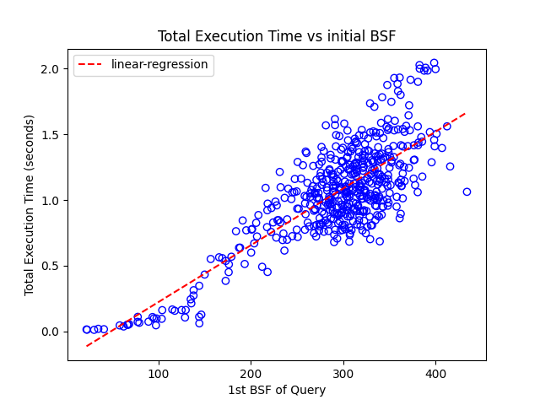

Estimating Execution Time
Correlation between 1st BSF and total execution time
  $pred=w ∗BSF+β$
Notes:
To generate the estimations of execution time, we correlated the 1st bsf and total execution time of the query, and performed a linear regression.

Slide 49
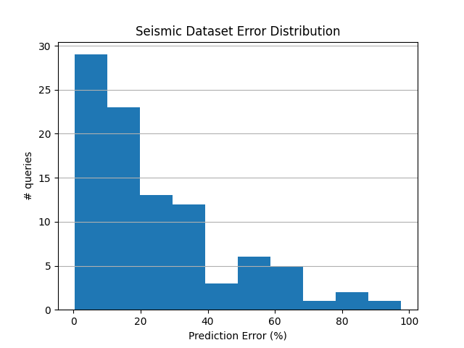
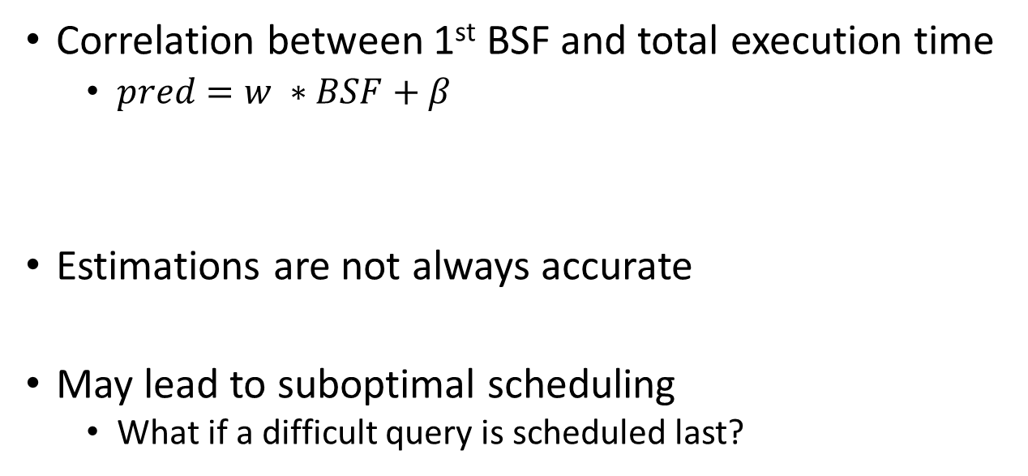
Estimating Execution Time
Correlation between 1st BSF and total execution time
  $pred=w ∗BSF+β$
Estimations are not always accurate
May lead to suboptimal scheduling
  What if a difficult query is scheduled last?
Notes:
However, regression can many times generate inaccurate estimations, and lead to suboptimal scheduling.
For example, a scenario where a hard query is misunderstood for an easy one and gets scheduled last would be problematic, as the node that will be assigned to it will be the only one working in the end, leading to imbalances.

Slide 50
Estimating Execution Time
Correlation between 1st BSF and total execution time
  $pred=w ∗BSF+β$
Estimations are not always accurate
May lead to suboptimal scheduling
  What if a difficult query is scheduled last?
We need a mechanism to handle inaccuracies!
Notes:
This why we need a mechanism to handle these exceptional cases, and thus, ensure good performance under all conditions.

Slide 51
Odyssey Work-Stealing
Within a replication group
When a node finishes its work with no other queries left
Helper node “steals” the priority queues that will be processed last
  by processing corresponding parts its local index
Queries Batch
sn1
sn2
sn3
sn4
work stealing
work stealing
Minimizes data-communication during work-stealing!
Notes:
This mechanism is a novel work stealing algorithm which operates within each replication group.
When a node has finished its own work and no other queries are left, it helps other nodes of the group by recreating their priority queues that would be processed last, as they contain the least-promising distances.
This helping scheme is efficient in practice and requires minimal data communication over the network, as the only information exchanged between the nodes is which subtree batch the priority queue belongs to.

Slide 52
Experimental Setup
Cluster of 16 SR645 Nodes
  128 physical cores (no hyperthreading)
  200GB available memory
Datasets:
  Seismic (100GB): 100M Series
  Astro (265GB): 270M Series
  Yan-TtI (800GB): 1B Series
  SIFT (477GB): 1B Series
  Deep (358GB): 1B Series
  Random (100-1600GB): 100-1600M Series
Notes:
Our experimental evaluation was performed using a cluster of 16 nodes that had 200GB of available memory and 128 cores each,
and we utilized several data series datasets of varying sizes.

Slide 53
Competitors
(distributed variant, Peng et Al. IEEE Data Eng.)
(distributed variant)
(Yagoubi et Al. IEEE Data Mining)
(Odyssey, naive)
(Odyssey, no rep.)
(Odyssey, 1 rep. group)
Odyssey can be 3x faster than the best competitor!
Notes:
This graph presents the comparison of multiple Odyssey variations with other competitors, for 100GB of seismic data.
The X-axis represents the number of the nodes, while on the Y-axis we report the total query answering time for a batch of 100 queries.
The variations of Odyssey we used are the naïve equally-split, the no-replication case with the density aware distribution and the full-replication version of odyssey, where all nodes load all data.
From the graph, we see that all variations of Odyssey manage to outperform their competitors and
that Odyssey can be more than 3x times faster than its best competitor.

Slide 54
Replication
(no replication, naive)
(4 replication groups)
(2 replication groups)
(1 replication group)
more replication,
faster query answering
More replication enhances query answering!
Notes:
This graph represents the query answering performance of Odyssey for multiple replication settings, for 100 queries of seismic data, starting from no replication, to full replication, using density-aware distribution.
X-axis represents the total nodes in each configuration, while Y-axis reports the total query answering time.
As we see, when any replication setting is used, faster and scalable query answering is achieved.

Slide 55
Throughput
Scalable query answering for multiple workloads!
Notes:
This last graph presents the throughput of odyssey for 100GB of random data and multiple query workloads, using full replication.
We see that odyssey performs highly scalable query answering and scales almost perfectly for several workloads.

Slide 56

Summary
Distributed Data Series Similarity Search
  has many real-world applications
  is a hard problem with several intertwining challenges
Odyssey:
  Addresses distributed challenges
  Achieves significant speedup
  Gracefully navigates trade-off between space (memory requirements) and time (query execution)
Notes:
To summarize, we care about distributed data series similarity search because it has many real-world applications,
but it is a hard problem with several intertwining challenges.
We presented Odyssey, a framework that addresses the distributed challenges,
it achieves significant speedup compared to competitors and is able to navigate the trade-offs between memory requirements and query execution time.

Slide 57


Thank you!
Questions?
Poster E5-74

Slide 58

Appendix

Slide 59
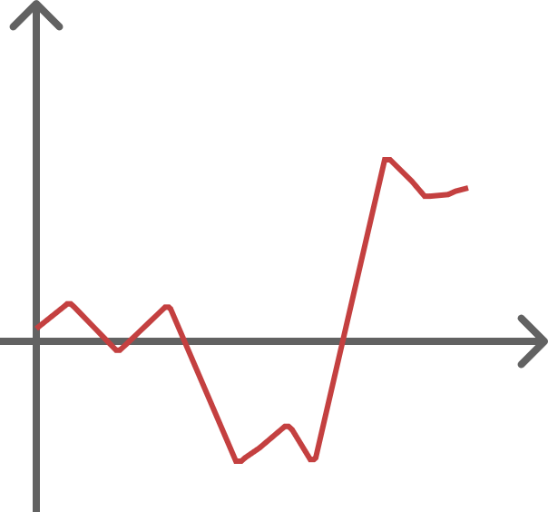
Data Series
Summarize data series as bitwise representation (iSAX)

Slide 60
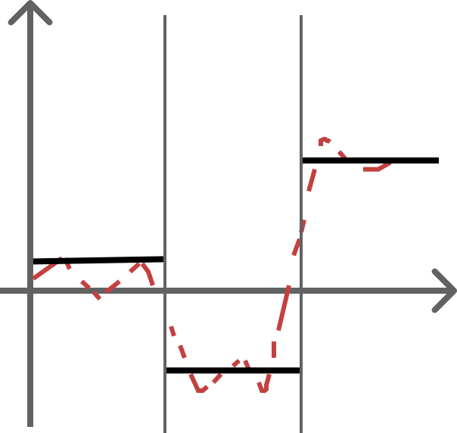
Data Series
PAA segments = 3
Summarize data series as bitwise representation (iSAX)
  Split x-axis (PAA segments)

Slide 61
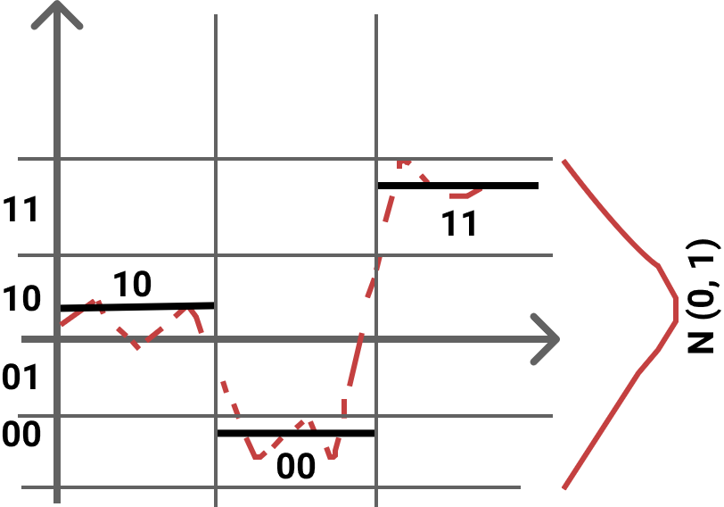
Data Series
PAA segments = 3
Cardinality = 2 bits
iSAX summary = 10 00 11
Summarize data series as bitwise representation (iSAX)
  Split x-axis (PAA segments)
  Split y-axis (cardinality)

Slide 62
Data Series
PAA segments = 3
Cardinality = 2 bits
iSAX summary = 10 00 11
Summarize data series as bitwise representation (iSAX)
  Split x-axis (PAA segments)
  Split y-axis (cardinality)
From data series to binary representations!

Slide 63
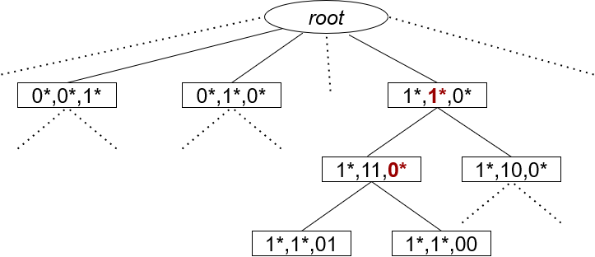
Data Series
Query: 10,11,00
Similarity Search:
  Obtain a temporary answer by traversing the tree, matching the summaries (approximate search)
  Search all tree using BSF to prune subtrees
Index allows high pruning rates!

Slide 64
Query Scheduling
work-steal-predict method outperforms all!
Notes:
Seismic
Partial-2

Slide 65
Throughput (2 replication groups)
Scalable query answering for multiple workloads!
Notes:
This last graph presents the throughput of odyssey for 100GB of random data and multiple query workloads, using two replication groups (partial-2).
We see that odyssey performs highly scalable query answering with linear speedup for different query batches!

Slide 66
KNN with Replication
Same trends for k-NN!
Notes:
20-NN with random 100 GB

Slide 67
DTW With Replication
Same trends for DTW!

Slide 68
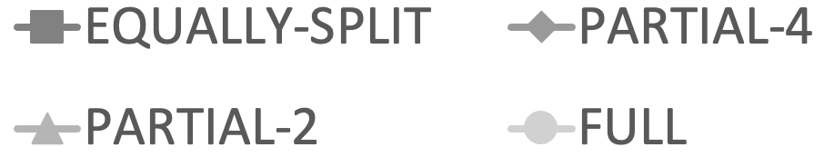
Replication (100 Queries)
Notes:
Seismic 100 queries

Slide 69
Replication (800 queries)
Replication with big query batches leads to better total time!

Slide 70
Data Replication
Partial-4 Replication
(4 replication groups)
chunk1
chunk2
chunk3
chunk4
sn1
sn2
sn3
sn4
work stealing
work stealing
work stealing
work stealing
BSF
Sharing
sn5
sn6
sn7
sn8
replication group 1
replication group 2
replication group 3
replication group 4

Slide 71
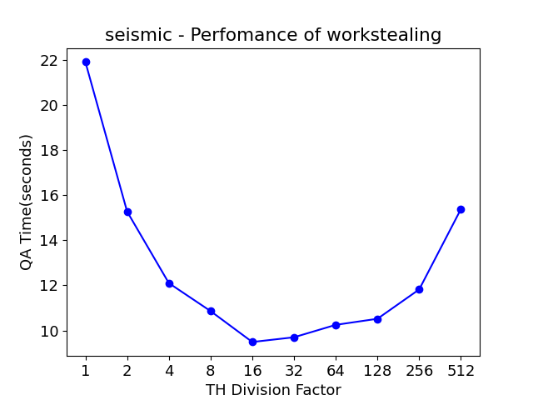
Odyssey:
Single-node query answering
Priority Queue Size Threshold Estimation
  Correlation between 1st BSF and median size of the priority queues of the query
  $MedFun=m+\left(M−m\right)\frac{1}{1+b exp⁡(−c\left(BSF−d\right))}$
    $M∈\left[0,1\right], m≤M,$
    $b,c∈ℝ^{∗}, d∈ℝ$
    Divide by a constant
Notes:
Thus, we fitted a sigmoid function to our data,
and we use the generated value of sigmoid as our threshold.

Slide 72
Replication Index Size
more replication,
bigger index size
More replication requires more memory!

Slide 73
Resources
Code: https://github.com/PLATON-MARIE-CURIE-PROJECT/Odyssey
Paper: https://www.vldb.org/pvldb/vol16/p1140-chatzakis.pdf

