Slide 1


Blocking for BIG Data Integration
Challenges, Algorithms, Practical Examples
updated: 12 May 2017
George Papadakis Themis Palpanas
University of Athens Paris Descartes University
gpapadis@di.uoa.gr themis@mi.parisdescartes.fr

Slide 2
Entities: an invaluable asset
“Entities” is what a large part of our knowledge is about:
Locations
Organizations
Projects
Persons
Products
Events
Notes:
The first question we have to answer is why entity resolution is important.
Web data are dominated by entity profiles.
In an ideal world, every entity is described by a universally unique identifier, thus facilitating all applications that are based on entities, e.g., entity-centric search.

Slide 3

However …
How many names, descriptions or IDs (URIs) are
used for the same real-world “entity”?
Notes:
In reality, there is ambiguity/noise of two forms:
different entities with the same description/name, and
same entity with different descriptions/names.

Slide 4
However …
How many names, descriptions or IDs (URIs) are
used for the same real-world “entity”?
London 런던 ܠܘܢܕܘܢ लंडन लंदन લંડન ለንደን ロンドン লন্ডন ลอนดอน இலண்டன் ლონდონი Llundain Londain Londe Londen Londen Londen Londinium London Londona Londonas Londoni Londono Londra Londres Londrez Londyn Lontoo Loundres Luân Đôn Lunden Lundúnir Lunnainn Lunnon لندن لندن لندن لوندون לאנדאן לונדון Λονδίνο Лёндан Лондан Лондон Лондон Лондон Լոնդոն 伦敦 …

Slide 5
However …
How many names, descriptions or IDs (URIs) are
used for the same real-world “entity”?
London 런던 ܠܘܢܕܘܢ लंडन लंदन લંડન ለንደን ロンドン লন্ডন ลอนดอน இலண்டன் ლონდონი Llundain Londain Londe Londen Londen Londen Londinium London Londona Londonas Londoni Londono Londra Londres Londrez Londyn Lontoo Loundres Luân Đôn Lunden Lundúnir Lunnainn Lunnon لندن لندن لندن لوندون לאנדאן לונדון Λονδίνο Лёндан Лондан Лондон Лондон Лондон Լոնդոն 伦敦 …
capital of UK, host city of the IV Olympic Games, host city of the XIV Olympic Games, future host of the XXX Olympic Games, city of the Westminster Abbey, city of the London Eye, the city described by Charles Dickens in his novels, …

Slide 6
However …
How many names, descriptions or IDs (URIs) are
used for the same real-world “entity”?
London 런던 ܠܘܢܕܘܢ लंडन लंदन લંડન ለንደን ロンドン লন্ডন ลอนดอน இலண்டன் ლონდონი Llundain Londain Londe Londen Londen Londen Londinium London Londona Londonas Londoni Londono Londra Londres Londrez Londyn Lontoo Loundres Luân Đôn Lunden Lundúnir Lunnainn Lunnon لندن لندن لندن لوندون לאנדאן לונדון Λονδίνο Лёндан Лондан Лондон Лондон Лондон Լոնդոն 伦敦 …
capital of UK, host city of the IV Olympic Games, host city of the XIV Olympic Games, future host of the XXX Olympic Games, city of the Westminster Abbey, city of the London Eye, the city described by Charles Dickens in his novels, …
http://sws.geonames.org/2643743/
http://en.wikipedia.org/wiki/London
http://dbpedia.org/resource/Category:London
…

Slide 7
… or …
How many “entities” have the same name?
  London, KY
  London, Laurel, KY
  London, OH
  London, Madison, OH
  London, AR
  London, Pope, AR
  London, TX
  London, Kimble, TX
  London, MO
  London, MO
  London, London, MI
  London, London, Monroe, MI
  London, Uninc Conecuh County, AL
  London, Uninc Conecuh County, Conecuh, AL
  London, Uninc Shelby County, IN
  London, Uninc Shelby County, Shelby, IN
  London, Deerfield, WI
  London, Deerfield, Dane, WI
  London, Uninc Freeborn County, MN
  ...

Slide 8
… or …
How many “entities” have the same name?
  London, KY
  London, Laurel, KY
  London, OH
  London, Madison, OH
  London, AR
  London, Pope, AR
  London, TX
  London, Kimble, TX
  London, MO
  London, MO
  London, London, MI
  London, London, Monroe, MI
  London, Uninc Conecuh County, AL
  London, Uninc Conecuh County, Conecuh, AL
  London, Uninc Shelby County, IN
  London, Uninc Shelby County, Shelby, IN
  London, Deerfield, WI
  London, Deerfield, Dane, WI
  London, Uninc Freeborn County, MN
  ...
  London, Jack
  2612 Almes Dr
  Montgomery, AL
  (334) 272-7005
  London, Jack R
  2511 Winchester Rd
  Montgomery, AL 36106-3327
  (334) 272-7005
  London, Jack
  1222 Whitetail Trl
  Van Buren, AR 72956-7368
  (479) 474-4136
  London, Jack
  7400 Vista Del Mar Ave
  La Jolla, CA 92037-4954
  (858) 456-1850
  ...

Slide 9


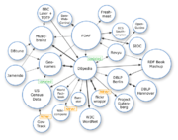





Content Providers
How many content types / applications provide
valuable information about each of these “entities”?
News about London
reviews on hotels in London
Wiki pages about the London
Pictures and tags about London
Social networks in London
Videos and tags for London
Notes:
The situation is aggrevated due to the Web 2.0 tools, which allow every Web user to upload non-curated and, thus, noisy content.

Slide 10
Preliminaries on Entity Resolution
Entity Resolution [Christen, TKDE 2011]:
  identifies and aggregates the different entity profiles/records that actually describe the same real-world object.
  Useful because:
  improves data quality and integrity
  fosters re-use of existing data sources
  Application areas:
  Linked Data, Social Networks, census data,
  price comparison portals
Notes:
To leverage Big Data, we need to perform ER.
ER is a core task for many applications, like Linked Data.

Slide 11
Types of Entity Resolution
The input of ER consists of entity collections that can be of two
types [Christen, TKDE 2011]:
clean, which are duplicate-free
  e.g., DBLP, ACM Digital Library, Wikipedia, Freebase
dirty, which contain duplicate entity profiles in themselves
e.g., Google Scholar, Citeseer^{X}
Notes:
The most important aspect of the input entity collections: their quality.
DBLP -> most authors/papers appear only once
Google Scholar -> same paper with different titles, same author with different names.

Slide 12
Types of Entity Resolution
The input of ER consists of entity collections that can be of two
types [Christen, TKDE 2011]:
clean, which are duplicate-free
  e.g., DBLP, ACM Digital Library, Wikipedia, Freebase
dirty, which contain duplicate entity profiles in themselves
e.g., Google Scholar, Citeseer^{X}
Based on the quality of input, we distinguish ER into 3 sub-tasks:
Clean-Clean ER (a.k.a. Record Linkage in databases)
Dirty-Clean ER
Dirty-Dirty ER
Equivalent to Dirty ER
(a.k.a. Deduplication in databases)
Notes:
Clean-Clean ER: Given two individually clean, but overlapping entity collections, identify the entity profiles they have in common without executing comparisons within each source.
For simplicity, we treat the other two tasks as equivalent to Dirty ER, which receives a single dirty entity collection as input.
The goal is to partition its entities into sets of equivalence clusters.

Slide 13
Computational cost
  ER is an inherently quadratic problem (i.e., O(n²)):
  every entity has to be compared with all others
  ER does not scale well to large entity collections (e.g., Web Data).
Notes:
Typically, ER is performed by comparing every entity profile with all others using string similarity measures.

Slide 14
Computational cost
  ER is an inherently quadratic problem (i.e., O(n²)):
  every entity has to be compared with all others
  ER does not scale well to large entity collections (e.g., Web Data)
Solution: Blocking
  group similar entities into blocks
  execute comparisons only inside each block
    complexity is now quadratic to the size of the block (much smaller than dataset size!)
Notes:
Basic idea of blocking: most comparisons involve non-matching entities.
It constitutes an approximate solution, sacrificing recall to a controllable extent for much higher precision.

Slide 15
Computational cost
Brute-force approach
Input:
Entity Collection E
Blocking
Duplicate Pairs
|E| entities
|E| entities
Notes:
We can illustrate the relative cost of the main approaches through a diagram.
In the ideal case, the green circle coincides with the red one.
Blocking covers the largest part of duplicate pairs, but not all of them.
It also incorporates comparisons between non-matching entities.
The closer the green circle is to the red one, the better the blocking method is.

Slide 16
Example of Computational cost
  DBPedia 3.0rc ↔ DBPedia 3.4
  1.2 million entities ↔ 2.2 million entities
  Entity matching: Jaccard similarity of all tokens
  Cost per comparison: 0.045 milliseconds (average of 0.1 billion comparisons)
  Brute-force approach
  Comparisons: 2.58 ∙ 10¹²
  Recall: 100%
  Running time: 1,344 days → 3.7 years
  Optimized Token Blocking Workflow
  Overhead time: 4 hours
  Comparisons: 8.95 ∙ 10⁶
  Recall: 99%
  Total Running time: 10 hours
Notes:
total comparisons for brute force approach: multiplication of the two (we assume dbpedia is clean)
the true number of entities are not exactly 1.2 and 2.2 million, this is why the result is not 2.64

Slide 17
Example of Computational cost
  DBPedia 3.0rc ↔ DBPedia 3.4
  1.2 million entities ↔ 2.2 million entities
  Entity matching: Jaccard similarity of all tokens
  Cost per comparison: 0.045 milliseconds (average of 0.1 billion comparisons)
  Brute-force approach
  Comparisons: 2.58 ∙ 10¹²
  Recall: 100%
  Running time: 1,344 days → 3.7 years
  Optimized Token Blocking Workflow
  Overhead time: 4 hours
  Comparisons: 8.95 ∙ 10⁶
  Recall: 99%
  Total Running time: 10 hours

Slide 18
Outline
Introduction to Blocking
Blocking Methods for Relational Data
Blocking Methods for Web Data
Block Processing Techniques
Meta-blocking
Challenges
JedAI Toolkit
Conclusions
Notes:
Sections 3 and 4 pertain to the creation of blocks.
Sections 5 and 6 pertain to the processing of blocks.

Slide 19
Part 1:
Introduction to Blocking

Slide 20
Fundamental Assumptions
Every entity profile consists of a uniquely identified set of name-value pairs.
Every entity profile corresponds to a single real-world object.
Two matching profiles are detected as long as they co-occur in at least one block → entity matching is an orthogonal problem.
Focus on string values.
Notes:
1. Flexible representation model that accommodates any format: databases, XML, RDF. If the representation is not unique, then our only choice is to merge the exact duplicates (there is no way to tell them apart). Usually, some attribute(s) is(are) different.
3. Precision of entity matching is dependent on the entity similarity measures, and is orthogonal to the above problem.
Many reasons for this assumption. For example, there is no universal entity matching method. Entity Matching is a difficult problem itself.

Slide 21
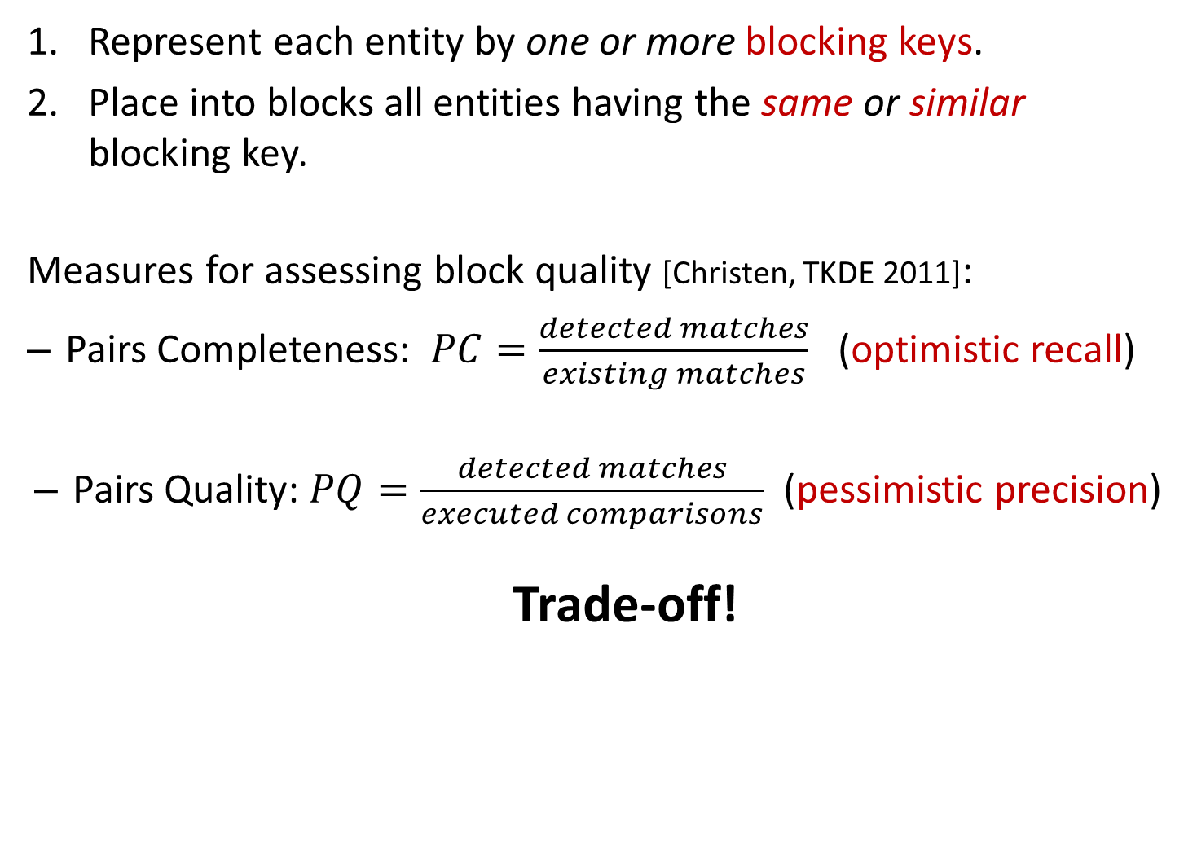
General Principles
Represent each entity by one or more blocking keys.
Place into blocks all entities having the same or similar blocking key.
Measures for assessing block quality [Christen, TKDE 2011]:
  Pairs Completeness: $PC=\frac{detected matches}{existing matches}$ (optimistic recall)
  Pairs Quality: $PQ=\frac{detected matches}{executed comparisons}$ (pessimistic precision)
  Trade-off!
Notes:
Blocking in a nutshell: use signatures to represent entities.
The more comparisons are executed, the higher PC gets. PQ, though, decreases, as the denominator increases faster than the numerator.
detected matches: duplicate entities co-occurring in a block
optimistic recall: we assume that entity matching never fails
pessimistic precision: we count all redundant comparisons as false positives (but in reality some of them are true positives)

Slide 22
Problem Definition
Given one dirty (Dirty ER), or two clean (Clean-Clean ER)
entity collections, cluster their profiles into blocks
and process them so that both Pairs Completeness (PC) and Pairs Quality (PQ) are maximized.
caution:
Emphasis on Pairs Completeness (PC).
  if two entities are matching then they should coincide at some block
Notes:
Goal: maximize the number of detected duplicates, while minimizing the number of executed comparisons.
Blocking is not an optimization task, but an engineering task, because there is no way we can know that two entities are matching. If for example, we knew that their Jaccard similarity should exceed a threshold, we could do some optimization. In practice, though, it is possible for two duplicates to share no information at all, if for example they are described in different languages.
This definition implies that PC and PQ are equally important. In practice, though, emphasis should be placed on PC, as it should exceed 80% or 90% in order to be useful.

Slide 23
Blocking Techniques Taxonomy
  Performance-wise
    Exact methods
    Approximate methods
  Functionality-wise
    Supervised methods
    Unsupervised methods
  Blocks-wise
    Disjoint blocks
    Overlapping blocks
      Redundancy-neutral
      Redundancy-positive
      Redundancy-negative
Signature-wise
    Schema-based
    Schema-agnostic
Notes:
To facilitate the understanding of the blocking methods we discuss in the following, we now present a taxonomy based on 4 dimensions. Every dimension splits blocking methods into main categories. We will examine every dimension in detail in the following slides.

Slide 24
Performance-wise Categorization
Exact Blocking Methods
  Maximize PQ for PC = 100%
  Closed-world assumption
  E.g., for bibliographical records , s ≡ t if:
JaccardSimilarity(s.title, t.title) > 0.80 AND
EditDistance(s.venue, t.venue) < 3
  Existing methods:
    Silk → filtering technique for edit distance
    LIMES → triangle inequality for similarity metrics
Approximate Blocking Methods
  PC < 100% → high PQ
  Open-world assumption
Notes:
To have a better understanding on the scope of this tutorial, we now present a taxonomy of blocking methods according to two fundamental dimensions.
Closed-world assumption -> in conjunction with entity matching
we assume that we know which similarity function and when a similarity value implies a match
Approximate Blocking methods are usually independent of similarity metrics and thresholds. To this category belongs the vast majority of blocking methods. We focus on them.
Open-world assumption -> standalone blocking methods
we assume that we don’t know how entity matching perfoms/works
Silk (Univ of Mannheim) is an open source framework for integrating heterogeneous data sources. The primary uses cases of Silk include:
- Generating links between related data items within different Linked Data sources.
- Linked Data publishers can use Silk to set RDF links from their data sources to other data sources on the Web.
- Applying data transformations to structured data sources.
Silk is based on the Linked Data paradigm
LIMES (Leipzig Univ)
The Linked Data paradigm has evolved into a powerful enabler for the transition from the document-oriented Web into the Semantic Web. While the amount of data published as Linked Data grows steadily and has surpassed 25 billion triples, less than 5% of these triples are links between knowledge bases. Link discovery frameworks provide the functionality necessary to discover missing links between knowledge bases. Yet, this task requires a significant amount of time, especially when it is carried out on large data sets. This paper presents and evaluates LIMES, a novel time-efficient approach for link discovery in metric spaces. Our approach utilizes the mathematical characteristics of metric spaces during the mapping process to filter out a large number of those instance pairs that do not suffice the mapping conditions. We present the mathematical foundation and the core algorithms employed in LIMES. We evaluate our algorithms with synthetic data to elucidate their behavior on small and large data sets with different configurations and compare the runtime of LIMES with another state-of-the-art link discovery tool.

Slide 25
Performance-wise Categorization
Exact Blocking Methods
  Maximize PQ for PC = 100%
  Closed-world assumption
  E.g., for bibliographical records , s ≡ t if:
JaccardSimilarity(s.title, t.title) > 0.80 AND
EditDistance(s.venue, t.venue) < 3
  Existing methods:
    Silk → filtering technique for edit distance
    LIMES → triangle inequality for similarity metrics
Approximate Blocking Methods
  PC < 100% → high PQ
  Open-world assumption
our focus
Notes:
To have a better understanding on the scope of this tutorial, we now present a taxonomy of blocking methods according to two fundamental dimensions.
Closed-world assumption -> in conjunction with entity matching
Approximate Blocking methods are usually independent of similarity metrics and thresholds. To this category belongs the vast majority of blocking methods. We focus on them.
Open-world assumption -> standalone blocking methods
Silk (Univ of Mannheim) is an open source framework for integrating heterogeneous data sources. The primary uses cases of Silk include:
- Generating links between related data items within different Linked Data sources.
- Linked Data publishers can use Silk to set RDF links from their data sources to other data sources on the Web.
- Applying data transformations to structured data sources.
Silk is based on the Linked Data paradigm
LIMES (Leipzig Univ)
The Linked Data paradigm has evolved into a powerful enabler for the transition from the document-oriented Web into the Semantic Web. While the amount of data published as Linked Data grows steadily and has surpassed 25 billion triples, less than 5% of these triples are links between knowledge bases. Link discovery frameworks provide the functionality necessary to discover missing links between knowledge bases. Yet, this task requires a significant amount of time, especially when it is carried out on large data sets. This paper presents and evaluates LIMES, a novel time-efficient approach for link discovery in metric spaces. Our approach utilizes the mathematical characteristics of metric spaces during the mapping process to filter out a large number of those instance pairs that do not suffice the mapping conditions. We present the mathematical foundation and the core algorithms employed in LIMES. We evaluate our algorithms with synthetic data to elucidate their behavior on small and large data sets with different configurations and compare the runtime of LIMES with another state-of-the-art link discovery tool.

Slide 26
Functionality-wise Categorization
Supervised Methods
Goal: learn the best blocking keys from a training set
Approach: identify best combination of attribute names and transformations
E.g., CBLOCK [Sarma et. al, CIKM 2012],
[Bilenko et. al., ICDM 2006], [Michelson et. al., AAAI 2006]
Drawbacks:
  labelled data
  domain-dependent
Unsupervised Methods
Generic, popular methods
Notes:
To facilitate the understanding of blocking methods, we present a categorization.
The supervised blocking methods try to learn the best blocking key definitions from a training set, e.g., by using combinations of attribute names.
The main drawback of supervised blocking techniques is the requirement for a training set.
Even if there is a set of labeled instances for a specific domain available, it is application specific, in the sense that it does not necessarily yield a good classifier on another domain.
Most techniques in the literature are unsupervised. We focus on them.

Slide 27
Functionality-wise Categorization
Supervised Methods
Goal: learn the best blocking keys from a training set
Approach: identify best combination of attribute names and transformations
E.g., CBLOCK [Sarma et. al, CIKM 2012],
[Bilenko et. al., ICDM 2006], [Michelson et. al., AAAI 2006]
Drawbacks:
  labelled data
  domain-dependent
Unsupervised Methods
Generic, popular methods
our focus
Notes:
To facilitate the understanding of blocking methods, we present a categorization.
The supervised blocking methods try to learn the best blocking key definitions from a training set, e.g., by using combinations of attribute names.
The main drawback of supervised blocking techniques is the requirement for a training set.
Even if there is a set of labeled instances for a specific domain available, it is application specific, in the sense that it does not necessarily yield a good classifier on another domain.
Most techniques in the literature are unsupervised. We focus on them.

Slide 28
Blocking Workflow [Papadakis et. al., VLDB 2016]
E
Block
Building
Block
Cleaning
Comparison
Cleaning
B
Lazy
blocking
methods
Block-refinement
methods
Comparison-refinement
methods
Proactive blocking methods
Notes:
For the approximate, unsupervised blocking methods we consider in this work, we can describe their internal functionality using three steps.
BlCl -> faster, less accurate
CoCl -> more accurate, more time-consuming
The methods that perform only Block Building are called Lazy. Those performing only BlCl, Block-refinement.
Block Building (Lazy & Proactive) vs Block Processing (Block- and Comparison-refinement)

Slide 29
Blocks- and Signature-wise Categorization of Block Building Methods
 | Disjoint Blocks | Overlapping Blocks
 |  | Redundancy- negative | Redundancy- neutral | Redundancy- positive
Schema- based | Standard Blocking | (Extended) Canopy Clustering | (Extended) Sorted Neighborhood MFIBlocks | (Extended) Q-grams Blocking (Extended) Suffix Arrays
Schema- agnostic | - | - | - | Token Blocking Agnostic Clustering TYPiMatch URI Semantics Blocking
Notes:
Redundancy expresses the number of blocks that are associated with every entity, on average.
First row: methods for databases. They cover all categories of redundancy.
Second row: methods for Web data. They are all redundancy-positive.
overlapping methods: the same entity may appear in more than 1 block
redundancy-positive: the more common blocks for two entities, the higher the probability to match
redundancy-negative: the most similar entities coincide (almost always) in a single block
redundancy-neutral: number of common blocks independent of matching probability

Slide 30
Block Processing Methods
[Papadakis et. al., VLDB 2016]
Mostly for redundancy-positive block building methods.
Block Cleaning
Block-level
  constraints on block characteristics
Entity-level
  constraints on entity characteristics
Comparison Cleaning
Redundant comparisons
  repeated across different blocks
Superfluous comparisons
  Involve non-matching entities
Notes:
block cleaning
block level: block purging (remove blocks with many entities/comparisons)
entity level: block filtering (remove a given entity from a percentage r of the largest blocks it belongs to)
comparison cleaning
redundant comparison: comparison propagation (removes redundant comparisons by executing comparisons in a sorted order)
superfluous comparisons: meta-blocking

Slide 31
Part 2:
Block Building for Relational Data

Slide 32
General Principles
Mostly schema-based techniques.
Rely on two assumptions:
A-priori known schema → no noise in attribute names.
For each attribute name we know some metadata:
  level of noise (e.g., spelling mistakes, false or missing values)
  distinctiveness of values
Notes:
All entity profiles adhere to a specific schema.
Many methods operate in this way. We will examine the most important ones.

Slide 33
Overview of Schema-based Methods
Standard Blocking
Sorted
Neighborhood
Suffix
Arrays
Q-grams
Blocking
Extended Sorted
Neighborhood
Extended Suffix
Arrays
MFIBlocks
Extended Q-grams
Blocking
Canopy
Clustering
Extended
Canopy
Clustering
Notes:
Here is the family tree of blocking methods. Standard Blocking is the cornerstone method.
All other methods employ the same BKs but in a different way in order to offer higher robustness and a better balance between recall and precision.
Every method has many variations. We present just one extended version for each one of them.
Blue indicates lazy blocking methods, and red proactive blocking methods.
We have 3 branches. On the left, blocks contain entities with similar blocking keys, on the right, blocks contain entities with the same blocking keys, and in the middle, we have a mixture.

Slide 34
Overview of Schema-based Methods
Standard Blocking
Sorted
Neighborhood
Suffix
Arrays
Q-grams
Blocking
Extended Sorted
Neighborhood
Extended Suffix
Arrays
MFIBlocks
Extended Q-grams
Blocking
Canopy
Clustering
Extended
Canopy
Clustering
LAZY BLOCKING
METHODS
Notes:
Here is the family tree of blocking methods. Standard Blocking is the cornerstone method.
All other methods employ the same BKs but in a different way in order to offer higher robustness and a better balance between recall and precision.
Every method has many variations. We present just one extended version for each one of them.
Blue indicates lazy blocking methods, and red proactive blocking methods.
We have 3 branches. On the left, blocks contain entities with similar blocking keys, on the right, blocks contain entities with the same blocking keys, and in the middle, we have a mixture.

Slide 35
Overview of Schema-based Methods
Standard Blocking
Sorted
Neighborhood
Suffix
Arrays
Q-grams
Blocking
Extended Sorted
Neighborhood
Extended Suffix
Arrays
MFIBlocks
Extended Q-grams
Blocking
Canopy
Clustering
Extended
Canopy
Clustering
PROACTIVE
BLOCKING
METHODS
LAZY BLOCKING
METHODS
Notes:
Here is the family tree of blocking methods. Standard Blocking is the cornerstone method.
All other methods employ the same BKs but in a different way in order to offer higher robustness and a better balance between recall and precision.
Every method has many variations. We present just one extended version for each one of them.
Blue indicates lazy blocking methods, and red proactive blocking methods.
We have 3 branches. On the left, blocks contain entities with similar blocking keys, on the right, blocks contain entities with the same blocking keys, and in the middle, we have a mixture.

Slide 36
Overview of Schema-based Methods
Standard Blocking
Sorted
Neighborhood
Suffix
Arrays
Q-grams
Blocking
Extended Sorted
Neighborhood
Extended Suffix
Arrays
MFIBlocks
Extended Q-grams
Blocking
Canopy
Clustering
Extended
Canopy
Clustering
PROACTIVE
BLOCKING
METHODS
LAZY BLOCKING
METHODS
Notes:
Here is the family tree of blocking methods. Standard Blocking is the cornerstone method.
All other methods employ the same BKs but in a different way in order to offer higher robustness and a better balance between recall and precision.
Every method has many variations. We present just one extended version for each one of them.
Blue indicates lazy blocking methods, and red proactive blocking methods.
We have 3 branches. On the left, blocks contain entities with similar blocking keys, on the right, blocks contain entities with the same blocking keys, and in the middle, we have a mixture.

Slide 37
Standard Blocking [Fellegi et. al., JASS 1969]
Earliest, simplest form of blocking.
Algorithm:
Select the most appropriate attribute name(s) w.r.t. noise and distinctiveness.
Transform the corresponding value(s) into a Blocking Key (BK)
For each BK, create one block that contains all entities having this BK in their transformation.
Works as a hash function! → Blocks on the equality of BKs

Slide 38
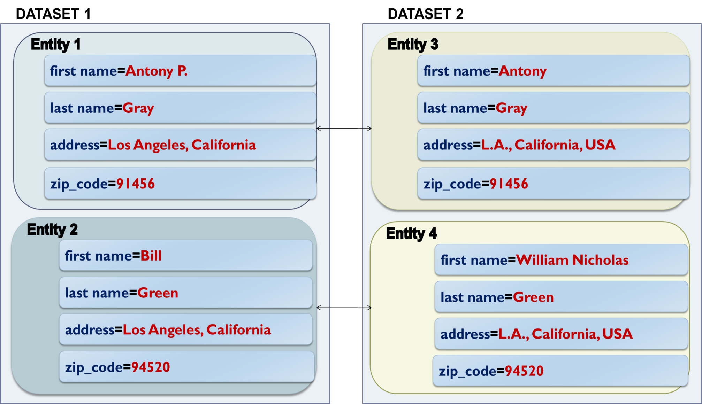
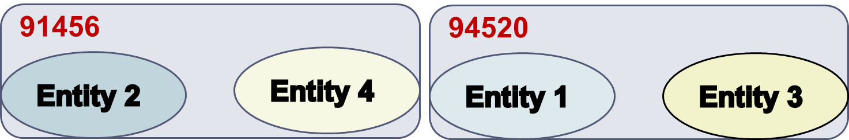
Example of Standard Blocking
Blocks on zip_code:
Notes:
Two homogeneous datasets described by the same schema.
E1 matches E3 and E2 with E4.
Brute force approach: four comparisons.
Advantages of Standard Blocking: highly efficient (disjoint blocks, which produce few comparisons) -> high precision.
Disadvantages of Standard Blocking: not robust to noise (mainly in values) -> low recall.
One solution: multiple blocking keys per entity -> redundancy.
Another solution is to use more advanced methods that are inherently crafted for noise in BKs.

Slide 39
Overview of Schema-based Methods
Standard Blocking
Sorted
Neighborhood
Suffix
Arrays
Q-grams
Blocking
Extended Sorted
Neighborhood
Extended Suffix
Arrays
MFIBlocks
Extended Q-grams
Blocking
Canopy
Clustering
Extended
Canopy
Clustering
Notes:
Let’s now look at the similarity branch of Blocking Methods.

Slide 40
Overview of Schema-based Methods blocks contain entities with similar blocking keys
Standard Blocking
Sorted
Neighborhood
Suffix
Arrays
Q-grams
Blocking
Extended Sorted
Neighborhood
Extended Suffix
Arrays
MFIBlocks
Extended Q-grams
Blocking
Canopy
Clustering
Extended
Canopy
Clustering
Notes:
Let’s now look at the similarity branch of Blocking Methods.

Slide 41
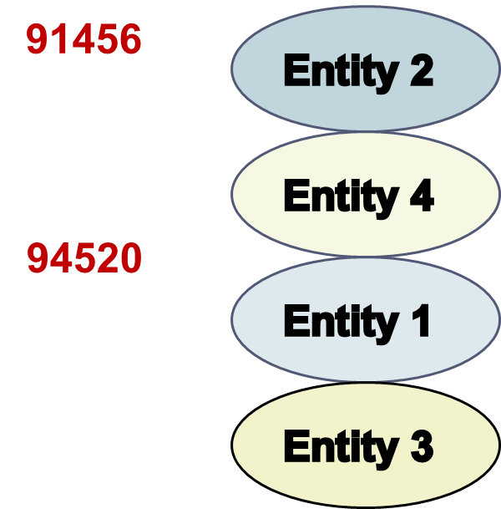
Sorted Neighborhood [Hernandez et. al., SIGMOD 1995]
Blocks on the similarity of BKs.
Entities are sorted in
alphabetic order of BKs.
A window of fixed size
slides over the sorted list of entities.
At each iteration, it compares
the entities that co-occur
within the window.

Slide 42
Sorted Neighborhood [Hernandez et. al., SIGMOD 1995]
Blocks on the similarity of BKs.
Entities are sorted in
alphabetic order of BKs.
A window of fixed size
slides over the sorted list of entities.
At each iteration, it compares
the entities that co-occur
within the window.

Slide 43
Sorted Neighborhood [Hernandez et. al., SIGMOD 1995]
Blocks on the similarity of BKs.
Entities are sorted in
alphabetic order of BKs.
A window of fixed size
slides over the sorted list of entities.
At each iteration, it compares
the entities that co-occur
within the window.

Slide 44
Sorted Neighborhood [Hernandez et. al., SIGMOD 1995]
Blocks on the similarity of BKs.
Entities are sorted in
alphabetic order of BKs.
A window of fixed size
slides over the sorted list of entities.
At each iteration, it compares
the entities that co-occur
within the window.
Notes:
Redundancy neutral method for two reasons:
Two entities might share a block even if their values are not similar.
Every pair of entities shares the same number of blocks.

Slide 45
Sorted Neighborhood [Hernandez et. al., SIGMOD 1995]
Blocks on the similarity of BKs.
Entities are sorted in
alphabetic order of BKs.
A window of fixed size
slides over the sorted list of entities.
At each iteration, it compares
the entities that co-occur
within the window.
Extended Sorted Neighborhood [Christen, TKDE 2011]
2’. A window of fixed size slides over the sorted list of BKs.
Notes:
Disadvantages: depends heavily on the size of the window.
A very small window leads to high precision, but low recall and vice versa for a large window.

Slide 46
Sorted Neighborhood [Hernandez et. al., SIGMOD 1995]
Blocks on the similarity of BKs.
Entities are sorted in
alphabetic order of BKs.
A window of fixed size
slides over the sorted list of entities.
At each iteration, it compares
the entities that co-occur
within the window.
Extended Sorted Neighborhood [Christen, TKDE 2011]
2’. A window of fixed size slides over the sorted list of BKs.
Notes:
Disadvantages: depends heavily on the size of the window.
A very small window leads to high precision, but low recall and vice versa for a large window.

Slide 47
Sorted Neighborhood [Hernandez et. al., SIGMOD 1995]
Blocks on the similarity of BKs.
Entities are sorted in
alphabetic order of BKs.
A window of fixed size
slides over the sorted list of entities.
At each iteration, it compares
the entities that co-occur
within the window.
Extended Sorted Neighborhood [Christen, TKDE 2011]
2’. A window of fixed size slides over the sorted list of BKs.
Notes:
Disadvantages: depends heavily on the size of the window.
A very small window leads to high precision, but low recall and vice versa for a large window.

Slide 48
Overview of Schema-based Methods
Standard Blocking
Sorted
Neighborhood
Suffix
Arrays
Q-grams
Blocking
Extended Sorted
Neighborhood
Extended Suffix
Arrays
MFIBlocks
Extended Q-grams
Blocking
Canopy
Clustering
Extended
Canopy
Clustering
Notes:
Let’s have a look now at the mixture-branch of blocking methods.

Slide 49
Overview of Schema-based Methods blocks contain entities with same, or similar blocking keys
Standard Blocking
Sorted
Neighborhood
Suffix
Arrays
Q-grams
Blocking
Extended Sorted
Neighborhood
Extended Suffix
Arrays
MFIBlocks
Extended Q-grams
Blocking
Canopy
Clustering
Extended
Canopy
Clustering
Notes:
Let’s have a look now at the mixture-branch of blocking methods.

Slide 50
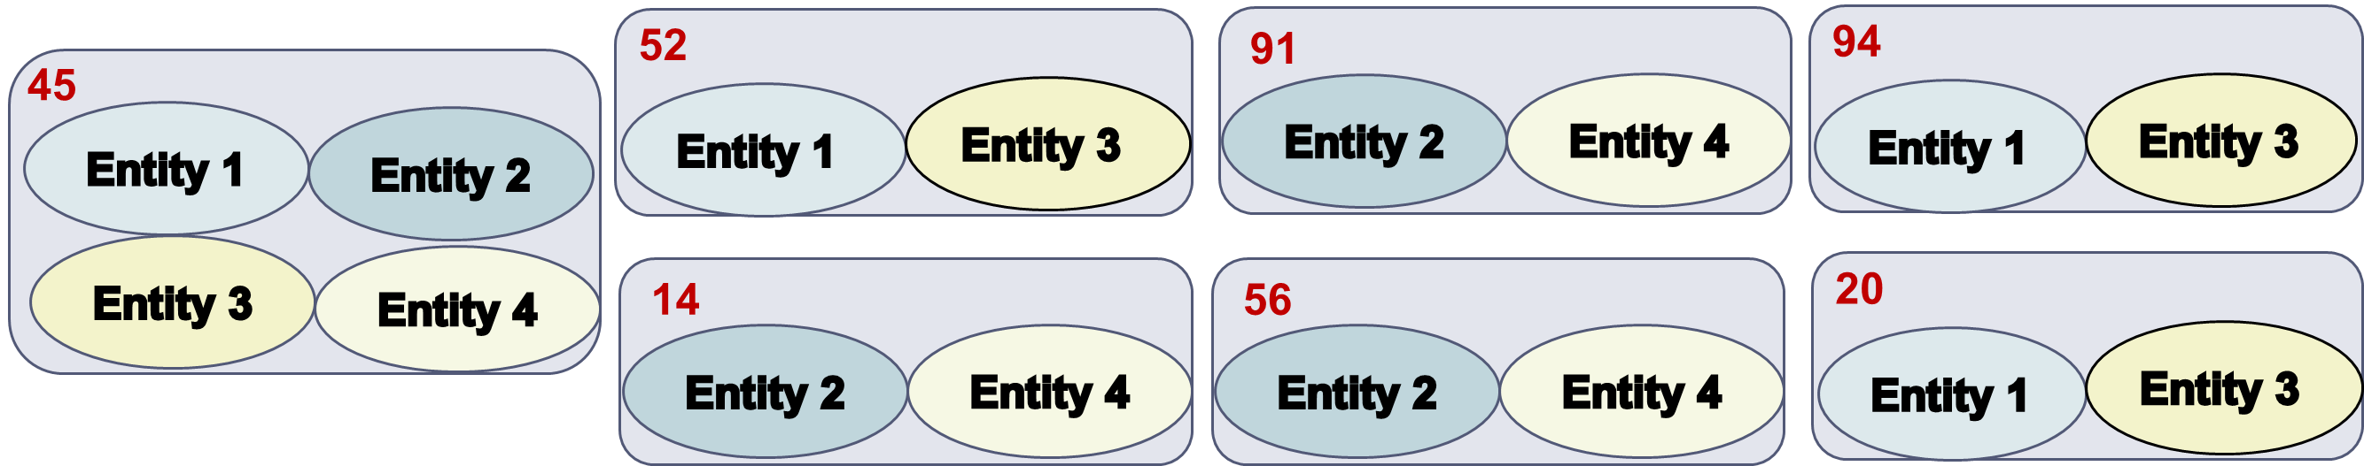
Q-grams Blocking [Gravano et. al., VLDB 2001]
Blocks on equality of BKs.
Converts every BK into the list of its q-grams.
For q=2, the BKs 91456 and 94520 yield the following blocks:
Advantage:
robust to noisy BKVs
Drawback:
larger blocks → higher computational cost
Notes:
The smaller the q is, the more robust it is to noise, but the more frequent its keys are, and the larger are the resulting blocks.
the 45 block with two entities is wrong: the correct label is 52

Slide 51
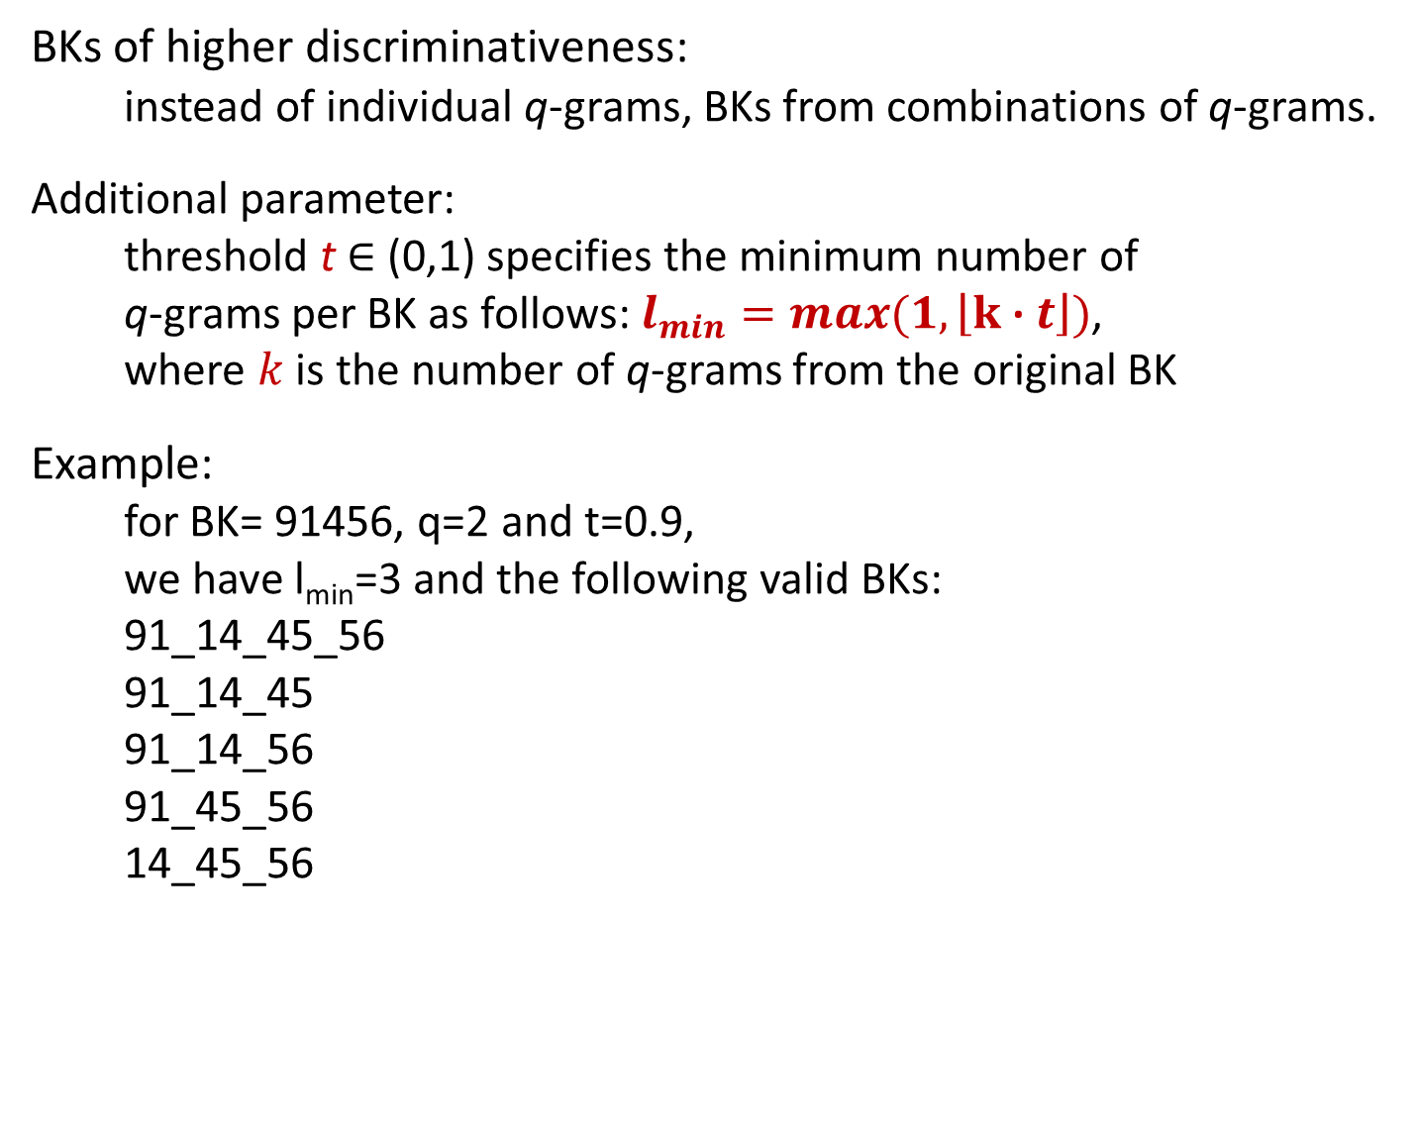
Extended Q-grams Blocking [Baxter et. al., KDD 2003]
BKs of higher discriminativeness:
instead of individual q-grams, BKs from combinations of q-grams.
Additional parameter:
threshold t ∈ (0,1) specifies the minimum number of
q-grams per BK as follows: $l_{min}=\max{(1,\left\lfloor k \text{∙} t\right\rfloor )}$,
where $k$ is the number of q-grams from the original BK
Example:
for BK= 91456, q=2 and t=0.9,
we have l_{min}=3 and the following valid BKs:
91_14_45_56
91_14_45
91_14_56
91_45_56
14_45_56
Notes:
To increase the discriminativeness of q-grams, we use their combinations.
More blocks, but smaller in size and comparisons.

Slide 52
MFIBlocks [Kenig et. al., IS 2013]
Based on mining Maximum Frequent Itemsets.
Algorithm:
Place all entities in a pool
while (minimum_support > 2)
  For each itemset that satisfies minimum_support
    Create a block b
    If b satisfies certain constraints (Block Cleaning)
      remove its entities from the pool
      retain the best comparisons (Comparison Cleaning)
  decrease minimum_support
Pros:
Usually the most effective blocking method for relational data → maximizes PQ (precision)
Cons:
Difficult to configure
Time consuming
Notes:
itemset: set of entities
support: the number of blocks where all these entities coincide

Slide 53
Overview of Schema-based Methods
Standard Blocking
Sorted
Neighborhood
Suffix
Arrays
Q-grams
Blocking
Extended Sorted
Neighborhood
Extended Suffix
Arrays
MFIBlocks
Extended Q-grams
Blocking
Canopy
Clustering
Extended
Canopy
Clustering
Notes:
Let’s now have a look at the similarity-based variations of StBl that rely on q-grams.

Slide 54
Overview of Schema-based Methods blocks contain entities with similar blocking keys
Standard Blocking
Sorted
Neighborhood
Suffix
Arrays
Q-grams
Blocking
Extended Sorted
Neighborhood
Extended Suffix
Arrays
MFIBlocks
Extended Q-grams
Blocking
Canopy
Clustering
Extended
Canopy
Clustering
Notes:
Let’s now have a look at the similarity-based variations of StBl that rely on q-grams.

Slide 55
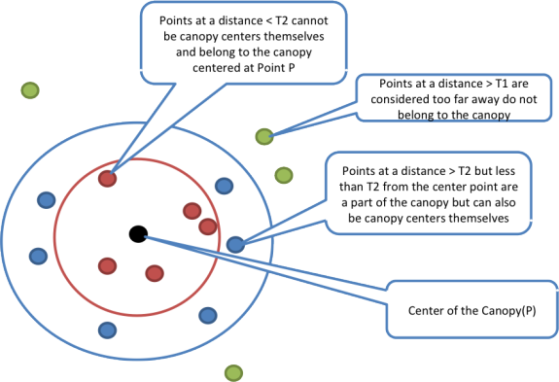
Canopy Clustering [McCallum et. al., KDD 2000]
Blocks on similarity of BKs.
Notes:
Redundancy-negative method.
Was proposed for clustering, but is widely used for blocking.
typo: “points at a distance > T2 but less than T1…”

Slide 56
Extended Canopy Clustering [Christen, TKDE 2011]
Canopy Clustering is too sensitive w.r.t. its weight thresholds:
- high values may leave many entities out of blocks.
Solution: Extended Canopy Clustering [Christen, TKDE 2011]
cardinality thresholds instead of weight thresholds
for each center of a canopy:
  the n₁ nearest entities are placed in its block
  the n₂ (≤ n₁) nearest entities are removed from the pool
Notes:
Redundancy-negative.

Slide 57
Overview of Schema-based Methods
Standard Blocking
Sorted
Neighborhood
Suffix
Arrays
Q-grams
Blocking
Extended Sorted
Neighborhood
Extended Suffix
Arrays
MFIBlocks
Extended Q-grams
Blocking
Canopy
Clustering
Extended
Canopy
Clustering
Notes:
Finally, we look into the equality-branch of blocking methods, which exclusively involves proactive techniques.

Slide 58
Overview of Schema-based Methods blocks contain entities with same blocking keys
Standard Blocking
Sorted
Neighborhood
Suffix
Arrays
Q-grams
Blocking
Extended Sorted
Neighborhood
Extended Suffix
Arrays
MFIBlocks
Extended Q-grams
Blocking
Canopy
Clustering
Extended
Canopy
Clustering
Notes:
Finally, we look into the equality-branch of blocking methods, which exclusively involves proactive techniques.

Slide 59
Overview of Schema-based Methods blocks contain entities with same blocking keys
Standard Blocking
Sorted
Neighborhood
Suffix
Arrays
PROACTIVE
BLOCKING
METHODS
Q-grams
Blocking
Extended Sorted
Neighborhood
Extended Suffix
Arrays
MFIBlocks
Extended Q-grams
Blocking
Canopy
Clustering
Extended
Canopy
Clustering
Notes:
Finally, we look into the equality-branch of blocking methods, which exclusively involves proactive techniques.

Slide 60
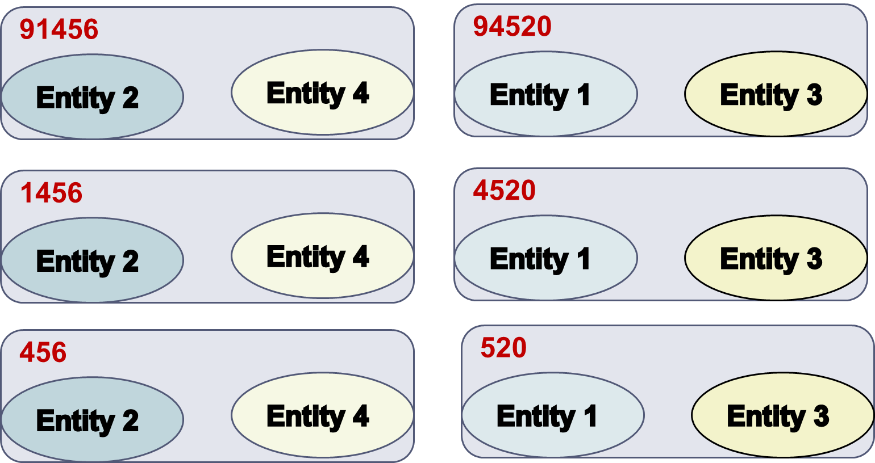
Suffix Arrays Blocking [Aizawa et. al., WIRI 2005]
Blocks on the equality of BKs.
Converts every BK to the list of its suffixes that are longer than a predetermined minimum length l_{min}.
For l_{min} =3, the keys 91456 and 94520 yield the blocks:
Frequent suffixes are discarded with the help of the parameter b_{M}:
- specifies the maximum number of entities per block
Notes:
In a way, it builds hierarchical blocks.
Advantage: robust to noisy BKs, redundancy-positive
Disadvantage: cannot support noise at the end of BKs

Slide 61
Extended Suffix Arrays Blocking [Christen, TKDE 2011]
Goal:
support errors at the end of BKs
Solution:
consider all substrings (not only suffixes) with more than l_{min}
characters.
For l_{min}=3, the keys 91456 and 94520 are converted to the BKs:
91456, 94520
9145, 9452
1456, 4520
914, 945
145, 452
456 520
Notes:
Similar to Q-grams, but discards very frequent suffixes.

Slide 62
Summary of Blocking for Databases [Christen, TKDE2011]
They typically employ redundancy to ensure higher recall in the context of noise at the cost of lower precision (more comparisons). Still, recall remains low for many datasets.
Several parameters to be configured
  E.g., Canopy Clustering has the following parameters:
    String matching method
    Threshold t₁
    Threshold t₂
Schema-dependent → manual definition of BKs
Notes:
Redundancy: every entity participates in many blocks.
The most important of these parameters is BKs.
They need an expert to fine-tune their BKs manually.
recall low because blocking keys are usually not correctly selected

Slide 63
Improving Blocking for Databases [Papadakis et. al., VLDB 2015]
Schema-agnostic blocking keys
Use every token as a key
Applies to all schema-based blocking methods
Simplifies configuration, unsupervised approach
Performance evaluation
For lazy blocking methods →
very high, robust recall at the cost of more comparisons
For proactive blocking methods →
relative recall gets higher with more comparisons,
absolute recall depends on block constraints
Notes:
Use every token as a key independently of the associated attribute-name and then apply the usual transformations on the resulting keys.
every token (in attribute values) becomes a blocking key, and every blocking key leads to a block (with all entities that contain this blocking key)

Slide 64
Part 3:
Block Building for Web Data

Slide 65
Characteristics of Web Data
Voluminous, (semi-)structured datasets.
    DBPedia 2014: 3 billion triples and 38 million entities
    BTC09: 1.15 billion triples, 182 million entities.
Users are free to add attribute values and/or attribute names
→ unprecedented levels of schema heterogeneity.
    DBPedia 3.4: 50,000 attribute names
    Google Base: 100,000 schemata for 10,000 entity types
    BTC09: 136,000 attribute names
Several datasets produced by automatic information extraction techniques
→ noise, tag-style values.
Notes:
The characteristics differ substantially from databases.
Schema-based blocking methods were usually applied up to tens of thousands of entities.
Schema matching is not simply not applicable here, because it does not scale.

Slide 66
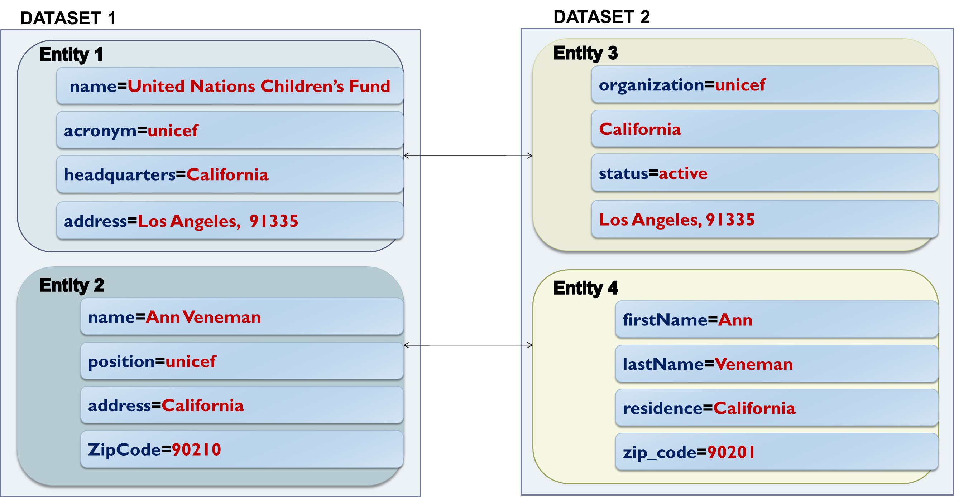
Example of Web Data
Loose Schema Binding
Split
values
Attribute
Heterogeneity
Noise
Notes:
Different granularity in attribute names and values.
Loose schema binding: tag-style values, different schema for each entity.
These settings call for blocking methods that are:
Inherently robust to noise in both attribute names and attribute values
decoupled from schema information.

Slide 67
Token Blocking [Papadakis et al., WSDM2011]
Functionality:
given an entity profile, extract all tokens that are contained in its attribute values.
create one block for every distinct token → each block contains all entities with the corresponding token*.
Attribute-agnostic functionality:
  completely ignores all attribute names, but considers all attribute values
  efficient implementation with the help of inverted indices
  parameter-free!
*Each block should contain at least two entities.
Notes:
Simplest schema-agnostic approach.
Ignores attribute names completely.
Deals with heterogeneity of any scale.

Slide 68
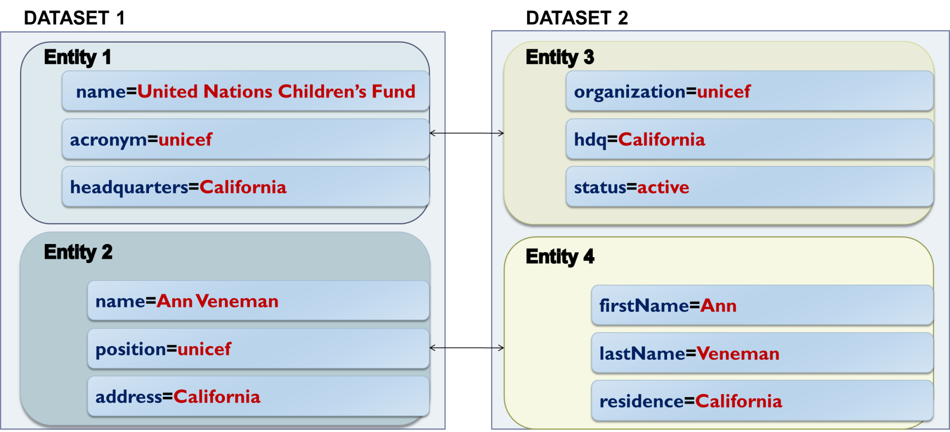
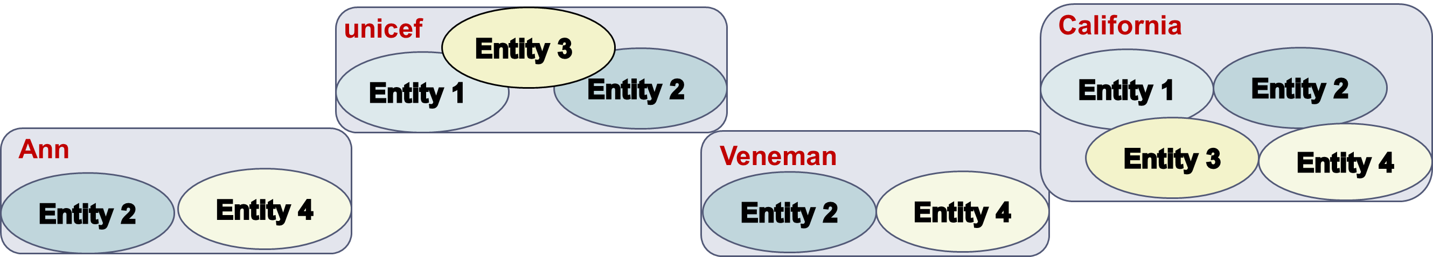
Token Blocking Example
Notes:
“united”, “nations”, children’s”, and “fund” all lead to blocks with a single entity (E1), and therefore are discarded
Highly robust to noise.
Drawback: many comparisons, large blocks.
Two solutions to overcome this issue:
We use more advanced blocking methods that build more refined blocks.
We employ block processing techniques to discard the unnecessary comparisons, without affecting the matching ones.
The two solutions are complementary.

Slide 69
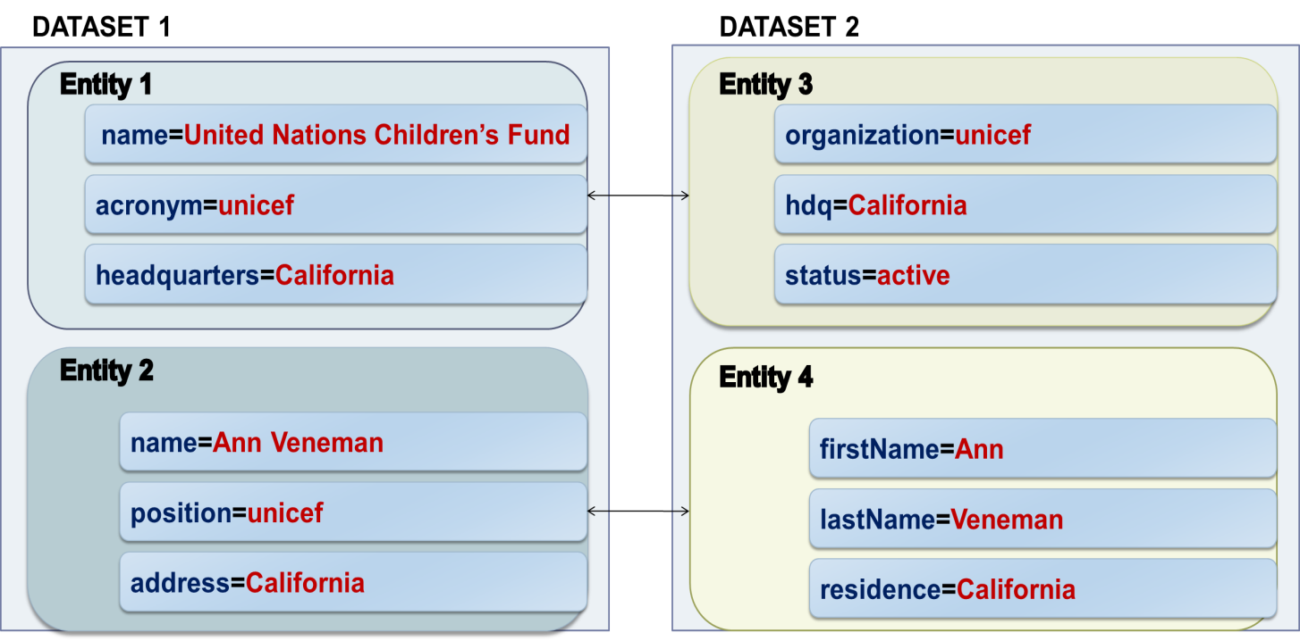
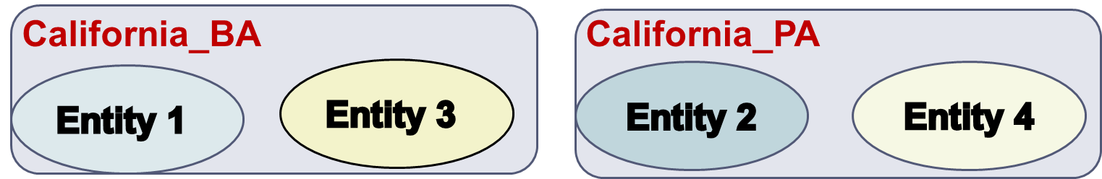
Attribute-Clustering Blocking
[Papadakis et. al., TKDE 2013]
Goal:
group attribute names into clusters s.t. we can apply Token Blocking independently inside each cluster, without affecting effectiveness → smaller blocks, higher efficiency.
Building address
headquarters
hdq
Person address
address
residence
Notes:
cluster attribute names based on the attribute values
goal: break the token-based blocks into smaller ones
Every node represents the aggregate values of each attribute name.
Example: block for California in the previous slide.

Slide 70
Attribute-Clustering Blocking
  Algorithm
  Create a graph, where every node represents an attribute name and its attribute values
For each attribute name/node n_{i}
  Find the most similar node n_{j}
  If sim(n_{i},n_{j}) > 0, add an edge <n_{i},n_{j}>
Extract connected components
Put all singleton nodes in a “glue” cluster
Parameters
Representation model
  Character n-grams, Character n-gram graphs, Tokens
Similarity Metric
  Jaccard, Graph Value Similarity, TF-IDF
Notes:
cluster attribute names based on the attribute values
goal: break the token-based blocks into smaller ones
Every node represents the aggregate values of each attribute name.
Example: block for California in the previous slide.

Slide 71
Attribute-Clustering vs
Schema Matching
Similar to Schema Matching, …but fundamentally different:
Associated attribute names do not have to be semantically equivalent. They only have to produce good blocks
All singleton attribute names are associated with each other
Unlike Schema Matching, it scales to the very high levels of heterogeneity of Web Data
  because of the above simplifying assumptions
Notes:
singleton: are in a block by themselves

Slide 72

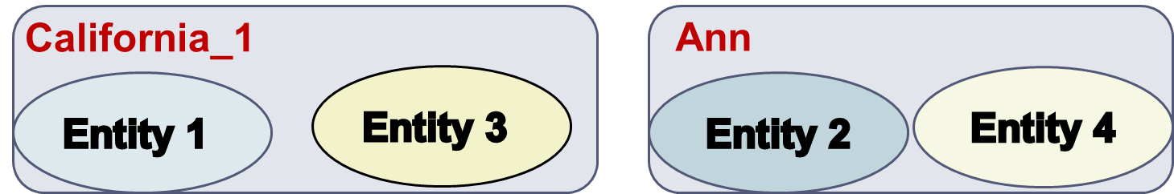
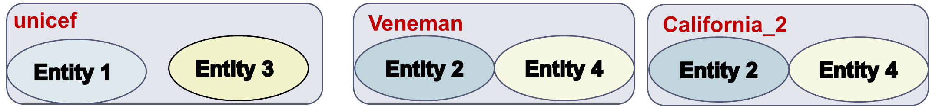
TYPiMatch [Ma et. al., WSDM 2013]
Goal:
cluster entities into overlapping types and apply Token
Blocking to the values of the best attribute for each type.
organizations
persons

Slide 73
TYPiMatch
Algorithm:
Create a directed graph G, where nodes correspond to tokens, and edges connect those co-occurring in the same entity profile, weighted according to conditional co-occurrence probability.
Convert G to undirected graph G’ and get maximal cliques (parameter θ).
Create an undirected graph G’’, where nodes correspond to cliques and edges connect the frequently co-occurring cliques (parameter ε).
Get connected components to form entity types.
Get best attribute name for each type using an entropy-based criterion.

Slide 74
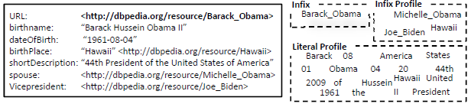
Evidence for Semantic Web Blocking
For Semantic Web data, three sources of evidence create blocks of lower redundancy than Token Blocking:
Infix
Infix Profile
Literal Profile
Algorithm for URI decomposition in PI(S)-form in [Papadakis et al., iiWAS 2010].
Notes:
Blocking method for Semantic Web only.
Unlike Token Blocking, it does not tokenize the entire URIs. Example: URL of entity “Obama”.
In addition, Infixes may consist of several concatenated tokens.
Infix Profile -> Relations between entities
Values that do not correspond to blank nodes or URIs can be represented by their tokens.

Slide 75
URI Semantics Blocking [Papadakis et al., WSDM2012]
The above sources of evidence lead to 3 parameter-free blocking methods:
Infix Blocking
every block contains all entities whose URI has a specific Infix
Infix Profile Blocking
every block corresponds to a specific Infix (of an attribute value) and contains all entities having it in their Infix Profile
Literal Profile Blocking
every block corresponds to a specific token and contains all entities having it in their Literal Profile
Individually, these atomic methods have limited coverage and,
thus, low effectiveness (e.g., Infix Blocking does not cover blank
nodes).
However, they are complementary and can be combined
into composite blocking methods with high robustness and
effectiveness!
Notes:
Their combination yields significantly better performance than Token Blocking.

Slide 76
  Summary of Blocking for Web Data
High Recall in the context of noisy entity profiles and extreme schema heterogeneity thanks to:
redundancy that reduces the likelihood of missed matches.
attribute-agnostic functionality that requires no schema semantics.
Low Precision because:
the blocks are overlapping → redundant comparisons
high number of comparisons between irrelevant entities → superfluous comparisons

Slide 77
Token Blocking Example
Redundant
Comparison
Superfluous
Comparison
Notes:
superfluous comparison E3-E2, because they do not match
redundant comparison E2-E4, because it appears again in block “Ann”

Slide 78
Part 4:
Block Processing Techniques
Notes:
Goal: to process a set of blocks in the optimal way.

Slide 79
Outline
Introduction to Blocking
Blocking Methods for Relational Data
Blocking Methods for Web Data
Block Processing Techniques
  Block Purging
  Block Filtering
  Block Clustering
  Comparison Propagation
  Iterative Blocking
Meta-blocking
Challenges
ER framework
Notes:
Sections 3 and 4 pertain to the creation of blocks.
Sections 5 and 6 pertain to the processing of blocks.

Slide 80
General Principles
Goals:
eliminate all redundant comparisons
avoid most superfluous comparisons
without affecting matching comparisons (i.e., PC).
Depending on the granularity of their functionality, they are distinguished into:
Block-refinement
Comparison-refinement
    Iterative Methods
Notes:
The block-refinement are faster, but have a less accurate functionality.
The comparison-refinement techniques are more accurate, but more time-consuming.

Slide 81
Block Purging
Exploits power-law distribution of block sizes.
Targets oversized blocks (i.e., many comparisons, no duplicates)
Discards them by setting an upper limit on:
the size of each block [Papadakis et al., WSDM 2011],
the cardinality of each block [Papadakis et al., WSDM 2012]
Core method:
  Low computational cost.
  Low impact on effectiveness.
  Boosts efficiency to a large extent.
Notes:
Exploits the power-law distribution of block sizes and tries to prune its tail.
The power law distribution isn’t reported by other researchers, but it is obvious in the following diagrams, slides 81 to 83. The same pattern appears in all other datasets we have tested in our experiments. The cardinality limit is automatically set through the BC-CC metric space. More details in the WSDM 2012 paper. The size limit was empirically determined to be equal to 0.005 * min (|E1|,|E2|).

Slide 82
Distributions of Block Sizes and Duplicates

Slide 83
Distributions of Block Sizes and Duplicates

Slide 84
Distributions of Block Sizes and Duplicates
Notes:
The upper diagram is log-log. There are 2 or 3 blocks of size 10^13.

Slide 85
Block Filtering [Papadakis et. al, EDBT 2016]
Main ideas:
each block has a different importance for every entity it contains.
Larger blocks are less likely to contain unique duplicates and, thus, are less important.
Algorithm
sort blocks in ascending cardinality
build Entity Index
retain every entity in r% of its smallest blocks
reconstruct blocks
Notes:
because very large blocks are highly probable to contain a random mix of entities

Slide 86
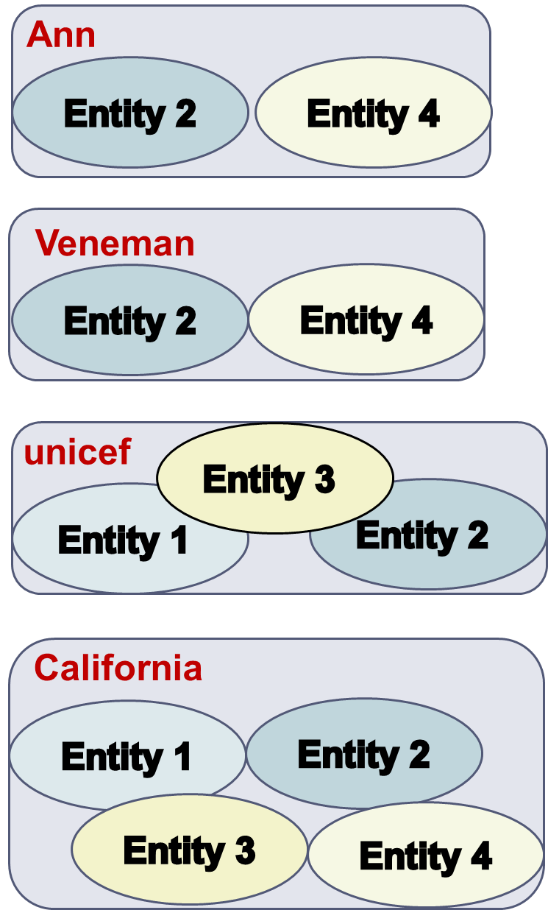
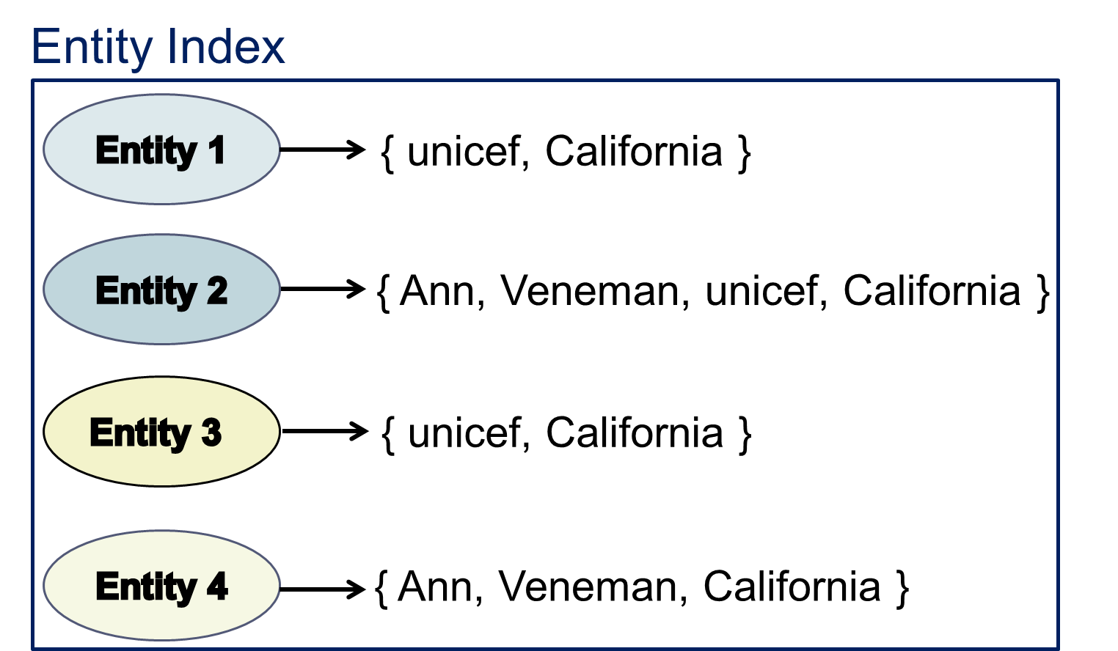
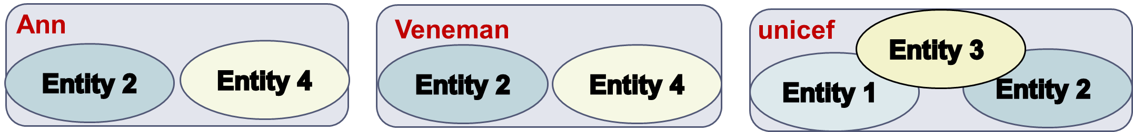
Block Filtering Example
Notes:
the matching entities still coincide in some block: E1-E3 in “unicef”, and E2-E4 in “Ann” (and “Veneman”)

Slide 87
Block Clustering [Fisher et. al., KDD 2015]
Main idea:
restrict the size of every block into [b_{min}, b_{max}]
  necessary in applications like privacy-preserving ER
  operates so that ||B|| increases linearly with |E|
Algorithm
recursive agglomerative clustering
  merge similar blocks with size lower than b_{min}
  split blocks with size larger than b_{max}
until all blocks have the desired size
Notes:
In privacy-preserving record linkage, there may be privacy requirements on both the minimum and maximum block size. For example, to guarantee k-anonymous privacy it is necessary that each block contains at least k records. If all blocks have a similar size, this reduces the vulnerability of the ER process to frequency-based attacks. In this situation it is important to produce blocks in the specified size range.
The scalability analysis in the paper shows an almost linear increase in comparison when increasing the size of the dataset.
[b_{min}, b_{max}] are input parameters. They can be set in accordance with operational requirements such as computational limitations, real-time efficiency requirements, or privacy-preserving requirements.

Slide 88
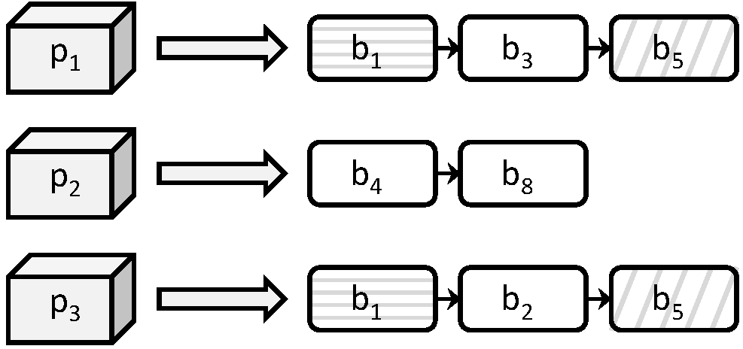
Comparison Propagation [Papadakis et al., JCDL 2011]
Eliminate all redundant comparisons at no cost in recall.
Naïve approach does not scale.
Functionality:
  Build Entity Index
  Least Common Block Index condition.
Notes:
Naïve approach stores all executed comparisons explicitly in memory, having a space complexity that is linear to the number of comparisons. It uses a hashset that allows to check in constant time O(1) whether a new comparison has already been executed.
Comparison Propagation stores executed comparisons implicitly in memory, having a space complexity that is linear to the number of entities. It uses an inverted index that points from entity ids to block ids and compares two entities e_i and e_j in block b_k only if k is the least common block id of e_i and e_j. The time complexity in this case is linear to the average number of blocks per entity.

Slide 89
Iterative Blocking [Whang et. Al, SIGMOD 2009]
Main idea:
integrate block processing with entity matching and reflect outcomes to subsequently processed blocks, until no new matches are detected.
Algorithm
Put all blocks in a queue Q
While Q is not empty
  Get first block
  Get matches with an ER algorithm (e.g., R-Swoosh)
    For each new pair of duplicates p_{i}≡p_{j}
      Merge their profiles p’_{i} = p’_{j} =< p_{i,} p_{j} > and update them in all associated blocks
      Place in Q all associated blocks that are not already in it
Notes:
Saves repeated comparisons and increases recall.

Slide 90
Part 5:
Meta-blocking
Notes:
The most versatile and powerful block processing/comparison cleaning method.

Slide 91
Motivation
E
Block
Building
Block
Cleaning
Comparison
Cleaning
B
  DBPedia 3.0rc ↔ DBPedia 3.4
  1.2 million entities ↔ 2.2 million entities
Notes:
attribute clustering would lead to less comparisons than token blocking, but is more time consuming
would only make sense for a very expensive entity similarity function
26 days (with optimal parameters)
block building: token blocking
block cleaning: block filtering
5 hours (with optimal parameters)
block building: token blocking
block cleaning: block filtering
comparison cleaning: metablocking single core; parallel metablocking:

Slide 92
Motivation
E
Block
Building
Block
Cleaning
Comparison
Cleaning
B
  DBPedia 3.0rc ↔ DBPedia 3.4
  1.2 million entities ↔ 2.2 million entities
  Brute-force approach
  Comparisons: 2.58 ∙ 10¹²
  Recall: 100%
  Running time: 1,344 days → 3.7 years
Notes:
attribute clustering would lead to less comparisons than token blocking, but is more time consuming
would only make sense for a very expensive entity similarity function
26 days (with optimal parameters)
block building: token blocking
block cleaning: block filtering
5 hours (with optimal parameters)
block building: token blocking
block cleaning: block filtering
comparison cleaning: metablocking single core; parallel metablocking:

Slide 93
Motivation
E
Block
Building
Block
Cleaning
Comparison
Cleaning
B
  DBPedia 3.0rc ↔ DBPedia 3.4
  1.2 million entities ↔ 2.2 million entities
  Brute-force approach
  Comparisons: 2.58 ∙ 10¹²
  Recall: 100%
  Running time: 1,344 days → 3.7 years
  Token Blocking + Block Filtering + Comparison Propagation
  Overhead time: <30 mins
  Comparisons: 3.5 ∙ 10¹⁰
  Recall: 99%
  Total Running time: 19 days
Notes:
attribute clustering would lead to less comparisons than token blocking, but is more time consuming
would only make sense for a very expensive entity similarity function
26 days (with optimal parameters)
block building: token blocking
block cleaning: block filtering
5 hours (with optimal parameters)
block building: token blocking
block cleaning: block filtering
comparison cleaning: metablocking single core; parallel metablocking:

Slide 94
Motivation
E
Block
Building
Block
Cleaning
Comparison
Cleaning
B
  DBPedia 3.0rc ↔ DBPedia 3.4
  1.2 million entities ↔ 2.2 million entities
  Brute-force approach
  Comparisons: 2.58 ∙ 10¹²
  Recall: 100%
  Running time: 1,344 days → 3.7 years
  Token Blocking + Block Filtering + Comparison Propagation
  Overhead time: <30 mins
  Comparisons: 3.5 ∙ 10¹⁰
  Recall: 99%
  Total Running time: 19 days
Notes:
attribute clustering would lead to less comparisons than token blocking, but is more time consuming
would only make sense for a very expensive entity similarity function
26 days (with optimal parameters)
block building: token blocking
block cleaning: block filtering
5 hours (with optimal parameters)
block building: token blocking
block cleaning: block filtering
comparison cleaning: metablocking single core; parallel metablocking:

Slide 95
Motivation
E
Block
Building
Block
Cleaning
Comparison
Cleaning
B
  DBPedia 3.0rc ↔ DBPedia 3.4
  1.2 million entities ↔ 2.2 million entities
  Brute-force approach
  Comparisons: 2.58 ∙ 10¹²
  Recall: 100%
  Running time: 1,344 days → 3.7 years
  Token Blocking + Block Filtering + Comparison Propagation
  Overhead time: <30 mins
  Comparisons: 3.5 ∙ 10¹⁰
  Recall: 99%
  Total Running time: 19 days
  Token Blocking + Block Filtering + ??
Notes:
attribute clustering would lead to less comparisons than token blocking, but is more time consuming
would only make sense for a very expensive entity similarity function
26 days (with optimal parameters)
block building: token blocking
block cleaning: block filtering
5 hours (with optimal parameters)
block building: token blocking
block cleaning: block filtering
comparison cleaning: metablocking single core; parallel metablocking:

Slide 96
Meta-blocking [Papadakis et. al., TKDE 2014]
Goal:
restructure a redundancy-positive block collection into a new one that contains substantially lower number of redundant and superfluous comparisons, while maintaining the original number of matching ones (ΔPC ≈ 0, ΔPQ >> 1) →
Notes:
redundancy-positive: the more common blocks for two entities, the higher the probability to match

Slide 97
Meta-blocking [Papadakis et. al., TKDE 2014]
Goal:
restructure a redundancy-positive block collection into a new one that contains substantially lower number of redundant and superfluous comparisons, while maintaining the original number of matching ones (ΔPC ≈ 0, ΔPQ >> 1) →
Main idea:
common blocks provide valuable evidence for the similarity of entities
→ the more blocks two entities share, the more similar and the more likely they are to be matching
Notes:
redundancy-positive: the more common blocks for two entities, the higher the probability to match

Slide 98
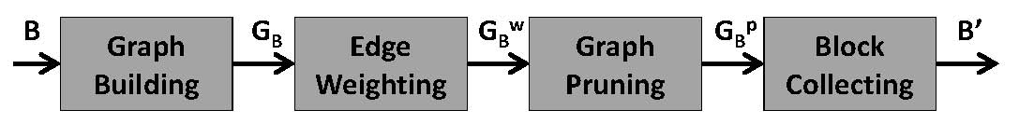
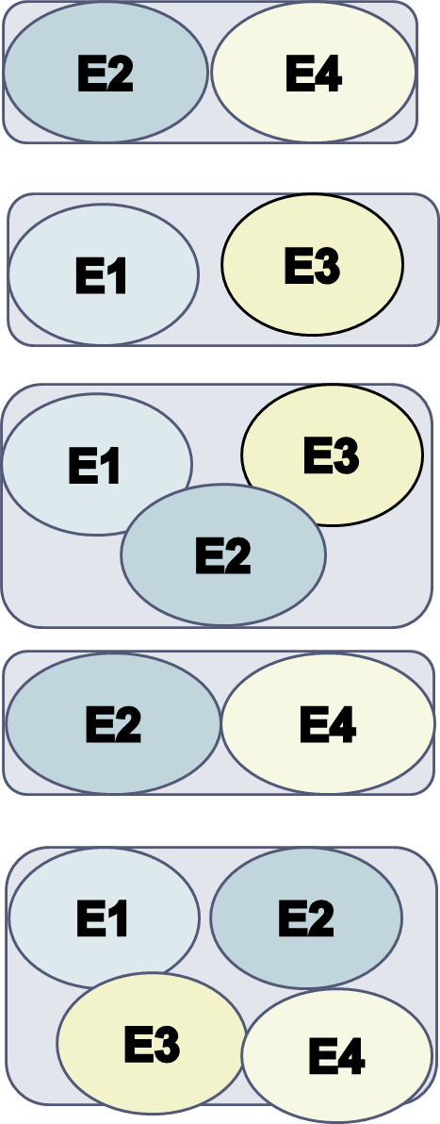
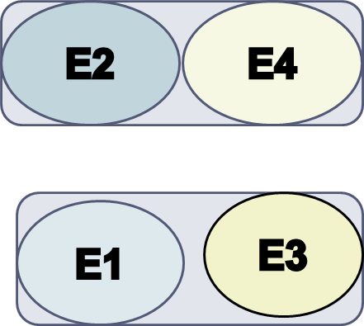
Outline of Meta-blocking
n₁
n₃
n₁
n₃
n₁
n₃
3
1
2
2
2
n₂
n₄
n₂
n₄
n₂
n₄
3
Notes:
Blocking graph
Nodes → entities
Edges → between entities co-occurring in at least one block
Weights → how similar are the adjacent entities, the higher the weight, the more similar the entities

Slide 99
Graph Building
For every block:
for every entity → add a node
for every pair of co-occurring entities → add an undirected edge
Blocking graph:
It eliminates all redundant comparisons →
no parallel edges.
Low materialization cost →
implicit materialization through inverted indices
Different from similarity graph!
Notes:
Co-occurring pair of entities: they belong to the same block (and not in the same dataset in the case of clean-clean ER).
Technical issues with the implementation of the graph.
Similarity graph -> materialized, edge weights derived from entity matching, used for clustering entities into equivalence clusters

Slide 100
Edge Weighting
Five generic, attribute-agnostic weighting schemes that rely on the following evidence:
the number of blocks shared by two entities
the size of the common blocks
the number of blocks or comparisons involving each entity.
Computational Cost:
In theory, equal to executing all pair-wise comparisons in the given block collection.
In practice, significantly lower because it does not employ string similarity metrics.

Slide 101
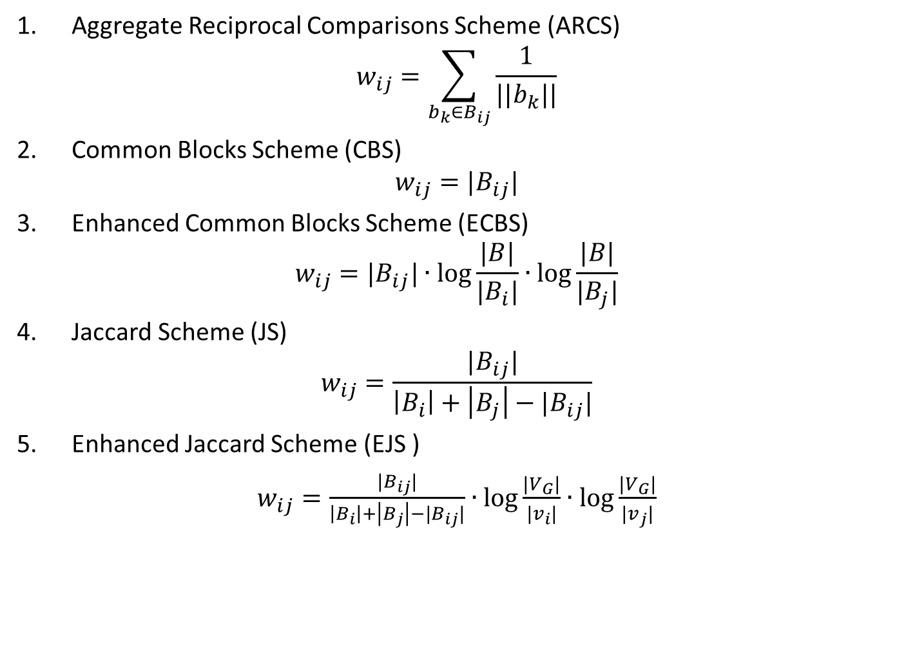
Weighting Schemes
Aggregate Reciprocal Comparisons Scheme (ARCS)
$$w_{ij}=\sum_{b_{k}∈B_{ij}}{\frac{1}{||b_{k}||}}$$
Common Blocks Scheme (CBS)
$$w_{ij}={|B}_{ij}|$$
Enhanced Common Blocks Scheme (ECBS)
$$w_{ij}={|B}_{ij}|∙\log{\frac{|B|}{|B_{i}|}∙\log{\frac{|B|}{|B_{j}|}}}$$
Jaccard Scheme (JS)
$$w_{ij}=\frac{{|B}_{ij}|}{{\left|B_{i}\right|+\left|B_{j}\right|−|B}_{ij}|}$$
Enhanced Jaccard Scheme (EJS )
$w_{ij}=\frac{{|B}_{ij}|}{{\left|B_{i}\right|+\left|B_{j}\right|−|B}_{ij}|}∙\log{\frac{|V_{G}|}{|v_{i}|}}$ $∙\log{\frac{|V_{G}|}{|v_{j}|}}$
Notes:
For all schemes, the higher the value, the more likely the adjacent entities are to be matching.
ECBS/EJS enhances CBS/JS through an IDF scheme.

Slide 102
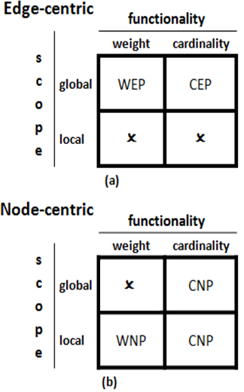
Graph Pruning
Pruning algorithms
Edge-centric
Node-centric
they produce directed blocking graphs
Pruning criteria
Scope:
  Global
  Local
  Functionality:
  Weight thresholds
  Cardinality thresholds
Notes:
Graph Pruning consists of two parts: the pruning algorithm and the pruning criterion.
Edge-centric: best edges over the entire graph.
Node-centric: best edges for each node neighborhood.
Weight threshold: minimum weight of retained edges.
Cardinality threshold: maximum number of retained edges.

Slide 103
Thresholds for Graph Pruning
Experiments show robust behavior of the following configurations:
Weighted Edge Pruning (WEP)
threshold: average weight across all edges
Cardinality Edge Pruning (CEP)
threshold: K = BPE∙|E|/2
Weighted Node Pruning (WNP)
threshold: for each node, the average weight of the adjacent edges
Cardinality Node Pruning (CNP)
threshold: for each node, k=BPE-1
Notes:
BPE: average number of blocks per entity.
Used the BC-CC metric space to compute the cardinality thresholds.
Weight-Edge Pruning (WEP) retains all edges whose weight exceeds a certain threshold
Cardinality-Edge Pruning (CEP) retains the top-K weighted edges
Weight-Node Pruning (WNP) for every node, retains all edges whose weight exceeds a certain threshold
Cardinality-Node Pruning (CNP) for every node, retains the top-k weighted edges

Slide 104
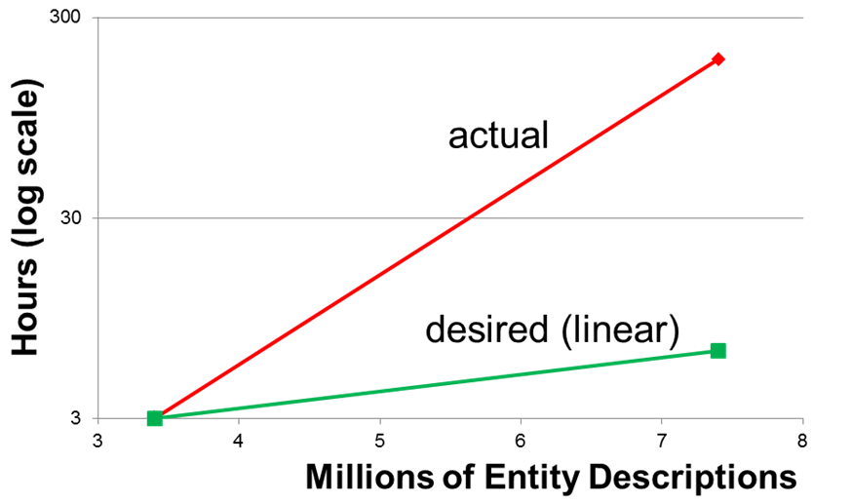
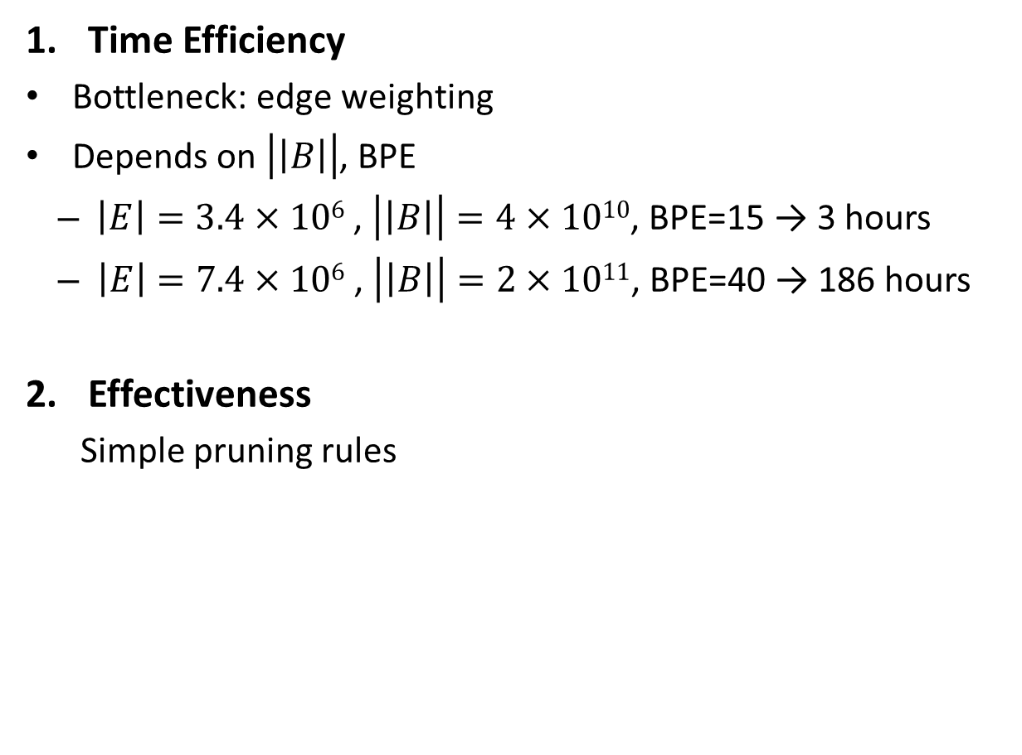
Meta-blocking Challenges
Time Efficiency
Bottleneck: edge weighting
Depends on $\left|\left|B\right|\right|$, BPE
  $\left|E\right|=3.4×106$ , $\left|\left|B\right|\right|=4×1010$, BPE=15 → 3 hours
  $\left|E\right|=7.4×106$ , $\left|\left|B\right|\right|=2×1011$, BPE=40 → 186 hours
Effectiveness
  Simple pruning rules
Notes:
BPE: average number of blocks per entity.

Slide 105
Enhancing Meta-blocking Efficiency
Block Filtering
  r = 0.8 → 4 times faster processing, on average
  reduces both ||B|| and BPE
Optimized Edge Weighting
[Papadakis et. al., EDBT 2016]
  Entity-based instead of Block-based implementation
  An order of magnitude faster processing, in combination with Block Filtering
Parallel Meta-blocking
[Efthymiou et. al., BigData 2015]
  Load-balanced, distributed approach based on MapReduce (Apache Hadoop)
Notes:
Complementary solutions.

Slide 106
Motivation
E
Block
Building
Block
Cleaning
Comparison
Cleaning
B
  DBPedia 3.0rc ↔ DBPedia 3.4
  Brute-force approach
  Comparisons: 2.58 ∙ 10¹²
  Recall: 100%
  Running time: 1,344 days → 3.7 years
  Token Blocking + Block Filtering + Comparison Propagation
  Overhead time: <30 mins
  Comparisons: 3.5 ∙ 10¹⁰
  Recall: 99%
  Total Running time: 19 days
  Token Blocking + Block Filtering + Meta-blocking
  Overhead time: 4 hours
  Comparisons: 8.95 ∙ 10⁶
  Recall: 92%
  Total Running time: 5 hours
Notes:
attribute clustering would lead to less comparisons than token blocking, but is more time consuming
would only make sense for a very expensive entity similarity function
26 days (with optimal parameters)
block building: token blocking
block cleaning: block filtering
5 hours (with optimal parameters)
block building: token blocking
block cleaning: block filtering
comparison cleaning: metablocking single core; parallel metablocking:

Slide 107
Motivation
E
Block
Building
Block
Cleaning
Comparison
Cleaning
B
  DBPedia 3.0rc ↔ DBPedia 3.4
  Brute-force approach
  Comparisons: 2.58 ∙ 10¹²
  Recall: 100%
  Running time: 1,344 days → 3.7 years
  Token Blocking + Block Filtering + Comparison Propagation
  Overhead time: <30 mins
  Comparisons: 3.5 ∙ 10¹⁰
  Recall: 99%
  Total Running time: 19 days
  Token Blocking + Block Filtering + Meta-blocking
  Overhead time: 4 hours
  Comparisons: 8.95 ∙ 10⁶
  Recall: 99%
  Total Running time: 10 hours
Notes:
attribute clustering would lead to less comparisons than token blocking, but is more time consuming
would only make sense for a very expensive entity similarity function
26 days (with optimal parameters)
block building: token blocking
block cleaning: block filtering
5 hours (with optimal parameters)
block building: token blocking
block cleaning: block filtering
comparison cleaning: metablocking single core; parallel metablocking:

Slide 108
Motivation
E
Block
Building
Block
Cleaning
Comparison
Cleaning
B
  DBPedia 3.0rc ↔ DBPedia 3.4
  Brute-force approach
  Comparisons: 2.58 ∙ 10¹²
  Recall: 100%
  Running time: 1,344 days → 3.7 years
  Token Blocking + Block Filtering + Comparison Propagation
  Overhead time: <30 mins
  Comparisons: 3.5 ∙ 10¹⁰
  Recall: 99%
  Total Running time: 19 days
  Token Blocking + Block Filtering + Meta-blocking
  Overhead time: 4 hours
  Comparisons: 8.95 ∙ 10⁶
  Recall: 99%
  Total Running time: 10 hours
Notes:
attribute clustering would lead to less comparisons than token blocking, but is more time consuming
would only make sense for a very expensive entity similarity function
26 days (with optimal parameters)
block building: token blocking
block cleaning: block filtering
5 hours (with optimal parameters)
block building: token blocking
block cleaning: block filtering
comparison cleaning: metablocking single core; parallel metablocking: 1.2hours

Slide 109
Parallel Meta-blocking
Two strategies:
  Basic: explicitly creates the blocking graph
    it performs all weight computations and stores all edges in disk
  Advanced: uses the blocking graph as a conceptual model
    enriches the input of the pruning algorithms with all the information necessary to compute the weights

Slide 110
Meta-blocking (advanced)
Pre-processing
Key
Value
Key
Value
Key
Value
b₁ | [e₁,b₁,b₄,b₆]
b₄ | [e₁,b₁,b₄,b₆]
b₆ | [e₁,b₁,b₄,b₆]
b₁ | [e₂,b₁]
... | …
b₁ | [e₁,b₁,b₄,b₆]
b₁ | [e₂,b₁]
b₁ | [e₃,b₁,b₄]
... | …
b₁ | [e₁,b₁,b₄,b₆], [e₂,b₁], [e₃,b₁,b₄],...
… | …
Reduce
Key
Value
Group by key
e₁ | b₁,b₄,b₆
e₂ | b₁
e₃ | b₁,b₄
e₄ | b₄,b₅
... | ...
Map
b₄ | [e₁,b₁,b₄,b₆]
b₄ | [e₃,b₁,b₄]
b₄ | [e₄,b₄,b₅]
... | …
b₄ | [e₁,b₁,b₄,b₆], [e₃,b₁,b₄], [e₄,b₄,b₅],...
... | ...
Reduce
b₁ | [e₃,b₁,b₄]
b₄ | [e₃,b₁,b₄]
b₄ | [e₄,b₄,b₅]
b₅ | [e₄,b₄,b₅]
... | …
Map
b₅ | [e₄,b₄,b₅]
... | …
Reduce
b₅ | [e₄,b₄,b₅],...
... | ...
b₆ | [e₁,b₁,b₄,b₆]
... | …
Reduce
b₆ | [e₁,b₁,b₄,b₆],...
... | ...

Slide 111
Meta-blocking (advanced)
Weighted Edge Pruning (WEP) & Jaccard Scheme (JS)
Key
Value
Key
Value
Key
Value
e₁.e₂ | 1/3
e₁.e₃ | 2/3
e₂.e₃ | 1/2
... | …
e₁.e₂ | 1/3
... | ...
e₁.e₃ | 2/3
... | …
b₁ | [e₁,b₁,b₄,b₆], [e₂,b₁], [e₃,b₁,b₄]
… | …
b₄ | [e₁,b₁,b₄,b₆], [e₃,b₁,b₄], [e₄,b₄,b₅]
... | ...
Reduce
e₁.e₃ | 2/3
... | …
Map
Group by key
e₂.e₃ | 1/2
... | ...
Reduce
e₂.e₃ | 1/2
... | …
e₁.e₄ | 1/4
e₃.e₄ | 1/3
... | …
Map
e₁.e₄ | 1/4
... | ...
e₃.e₄ | 1/3
... | …
Reduce
Count #keys
... | …
Sum up values
Notes:
how could we improve this using Flink/Spark/Gradoop?
For e_1 and e_2, the edge weight is 1/3 because it is given by the Jaccard Weighting Scheme. For e_1, we have the following list of blocks containing it: b₁,b₄,b₆, while e_2 is contained only in b₁. The Jaccard similarity of these two block lists is 1/3. Assuming that the overall weight threshold of WEP is ½, we get the two edges in the end.

Slide 112
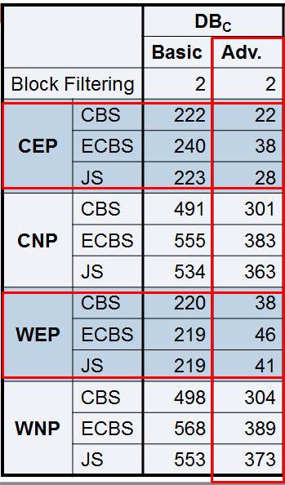
Meta-blocking (advanced)
Weighted Edge Pruning (WEP) & Jaccard Scheme (JS)
Notes:
how could we improve this using Flink/Spark/Gradoop?
Time in minutes. The edge-centric algorithms (CEP & WEP) are much faster than the node-centric ones (CNP & WNP). The advanced strategy significantly outperforms the basic one, which materializes the blocking graph. The 3 weighting schemes have similar times. Speedup is almost linear.
Using Flink/Spark instead of Hadoop should improve performance to a large extent, as they store intermediate in memory instead of on-disk.

Slide 113
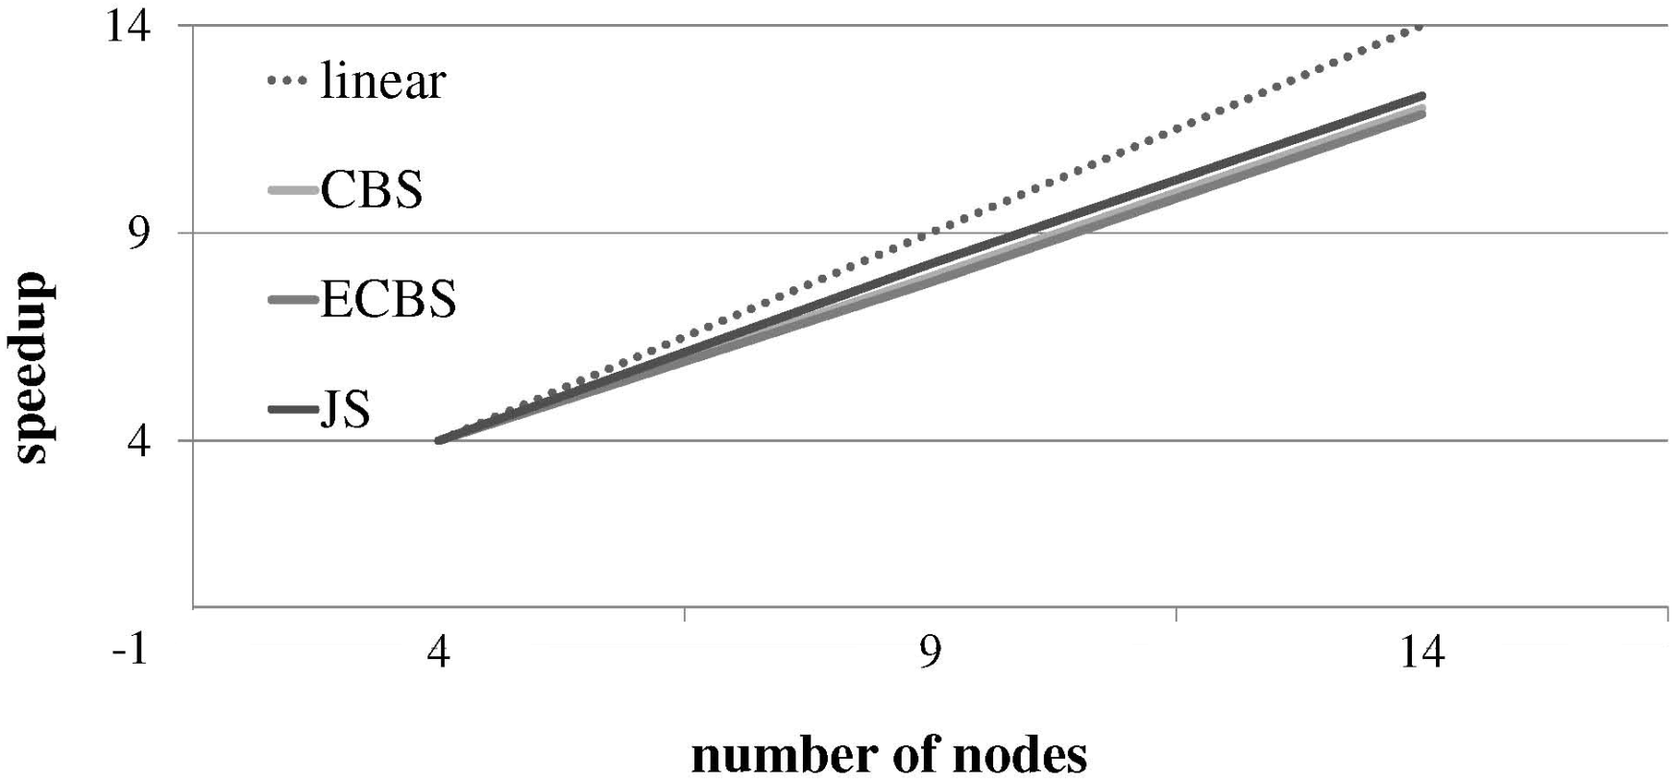
Meta-blocking (advanced)
Weighted Edge Pruning (WEP) & Jaccard Scheme (JS)
Parallel Meta-blocking achieves linear scale-up!
Notes:
how could we improve this using Flink/Spark/Gradoop?
Time in minutes. The edge-centric algorithms (CEP & WEP) are much faster than the node-centric ones (CNP & WNP). The advanced strategy significantly outperforms the basic one, which materializes the blocking graph. The 3 weighting schemes have similar times. Speedup is almost linear.
Using Flink/Spark instead of Hadoop should improve performance to a large extent, as they store intermediate in memory instead of on-disk.

Slide 114
Enhancing Meta-blocking Effectiveness
Supervised Meta-blocking [Papadakis et. al., VLDB 2014]
Goal:
more accurate and comprehensive methodology for
pruning the edges of the blocking graph.
Solution:
- model edge pruning as a classification task per edge
- two classes: “likely match”, “unlikely match”
- associate each edge with a set of features that are:
    generic
    effective
    efficient
    minimal
Notes:
Generic -> not crafted for a particular application or schema
Effective -> capture distinctive information
Efficient -> low extraction cost
Minimal -> low classification cost

Slide 115
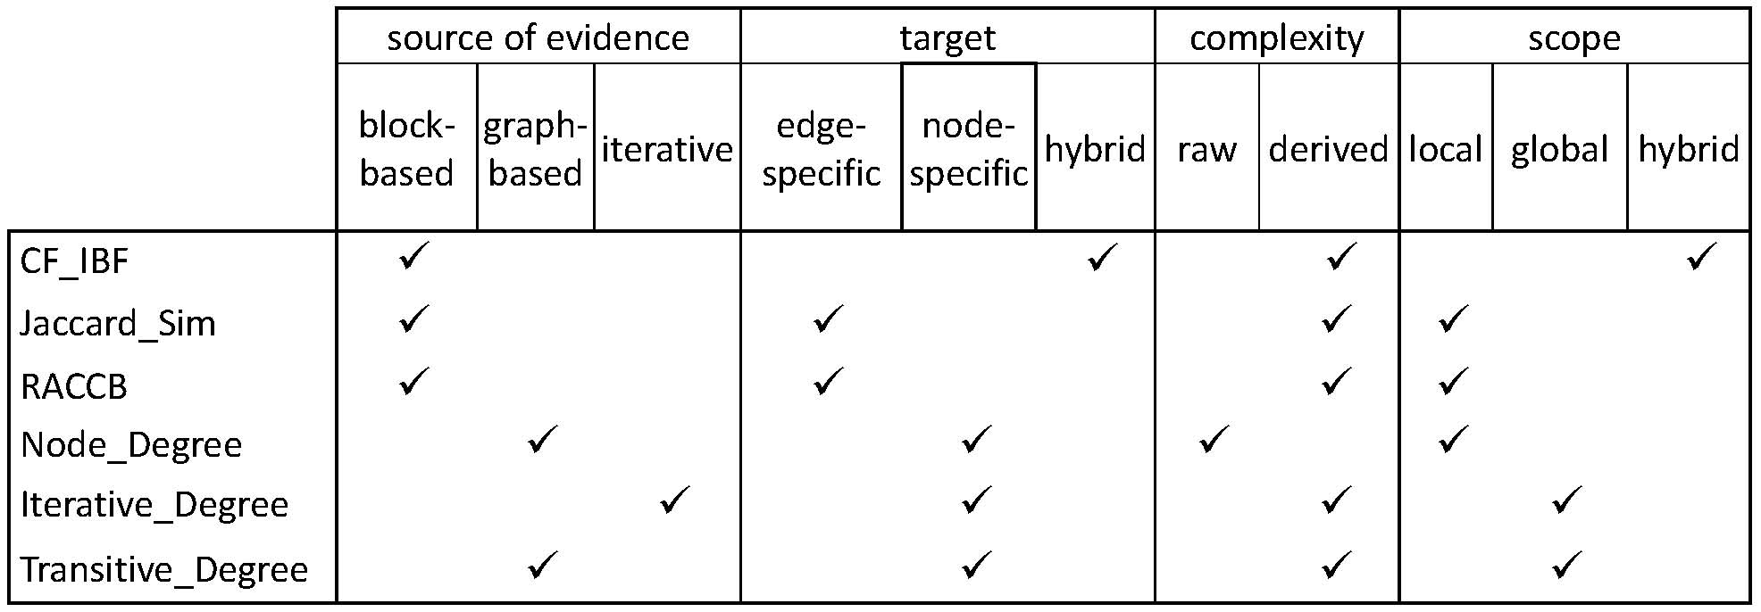
Enhancing Meta-blocking Effectiveness
Feature Engineering
Examined all 63 possible combinations to find the minimal set of features, which comprises the first four features.
We combined them with state-of-the-art classification algorithms:
C4.5, SVM, Naïve Bayes, Bayesian Networks.
Robust performance w.r.t. algorithm parameters.
Notes:
CF_IBF -> Extended Common Blocks
RACCB -> ARCS
Iterative Degree -> PageRank
Transitive Degree -> sum of adjacent node degrees

Slide 116
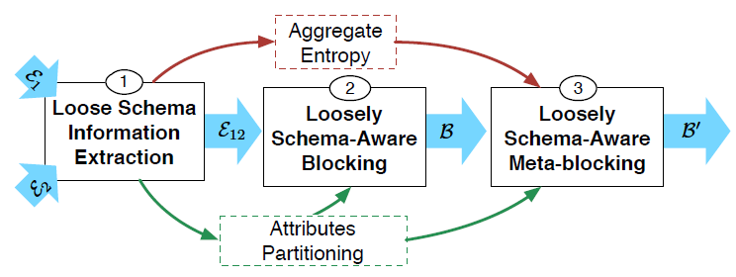
BLAST: Loosely Schema-aware Meta-blocking
[Simonini et. al., VLDB 2017]
Goal:
improve the edge weighting and pruning in unsupervised WNP with loose schema information
Solution:
It works for Dirty ER, as well.

Slide 117
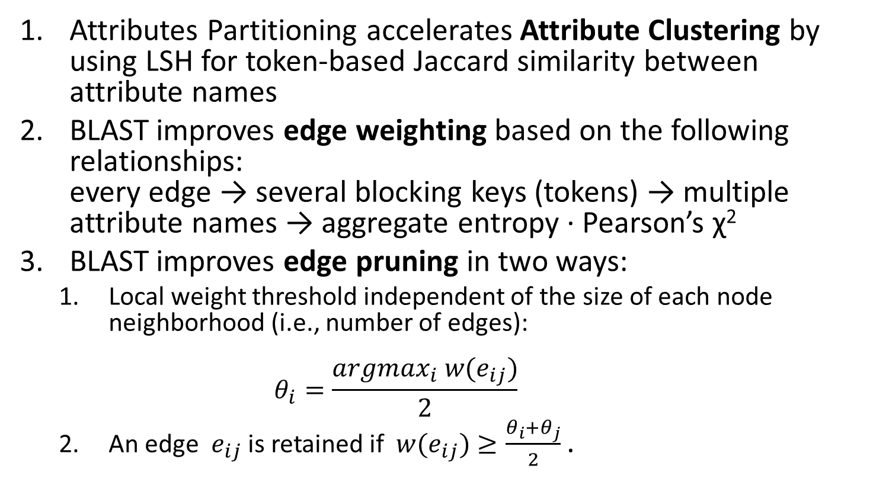
BLAST Algorithm
Attributes Partitioning accelerates Attribute Clustering by using LSH for token-based Jaccard similarity between attribute names
BLAST improves edge weighting based on the following relationships:
every edge → several blocking keys (tokens) → multiple attribute names → aggregate entropy ∙ Pearson’s χ²
BLAST improves edge pruning in two ways:
  Local weight threshold independent of the size of each node neighborhood (i.e., number of edges):
  $θ_{i}=\frac{{argmax}_{i}{ w(e}_{ij})}{2}$
  An edge ${ e}_{ij}$ is retained if ${ w(e}_{ij})≥\frac{θ_{i}+θ_{j}}{2}$ .

Slide 118
Comparative Analysis of Approximate
Blocking Techniques [Papadakis et. al., VLDB 2016]
employed 3 sub-tasks of blocking
E
Block
Building
Block
Cleaning
Comparison
Cleaning
B
Lazy
blocking
methods
Block-refinement
methods
Comparison-refinement
methods
Proactive blocking methods

Slide 119
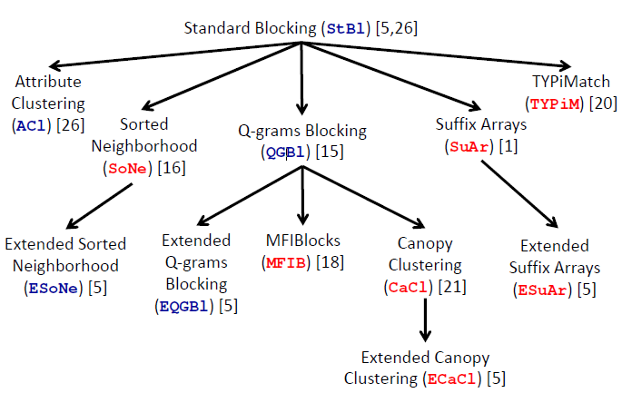
Comparative Analysis of Approximate
Blocking Techniques [Papadakis et. al., VLDB 2016]
considered 5 lazy and 7 proactive blocking methods

Slide 120
Experimental Analysis Setup
Block Cleaning methods:
  Block Purging
  Block Filtering
Comparison Cleaning methods:
  Comparison Propagation
  Iterative Blocking
  Meta-blocking

Slide 121
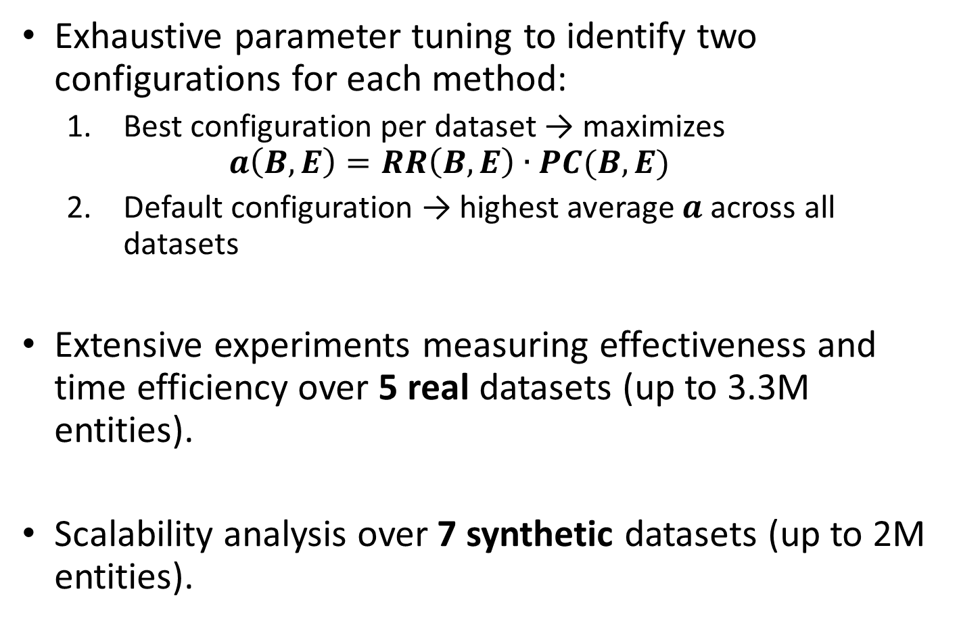
Experimental Analysis Setup
Exhaustive parameter tuning to identify two configurations for each method:
  Best configuration per dataset → maximizes
  $a\left(B,E\right)=RR\left(B,E\right)∙PC(B,E)$
  Default configuration → highest average $a$across all datasets
Extensive experiments measuring effectiveness and time efficiency over 5 real datasets (up to 3.3M entities).
Scalability analysis over 7 synthetic datasets (up to 2M entities).
Notes:
Reduction Ratio (RR) estimates the portion of comparisons that are avoided in B with respect to the naive, brute-force approach.
Formally, RR(B, E)=1-||B||=||E||.

Slide 122
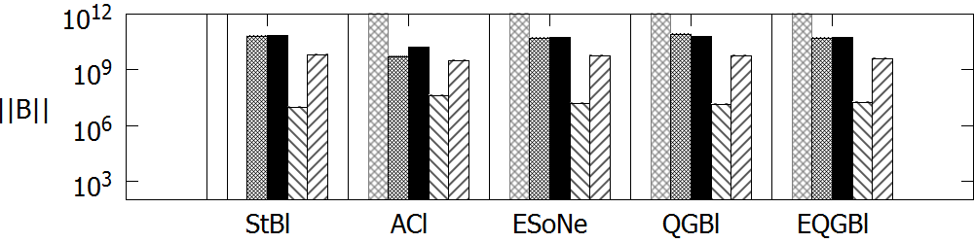
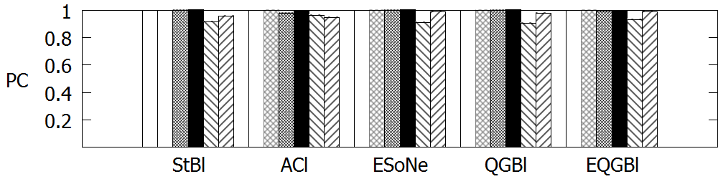
Effectiveness of Lazy Methods on DBPedia
Notes:
Very high recall (PC>>0.80), for all steps and configurations. This applies to all datasets. Difference between best and default configuration increases as we move from Block Building to Block Clean and Comparison Cleaning. All steps are indispensable, especially Meta-blocking, which decreases comparisons by up to 3 orders of magnitude! Without it, the number of comparisons remains very high.
I have highlighted the performance of the best configuration of Meta-blocking for Token Blocking. Comparisons are reduced by 3 orders of magnitude, at a very limited cost in recall. The same applies to all other lazy methods. The performance of default configuration is not that good, but the best configuration shows that there is great potential.

Slide 123
Effectiveness of Lazy Methods on DBPedia
Token-blocking and
Meta-blocking
Notes:
Very high recall (PC>>0.80), for all steps and configurations. This applies to all datasets. Difference between best and default configuration increases as we move from Block Building to Block Clean and Comparison Cleaning. All steps are indispensable, especially Meta-blocking, which decreases comparisons by up to 3 orders of magnitude! Without it, the number of comparisons remains very high.
I have highlighted the performance of the best configuration of Meta-blocking for Token Blocking. Comparisons are reduced by 3 orders of magnitude, at a very limited cost in recall. The same applies to all other lazy methods. The performance of default configuration is not that good, but the best configuration shows that there is great potential.

Slide 124
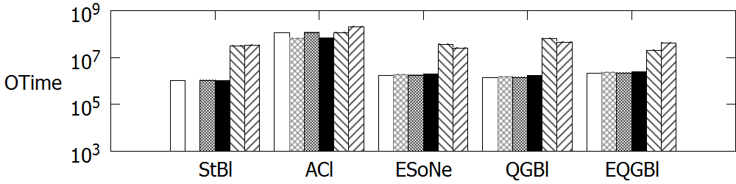
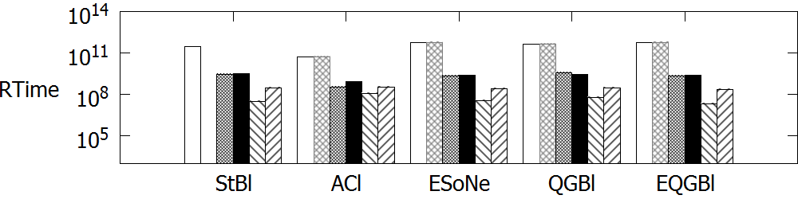
Time Efficiency of Lazy Methods on DBPedia
Notes:
Meta-blocking increases overhead time, Otime, but compensates for this by decreasing resolution time, Rtime, by 2 to 3 orders of magnitude. Token Blocking should be preferred when using a cheap entity matching method. For more expensive ones, the higher run time of Attribute Clustering pays off. This was shown in the scalability analysis, as well.
Again, the best configuration of Meta-blocking over Token Blocking is highlighted. The same pattern applies to all other lazy blocking methods.

Slide 125
Time Efficiency of Lazy Methods on DBPedia
Token-blocking and
Meta-blocking
Notes:
Meta-blocking increases overhead time, Otime, but compensates for this by decreasing resolution time, Rtime, by 2 to 3 orders of magnitude. Token Blocking should be preferred when using a cheap entity matching method. For more expensive ones, the higher run time of Attribute Clustering pays off. This was shown in the scalability analysis, as well.
Again, the best configuration of Meta-blocking over Token Blocking is highlighted. The same pattern applies to all other lazy blocking methods.

Slide 126
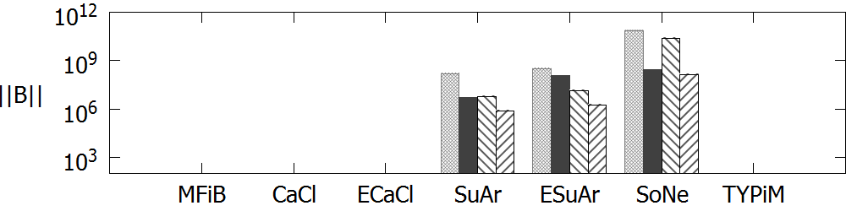
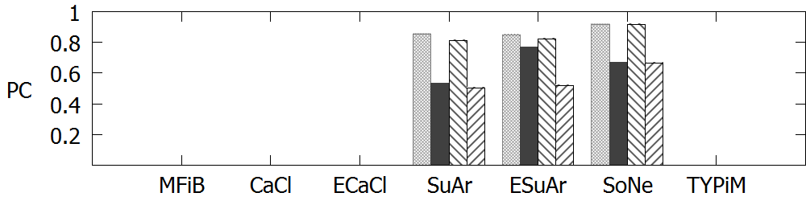
Effectiveness of Proactive methods on DBPedia
Notes:
Most proactive methods cannot scale to DBPedia, due to their very high overhead time.
This was shown in the scalability analysis, as well.
They depend heavily on their configuration: their default configuration has very poor performance.
Very poor recall, unless they execute a lot of comparisons.
Comparison Cleaning for SoNe is performed with Comparison Propagation. Meta-blocking is not applicable here, as it is a redundancy-neutral method. For SuAr and ESuAr, we employ Meta-blocking and again, its best configuration reduces ||B|| by 2 orders of magnitude at a rather limited cost in recall.

Slide 127
Effectiveness of Proactive methods on DBPedia
Suffix-arrays and
Meta-blocking
Notes:
Most proactive methods cannot scale to DBPedia, due to their very high overhead time.
This was shown in the scalability analysis, as well.
They depend heavily on their configuration: their default configuration has very poor performance.
Very poor recall, unless they execute a lot of comparisons.
Comparison Cleaning for SoNe is performed with Comparison Propagation. Meta-blocking is not applicable here, as it is a redundancy-neutral method. For SuAr and ESuAr, we employ Meta-blocking and again, its best configuration reduces ||B|| by 2 orders of magnitude at a rather limited cost in recall.

Slide 128
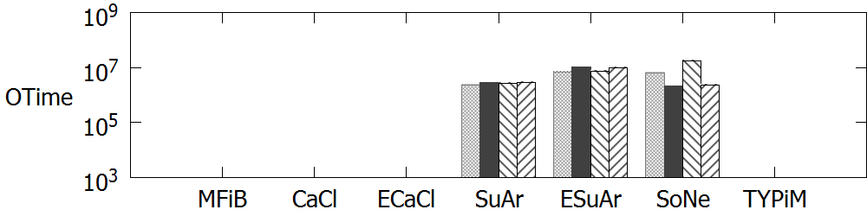
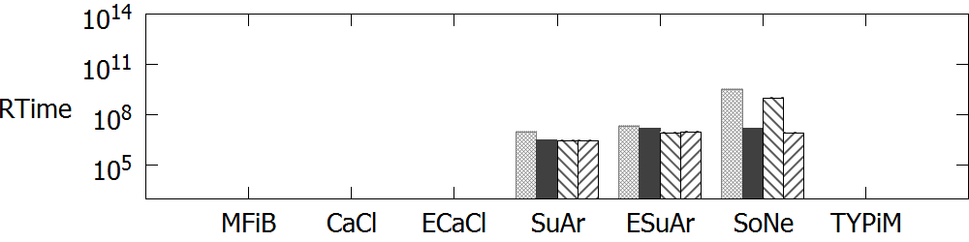
Time Efficiency of Proactive Methods on DBPedia
Notes:
The proactive methods are very fast and could be used for applications that emphasize time efficiency, instead of effectiveness.
Meta-blocking does not increase their overhead to a significant extend, because they already involve a low number of comparisons. Remember that the running time of Meta-blocking is linear to the number of input comparisons and the average number of blocks per entity.

Slide 129
Time Efficiency of Proactive Methods on DBPedia
Suffix-arrays and
Meta-blocking
Notes:
The proactive methods are very fast and could be used for applications that emphasize time efficiency, instead of effectiveness.
Meta-blocking does not increase their overhead to a significant extend, because they already involve a low number of comparisons. Remember that the running time of Meta-blocking is linear to the number of input comparisons and the average number of blocks per entity.

Slide 130
Part 6:
Challenges

Slide 131
Automatic Configuration
Facts:
Several parameters in every blocking workflow
  Both for lazy and proactive methods
Blocking performance sensitive to internal configuration
  Experimentally verified in [Papadakis et. al., VLDB 2016]
Manual fine-tuning required
Open Research Directions:
Plug-and-play blocking
Data-driven configuration
Notes:
The lazy methods are more robust in block building, but need configuration for block and comparison cleaning. The opposite is true for proactive methods.

Slide 132
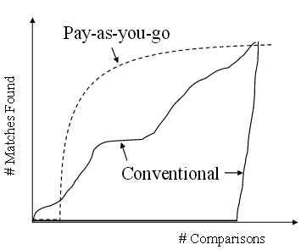
Progressive Blocking
Facts:
Progressive, or Pay-as-you-go ER comes is useful
Notes:
More formally, it requires:
Improved Early Quality
Same Eventual Quality
In other words, it aims to define the optimal processing order for a set of entities.
Use cases:
Limited, unknown time for ER (online ER)
Exploratory ER
Empirical by nature, based on heuristics.
Steven Euijong Whang, Hector Garcia-Molina: Pay-As-You-Go Entity Resolution, IEEE TKDE, 2013
Static Methods: They are independent of entity matching, producing an immutable processing order.
Thorsten Papenbrock, Arvid Heise, Felix Naumann: Progressive Duplicate Detection. IEEE TKDE, 2015
Dynamic Methods: They are integrated with entity matching, adjusting the processing order on-the-fly. They assume that entity matching is performed by an oracle (α=100%), thus yielding an optimistic estimation of their performance. They need to load the compared entity profiles in memory
Both works present methods that assume structured data.
They rely on schema-based blocking methods, which cluster entities into blocks using schema knowledge. In this way, they extract blocking keys of low noise and high discriminativeness, boosting the performance of their progressive methods.
To ensure high recall for their methods, they employ multiple schema-based blocking keys (see Naumann’s paper).
They evaluate their methods mostly on relatively medium-sized datasets (up to 1 million entities).
Our contribution: Introduce schema-agnostic methods for Progressive Block-based ER that are able to handle large, semi-structured, heterogeneous data (Big Data).
Ideally, we could prove that they perform well on structured data, as well, outperforming the existing schema-based methods.

Slide 133
Progressive Blocking
Facts:
Progressive, or Pay-as-you-go ER comes is useful
get most of the benefit
much earlier
Notes:
More formally, it requires:
Improved Early Quality
Same Eventual Quality
In other words, it aims to define the optimal processing order for a set of entities.
Use cases:
Limited, unknown time for ER (online ER)
Exploratory ER
Empirical by nature, based on heuristics.
Steven Euijong Whang, Hector Garcia-Molina: Pay-As-You-Go Entity Resolution, IEEE TKDE, 2013
Static Methods: They are independent of entity matching, producing an immutable processing order.
Thorsten Papenbrock, Arvid Heise, Felix Naumann: Progressive Duplicate Detection. IEEE TKDE, 2015
Dynamic Methods: They are integrated with entity matching, adjusting the processing order on-the-fly. They assume that entity matching is performed by an oracle (α=100%), thus yielding an optimistic estimation of their performance. They need to load the compared entity profiles in memory
Both works present methods that assume structured data.
They rely on schema-based blocking methods, which cluster entities into blocks using schema knowledge. In this way, they extract blocking keys of low noise and high discriminativeness, boosting the performance of their progressive methods.
To ensure high recall for their methods, they employ multiple schema-based blocking keys (see Naumann’s paper).
They evaluate their methods mostly on relatively medium-sized datasets (up to 1 million entities).
Our contribution: Introduce schema-agnostic methods for Progressive Block-based ER that are able to handle large, semi-structured, heterogeneous data (Big Data).
Ideally, we could prove that they perform well on structured data, as well, outperforming the existing schema-based methods.

Slide 134
Progressive Blocking
Facts:
Progressive, or Pay-as-you-go ER comes is useful
get most of the benefit
much earlier
may require some
pre-processing
Notes:
More formally, it requires:
Improved Early Quality
Same Eventual Quality
In other words, it aims to define the optimal processing order for a set of entities.
Use cases:
Limited, unknown time for ER (online ER)
Exploratory ER
Empirical by nature, based on heuristics.
Steven Euijong Whang, Hector Garcia-Molina: Pay-As-You-Go Entity Resolution, IEEE TKDE, 2013
Static Methods: They are independent of entity matching, producing an immutable processing order.
Thorsten Papenbrock, Arvid Heise, Felix Naumann: Progressive Duplicate Detection. IEEE TKDE, 2015
Dynamic Methods: They are integrated with entity matching, adjusting the processing order on-the-fly. They assume that entity matching is performed by an oracle (α=100%), thus yielding an optimistic estimation of their performance. They need to load the compared entity profiles in memory
Both works present methods that assume structured data.
They rely on schema-based blocking methods, which cluster entities into blocks using schema knowledge. In this way, they extract blocking keys of low noise and high discriminativeness, boosting the performance of their progressive methods.
To ensure high recall for their methods, they employ multiple schema-based blocking keys (see Naumann’s paper).
They evaluate their methods mostly on relatively medium-sized datasets (up to 1 million entities).
Our contribution: Introduce schema-agnostic methods for Progressive Block-based ER that are able to handle large, semi-structured, heterogeneous data (Big Data).
Ideally, we could prove that they perform well on structured data, as well, outperforming the existing schema-based methods.

Slide 135
Progressive Blocking
Facts:
Progressive, or Pay-as-you-go ER comes is useful
Progressive Blocking in its infancy
  Static methods
  [Whang et. al., TKDE 2013]
  Dynamic methods
  [Papenbrock et. al., TKDE 2015]
Only for relational data (schema-aware)
Open Research Directions:
Schema-agnostic Progressive Blocking
Notes:
More formally, it requires:
Improved Early Quality
Same Eventual Quality
In other words, it aims to define the optimal processing order for a set of entities.
Use cases:
Limited, unknown time for ER (online ER)
Exploratory ER
Empirical by nature, based on heuristics.
Steven Euijong Whang, Hector Garcia-Molina: Pay-As-You-Go Entity Resolution, IEEE TKDE, 2013
Static Methods: They are independent of entity matching, producing an immutable processing order.
Thorsten Papenbrock, Arvid Heise, Felix Naumann: Progressive Duplicate Detection. IEEE TKDE, 2015
Dynamic Methods: They are integrated with entity matching, adjusting the processing order on-the-fly. They assume that entity matching is performed by an oracle (α=100%), thus yielding an optimistic estimation of their performance. They need to load the compared entity profiles in memory
Both works present methods that assume structured data.
They rely on schema-based blocking methods, which cluster entities into blocks using schema knowledge. In this way, they extract blocking keys of low noise and high discriminativeness, boosting the performance of their progressive methods.
To ensure high recall for their methods, they employ multiple schema-based blocking keys (see Naumann’s paper).
They evaluate their methods mostly on relatively medium-sized datasets (up to 1 million entities).
Our contribution: Introduce schema-agnostic methods for Progressive Block-based ER that are able to handle large, semi-structured, heterogeneous data (Big Data).
Ideally, we could prove that they perform well on structured data, as well, outperforming the existing schema-based methods.

Slide 136
Privacy Preserving Blocking
Facts:
several applications ask for privacy-preserving ER
lots of interest in this area [Christen, PADM 2006][Karakasidis et al., 2012][Ziad et al, BTW 2015]
Open Research Directions:
What is the role of blocking workflow techniques?
  block building, block filtering, comparison cleaning
How can existing blocking techniques be adjusted?
Novel blocking methods for this context

Slide 137
Incremental Blocking
Facts:
Velocity in Web Data
Dynamic ER
Incremental ER [Gruenheid et. al., VLDB 2014]
  Blocking → black box
Open Research Directions:
Incremental (Meta-)Blocking
Notes:
So far, ER has been considered a static, offline procedure that is applied only once. In practice, it is a constant, dynamic process, as its results have to be updated whenever new data become available.
Updating blocks is easy when relying on a signature-based functionality, such as Token Blocking. What happens, though, when we have a large, dense graph that is not materialized and we have to process with a global constraint (e.g., average edge weight) that is updated?

Slide 138
Distributed Blocking
Facts:
Velocity in Big Data
Need for even faster/more scalable ER solutions
Open Research Directions:
What is the best way to use the modern distributed platforms/paradigms?
  Flink/Spark
How can we further improve performance of Parallel Meta-blocking?
  Gelly/Gradoop/GraphX
Minimize both time performance and total CPU cycles

Slide 139
Part 7:
JedAI Toolkit

Slide 140
What is the JedAI Toolkit?
JedAI can be used in three ways:
As an open source library that implements numerous state-of-the-art methods for all steps of an established end-to-end ER workflow.
As a desktop application for ER with an intuitive Graphical User Interface that is suitable for both expert and lay users.
As a workbench for comparing all performance aspects of various (configurations of) end-to-end ER workflows.

Slide 141
How does the JedAI Toolkit work?
JedAI implements the following schema-agnostic, end-to-end workflow for both Clean-Clean and Dirty ER:
Step 1
Step 2
Step 3
Step 4
Step 5
Step 6
Step 7
Data Reading
Block
Building
Block
Cleaning
Comparison
Cleaning
Entity
Matching
Entity
Clustering
Evaluation & Storing
Reads files containing the entity profiles and the golden standard.
Creates
overlapping blocks.
Optional step that cleans blocks from useless comparisons (repeated, superfluous).
Optional step that operates on the level of individual comparisons to remove the useless ones.
Executes all retained comparisons.
Partitions the similarity graph into equivalence clusters.
Stores and presents performance results
w.r.t. numerous measures.

Slide 142
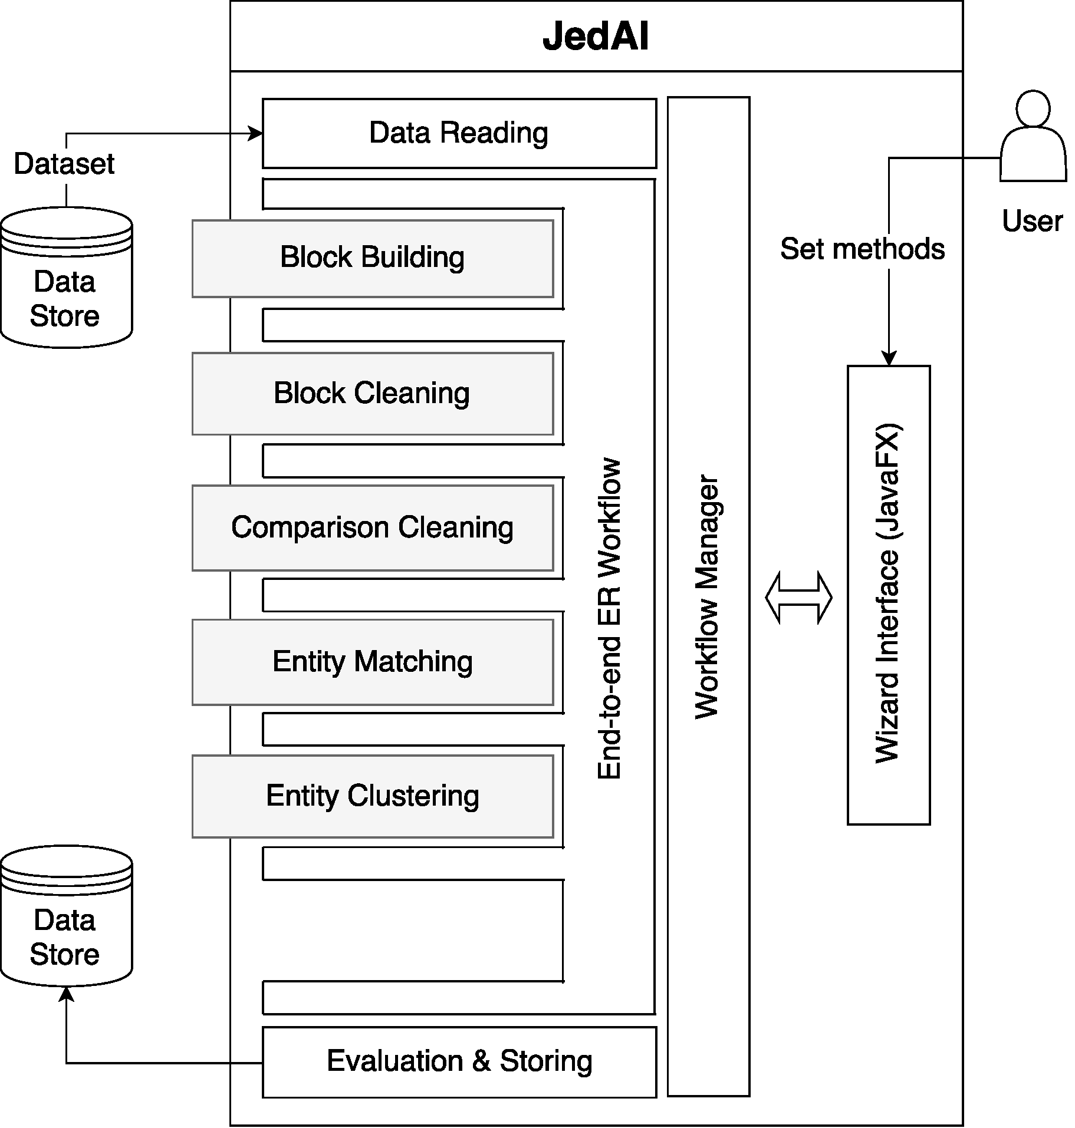
How is the JedAI Toolkit structured?
Modular architecture: one module per workflow step.
Extensible architecture (e.g., ontology matching)
???

Slide 143
How can I build an ER workflow?
JedAI supports several established methods for each workflow step:
Step 1
Step 2
Step 3
Step 4
Step 5
Step 6
Step 7
Data Reading
Block
Building
Block
Cleaning
Comparison
Cleaning
Entity
Matching
Entity
Clustering
Evaluation & Storing
Possible to read CSV, RDF/XML files & relational DBs in any combination!
Choose
1 out of 8 methods.
Specify any combination of 3 (4) complementary methods for Dirty (Clean-Clean) ER.
Choose
1 out of 7 methods (including
Meta-blocking).
Combine
1 out of 2
methods with 12 textual representation models and 10 similarity measures.
Choose
1 out of 6
methods for Dirty ER. For Clean-Clean ER, 1 method is available.
Store results as a CSV file.

Slide 144
Which Blocking Methods are included?
Block Building | Block Cleaning | Comparison Cleaning
Token Blocking | Block Filtering | Comparison Propagation
Sorted Neighborhood | Size-based Block Purging | Cardinality Edge Pruning (CEP)
Extended Sorted Neighborhood | Cardinality-based Block Purging | Cardinality Node Pruning (CNP)
Attribute Clustering | Block Scheduling | Weighted Edge Pruning (WEP)
Q-Grams Blocking |  | Weighted Node Pruning (WNP)
Extended Q-Grams Blocking |  | Reciprocal CNP
Suffix Arrays |  | Reciprocal WNP
Extended Suffix Arrays

Slide 145
Where can I find JedAI Toolkit?
Project website: http://jedai.scify.org .
Github repository of JedAI Library: https://github.com/scify/JedAIToolkit .
Github repository of JedAI Desktop Application and Workbench: https://github.com/scify/jedai-ui .
  All code is implemented using Java 8.
  All code is publicly available under Apache License V2.0.
Documentation (slides, videos, etc) available at https://github.com/scify/JedAIToolkit/tree/master/documentation .
When using JedAI, please cite:
George Papadakis, Leonidas Tsekouras, Emmanouil Thanos, George Giannakopoulos, Themis Palpanas and Manolis Koubarakis: "JedAI: The Force behind Entity Resolution", in ESWC 2017.

Slide 146
Which datasets are available for testing?
Several datasets are available for testing at https://github.com/scify/JedAIToolkit .
Can be used for Dirty
ER, as well.
Clean-Clean ER (real) | D1 Entities | D2 Entities
Abt-Buy | 1,076 | 1,076
DBLP-ACM | 2,616 | 2,294
DBLP-Scholar | 2,516 | 61,353
Amazon-GP | 1,354 | 3,039
Movies | 27,615 | 23,182
DBPedia | 1,190,733 | 2,164,040
Dirty ER (synthetic) | Entities
10K | 10,000
50K | 50,000
100K | 100,000
200K | 200,00
300K | 300,00
1M | 1,000,000
2M | 2,000,000

Slide 147
What are the next steps?
Version 2.0:
  Includes support for SPARQL endpoints, multicore functionality and configuration optimization.
  Available at the end of September, 2017.
Version 3.0:
  Includes support for ontology matching, progressive ER as well as a workflow builder.
  Available at the end of December, 2017.
Version 4.0:
  All functionality is implemented in Apache Spark.
  Available at the end of December, 2018.

Slide 148
Part 8:
Conclusions

Slide 149
Conclusions – Block Building
Traditional proactive blocking methods only suitable for relational data
  background schema knowledge should be available for their configuration
Recent lazy blocking methods scale well to heterogeneous, semi-structured Big Data
  Variety is addressed with schema-agnostic keys
  Volume is addressed with Block and Comparison Cleaning methods → they trade slightly lower recall, for much higher precision
  Token Blocking → the only parameter-free blocking method

Slide 150
Conclusions – Block Cleaning
  Coarse-grained functionality:
    operation at the level of entire blocks
    low cost (fast) methods
  Only applicable to lazy blocking methods
They boost the overall performance to a large extent:
  comparisons drop by orders of magnitude
  recall drops to a controllable extent (~1-2%)
Mostly complementary methods
  multiple Block Cleaning methods can be combined in a single workflow

Slide 151
Conclusions – Comparison Cleaning
Fine-grained functionality:
  operate at the level of individual comparisons → computationally intensive process
Apply to both lazy and proactive methods
Meta-blocking is the current state-of-the-art
  Discards both superfluous and redundant comparisons
  Necessary for reducing comparisons to manageable levels for single-threaded ER workflows
    reduces comparisons by orders of magnitude, with recall > 98%
  Naturally parallelizable

Slide 152

Big Data Research (BDR) Journal http://www.journals.elsevier.com/big-data-research/
New Elsevier journal on topics related to big data
  advances in big data management/processing
  interdisciplinary applications
Editor in Chief for BDR
  submit your work
  propose special issues
google: bdr journal

Slide 153
thank you!
questions?
  http://sourceforge.net/projects/erframework
google: themis palpanas
-> publications -> tutorials

Slide 154
References – Part A
[Aizawa et. al., WIRI 2005] Akiko N. Aizawa, Keizo Oyama, "A Fast Linkage Detection Scheme for Multi-Source Information Integration" in WIRI, 2005.
[Baxter et. al., KDD 2003] R. Baxter, P. Christen, T. Churches, “A comparison of fast blocking methods for record linkage”, in Workshop on Data Cleaning, Record Linkage and Object Consolidation at KDD, 2003.
[Bilenko et. al., ICDM 2006] Mikhail Bilenko, Beena Kamath, Raymond J. Mooney, "Adaptive Blocking: Learning to Scale Up Record Linkage", in ICDM 2006.
[Christen, PADM 2006] Christen P: Privacy-preserving data linkage and geocoding: Current approaches and research directions. PADM held at IEEE ICDM, Hong Kong, 2006.
[Christen, TKDE 2011] P. Christen, " A survey of indexing techniques for scalable record linkage and deduplication.” in IEEE TKDE 2011.
[Efthymiou et. al., BigData 2015] Vasilis Efthymiou, George Papadakis, George Papastefanatos, Kostas Stefanidis, Themis Palpanas, "Parallel meta-blocking: Realizing scalable entity resolution over large, heterogeneous data", in IEEE Big Data 2015.
[Fellegi et. al., JASS 1969] P. Fellegi, A. Sunter, “A theory for record linkage,” in Journal of the American Statistical Society, vol. 64, no. 328, 1969.
[Fisher et. al., KDD 2015] Jeffrey Fisher, Peter Christen, Qing Wang, Erhard Rahm, "A Clustering-Based Framework to Control Block Sizes for Entity Resolution" in KDD 2015.
[Gravano et. al., VLDB 2001] L. Gravano, P. Ipeirotis, H. Jagadish, N. Koudas, S. Muthukrishnan, D. Srivastava, “Approximate string joins in a database (almost) for free’, in VLDB, 2001.
[Gruenheid et. al., VLDB 2014] Anja Gruenheid, Xin Luna Dong, Divesh Srivastava, "Incremental Record Linkage", in PVLDB 2014.
[Hernandez et. al., SIGMOD 1995] M. Hernandez, S. Stolfo, “The merge/purge problem for large databases”, in SIGMOD, 1995.

Slide 155
References – Part B
[Karakasidis et al., SAC 2012] Karakasidis A and Verykios VS: Reference table based k-anonymous private blocking. Symposium on Applied Computing, 2012.
[Kenig et. al., IS 2013] Batya Kenig, Avigdor Gal, "MFIBlocks: An effective blocking algorithm for entity resolution", in Inf. Syst. 2013.
[Ma et. Al., WSDM 2013] Y. Ma, T. Tran, "TYPiMatch: type-specific unsupervised learning of keys and key values for heterogeneous web data integration", in WSDM 2013.
[McCallum et. al., KDD 2000] A. McCallum, K. Nigam, L. Ungar, “Efficient clustering of high-dimensional data sets with application to reference matching”, in KDD, 2000.
[Michelson et. al., AAAI 2006] Matthew Michelson, Craig A. Knoblock, "Learning Blocking Schemes for Record Linkage", in AAAI 2006.
[Papadakis et. al., EDBT 2016] George Papadakis, George Papastefanatos, Themis Palpanas, Manolis Koubarakis, "Scaling Entity Resolution to Large, Heterogeneous Data with Enhanced Meta-blocking", in EDBT 2016.
[Papadakis et al., iiWAS 2010] G. Papadakis, G. Demartini, P. Fankhauser, P. Karger, "The missing links: discovering hidden same-as links among a billion of triples”, in iiWAS 2010.
[Papadakis et al., JCDL 2011] G. Papadakis, E. Ioannou, C. Niederee, T. Palpanas, W. Nejdl, “Eliminating the redundancy in blocking-based entity resolution methods”, in JCDL 2011.
[Papadakis et al., SWIM 2011] G. Papadakis, E. Ioannou, C. Niederee, T. Palpanas, W. Nejdl, “To Compare or Not to Compare: making Entity Resolution more Efficient”, in SWIM workshop (collocated with SIGMOD), 2011.
[Papadakis et. al., TKDE 2013] George Papadakis, Ekaterini Ioannou, Themis Palpanas, Claudia Niederee, Wolfgang Nejdl, "A Blocking Framework for Entity Resolution in Highly Heterogeneous Information Spaces", in IEEE TKDE 2013.

Slide 156
References – Part C
[Papadakis et. al., TKDE 2014] George Papadakis, Georgia Koutrika, Themis Palpanas, Wolfgang Nejdl, "Meta-Blocking: Taking Entity Resolution to the Next Level", in IEEE TKDE 2014.
[Papadakis et. al., VLDB 2014] G. Papadakis, G. Papastefanatos, G. Koutrika, "Supervised Meta-blocking", in PVLDB 2014.
[Papadakis et. al., VLDB 2015] George Papadakis, George Alexiou, George Papastefanatos, Georgia Koutrika, “Schema-agnostic vs Schema-based Configurations for Blocking Methods on Homogeneous Data”, in PVLDB 2015.
[Papadakis et. al., VLDB 2016] George Papadakis, Jonathan Svirsky, Avigdor Gal, Themis Palpanas, “Comparative Analysis of Approximate Blocking Techniques for Entity Resolution”, in PVLDB 2016.
[Papadakis et al., WSDM 2011] G. Papadakis, E. Ioannou, C. Niederee, P. Fankhauser, “Efficient entity resolution for large heterogeneous information spaces”, in WSDM 2011.
[Papadakis et al., WSDM 2012] G. Papadakis, E. Ioannou, C. Niederee, T. Palpanas, W. Nejdl, “Beyond 100 million entities: large-scale blocking-based resolution for heterogeneous data”, in WSDM 2012.
[Papenbrock et. al., TKDE 2015] Thorsten Papenbrock, Arvid Heise, Felix Naumann, "Progressive Duplicate Detection", in IEEE TKDE 2015.
[Sarma et. al, CIKM 2012] Anish Das Sarma, Ankur Jain, Ashwin Machanavajjhala, Philip Bohannon, "An automatic blocking mechanism for large-scale de-duplication tasks" in CIKM 2012.
[Simonini et. al, VLDB 2017] Giovanni Simonini, Sonia Bergamaschi and H.V. Jagadish, "Blast: a Loosely schema-aware Meta-blocking Approach for Entity Resolution" in VLDB 2017.
[Whang et. Al, SIGMOD 2009] Whang, D. Menestrina, G. Koutrika, M. Theobald, H. Garcia-Molina, "Entity resolution with iterative blocking", in SIGMOD 2009.
[Whang et. al., TKDE 2013] Steven Euijong Whang, David Marmaros, Hector Garcia-Molina, "Pay-As-You-Go Entity Resolution", in IEEE TKDE 2013.
[Ziad et al, BTW 2015] Ziad Sehili, Lars Kolb, Christian Borgs, Rainer Schnell, Erhard Rahm: Privacy Preserving Record Linkage with PPJoin. BTW 2015.

