Slide 1





Web-scale, Schema-Agnostic,
End-to-End Entity Resolution
updated: 23 April 2018
George Papadakis
University of Athens
gpapadis@di.uoa.gr
Themis Palpanas
Paris Descartes University
French University Institute
themis@mi.parisdescartes.fr

Slide 2
Entities: an invaluable asset
“Entities” is what a large part of our knowledge is about:
Locations
Organizations
Projects
Persons
Products
Events
Notes:
The first question we have to answer is why entity resolution is important.
Web data are dominated by entity profiles.
In an ideal world, every entity is described by a universally unique identifier, thus facilitating all applications that are based on entities, e.g., entity-centric search.

Slide 3

However …
How many names, descriptions or IDs (URIs) are
used for the same real-world “entity”?
Notes:
In reality, there is ambiguity/noise of two forms:
different entities with the same description/name, and
same entity with different descriptions/names.

Slide 4
However …
How many names, descriptions or IDs (URIs) are
used for the same real-world “entity”?
London 런던 ܠܘܢܕܘܢ लंडन लंदन લંડન ለንደን ロンドン লন্ডন ลอนดอน இலண்டன் ლონდონი Llundain Londain Londe Londen Londen Londen Londinium London Londona Londonas Londoni Londono Londra Londres Londrez Londyn Lontoo Loundres Luân Đôn Lunden Lundúnir Lunnainn Lunnon لندن لندن لندن لوندون לאנדאן לונדון Λονδίνο Лёндан Лондан Лондон Лондон Лондон Լոնդոն 伦敦 …

Slide 5
However …
How many names, descriptions or IDs (URIs) are
used for the same real-world “entity”?
London 런던 ܠܘܢܕܘܢ लंडन लंदन લંડન ለንደን ロンドン লন্ডন ลอนดอน இலண்டன் ლონდონი Llundain Londain Londe Londen Londen Londen Londinium London Londona Londonas Londoni Londono Londra Londres Londrez Londyn Lontoo Loundres Luân Đôn Lunden Lundúnir Lunnainn Lunnon لندن لندن لندن لوندون לאנדאן לונדון Λονδίνο Лёндан Лондан Лондон Лондон Лондон Լոնդոն 伦敦 …
capital of UK, host city of the IV Olympic Games, host city of the XIV Olympic Games, future host of the XXX Olympic Games, city of the Westminster Abbey, city of the London Eye, the city described by Charles Dickens in his novels, …

Slide 6
However …
How many names, descriptions or IDs (URIs) are
used for the same real-world “entity”?
London 런던 ܠܘܢܕܘܢ लंडन लंदन લંડન ለንደን ロンドン লন্ডন ลอนดอน இலண்டன் ლონდონი Llundain Londain Londe Londen Londen Londen Londinium London Londona Londonas Londoni Londono Londra Londres Londrez Londyn Lontoo Loundres Luân Đôn Lunden Lundúnir Lunnainn Lunnon لندن لندن لندن لوندون לאנדאן לונדון Λονδίνο Лёндан Лондан Лондон Лондон Лондон Լոնդոն 伦敦 …
capital of UK, host city of the IV Olympic Games, host city of the XIV Olympic Games, future host of the XXX Olympic Games, city of the Westminster Abbey, city of the London Eye, the city described by Charles Dickens in his novels, …
http://sws.geonames.org/2643743/
http://en.wikipedia.org/wiki/London
http://dbpedia.org/resource/Category:London
…

Slide 7
… or …
How many “entities” have the same name?
  London, KY
  London, Laurel, KY
  London, OH
  London, Madison, OH
  London, AR
  London, Pope, AR
  London, TX
  London, Kimble, TX
  London, MO
  London, MO
  London, London, MI
  London, London, Monroe, MI
  London, Uninc Conecuh County, AL
  London, Uninc Conecuh County, Conecuh, AL
  London, Uninc Shelby County, IN
  London, Uninc Shelby County, Shelby, IN
  London, Deerfield, WI
  London, Deerfield, Dane, WI
  London, Uninc Freeborn County, MN
  ...

Slide 8
… or …
How many “entities” have the same name?
  London, KY
  London, Laurel, KY
  London, OH
  London, Madison, OH
  London, AR
  London, Pope, AR
  London, TX
  London, Kimble, TX
  London, MO
  London, MO
  London, London, MI
  London, London, Monroe, MI
  London, Uninc Conecuh County, AL
  London, Uninc Conecuh County, Conecuh, AL
  London, Uninc Shelby County, IN
  London, Uninc Shelby County, Shelby, IN
  London, Deerfield, WI
  London, Deerfield, Dane, WI
  London, Uninc Freeborn County, MN
  ...
  London, Jack
  2612 Almes Dr
  Montgomery, AL
  (334) 272-7005
  London, Jack R
  2511 Winchester Rd
  Montgomery, AL 36106-3327
  (334) 272-7005
  London, Jack
  1222 Whitetail Trl
  Van Buren, AR 72956-7368
  (479) 474-4136
  London, Jack
  7400 Vista Del Mar Ave
  La Jolla, CA 92037-4954
  (858) 456-1850
  ...

Slide 9


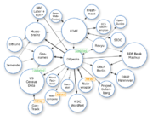

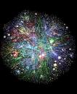



Content Providers
How many content types / applications provide
valuable information about each of these “entities”?
News about London
reviews on hotels in London
Wiki pages about the London
Pictures and tags about London
Social networks in London
Videos and tags for London
Notes:
The situation is aggrevated due to the Web 2.0 tools, which allow every Web user to upload non-curated and, thus, noisy content.

Slide 10
Preliminaries on Entity Resolution
Entity Resolution [Dong et al., Book 2015] [Elmagarmid et al., TKDE 2007] :
  identifies and aggregates the different entity profiles/records that actually describe the same real-world object.
  Useful because:
  improves data quality and integrity
  fosters re-use of existing data sources
  Application areas:
  Linked Data, Social Networks, census data,
  price comparison portals
Notes:
To leverage Big Data, we need to perform ER.
ER is a core task for many applications, like Linked Data.

Slide 11
Types of Entity Resolution
The input of ER consists of entity collections that can be of two
types [Christen, TKDE 2011]:
clean, which are duplicate-free
  e.g., DBLP, ACM Digital Library, Wikipedia, Freebase
dirty, which contain duplicate entity profiles in themselves
e.g., Google Scholar, Citeseer^{X}
Notes:
The most important aspect of the input entity collections: their quality.
DBLP -> most authors/papers appear only once
Google Scholar -> same paper with different titles, same author with different names.

Slide 12
Types of Entity Resolution
The input of ER consists of entity collections that can be of two
types [Christen, TKDE 2011]:
clean, which are duplicate-free
  e.g., DBLP, ACM Digital Library, Wikipedia, Freebase
dirty, which contain duplicate entity profiles in themselves
e.g., Google Scholar, Citeseer^{X}
Based on the quality of input, we distinguish ER into 3 sub-tasks:
Clean-Clean ER (a.k.a. Record Linkage in databases)
Dirty-Clean ER
Dirty-Dirty ER
Equivalent to Dirty ER
(a.k.a. Deduplication in databases)
Notes:
Clean-Clean ER: Given two individually clean, but overlapping entity collections, identify the entity profiles they have in common without executing comparisons within each source.
For simplicity, we treat the other two tasks as equivalent to Dirty ER, which receives a single dirty entity collection as input.
The goal is to partition its entities into sets of equivalence clusters.

Slide 13
Challenges for ER over Web Data
Volume
  Millions of entities
  Billions of name-value pairs describing them
  LOD Cloud*: >5,5∙10⁷ entities, ~1,5∙10¹¹ triples
Variety
  Semi-structured data → unprecedented levels of heterogeneity
  Numerous entity types & vocabularies
  LOD Cloud*: ~50,000 predicates, ~12,000 vocabularies
Velocity
  New DBPedia version every ~6 months
  *http://stats.lod2.eu:

Slide 14
Computational cost
  ER is an inherently quadratic problem (i.e., O(n²)):
  every entity has to be compared with all others
  ER does not scale well to large entity collections (e.g., Web Data).
Notes:
Typically, ER is performed by comparing every entity profile with all others using string similarity measures.

Slide 15
Computational cost
  ER is an inherently quadratic problem (i.e., O(n²)):
  every entity has to be compared with all others
  ER does not scale well to large entity collections (e.g., Web Data)
Solution: Blocking
  group similar entities into blocks
  execute comparisons only inside each block
    complexity is now quadratic to the size of the block (much smaller than dataset size!)
Notes:
Basic idea of blocking: most comparisons involve non-matching entities.
It constitutes an approximate solution, sacrificing recall to a controllable extent for much higher precision.

Slide 16
Computational cost
Brute-force approach
Input:
Entity Collection E
Blocking
Duplicate Pairs
|E| entities
|E| entities
Notes:
We can illustrate the relative cost of the main approaches through a diagram.
In the ideal case, the green circle coincides with the red one.
Blocking covers the largest part of duplicate pairs, but not all of them.
It also incorporates comparisons between non-matching entities.
The closer the green circle is to the red one, the better the blocking method is.

Slide 17
Example of Computational cost
  DBPedia 3.0rc ↔ DBPedia 3.4
  1.2 million entities ↔ 2.2 million entities
  Entity matching: Jaccard similarity of all tokens
  Cost per comparison: 0.045 milliseconds (average of 0.1 billion comparisons)
  Brute-force approach
  Comparisons: 2.58 ∙ 10¹²
  Recall: 100%
  Running time: 1,344 days → 3.7 years
  Optimized Token Blocking Workflow
  Overhead time: 4 hours
  Comparisons: 8.95 ∙ 10⁶
  Recall: 99%
  Total Running time: 10 hours
Notes:
total comparisons for brute force approach: multiplication of the two (we assume dbpedia is clean)
the true number of entities are not exactly 1.2 and 2.2 million, this is why the result is not 2.64

Slide 18
Example of Computational cost
  DBPedia 3.0rc ↔ DBPedia 3.4
  1.2 million entities ↔ 2.2 million entities
  Entity matching: Jaccard similarity of all tokens
  Cost per comparison: 0.045 milliseconds (average of 0.1 billion comparisons)
  Brute-force approach
  Comparisons: 2.58 ∙ 10¹²
  Recall: 100%
  Running time: 1,344 days → 3.7 years
  Optimized Token Blocking Workflow
  Overhead time: 4 hours
  Comparisons: 8.95 ∙ 10⁶
  Recall: 99%
  Total Running time: 10 hours

Slide 19
Scalable End-to-end ER workflow
Step 1
Step 2
Step 3
Step 4
Block
Building
Block
Processing
Entity
Matching
Entity
Clustering
Cluster together similar entities
Refine blocks to increase precision at no significant cost in recall
Compare the candidate matches
Partition the compared profiles into real-world entities
Notes:
The basis of this tutorial

Slide 20
Outline
Introduction to Blocking
Blocking Methods for Relational Data
Blocking Methods for Web Data
Block Processing Techniques
Meta-blocking
Entity Matching
Entity Clustering
Massive Parallelization Methods
Progressive Entity Resolution
Challenges
JedAI Toolkit
Conclusions
Notes:
Sections 3 and 4 pertain to the creation of blocks.
Sections 5 and 6 pertain to the processing of blocks.

Slide 21
Part 1:
Introduction to Blocking

Slide 22
Fundamental Assumptions
Every entity profile consists of a uniquely identified set of name-value pairs.
Every entity profile corresponds to a single real-world object.
Two matching profiles are detected as long as they co-occur in at least one block → entity matching is an orthogonal problem.
Focus on string values.
Notes:
1. Flexible representation model that accommodates any format: databases, XML, RDF. If the representation is not unique, then our only choice is to merge the exact duplicates (there is no way to tell them apart). Usually, some attribute(s) is(are) different.
3. Precision of entity matching is dependent on the entity similarity measures, and is orthogonal to the above problem.
Many reasons for this assumption. For example, there is no universal entity matching method. Entity Matching is a difficult problem itself.

Slide 23
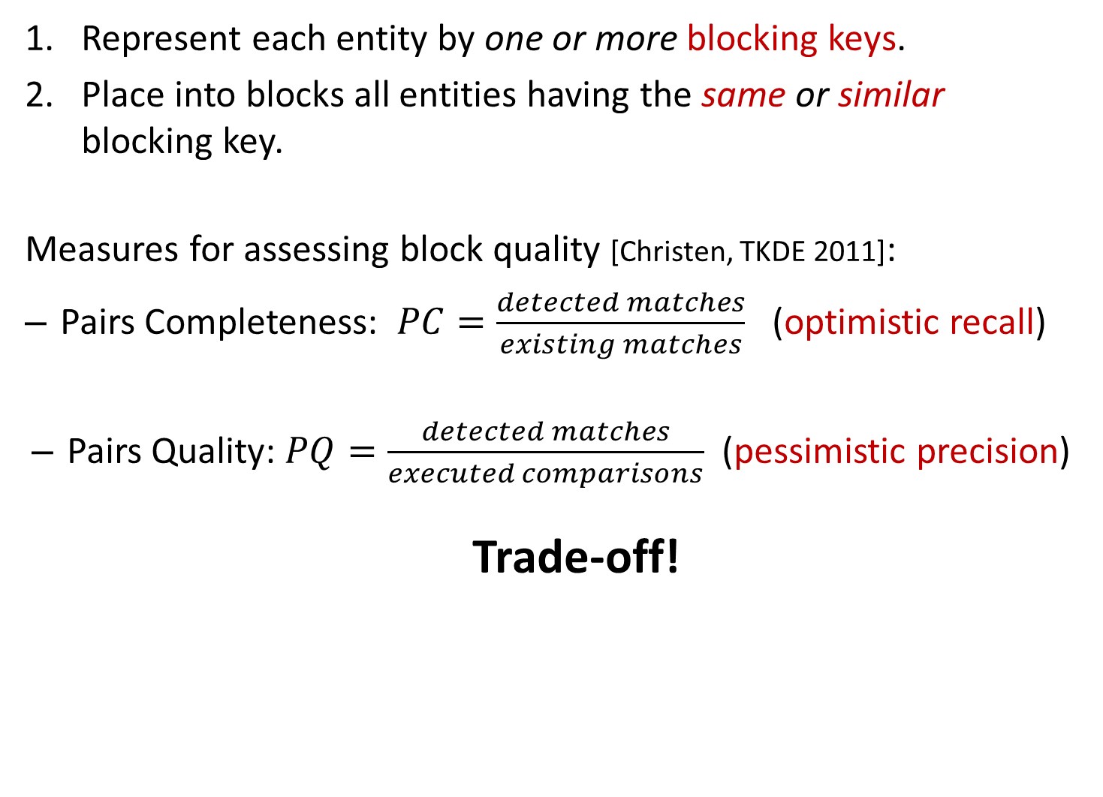
General Principles
Represent each entity by one or more blocking keys.
Place into blocks all entities having the same or similar blocking key.
Measures for assessing block quality [Christen, TKDE 2011]:
  Pairs Completeness: $PC=\frac{detected matches}{existing matches}$ (optimistic recall)
  Pairs Quality: $PQ=\frac{detected matches}{executed comparisons}$ (pessimistic precision)
  Trade-off!
Notes:
Blocking in a nutshell: use signatures to represent entities.
The more comparisons are executed, the higher PC gets. PQ, though, decreases, as the denominator increases faster than the numerator.
detected matches: duplicate entities co-occurring in a block
optimistic recall: we assume that entity matching never fails
pessimistic precision: we count all redundant comparisons as false positives (but in reality some of them are true positives)

Slide 24
Problem Definition
Given one dirty (Dirty ER), or two clean (Clean-Clean ER)
entity collections, cluster their profiles into blocks
and process them so that both Pairs Completeness (PC) and Pairs Quality (PQ) are maximized.
caution:
Emphasis on Pairs Completeness (PC).
  if two entities are matching then they should coincide at some block
Notes:
Goal: maximize the number of detected duplicates, while minimizing the number of executed comparisons.
Blocking is not an optimization task, but an engineering task, because there is no way we can know that two entities are matching. If for example, we knew that their Jaccard similarity should exceed a threshold, we could do some optimization. In practice, though, it is possible for two duplicates to share no information at all, if for example they are described in different languages.
This definition implies that PC and PQ are equally important. In practice, though, emphasis should be placed on PC, as it should exceed 80% or 90% in order to be useful.

Slide 25
Blocking Techniques Taxonomy
  Performance-wise
    Exact methods
    Approximate methods
  Functionality-wise
    Supervised methods
    Unsupervised methods
  Blocks-wise
    Disjoint blocks
    Overlapping blocks
      Redundancy-neutral
      Redundancy-positive
      Redundancy-negative
Signature-wise
    Schema-based
    Schema-agnostic
Notes:
To facilitate the understanding of the blocking methods we discuss in the following, we now present a taxonomy based on 4 dimensions. Every dimension splits blocking methods into main categories. We will examine every dimension in detail in the following slides.

Slide 26
Performance-wise Categorization
Exact Blocking Methods
  Maximize PQ for PC = 100%
  Closed-world assumption
  E.g., for bibliographical records , s ≡ t if:
JaccardSimilarity(s.title, t.title) > 0.80 AND
EditDistance(s.venue, t.venue) < 3
  Existing methods:
    Silk → filtering technique for edit distance
    LIMES → triangle inequality for similarity metrics
Approximate Blocking Methods
  PC < 100% → high PQ
  Open-world assumption
Notes:
To have a better understanding on the scope of this tutorial, we now present a taxonomy of blocking methods according to two fundamental dimensions.
Closed-world assumption -> in conjunction with entity matching
we assume that we know which similarity function and when a similarity value implies a match
Approximate Blocking methods are usually independent of similarity metrics and thresholds. To this category belongs the vast majority of blocking methods. We focus on them.
Open-world assumption -> standalone blocking methods
we assume that we don’t know how entity matching perfoms/works
Silk (Univ of Mannheim) is an open source framework for integrating heterogeneous data sources. The primary uses cases of Silk include:
- Generating links between related data items within different Linked Data sources.
- Linked Data publishers can use Silk to set RDF links from their data sources to other data sources on the Web.
- Applying data transformations to structured data sources.
Silk is based on the Linked Data paradigm
LIMES (Leipzig Univ)
The Linked Data paradigm has evolved into a powerful enabler for the transition from the document-oriented Web into the Semantic Web. While the amount of data published as Linked Data grows steadily and has surpassed 25 billion triples, less than 5% of these triples are links between knowledge bases. Link discovery frameworks provide the functionality necessary to discover missing links between knowledge bases. Yet, this task requires a significant amount of time, especially when it is carried out on large data sets. This paper presents and evaluates LIMES, a novel time-efficient approach for link discovery in metric spaces. Our approach utilizes the mathematical characteristics of metric spaces during the mapping process to filter out a large number of those instance pairs that do not suffice the mapping conditions. We present the mathematical foundation and the core algorithms employed in LIMES. We evaluate our algorithms with synthetic data to elucidate their behavior on small and large data sets with different configurations and compare the runtime of LIMES with another state-of-the-art link discovery tool.

Slide 27
Performance-wise Categorization
Exact Blocking Methods
  Maximize PQ for PC = 100%
  Closed-world assumption
  E.g., for bibliographical records , s ≡ t if:
JaccardSimilarity(s.title, t.title) > 0.80 AND
EditDistance(s.venue, t.venue) < 3
  Existing methods:
    Silk → filtering technique for edit distance
    LIMES → triangle inequality for similarity metrics
Approximate Blocking Methods
  PC < 100% → high PQ
  Open-world assumption
our focus
Notes:
To have a better understanding on the scope of this tutorial, we now present a taxonomy of blocking methods according to two fundamental dimensions.
Closed-world assumption -> in conjunction with entity matching
Approximate Blocking methods are usually independent of similarity metrics and thresholds. To this category belongs the vast majority of blocking methods. We focus on them.
Open-world assumption -> standalone blocking methods
Silk (Univ of Mannheim) is an open source framework for integrating heterogeneous data sources. The primary uses cases of Silk include:
- Generating links between related data items within different Linked Data sources.
- Linked Data publishers can use Silk to set RDF links from their data sources to other data sources on the Web.
- Applying data transformations to structured data sources.
Silk is based on the Linked Data paradigm
LIMES (Leipzig Univ)
The Linked Data paradigm has evolved into a powerful enabler for the transition from the document-oriented Web into the Semantic Web. While the amount of data published as Linked Data grows steadily and has surpassed 25 billion triples, less than 5% of these triples are links between knowledge bases. Link discovery frameworks provide the functionality necessary to discover missing links between knowledge bases. Yet, this task requires a significant amount of time, especially when it is carried out on large data sets. This paper presents and evaluates LIMES, a novel time-efficient approach for link discovery in metric spaces. Our approach utilizes the mathematical characteristics of metric spaces during the mapping process to filter out a large number of those instance pairs that do not suffice the mapping conditions. We present the mathematical foundation and the core algorithms employed in LIMES. We evaluate our algorithms with synthetic data to elucidate their behavior on small and large data sets with different configurations and compare the runtime of LIMES with another state-of-the-art link discovery tool.

Slide 28
Functionality-wise Categorization
Supervised Methods
Goal: learn the best blocking keys from a training set
Approach: identify best combination of attribute names and transformations
E.g., CBLOCK [Sarma et. al, CIKM 2012],
[Bilenko et. al., ICDM 2006], [Michelson et. al., AAAI 2006]
Drawbacks:
  labelled data
  domain-dependent
Unsupervised Methods
Generic, popular methods
Notes:
To facilitate the understanding of blocking methods, we present a categorization.
The supervised blocking methods try to learn the best blocking key definitions from a training set, e.g., by using combinations of attribute names.
The main drawback of supervised blocking techniques is the requirement for a training set.
Even if there is a set of labeled instances for a specific domain available, it is application specific, in the sense that it does not necessarily yield a good classifier on another domain.
Most techniques in the literature are unsupervised. We focus on them.

Slide 29
Functionality-wise Categorization
Supervised Methods
Goal: learn the best blocking keys from a training set
Approach: identify best combination of attribute names and transformations
E.g., CBLOCK [Sarma et. al, CIKM 2012],
[Bilenko et. al., ICDM 2006], [Michelson et. al., AAAI 2006]
Drawbacks:
  labelled data
  domain-dependent
Unsupervised Methods
Generic, popular methods
our focus
Notes:
To facilitate the understanding of blocking methods, we present a categorization.
The supervised blocking methods try to learn the best blocking key definitions from a training set, e.g., by using combinations of attribute names.
The main drawback of supervised blocking techniques is the requirement for a training set.
Even if there is a set of labeled instances for a specific domain available, it is application specific, in the sense that it does not necessarily yield a good classifier on another domain.
Most techniques in the literature are unsupervised. We focus on them.

Slide 30
Blocking Workflow [Papadakis et. al., VLDB 2016]
E
Block
Building
Block
Cleaning
Comparison
Cleaning
B
Lazy
blocking
methods
Block-refinement
methods
Comparison-refinement
methods
Proactive blocking methods
Notes:
For the approximate, unsupervised blocking methods we consider in this work, we can describe their internal functionality using three steps.
BlCl -> faster, less accurate
CoCl -> more accurate, more time-consuming
The methods that perform only Block Building are called Lazy. Those performing only BlCl, Block-refinement.
Block Building (Lazy & Proactive) vs Block Processing (Block- and Comparison-refinement)

Slide 31
Blocks- and Signature-wise Categorization of Block Building Methods
 | Disjoint Blocks | Overlapping Blocks
 |  | Redundancy- negative | Redundancy- neutral | Redundancy- positive
Schema- based | Standard Blocking | (Extended) Canopy Clustering | (Extended) Sorted Neighborhood MFIBlocks | (Extended) Q-grams Blocking (Extended) Suffix Arrays
Schema- agnostic | - | - | - | Token Blocking Agnostic Clustering TYPiMatch URI Semantics Blocking
Notes:
Redundancy expresses the number of blocks that are associated with every entity, on average.
First row: methods for databases. They cover all categories of redundancy.
Second row: methods for Web data. They are all redundancy-positive.
overlapping methods: the same entity may appear in more than 1 block
redundancy-positive: the more common blocks for two entities, the higher the probability to match
redundancy-negative: the most similar entities coincide (almost always) in a single block
redundancy-neutral: number of common blocks independent of matching probability

Slide 32
Block Processing Methods
[Papadakis et. al., VLDB 2016]
Mostly for redundancy-positive block building methods.
Block Cleaning
Block-level
  constraints on block characteristics
Entity-level
  constraints on entity characteristics
Comparison Cleaning
Redundant comparisons
  repeated across different blocks
Superfluous comparisons
  Involve non-matching entities
Notes:
block cleaning
block level: block purging (remove blocks with many entities/comparisons)
entity level: block filtering (remove a given entity from a percentage r of the largest blocks it belongs to)
comparison cleaning
redundant comparison: comparison propagation (removes redundant comparisons by executing comparisons in a sorted order)
superfluous comparisons: meta-blocking

Slide 33
Part 2:
Block Building for Relational Data

Slide 34
General Principles
Mostly schema-based techniques.
Rely on two assumptions:
A-priori known schema → no noise in attribute names.
For each attribute name we know some metadata:
  level of noise (e.g., spelling mistakes, false or missing values)
  distinctiveness of values
Notes:
All entity profiles adhere to a specific schema.
Many methods operate in this way. We will examine the most important ones.

Slide 35
Overview of Schema-based Methods
Standard Blocking
Sorted
Neighborhood
Suffix
Arrays
Q-grams
Blocking
Extended Sorted
Neighborhood
Extended Suffix
Arrays
MFIBlocks
Extended Q-grams
Blocking
Canopy
Clustering
Extended
Canopy
Clustering
Notes:
Here is the family tree of blocking methods. Standard Blocking is the cornerstone method.
All other methods employ the same BKs but in a different way in order to offer higher robustness and a better balance between recall and precision.
Every method has many variations. We present just one extended version for each one of them.
Blue indicates lazy blocking methods, and red proactive blocking methods.
We have 3 branches. On the left, blocks contain entities with similar blocking keys, on the right, blocks contain entities with the same blocking keys, and in the middle, we have a mixture.

Slide 36
Overview of Schema-based Methods
Standard Blocking
Sorted
Neighborhood
Suffix
Arrays
Q-grams
Blocking
Extended Sorted
Neighborhood
Extended Suffix
Arrays
MFIBlocks
Extended Q-grams
Blocking
Canopy
Clustering
Extended
Canopy
Clustering
LAZY BLOCKING
METHODS
Notes:
Here is the family tree of blocking methods. Standard Blocking is the cornerstone method.
All other methods employ the same BKs but in a different way in order to offer higher robustness and a better balance between recall and precision.
Every method has many variations. We present just one extended version for each one of them.
Blue indicates lazy blocking methods, and red proactive blocking methods.
We have 3 branches. On the left, blocks contain entities with similar blocking keys, on the right, blocks contain entities with the same blocking keys, and in the middle, we have a mixture.

Slide 37
Overview of Schema-based Methods
Standard Blocking
Sorted
Neighborhood
Suffix
Arrays
Q-grams
Blocking
Extended Sorted
Neighborhood
Extended Suffix
Arrays
MFIBlocks
Extended Q-grams
Blocking
Canopy
Clustering
Extended
Canopy
Clustering
PROACTIVE
BLOCKING
METHODS
LAZY BLOCKING
METHODS
Notes:
Here is the family tree of blocking methods. Standard Blocking is the cornerstone method.
All other methods employ the same BKs but in a different way in order to offer higher robustness and a better balance between recall and precision.
Every method has many variations. We present just one extended version for each one of them.
Blue indicates lazy blocking methods, and red proactive blocking methods.
We have 3 branches. On the left, blocks contain entities with similar blocking keys, on the right, blocks contain entities with the same blocking keys, and in the middle, we have a mixture.

Slide 38
Overview of Schema-based Methods
Standard Blocking
Sorted
Neighborhood
Suffix
Arrays
Q-grams
Blocking
Extended Sorted
Neighborhood
Extended Suffix
Arrays
MFIBlocks
Extended Q-grams
Blocking
Canopy
Clustering
Extended
Canopy
Clustering
PROACTIVE
BLOCKING
METHODS
LAZY BLOCKING
METHODS
Notes:
Here is the family tree of blocking methods. Standard Blocking is the cornerstone method.
All other methods employ the same BKs but in a different way in order to offer higher robustness and a better balance between recall and precision.
Every method has many variations. We present just one extended version for each one of them.
Blue indicates lazy blocking methods, and red proactive blocking methods.
We have 3 branches. On the left, blocks contain entities with similar blocking keys, on the right, blocks contain entities with the same blocking keys, and in the middle, we have a mixture.

Slide 39
Standard Blocking [Fellegi et. al., JASS 1969]
Earliest, simplest form of blocking.
Algorithm:
Select the most appropriate attribute name(s) w.r.t. noise and distinctiveness.
Transform the corresponding value(s) into a Blocking Key (BK)
For each BK, create one block that contains all entities having this BK in their transformation.
Works as a hash function! → Blocks on the equality of BKs

Slide 40
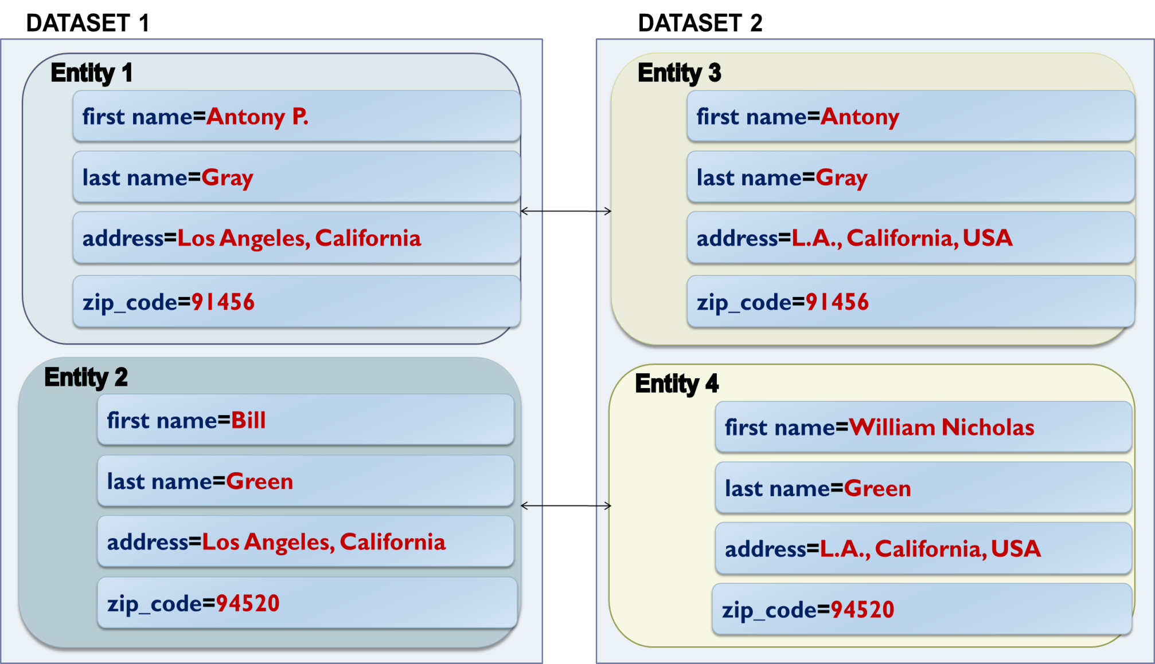
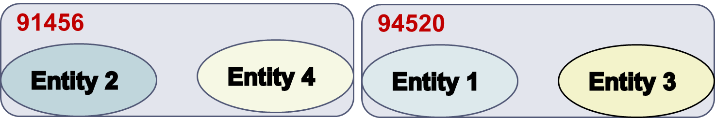
Example of Standard Blocking
Blocks on zip_code:
Notes:
Two homogeneous datasets described by the same schema.
E1 matches E3 and E2 with E4.
Brute force approach: four comparisons.
Advantages of Standard Blocking: highly efficient (disjoint blocks, which produce few comparisons) -> high precision.
Disadvantages of Standard Blocking: not robust to noise (mainly in values) -> low recall.
One solution: multiple blocking keys per entity -> redundancy.
Another solution is to use more advanced methods that are inherently crafted for noise in BKs.

Slide 41
Overview of Schema-based Methods
Standard Blocking
Sorted
Neighborhood
Suffix
Arrays
Q-grams
Blocking
Extended Sorted
Neighborhood
Extended Suffix
Arrays
MFIBlocks
Extended Q-grams
Blocking
Canopy
Clustering
Extended
Canopy
Clustering
Notes:
Let’s now look at the similarity branch of Blocking Methods.

Slide 42
Overview of Schema-based Methods blocks contain entities with similar blocking keys
Standard Blocking
Sorted
Neighborhood
Suffix
Arrays
Q-grams
Blocking
Extended Sorted
Neighborhood
Extended Suffix
Arrays
MFIBlocks
Extended Q-grams
Blocking
Canopy
Clustering
Extended
Canopy
Clustering
Notes:
Let’s now look at the similarity branch of Blocking Methods.

Slide 43
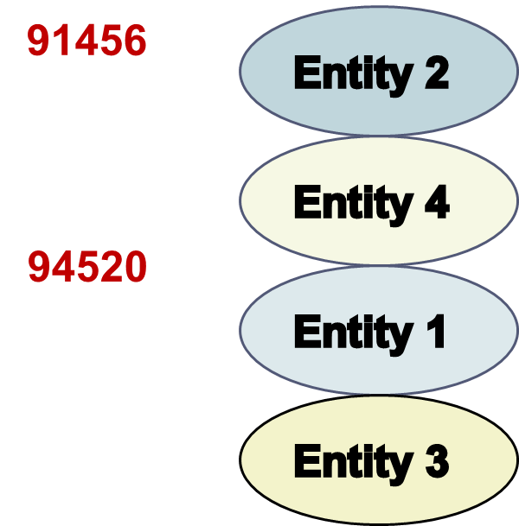
Sorted Neighborhood [Hernandez et. al., SIGMOD 1995]
Blocks on the similarity of BKs.
Entities are sorted in
alphabetic order of BKs.
A window of fixed size
slides over the sorted list of entities.
At each iteration, it compares
the entities that co-occur
within the window.

Slide 44
Sorted Neighborhood [Hernandez et. al., SIGMOD 1995]
Blocks on the similarity of BKs.
Entities are sorted in
alphabetic order of BKs.
A window of fixed size
slides over the sorted list of entities.
At each iteration, it compares
the entities that co-occur
within the window.

Slide 45
Sorted Neighborhood [Hernandez et. al., SIGMOD 1995]
Blocks on the similarity of BKs.
Entities are sorted in
alphabetic order of BKs.
A window of fixed size
slides over the sorted list of entities.
At each iteration, it compares
the entities that co-occur
within the window.

Slide 46
Sorted Neighborhood [Hernandez et. al., SIGMOD 1995]
Blocks on the similarity of BKs.
Entities are sorted in
alphabetic order of BKs.
A window of fixed size
slides over the sorted list of entities.
At each iteration, it compares
the entities that co-occur
within the window.
Notes:
Redundancy neutral method for two reasons:
Two entities might share a block even if their values are not similar.
Every pair of entities shares the same number of blocks.

Slide 47
Sorted Neighborhood [Hernandez et. al., SIGMOD 1995]
Blocks on the similarity of BKs.
Entities are sorted in
alphabetic order of BKs.
A window of fixed size
slides over the sorted list of entities.
At each iteration, it compares
the entities that co-occur
within the window.
Extended Sorted Neighborhood [Christen, TKDE 2011]
2’. A window of fixed size slides over the sorted list of BKs.
Notes:
Disadvantages: depends heavily on the size of the window.
A very small window leads to high precision, but low recall and vice versa for a large window.

Slide 48
Sorted Neighborhood [Hernandez et. al., SIGMOD 1995]
Blocks on the similarity of BKs.
Entities are sorted in
alphabetic order of BKs.
A window of fixed size
slides over the sorted list of entities.
At each iteration, it compares
the entities that co-occur
within the window.
Extended Sorted Neighborhood [Christen, TKDE 2011]
2’. A window of fixed size slides over the sorted list of BKs.
Notes:
Disadvantages: depends heavily on the size of the window.
A very small window leads to high precision, but low recall and vice versa for a large window.

Slide 49
Sorted Neighborhood [Hernandez et. al., SIGMOD 1995]
Blocks on the similarity of BKs.
Entities are sorted in
alphabetic order of BKs.
A window of fixed size
slides over the sorted list of entities.
At each iteration, it compares
the entities that co-occur
within the window.
Extended Sorted Neighborhood [Christen, TKDE 2011]
2’. A window of fixed size slides over the sorted list of BKs.
Notes:
Disadvantages: depends heavily on the size of the window.
A very small window leads to high precision, but low recall and vice versa for a large window.

Slide 50
Overview of Schema-based Methods
Standard Blocking
Sorted
Neighborhood
Suffix
Arrays
Q-grams
Blocking
Extended Sorted
Neighborhood
Extended Suffix
Arrays
MFIBlocks
Extended Q-grams
Blocking
Canopy
Clustering
Extended
Canopy
Clustering
Notes:
Let’s have a look now at the mixture-branch of blocking methods.

Slide 51
Overview of Schema-based Methods blocks contain entities with same, or similar blocking keys
Standard Blocking
Sorted
Neighborhood
Suffix
Arrays
Q-grams
Blocking
Extended Sorted
Neighborhood
Extended Suffix
Arrays
MFIBlocks
Extended Q-grams
Blocking
Canopy
Clustering
Extended
Canopy
Clustering
Notes:
Let’s have a look now at the mixture-branch of blocking methods.

Slide 52
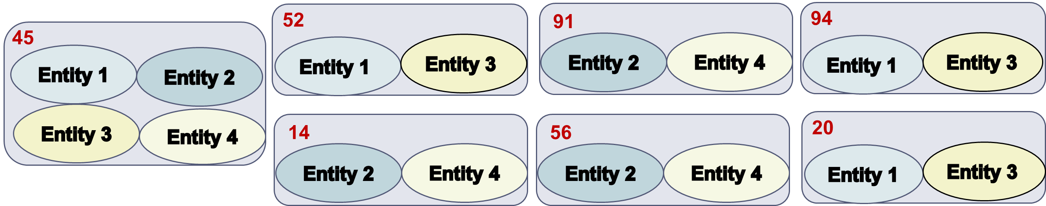
Q-grams Blocking [Gravano et. al., VLDB 2001]
Blocks on equality of BKs.
Converts every BK into the list of its q-grams.
For q=2, the BKs 91456 and 94520 yield the following blocks:
Advantage:
robust to noisy BKVs
Drawback:
larger blocks → higher computational cost
Notes:
The smaller the q is, the more robust it is to noise, but the more frequent its keys are, and the larger are the resulting blocks.
the 45 block with two entities is wrong: the correct label is 52

Slide 53
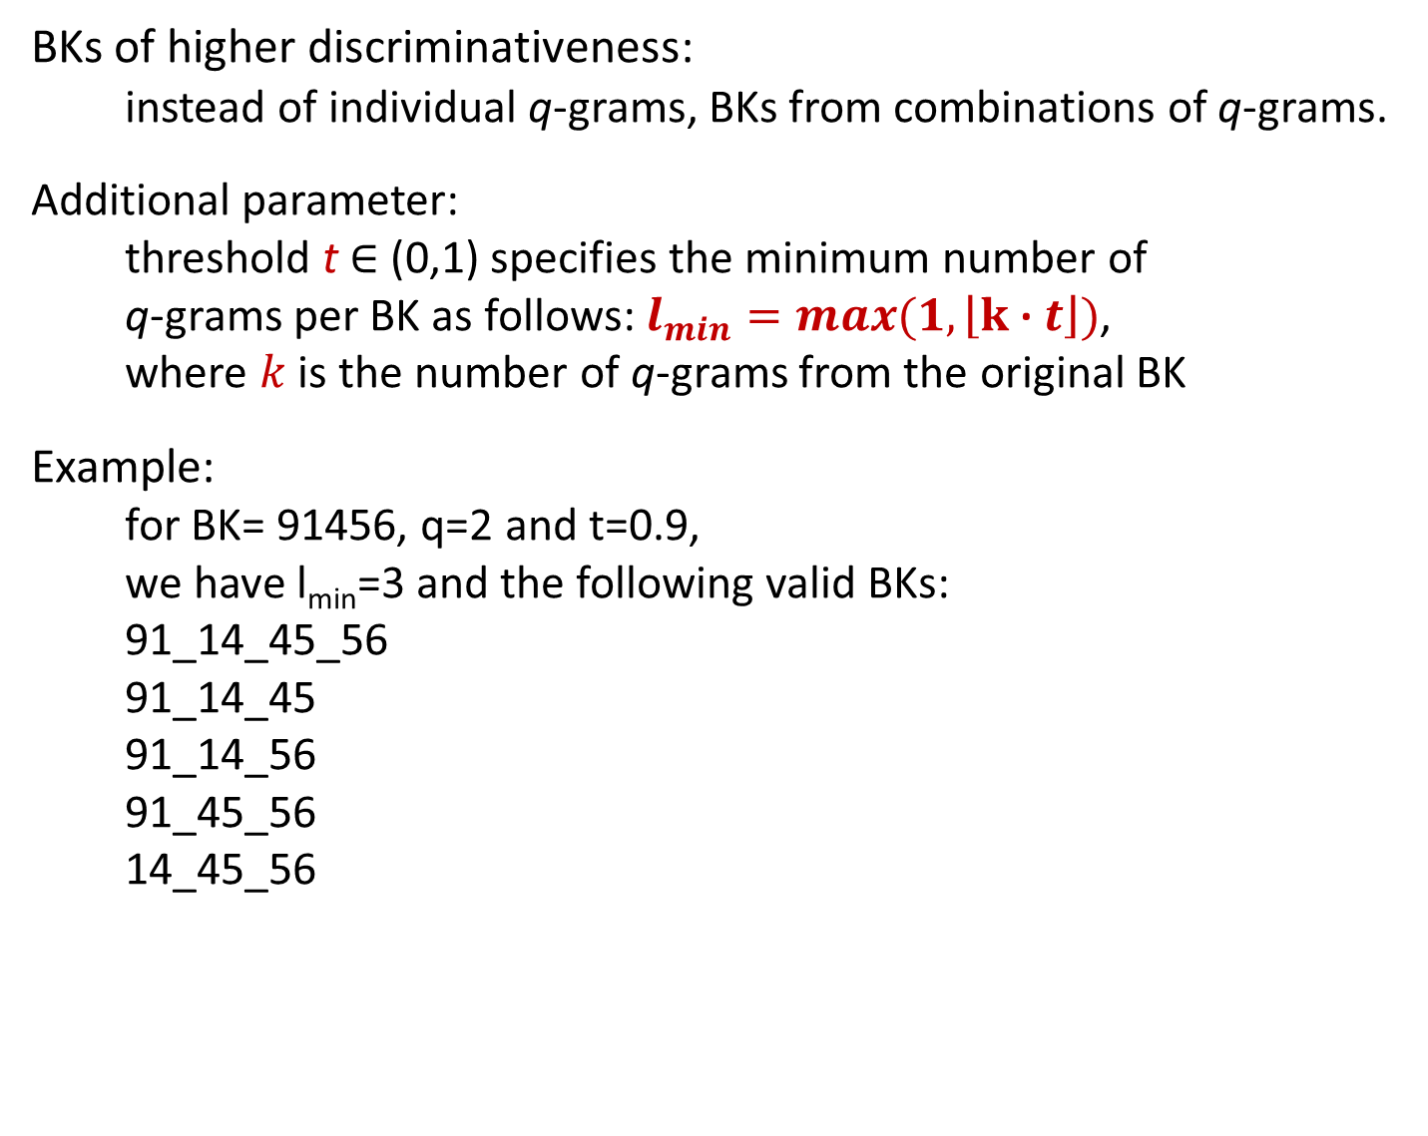
Extended Q-grams Blocking [Baxter et. al., KDD 2003]
BKs of higher discriminativeness:
instead of individual q-grams, BKs from combinations of q-grams.
Additional parameter:
threshold t ∈ (0,1) specifies the minimum number of
q-grams per BK as follows: $l_{min}=\max{(1,\left\lfloor k \text{∙} t\right\rfloor )}$,
where $k$ is the number of q-grams from the original BK
Example:
for BK= 91456, q=2 and t=0.9,
we have l_{min}=3 and the following valid BKs:
91_14_45_56
91_14_45
91_14_56
91_45_56
14_45_56
Notes:
To increase the discriminativeness of q-grams, we use their combinations.
More blocks, but smaller in size and comparisons.

Slide 54
MFIBlocks [Kenig et. al., IS 2013]
Based on mining Maximum Frequent Itemsets.
Algorithm:
Place all entities in a pool
while (minimum_support > 2)
  For each itemset that satisfies minimum_support
    Create a block b
    If b satisfies certain constraints (Block Cleaning)
      remove its entities from the pool
      retain the best comparisons (Comparison Cleaning)
  decrease minimum_support
Pros:
Usually the most effective blocking method for relational data → maximizes PQ (precision)
Cons:
Difficult to configure
Time consuming
Notes:
itemset: set of entities
support: the number of blocks where all these entities coincide

Slide 55
Overview of Schema-based Methods
Standard Blocking
Sorted
Neighborhood
Suffix
Arrays
Q-grams
Blocking
Extended Sorted
Neighborhood
Extended Suffix
Arrays
MFIBlocks
Extended Q-grams
Blocking
Canopy
Clustering
Extended
Canopy
Clustering
Notes:
Let’s now have a look at the similarity-based variations of StBl that rely on q-grams.

Slide 56
Overview of Schema-based Methods blocks contain entities with similar blocking keys
Standard Blocking
Sorted
Neighborhood
Suffix
Arrays
Q-grams
Blocking
Extended Sorted
Neighborhood
Extended Suffix
Arrays
MFIBlocks
Extended Q-grams
Blocking
Canopy
Clustering
Extended
Canopy
Clustering
Notes:
Let’s now have a look at the similarity-based variations of StBl that rely on q-grams.

Slide 57
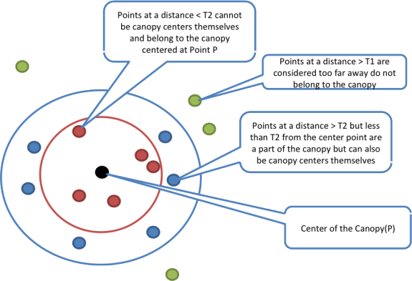
Canopy Clustering [McCallum et. al., KDD 2000]
Blocks on similarity of BKs.
Notes:
Redundancy-negative method.
Was proposed for clustering, but is widely used for blocking.

Slide 58
Extended Canopy Clustering [Christen, TKDE 2011]
Canopy Clustering is too sensitive w.r.t. its weight thresholds:
- high values may leave many entities out of blocks.
Solution: Extended Canopy Clustering [Christen, TKDE 2011]
cardinality thresholds instead of weight thresholds
for each center of a canopy:
  the n₁ nearest entities are placed in its block
  the n₂ (≤ n₁) nearest entities are removed from the pool
Notes:
Redundancy-negative.

Slide 59
Overview of Schema-based Methods
Standard Blocking
Sorted
Neighborhood
Suffix
Arrays
Q-grams
Blocking
Extended Sorted
Neighborhood
Extended Suffix
Arrays
MFIBlocks
Extended Q-grams
Blocking
Canopy
Clustering
Extended
Canopy
Clustering
Notes:
Finally, we look into the equality-branch of blocking methods, which exclusively involves proactive techniques.

Slide 60
Overview of Schema-based Methods blocks contain entities with same blocking keys
Standard Blocking
Sorted
Neighborhood
Suffix
Arrays
Q-grams
Blocking
Extended Sorted
Neighborhood
Extended Suffix
Arrays
MFIBlocks
Extended Q-grams
Blocking
Canopy
Clustering
Extended
Canopy
Clustering
Notes:
Finally, we look into the equality-branch of blocking methods, which exclusively involves proactive techniques.

Slide 61
Overview of Schema-based Methods blocks contain entities with same blocking keys
Standard Blocking
Sorted
Neighborhood
Suffix
Arrays
PROACTIVE
BLOCKING
METHODS
Q-grams
Blocking
Extended Sorted
Neighborhood
Extended Suffix
Arrays
MFIBlocks
Extended Q-grams
Blocking
Canopy
Clustering
Extended
Canopy
Clustering
Notes:
Finally, we look into the equality-branch of blocking methods, which exclusively involves proactive techniques.

Slide 62
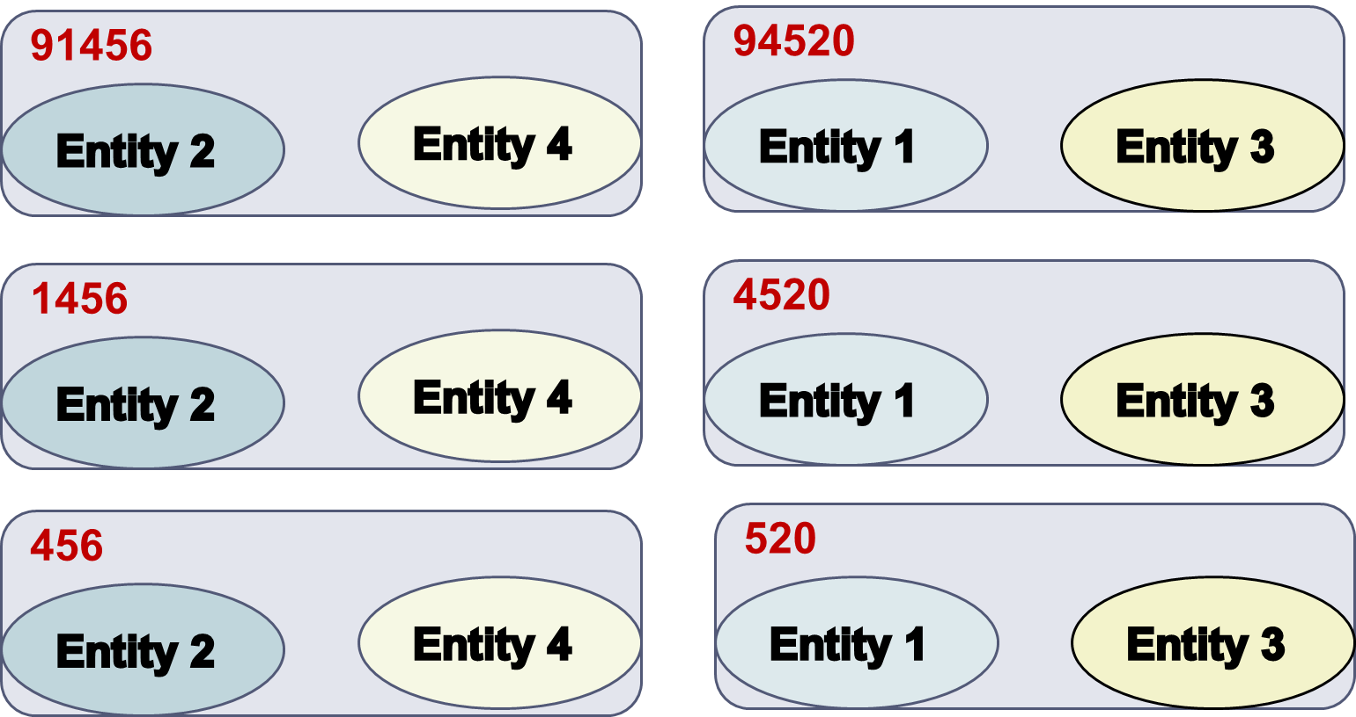
Suffix Arrays Blocking [Aizawa et. al., WIRI 2005]
Blocks on the equality of BKs.
Converts every BK to the list of its suffixes that are longer than a predetermined minimum length l_{min}.
For l_{min} =3, the keys 91456 and 94520 yield the blocks:
Frequent suffixes are discarded with the help of the parameter b_{M}:
- specifies the maximum number of entities per block
Notes:
In a way, it builds hierarchical blocks.
Advantage: robust to noisy BKs, redundancy-positive
Disadvantage: cannot support noise at the end of BKs

Slide 63
Extended Suffix Arrays Blocking [Christen, TKDE 2011]
Goal:
support errors at the end of BKs
Solution:
consider all substrings (not only suffixes) with more than l_{min}
characters.
For l_{min}=3, the keys 91456 and 94520 are converted to the BKs:
91456, 94520
9145, 9452
1456, 4520
914, 945
145, 452
456 520
Notes:
Similar to Q-grams, but discards very frequent suffixes.

Slide 64
Summary of Blocking for Databases [Christen, TKDE2011]
They typically employ redundancy to ensure higher recall in the context of noise at the cost of lower precision (more comparisons). Still, recall remains low for many datasets.
Several parameters to be configured
  E.g., Canopy Clustering has the following parameters:
    String matching method
    Threshold t₁
    Threshold t₂
Schema-dependent → manual definition of BKs
Notes:
Redundancy: every entity participates in many blocks.
The most important of these parameters is BKs.
They need an expert to fine-tune their BKs manually.
recall low because blocking keys are usually not correctly selected

Slide 65
Improving Blocking for Databases [Papadakis et. al., VLDB 2015]
Schema-agnostic blocking keys
Use every token as a key
Applies to all schema-based blocking methods
Simplifies configuration, unsupervised approach
Performance evaluation
For lazy blocking methods →
very high, robust recall at the cost of more comparisons
For proactive blocking methods →
relative recall gets higher with more comparisons,
absolute recall depends on block constraints
Notes:
Use every token as a key independently of the associated attribute-name and then apply the usual transformations on the resulting keys.
every token (in attribute values) becomes a blocking key, and every blocking key leads to a block (with all entities that contain this blocking key)

Slide 66
Part 3:
Block Building for Web Data

Slide 67
Characteristics of Web Data
Voluminous, (semi-)structured datasets.
    DBPedia 2014: 3 billion triples and 38 million entities
    BTC09: 1.15 billion triples, 182 million entities.
Users are free to add attribute values and/or attribute names
→ unprecedented levels of schema heterogeneity.
    DBPedia 3.4: 50,000 attribute names
    Google Base: 100,000 schemata for 10,000 entity types
    BTC09: 136,000 attribute names
Several datasets produced by automatic information extraction techniques
→ noise, tag-style values.
Notes:
The characteristics differ substantially from databases.
Schema-based blocking methods were usually applied up to tens of thousands of entities.
Schema matching is simply not applicable here, because it does not scale.

Slide 68
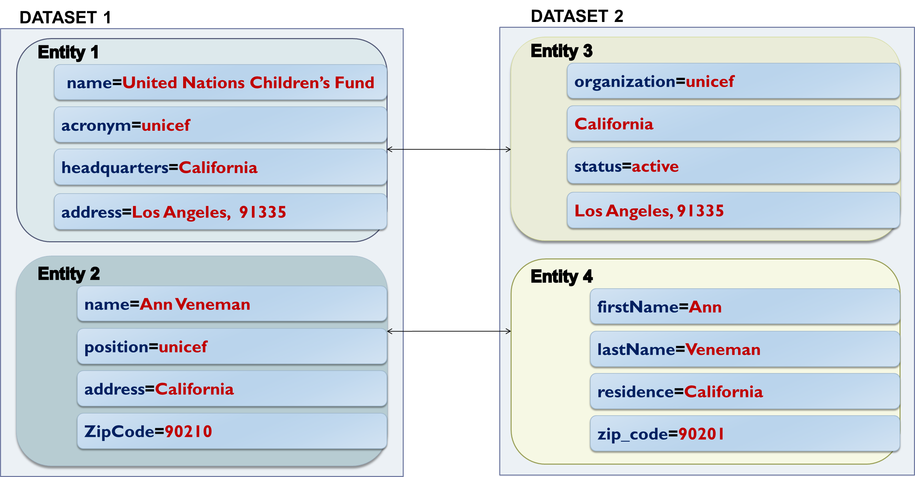
Example of Web Data
Loose Schema Binding
Split
values
Attribute
Heterogeneity
Noise
Notes:
Different granularity in attribute names and values.
Loose schema binding: tag-style values, different schema for each entity.
These settings call for blocking methods that are:
Inherently robust to noise in both attribute names and attribute values
decoupled from schema information.

Slide 69
Token Blocking [Papadakis et al., WSDM2011]
Functionality:
given an entity profile, extract all tokens that are contained in its attribute values.
create one block for every distinct token → each block contains all entities with the corresponding token*.
Attribute-agnostic functionality:
  completely ignores all attribute names, but considers all attribute values
  efficient implementation with the help of inverted indices
  parameter-free!
*Each block should contain at least two entities.
Notes:
Simplest schema-agnostic approach.
Ignores attribute names completely.
Deals with heterogeneity of any scale.

Slide 70
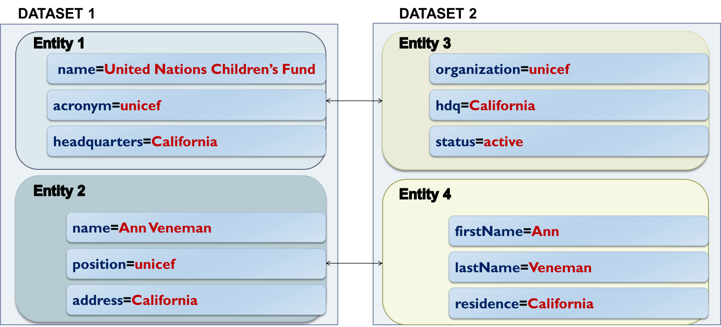
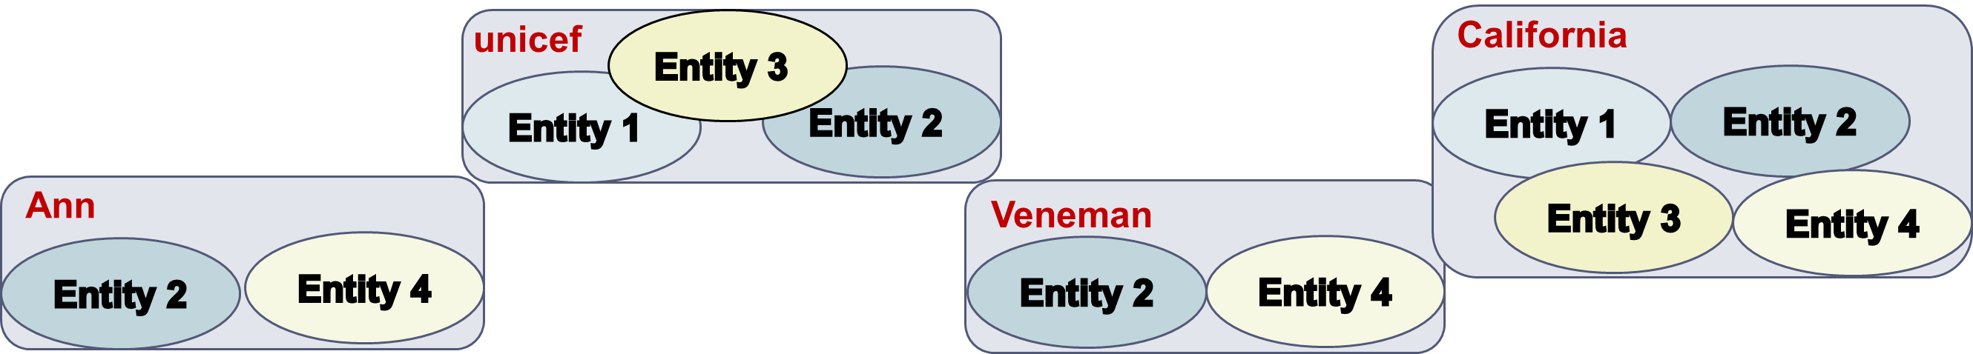
Token Blocking Example
Notes:
“united”, “nations”, children’s”, and “fund” all lead to blocks with a single entity (E1), and therefore are discarded
Highly robust to noise.
Drawback: many comparisons, large blocks.
Two solutions to overcome this issue:
We use more advanced blocking methods that build more refined blocks.
We employ block processing techniques to discard the unnecessary comparisons, without affecting the matching ones.
The two solutions are complementary.

Slide 71
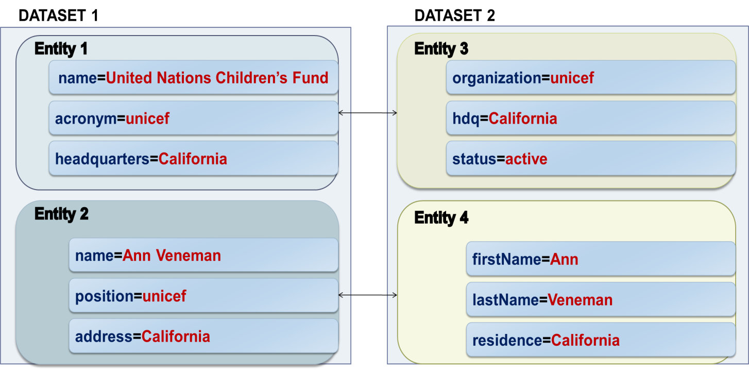
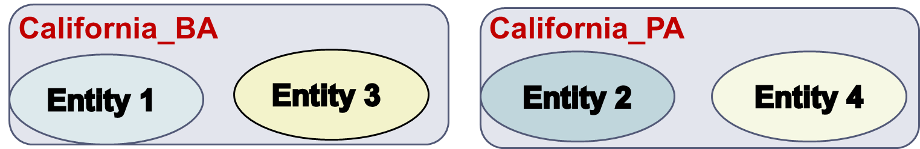
Attribute-Clustering Blocking
[Papadakis et. al., TKDE 2013]
Goal:
group attribute names into clusters s.t. we can apply Token Blocking independently inside each cluster, without affecting effectiveness → smaller blocks, higher efficiency.
Building address
headquarters
hdq
Person address
address
residence
Notes:
cluster attribute names based on the attribute values
goal: break the token-based blocks into smaller ones
Every node represents the aggregate values of each attribute name.
Example: block for California in the previous slide.

Slide 72
Attribute-Clustering Blocking
  Algorithm
  Create a graph, where every node represents an attribute name and its attribute values
For each attribute name/node n_{i}
  Find the most similar node n_{j}
  If sim(n_{i},n_{j}) > 0, add an edge <n_{i},n_{j}>
Extract connected components
Put all singleton nodes in a “glue” cluster
Parameters
Representation model
  Character n-grams, Character n-gram graphs, Tokens
Similarity Metric
  Jaccard, Graph Value Similarity, TF-IDF
Notes:
cluster attribute names based on the attribute values
goal: break the token-based blocks into smaller ones
Every node represents the aggregate values of each attribute name.
Example: block for California in the previous slide.

Slide 73
Attribute-Clustering vs
Schema Matching
Similar to Schema Matching, …but fundamentally different:
Associated attribute names do not have to be semantically equivalent. They only have to produce good blocks
All singleton attribute names are associated with each other
Unlike Schema Matching, it scales to the very high levels of heterogeneity of Web Data
  because of the above simplifying assumptions
Notes:
singleton: are in a block by themselves

Slide 74

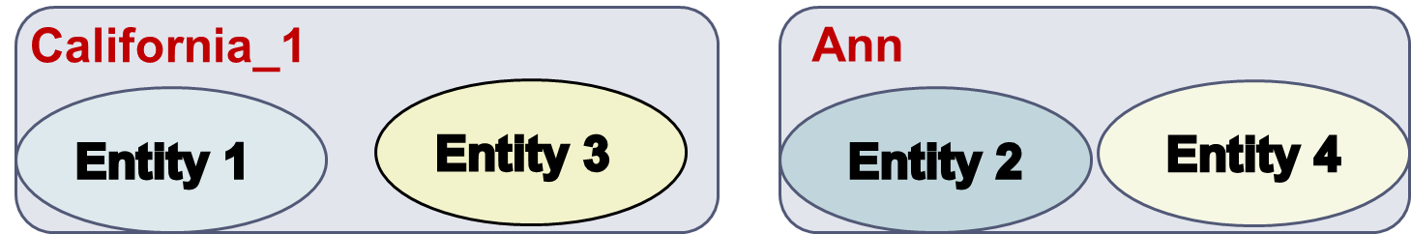
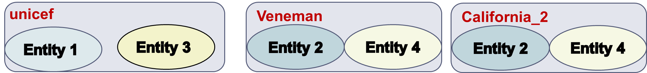
TYPiMatch [Ma et. al., WSDM 2013]
Goal:
cluster entities into overlapping types and apply Token
Blocking to the values of the best attribute for each type.
organizations
persons

Slide 75
TYPiMatch
Algorithm:
Create a directed graph G, where nodes correspond to tokens, and edges connect those co-occurring in the same entity profile, weighted according to conditional co-occurrence probability.
Convert G to undirected graph G’ and get maximal cliques (parameter θ).
Create an undirected graph G’’, where nodes correspond to cliques and edges connect the frequently co-occurring cliques (parameter ε).
Get connected components to form entity types.
Get best attribute name for each type using an entropy-based criterion.

Slide 76
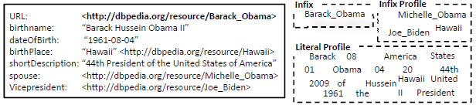
Evidence for Semantic Web Blocking
For Semantic Web data, three sources of evidence create blocks of lower redundancy than Token Blocking:
Infix
Infix Profile
Literal Profile
Algorithm for URI decomposition in PI(S)-form in [Papadakis et al., iiWAS 2010].
Notes:
Blocking method for Semantic Web only.
Unlike Token Blocking, it does not tokenize the entire URIs. Example: URL of entity “Obama”.
In addition, Infixes may consist of several concatenated tokens.
Infix Profile -> Relations between entities
Values that do not correspond to blank nodes or URIs can be represented by their tokens.

Slide 77
URI Semantics Blocking [Papadakis et al., WSDM2012]
The above sources of evidence lead to 3 parameter-free blocking methods:
Infix Blocking
every block contains all entities whose URI has a specific Infix
Infix Profile Blocking
every block corresponds to a specific Infix (of an attribute value) and contains all entities having it in their Infix Profile
Literal Profile Blocking
every block corresponds to a specific token and contains all entities having it in their Literal Profile
Individually, these atomic methods have limited coverage and,
thus, low effectiveness (e.g., Infix Blocking does not cover blank
nodes).
However, they are complementary and can be combined
into composite blocking methods with high robustness and
effectiveness!
Notes:
Their combination yields significantly better performance than Token Blocking.

Slide 78
  Summary of Blocking for Web Data
High Recall in the context of noisy entity profiles and extreme schema heterogeneity thanks to:
redundancy that reduces the likelihood of missed matches.
attribute-agnostic functionality that requires no schema semantics.
Low Precision because:
the blocks are overlapping → redundant comparisons
high number of comparisons between irrelevant entities → superfluous comparisons

Slide 79
Token Blocking Example
Redundant
Comparison
Superfluous
Comparison
Notes:
superfluous comparison E3-E2, because they do not match
redundant comparison E2-E4, because it appears again in block “Ann”

Slide 80
Part 4:
Block Processing Techniques
Notes:
Goal: to process a set of blocks in the optimal way.

Slide 81
Outline
Introduction to Blocking
Blocking Methods for Relational Data
Blocking Methods for Web Data
Block Processing Techniques
  Block Purging
  Block Filtering
  Block Clustering
  Comparison Propagation
  Iterative Blocking
Meta-blocking
Entity Matching
Entity Clustering
Massive Parallelization Methods
Progressive Entity Resolution
Challenges
JedAI Toolkit
Conclusions
Notes:
Sections 3 and 4 pertain to the creation of blocks.
Sections 5 and 6 pertain to the processing of blocks.

Slide 82
General Principles
Goals:
eliminate all redundant comparisons
avoid most superfluous comparisons
without affecting matching comparisons (i.e., PC).
Depending on the granularity of their functionality, they are distinguished into:
Block-refinement
Comparison-refinement
    Iterative Methods
Notes:
The block-refinement are faster, but have a less accurate functionality.
The comparison-refinement techniques are more accurate, but more time-consuming.

Slide 83
Block Purging
Exploits power-law distribution of block sizes.
Targets oversized blocks (i.e., many comparisons, no duplicates)
Discards them by setting an upper limit on:
the size of each block [Papadakis et al., WSDM 2011],
the cardinality of each block [Papadakis et al., WSDM 2012]
Core method:
  Low computational cost.
  Low impact on effectiveness.
  Boosts efficiency to a large extent.
Notes:
Exploits the power-law distribution of block sizes and tries to prune its tail.
The power law distribution isn’t reported by other researchers, but it is obvious in the following diagrams, slides 81 to 83. The same pattern appears in all other datasets we have tested in our experiments. The cardinality limit is automatically set through the BC-CC metric space. More details in the WSDM 2012 paper. The size limit was empirically determined to be equal to 0.005 * min (|E1|,|E2|).

Slide 84
Distributions of Block Sizes and Duplicates

Slide 85
Distributions of Block Sizes and Duplicates

Slide 86
Distributions of Block Sizes and Duplicates
Notes:
The upper diagram is log-log. There are 2 or 3 blocks of size 10^13.

Slide 87
Block Filtering [Papadakis et. al, EDBT 2016]
Main ideas:
each block has a different importance for every entity it contains.
Larger blocks are less likely to contain unique duplicates and, thus, are less important.
Algorithm
sort blocks in ascending cardinality
build Entity Index
retain every entity in r% of its smallest blocks
reconstruct blocks
Notes:
because very large blocks are highly probable to contain a random mix of entities

Slide 88
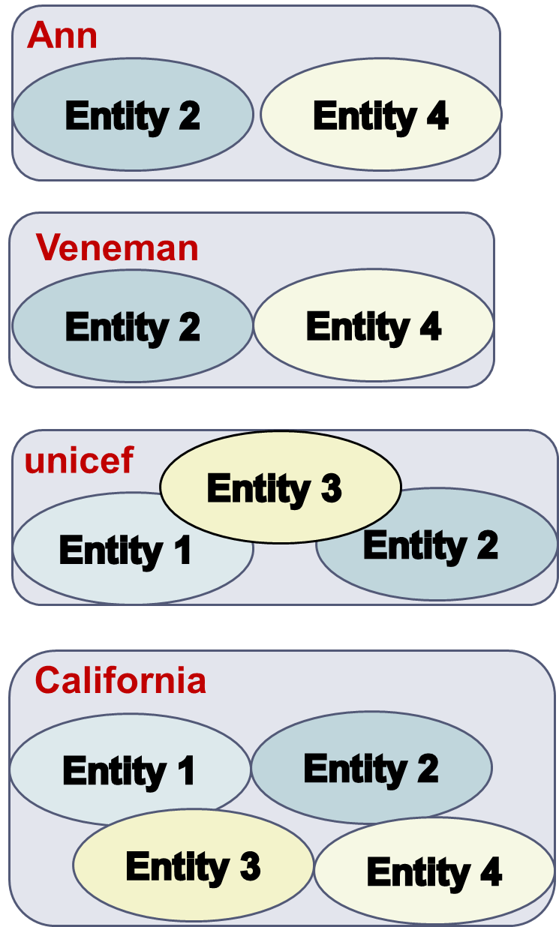
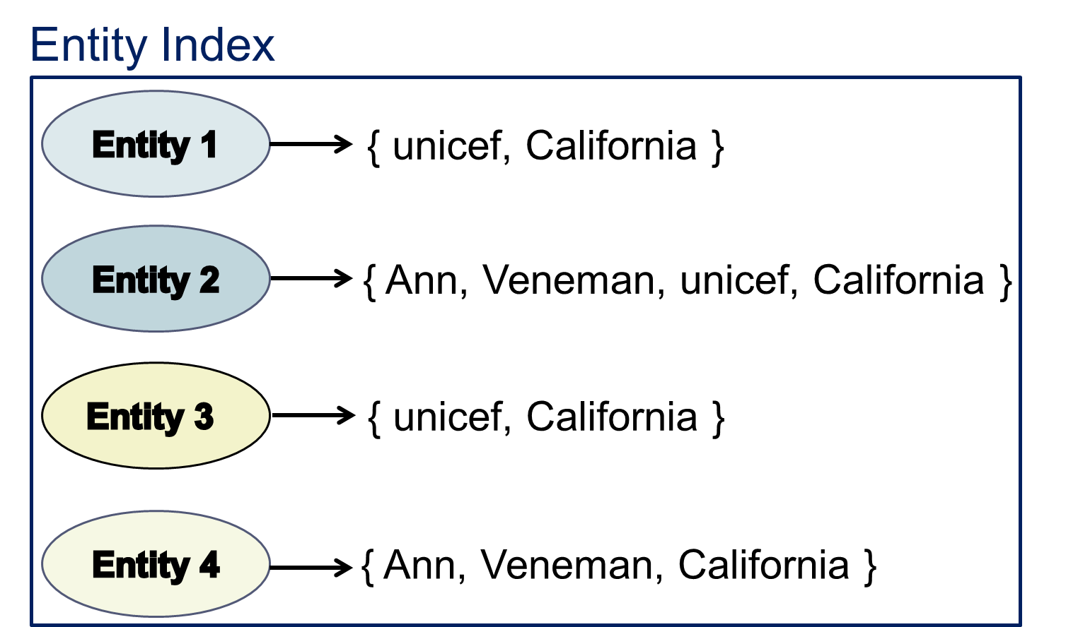
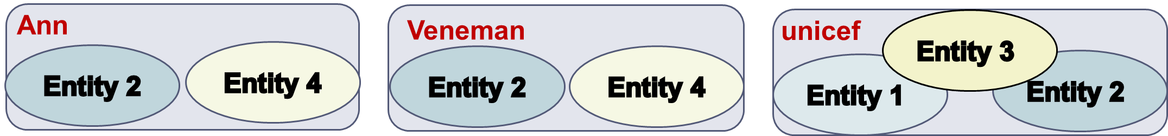
Block Filtering Example
Notes:
the matching entities still coincide in some block: E1-E3 in “unicef”, and E2-E4 in “Ann” (and “Veneman”)

Slide 89
Block Clustering [Fisher et. al., KDD 2015]
Main idea:
restrict the size of every block into [b_{min}, b_{max}]
  necessary in applications like privacy-preserving ER
  operates so that ||B|| increases linearly with |E|
Algorithm
recursive agglomerative clustering
  merge similar blocks with size lower than b_{min}
  split blocks with size larger than b_{max}
until all blocks have the desired size
Notes:
In privacy-preserving record linkage, there may be privacy requirements on both the minimum and maximum block size. For example, to guarantee k-anonymous privacy it is necessary that each block contains at least k records. If all blocks have a similar size, this reduces the vulnerability of the ER process to frequency-based attacks. In this situation it is important to produce blocks in the specified size range.
The scalability analysis in the paper shows an almost linear increase in comparison when increasing the size of the dataset.
[b_{min}, b_{max}] are input parameters. They can be set in accordance with operational requirements such as computational limitations, real-time efficiency requirements, or privacy-preserving requirements.

Slide 90
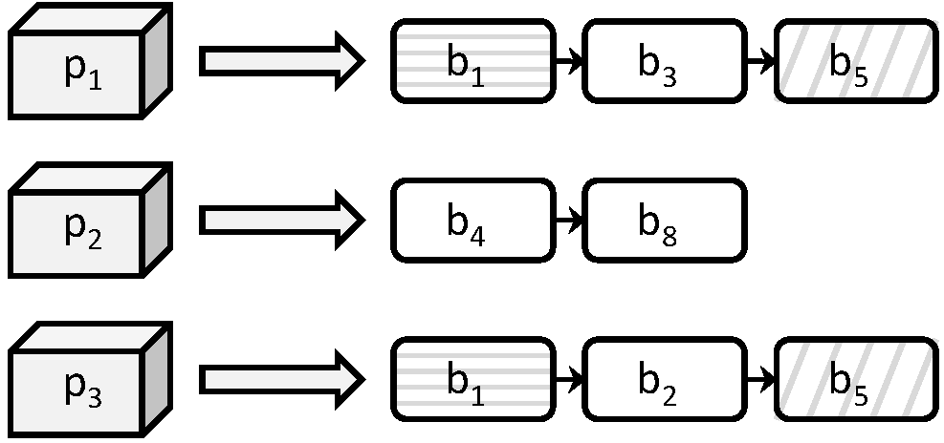
Comparison Propagation [Papadakis et al., JCDL 2011]
Eliminate all redundant comparisons at no cost in recall.
Naïve approach does not scale.
Functionality:
  Build Entity Index
  Least Common Block Index condition.
Notes:
Naïve approach stores all executed comparisons explicitly in memory, having a space complexity that is linear to the number of comparisons. It uses a hashset that allows to check in constant time O(1) whether a new comparison has already been executed.
Comparison Propagation stores executed comparisons implicitly in memory, having a space complexity that is linear to the number of entities. It uses an inverted index that points from entity ids to block ids and compares two entities e_i and e_j in block b_k only if k is the least common block id of e_i and e_j. The time complexity in this case is linear to the average number of blocks per entity.

Slide 91
Iterative Blocking [Whang et. Al, SIGMOD 2009]
Main idea:
integrate block processing with entity matching and reflect outcomes to subsequently processed blocks, until no new matches are detected.
Algorithm
Put all blocks in a queue Q
While Q is not empty
  Get first block
  Get matches with an ER algorithm (e.g., R-Swoosh)
    For each new pair of duplicates p_{i}≡p_{j}
      Merge their profiles p’_{i} = p’_{j} =< p_{i,} p_{j} > and update them in all associated blocks
      Place in Q all associated blocks that are not already in it
Notes:
Saves repeated comparisons and increases recall.

Slide 92
Part 5:
Meta-blocking
Notes:
The most versatile and powerful block processing/comparison cleaning method.

Slide 93
Motivation
E
Block
Building
Block
Cleaning
Comparison
Cleaning
B
  DBPedia 3.0rc ↔ DBPedia 3.4
  1.2 million entities ↔ 2.2 million entities
Notes:
attribute clustering would lead to less comparisons than token blocking, but is more time consuming
would only make sense for a very expensive entity similarity function
26 days (with optimal parameters)
block building: token blocking
block cleaning: block filtering
5 hours (with optimal parameters)
block building: token blocking
block cleaning: block filtering
comparison cleaning: metablocking single core; parallel metablocking:

Slide 94
Motivation
E
Block
Building
Block
Cleaning
Comparison
Cleaning
B
  DBPedia 3.0rc ↔ DBPedia 3.4
  1.2 million entities ↔ 2.2 million entities
  Brute-force approach
  Comparisons: 2.58 ∙ 10¹²
  Recall: 100%
  Running time: 1,344 days → 3.7 years
Notes:
attribute clustering would lead to less comparisons than token blocking, but is more time consuming
would only make sense for a very expensive entity similarity function
26 days (with optimal parameters)
block building: token blocking
block cleaning: block filtering
5 hours (with optimal parameters)
block building: token blocking
block cleaning: block filtering
comparison cleaning: metablocking single core; parallel metablocking:

Slide 95
Motivation
E
Block
Building
Block
Cleaning
Comparison
Cleaning
B
  DBPedia 3.0rc ↔ DBPedia 3.4
  1.2 million entities ↔ 2.2 million entities
  Brute-force approach
  Comparisons: 2.58 ∙ 10¹²
  Recall: 100%
  Running time: 1,344 days → 3.7 years
  Token Blocking + Block Filtering + Comparison Propagation
  Overhead time: <30 mins
  Comparisons: 3.5 ∙ 10¹⁰
  Recall: 99%
  Total Running time: 19 days
Notes:
attribute clustering would lead to less comparisons than token blocking, but is more time consuming
would only make sense for a very expensive entity similarity function
26 days (with optimal parameters)
block building: token blocking
block cleaning: block filtering
5 hours (with optimal parameters)
block building: token blocking
block cleaning: block filtering
comparison cleaning: metablocking single core; parallel metablocking:

Slide 96
Motivation
E
Block
Building
Block
Cleaning
Comparison
Cleaning
B
  DBPedia 3.0rc ↔ DBPedia 3.4
  1.2 million entities ↔ 2.2 million entities
  Brute-force approach
  Comparisons: 2.58 ∙ 10¹²
  Recall: 100%
  Running time: 1,344 days → 3.7 years
  Token Blocking + Block Filtering + Comparison Propagation
  Overhead time: <30 mins
  Comparisons: 3.5 ∙ 10¹⁰
  Recall: 99%
  Total Running time: 19 days
Notes:
attribute clustering would lead to less comparisons than token blocking, but is more time consuming
would only make sense for a very expensive entity similarity function
26 days (with optimal parameters)
block building: token blocking
block cleaning: block filtering
5 hours (with optimal parameters)
block building: token blocking
block cleaning: block filtering
comparison cleaning: metablocking single core; parallel metablocking:

Slide 97
Motivation
E
Block
Building
Block
Cleaning
Comparison
Cleaning
B
  DBPedia 3.0rc ↔ DBPedia 3.4
  1.2 million entities ↔ 2.2 million entities
  Brute-force approach
  Comparisons: 2.58 ∙ 10¹²
  Recall: 100%
  Running time: 1,344 days → 3.7 years
  Token Blocking + Block Filtering + Comparison Propagation
  Overhead time: <30 mins
  Comparisons: 3.5 ∙ 10¹⁰
  Recall: 99%
  Total Running time: 19 days
  Token Blocking + Block Filtering + ??
Notes:
attribute clustering would lead to less comparisons than token blocking, but is more time consuming
would only make sense for a very expensive entity similarity function
26 days (with optimal parameters)
block building: token blocking
block cleaning: block filtering
5 hours (with optimal parameters)
block building: token blocking
block cleaning: block filtering
comparison cleaning: metablocking single core; parallel metablocking:

Slide 98
Meta-blocking [Papadakis et. al., TKDE 2014]
Goal:
restructure a redundancy-positive block collection into a new one that contains substantially lower number of redundant and superfluous comparisons, while maintaining the original number of matching ones (ΔPC ≈ 0, ΔPQ >> 1) →
Notes:
redundancy-positive: the more common blocks for two entities, the higher the probability to match

Slide 99
Meta-blocking [Papadakis et. al., TKDE 2014]
Goal:
restructure a redundancy-positive block collection into a new one that contains substantially lower number of redundant and superfluous comparisons, while maintaining the original number of matching ones (ΔPC ≈ 0, ΔPQ >> 1) →
Main idea:
common blocks provide valuable evidence for the similarity of entities
→ the more blocks two entities share, the more similar and the more likely they are to be matching
Notes:
redundancy-positive: the more common blocks for two entities, the higher the probability to match

Slide 100
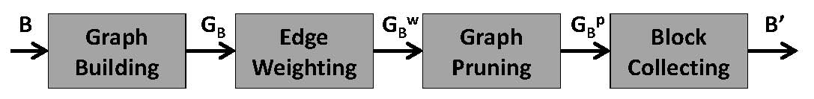
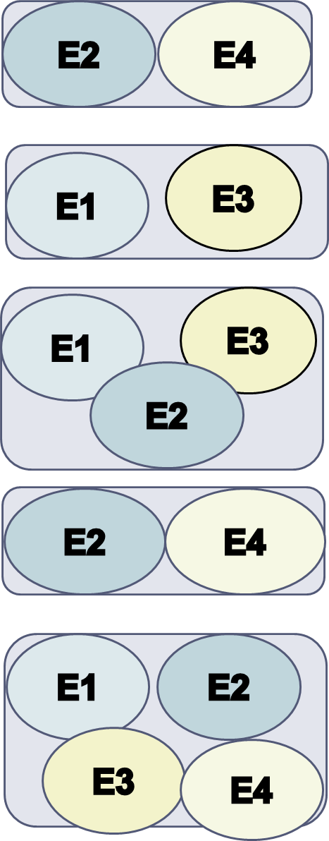
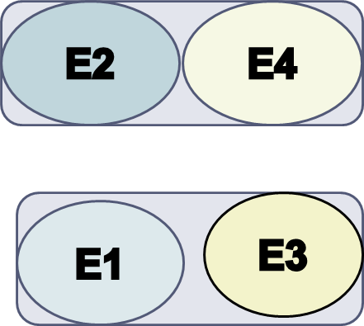
Outline of Meta-blocking
n₁
n₃
n₁
n₃
n₁
n₃
3
1
2
2
2
n₂
n₄
n₂
n₄
n₂
n₄
3
Notes:
Blocking graph
Nodes → entities
Edges → between entities co-occurring in at least one block
Weights → how similar are the adjacent entities, the higher the weight, the more similar the entities

Slide 101
Graph Building
For every block:
for every entity → add a node
for every pair of co-occurring entities → add an undirected edge
Blocking graph:
It eliminates all redundant comparisons →
no parallel edges.
Low materialization cost →
implicit materialization through inverted indices
Different from similarity graph!
Notes:
Co-occurring pair of entities: they belong to the same block (and not in the same dataset in the case of clean-clean ER).
Technical issues with the implementation of the graph.
Similarity graph -> materialized, edge weights derived from entity matching, used for clustering entities into equivalence clusters

Slide 102
Edge Weighting
Five generic, attribute-agnostic weighting schemes that rely on the following evidence:
the number of blocks shared by two entities
the size of the common blocks
the number of blocks or comparisons involving each entity.
Computational Cost:
In theory, equal to executing all pair-wise comparisons in the given block collection.
In practice, significantly lower because it does not employ string similarity metrics.

Slide 103
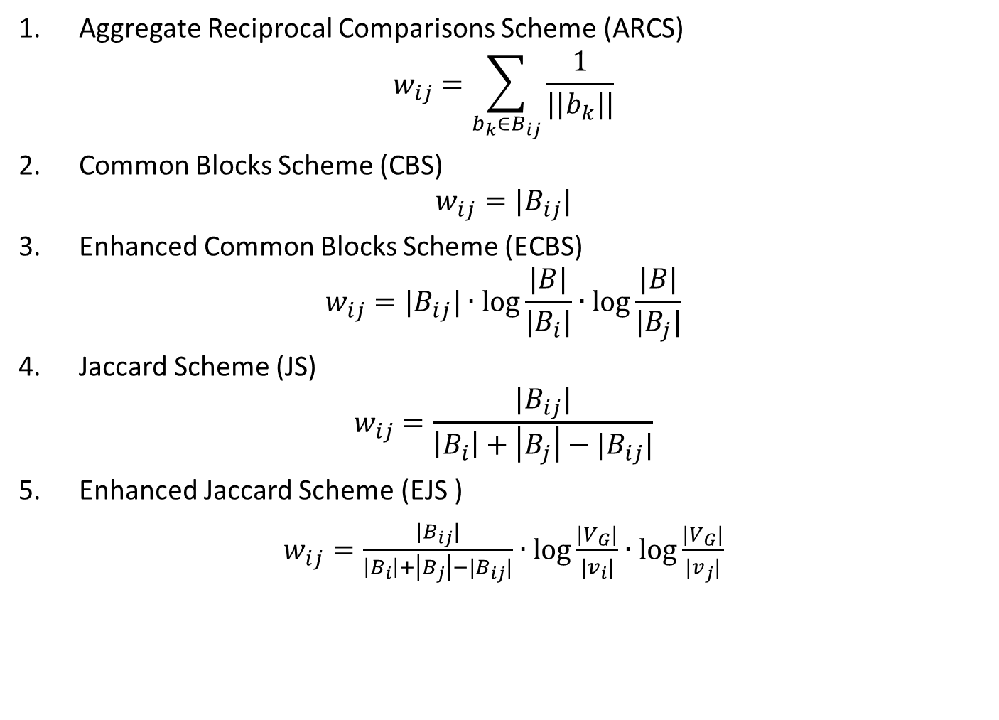
Weighting Schemes
Aggregate Reciprocal Comparisons Scheme (ARCS)
$$w_{ij}=\sum_{b_{k}∈B_{ij}}{\frac{1}{||b_{k}||}}$$
Common Blocks Scheme (CBS)
$$w_{ij}={|B}_{ij}|$$
Enhanced Common Blocks Scheme (ECBS)
$$w_{ij}={|B}_{ij}|∙\log{\frac{|B|}{|B_{i}|}∙\log{\frac{|B|}{|B_{j}|}}}$$
Jaccard Scheme (JS)
$$w_{ij}=\frac{{|B}_{ij}|}{{\left|B_{i}\right|+\left|B_{j}\right|−|B}_{ij}|}$$
Enhanced Jaccard Scheme (EJS )
$w_{ij}=\frac{{|B}_{ij}|}{{\left|B_{i}\right|+\left|B_{j}\right|−|B}_{ij}|}∙\log{\frac{|V_{G}|}{|v_{i}|}}$ $∙\log{\frac{|V_{G}|}{|v_{j}|}}$
Notes:
For all schemes, the higher the value, the more likely the adjacent entities are to be matching.
ECBS/EJS enhances CBS/JS through an IDF scheme.

Slide 104
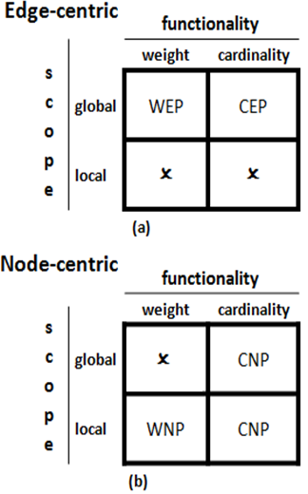
Graph Pruning
Pruning algorithms
Edge-centric
Node-centric
they produce directed blocking graphs
Pruning criteria
Scope:
  Global
  Local
  Functionality:
  Weight thresholds
  Cardinality thresholds
Notes:
Graph Pruning consists of two parts: the pruning algorithm and the pruning criterion.
Edge-centric: best edges over the entire graph.
Node-centric: best edges for each node neighborhood.
Weight threshold: minimum weight of retained edges.
Cardinality threshold: maximum number of retained edges.

Slide 105
Thresholds for Graph Pruning
Experiments show robust behavior of the following configurations:
Weighted Edge Pruning (WEP)
threshold: average weight across all edges
Cardinality Edge Pruning (CEP)
threshold: K = BPE∙|E|/2
Weighted Node Pruning (WNP)
threshold: for each node, the average weight of the adjacent edges
Cardinality Node Pruning (CNP)
threshold: for each node, k=BPE-1
Notes:
BPE: average number of blocks per entity.
Used the BC-CC metric space to compute the cardinality thresholds.
Weight-Edge Pruning (WEP) retains all edges whose weight exceeds a certain threshold
Cardinality-Edge Pruning (CEP) retains the top-K weighted edges
Weight-Node Pruning (WNP) for every node, retains all edges whose weight exceeds a certain threshold
Cardinality-Node Pruning (CNP) for every node, retains the top-k weighted edges

Slide 106
Back to Motivation
E
Block
Building
Block
Cleaning
Comparison
Cleaning
B
  DBPedia 3.0rc ↔ DBPedia 3.4
  Brute-force approach
  Comparisons: 2.58 ∙ 10¹²
  Recall: 100%
  Running time: 1,344 days → 3.7 years
  Token Blocking + Block Filtering + Comparison Propagation
  Overhead time: <30 mins
  Comparisons: 3.5 ∙ 10¹⁰
  Recall: 99%
  Total Running time: 19 days
  Token Blocking + Block Filtering + Meta-blocking
  Overhead time: 4 hours
  Comparisons: 8.95 ∙ 10⁶
  Recall: 92%
  Total Running time: 5 hours
Notes:
attribute clustering would lead to less comparisons than token blocking, but is more time consuming
would only make sense for a very expensive entity similarity function
26 days (with optimal parameters)
block building: token blocking
block cleaning: block filtering
5 hours (with optimal parameters)
block building: token blocking
block cleaning: block filtering
comparison cleaning: metablocking single core; parallel metablocking:

Slide 107
Back to Motivation
E
Block
Building
Block
Cleaning
Comparison
Cleaning
B
  DBPedia 3.0rc ↔ DBPedia 3.4
  Brute-force approach
  Comparisons: 2.58 ∙ 10¹²
  Recall: 100%
  Running time: 1,344 days → 3.7 years
  Token Blocking + Block Filtering + Comparison Propagation
  Overhead time: <30 mins
  Comparisons: 3.5 ∙ 10¹⁰
  Recall: 99%
  Total Running time: 19 days
  Token Blocking + Block Filtering + Meta-blocking
  Overhead time: 4 hours
  Comparisons: 8.95 ∙ 10⁶
  Recall: 99%
  Total Running time: 10 hours
Notes:
attribute clustering would lead to less comparisons than token blocking, but is more time consuming
would only make sense for a very expensive entity similarity function
26 days (with optimal parameters)
block building: token blocking
block cleaning: block filtering
5 hours (with optimal parameters)
block building: token blocking
block cleaning: block filtering
comparison cleaning: metablocking single core; parallel metablocking:

Slide 108
Back to Motivation
E
Block
Building
Block
Cleaning
Comparison
Cleaning
B
  DBPedia 3.0rc ↔ DBPedia 3.4
  Brute-force approach
  Comparisons: 2.58 ∙ 10¹²
  Recall: 100%
  Running time: 1,344 days → 3.7 years
  Token Blocking + Block Filtering + Comparison Propagation
  Overhead time: <30 mins
  Comparisons: 3.5 ∙ 10¹⁰
  Recall: 99%
  Total Running time: 19 days
  Token Blocking + Block Filtering + Meta-blocking
  Overhead time: 4 hours
  Comparisons: 8.95 ∙ 10⁶
  Recall: 99%
  Total Running time: 10 hours
Notes:
attribute clustering would lead to less comparisons than token blocking, but is more time consuming
would only make sense for a very expensive entity similarity function
26 days (with optimal parameters)
block building: token blocking
block cleaning: block filtering
5 hours (with optimal parameters)
block building: token blocking
block cleaning: block filtering
comparison cleaning: metablocking single core; parallel metablocking: 1.2hours

Slide 109
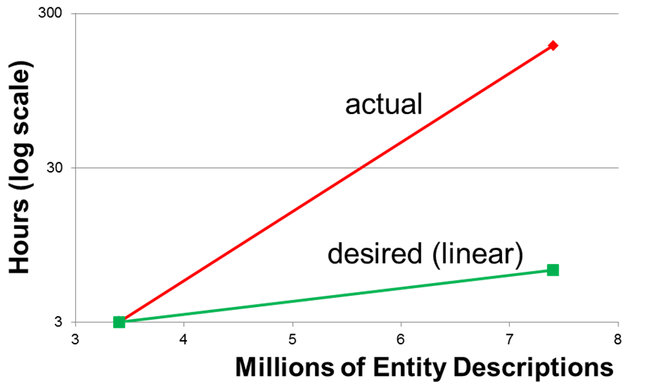

Meta-blocking Challenges: Time Efficiency
Bottleneck: edge weighting
Depends on $\left|\left|B\right|\right|$ & BPE
  $\left|E\right|=3.4×106$ , $\left|\left|B\right|\right|=4×1010$, BPE=15 → 3 hours
  $\left|E\right|=7.4×106$ , $\left|\left|B\right|\right|=2×1011$, BPE=40 → 186 hours
Notes:
BPE: average number of blocks per entity. -> determines the cost of estimating the number of common blocks between two entities

Slide 110
Enhancing Meta-blocking Time Efficiency
Block Filtering
  r = 0.8 → 4 times faster processing, on average
  reduces both ||B|| and BPE
Optimized Edge Weighting [Papadakis et. al., EDBT 2016]
  Entity-based instead of Block-based implementation
  An order of magnitude faster processing, in combination with Block Filtering
Multi-core Meta-blocking
  Commodity hardware
Parallel Meta-blocking
  Hadoop Cluster
Notes:
We will examine Parallel Meta-blocking in the Massive Parallelization section.

Slide 111
Multi-core Meta-blocking [Papadakis et. al, Semantics 2017]
Two types of methods:
Block-based
Entity-based
Fork-join approach:
computational cost split into set of chunks* placed in an array, with an index indicating next chunk to be processed
Every thread retrieves current value of index and assigned to process corresponding chunk
*chunk = individual items* or a non-overlapping set of items
*item = an individual block or an individual entity
Notes:
We distinguish Multi-core Meta-blocking in two types of methods depending on how they estimate the number of blocks two entities have in common. This information lies at the core of all meta-blocking algorithms. On the one hand, we have the block-based methods, go over the input blocks one by one and for each comparison they find, they compute the intersection of the blocks associated with the corresponding using the Entity Index (this is an inverted index that associates every entity id with the ids of the blocks that contain it). On the other hand, we have the entity-based methods, which iterate over the input every the given set of entities. For each entity, they aggregate its neighbors from all associated blocks. Then, the number of occurrences of each neighbor is recorded, as it is equal to the number of common blocks.
In our approach to Multi-core Meta-blocking, we follow the established fork–join model. As you might know, this approach sets up and executes parallel programs, such that execution branches off in parallel at designated points in the program, to "join" (merge) at a subsequent point and resume sequential execution. In more detail, the core idea of Multi-core Meta-blocking is that (read the bullets).

Slide 112
Parallelization Strategies
Depending on the definition of chunks, we defined the following parallelization strategies:
Random parallelization → individual items in arbitrary order
Naïve Parallelization → individual items sorted by cost (#comparisons)
Partition Parallelization → an arbitrary number of non-overlapping groups of items with the same computational cost
Segment Parallelization → #cores non-overlapping groups of items with the same computational cost
Notes:
Random Parallelization: Every chunk corresponds to an individual item and its position in the array is arbitrarily determined. This may result in consecutive chunks of very low cost, causing the threads to frequently wait for the lock. Or, the largest chunk may be placed in one of the last positions in the array, thus causing significant waiting time.
Naïve Parallelization: The chunks correspond to individual items, but they are placed in the array in decreasing order of cost: the first position is occupied by the item with the most comparisons, while the last place contains the item with the least comparisons. This distribution is like a power law one: the first few items correspond to a high number of blocks, while the vast majority involves just a couple of comparisons. Thus, significant waiting for the lock will take place at the end of the chunk array.
Partition Parallelization: The idea behind this approach is to reduce the waiting for the lock by clustering items into larger chunks that have similar computational costs. We will demonstrate the algorithm we developed for this purpose in the next slide.
Segment Parallelization: The motivation here is to develop a thread confinement parallelization strategy that eliminates the waiting time for the lock, due to a shared-nothing functionality. We explain this algorithm through an example in the second next slide.

Slide 113
Segment Parallelization
Input:
I = { 3, 5, 10, 6, 1, 9, 2, 4, 7, 8 }
number of segments (4)
I_{sorted} = { 10, 9, 8, 7, 6, 5, 4, 3, 2, 1 }
Notes:
set I of items: blocks, or entities
the numbers represent the cost of a block/entity in terms of # of comparisons (in the case of entities it is the sum of the # of comparisons in the blocks in which the entity appears)
we know the number of comparisons from the preprocessing step (where we know the size of each block)
This algorithm creates a priority queue with one empty segment per thread. The queue sorts the segments in increasing cost, from the least comparisons to the most ones. Then, our algorithm iterates over the input items and places each of them in the segment located at the head of the queue. The resulting segments are then placed in the chunk array and each thread undertakes one of them by retrieving the value of the index just once, at the beginning of its processing

Slide 114
Segment Parallelization
Input:
I = { 3, 5, 10, 6, 1, 9, 2, 4, 7, 8 }
number of segments (4)
I_{sorted} = { 10, 9, 8, 7, 6, 5, 4, 3, 2, 1 }
Iterations
It1
Total Cost
Segment1
10
10

Slide 115
Segment Parallelization
Input:
I = { 3, 5, 10, 6, 1, 9, 2, 4, 7, 8 }
number of segments (4)
I_{sorted} = { 10, 9, 8, 7, 6, 5, 4, 3, 2, 1 }
Iterations
It1
It2
Total Cost
Segment1
10
10
9
10
Segment2
9

Slide 116
Segment Parallelization
Input:
I = { 3, 5, 10, 6, 1, 9, 2, 4, 7, 8 }
number of segments (4)
I_{sorted} = { 10, 9, 8, 7, 6, 5, 4, 3, 2, 1 }
Iterations
It1
It2
It3
Total Cost
Segment1
10
10
9
10
9
8
10
Segment2
9
Segment3
8

Slide 117
Segment Parallelization
Input:
I = { 3, 5, 10, 6, 1, 9, 2, 4, 7, 8 }
number of segments (4)
I_{sorted} = { 10, 9, 8, 7, 6, 5, 4, 3, 2, 1 }
Iterations
It1
It2
It3
It4
Total Cost
Segment1
10
10
9
10
9
8
10
9
8
7
10
Segment2
9
Segment3
8
Segment4
7

Slide 118
Segment Parallelization
Input:
I = { 3, 5, 10, 6, 1, 9, 2, 4, 7, 8 }
number of segments (4)
I_{sorted} = { 10, 9, 8, 7, 6, 5, 4, 3, 2, 1 }
Iterations
It1
It2
It3
It4
It5
Total Cost
Segment1
10
10
9
10
9
8
10
9
8
7
10
9
8
6 | 7
10
Segment2
9
Segment3
8
Segment4
13

Slide 119
Segment Parallelization
Input:
I = { 3, 5, 10, 6, 1, 9, 2, 4, 7, 8 }
number of segments (4)
I_{sorted} = { 10, 9, 8, 7, 6, 5, 4, 3, 2, 1 }
Iterations
It1
It2
It3
It4
It5
It6
Total Cost
Segment1
10
10
9
10
9
8
10
9
8
7
10
9
8
6 | 7
10
9
5 | 8
6 | 7
10
Segment2
9
Segment3
13
Segment4
13

Slide 120
Segment Parallelization
Input:
I = { 3, 5, 10, 6, 1, 9, 2, 4, 7, 8 }
number of segments (4)
I_{sorted} = { 10, 9, 8, 7, 6, 5, 4, 3, 2, 1 }
Iterations
It1
It2
It3
It4
It5
It6
It7
Total Cost
Segment1
10
10
9
10
9
8
10
9
8
7
10
9
8
6 | 7
10
9
5 | 8
6 | 7
10
4 | 9
5 | 8
6 | 7
10
Segment2
13
Segment3
13
Segment4
13

Slide 121
Segment Parallelization
Input:
I = { 3, 5, 10, 6, 1, 9, 2, 4, 7, 8 }
number of segments (4)
I_{sorted} = { 10, 9, 8, 7, 6, 5, 4, 3, 2, 1 }
Iterations
It1
It2
It3
It4
It5
It6
It7
It8
Total Cost
Segment1
10
10
9
10
9
8
10
9
8
7
10
9
8
6 | 7
10
9
5 | 8
6 | 7
10
4 | 9
5 | 8
6 | 7
3 | 10
4 | 9
5 | 8
6 | 7
13
Segment2
13
Segment3
13
Segment4
13

Slide 122
Segment Parallelization
Input:
I = { 3, 5, 10, 6, 1, 9, 2, 4, 7, 8 }
number of segments (4)
I_{sorted} = { 10, 9, 8, 7, 6, 5, 4, 3, 2, 1 }
Iterations
It1
It2
It3
It4
It5
It6
It7
It8
It9
Total Cost
Segment1
10
10
9
10
9
8
10
9
8
7
10
9
8
6 | 7
10
9
5 | 8
6 | 7
10
4 | 9
5 | 8
6 | 7
3 | 10
4 | 9
5 | 8
6 | 7
3 | 10
4 | 9
5 | 8
6 | 2 | 7
13
Segment2
13
Segment3
13
Segment4
15

Slide 123
Segment Parallelization
Input:
I = { 3, 5, 10, 6, 1, 9, 2, 4, 7, 8 }
number of segments (4)
I_{sorted} = { 10, 9, 8, 7, 6, 5, 4, 3, 2, 1 }
Iterations
It1
It2
It3
It4
It5
It6
It7
It8
It9
It10
Total Cost
Segment1
10
10
9
10
9
8
10
9
8
7
10
9
8
6 | 7
10
9
5 | 8
6 | 7
10
4 | 9
5 | 8
6 | 7
3 | 10
4 | 9
5 | 8
6 | 7
3 | 10
4 | 9
5 | 8
6 | 2 | 7
3 | 10
4 | 9
5 | 1 | 8
6 | 2 | 7
13
Segment2
13
Segment3
14
Segment4
13
Time complexity: O(n log n)

Slide 124
Execution Plan
Stage 1
MWEP
MWNP
MCEP
MCNP
Initialization
Initialize chunk array and N threads.
Initialize chunk array and N threads.
Initialize chunk
array and N threads. Estimate K.
Initialize chunk array and N threads. Estimate k.
Each thread
computes local aggregate edge weight and #comparisons
Each thread
stores the total weight and #comparisons per entity in two arrays
Each thread stores the K top-weighted edges in the processed chunks in a priority queue
Every thread stores the k top-weighted edges for every processed entity in a priority queue
th₁
th₂
th₃
…
th_{N}
Merge
Estimate average edge weight
Merge the 2 arrays to compute the average edge weight of each node
Output the comparisons that are among the k top-weighted ones for any of the adjacent entities
Output the overall K top-weighted comparisons
Stage 2
Check and keep valid comparisons above the weight threshold
Check and keep valid comparisons above the weight threshold of any adjacent node
th₁
th₂
th₃
…
th_{N}
Total valid comparisons
Output total valid comparisons
Output total valid comparisons
Notes:
Quickly go through the text of the figure.
first two methods work on a threshold, this is why they need the extra two steps (stage 2)

Slide 125
Experimental Evaluation - Datasets
Original Datasets | DBPedia 3.0rc |  | DBPedia 3.4
Entities | 1,190,733 |  | 2,164,040
Duplicates | 892,579
Triples | 1.69∙10⁷ | 3.50∙10⁷
Predicates | 30,757 | 52,554
Brute-force | 2.58∙10¹²
Blocks | Input | Output (CNP)
Blocks | 1,239,066 | 1,190,733
Comparisons | 1.30∙10¹⁰ | 3.30∙10⁷
Detected Matches | 890,817 | 859,554
Recall | 0.998 | 0.963
Precision | 6.86∙10⁻⁵ | 2.61∙10⁻²
token blocking + block purging +
block filtering + meta-blocking CNP
token blocking + block purging + block filtering
System: Server running Ubuntu 12.04, 32GB RAM and 2 Intel Xeon E5620 processors, each having 4 physical cores and 8 logical cores at 2.40GHz.
Notes:
The goal of our experiments is to identify the most efficient parallelization strategy in terms of absolute execution time, and to identify the strategy that scales better as the number of physical cores increases. It’s not our purpose to evaluate the performance of Meta-blocking with respect to effectiveness, as this has already been examined in a series of previous works in major conferences and journals.
The table on the left presents the KBs we used in our experiments. The two versions of DBPedia chronologically differ by 2 years. As a result, out of 52 million triples, in total, only 10,36 million (<25%) are common, turning the application of ER to these datasets a non-trivial task. As duplicate entities, we defined those having exactly the same URL. The number of predicates indicates the Variety of the dataset, while the last column indicates the number of comparisons executed by the brute force approach.
The table on the right presents the performance of the block extracted from the input entities. The second column corresponds to the blocks that were given as input to Meta-blocking. In comparison with the brute-force approach, it reduces the number of comparisons by 2 orders of magnitude, even though its recall is almost 100%. To build these blocks, we first applied Token Blocking. Then, we used Block Purging to remove the blocks containing more than half the input entities. In the end, we applied Block Filtering, which retains every entity in 80% of its smaller blocks. In this way, we managed to reduce the number of superfluous and redundant comparisons to a large extent.
The right-most column demonstrates the performance after applying CNP. Note that precision raises by 3 orders of magnitude, because the comparisons are reduced to the same extent, while recall gets lower only by 2,5%.

Slide 126
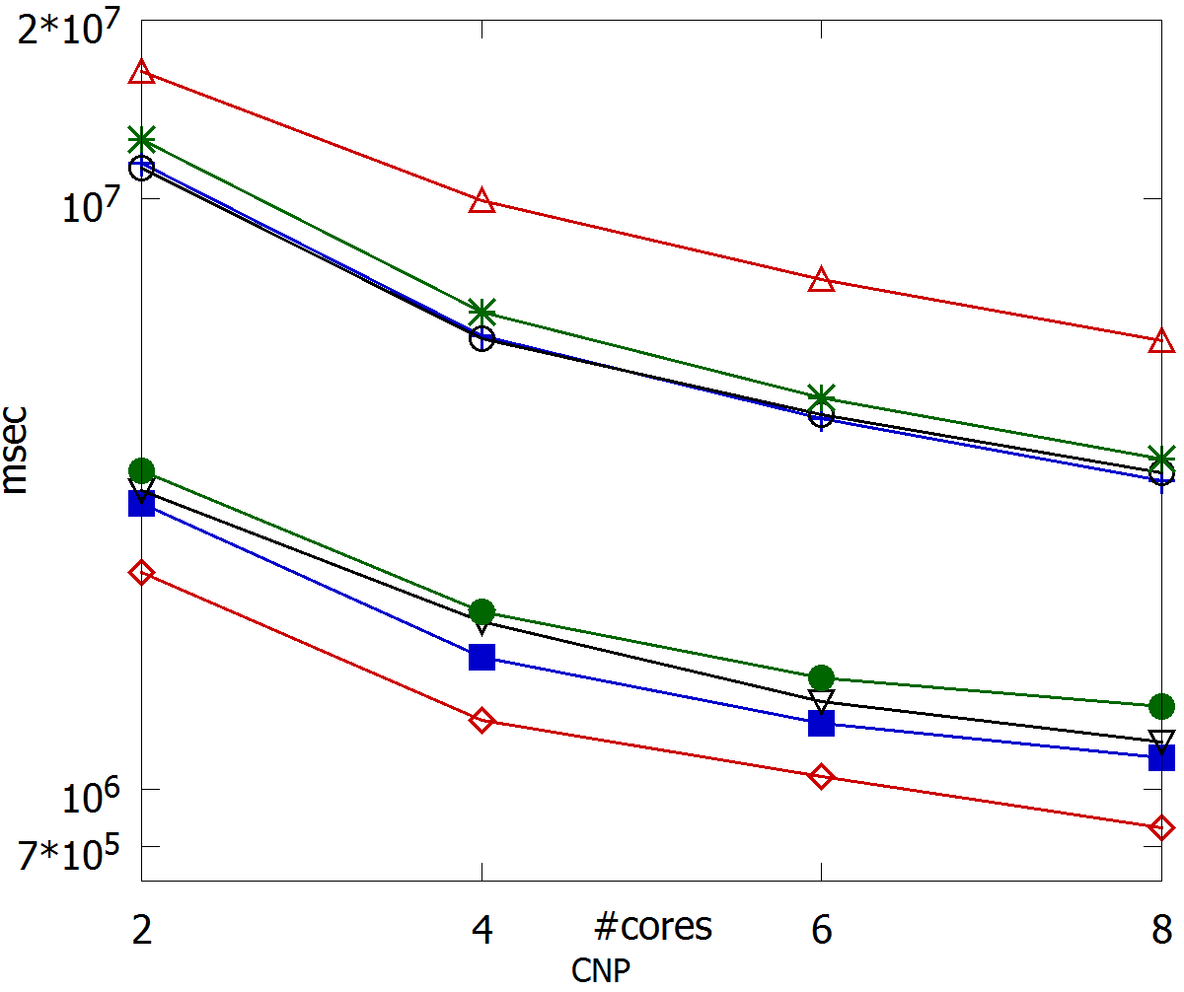
Experimental Evaluation – CNP Wall Clock Time
RB=Random, block-based parallelization
NB=Naïve, block-based parallelization
PB=Partition, block-based parallelization
SB=Segment, block-based parallelization
RE=Random, entity-based parallelization
NE=Naïve, entity-based parallelization
PE=Partition, entity-based parallelization
SE=Segment, entity-based parallelization
Single-threaded time = 3.5 hours
15 min
Notes:
Note that in our experiments we used 2, 4, 6 and 8 cores so that we avoid using logical cores (i.e., we only used physical ones). In this figure, we present the Wall Clock Time (WCT), which is the time that intervenes between receiving a block collection as input and returning the restructured blocks as output. Lower values correspond to higher efficiency for Meta-blocking. We actually examine all 8 parallelization strategies for CNP, which gathers the top-k weighted edges per entity.
Note that the block-based methods exhibit poor performance, which is worse than the single-threaded approach for 2 cores, because the single-threaded implementation relies on a string similarity join technique with entity-centric functionality that is much faster than the block-based one. In contrast, we observe that all entity-based strategies perform much better, being significantly faster than the single-threaded approach already for 2 cores. Finally, the overall best performance is achieved by entity-based segment parallelization: it requires around 15 minutes (9・10⁶ milliseconds) to apply CNP, when using 8 cores. Its advantages are the very low non-parallelizable cost and its shared-nothing functionality.

Slide 127
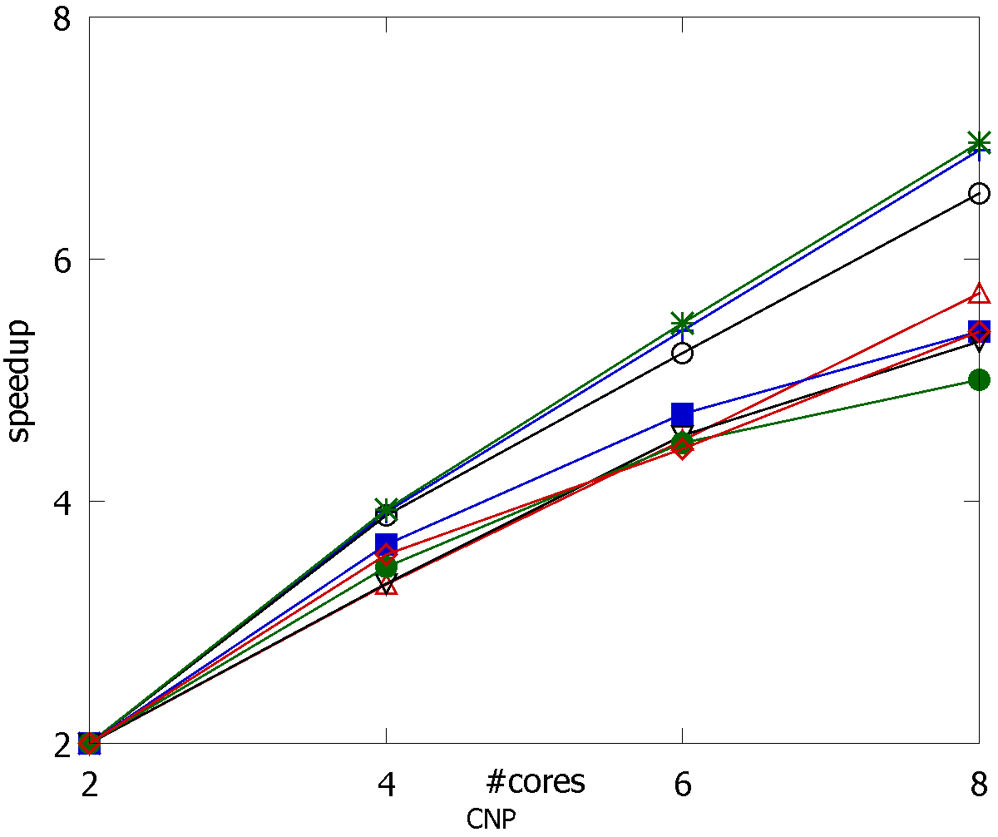
Experimental Evaluation – CNP Speedup
RB=Random, block-based parallelization
NB=Naïve, block-based parallelization
PB=Partition, block-based parallelization
SB=Segment, block-based parallelization
RE=Random, entity-based parallelization
NE=Naïve, entity-based parallelization
PE=Partition, entity-based parallelization
SE=Segment, entity-based parallelization
linear speedup
Notes:
We now examine the speedup of our parallelization strategies. Speedup expresses the extent to which WCT time decreases as we increase the number of available cores. Higher values are better. For the number of cores we consider, a speedup=8 corresponds to the ideal case. We observe that the block-based strategies consistently achieve a significantly higher speedup than the entity-based ones. According to Amdahl’s law this means that a larger part of their functionality is parallelizable. Also, the number of comparisons reflects more accurately their computational cost than the entity-based methods, due to the larger portion of redundant comparisons per entity than per block.

Slide 128
Meta-blocking Challenges: Effectiveness
  Problem:
  Simple pruning rules
Solutions:
Unsupervised methods
  BLAST
    Integrates schema information
Supervised methods
  Supervised Meta-blocking (SMB)
    utilizes feature-based classification of blocking-graph edges
  BLOSS
    minimizes the size of the required training set
Notes:
Complementary solutions.

Slide 129
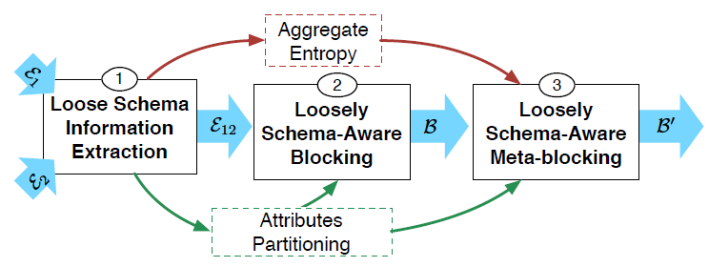
BLAST [Simonini et. al., VLDB 2017]
Goal:
improve the edge weighting and pruning in unsupervised WNP with loose schema information
Solution:
It works for Dirty ER, as well.
Courtesy of Giovanni Simonini
Notes:
BLAST involves 3 phases:
The loose schema information is extracted. It consists of: the attributes partitioning, and the aggregate entropy. The former describes how the attributes are partitioned according to the similarity of their values; it is the result of the attribute-match induction task. The latter is a measure associated to each cluster of attributes, derived from the attribute entropies.
A traditional schema-agnostic blocking technique is enhanced by exploiting the attributes partitioning. In particular, Blast employs Token Blocking.
A graph-based meta-blocking is applied to the block collection generated in the previous phase. In particular, Blast meta-blocking exploits the aggregate entropy to weight the blocking graph.

Slide 130
Loose Schema Information Extraction
Similar to Attribute Clustering:
Each attribute is represented as the set of its possible values
Builds a (bipartite*) graph with one node for every attribute
There is an edge for every pair of attributes with similarity > 0
Each connected component is an attribute cluster
* In the case of Clean-Clean ER.
The original Attribute Clustering does not scale to thousands of attributes → very inefficient
BLAST employs LSH to reduce the time complexity (for JaccardSim)
Scales well to hundred of thousands attributes
Simultaneously estimates aggregate entropy per cluster
Courtesy of Giovanni Simonini
Notes:
This is BLAST’s Phase 1. There is no slide for Phase 2, because it’s rather simple: Token Blocking + schema information = Attribute Clustering.
The aggregate entropy per cluster tries to capture the “information content” of each blocking key. The rationale behind it is that the importance of a blocking key is proportional to the entropy of the attribute from which it is derived. If the attribute assumes predictable values (e.g., there are only 2 equiprobable values), the observation of the same value in two different entity profiles does not have a great relevance; on the contrary, if the attribute has more unpredictable values (e.g., the possible equiprobable values are 100), observing two entity profiles that have the same value for that attribute can be considered a more significant clue for entity resolution

Slide 131

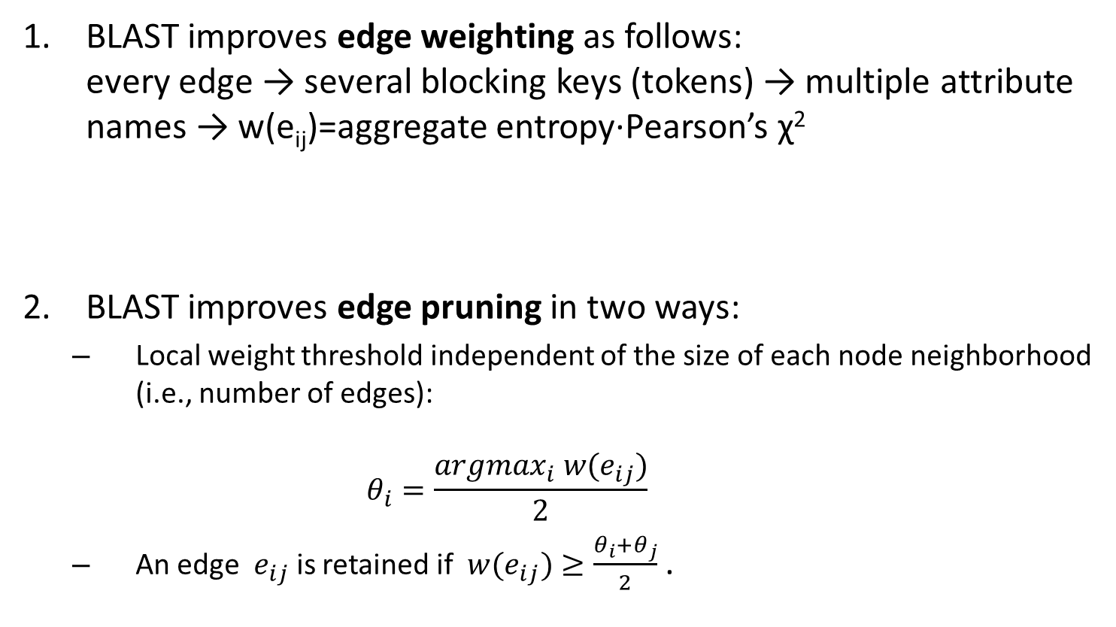
Loosely Schema-aware Meta-blocking
BLAST improves edge weighting as follows:
every edge → several blocking keys (tokens) → multiple attribute names → w(e_{ij})=aggregate entropy∙Pearson’s χ²
BLAST improves edge pruning in two ways:
  Local weight threshold independent of the size of each node neighborhood (i.e., number of edges):
  $θ_{i}=\frac{{argmax}_{i}{ w(e}_{ij})}{2}$
  An edge ${ e}_{ij}$ is retained if ${ w(e}_{ij})≥\frac{θ_{i}+θ_{j}}{2}$ .
Courtesy of Giovanni Simonini
Notes:
This is BLAST’s Phase 3.
h(Buv) is the aggregate entropy. It is estimated from the attribute names that are associated with every blocking key.
Pearson’s chisquared test quantifies the independence of pu and pv in the given block collection; i.e., it tests if the block distribution of pu, given that pv is present in the blocks, is the same as the distribution of pu, given that pn is not present. In practice, the chi-squared test measures the divergence of observed and expected sample counts, where the expected values are with reference to the null hypothesis, i.e., assuming that pu and pv appear independently in the blocks.
Edge Pruning.
1) The local threshold for each node is maxWeight/2.
2) Condition 2Instead of taking a local decision for each edge, according to the local thresholds of each adjacent node (WNP), BLAST takes a global decision for each edge, based on the average of the adjacent local thresholds.

Slide 132
Example – Original Meta-blocking
Entity Collection
Token Blocking
Blocking Graph
New Collection
Pruned Graph
Courtesy of Giovanni Simonini
Notes:
Dashed lines represent pruned edges, and red ones the superfluous comparisons that remain after pruning.
The example is about Clean-Clean ER. Threshold for pruning: weight <= 2.

Slide 133
Example – Meta-blocking over Attribute Clustering
Entity Collection
Attribute Clustering
Attribute Clusters
Blocking Graph
New Collection
Pruned Graph
C1
C2
name,f.name,
s.name
Other
Attributes
Courtesy of Giovanni Simonini
Notes:
Dashed lines represent pruned edges, and red ones the superfluous comparisons that remain after pruning.
Threshold for pruning: weight <= 2.
1 of the superfluous comparison is not removed after pruning.

Slide 134
Example - BLAST
Entity Collection
Attribute Clustering
Attribute Clusters
Blocking Graph
New Collection
Pruned Graph
C1
C2
name,f.name,
s.name
Other
Attributes
Courtesy of Giovanni Simonini
Notes:
All superfluous comparisons are now removed.
The weighting is done taking account the entropy.
How pruning is done: for all nodes, θi is 11/2, so the pruning threshold is (11/2+11/2)/2=5.5 for all edges. SMALL ERROR HERE BY B

Slide 135
Supervised Meta-blocking [Papadakis et. al., VLDB 2014]
Goal:
more accurate and comprehensive methodology for
pruning the edges of the blocking graph
Solution:
- model edge pruning as a classification task per edge
- two classes: “likely match”, “unlikely match”
Open issues:
Classification Features
Training Set
Classification Algorithms & Configuration

Slide 136
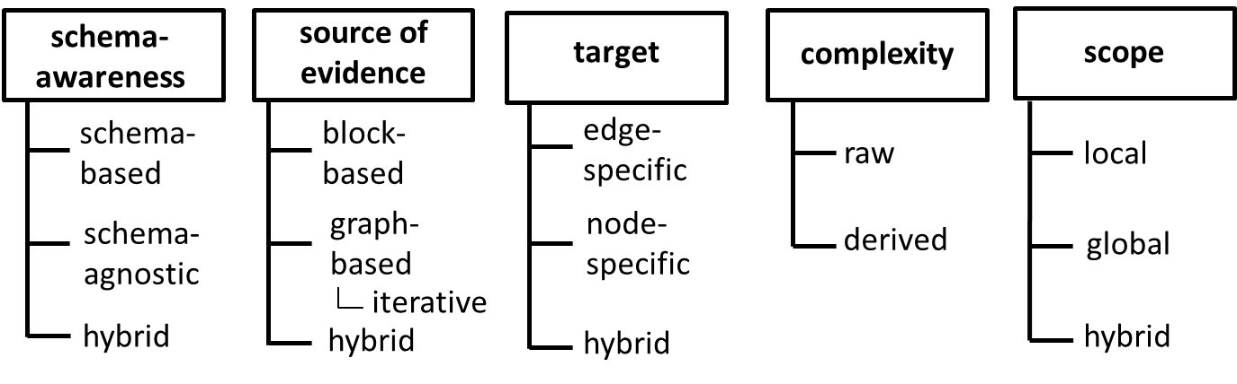
Classification Features
Requirements:
Generic 2. Effective
Efficient 4. Minimal
Notes:
Generic -> not crafted for a particular application or schema
Effective -> capture distinctive information
Efficient -> low extraction cost
Minimal -> low classification cost
bottom half of slide:
categories of features

Slide 137
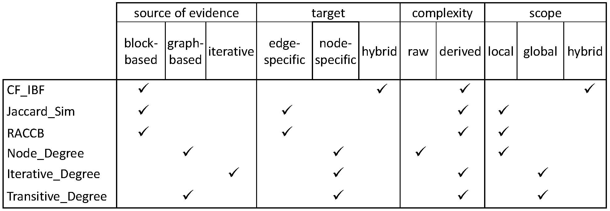
Feature Engineering
CF-IBF = # of Common Blocks × Inverse Block Frequency per entity
RACCB = Sum of Inverse Block Sizes
We examined all 63 possible combinations to find the minimal set of features, which comprises the first four features.
Notes:
in terms of blocks:
CF_IBF -> Extended Common Blocks (IBF: log(# of all blocks / # of blocks containing this entity) )
Jaccard_sim -> # of blocks containing the two entities / (# of blocks containing the 1st entity + # of blocks for 2nd entity)
RACCB -> ARCS (sum of inverse block sizes for blocks where both entities co-occur)
node_degree -> degree of this node in the meta-blocking graph (# of distinct comparisons for this entity)
Iterative Degree -> PageRank
Transitive Degree -> sum of adjacent (1 hop) node degrees

Slide 138
Training Set
Challenge:
binary classification with heavily imbalanced classes
Solutions:
Oversampling
Cost-sensitive learning
Ensemble learning
Undersampling
  Sample size equal to 5% of the minority class.
Notes:
Relatively small training sets are necessary

Slide 139
Classification Algorithms
Weighted Edge Pruning (WEP)
compatible with any classifier
we selected 4 state-of-the-art:
  Naïve Bayes
  Bayesian Networks
  C4.5 Decision Trees
  Support Vector Machines
  Cardinality Edge Pruning (CEP) &
  Cardinality Node Pruning (CNP)
  compatible with probabilistic classifiers
  we selected Naïve Bayes, Bayesian Networks
  Configuration
  For selected features and sample size, classifiers are robust with respect to their internal parameters
Notes:
these pruning methods do not need fixed thresholds now, but can operate automatically based on the classifiers

Slide 140
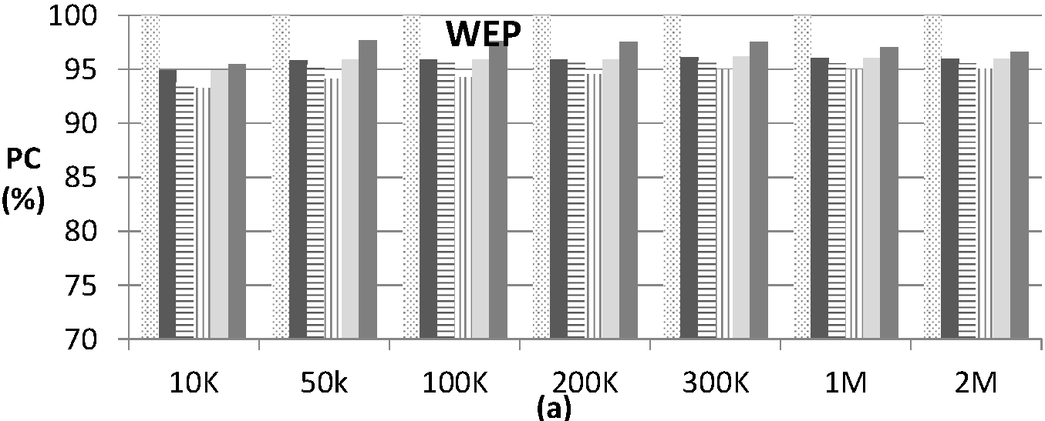
Experiments
recall
Notes:
Baseline methods:
Iterative Blocking
Unsupervised WEP
RRT = Relative Running Time wrt to the original blocks (before meta-blocking)
Conclusion: regardless of the classification algorithm, the recall is reduced to a minor extent, remaining constantly higher than 93%, while the running time is significantly reduced.
This means that our generic features have low extraction cost and high discriminatory power.

Slide 141
Experiments
recall almost unaffected
Notes:
Baseline methods:
Iterative Blocking
Unsupervised WEP
RRT = Relative Running Time wrt to the original blocks (before meta-blocking)
Conclusion: regardless of the classification algorithm, the recall is reduced to a minor extent, remaining constantly higher than 93%, while the running time is significantly reduced.
This means that our generic features have low extraction cost and high discriminatory power.

Slide 142
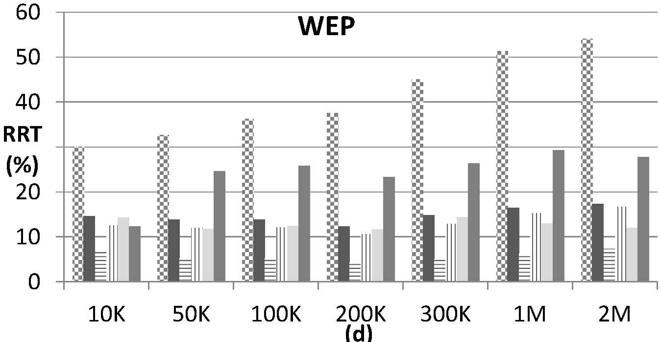
Experiments
recall almost unaffected
running time
Notes:
Baseline methods:
Iterative Blocking
Unsupervised WEP
RRT = Relative Running Time wrt to the original blocks (before meta-blocking)
Conclusion: regardless of the classification algorithm, the recall is reduced to a minor extent, remaining constantly higher than 93%, while the running time is significantly reduced.
This means that our generic features have low extraction cost and high discriminatory power.

Slide 143
Experiments
recall almost unaffected
running time up to 6x faster
(than original meta-blocking)
Notes:
Baseline methods:
Iterative Blocking
Unsupervised WEP
RRT = Relative Running Time wrt to the original blocks (before meta-blocking)
Conclusion: regardless of the classification algorithm, the recall is reduced to a minor extent, remaining constantly higher than 93%, while the running time is significantly reduced.
This means that our generic features have low extraction cost and high discriminatory power.

Slide 144
BLOSS [Dal Bianco et al., Information Systems, 2018]
Goal:
minimize the labelling effort
for training Supervised Meta-blocking
Solution:
meta-BLOcking Sampling Selection
- involves a novel sampling methodology
- combines it with active learning
Key feature:
removes outliers to improve recall
Courtesy of Guilherme Dal Bianco
Notes:
extension of supervised meta-blocking
main idea: with a much smaller training set (carefully selected), you get the same performance
The main goal of BLOSS is to select a reduced and very informative set of pairs to configure the meta-blocking step.

Slide 145
BLOSS Outline
It comprises three steps:
Definition of Similarity Levels and Random Sampling
  pre-selects candidate pairs using a metric that assesses the potential of a pair being a match
  level-based sampling ensures diversity
Selection of Pairs for Labeling
  applies active learning applied to the pre-selected pairs
Pruning Non-Matching Outliers
  filters out noisy non-matching pairs that have been labeled
Courtesy of Guilherme Dal Bianco
Notes:
Stage 1 makes it feasible to apply the active learning solution used in the second stage, besides accelerating its convergence. It is unfeasible to apply any active
learning approach to all unlabeled pairs due to the involved computational costs;
Stage 2 maximizes the gain of information for the meta-blocking learning process while reducing the user labeling effort.
Stage 3 corrects some potential bias of the learning process due to skewness issues (i.e., a dominance of non-matchings in the dataset) and presence of outliers that could harm the effectiveness of the learned model.

Slide 146
BLOSS First Stage
Relies on CF_IBF, which is proportional to matching likelihood.
Group candidate pairs
into L layers
Random selection N pairs inside each level
CF_IBF | Entity 1 | Entity 2
30 | A B C D | A E F G
30 | C T U Z | E W U V
80 | A I V X | A E P X
80 | L M Q X | S M P X
160 | D E F G | D E F G
160 | A L W X | A L W X
CF_IBF | Entity 1 | Entity 2
30 | C T U Z | E W U V
80 | A I V X | A E P X
160 | A L W X | A L W X
Level 0
Level 1
Level L
Courtesy of Guilherme Dal Bianco
Papadakis & Palpanas, WWW 2018, April 2018
146
Notes:
A high value of CF_IBF represents a high probability of a pair to be matching (and vice-versa).
high CF_IBF value means we have two entities that appear in a small number of blocks, and they appear together in a large percentage of those.
As the metric is not normalized, the number of levels depends on the dataset patterns and size.
divides all candidate matching pairs of entities (from all blocks) into levels based on CF_IBF
then picks one pair at random from each level

Slide 147
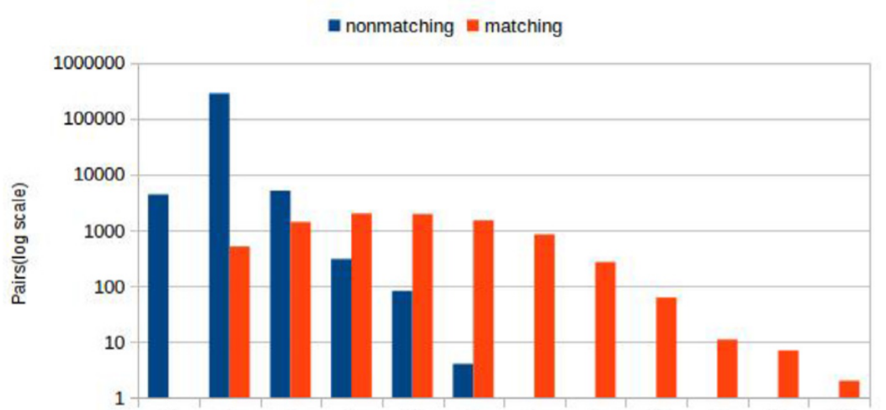
BLOSS First Stage – Layers distribution
increasing CF_IBF
first levels probably include more non-matching pairs
last levels group more matching pairs
Courtesy of Guilherme Dal Bianco
Papadakis & Palpanas, WWW 2018, April 2018
147
Notes:
The first levels have small threshold values, that is, they probably have more non-matching pairs. The last levels, on the other hand, group more matching pairs.

Slide 148
BLOSS Second Stage: Pairs Selection
Random selection of unlabeled pairs
Rule-based active learning
Reduced sample of labeled pairs
Projected Set
Unlabeled Dataset
Already Labeled Dataset
lu3 |  | C
lu4 |  |  | V
2 Rules
u1 | A | C | V
u2 | A | C | U
u3 | T | C | R
l1 | T | B | R
l2 | L | K | N
l3 | O | C | M
l4 | P | R | V
lu3 |  | C
1 Rules
lu1 | T |  | R
lu3 |  | C
5 Rules
Pair u2 is the most dissimilar instance compared to the actual training set.
Courtesy of Guilherme Dal Bianco
Papadakis & Palpanas, WWW 2018, April 2018
148
Notes:
in this second step, we select among all randomly selected pairs the ones that we will label, in order to construct our training set
we use active learning to only label those pairs that are most dissimilar to the already labeled ones: each new pair should have the smallest possible number of common values with the values in the existing pairs
Remember that the goal of this step is to select the Pairs for Labeling. We look for pairs that when labeled and included in labelled set, they brings most information to the process. Such pairs usually shares few or no feature values at all with already labelled instances. In other words, the labelled set includes the rarest and most challenging pairs, which carry valuable information.
The process works as follows: An unlabeled pair ui is selected to be labeled by the user by considering the number of association rules produced within a projected training set specific for ui. The projected training set is produced by removing from the current training set instances and features that do not share features values with ui. When compared to the current training set, the unlabeled pair with fewer classification rules over the projected training set represents the most informative pair (i.e., the selected pair removed so many unrelated instances that there were not enough left for extracting many classification rules). BLOSS stops this selection process when it decides that it has already captured most of the information contained in the unlabeled set.

Slide 149
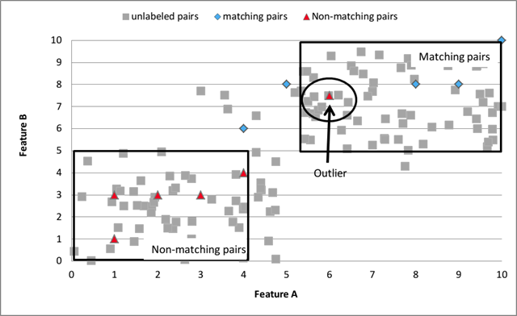
BLOSS Third Stage: Outliers Pruning
Goal: remove noise, while maximizing recall.
Courtesy of Guilherme Dal Bianco
Papadakis & Palpanas, WWW 2018, April 2018
149
Notes:
The problem is caused Non-Matching Outliers as show in the figure. If BLOSS is trained with such pairs, the matching pairs that are next to the outlier are probably identified as non-matching ones. Depending on the non-matching outliers in the training set, the number of matching pairs recovered may be substantially reduced (reducing recall). However, in the blocking context, it is better to retrieve some non-matching pairs as false-positives than missing a significant group of matching pairs.
Note that this is done only to improve the meta-blocking step, and, thus, all labeled pairs can indeed be exploited in the next deduplication step (i.e., classification).

Slide 150
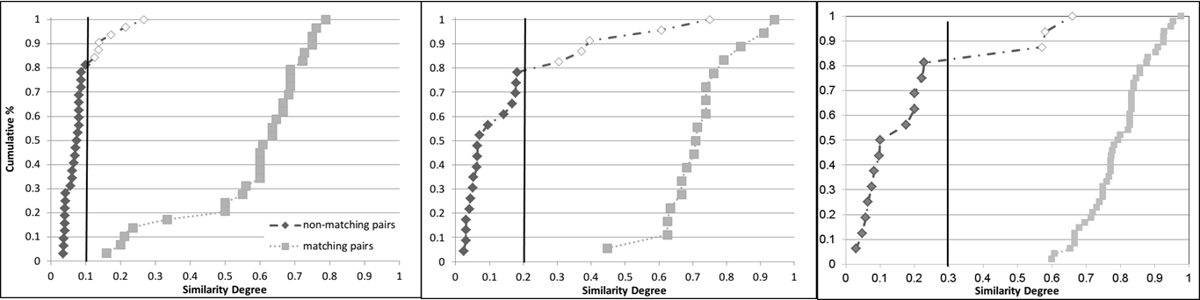
BLOSS Third Stage – Part B
Pruning Threshold:
average Jaccard similarity of non-matching labelled instances.
Synthetic Dataset
DBLP-Scholar
DBLP-ACM
Courtesy of Guilherme Dal Bianco
Papadakis & Palpanas, WWW 2018, April 2018
150
Notes:
from the non-matching training samples, we remove those that have a jaccard sim (because it’s normalized [0,1]) larger than the average sim of all non-matching labeled samples
The vertical line shows the pruning threshold for 3 different datasets.

Slide 151
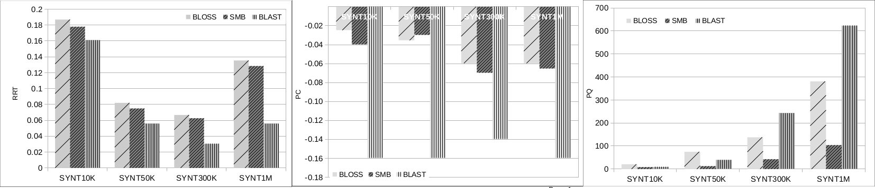
BLOSS Effectiveness & Time Efficiency
Measures:
RRT = Relative running time wrt to original blocking (without Meta-blocking)
ΔPC = Reduction in recall wrt to original blocking
ΔPQ = Increase in precision wrt to original blocking
BLOSS achieves a reduction in the training set size of around 40 times.
Courtesy of Guilherme Dal Bianco
Papadakis & Palpanas, WWW 2018, April 2018
151
Notes:
Baselines:
BLAST (best unsupervised meta-blocking), Supervised Meta-Blocking (SMB)
Results:
Figure 1 (leftmost): BLAST is the fastest one, followed by SMB. BLOSS increases the run-time of the latter by 10%, because of its first step. The reason is that BLAST retains a lower number of comparisons. As a result, it reduces recall to a larger extent (3x times), yielding much higher precision.
Figure 2: BLOSS and SMB have similar behavior, even though BLOSS uses 40 times smaller training sets.
Figure 3: BLOSS increases precision by 3 times more than SMB, because it retains a much smaller portion of non-matching comparisons.

Slide 152
Comparative Analysis of Approximate
Blocking Techniques [Papadakis et. al., VLDB 2016]
employed 3 sub-tasks of blocking
E
Block
Building
Block
Cleaning
Comparison
Cleaning
B
Lazy
blocking
methods
Block-refinement
methods
Comparison-refinement
methods
Proactive blocking methods

Slide 153
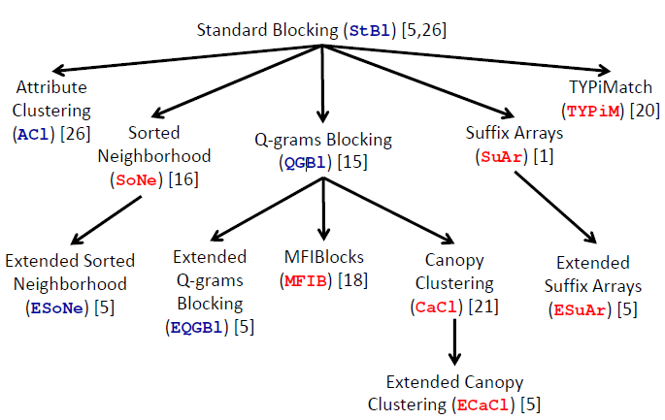
Comparative Analysis of Approximate
Blocking Techniques [Papadakis et. al., VLDB 2016]
considered 5 lazy and 7 proactive blocking methods

Slide 154
Experimental Analysis Setup
Block Cleaning methods:
  Block Purging
  Block Filtering
Comparison Cleaning methods:
  Comparison Propagation
  Iterative Blocking
  Meta-blocking

Slide 155
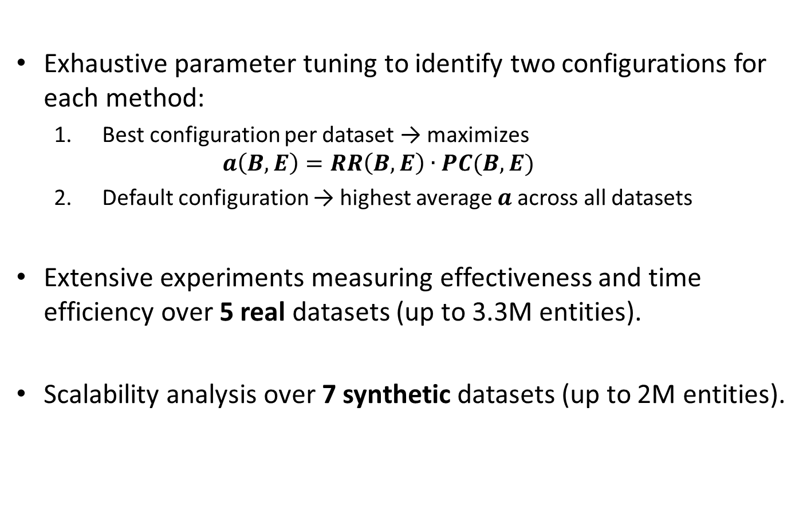
Experimental Analysis Setup
Exhaustive parameter tuning to identify two configurations for each method:
  Best configuration per dataset → maximizes
  $a\left(B,E\right)=RR\left(B,E\right)∙PC(B,E)$
  Default configuration → highest average $a$across all datasets
Extensive experiments measuring effectiveness and time efficiency over 5 real datasets (up to 3.3M entities).
Scalability analysis over 7 synthetic datasets (up to 2M entities).
Notes:
Reduction Ratio (RR) estimates the portion of comparisons that are avoided in B with respect to the naive, brute-force approach.
Formally, RR(B, E)=1-||B||=||E||.

Slide 156
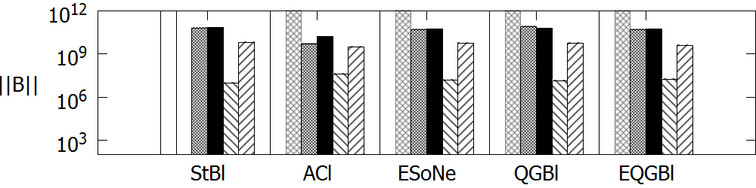
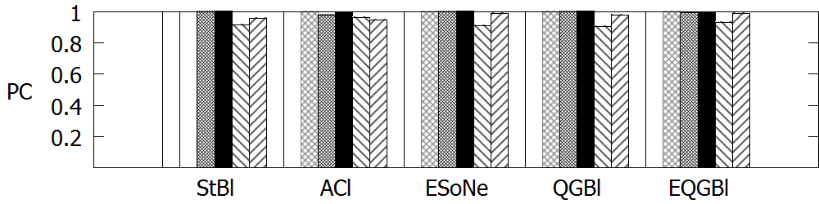
Effectiveness of Lazy Methods on DBPedia
Notes:
Very high recall (PC>>0.80), for all steps and configurations. This applies to all datasets. Difference between best and default configuration increases as we move from Block Building to Block Clean and Comparison Cleaning. All steps are indispensable, especially Meta-blocking, which decreases comparisons by up to 3 orders of magnitude! Without it, the number of comparisons remains very high.
I have highlighted the performance of the best configuration of Meta-blocking for Token Blocking. Comparisons are reduced by 3 orders of magnitude, at a very limited cost in recall. The same applies to all other lazy methods. The performance of default configuration is not that good, but the best configuration shows that there is great potential.

Slide 157
Effectiveness of Lazy Methods on DBPedia
Token-blocking and
Meta-blocking
Notes:
Very high recall (PC>>0.80), for all steps and configurations. This applies to all datasets. Difference between best and default configuration increases as we move from Block Building to Block Clean and Comparison Cleaning. All steps are indispensable, especially Meta-blocking, which decreases comparisons by up to 3 orders of magnitude! Without it, the number of comparisons remains very high.
I have highlighted the performance of the best configuration of Meta-blocking for Token Blocking. Comparisons are reduced by 3 orders of magnitude, at a very limited cost in recall. The same applies to all other lazy methods. The performance of default configuration is not that good, but the best configuration shows that there is great potential.

Slide 158
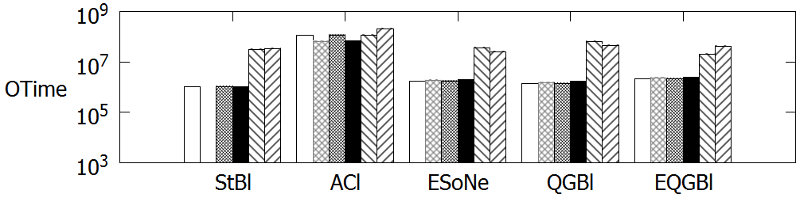
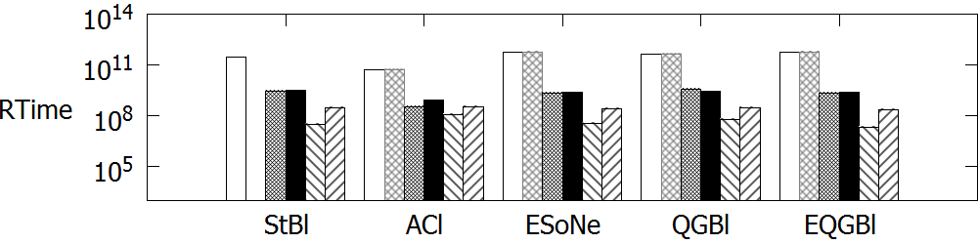
Time Efficiency of Lazy Methods on DBPedia
Notes:
Meta-blocking increases overhead time, Otime, but compensates for this by decreasing resolution time, Rtime, by 2 to 3 orders of magnitude. Token Blocking should be preferred when using a cheap entity matching method. For more expensive ones, the higher run time of Attribute Clustering pays off. This was shown in the scalability analysis, as well.
Again, the best configuration of Meta-blocking over Token Blocking is highlighted. The same pattern applies to all other lazy blocking methods.

Slide 159
Time Efficiency of Lazy Methods on DBPedia
Token-blocking and
Meta-blocking
Notes:
Meta-blocking increases overhead time, Otime, but compensates for this by decreasing resolution time, Rtime, by 2 to 3 orders of magnitude. Token Blocking should be preferred when using a cheap entity matching method. For more expensive ones, the higher run time of Attribute Clustering pays off. This was shown in the scalability analysis, as well.
Again, the best configuration of Meta-blocking over Token Blocking is highlighted. The same pattern applies to all other lazy blocking methods.

Slide 160
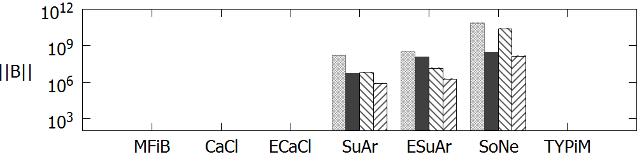
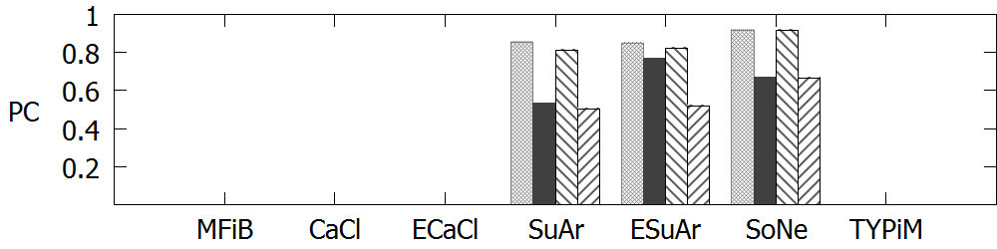
Effectiveness of Proactive methods on DBPedia
Notes:
Most proactive methods cannot scale to DBPedia, due to their very high overhead time.
This was shown in the scalability analysis, as well.
They depend heavily on their configuration: their default configuration has very poor performance.
Very poor recall, unless they execute a lot of comparisons.
Comparison Cleaning for SoNe is performed with Comparison Propagation. Meta-blocking is not applicable here, as it is a redundancy-neutral method. For SuAr and ESuAr, we employ Meta-blocking and again, its best configuration reduces ||B|| by 2 orders of magnitude at a rather limited cost in recall.

Slide 161
Effectiveness of Proactive methods on DBPedia
Suffix-arrays and
Meta-blocking
Notes:
Most proactive methods cannot scale to DBPedia, due to their very high overhead time.
This was shown in the scalability analysis, as well.
They depend heavily on their configuration: their default configuration has very poor performance.
Very poor recall, unless they execute a lot of comparisons.
Comparison Cleaning for SoNe is performed with Comparison Propagation. Meta-blocking is not applicable here, as it is a redundancy-neutral method. For SuAr and ESuAr, we employ Meta-blocking and again, its best configuration reduces ||B|| by 2 orders of magnitude at a rather limited cost in recall.

Slide 162
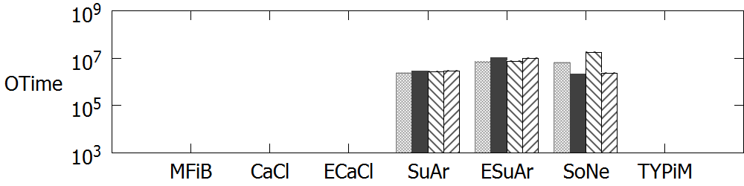

Time Efficiency of Proactive Methods on DBPedia
Notes:
The proactive methods are very fast and could be used for applications that emphasize time efficiency, instead of effectiveness.
Meta-blocking does not increase their overhead to a significant extend, because they already involve a low number of comparisons. Remember that the running time of Meta-blocking is linear to the number of input comparisons and the average number of blocks per entity.

Slide 163
Time Efficiency of Proactive Methods on DBPedia
Suffix-arrays and
Meta-blocking
Notes:
The proactive methods are very fast and could be used for applications that emphasize time efficiency, instead of effectiveness.
Meta-blocking does not increase their overhead to a significant extend, because they already involve a low number of comparisons. Remember that the running time of Meta-blocking is linear to the number of input comparisons and the average number of blocks per entity.

Slide 164
Part 6:
Entity Matching

Slide 165
Preliminaries
Estimates the similarity of candidate matches.
Input
  Pruned Blocking Graph
    Nodes → entities
    Edges → candidate matches
  Or, a set of blocks
    Every comparison in any block is a candidate match
Output
  Similarity Graph
    Nodes → entities
    Edges → candidate matches
    Edge weights → similarity of entity profiles (+neighbors)

Slide 166
Naïve Approach
For each pair of entities, e₁-e₂
  Estimate aggregate similarity based on:
    attribute values
    neighbors
    external knowledge
    combination of above
  If similarity > threshold → match! (unsupervised)
  If classifierDecision(e₁,e₂) = true → match! (supervised)
low recall!

Slide 167
Group Linkage [On et al., ICDE 2007]
Often, “entity” is represented as a uniquely identified group of information
In structured data:
  An author with a group of publication records
  A household in a census survey with a group of family members
In semi-structured data:
  Every entity is a group of name-value pairs.
Group Linkage Problem: to determine if two entities represented as groups are approximately the same or not
Courtesy of Dongwon Lee
Notes:
More advanced methods are required for higher performance. We begin with a method that was originally proposed for relational data, but can be easily extended to a schema-agnostic functionality that applies to Web data, too.

Slide 168
Group Linkage:
Popular Group Similarity
Jaccard
Intuitive, cheap to run
Error-prone
Bipartite Matching
  Cardinality
  Weighted
Rich
Expensive to run
Q: Can we combine Jaccard and Bipartite Matching for Group Linkage?
Courtesy of Dongwon Lee
Notes:
large ovals: entities
small circles: attr-value pairs

Slide 169
Group Linkage:
Intuition for Better Similarity
Two groups are similar if:
  A large fraction of elements in the two groups form matching element pairs
  There is high enough similarity between matching pairs of individual elements that constitute the two groups
Courtesy of Dongwon Lee

Slide 170
Group Linkage: Group Similarity
Two groups of elements:
  g₁ = {r₁₁, r₁₂, …, r_{1m1}}, g₂ = {r₂₁, r₂₂, …, r_{2m2}}
  The group measure BM is the normalized weight of the maximum bipartite matching M in the bipartite graph (N = g₁ U g₂, E=g₁ X g₂)
  such that
  BM(g₁, g₂) ≥ θ
user-defined parameters
Courtesy of Dongwon Lee

Slide 171
Group Linkage:
Example ( )
sparse bipartite graph
0.7
0.4
0.5
0.9
0.2
0.3
0.7
0.5
0.4
0.9
g₁
g₂
0.7
0.5
0.4
0.9
Therefore, g₁ <> g₂ !
M: max-weight
bipartite matching
Courtesy of Dongwon Lee
Notes:
we have all candidate distances
we prune distances less than local similarity threshold, rho (defined by the user)
we then keep only edges with maximum similarity (for both nodes in the pair)
then we compute group similarity (eg, all values of an entity), BM, and check if it’s above global (group) similarity threshold theta (defined by the user)

Slide 172
Group Linkage: Challenge
Each BM group measure uses the maximum weight bipartite matching
  Bellman-Ford: O(V²E)
  Hungarian: O(V³)
Large number of groups to match
  O(NM)
…
…
N
M
Courtesy of Dongwon Lee

Slide 173
Group Linkage:
Solution: Greedy matching
Bipartite matching computation is expensive because of the requirement
  No node in the bipartite graph can have more than one edge incident on it
Let’s relax this constraint:
  For each element e_{i} in g₁, find an element e_{j} in g₂ with the highest element-level similarity ⬄ S₁
  For each element e_{j} in g₂, find an element e_{i} in g₁ with the highest element-level similarity ⬄ S₂
Courtesy of Dongwon Lee
Notes:
S1 and S2 are the sets that contain the maximum similarities for every element

Slide 174
Upper/Lower Bounds
Courtesy of Dongwon Lee
Notes:
Properties:
Numerator of UB is at least as large as that of BM
Denominator of UB is no larger than that of BM
=> UB is the upper-bound of BM
Similarly for LB

Slide 175
Theorem & Algorithm
Theorem 1
IF UB(g₁,g₂) < θ → BM(g₁,g₂) < θ → g₁ ≠ g₂
Theorem 2
ELSE IF LB(g₁,g₂) ≥ θ → BM(g₁,g₂) ≥ θ → g₁≈ g₂
ELSE, compute BM(g₁,g₂)
Goal: BM(g₁,g₂) ≥ θ
Courtesy of Dongwon Lee
Notes:
The advantage of these simpler group similarity measures UBsim,ρ and LBsim,ρ is that these bounds can be easily and efficiently instantiated using SQL, permitting them to be implemented inside the database system itself.
The group similarity measures UBsim,ρ and LBsim,ρ can be used in a pre-processing step to speed up computation of the answers to the approximate match problem, without incurring any false negatives.

Slide 176
Iterative Approaches [Stefanidis et al., WWW 2014]
Increase recall by updating related entities upon detection of a new match
Core principles:
  Transitivity: if match(e₁,e₂)=true & match(e₂,e₃)=true → match(e₁,e₃)=true
  Duplicate dependency: if entities of one type (e.g., authors) are matches, related entities of another type (e.g., publications) are more likely to be matches, too.
  Merge dependency: if match(e₁,e₂)=true, replace e₁ & e₂ with e₁₂ and compare again with all other similar entities.
Notes:
Iterative matching approaches depend on relationships between entities
we propagate matchings already discovered to discover more matches

Slide 177

Swoosh [Benjelloun et al., VLDBJ 2009]
Iterative approach crafted for relational data.
Relies on two functions: match (m) and merge (μ)
Algorithm outline:
while the input list I is not empty
  e₁ ← I.removeFirstRecord()
  matchFound = false
  for each record in the output list , e₂ $∈O$
    if m (e₁, e₂ ) == true then
      O.remove ( e₂ )
      I .add( μ ( e₁ , e₂ ) )
      matchFound = true
      break
  if matchFound == false
      O.add( e₁ )
Notes:
Crafted for relational data.
insert all matching pairs in output
then I only need to compare new inputs to the elements in the output list
if I get a match, I merge, and move this back to the input list, so that I can compare it again to all the other elements

Slide 178
Swoosh Efficiency [Benjelloun et al., VLDBJ 2009]
Higher efficiency (fewer calls to match & merge) when specific properties hold:
  Idempotence:
    m(e_{i}, e_{i}) = true, μ(e_{i}, e_{i}) = e_{i}
  Commutativity:
  m(e_{i}, e_{j}) = M(e_{j}, e_{i}), μ(e_{i}, e_{j}) = μ(e_{j}, e_{i})
  Associativity:
  μ(e_{i}, μ(e_{j}, e_{k})) = μ(μ(e_{i},e_{j}), e_{k})
  Representativity:
  if μ(e_{i}, e_{i}) = e_{k} & m(e_{i}, e_{l}) = true → m(e_{k}, e_{l}) = true

Slide 179
Simple Greedy Matching (SiGMa)
[Lacoste-Julien et al., KDD 2013]
relies on the 1-1 assumption of Clean-Clean ER
  once a match is identified, it never needs to be compared to other entities
exploits relationship graph to score decisions and to propose candidates
can easily use tailored similarity measures
iterative algorithm
  provides natural tradeoff between precision & recall as well as between computation and recall
simplicity & greediness → high time efficiency
exhibits high effectiveness, as well
Courtesy of Simon Lacoste-Julien
Notes:
Let’s examine another greedy algorithm for matching.
works only on knowledge graphs, because it is based on relations among the elements
makes 1-1 assumption: once I find a match, I never compare it to other elements
iterative in the sense that a match may affect the similarity score of other elements in the graph

Slide 180

SiGMa intuition
SiGMa uses neighbors for:
1) scoring candidates
2) suggest candidates (iterative blocking)
Courtesy of Simon Lacoste-Julien
Notes:
Example of neighborhood to match in YAGO & IMDb: even though entities i & j share no words in their literal values, the fact that several of their respective neighbors are already matched together is a strong signal that i & j should also be matched together
SiGMa uses these contextual neighborhoods not only to suggest candidate pairs, but to score possible matches.

Slide 181



Quadratic Assignment objective
normalizing weight
pairwise similarity score
graph compatibility score:
counts the number of valid neighbors which are currently matched (context)
Courtesy of Simon Lacoste-Julien
Notes:
SiGMa can be formalized as a greedy algorithm to optimize the following Quadratic Assignment Problem objective.
y is the matching matrix. yij=1 means that entity i is matched to entity j, yij=0 otherwise
Nij = compatible neighbors: (k,l) is a valid neighboring pair of (i,j) if i is related to k in KB1 the same way as j is related to l in KB2
Main idea: Amongst a small set S of reasonable candidate unmatched pairs, choose (i,j) which maximally increase objective

Slide 182



SiGMa similarity scores
Increase in objective when matching pair (i,j):
Pairwise similarity score (could use others):
Similarity on string representation of entities:
  Jaccard measure on words in common + smoothing + weights (TF-IDF weights)
  Property similarity measure: also smoothed weighted Jaccard similarity measure between sets of properties, with additional similarity on literals:
Courtesy of Simon Lacoste-Julien
Notes:
String: the string representation property - label - of entities (as it is such a strong signal for our datasets),
Prop: considers the other properties except for the string representation property. We assume that the user provides a partial matching between properties of both databases. I.e., it relies on manually aligned relationships and propertie.

Slide 183

SiGMa Algorithm
1. Start with seed match
2. Put neighbors in S
3. At each iteration:
  a) pick new pair in S which max. increase
  b) add new neighbors in S
4. Stop when variation below threshold
Courtesy of Simon Lacoste-Julien
Notes:
Step 1: it looks for entities with the same string representation (with minimal standardization like removing capitalization and punctuation) with an unambiguous 1–1 match – that is, we do not include an exact matched pair when more than two entities have this same string representation, thereby increasing precision.
-- define N_ij -> compatible neighbors (with relationship)
-- w_ij,kl -> Jaccard normalization distance + smoothing
-- s_ij -> pairwise similarity measure (Jaccard on words + other properties of entities like dates
-- threshold -> 0.25 in experiments – correlated with leveling of F-measure; can use as pr/recall tradeoff
++ include inverted index suggestions in S as well...
Information propagation on the graph (fire analogy)
All score updates & score computation are local in the graph -> efficient implementation
Starting seed not that important on the datasets tested

Slide 184
PARIS [Suchanek et al., PVLDB 2011]
Probabilistic, iterative, parameter-free method
Collective approach for holistically aligning entities, relations and classes
  applicable to Clean-Clean ER (for knowledge graphs)
Algorithm outline:
  Fix equalities for literals (numbers, or strings)
  Set equalities for relations to a small initial value
  Iterate the estimations for relations and entities until convergence (*)
  Compute the estimations for classes
  (*) There is no proof for convergence, but it seems to happen
Courtesy of Fabian Suchanek
Notes:
for 2 clean knowledge graphs
3 is the iteration step
We have not yet succeeded in proving a theoretical condition under which the iteration of Equations (12) and (13) reaches a fixpoint. In practice, we iterate until the entity pairs under the maximal assignments change no more (which is what we call convergence). In our experiments, this state was always reached after a few iterations. We note that one could always enforce convergence of such iterations by introducing a progressively increasing dampening factor.
4 is the final step. In practice, we found that the class information is of less use for the equivalence of instances. This may be because of different granularities in the class hierarchies. It might also be because some ontologies use classes to express certain properties (MaleSingers), whereas others use relations for the same purpose (gender = male). Therefore, we compute the class equivalences only after the instance equivalences have been computed.

Slide 185
PARIS – Part B
Equality of Literals
  Pr(x ≡ y) := (x = y) ? 1 : 0
Equality of Entities
  Based on the local inverse functionality of a relation r
  1/#the number of entities with a given argument for r
  The probability of a relation being inverse functional is the harmonic mean of the local inverse functionalities
  Two entities are matching if they share at least one argument for a highly inverse functional relation
Equality of Classes
  Based on the subsumption probability: if all entities of one class are entities of the other, then the former subsumes the latter
  Equality of Relations
    Based on the probability that one relation is sub-property of the other
Notes:
Literals: Then we set the probability Pr(x ≡ y) to 1 if x and y are identical literals, to 0 otherwise. The goal of this work is to show that even with such a simple, domain-agnostic, similarity comparison between literals our probabilistic model is able to align ontologies with high precision; obviously, precision could be raised even higher by implementing more elaborate literal similarity functions.
Entities: Note that the probability of x ≡ x’ (x matches x’) depends recursively on the probabilities of other equivalences. These other equivalences may hold either between instances or between literals (as long as, for literals we choose a more elaborate similarity function).
The formulas we have just established estimate the equivalence between two entities that reside in two different ontologies, if there is a relation r that is common to the ontologi
Classes: we aim to find out not whether one class c of one ontology is equivalent to another class c 0 of another ontology, but whether c is a subclass of c 0 , c ⊆ c 0 . Intuitively, the probability Pr(c ⊆ c 0 ) shall be proportional to the number of instances of c that are also instances of c 0
The Equality of Relations can be solved analogously to the subsumption of classes.

Slide 186

Synthesizing Entity Matching Rules
Machine Learning System
Rule-Based Approach
Best F-measure
Not interpretable
Lower F-measure
Interpretable
Courtesy of Paolo Papotti
Papadakis & Palpanas, WWW 2018, April 2018
Notes:
small number of human provided examples!! demo in SIGMOD17

Slide 187


Synthesizing Entity Matching Rules Using Examples [Singh et al., PVLDB 2017]
Program Synthesis
Tuneable trade off
between F1 and complexity
General Boolean Formula (GBF): can include
arbitrary attribute matching predicates combined
by conjunctions, disjunctions, and negations
Courtesy of Paolo Papotti
Papadakis & Palpanas, WWW 2018, April 2018
Notes:
small number of human provided examples!! demo in SIGMOD17

Slide 188

Synthesizing Entity Matching Rules Using Examples [Singh et al., PVLDB 2017]
F-measure comparable to DTs depth 10 and SVM
Courtesy of Paolo Papotti
Papadakis & Palpanas, WWW 2018, April 2018
Notes:
exploit PL cutting edge results for more expressive rules

Slide 189
Part 7:
Entity Clustering

Slide 190
Preliminaries
Partitions the matched pairs into equivalence clusters → groups of entity profiles describing the same real-world object
Input
  Similarity Graph:
    Nodes → entities
    Edges → candidate matches
    Edge weights → likelihood of matching entities
Output
  Equivalence Clusters

Slide 191
Clustering Algorithms for Clean-Clean ER
Unique Mapping Clustering [Lacoste-Julien et al., KDD 2013] [Suchanek et al., PVLDB 2011]
  Relies on 1-1 constraint
    1 entity from first dataset matches to 1 entity from second
  Sorts all edges in decreasing weight
  Starting from the top, each edge corresponds to a pair of duplicates if:
    None of the adjacent entities has already been matched
    predefined threshold < edge weight
Notes:
only this algo for clean-clean ER
there is only match for each entity

Slide 192

Clustering Algorithms for Dirty ER
A wealth of literature on clustering algorithms
Requirements:
  Partitional and disjoint Algorithms
    Sometimes overlapping may be desirable
  Goal: Sets of clusters that
    maximize the intra-cluster weights
    minimize the inter-cluster edge weights
Classification of clustering algorithms
[Jain&Dubes88]
Courtesy of Oktie Hassanzadeh
192

Slide 193
Clustering Algorithms Characteristics [Hassanzadeh et al., VLDB 2009]
Most important feature
“Unconstrained algorithms”
I.e. , algorithms that do not require as input:
  The number of clusters
  The diameter of the clusters
  Any other domain specific parameters
Algorithms need to be able to predict the correct number of clusters
Courtesy of Oktie Hassanzadeh

Slide 194
Clustering Algorithms Characteristics [Hassanzadeh et al., VLDB 2009]
Need to scale well
  Time complexity < O(n²)
Need to be robust with respect to characteristics of the data
  E.g., distribution of the duplicates
Need to be capable of finding ‘singleton’ clusters
  Different from many clustering algorithms
    E.g., algorithms proposed for image segmentation
Courtesy of Oktie Hassanzadeh

Slide 195
Single-pass Algorithms [Hassanzadeh et al., VLDB 2009]
Perform clustering by a single scan of the output of the similarity join (the edges of the graph)
  Partitioning
    TRANSITIVE CLOSURE
  CENTER [HGI-WebDB'00]
  MERGE-CENTER [HM-VLDBJ09]
Courtesy of Oktie Hassanzadeh

Slide 196
Single-pass Algorithms [Hassanzadeh et al., VLDB 2009]
Perform clustering by a single scan of the output of the similarity join (the edges of the graph)
  Partitioning
    TRANSITIVE CLOSURE
  CENTER [HGI-WebDB'00]
  MERGE-CENTER [HM-VLDBJ09]
Courtesy of Oktie Hassanzadeh
Notes:
Transitive Closure: the standard approach
But
May put together many dissimilar records (low threshold)
May split many similar records (high thresholds)
Very sensitive to the value of the threshold used for the similarity join

Slide 197
Single-pass Algorithms [Hassanzadeh et al., VLDB 2009]
Perform clustering by a single scan of the output of the similarity join (the edges of the graph)
  Partitioning
    TRANSITIVE CLOSURE
  CENTER [HGI-WebDB'00]
  MERGE-CENTER [HM-VLDBJ09]
Courtesy of Oktie Hassanzadeh
Notes:
The CENTER algorithm performs clustering by partitioning the similarity graph into clusters that have a center, and all records in each cluster are similar to the center of the cluster. The input should be sorted in decreasing order of similarity scores. For the first edge u-v, the center of the cluster is the node with the highest average weight across all its adjacent edge. All the subsequent nodes w that are similar to u (i.e., appear in a pair (u, w) in the list) are assigned to the cluster of u and are not considered again – as long as they are not centers themselves. This algorithm could result in more clusters than Connected Components since it assigns to a cluster only those records that are similar to the center of the cluster.
MIGHT BE A PROBLEM HERE!!!

Slide 198
Single-pass Algorithms [Hassanzadeh et al., VLDB 2009]
Perform clustering by a single scan of the output of the similarity join (the edges of the graph)
  Partitioning
    TRANSITIVE CLOSURE
  CENTER [HGI-WebDB'00]
  MERGE-CENTER [HM-VLDBJ09]
Courtesy of Oktie Hassanzadeh
Notes:
It performs similar to CENTER, but merges two clusters ci and cj whenever a record similar to the center node of cj is in the cluster ci, i.e., a record that is similar to the center of the cluster ci is similar to the center of cj . Again, the first time a node u appears in a pair, it is assigned as the center of the cluster. All the subsequent nodes v that appear in a pair (u, v) in the scan and are not assigned to any cluster, are assigned to the cluster of u, and are not assigned as the center of any other cluster. Whenever a pair (u, v′ ) is encountered such that v ′ is already in another cluster, the cluster of u is merged with the cluster of v ′.
MERGE-CENTER creates fewer clusters for the sample graph than the CENTER algorithm, but more than the Partitioning algorithm.

Slide 199
Star Algorithm [APR-JGraph04]
Creates star-shaped clusters
  heuristic to approximate problem of finding minimal clique cover of graph
Similar to CENTER but
  Allows overlapping clusters
  First sorts nodes in descending order of their degrees
Courtesy of Oktie Hassanzadeh
199
Notes:
Let each vertex in G be initially unmarked.
Calculate the degree of each vertex u ∈ U.
Let the highest degree unmarked vertex be a star center, and construct a cluster from the center and its associated vertices. Mark each node in the newly constructed star.
Repeat step c until all the nodes are marked.

Slide 200
Ricochet Algorithms [WB-DASFAA’09]
Ricochet family of algorithms
  Based on a strategy that resembles the rippling of stones thrown in a pond
  Combine ideas from the classic K-means algorithm and the Star algorithm
    First selecting seeds (star centers) for the clusters and then refining the clusters iteratively
  Four unconstrained clustering algorithms, originally proposed for document clustering
    SR, BSR, CR and OCR
  SR and BSR perform a sequential selection of the cluster seeds; CR and OCR perform a concurrent selection of the seeds
Courtesy of Oktie Hassanzadeh
Notes:
Two phases:
The seeds of the clusters are specified, which is similar to selecting star centers in the Star algorithm.
Vertices are assigned to clusters associated with seeds. This phase is similar to the re-assignment phase in the K-means algorithm.
Names of algorithms:
Sequential Rippling (SR)
Balanced Sequential Rippling (BSR)
Concurrent Rippling (CR)
Ordered Concurrent Rippling (OCR)

Slide 201
Min-Cut Clustering [Hassanzadeh et al., VLDB 2009]
Based on the Cut-Clustering Algorithm [FTT-IM04]
  Finding minimum cuts of edges in the similarity graph after inserting an artificial sink into similarity graph G
Courtesy of Oktie Hassanzadeh

Slide 202


Articulation Point Clustering
[Hassanzadeh et al., VLDB 2009]
A scalable graph partitioning algorithm
Based on finding articulation points
  Articulation point: a vertex whose removal makes the graph disconnected
Efficient implementations proposed for identifying chatter in the blogosphere [BCKT-VLDB07]
Courtesy of Oktie Hassanzadeh
202

Slide 203

Markov Clustering (MCL) [Dongen-Thesis00]
Based on simulation of stochastic flow in graphs
  Graph is mapped to Markov matrix
  Transition probabilities recomputed through alternate application of two algebraic operations on matrices
    Expansion and Inflation
Clusterings with different scales of granularity by varying the inflation parameter of the algorithm
Optimized implementation that makes the algorithm scalable
Courtesy of Oktie Hassanzadeh
203

Slide 204
Correlation Clustering [BBC-ML04]
Original problem: a graph clustering given edges labelled with ‘+’ or ‘−’
  ‘+’ indicates correlation between the nodes
  ‘−’ indicates uncorrelated nodes
The goal is to find a clustering that agrees as much as possible with the edge labels
  NP-Hard: approximations needed
The labels can be assigned to edges based on the similarity scores of the records (edge weights) and a threshold value
Several approximations exist
  We use algorithm Cautious from [BBC-ML04] in our paper
Courtesy of Oktie Hassanzadeh

Slide 205

Summary of Experimental Results
[Hassanzadeh et al., VLDB 2009]
Courtesy of Oktie Hassanzadeh

Slide 206
Main Conclusions [Hassanzadeh et al., VLDB 2009]
None of the clustering algorithms produces perfect clustering
Transitive closure:
  highly scalable, but results in poor quality of duplicate groups
  Poor quality even wrt other single-pass algorithms
Most algorithms are robust to distribution of duplicates, except Ricochet algorithms:
  high performance over uniformly distributed duplicates
  poor performance otherwise
Cut clustering and Correlation clustering:
  sophisticated & popular algorithms
  achieve lower accuracy than some single-pass algorithms
Markov clustering:
  very efficient
  one the most accurate algorithms
Courtesy of Oktie Hassanzadeh

Slide 207
Part 8:
Massive Parallelization Methods

Slide 208
Massive Parallelization Outline
Based on the Map-Reduce paradigm
  Data partitioned across the nodes of a cluster
  Map Phase: transforms a data partition into (key, value) pairs
  Reduce Phase: processes pairs with the same key
Parallelization of Blocking
  Standard Blocking (Dedoop)
Parallelization of Block Processing
  Block Filtering
  Meta-blocking
Parallelization of Entity Matching
  LINDA

Slide 209


Parallel Standard Blocking [Kolb et al., PVLDB 2012]
MAP function pseudo-code
REDUCE function pseudo-code
1: Input
Key: id of entity e_{i,} $i$
Value: entity profile of e_{i}
2: Output
Key: blocking key value, $bkv$
Value: entity profile of e_{i}
3: $bkv=$ extractBlockingKey(e_{i})
4: emit($bkv$, $k.||bk||$ );
1: Input
Key: blocking key value, $bkv$
Value: list of entity profiles $V=\{e_{i},e_{j}, …,\}$
2: Output
Key: pair of concatenated entity ids, $i.j$
Value: true (match) or false (non-match) 3: for each pair of entities e_{i-}e_{j} in $V$
4: decision = compareProfiles( $\text{e}\text{i} \text{, }\text{ej}\text{ ) }$
5: emit($i.j$ , decision );
6: end loop
Notes:
Map function
Input: an entity description ei
Output: a (key, value) pair
key: the blocking key of ei
value: the entire entity description ei
Reduce function
Gathers all entities with the same key, creating a block. Then, it computes all similarities between the co-occurring entities
Input: A BKV along with descriptions with this BKV
Output: (key, value) pairs
key: i-j, the ids of a pair of descriptions, ei-ej
value: Boolean value (1 for match, 0 for non-match)

Slide 210


Parallel Block Filtering [Efthymiou et. al., BigData 2015]
MAP function pseudo-code
REDUCE function pseudo-code
1: Input
Key: id of block b_{k,} $k$
Value: list of entity ids, $b_{k}=\{i,j,…,m\}$
2: Output
Key: id of entity e_{i}, $i$
Value: block id and cardinality, $k.||bk||$
3: compute comparisons in block, $||bk||$
4: for each $i∈b_{k}$ loop
5: emit($i$, $k.||bk||$ );
6: end loop
1: Input
Key: id of entity e_{i}, $i$
Value: list of pairs < $k.||bk||$ >, $V$
2: Output
Key: id of entity e_{i}, $i$
Value: list of top-N blocks in $B_{i}$, ${B′}_{i}$
3: order $V$ in ascending block cardinality
4: ${B′}_{i}=getTopNBlockIds(V)$
5: emit( $i$ , ${B′}_{i}$ );

Slide 211
Example Parallel Block Filtering
Key
Value
e₁ | b₁.3
e₂ | b₁.3
e₃ | b₁.3
... | …
Key
Value
Key
Value
e₁ | b₁.3
e₁ | b₄.3
e₁ | b₆.6
e₁ | b₇.10
... | …
b₁ | e₁,e₂,e₃
… | …
b₄ | e₁,e₃,e₄
... | ...
b₆ | e₁,e₆,e₇,e₉
b₇ | e₁,e₅,e₆,e_{8,}e₉
... | ...
Map
Reduce
e₁ | b₁,b₄,b₆
... | …
e₁ | b₄.3
e₃ | b₄.3
e₄ | b₄.3
... | …
Group by key
Map
Map
e₂ | b₁.3
... | …
Reduce
e₂ | b₁
... | …
e₁ | b₆.6
e₆ | b₆.6
e₇ | b₆.6
e₉ | b₆.6
e₁ | b₇.10
... | …
e₃ | b₁.3
e₃ | b₄.3
... | …
Reduce
e₃ | b₁,b₄
... | …

Slide 212
Parallel Meta-blocking [Efthymiou et al., IS 2017]
Three strategies:
  Edge-based: explicitly creates the blocking graph
    needs pre-processing to perform all weight computations
    stores all edges of the blocking graph on disk
    at least 2 MapReduce jobs per pruning algorithm with high I/O
  Comparison-based: implicitly creates the blocking graph
    defers weight computations to avoid creating any edges
    pre-processing enriches the input blocks with the block list of every entity, which is necessary for weight estimation → ideal for CEP/WEP
  Entity-based: uses the blocking graph only as a conceptual model
    no pre-processing, all computations in the reducer
    gathers entire blocks for each entity → ideal for CNP/WNP
Notes:
Edge-based -> baseline
Comparison-based -> ideal for CEP and EP
Edge-based -> ideal for CNP and WNP (node-based pruning algorithms)
In the following examples, we focus on comparison-based, as it is easier to illustrate.

Slide 213


Comparison-based Parallel Meta-blocking Pre-processing
MAP function pseudo-code
REDUCE function pseudo-code
1: Input
Key: id of entity e_{i}, $i$
Value: list of associated block ids, $B_{i}$
2: Output
Key: id of block b_{k,} $k$
Value: id of entity e_{i} and associated
block ids, $i.B_{i}$
3: sort $B_{i}$ in ascending order of block ids
4: for each $k ∈B_{i}$ loop
5: emit($k$, $i.B_{i}$ );
6: end loop
1: Input
Key: id of block b_{k,} $k$
Value: list of pairs < $i.B_{i}$ >, $V$
2: Output
Key: input key
Value: input value
3: if ( $2 ≤|V|$ )
4: emit( $k$ , $V$ );

Slide 214
Comparison-based Parallel Meta-blocking Pre-processing Example
Key
Value
Key
Value
Key
Value
b₁ | [e₁,b₁,b₄,b₆]
b₄ | [e₁,b₁,b₄,b₆]
b₆ | [e₁,b₁,b₄,b₆]
b₁ | [e₂,b₁]
... | …
b₁ | [e₁,b₁,b₄,b₆]
b₁ | [e₂,b₁]
b₁ | [e₃,b₁,b₄]
... | …
b₁ | [e₁,b₁,b₄,b₆], [e₂,b₁], [e₃,b₁,b₄],...
… | …
Reduce
Key
Value
Group by key
e₁ | b₁,b₄,b₆
e₂ | b₁
e₃ | b₁,b₄
e₄ | b₄,b₅
... | ...
Map
b₄ | [e₁,b₁,b₄,b₆]
b₄ | [e₃,b₁,b₄]
b₄ | [e₄,b₄,b₅]
... | …
b₄ | [e₁,b₁,b₄,b₆], [e₃,b₁,b₄], [e₄,b₄,b₅],...
... | ...
Reduce
b₁ | [e₃,b₁,b₄]
b₄ | [e₃,b₁,b₄]
b₄ | [e₄,b₄,b₅]
b₅ | [e₄,b₄,b₅]
... | …
Map
b₅ | [e₄,b₄,b₅]
... | …
Reduce
b₅ | [e₄,b₄,b₅],...
... | ...
b₆ | [e₁,b₁,b₄,b₆]
... | …
Reduce
b₆ | [e₁,b₁,b₄,b₆],...
... | ...

Slide 215


Comparison-based Parallel Meta-blocking Weighted Edge Pruning (WEP) & Jaccard Scheme (JS)
MAP function pseudo-code
REDUCE function pseudo-code
1: Input
Key: id of block b_{k,} $k$
Value: list of entity ids, associated blocks and
local information, $V=\{i.B_{i}.X_{i},j.B_{j}{.X}_{j},…\}$
2: Output
Key: entity ids defining edge <n_{i},n_{j}>, $i.j$
Value: total weight of <n_{i},n_{j}>,$wij$
3: for each $c_{ij}∈b_{k}.comparisons()$ loop
4: if ( $isNonRedundant\left(c_{ij}\right)$ = true )
5: compute $wij$from $B_{i}.X_{i}$, $B_{j}{.X}_{j}$ ;
6: emit($i .j$, $wij$ );
7: ${|E}_{G}|$++;
8: $tw+=$ $wij$ ;
9: end loop
1: Input
Key: entity ids defining edge
<n_{i},n_{j}>, $i.j$
Value: total weight of <n_{i},n_{j}>,$wij$
2: Output
Key: entity ids of retained edge <n_{i},n_{j}>, $i.j$
Value: total weight of <n_{i},n_{j}>,$wij$
3: if ( $wij>tw$/$\left|E_{G}\right|$)
4: emit( $i.j$, $wij$ );

Slide 216
Comparison-based Parallel Meta-blocking Weighted Edge Pruning (WEP) & Jaccard Scheme (JS)
Key
Value
Key
Value
Key
Value
e₁.e₂ | 1/3
e₁.e₃ | 2/3
e₂.e₃ | 1/2
... | …
e₁.e₂ | 1/3
... | ...
e₁.e₃ | 2/3
... | …
b₁ | [e₁,b₁,b₄,b₆], [e₂,b₁], [e₃,b₁,b₄]
… | …
b₄ | [e₁,b₁,b₄,b₆], [e₃,b₁,b₄], [e₄,b₄,b₅]
... | ...
Reduce
e₁.e₃ | 2/3
... | …
Map
Group by key
e₂.e₃ | 1/2
... | ...
Reduce
e₂.e₃ | 1/2
... | …
e₁.e₄ | 1/4
e₃.e₄ | 1/3
... | …
Map
e₁.e₄ | 1/4
... | ...
e₃.e₄ | 1/3
... | …
Reduce
Count #keys
... | …
Sum up values
Notes:
how could we improve this using Flink/Spark/Gradoop?
For e_1 and e_2, the edge weight is 1/3 because it is given by the Jaccard Weighting Scheme. For e_1, we have the following list of blocks containing it: b₁,b₄,b₆, while e_2 is contained only in b₁. The Jaccard similarity of these two block lists is 1/3. Assuming that the overall weight threshold of WEP is ½, we get the two edges in the end.

Slide 217


Entity-based Parallel Meta-blocking
Cardinality Node Pruning (CNP)
MAP function pseudo-code
REDUCE function pseudo-code
1: Input
Key: id of block b_{k,} $k$
Value: list of entity ids, $b_{k}=\{i,j,…,m\}$
2: Output
Key: id of entity e_{i}, $i$
Value: input value
3: for each $j∈b_{k}$ loop
4: emit ( $j$, $b_{k}$ );
5: end loop
1: Input
Key: id of entity e_{i}, $i$
Value: co-occurrence bag,$βi$
2: Output
Key: entity ids of retained edge <n_{i},n_{j}>, $i.j$
Value: total weight of <n_{i},n_{j}>,$wij$
3: frequencies[] ← {}; setOfNeighbors ← {};
4: for each $j∈V$ loop
5: frequencies[$j$ ]++;
6: setOfNeighbors .add($j$ );
7: end loop
8: topEdges ← {};
9: for each $j∈$ setOfNeighbors loop
10: $wij$ = getWeight ($i , j ,$ frequencies[$j$ ] );
11: topEdges.add($j , wij$ );
12: if ( topEdges.size() < k )
13: topEdges.pop();
14: end loop
15: for each $\left( j , wij \right)∈$ topEdges loop
16: emit ( $i.j$ , $wij$ );
17: end loop

Slide 218
Load Balancing: MaxBlock Algorithm
2
max comparisons
max comparisons
1
1
1
2
2
3
3
3
4
5
6
4
5
6
4
5
6
max comparisons
3
max comparisons
max comparisons
1
1
1
2
2
2
3
3
4
5
6
4
5
6
4
5
6
max comparisons
max comparisons
max comparisons
1
1
5
1
6
5
2
2
2
4
4
4
3
3
3
5
6
6
: unassigned block
: block accepted in partition
: block rejected from partition
: new partition
Notes:
Similar to Partition Multicore Parallelization.
Prev. slide: different blocks are processed in different cluster nodes
goal: create partitions that have similar workloads (similar #comparisons to execute)
sort blocks (desc. size) and assign the next biggest block to the next smallest partition.
if not fitting (>max size), add it to a new partition
…and so on and so forth…
Note: we do not require a given number of partitions; this is determined dynamically.

Slide 219

Parallel Meta-blocking Performance
Notes:
Time in minutes. For the comparison-based strategy, the edge-centric algorithms (CEP & WEP) are much faster than the node-centric ones (CNP & WNP), and vice versa for the entity-based strategy. Both strategies significantly outperform the edge-based, which materializes the blocking graph.
Using Flink/Spark instead of Hadoop should improve performance to a large extent, as they store intermediate results in memory instead of on-disk.

Slide 220

Comparison-based Parallel Meta-blocking Weighted Edge Pruning (WEP) & Jaccard Scheme (JS)
linear
parallel
meta-blocking
Parallel Meta-blocking achieves (almost) linear scale-up
Notes:
how could we improve this using Flink/Spark/Gradoop?
Time in minutes. The edge-centric algorithms (CEP & WEP) are much faster than the node-centric ones (CNP & WNP). The advanced strategy significantly outperforms the basic one, which materializes the blocking graph. The 3 weighting schemes have similar times. Speedup is almost linear.
Using Flink/Spark instead of Hadoop should improve performance to a large extent, as they store intermediate in memory instead of on-disk.

Slide 221
LINDA: Parallel Entity Matching as an Optimization Problem [Böhm et al., CIKM 2012]
Input:
  Entity Graph G=(V,E) where vertices represent distinct URIs
Output:
  Assignment Matrix X where x_{a,b}=1 if a and b refer to same entity
Constraints:
  reflexivity, symmetry, transitivity, and unique mapping per source
  (entity from source 1 matches with at most one entity from source 2)
Objective:
  Given sim(a, b, G, X), find X that maximizes
Courtesy of Gerhard Weikum
Notes:
----- Besprechungsnotizen (10/17/12 12:13) -----
consider figure with overview
unify Xes
unique mapping constraint example

Slide 222
Multi-Core Assignment Algorithm
Initialize matrix X as identity matrix
Initialize priority queue Q with initial similarities
While Q not empty
  Retrieve pair (a,b) of entities with highest similarity value
  Accept pairs (a’,b’) with a’ and b’ in equivalence class of a and b
  (uses current X to determine equivalents, updates X)
  For all pairs (c,d) of entities where similarity could have changed
    Compute new similarities in parallel
    If similarity has changed for (c,d)
      Update queue with new similarity for (c,d)
Return X
Courtesy of Gerhard Weikum

Slide 223
Map/Reduce Assignment Algorithm
Entity Graph
Queue
distribute
distribute
e_{i} e_{j} y
e_{i}
e_{i} e_{k} y
e_{k} e_{l} y
e_{k}
…
…
…
…
…
e_{l}
e_{j}
Courtesy of Gerhard Weikum

Slide 224
Map/Reduce Assignment Algorithm
Entity Graph
Q-part 1
Q-part n
Queue
e_{i} e_{j} y
e_{k} e_{l} y
distribute
distribute
…
…
e_{i} e_{j} y
…
…
e_{i}
e_{i} e_{k} y
G-part 1
G-part n
e_{k} e_{l} y
e_{i}
e_{j}
e_{k}
e_{l}
…
e_{k}
…
…
…
…
…
…
e_{l}
e_{j}
Courtesy of Gerhard Weikum

Slide 225
Map/Reduce Assignment Algorithm
Entity Graph
Q-part 1
(2) notify*
Q-part n
Queue
e_{i} e_{j} y
e_{k} e_{l} y
distribute
distribute
…
(3) update
…
e_{i} e_{j} y
…
…
e_{i}
e_{i} e_{k} y
G-part 1
G-part n
e_{k} e_{l} y
e_{i}
e_{j}
(1) accept
e_{k}
e_{l}
e_{k}
…
…
(4) register
…
…
…
…
…
e_{l}
read
read
distribute
Result
Matrix
Queue
Updates
e₁ … e_{m}
e_{i} e_{j} y‘
e_{j}
e_{m}… e₁
e_{i} e_{k} y‘
…
Courtesy of Gerhard Weikum

Slide 226
Part 9:
Progressive Entity Resolution

Slide 227

Preliminaries
Facts:
Progressive, or Pay-as-you-go ER comes is useful
Notes:
Addresses Velocity.

Slide 228
Preliminaries
Facts:
Progressive, or Pay-as-you-go ER comes is useful
get most of the benefit
much earlier

Slide 229
Preliminaries
Facts:
Progressive, or Pay-as-you-go ER comes is useful
get most of the benefit
much earlier
may require some
pre-processing

Slide 230
Progressive Entity Resolution
requires:
  Improved Early Quality
  Same Eventual Quality
defines optimal processing order for a set of entities
Use cases:
  Limited, unknown time for ER (online ER)
  Exploratory ER
Empirical by nature, based on heuristics

Slide 231
Static Progressive Methods
Guide which records to compare first, independently of Entity Matching results
Three flavors
  Sorted list of pairs: a list of record pairs, ranked by the likelihood that the pairs match
  Hierarchy of partitions: likely matching records in the form of partitions with different levels of granularity
  Sorted list of records: maximize the number of matching records identified when the list is resolved sequentially
Courtesy of Steven Euijong Whang

Slide 232
Taxonomy of Progressive Methods
Standard Blocking
Sorted
Neighborhood
(SN)
Suffix Arrays Blocking
(SAB)
Token Blocking
Batch
Meta-blocking
(Blocking Graph)
Progressive SN
(PSN)
Hierarchy
of Record
Partitions
(HRP)
Ordered
List of
Records
(OLR)
Schema-based
Schema-Agnostic PSN (SA-PSN)
Progressive Suffix
Arrays Blocking
(SA-PSAB)
Naïve
Progressive
Local SA-PSN
(LS-PSN)
Progressive
Block
Scheduling
(PBS)
Schema-agnostic
Advanced
Progressive
Profile Scheduling
(PPS)
Global SA-PSN
(GS-PSN)
Comparison-based
Block-based
Profile-based
Hybrid

Slide 233
Progressive Sorted Neighborhood (PSN)
[Whang et al, IEEE TKDE, 2013]
The Comparison Matrix
Record
 | A | B | C | D | E | F | G | H | I | J | K | L | M | N | O | P
A
B
C
D
E
F
G
H
I
J
K
L
M
N
O
P
Comparison
Duplicate
0
1
3
6
10
Courtesy of Thorsten Papenbrock
Papadakis & Palpanas, WWW 2018, April 2018
Notes:
If recall is low, multiple schema-based blocking keys should be used.

Slide 234
Taxonomy of Progressive Methods
Standard Blocking
Sorted
Neighborhood
(SN)
Suffix Arrays Blocking
(SAB)
Token Blocking
Batch
Meta-blocking
(Blocking Graph)
Progressive SN
(PSN)
Hierarchy
of Record
Partitions
(HRP)
Ordered
List of
Records
(OLR)
Schema-based
Schema-Agnostic PSN (SA-PSN)
Progressive Suffix
Arrays Blocking
(SA-PSAB)
Naïve
Progressive
Local SA-PSN
(LS-PSN)
Progressive
Block
Scheduling
(PBS)
Schema-agnostic
Advanced
Progressive
Profile Scheduling
(PPS)
Global SA-PSN
(GS-PSN)
Comparison-based
Block-based
Profile-based
Hybrid

Slide 235

Hierarchy of Partitions
[Whang et al, IEEE TKDE, 2013]
Compare {r₁, r₂} and {r₄, r₅}.
If there is more budget, compare {r₁, r₂, r₃}.
If there is still more budget, compare {r₁, r₂, r₃, r₄, r₅}.
Courtesy of Steven Euijong Whang
Notes:
A partition hierarchy gives information on likely matching records in the form of partitions with different levels of granularity where each partition represents a “possible world” of an ER result. The partition of the bottom-most level is the most fine-grained clustering of the input records. Higher partitions in the hierarchy are more coarse grained with larger clusters. That is, instead of storing arbitrary partitions, we require the partitions to have an order of granularity where coarser partitions are higher up in the hierarchy. A significant advantage of the partition hierarchy structure is that the storage space is linear in the number of records regardless of the height L.

Slide 236
Taxonomy of Progressive Methods
Standard Blocking
Sorted
Neighborhood
(SN)
Suffix Arrays Blocking
(SAB)
Token Blocking
Batch
Meta-blocking
(Blocking Graph)
Progressive SN
(PSN)
Hierarchy
of Record
Partitions
(HRP)
Ordered
List of
Records
(OLR)
Schema-based
Schema-Agnostic PSN (SA-PSN)
Progressive Suffix
Arrays Blocking
(SA-PSAB)
Naïve
Progressive
Local SA-PSN
(LS-PSN)
Progressive
Block
Scheduling
(PBS)
Schema-agnostic
Advanced
Progressive
Profile Scheduling
(PPS)
Global SA-PSN
(GS-PSN)
Comparison-based
Block-based
Profile-based
Hybrid

Slide 237
Ordered List of Records
[Whang et al, IEEE TKDE, 2013]
Goal:
maximize the number of matching records identified while resolving the list sequentially
Advantages:
zero space requirements
no change in resolution algorithm
Generation:
Sort all entities according to a weight derived from the partitions that involve them, under the assumption that each partition is equally likely to be the correct ER outcome.

Slide 238
Schema-agnostic Progressive ER
[Simonini et. al., ICDE 2018]
Previous works assume structured data.
  (Multiple) Schema-based blocking methods.
Problems:
  Inapplicable to Big Data, due to Volume and Variety.
  Plenty of room for improvement
    even for schema-based methods!

Slide 239

Schema-agnostic Progressive ER
[Simonini et. al., ICDE 2018]
state of the art schema-based solution: PSN

Slide 240
Schema-agnostic Progressive ER
[Simonini et. al., ICDE 2018]
state of the art schema-based solution: PSN
when optimal finds 100% of matches, PSN finds 2-35% of matches

Slide 241
Schema-agnostic Progressive ER
[Simonini et. al., ICDE 2018]
state of the art schema-based solution: PSN
when optimal finds 100% of matches, PSN finds 2-35% of matches
after 10x the comparisons optimal needs, PSN finds 15-85% of matches

Slide 242
Schema-agnostic Progressive ER
[Simonini et. al., ICDE 2018]
state of the art schema-based solution: PSN
when optimal finds 100% of matches, PSN finds 2-35% of matches
after 10x the comparisons optimal needs, PSN finds 15-85% of matches
after 100x the comparisons optimal needs, PSN finds 80-99% of matches

Slide 243
Schema-agnostic Progressive ER
[Simonini et. al., ICDE 2018]
Solution:
  schema-agnostic methods that are able to handle large, semi-structured, heterogeneous data
  proposed solutions also applicable to structured data

Slide 244
Taxonomy of Progressive Methods
Standard Blocking
Sorted
Neighborhood
(SN)
Suffix Arrays Blocking
(SAB)
Token Blocking
Batch
Meta-blocking
(Blocking Graph)
Progressive SN
(PSN)
Hierarchy
of Record
Partitions
(HRP)
Ordered
List of
Records
(OLR)
Schema-based
Schema-Agnostic PSN (SA-PSN)
Progressive Suffix
Arrays Blocking
(SA-PSAB)
Naïve
Progressive
Local SA-PSN
(LS-PSN)
Progressive
Block
Scheduling
(PBS)
Schema-agnostic
Advanced
Progressive
Profile Scheduling
(PPS)
Global SA-PSN
(GS-PSN)
Comparison-based
Block-based
Profile-based
Hybrid
Notes:
We start with the similarity-based algorithms, which rely on the similarity of blocking keys. They produce a list of profiles by sorting all profiles alphabetically, according to the blocking keys that represent them. They assume that the matching likelihood of any two profiles is analogous to their proximity after sorting.

Slide 245
Schema-agnostic PSN [Simonini et. al., ICDE 2018]
Use all attribute values as blocking keys – regardless of attribute values
Sort them alphabetically
Sort the entities accordingly → Neighbor List
  The same entity might be placed in consecutive places
Slide the incremental window over the Neighbor List
Execute the valid comparisons
Notes:
We start with a naïve approach that demonstrates that schema-agnostic PER is a non-trivial task.
Valid comparisons: entities from different entity collections (for Clean-Clean ER) or simply different entities (for Dirty ER)

Slide 246


Example of Schema-agnostic PSN
Data Lake
Sliding Window
Blocking Keys
Neighbor List

Slide 247
Taxonomy of Progressive Methods
Standard Blocking
Sorted
Neighborhood
(SN)
Suffix Arrays Blocking
(SAB)
Token Blocking
Batch
Meta-blocking
(Blocking Graph)
Progressive SN
(PSN)
Hierarchy
of Record
Partitions
(HRP)
Ordered
List of
Records
(OLR)
Schema-based
Schema-Agnostic PSN (SA-PSN)
Progressive Suffix
Arrays Blocking
(SA-PSAB)
Naïve
Progressive
Local SA-PSN
(LS-PSN)
Progressive
Block
Scheduling
(PBS)
Schema-agnostic
Advanced
Progressive
Profile Scheduling
(PPS)
Global SA-PSN
(GS-PSN)
Comparison-based
Block-based
Profile-based
Hybrid

Slide 248
Local/Global Schema-agnostic PSN
[Simonini et. al., ICDE 2018]
Drawbacks of SA-PSN
  coincidental proximity → random ordering
  redundant comparisons
LS-PSN:
  discards redundant comparisons within the current window
  local execution order through comparison weighting with Position Index
  weighting scheme: Relative Co-occurrence Frequency (RCF)
GS-PSN:
  similar to LS-PSN, but defines a global execution order for all comparisons in a range of window sizes up to w_{max}
Notes:
RCF counts how many times a pair of profiles lies at a distance of w positions in the Neighbor List and then normalizes it by the number of positions corresponding to each profile

Slide 249



Example of LS-PSN
Data Lake
Sliding Window
Comparison Weighting
Blocking Keys
Comparison Sorting
Neighbor List
Notes:
[comparison weighting numbers for p1-p2, p2-p3, p3-p4, p4-p5]
1) [blocking keys] LS-PSN extracts blocking keys, sorts them alphabetically.
2) [Neighbor List] LS-PSN forms Neighbor List by sorting the entity profiles according to the sorted list of blocking keys (from the previous step).
- Notice that: each profile appears in the Neighbor List as many times as the number of its tokens (i.e., Redundancy)
3) [Sliding Window] LS-PSN slides window of size 1, so to count how many times each pair of profiles appear together with a distance = 1 (co-occurrences)
4) [Comparison Weighting] Each pair is weighted taking into account: the co-occurrence, the number of times that each profile appear in the list (normalization factor)
We call this RCF: Relative Co-occurrence Frequency
The pair (p1-p2) appears 3 times (for win=1)
p1 has 4 positions in the list (i.e., appears 4 times)
p2 has 4 positions in the list (i.e., appears 4 times)
w(p1-p2) = count(p1-p2) / count(p1)+count(p2)-count(p1-p2) = 3 / (4+4-3) = 3 / 5 = .6
Basically: "count(p1)+count(p2)-count(p1-p2)” is the normalization factor
5) All comparisons are added to a priority queue (of the size of the Neighbor List)
- Emitting them one by one, the result is to have an emission of pairs sorted by their weight (high to low)

Slide 250
Taxonomy of Progressive Methods
Standard Blocking
Sorted
Neighborhood
(SN)
Suffix Arrays Blocking
(SAB)
Token Blocking
Batch
Meta-blocking
(Blocking Graph)
Progressive SN
(PSN)
Hierarchy
of Record
Partitions
(HRP)
Ordered
List of
Records
(OLR)
Schema-based
Schema-Agnostic PSN (SA-PSN)
Progressive Suffix
Arrays Blocking
(SA-PSAB)
Naïve
Progressive
Local SA-PSN
(LS-PSN)
Progressive
Block
Scheduling
(PBS)
Schema-agnostic
Advanced
Progressive
Profile Scheduling
(PPS)
Global SA-PSN
(GS-PSN)
Comparison-based
Block-based
Profile-based
Hybrid
Notes:
We now look into equality-based methods, which consider the equality of blocking keys.
Most of them rely on redundancy-positive blocks, assuming that the similarity of two profiles is proportional to the number of blocks they share.
We start with a naïve approach that demonstrates that schema-agnostic PER is a non-trivial task.

Slide 251

Progressive Suffix Arrays Blocking
[Simonini et. al., ICDE 2018]
Every token in any attribute value is a blocking key
Every key is converted to all suffixes with at least l_{min} characters
Every suffix of minimum length creates a tree with that suffix at its root → Hierarchy of Partitions
Poor Performance!!!

Slide 252
Taxonomy of Progressive Methods
Standard Blocking
Sorted
Neighborhood
(SN)
Suffix Arrays Blocking
(SAB)
Token Blocking
Batch
Meta-blocking
(Blocking Graph)
Progressive SN
(PSN)
Hierarchy
of Record
Partitions
(HRP)
Ordered
List of
Records
(OLR)
Schema-based
Schema-Agnostic PSN (SA-PSN)
Progressive Suffix
Arrays Blocking
(SA-PSAB)
Naïve
Progressive
Local SA-PSN
(LS-PSN)
Progressive
Block
Scheduling
(PBS)
Schema-agnostic
Advanced
Progressive
Profile Scheduling
(PPS)
Global SA-PSN
(GS-PSN)
Comparison-based
Block-based
Profile-based
Hybrid

Slide 253

Progressive Block Scheduling (PBS)
[Simonini et. al., ICDE 2018]
Based on redundancy-positive blocking methods
Orders blocks in increasing comparisons
For each block:
  Estimate the weight of all comparisons
  Sort and process the non-redundant comparisons in decreasing weight
  Relies on Entity (Profile) Index

Slide 254
Example of PBS
Data Lake
Block Processing
Block Collection
Notes:
the Least Common Block Index (LeCoBI) condition checks whether a comparison is repeated in the following way: given a comparison cij in block bY , the LeCoBI condition identifies the least common block id, X, between the profiles pi and pj and compares it with the id of bY , Y. If the two ids match (X = Y ), cij corresponds to a new comparison. Otherwise X < Y , which means that cij has already been compared in block bX, but is repeated in block bY . Note that X > Y is impossible, because the id of every block indicates its position in the processing list after sorting all blocks in increasing cardinalities (i.e., bk denotes the block placed in the k th position after sorting).
LeCoBi in green means that the comparison is non-redundant, as it has not been executed before.
LeCoBi in red means that the comparison is redundant, as it has already been repeated in a previous block (b2).
The Comparison p4-p5 is emitted only once: when block b2 is evaluated

Slide 255
Taxonomy of Progressive Methods
Standard Blocking
Sorted
Neighborhood
(SN)
Suffix Arrays Blocking
(SAB)
Token Blocking
Batch
Meta-blocking
(Blocking Graph)
Progressive SN
(PSN)
Hierarchy
of Record
Partitions
(HRP)
Ordered
List of
Records
(OLR)
Schema-based
Schema-Agnostic PSN (SA-PSN)
Progressive Suffix
Arrays Blocking
(SA-PSAB)
Naïve
Progressive
Local SA-PSN
(LS-PSN)
Progressive
Block
Scheduling
(PBS)
Schema-agnostic
Advanced
Progressive
Profile Scheduling
(PPS)
Global SA-PSN
(GS-PSN)
Comparison-based
Block-based
Profile-based
Hybrid
Notes:
We now look into equality-based methods. They rely on redundancy-positive blocks, assuming that the similarity of two profiles is proportional to the number of blocks they share.

Slide 256
Progressive Profile Scheduling (PPS)
[Simonini et. al., ICDE 2018]
Based on redundancy-positive blocking methods
Orders entities in decreasing duplication likelihood
Simultaneously, it aggregates the top-weighted comparison per entity → these are the first comparisons to be processed
Processes one entity at a time
  For each entity, it considers the k top-weighted co-occurring ones in decreasing edge weight
Notes:
RCF counts how many times a pair of profiles lies at a distance of w positions in the Neighbor List and then normalizes it by the number of positions corresponding
to each profile

Slide 257

Example of PPS
Data Lake
Blocking Graph
Sorted Profile List
Block Collection
Local Comparison List for p₂
Notes:
blocking graph edge weights:
the ARCS function sums the inverse cardinality of common blocks, assigning higher scores to pairs of profiles sharing smaller (i.e., more distinctive) blocks
For instance:
p1-p2 appear together in blocks:
“carl” (1 comparison in this block);
“ny” (3 comparisons in this block);
“white” (15 comparisons in this block);
“tailor” (6 comparisons in this blcok)
Then: (1/1 + 1/3 + 1/15 + 1/6) = 1.57
The weight of each profile is obtained averaging the weight of all it adjacent edges in the Blocking Graph.
For instance:
Weight(p5)= (4*.07 + 2.7)/5 = .6
Weight(p2)= (1.57 + .57 + 0.14 + .23)/5 = .5
Local comparison list for p2 graph (what are the dotted edges?)
Dotted edges are discarded comparisons (WNP, local pruning).
- Notice that p2-p1 here is discarded because p1 has already been evaluated (so p1-p2 has been emitted when evaluating p1). To do that, PPS just checks for the condition profile1_position < profile2_position (w.r.t. the sorted profile list).

Slide 258

Experimental Results [Simonini et. al., ICDE 2018]
datasets used:
Notes:
Note that the pink column corresponds to schema-based PSN. We outperform it even over structured datasets!

Slide 259
Experimental Results [Simonini et. al., ICDE 2018]
datasets used:
Notes:
Note that the pink column corresponds to schema-based PSN. We outperform it even over structured datasets!

Slide 260


Experimental Results [Simonini et. al., ICDE 2018]
datasets used:
$$Recall=\frac{\# emitted matches}{\# existing matches}$$
$${ec}^{∗}=\frac{\# emitted comparisons}{\# existing matches}$$
measures used:
${ec}^{∗}$ measures # of comparisons as multiples of all comparisons of optimal
Notes:
Note that the pink column corresponds to schema-based PSN. We outperform it even over structured datasets!

Slide 261


Experimental Results [Simonini et. al., ICDE 2018]
datasets used:
$$Recall=\frac{\# emitted matches}{\# existing matches}$$
$${ec}^{∗}=\frac{\# emitted comparisons}{\# existing matches}$$
measures used:
$${area under curve: AUC}_{m}^{∗}@{ec}^{∗}=\int_{0}^{{ec}^{∗}}{\frac{Recall Curve of m}{ideal Recall Curve}}$$
${ec}^{∗}$ measures # of comparisons as multiples of all comparisons of optimal
${AUC}_{m}^{∗}@{ec}^{∗}$measures performance of method m for effort ${ec}^{∗}$
  the higher the ${AUC}_{m}^{∗}@{ec}^{∗}$, the better (optimal has ${AUC}_{m}^{∗}@{ec}^{∗}$=1)
Notes:
Note that the pink column corresponds to schema-based PSN. We outperform it even over structured datasets!

Slide 262

Experimental Results [Simonini et. al., ICDE 2018]
performance over heterogeneous datasets
Notes:
Note that the pink column corresponds to schema-based PSN. We outperform it even over structured datasets!

Slide 263
Experimental Results [Simonini et. al., ICDE 2018]
performance over heterogeneous datasets
methods based on redundancy-positive blocking perform significantly better
PPS is the winner
Notes:
Note that the pink column corresponds to schema-based PSN. We outperform it even over structured datasets!

Slide 264

Experimental Results [Simonini et. al., ICDE 2018]
performance over structured datasets
Notes:
Note that the pink column corresponds to schema-based PSN. We outperform it even over structured datasets!

Slide 265
Experimental Results [Simonini et. al., ICDE 2018]
performance over structured datasets
the LS/GS-PSN methods perform significantly better
Notes:
Note that the pink column corresponds to schema-based PSN. We outperform it even over structured datasets!

Slide 266
Experimental Results [Simonini et. al., ICDE 2018]
performance over structured datasets
the LS/GS-PSN methods perform significantly better
PPS achieves almost the same performance
Notes:
Note that the pink column corresponds to schema-based PSN. We outperform it even over structured datasets!

Slide 267
Experimental Results [Simonini et. al., ICDE 2018]
performance over structured datasets
the LS/GS-PSN methods perform significantly better
PPS achieves almost the same performance
overall, PPS is method of choice for progressive ER on both structured/ heterogeneous data
Notes:
Note that the pink column corresponds to schema-based PSN. We outperform it even over structured datasets!

Slide 268
Dynamic Progressive Methods
Problem of Static Methods:
  The order of comparisons is immutable.
Impact:
  The algorithm cannot react to a skewed distribution of duplicates.
Solution:
  If (i,j) is a duplicate, then check (i+1,j) and (i,j+1) as well.
  Assumption:
    Oracle for Entity Matching
Notes:
They are integrated with entity matching, adjusting the processing order on-the-fly. They assume that entity matching is performed by an oracle (α=100%), thus yielding an optimistic estimation of their performance. They need to load the compared entity profiles in memory

Slide 269
Dynamic Progressive SN
[Papenbrock et a., IEEE TKDE, 2015]
Courtesy of Thorsten Papenbrock

Slide 270
Part 10:
JedAI Toolkit

Slide 271
What is the JedAI Toolkit?
JedAI can be used in three ways:
As an open source library that implements numerous state-of-the-art methods for all steps of an established end-to-end ER workflow.
As a desktop application for ER with an intuitive Graphical User Interface that is suitable for both expert and lay users.
As a workbench for comparing all performance aspects of various (configurations of) end-to-end ER workflows.

Slide 272


JedAI vs other tools
Magellan
JedAI
limited variety of (blocking) methods
rich variety available methods for every step in the end-to-end workflow

Slide 273
JedAI vs other tools
Magellan
JedAI
limited variety of (blocking) methods
restricted to relational data only
rich variety available methods for every step in the end-to-end workflow
applies to both structured and non-structured data

Slide 274
JedAI vs other tools
Magellan
JedAI
limited variety of (blocking) methods
restricted to relational data only
targeted to expert users, focusing on development of tailor-made methods
rich variety available methods for every step in the end-to-end workflow
applies to both structured and non-structured data
hands-off functionality through default configuration of every method, but also extensible

Slide 275
JedAI vs other tools
Magellan
JedAI
limited variety of (blocking) methods
restricted to relational data only
targeted to expert users, focusing on development of tailor-made methods
offers command-line interface, no GUI
rich variety available methods for every step in the end-to-end workflow
applies to both structured and non-structured data
hands-off functionality through default configuration of every method, but also extensible
intuitive GUI with guidelines even for novice users

Slide 276
JedAI vs other tools
Magellan
JedAI
limited variety of (blocking) methods
restricted to relational data only
targeted to expert users, focusing on development of tailor-made methods
offers command-line interface, no GUI
rich variety available methods for every step in the end-to-end workflow
applies to both structured and non-structured data
hands-off functionality through default configuration of every method, but also extensible
intuitive GUI with guidelines even for novice users
multi-core execution (coming soon)

Slide 277
How does the JedAI Toolkit work?
JedAI implements the following schema-agnostic, end-to-end workflow for both Clean-Clean and Dirty ER:
Step 1
Step 2
Step 3
Step 4
Step 5
Step 6
Step 7
Data Reading
Block
Building
Block
Cleaning
Comparison
Cleaning
Entity
Matching
Entity
Clustering
Evaluation & Storing
Reads files containing the entity profiles and the golden standard.
Creates
overlapping blocks.
Optional step that cleans blocks from useless comparisons (repeated, superfluous).
Optional step that operates on the level of individual comparisons to remove the useless ones.
Executes all retained comparisons.
Partitions the similarity graph into equivalence clusters.
Stores and presents performance results
w.r.t. numerous measures.

Slide 278

How is the JedAI Toolkit structured?
Modular architecture
  one module per workflow step
Extensible architecture
  e.g., ontology matching module
???

Slide 279
How can I build an ER workflow?
JedAI supports several established methods for each workflow step:
Step 1
Step 2
Step 3
Step 4
Step 5
Step 6
Step 7
Data Reading
Block
Building
Block
Cleaning
Comparison
Cleaning
Entity
Matching
Entity
Clustering
Evaluation & Storing
Possible to read CSV, RDF/XML files, SPARQL endpoints & relational DBs in any combination
Choose
1 out of 7 methods.
Specify any combination of 3 complementarymethods
Choose
1 out of 7 methods (including
Meta-blocking)
Combine
1 out of 2
methods with 12 textual representation models and 10 similarity measures
Choose
1 out of 6
methods for Dirty ER. For Clean-Clean ER, 1 method is available
Store results as a CSV file

Slide 280
Which Data Formats are supported?
Data Formats
CSV files
Relational databases
XML/RDF/OWL files
SPARQL endpoints
Java Serialized Objects (using JedAI data model)

Slide 281
Which Blocking Methods are supported?
Block Building | Block Cleaning | Comparison Cleaning
Token Blocking | Block Filtering | Comparison Propagation
Sorted Neighborhood | Size-based Block Purging | Cardinality Edge Pruning (CEP)
Extended Sorted Neighborhood | Cardinality-based Block Purging | Cardinality Node Pruning (CNP)
Q-Grams Blocking | Block Scheduling | Weighted Edge Pruning (WEP)
Extended Q-Grams Blocking |  | Weighted Node Pruning (WNP)
Suffix Arrays |  | Reciprocal CNP
Extended Suffix Arrays |  | Reciprocal WNP

Slide 282
Which Entity Matching/Clustering Methods are supported?
Entity Matching | Entity Clustering
Group Linkage* | Center Clustering
Profile Matcher* | Connected Components
 | Cut Clustering
* In combination with bag and graph textual models based on token and character n-grams and various established string similarity measures | Markov Clustering
 | Merge-Center Clustering
 | Ricochet SR Clustering
 | Unique Mapping Clustering
Notes:
For Entity Matching, more methods will be added in JedAI v2. Profile Matcher builds a single vector or graph model for each entity profile, by aggregating all attribute values, regardless of the associated attribute names.
For Entity Clustering, all methods apply exclusively to Dirty ER, except for Unique Mapping Clustering, which applies exclusively to Clean-Clean ER.

Slide 283
Which Datasets are included?
Several datasets are available for testing
Clean-Clean ER (real) | D1 Entities | D2 Entities
Abt-Buy | 1,076 | 1,076
DBLP-ACM | 2,616 | 2,294
DBLP-Scholar | 2,516 | 61,353
Amazon-GP | 1,354 | 3,039
Movies | 27,615 | 23,182
DBPedia | 1,190,733 | 2,164,040
Dirty ER (synthetic) | Entities
10K | 10,000
50K | 50,000
100K | 100,000
200K | 200,00
300K | 300,00
1M | 1,000,000
2M | 2,000,000
can be used for Dirty ER, too

Slide 284
What are the next steps?
Version 2.0:
  Includes support for schema clustering, multicore functionality, GNU Trove for higher time efficiency.
  Available at the end of August, 2018.
Version 3.0:
  Includes support for data fusion, progressive ER as well as a workflow builder.
  Available at the end of December, 2018.
Version 4.0:
  All functionality is implemented in Apache Spark.
  Available at the end of December, 2019.
Notes:
Schema Clustering is similar to Schema Matching in the sense that it yields a mapping between attributes based on their relatedness, as inferred from the similarity of their structure, name and values. Yet, its purpose is fundamentally different: instead of seeking semantically identical attributes (e.g., "profession" and "job"), its goal is to improve the creation and processing of schema-agnostic blocks. This is accomplished by splitting large blocks into smaller ones according to the schema clusters that are associated with every signature. This idea has been successfully applied to blocking via Attribute Clustering and to meta-blocking via BLAST. JedAI 2.0 generalizes it to cover the first three steps of its workflow, from Block Building to Comparison Cleaning.

Slide 285
Where can I find JedAI Toolkit?
Project website: http://jedai.scify.org
Documentation (slides, videos, etc) available at github
Github repositories:
  JedAI Library: https://github.com/scify/JedAIToolkit
  JedAI Desktop Application and Workbench: https://github.com/scify/jedai-ui .
  All code is implemented using Java 8.
  All code is publicly available under Apache License V2.0.

Slide 286
Where can I find JedAI Toolkit?
Project website: http://jedai.scify.org
Documentation (slides, videos, etc) available at github
Github repositories:
  JedAI Library: https://github.com/scify/JedAIToolkit
  JedAI Desktop Application and Workbench: https://github.com/scify/jedai-ui .
  All code is implemented using Java 8.
  All code is publicly available under Apache License V2.0.
JedAI already used in the industry, and in university courses
When using JedAI, please cite:
George Papadakis, Leonidas Tsekouras, Emmanouil Thanos, George Giannakopoulos, Themis Palpanas and Manolis Koubarakis: "JedAI: The Force behind Entity Resolution", in ESWC 2017

Slide 287
Part 11:
Challenges

Slide 288
Automatic Configuration
Facts:
Several parameters in every blocking workflow
  Both for lazy and proactive methods
Blocking performance sensitive to internal configuration
  Experimentally verified in [Papadakis et. al., VLDB 2016]
Manual fine-tuning required
Open Research Directions:
Plug-and-play blocking
Data-driven configuration
Notes:
The lazy methods are more robust in block building, but need configuration for block and comparison cleaning. The opposite is true for proactive methods.

Slide 289
Privacy Preserving Blocking
Facts:
several applications ask for privacy-preserving ER
lots of interest in this area
[Christen, PADM 2006][Karakasidis et al., 2012][Ziad et al, BTW 2015]
Open Research Directions:
What is the role of blocking workflow techniques?
  block building, block filtering, comparison cleaning
How can existing blocking techniques be adjusted?
Novel blocking methods for this context

Slide 290
Incremental Blocking
Facts:
Velocity in Web Data
Dynamic ER
Incremental ER [Gruenheid et. al., VLDB 2014]
  Blocking → black box
Open Research Directions:
Incremental (Meta-)Blocking
Notes:
So far, ER has been considered a static, offline procedure that is applied only once. In practice, it is a constant, dynamic process, as its results have to be updated whenever new data become available.
Updating blocks is easy when relying on a signature-based functionality, such as Token Blocking. What happens, though, when we have a large, dense graph that is not materialized and we have to process with a global constraint (e.g., average edge weight) that is updated?

Slide 291
Distributed Blocking
Facts:
Velocity in Big Data
Need for even faster/more scalable ER solutions
Open Research Directions:
What is the best way to use the modern distributed platforms/paradigms?
  Flink/Spark
How can we further improve performance of Parallel Meta-blocking?
  Gelly/Gradoop/GraphX
Minimize both time performance and total CPU cycles

Slide 292
Part 12:
Conclusions

Slide 293
Conclusions – Block Building
Traditional proactive blocking methods only suitable for relational data
  background schema knowledge should be available for their configuration
Recent lazy blocking methods scale well to heterogeneous, semi-structured Big Data
  Variety is addressed with schema-agnostic keys
  Volume is addressed with Block and Comparison Cleaning methods → they trade slightly lower recall, for much higher precision
  Token Blocking → the only parameter-free blocking method

Slide 294
Conclusions – Block Cleaning
  Coarse-grained functionality:
    operation at the level of entire blocks
    low cost (fast) methods
  Only applicable to lazy blocking methods
They boost the overall performance to a large extent:
  comparisons drop by orders of magnitude
  recall drops to a controllable extent (~1-2%)
Mostly complementary methods
  multiple Block Cleaning methods can be combined in a single workflow

Slide 295
Conclusions – Comparison Cleaning
Fine-grained functionality:
  operate at the level of individual comparisons → computationally intensive process
Apply to both lazy and proactive methods
Meta-blocking is the current state-of-the-art
  Discards both superfluous and redundant comparisons
  Necessary for reducing comparisons to manageable levels
    reduces comparisons by orders of magnitude, with recall > 98%
  Naturally parallelizable

Slide 296

Big Data Research (BDR) Journal http://www.journals.elsevier.com/big-data-research/
New Elsevier journal on topics related to big data
  advances in big data management/processing
  interdisciplinary applications
Editor in Chief for BDR
  submit your work
  propose special issues
google: bdr journal

Slide 297
thank you!
questions?
  http://sourceforge.net/projects/erframework
google: themis palpanas
-> publications -> tutorials

Slide 298
References – Part A
[Aizawa et. al., WIRI 2005] Akiko N. Aizawa, Keizo Oyama, "A Fast Linkage Detection Scheme for Multi-Source Information Integration" in WIRI, 2005.
[Baxter et. al., KDD 2003] R. Baxter, P. Christen, T. Churches, “A comparison of fast blocking methods for record linkage”, in Workshop on Data Cleaning, Record Linkage and Object Consolidation at KDD, 2003.
[Bilenko et. al., ICDM 2006] Mikhail Bilenko, Beena Kamath, Raymond J. Mooney, "Adaptive Blocking: Learning to Scale Up Record Linkage", in ICDM 2006.
[Christen, PADM 2006] Christen P: Privacy-preserving data linkage and geocoding: Current approaches and research directions. PADM held at IEEE ICDM, Hong Kong, 2006.
[Christen, TKDE 2011] P. Christen, "A survey of indexing techniques for scalable record linkage and deduplication.” in IEEE TKDE 2011.
[Efthymiou et. al., BigData 2015] Vasilis Efthymiou, George Papadakis, George Papastefanatos, Kostas Stefanidis, Themis Palpanas, "Parallel meta-blocking: Realizing scalable entity resolution over large, heterogeneous data", in IEEE Big Data 2015.
[Fellegi et. al., JASS 1969] P. Fellegi, A. Sunter, “A theory for record linkage,” in Journal of the American Statistical Society, vol. 64, no. 328, 1969.
[Fisher et. al., KDD 2015] Jeffrey Fisher, Peter Christen, Qing Wang, Erhard Rahm, "A Clustering-Based Framework to Control Block Sizes for Entity Resolution" in KDD 2015.
[Gravano et. al., VLDB 2001] L. Gravano, P. Ipeirotis, H. Jagadish, N. Koudas, S. Muthukrishnan, D. Srivastava, “Approximate string joins in a database (almost) for free’, in VLDB, 2001.
[Gruenheid et. al., VLDB 2014] Anja Gruenheid, Xin Luna Dong, Divesh Srivastava, "Incremental Record Linkage", in PVLDB 2014.
[Hernandez et. al., SIGMOD 1995] M. Hernandez, S. Stolfo, “The merge/purge problem for large databases”, in SIGMOD, 1995.

Slide 299
References – Part B
[Karakasidis et al., SAC 2012] Karakasidis A and Verykios VS: Reference table based k-anonymous private blocking. Symposium on Applied Computing, 2012.
[Kenig et. al., IS 2013] Batya Kenig, Avigdor Gal, "MFIBlocks: An effective blocking algorithm for entity resolution", in Inf. Syst. 2013.
[Ma et. Al., WSDM 2013] Y. Ma, T. Tran, "TYPiMatch: type-specific unsupervised learning of keys and key values for heterogeneous web data integration", in WSDM 2013.
[McCallum et. al., KDD 2000] A. McCallum, K. Nigam, L. Ungar, “Efficient clustering of high-dimensional data sets with application to reference matching”, in KDD, 2000.
[Michelson et. al., AAAI 2006] Matthew Michelson, Craig A. Knoblock, "Learning Blocking Schemes for Record Linkage", in AAAI 2006.
[Papadakis et. al., EDBT 2016] George Papadakis, George Papastefanatos, Themis Palpanas, Manolis Koubarakis, "Scaling Entity Resolution to Large, Heterogeneous Data with Enhanced Meta-blocking", in EDBT 2016.
[Papadakis et al., iiWAS 2010] G. Papadakis, G. Demartini, P. Fankhauser, P. Karger, "The missing links: discovering hidden same-as links among a billion of triples”, in iiWAS 2010.
[Papadakis et al., JCDL 2011] G. Papadakis, E. Ioannou, C. Niederee, T. Palpanas, W. Nejdl, “Eliminating the redundancy in blocking-based entity resolution methods”, in JCDL 2011.
[Papadakis et al., SWIM 2011] G. Papadakis, E. Ioannou, C. Niederee, T. Palpanas, W. Nejdl, “To Compare or Not to Compare: making Entity Resolution more Efficient”, in SWIM workshop (collocated with SIGMOD), 2011.
[Papadakis et. al., TKDE 2013] George Papadakis, Ekaterini Ioannou, Themis Palpanas, Claudia Niederee, Wolfgang Nejdl, "A Blocking Framework for Entity Resolution in Highly Heterogeneous Information Spaces", in IEEE TKDE 2013.

Slide 300
References – Part C
[Papadakis et. al., TKDE 2014] George Papadakis, Georgia Koutrika, Themis Palpanas, Wolfgang Nejdl, "Meta-Blocking: Taking Entity Resolution to the Next Level", in IEEE TKDE 2014.
[Papadakis et. al., VLDB 2014] G. Papadakis, G. Papastefanatos, G. Koutrika, "Supervised Meta-blocking", in PVLDB 2014.
[Papadakis et. al., VLDB 2015] George Papadakis, George Alexiou, George Papastefanatos, Georgia Koutrika, “Schema-agnostic vs Schema-based Configurations for Blocking Methods on Homogeneous Data”, in PVLDB 2015.
[Papadakis et. al., VLDB 2016] George Papadakis, Jonathan Svirsky, Avigdor Gal, Themis Palpanas, “Comparative Analysis of Approximate Blocking Techniques for Entity Resolution”, in PVLDB 2016.
[Papadakis et al., WSDM 2011] G. Papadakis, E. Ioannou, C. Niederee, P. Fankhauser, “Efficient entity resolution for large heterogeneous information spaces”, in WSDM 2011.
[Papadakis et al., WSDM 2012] G. Papadakis, E. Ioannou, C. Niederee, T. Palpanas, W. Nejdl, “Beyond 100 million entities: large-scale blocking-based resolution for heterogeneous data”, in WSDM 2012.
[Papenbrock et. al., TKDE 2015] Thorsten Papenbrock, Arvid Heise, Felix Naumann, "Progressive Duplicate Detection", in IEEE TKDE 2015.
[Sarma et. al, CIKM 2012] Anish Das Sarma, Ankur Jain, Ashwin Machanavajjhala, Philip Bohannon, "An automatic blocking mechanism for large-scale de-duplication tasks" in CIKM 2012.
[Simonini et. al, VLDB 2017] Giovanni Simonini, Sonia Bergamaschi and H.V. Jagadish, "Blast: a Loosely schema-aware Meta-blocking Approach for Entity Resolution" in VLDB 2017.
[Whang et. Al, SIGMOD 2009] Whang, D. Menestrina, G. Koutrika, M. Theobald, H. Garcia-Molina, "Entity resolution with iterative blocking", in SIGMOD 2009.
[Whang et. al., TKDE 2013] Steven Euijong Whang, David Marmaros, Hector Garcia-Molina, "Pay-As-You-Go Entity Resolution", in IEEE TKDE 2013.
[Ziad et al, BTW 2015] Ziad Sehili, Lars Kolb, Christian Borgs, Rainer Schnell, Erhard Rahm, “Privacy Preserving Record Linkage with PPJoin”, in BTW 2015.

Slide 301
References – Part D
[APR-JGraph04] J. A. Aslam, E. Pelekhov, D. Rus, “The star clustering algorithm for static and dynamic information organization”, in Journal of Graph Algorithms and Appl 2004.
[BBC-ML04] N. Bansal, A. Blum, S. Chawla, “Correlation clustering”, in Machine Learning” 2004.
[BCKT-VLDB07] N. Bansal, F. Chiang, N. Koudas, F. W. Tompa, “Seeking stable clusters in the blogosphere”, in VLDB 2007.
[Dongen-Thesis00] S. van Dongen, “Graph clustering by flow simulation”, PhD thesis, University of Utrecht, 2000.
[Jain&Dubes88] A. Jain, R. Dubes, “Algorithms for Clustering Data”, Prentice Hall, 1988.
[FTT-IM04] G. W. Flake, R. E. Tarjan, K. Tsioutsiouliklis, “Graph clustering and minimum cut trees”, in Internet Mathematics 2004.
[HGI-WebDB'00] T. H. Haveliwala, A. Gionis, P. Indyk, “Scalable Techniques for Clustering the Web”, in WebDB 2000.
[HM-VLDBJ09] O. Hassanzadeh, R. J. Miller, “Creating Probabilistic Databases from Duplicated Data”, VLDB J. 2009.
[WB-TR07] D. T. Wijaya, S. Bressan, “Ricochet: A family of unconstrained algorithms for graph clustering”, Technical report, National University of Singapore, 2007.
[WB-DASFAA'09] D. T. Wijaya, S. Bressan. Ricochet: A Family of Unconstrained Algorithms for Graph Clustering. In Proc. of the Int’l Conf. on Database Systems for Advanced Applications (DASFAA), pages 153–167, Brisbane, Australia, 2009.
[On et al., ICDE 2007] Byung-Won On, Nick Koudas, Dongwon Lee, Divesh Srivastava, “Group Linkage”, in ICDE 2007.
[Lacoste-Julien et al., KDD 2013] Simon Lacoste-Julien, Konstantina Palla, Alex Davies, Gjergji Kasneci, Thore Graepel, Zoubin Ghahramani, “SIGMa: simple greedy matching for aligning large knowledge bases”, in KDD 2013.
[Suchanek et al., PVLDB 2011] Fabian M. Suchanek, Serge Abiteboul, Pierre Senellart, “PARIS: Probabilistic Alignment of Relations, Instances, and Schema”, in PVLDB 2011.
[Simonini et. al., ICDE 2018] Giovanni Simonini, George Papadakis, Themis Palpanas, Sonia Bergamaschi, “Schema-agnostic Progressive Entity Resolution”, in ICDE 2018.

Slide 302
References – Part E
[Dong et al., Book 2015] Xin Luna Dong, Divesh Srivastava, “Big Data Integration”, in Synthesis Lectures on Data Management, Morgan & Claypool Publishers, 2015.
[Elmagarmid et al., TKDE 2007] Ahmed K. Elmagarmid, Panagiotis G. Ipeirotis, Vassilios S. Verykios, “Duplicate Record Detection: A Survey”, in IEEE TKDE 2007.
[Papadakis et al., Semantics 2017] George Papadakis, Konstantina Bereta, Themis Palpanas, Manolis Koubarakis, “Multi-core Meta-blocking for Big Linked Data”, in SEMANTICS 2017.
[Böhm et al., CIKM 2012] Christoph Böhm, Gerard de Melo, Felix Naumann, Gerhard Weikum, “LINDA: distributed web-of-data-scale entity matching”, in CIKM 2012.
[Efthymiou et al., IS 2017] Vasilis Efthymiou, George Papadakis, George Papastefanatos, Kostas Stefanidis, Themis Palpanas, “Parallel meta-blocking for scaling entity resolution over big heterogeneous data” in Information Systems 2017.
[Hassanzadeh et al., VLDB 2009] Oktie Hassanzadeh, Fei Chiang, Renée J. Miller, Hyun Chul Lee, “Framework for Evaluating Clustering Algorithms in Duplicate Detection”, in PVLDB 2009.
[Stefanidis et al, WWW 2014] Kostas Stefanidis, Vasilis Efthymiou, Melanie Herschel, Vassilis Christophides, “Entity resolution in the web of data”, in WWW (Companion Volume) 2014.
[Benjelloun et al., VLDBJ 2009] Omar Benjelloun, Hector Garcia-Molina, David Menestrina, Qi Su, Steven Euijong Whang, Jennifer Widom, “Swoosh: a generic approach to entity resolution”, in VLDB Journal 2009.
[Kolb et al., PVLDB 2012] Lars Kolb, Andreas Thor, Erhard Rahm, “Dedoop: Efficient Deduplication with Hadoop”, in PVLDB, 2012.
[Singh et al., PVLDB 2017] Rohit Singh, Venkata Vamsikrishna Meduri, Ahmed K. Elmagarmid, Samuel Madden, Paolo Papotti, Jorge-Arnulfo Quiané-Ruiz, Armando Solar-Lezama, Nan Tang, “Synthesizing Entity Matching Rules by Examples”, in PVLDB 2017.

Slide 303
References – Part F
[Dal Bianco et al., Information Systems, 2018] Guilherme Dal Bianco, Marcos André Gonçalves, Denio Duarte, “BLOSS: Effective meta-blocking with almost no effort”, in Information Systems 2018.

