Slide 1
New Trends on Exploratory Methods for Data Analytics
Davide Mottin, Matteo Lissandrini,
Yannis Velegrakis, Themis Palpanas

Slide 2

Who we are
Davide Mottin
Graph Mining, Novel Query Paradigms, Interactive Methods
https://hpi.de/en/mueller/team/davide-mottin.html
Matteo Lissandrini
Knowledge Graphs , Novel Query Paradigms, Graph Mining
https://disi.unitn.it/~lissandrini
Yannis Velegrakis
Big Data Management & Analytics, Information Integration
https://velgias.github.io
Themis Palpanas
Data Series Indexing & Mining, Data Management, Data Analytics
http://www.mi.parisdescartes.fr/~themisp/
Slides. http://j.mp/DataExplore

Slide 3
Big data – Easy value?

Slide 4
Exploring
Traditional
On data

Slide 5
Data exploration
Visualization
Cleaning and profiling
Analysis

Slide 6
Data exploration software
Tableau: analysis and statistics
Trifacta: data preparation
OpenRefine: data preparation and cleanup

Slide 7
Traditional data exploration methods
[Idreos et al., 2015]
Efficiently extracting knowledge from data
even if we do not know exactly what we are looking for
SELECT avg(system-stars)
FROM Universe
WHERE system-stars > 10
GROUP BY galaxy
Not easy for novices

Slide 8
Declarative Exploratory methods
SELECT g.galaxy_name, SUM(s.stars) as st_s
FROM Universe.Galaxy AS g
JOIN Universe.Systems AS s
ON g.galaxy_name = s.galaxy_name
WHERE
g.st_s > 100B
AND diameter > 100k AND diameter > 180k
AND has_black_hole = TRUE
GROUP BY g.galaxy_name
SELECT galaxy_name
FROM Universe.Galaxy
Simple query (exploratory)
Complex query
(for data experts)
Over generic
100 billions results
Specific
Few results

Slide 9
Examples as Exploratory Methods
Is there a galaxy like this?
Answers

Slide 10
Historical perspective: Query-by-example
[Zloof et al. 1975]
Specify a query by example tables, or skeletons.
Name | Stars | Diameter | Black_hole | Color | Life
P._ | > 10B | >100k | TRUE
 |  | <180k
Intuitive GUI for simple queries
SQL not required
Restricted to SQL semantics
Not example-based

Slide 11
Tutorial’s goals
Exploratory methods using examples
Algorithms for retrieving data without using query languages
Interactive methods and user-in-the-loop feedback
Machine learning for adaptive, online methods
But NOT
Declarative query methods
User interfaces and visualization
Optimizations for fast data access
Dynamic data
Notes:
Exploration is a journey and we accompany the user in this journey

Slide 12
Tutorial structure
Relational databases (25 min)
Machine learning
(10 min)
Textual data (10 min)
Graph and networks (25 min)
Challenges and Remarks

Slide 13
Example-based methods
Query suggestion using examples
Reverse engineering queries
Entity extraction by example text
Web table completion using examples
Search by example
Community-based Node-retrieval
Entity Search
Path and SPARQL queries
Graph structures as Examples

Slide 14

Where we are
Relational databases
Machine learning
Textual data
Graphs and networks
Challenges and Remarks

Slide 15
Reverse engineering queries (REQ)
Given a set of examples, find the query that generated that set of tuples
Example tuples
SELECT g.galaxy_name, SUM(s.stars) AS st_s
FROM Universe.Galaxy AS g
JOIN Universe.System AS s
ON g.galaxy_name = s.galaxy_name
WHERE
g.st_s > 100B
AND diameter > 100k AND diameter > 180k
AND has_black_hole = TRUE
GROUP BY g.galaxy_name
SELECT galaxy_name
FROM Universe.Galaxy
How do you find such queries?

Slide 16
Reverse engineering queries (REQ)
REQ
Exact
Approximate
One-shot
Interactive
Minimal
Top-k
Query by output - TALOS
REQ SPJ queries from examples
Query From examples (QFE)
Interactive inference of join queries
Discovering Queries based on Examples
S4: Top-k Spreadsheet style

Slide 17
Query by Output - TALOS
[Tran et al. 2013]
Main idea: Find the set of queries that exactly return a set of examples
Query Q
Query
Results
Query by Output
Reverse engineered
Queries Q’
Two queries Q and Q’ are instance equivalent on a database D, if the results of Q are the same of the results of Q’

Slide 18
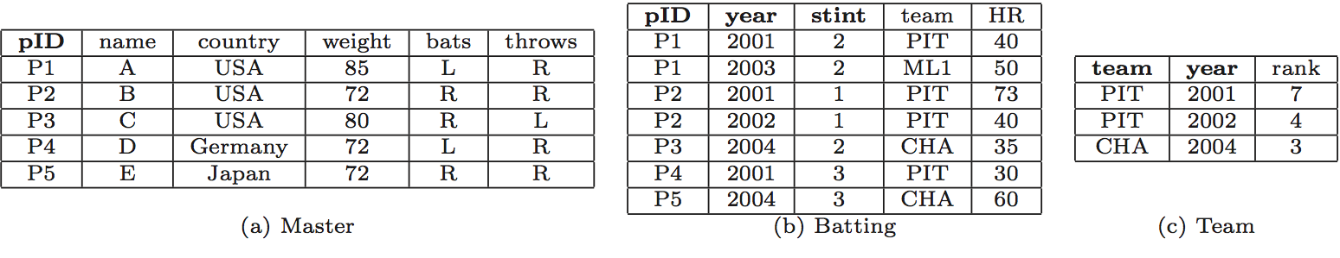
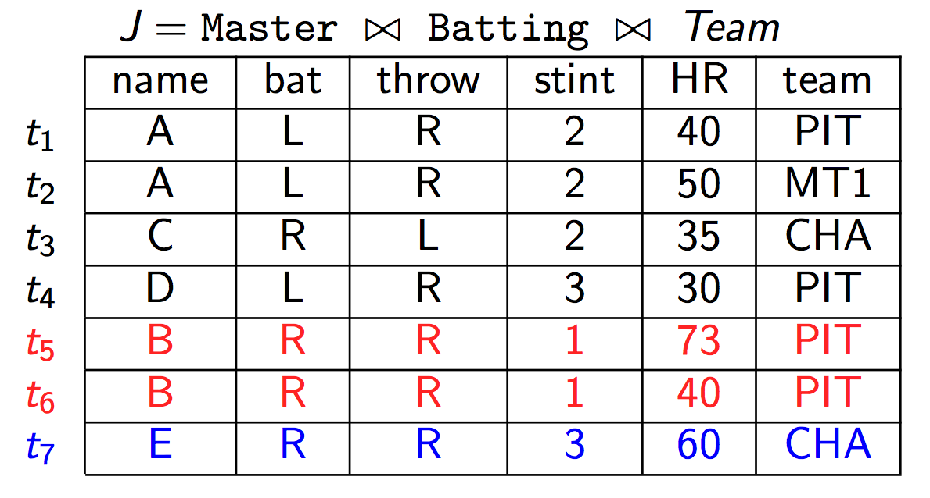
TALOS
[Tran et al. 2013]
Join table
Input
B | PIT
E | CHA
Master
Batting
Team
Join graph computation

Slide 19
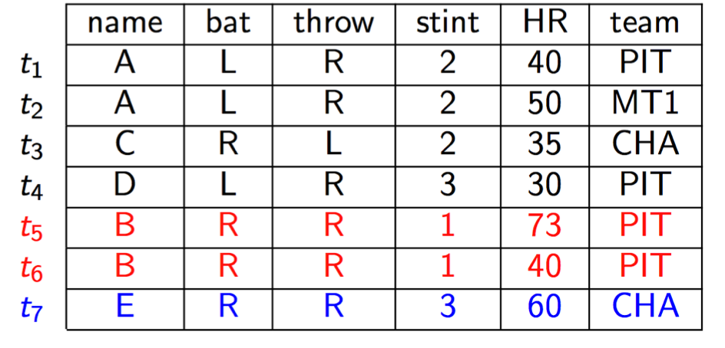
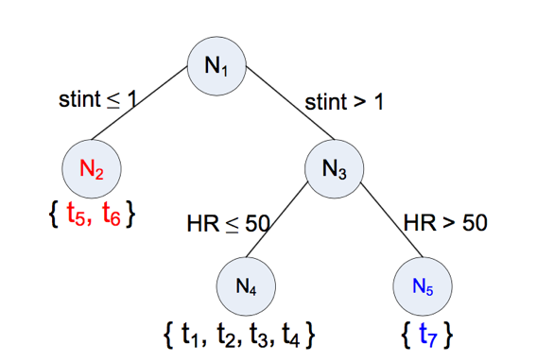
TALOS
[Tran et al. 2013]
Idea: treat the problem as a binary classification
Strict: all tuples must be captured
At-Least-one: one tuple for example must be captured
$$Gini\left(S\right)=1−{(f}_{+}^{2}+f_{−}^{2})$$
Positive and negative tuples in S
$$Gini\left(S_{1},S_{2}\right)=\frac{\left(\left|S_{1}\right|Gini\left(S_{1}\right)+{|S}_{2} | Gini\left(S_{2}\right)\right)}{\left|S_{1}\right|+\left|S_{2}\right|}$$
Decision tree

Slide 20
How complex is exact REQ?
[Weiss et al., 2017]
Relational Operators:
Database $D$
$σ$ selection $\{=,≠,≥,≤\}$
$π$ projection
$⋈$ natural join
$Q$ such that results contain
All positive examples
No negative example
$E^{+}$ Positive examples
$E^{−}$ Negative examples
REQ
How difficult is to find:
A bounded size Q? an unbounded Q?

Slide 21
Complexity - No parameters
[Weiss et al., 2017]
Operator | Unbounded Queries | Bounded Queries
$$π$$ | P | P
$$⋈$$ | P | NPC
$$σ$$ | P | NPC
$$σ,⋈$$ | P | NPC
$$π,σ$$ | NPC | NPC
$$σ,⋈$$ | DP | DP
$$π,σ,⋈$$ | DP | DP
Only projections: Easy
Unbounded selections: Easy
Unbounded selections: HARD
Combination of operators: HARD!!!

Slide 22
Unbounded Select
[Weiss et al., 2017]
A | B | C | D | E
1 | 2 | 3 | 4 | 5
1 | 3 | 2 | 3 | 4
2 | 4 | 4 | 1 | 3
5 | 3 | 2 | 4 | 2
4 | 2 | 3 | 1 | 2
2 | 2 | 4 | 3 | 2
1 | 1 | 2 | 1 | 5
1 | 5 | 4 | 2 | 3
Possible queries?
☑
☒
A = 1 AND
B ≥ 1 AND B ≤ 5 AND
☒
C ≥ 2 AND C ≤ 4 AND
D ≥ 1 AND D ≤ 4 AND D ≠ 4
☑
E ≥ 3 AND E ≤ 5 AND E ≠ 4
☑

Slide 23
Bounded select
Reduction from
Set Cover
NP-C
INPUT: Database D, Examples E, Query size k
OUTPUT: Does there exist a query satisfying D and E, of size at most k?
U = {1,2,3,4,5} S = { {1,2,3}, {2,4}, {3,4}, {4,5} }
S
S
S
S
1
2
3
4
☒
1
0
0
0
☒
1
1
0
0
☒
1
0
1
0
☒
0
1
1
1
☒
0
0
0
1
☑
0
0
0
0

Slide 24
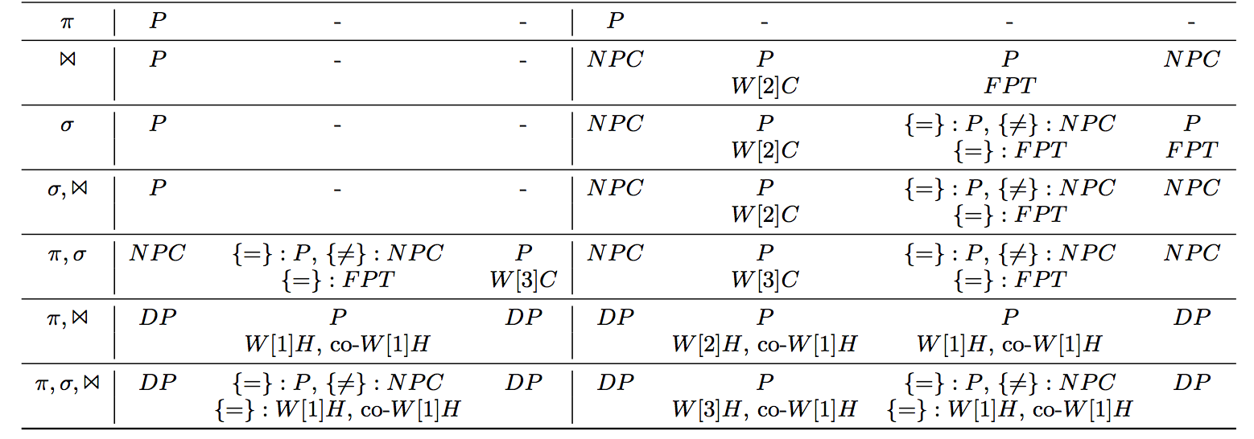
Complexity - Parameters
No param | Schema | Examples | No param | Query | Schema | Examples

Slide 25

Interactive REQ – Query from Examples
[Li et al., 2015]
Main idea: Interactively remove candidate queries proposing a new set of query results from a modified database
Use QBO
Modified database and results
Query
Results
REQ
Database
Refinement
Reverse engineered
Queries Q’

Slide 26

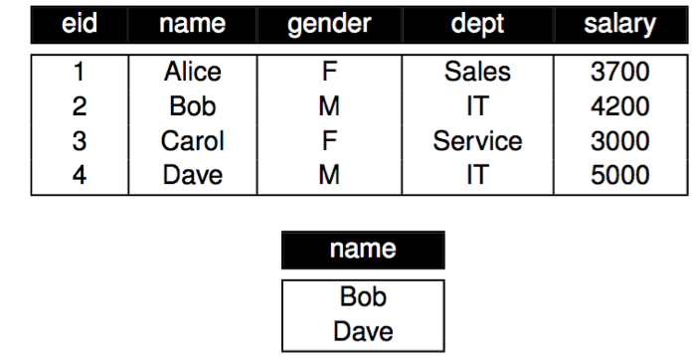
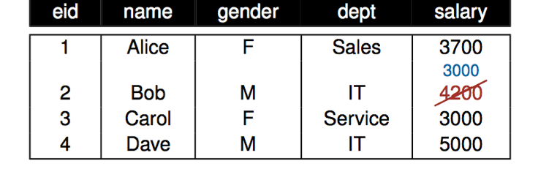
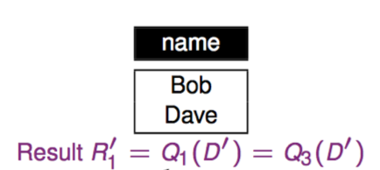
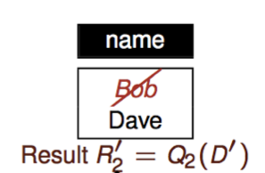
Database Refinement
[Li et al., 2015]
Results
Database
Refinement
REQs =
$Q_{1}=σ_{gender=M}\left(D\right)$
$Q_{2}=σ_{salary>3700}\left(D\right)$
$Q_{3}=σ_{dept=IT}\left(D\right)$

Slide 27
Cost model
[Li et al., 2015]
Number of modified tables
Number of new result sets
$$cost\left(D^{′}\right)=edit\left(D,D^{′}\right)+β⋅n+\sum_{i=1}^{k}{edit\left(R,R_{i}\right)+N⋅\frac{edit\left(D,D^{′}\right)}{μ}+β+\frac{2}{k}\sum_{i=1}^{k}{edit(R,R_{i})}}$$
Effort to examine D’
Effort to examine new results
DB cost
Results cost
Current cost
Residual cost
Main idea: Find a refined db D’ and results $R_{1}, …R_{k}$with:
Minimum number of results k
Minimum differences i the database
The query are balanced (less interactions)

Slide 28
Minimal Project Join REQ
[Shen et al., 2014]
Main idea: Find the set of queries that approximately return a set of examples
Partial query table
Minimal PJ
Queries Q’
 | A | B | C
1 | Mike | ThinkPad | Office
2 | Mary | iPad
3 | Bob |  | Dropbox
valid: every tuple is present in query results
minimal: any removal in query tree gets to an invalid query

Slide 29
Candidate Query Generation
[Shen et al., 2014]
  Use candidate network generation algorithm (Hristidis 2002)
 | A | B | C
1 | Mike | ThinkPad | Office
2 | Mary | iPad
3 | Bob |  | Dropbox
CQ₁
Sales
CQ₂
Owner
CQ₃
Owner
A
B
C
A
B
C
A
B
Generate join tree $J$
Generate mapping $φ$
Check minimal:
  - Every leaf node contains a column that is mapped by an input column
Customer
Device
App
Employee
Device
App
Employee
Device
C
ESR
CQ₄
Owner
CQ₅
Owner
C
B
A
B
App
Device
Employee
Device
App
ESR
C
A
ESR
Employee

Slide 30
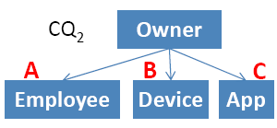
Validity verification
[Shen et al., 2014]
Naïve: check all candidate queries singularly if they return ALL examples
Candidate query
Better: exploit substructures in candidate queries for pruning
Substructures
Sub 1
Owner
Best: adaptively select the substructures to have the min number of evaluations
Sub 1 fails => $CQ_{2}$ invalid
A
B
Employee
Device
NP-hard
Owner
Sub 1 fails =>
Sub 2 fails
Sub 2
A
B
C
Employee
Device
App

Slide 31
Minimal Project Join REQ
[Psallidas et al., 2015]
Main idea: Allow missing rows/columns and rank the k best queries
Output: Top-k PJ Queries
Sales
Products
Customers
Partial query table
S4
Name
First Name
Last Name
Sales
 | A | B | C
1 | John | Smith | Xbox
2 | Jill | Hans | Surface
Products
Customers
Name
Last Name
City
Name

Slide 32
Ranking score
[Psallidas et al., 2015]
Linear combination of row score and column score
$α=1$ penalizes missing rows
$α=0$ penalizes missing columns
$$\frac{α∗score_{row}\left(Q\right)+\left(1−α\right)∗score_{col}\left(Q\right)}{\left|Q\right|}$$
Row score
Sales
Sales
 |  |  | Row Score
John | Smith | Xbox | 3 | 3
Jill | Hans | Surface | 2 | 1
 |  |  | 5 | 4
Products
Customers
Products
Customers
City
Name | First Name | Last Name
Xbox | John | Smith
iPhone | Michael | Douglas
Surface | Jill | Johnson
Name | City Name | Last Name
Xbox | St. John | Smith
iPhone | Montpellier | Douglas
Surface | Redmond | Johnson
Column score
Sales
Sales
 | John | Smith | Xbox
 | Jill | Hans | Surface
Column Score | 2 | 1 | 2 | 5
 | 2 | 1 | 1 | 4
Products
Customers
Products
Customers
Name
First Name
Last Name
City
Xbox
iPhone
Surface
John
Jill
Michael
Smith
Johnson
Douglas
Name
City Name
Last Name
Xbox
iPhone
Surface
St. John
Montpellier
Redmond
Smith
Johnson
Douglas

Slide 33
S4 Optimizations
[Psallidas et al., 2015]
Row score is always bounded by the column score
(row containment is more restrictive)
Exploit inverted indexes on columns/rows
Upper bound
Stop when current upper bound score is less than the k-th ranked evaluated query
Scan queries on decreasing upper bound
Early termination
Caching
Reuse common subparts in the candidate queries

Slide 34
Reverse engineering queries (REQ)
Lack of user models!
REQ
Exact
Approximate
One-shot
Interactive
Minimal
Top-k
Query by output - TALOS
REQ SPJ queries from examples
Query From examples (QFE)
Interactive inference of join queries
Discovering Queries based on Examples
S4: Top-k Spreadsheet style

Slide 35
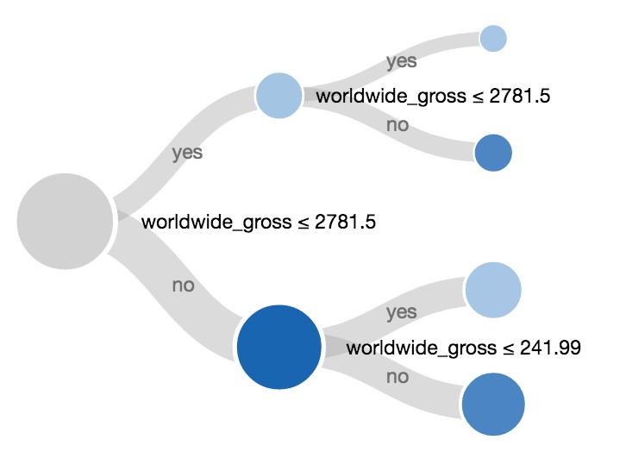
Examples for query suggestion: Blaeu
[Sellam et al., 2016]
Main idea: Allow interactive navigation of the query space in a hierarchy
Query Results
or Query
Blaeu
Query navigations

Slide 36
Examples for query suggestion: Blaeu
[Sellam et al., 2016]
Query results
Given a result of an example query Q, explore the data through data maps = partitions
Attribute 2
Output: Set of query refinements
Attribute 1
Problem: User utility is unknown
$$u:DB→\left\{−1,1\right\}, U\left(Q\right)=\sum_{t∈Q}{u(t)}$$
Cluster analysis for result exploration
Zoom and projection operations
User model
User utility

Slide 37
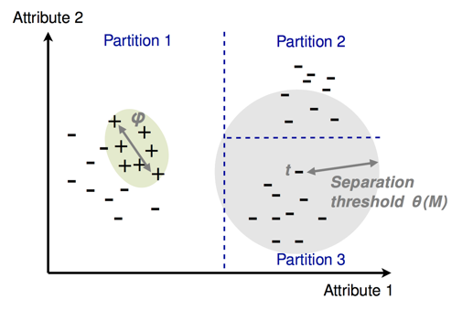
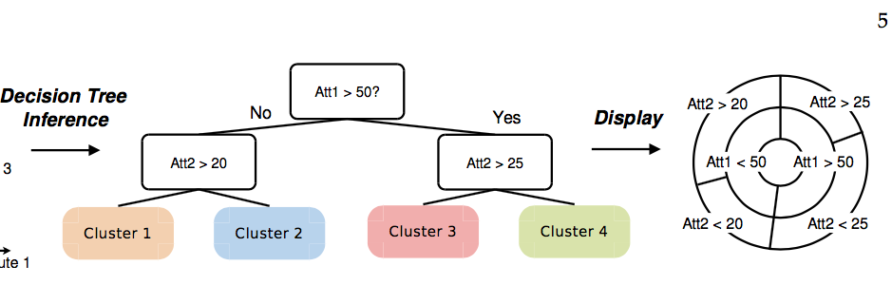
Examples for query suggestion: Blaeu
[Sellam et al., 2016]
$$u:DB→\left\{−1,1\right\}, U\left(C\right)=\sum_{t∈C}{u(t)}$$
Find the partition $𝒞=\left\{C_{1},…,C_{n}\right\}$ of the results of Q such that exists $C_{j}∈𝒞:U\left(C_{j}\right)>U(Q)$
Unknown User utility
Solution: interesting tuples are close to each other
within a maximum separation threshold $θ(𝒞)$
Detect clusters
(k-medoid)
Organize clusters
(decision tree)
Inference

Slide 38
Where we are
Relational databases
Machine learning
Textual data
Graphs and networks
Challenges and Remarks

Slide 39
Examples for textual data
Few methods for textual data using examples
Snowball [Agichtein 2000]
DIPRE [Brin 1999]
Entity Extraction
Web table
completion
Search by example
[Hanafi 2017]
[Yakout 2013]
Serendipitous search
Using example queries
[Bordino 2013]
[Zhu 2014]

Slide 40
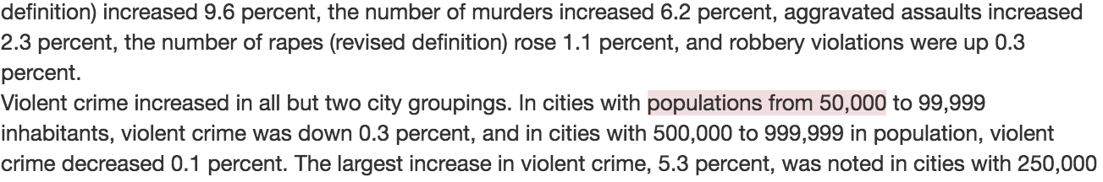
Entity extraction by-example (SEER)
[Hanafi et al., 2017]
Main idea: Create rules to extract wanted information from documents using examples
SEER
Output: Extraction rules
P: Percentage = 1.0
= 1.0
D: {5, 6} = 0.4
D: {percent, %} = 0.4
= 0.4
R: [0-9]+ = 0.2
D: {percent, %} = 0.4
= 0.3

Slide 41
Learning rules
[Hanafi et al., 2017]
Example:
5 percent up
Enumerate possible primitives per example token
Assign scores to primitives
5
P: Number
percent
L: ‘percent’
P: Integer
R: [A-Za-z]+
…
L: ‘5’
T: 0-1
R: [0-9]+
Token gap
≺
Literal
≺
Pre-builts
Regex
Dictionary
≺
≺
Dubai
:
T: 0-1
L: ‘Dubai’
P: City
0
1

Slide 42
Learning rules (cont’d)
[Hanafi et al., 2017]
3. Generate rules
4. Merge
Example:
5 percent
Example:
6%
Tokens:
5
percent
P: Percentage = 1.0
L: ‘%’ = 0.4
Tree:
P: Percentage = 1.0
L: ‘6’ = 0.4
R: symbols = 0.2
L: ‘percent’ = 0.4
L: ‘%’ = 0.4
L: ‘5’ = 0.4
R: [0-9]+ = 0.2
R: [A-Za-z]+ = 0.2
R: symbols = 0.2
R: [0-9]+ = 0.2
L: ‘percent’ = 0.4
Rule:
R: [A-Za-z]+ = 0.2
R: [0-9]+ = 0.2
L: ‘percent’ = 0.4
Intersection:
[5 percent, 6%]
P: Percentage = 1.0
D: {5, 6} = 0.4
D: {percent, %} = 0.4
R: [0-9]+ = 0.2
D: {percent, %} = 0.4

Slide 43
Web tables completion (InfoGather)
[Yakout et al., 2012]
Main idea: Complete tables using partial information about tuples
Model | Brand
S80 | Nikon
Easyshare CD44 | Kodak
DSC W570 | Sony
Optio E60 | Pentax
Part No | Mfg
DSC W570 | Sony
T1460 | Benq
Optio E60 | Pentax
S8100 | Nikon
Web tables
Part No | Mfg
DSC W570 | Sony
T1460 | Benq
Optio E60 | Pentax
S8100 | Nikon
Model | Brand
S80
A10
GX-1S
T1460
Model | Brand
S80 | Benq
A10 | Innostream
GX-1S | Samsung
T1460 | Benq
InfoGather
Incomplete table
Complete table

Slide 44
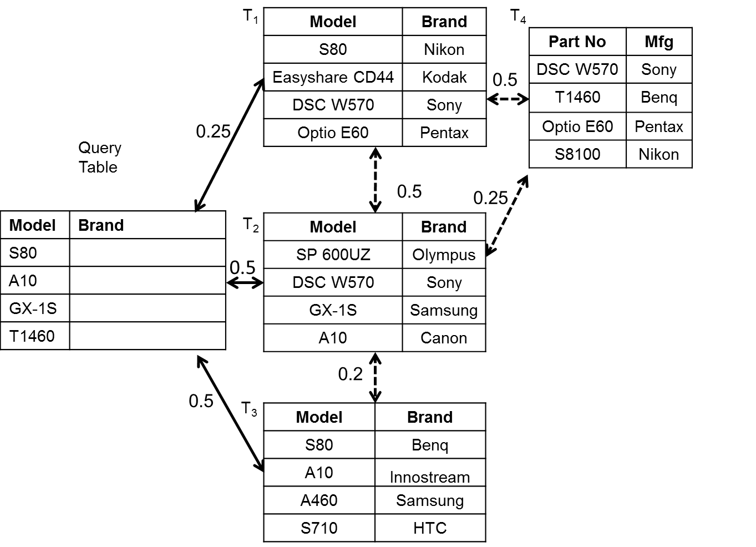
Augmentation framework
[Yakout et al., 2012]
Direct Match Approach (DMA)
  Traditional schema matching techniques using the attribute names and the values in the column
$$S_{DMA}\left(T\right)=\left\{\begin{matrix}\frac{|T∩_{K}Q|}{min(\left|Q\right|, |T|)} & & if Q.A≈T.B \\ 0 & & otherwise\end{matrix}\right.$$
Web tables
Input
Indirect matching table

Slide 45
Ranking tables using PageRank
PageRank
Personalized PageRank (PPR)
$π_{u}\left(v\right)=ε δ_{u}\left(v\right)+\left(1−ε\right)\sum_{\{w|\left(w,v\right)∈E\}}{π_{u}\left(w\right)α_{w,v}}$
Topic Sensitive Pagerank (TSP)
$π_{\vec{β}}\left(v\right)=ε \vec{β}+\left(1−ε\right)\sum_{\{w|\left(w,v\right)∈E\}}{π_{\vec{β}}\left(w\right)α_{w,v}}$
Adjacency matrix
Query Table
Nodes ➔ Web Tables
Edges ➔ Tables Similarity
Topic vector
Topic weight ➔ DMA score

Slide 46
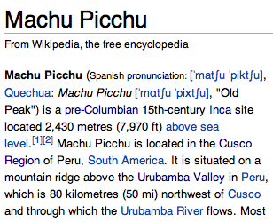
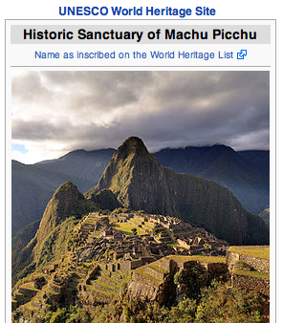
Serendipitous search
[Bordino et al., 2013]
Main idea: Use related entities and query logs to find serendipitous searches
America
Peru
Francisco Pizarro
Rafting
Amazon
...
Query
Logs
Machu Picchu
Connected entities
rafting excursion down the urubamba river
el dorado temple of sun
indios quechuas
map of peru
sapa inca
Serendipitous
Search
Searches related to Document content
Document

Slide 47
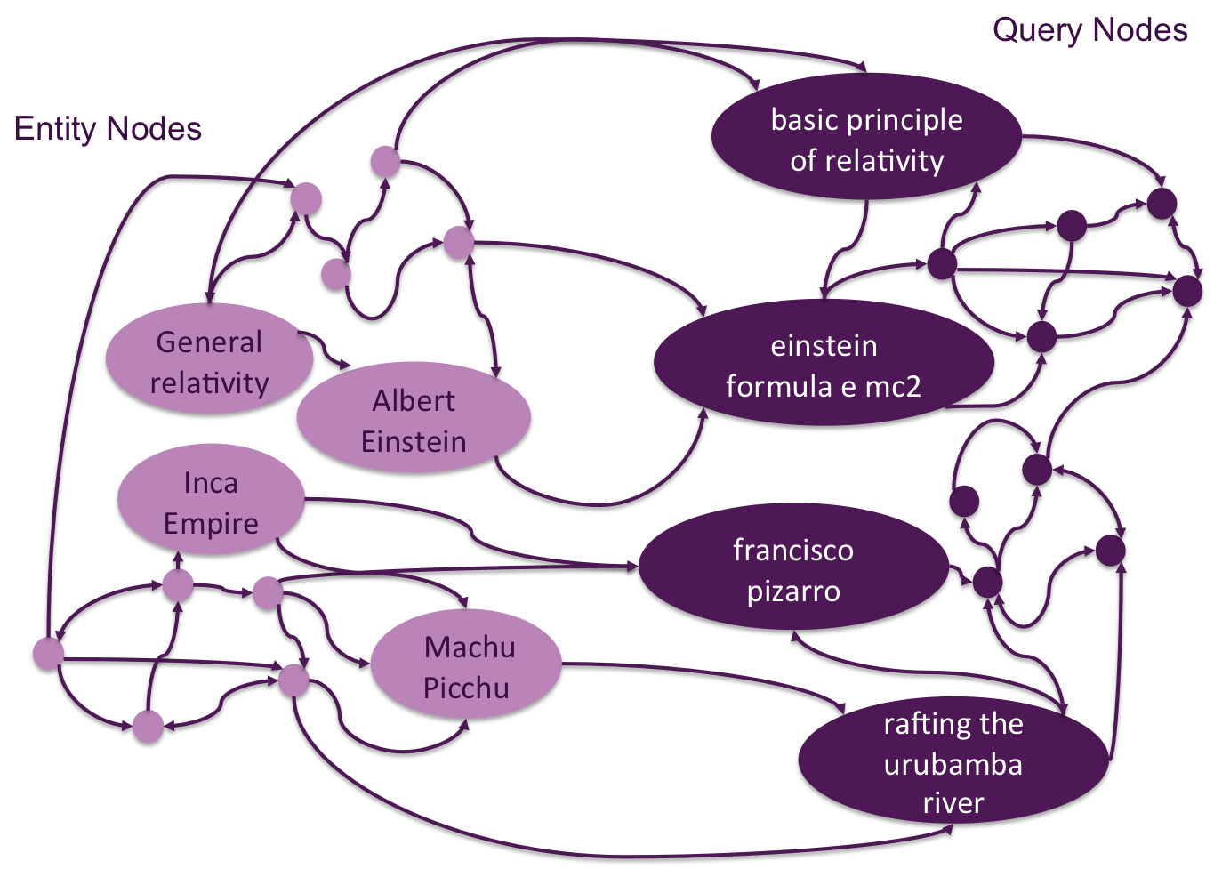
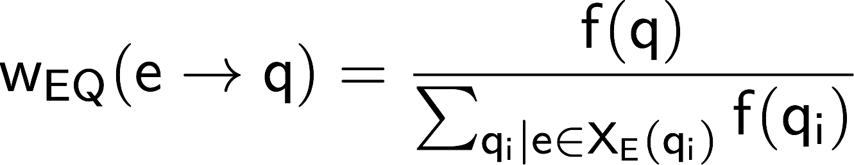
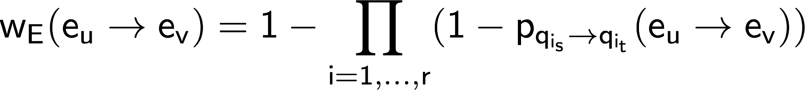
Find queries using entity-query graph
[Bordino et al., 2013]
Query-flow graph with entity nodes
Three types of arcs:
1. query to query:
2. entity to query
3. entity to entity
Frequency-based approach
The more queries entities share the higher the probability
Idea: Run Personalized PageRank on entity-query graphs

Slide 48
Search by multiple examples
[Zhu et al., 2014]
Main idea: Document examples are used to find topics
Action Movies
- Mission impossible
- Die Hard
- …
Chuck Norris
Search by examples
Arnold Schwarzenegger
Action Actors
- Bruce Willis
- Tom Cruise
- …
…
Related topics and documents

Slide 49
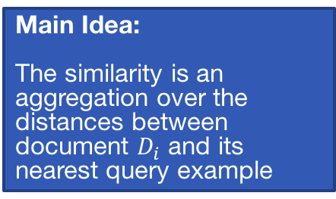
Nearest neighbor approach
[Zhu et al., 2014]
Main Idea:
The similarity is an aggregation over the distances between document $D_{i}$ and its nearest query example
Tb
Query Examples
B
D1
Tc
D3
Centroid
A
Ta
D2

Slide 50
Where we are
Relational databases
Machine learning
Textual data
Graphs and networks
Challenges and Remarks

Slide 51
Graphs
Fact Graph
Ontology Tree
Arnold Schwarzenegger
is A
Person
actedIN
is A
subClassOf
Terminator
Actor
Release | 1984
Budget | $6.4M
Length | 1h 48m
Notes:
There are : nodes & edges
Nodes are either Entities, Types (or classes) , and (rarely) Literal Values
Nodes (Entities) can also have atributes (Height, Age, title PhD)
In social graphs edges are of the same type (friends Of, follows),
A knowledge graph instead can be seen as divided into the FactGraph and an Ontology Tree
They are usually represented as triples, like in the RDF format, where each tripe is (subject, predicate, object).

Slide 52
Graphs
Arnold Schwarzenegger
is A
Person
actedIN
is A
subClassOf
Terminator
Actor
(subject,predicate,object)
(Arnold_Schwarzenegger,isA,Person)
(Actor, subClassOf, Person)
(Arnold_Schwarzenegger, actedIn, Terminator)
RDF
Fact Graph
Ontology Tree
Notes:
There are : nodes & edges
Nodes are either Entities, Types (or classes) , and (rarely) Literal Values
Nodes (Entities) can also have atributes (Height, Age, title PhD)
In social graphs edges are of the same type (friends Of, follows),
A knowledge graph instead can be seen as divided into the FactGraph and an Ontology Tree
They are usually represented as triples, like in the RDF format, where each tripe is (subject, predicate, object).

Slide 53
Exemplar Queries
[Mottin et al., 2014]
Input: $Qe$, an example element of interest
Output: set of elements in the desired result set
Exemplar Query Evaluation
evaluate $Qe$ in a database D, finding a sample S
find the set of elements A similar to S given a similarity relation
Nodes/Entities
Edges/Facts
Structures

Slide 54
Exemplar Queries
[Mottin et al., 2014]
Input: $Qe$, an example element of interest
Output: set of elements in the desired result set
Exemplar Query Evaluation
evaluate $Qe$ in a database D, finding a sample S
find the set of elements A similar to S given a similarity relation
[OPTIONAL] return only the subset A^{R} that are relevant
Nodes/Entities
Edges/Facts
Structures

Slide 55
SIMILARITY
Nodes
Structures
Connectivity
Properties
Queries
(Edge-)Labels
Mediator Nodes
[Ruchansky’15]
Entity Search
[Metzger’13,
Sobczak’15]
Path Queries
[Bonifati’15]
Entity Tuples
[Jayaram’15]
Clusters
[Perozzi’14]
SPARQL
[Arenas’16]
Graph Structures
[Mottin’14]
CHALLENGE: DISCOVER USER PREFERENCE
CHALLENGE: EFFICIENT SEARCH

Slide 56
The Minimum Wiener Connector Problem
[Ruchansky, et al., 2015]
Model: Unlabeled Undirected Graph
Query: A set of Nodes Q
Similarity: Shortest-Path distance
Output: A Set of Connector Nodes H
“explains” connections in Q
Connectors:
Nodes with HIGH closeness
to ALL the inputs
Case: Infected Patients
→ Culprit/Other Infected
Similar to a Steiner-Tree but
overall pairwise distances are optimized
Case: Target Audience
→ Influencers
Notes:
This is similr

Slide 57
The Minimum Wiener Connector Problem
[Ruchansky et al., 2015]
Model: Unlabeled Undirected Graph
Query: A set of Nodes Q
Similarity: Shortest-Path distance
Output: A Set of Connector Nodes H
Called: Wiener Index.
tradeoff between size
and average distance
Sometimes The Best Solution is NOT A Tree
W=1+2+1 =4
NP-Hard
minimize the sum of pairwise shortest-path-distances
between nodes in the connector H
W=1+1+1 = 3
d(u, v) is the shortest-path distance

Slide 58
Approximate minimum Wiener Index Connector
[Ruchansky et al., 2015]
Approximated with
Edge-Weighted SteinerTree
CHOOSE r & λ ∈ [1, log_{(1+β)} |V| ]
All Pairwise Distances
Enumerate Candidate Solutions for r ∈ Q & λ
and keep best
Distances from a root r
Measure distance in H
Precomputed distance in G
r
Edge Weights
w(u, v) =

Slide 59
Focused Clustering and Outlier Detection
[Perozzi et al., 2014]
PhD
NYC
English
Google
PhD
NYC
Greek
SAP
Model: Unlabeled Undirected Graph
with Node Attributes
Query: A set of Nodes Q
Similarity: Attribute Values & Connectivity
(to be inferred)
Output: Clusters of Nodes: Dense & Coherent
+Cluster Outliers
College
Paris
Dutch
Google
College
NYC
English
Google
PhD
NYC
Italian
IBM
Case: Target Users → Community with same interests
PhD
NYC
French
SAP
Case: Products→ Co-purchased products with similar features

Slide 60
Focused Clustering and Outlier Detection
[Perozzi et al., 2014]
PhD
NYC
English
Google
TASK: Infer “FOCUS” , important attributes
attribute weights β
1. Set of similar pairs, PS (from Q)
2. Set of dissimilar pairs, PD (random sample)
3. Learn a distance metric between PS and PD
( Distance Metric Learning, inverse Mahalanobis distance: Xing, et al 2002)
PhD
NYC
Greek
SAP
College
Paris
Dutch
Google
PhD
NYC
English
Google
PhD
NYC
French
SAP
0.5
0.5
0
0
College
NYC
English
Google
PhD
NYC
Italian
IBM
PhD
NYC
French
SAP

Slide 61
Focused Clustering and Outlier Detection
[Perozzi et al., 2014]
LOCAL
clusters
TASK: Extract Clusters on Focused Graph
attribute weights β -> Edge Weight
1. Find Starting Set of Candidates
1.a Drop low-weight edges
1.b Extract Strongly Connected Component C_{1,} C_{2, …}
2. Grow Clusters around Candidates
2.a Compute conductance of C: φ^{(w)} (C, G)
2.b Select node to add to C’: best improvement to ∆φ^{(w)} (C,C’) (greedy)
2.c Prune Underperforming nodes
3. Detect Outliers: High unweighted conductance
Seed

Slide 62
SIMILARITY
Nodes
Structures
Connectivity
Properties
Queries
(Edge-)Labels
Mediator Nodes
[Ruchansky’15]
Entity Search
[Metzger’13,
Sobczak’15]
Path Queries
[Bonifati’15]
Entity Tuples
[Jayaram’15]
Clusters
[Perozzi’14]
SPARQL
[Arenas’16]
Graph Structures
[Mottin’14]
✓

Slide 63

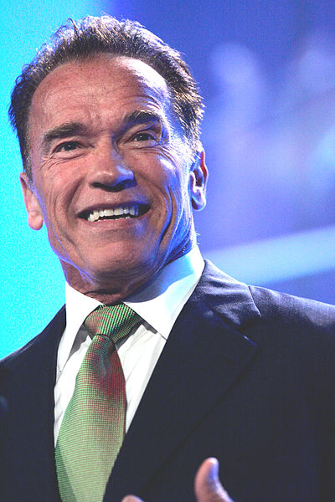
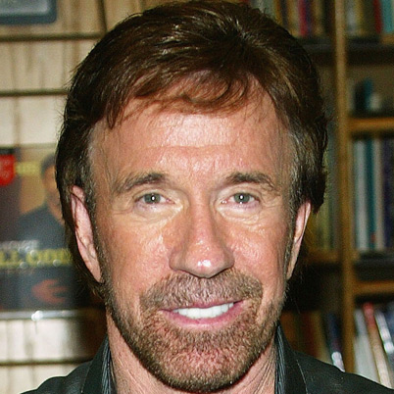

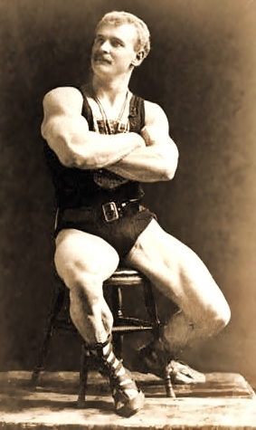


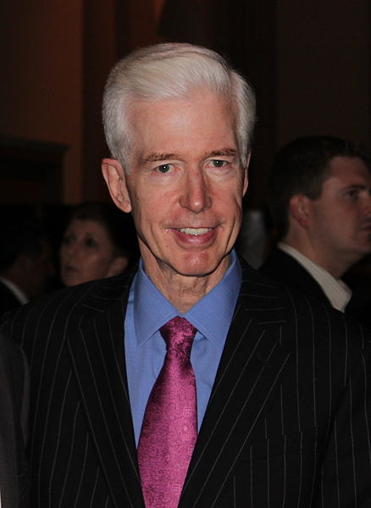
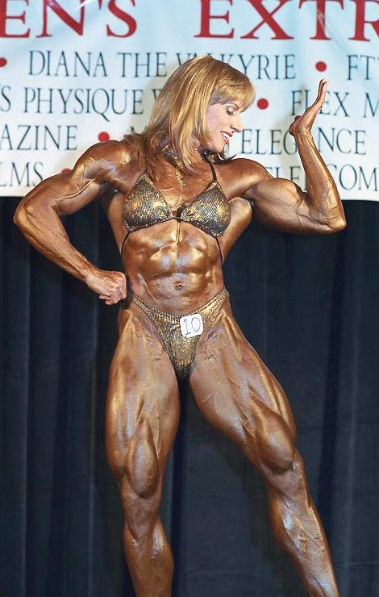
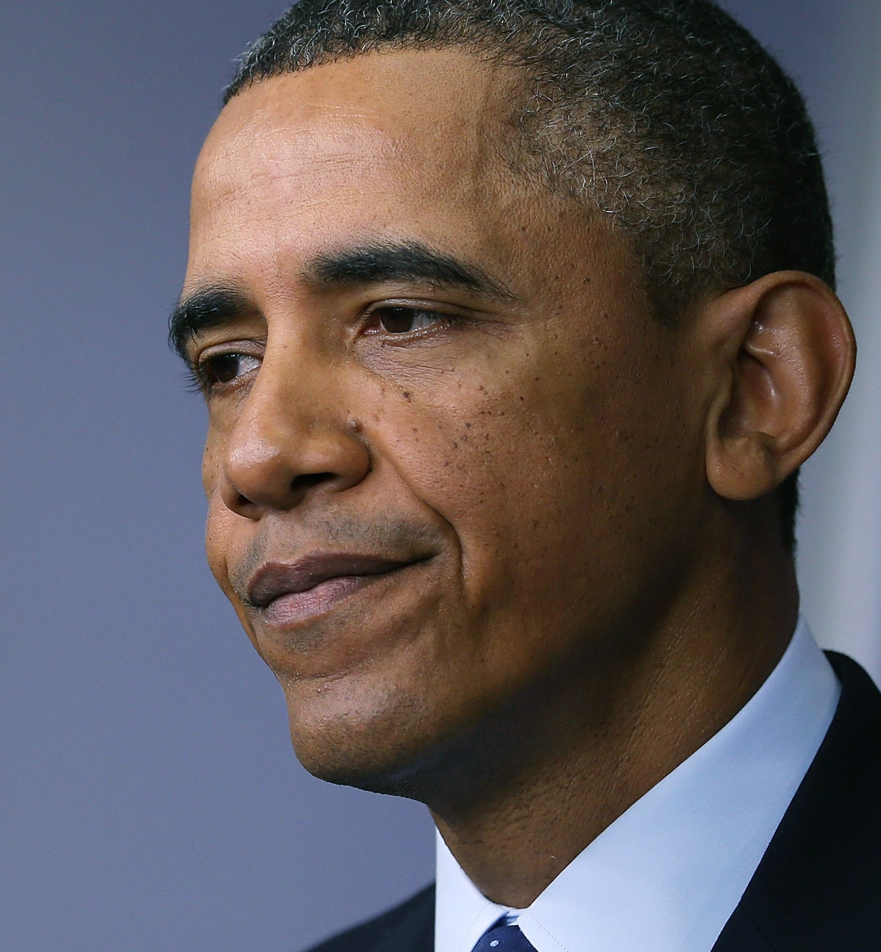
iQBEES: Entity Search by Example
[Metzger et al., 2013, Sobczak et al., 2015]
Model: Knowledge Graph
Query: A set of Entities Q
Similarity: shared semantic properties
Output: A Set of Similar Entities
ranked
Entity 1:
?
Entity 2:
?
?
Case: Products→ Find Similar Products
Case: Social Media→ User recommendation

Slide 64
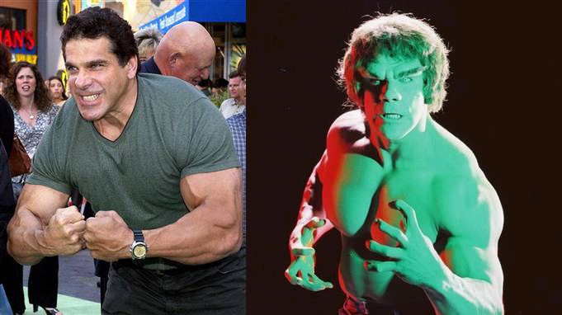
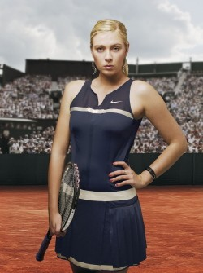
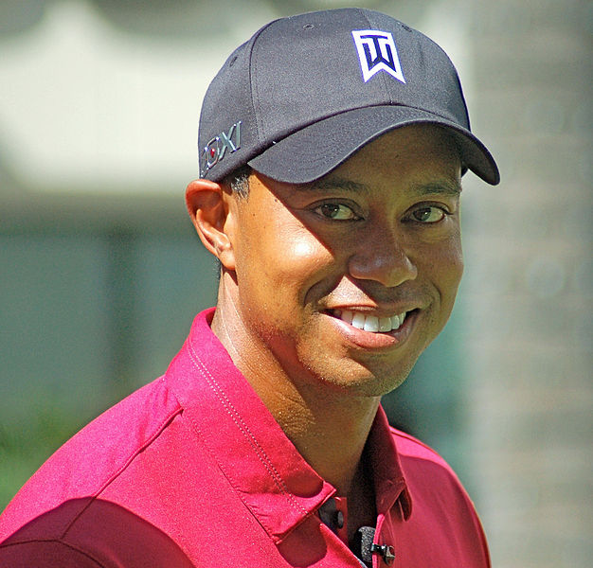

Maximal Aspects
[Metzger et al., 2013, Sobczak et al., 2015]
Adding any aspect
→ E(A)={Arnold}
?x type BodyBuilder
?x type AmericanActor
Include
Typical Types
?x type AmericanActor
?x type GovernorCalifornia
Prune
generic
aspects
?x hasHeight 1.88m
use most specific type
?x type Entity
Rank
Set of
aspects
?x type AmericanActor
REPEATABLE
Update Q
?x actedIn TheExpendables
?x type ActionActor

Slide 65
SIMILARITY
Nodes
Structures
Connectivity
Properties
Queries
(Edge-)Labels
Mediator Nodes
[Ruchansky’15]
Entity Search
[Metzger’13,
Sobczak’15]
Path Queries
[Bonifati’15]
Entity Tuples
[Jayaram’15]
Clusters
[Perozzi’14]
SPARQL
[Arenas’16]
Graph Structures
[Mottin’14]
✓
✓

Slide 66
Learning Path Queries on Graphs
[Bonifati et al., 2015]
Tram
Model: Edge Labeled Graph
Query: 2 sets of Entities Q⁺ , Q⁻
Positive, Negative
Similarity: common path query (RegExp)
(bus|tram)*Cinema
Output: A Set of Nodes Satisfying
some paths(Q⁺) but NOT paths(Q⁻)
X
✓
+
Tram
Tram
Tram
Bus
Bus
+
Walk
✓
-
Walk
Shop
Cinema
Walk
S₁
Shop
X
C₁
Case: Proteins→ Similar interactions/co-expression
MONADIC: only starting nodes
extensible to
BINARY/ N-ARY : path from X to Y
Case: Tasks Initiator→ Similar Processes/Behaviours

Slide 67
Learnability of Path Queries
[Bonifati et al., 2015]
Consistency Check:
PSPACE-complete
Query: Q⁺ & Q⁻ (Positive & Negative examples)
Consistecy:
1. Selecting the Smallest Consistent Paths
Infinite Paths? Fix maximal length K but…
When to use Kleene star * ?
2. Generalize SCP
a. Construct Prefix-Tree Acceptor
b. Generalize into DFA with Merge
Enumerate Paths
Up to Fixed distance
For paths of Length N
K = 2 ⅹ N +1
C | ( A﹒B﹒C) → ( A﹒B)*﹒C
PTA
DFA

Slide 68
Reverse engineering SPARQL queries
[Arenas et al., 2016]
Model: Knowledge Graph
Query: Set of ANSWERS*
Similarity: common AND/OPT/FILTER query
Output: A SPARQL QUERY/RESULT
Mexico
Spanish
Haiti
Jamaica
English
Case: Open Data→ Query Unknown Schema
 | ?e1 | ?e2
M1 | Mexico | Spanish
M2 | Haiti
M3 | Jamaica | English
Case: Novice User → Avoid SPARQL

Slide 69






Reverse engineering SPARQL queries
[Arenas et al., 2016]
Enumerate all possible
SPARQL queries satisfied
by the mappings
Query: Set of Variable Mappings
 | ?X | ?Y | ?Z
M1 | John
M2 | Mary | mary@email.eu
M3 | Lucy |  | Roses Street
INTRACTABLE
Build tree-shaped
SPARQL queries IMPLIED
by the mappings

Slide 70
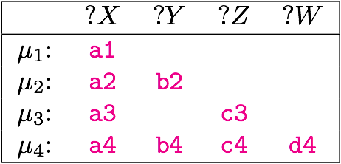



















Reverse engineering SPARQL queries
[Arenas et al., 2016]
Query: Set of Variable Mappings Ω
{M1,M2,M3,M4}
M1
M2
M3
M4
{M2,M4}
{M3,M4}
{M4}
M1
M2
M3
M4
Greedy: keep just enough to cover all variables
Notes:
Esmpi-> lattice ->trees

Slide 71
SIMILARITY
Nodes
Structures
Connectivity
Properties
Queries
(Edge-)Labels
Mediator Nodes
[Ruchansky’15]
Entity Search
[Metzger’13,
Sobczak’15]
Path Queries
[Bonifati’15]
Entity Tuples
[Jayaram’15]
Clusters
[Perozzi’14]
SPARQL
[Arenas’16]
Graph Structures
[Mottin’14]
✓
✓
✓

Slide 72
Exemplar Queries
[Mottin et al., 2014]
Model: Knowledge Graph
Input: Example Structure
Similarity: Isomorphism/Simulation
Output: A set of Graphs
Query:
Knowledge
Graph
S
A1
A2
Notes:
Q1, Q2 are user queries

Slide 73
Computing exemplar queries
NP-complete
(subgraph isomorphism)
[Mottin et al., 2014]
$O\left({\left|V\right|}^{4}\right)$(simulation)
Pruning technique:
Compute the neighbor labels of each node
Prune nodes not matching query nodes neighborhood labels
Apply iteratively on the query nodes
v
A
A
A
  $$W_{n,a,i}=\left\{n_{1} | l\left(n_{1},n_{2}\right)=a∨∈N_{i−1}\left(n\right)\right\}$$
X
B
B
B
A
u
Q
Sample
A1
B
A2
v neighborhood = {(B,1)}
$⊈$
u neighborhood = {(A,1)}
Labels at distance 1
No Match
D. Mottin, M. Lissandrini, T. Palpanas, Y. Velegrakis

Slide 74
Computing exemplar queries
NP-complete
(subgraph isomorphism)
[Mottin et al., 2014]
$O\left({\left|V\right|}^{4}\right)$(simulation)
Approximation:
Nodes closed to the sample are more important
Use Personalized PageRank with a weighted matrix
Weight edges: frequency of the edge-label
v
Sample
A1
A2
D. Mottin, M. Lissandrini, T. Palpanas, Y. Velegrakis

Slide 75
Ranking results
[Mottin et al., 2014]
User Query
Google
Yahoo!
CBS
S
A1
A2
Combination of two factors
Structural: similarity of two nodes in terms of neighbor relationships
Distance-based: the PageRank already computed
Notes:
in this example the lighter the color, the furthest away the node is from the query

Slide 76
Graph query by example (GQBE)
[Jayaram et al., 2015]
Model: Knowledge Graph
Input: Entity Tuples
Similarity: Isomorphism
Output: A set of Tuples
In GQBE Input is a set of (disconnected) entity mention tuples
Q = (Google, S. Mateo)
Results =
(Yahoo, S. Clara)
(CBS, New York)
D. Mottin, M. Lissandrini, T. Palpanas, Y. Velegrakis

Slide 77
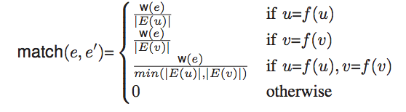
GQBE: Maximum Query Graph
[Jayaram et al., 2015]
Find the maximum query graph
  Graph with M edges having the maximum weight
Answers subgraph-isomorphic to the query graph
Return top-k
Q = (v₁,v₂)
0.1
0.2
0.1
z
v₁
u₂
0.4
0.7
0.1
0.8
NP-hard
0.5
0.3
v₂
u₁
Answer score:
Sum of query graph weights
Similarity match between edges in the answer and the query (shared nodes take extra credit)
0.5
Maximum Query Graph
Answer graph
D. Mottin, M. Lissandrini, T. Palpanas, Y. Velegrakis

Slide 78
Multiple query tuples
[Jayaram et al., 2015]
Subgraphs of
Maximum
Query graph
v₁
v₂
Maximum
Query Graph
is Very Large
v₁
v₂
v₁
v₂
v₁
v₂
v₁
v₂
Preserve the query connectivity
Find answers using a lattice obtained removing edges from the union graph
GQBE finds answers for multiple query tuples
Compute a re-weighted union graph of the individual query graphs
D. Mottin, M. Lissandrini, T. Palpanas, Y. Velegrakis

Slide 79
SIMILARITY
Nodes
Structures
Connectivity
Properties
Queries
Structures
Mediator Nodes
[Ruchansky’15]
Entity Search
[Metzger’13,
Sobczak’15]
Path Queries
[Bonifati’15]
Entity Tuples
[Jayaram’15]
Clusters
[Perozzi’14]
SPARQL
[Arenas’16]
Graph Structures
[Mottin’14]
Do not Include User Feedback

Slide 80
Where we are
Relational databases
Machine
learning
Textual data
Graphs and networks
Challenges and Remarks

Slide 81
Online exploration of datasets
Main idea: Learn the items to show online as more points are acquired
Two ways of learning: passive and active
items
Learn
v
items
Is t or ?
v
t
Learn
Passive
Active

Slide 82
MindReader
[Ishikawa et al., 1999]
Main idea: learn an implicit query from user examples and optional scores
Searching “mildly overweighted” patients
Weight
The doctor selects examples by browsing patient database
The examples have “oblique” correlation
We can “guess” the implied query
q
: good
: very good
Height

Slide 83
Learning an ellipsoid distance
[Ishikawa et al., 1999]
Weighted distance matrix
Euclidean
q
$D\left(x,q\right)={\left(x−q\right)}^{⊤}M(x−q)$
Implicit query
$$D\left(x,q\right)=\sum_{j}^{n}{\sum_{k}^{n}{m_{jk}(x_{j}−q_{j})(x_{k}−q_{k})}}$$
weighted
Euclidean
q
Learn the query minimizing the penalty = weighted sum of distances between query point and sample vectors
generalized
ellipsoid distance
$$minimize \sum_{i}{{\left(x_{i}−q\right)}^{⊤}M(x_{i}−q)}$$
$subject to\det\left(M\right)=1$
q

Slide 84
Learning the distance
[Ishikawa et al., 1999]
Query point is moved towards “good” examples — Rocchio formula in IR
Q₀: query point
: retrieved data
: relevance judgments
Q₁: new query point
Q₁
Q₀
Learning can be done online!!!

Slide 85
Active learning for online query systems
[Vanchinathan et al., 2015]
Main idea: the system “query” the user to understand her preferences
Get item
System
Ask user
preference
Learn unknown preferences and minimize the number of questions to the user

Slide 86
Learning unknown preferences
[Vanchinathan et al., 2015]
Problem: Find a set S that maximize the user preference within a budget (e.g., number of interactions)
User preferences
S (intended user set)
$$\arg{\max{\sum_{v∈S}{pref(v)}}}$$
$$subject to Cost\left(S\right)≤budget$$
Cost for the set S

Slide 87
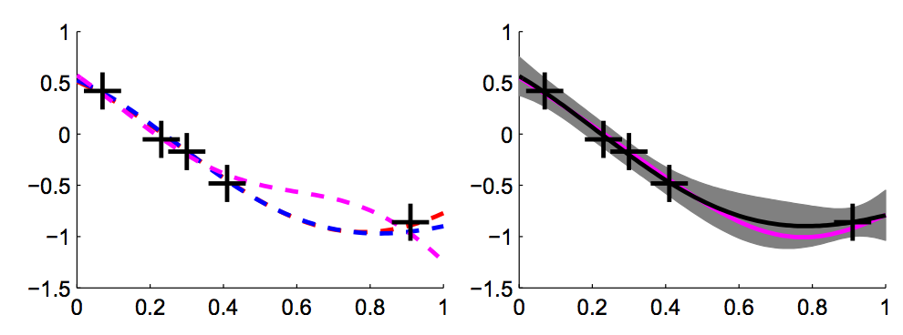
Background: Gaussian processes
[Bishop et al., 2006]
Idea: Model the user preferences as a Gaussian Process
A Gaussian Process (GP) is an infinite set of variables, any subset of this is Gaussian
$$P\left(f | Σ,μ\right)={\left|2πΣ\right|}^{\frac{1}{2}}\exp{(−\frac{1}{2}{\left(f−μ\right)}^{⊤}Σ^{−1}}(f−μ))$$
Gaussian prior
Specified only by mean and covariance
Given observations ${\left\{x,y\right\}}_{i=1}^{n}$ over an unknown function f drawn from a Gaussian prior, the posterior is Gaussian
$$P\left(f | y\right)∝\int{dx P(f,x,y)}$$

Slide 88
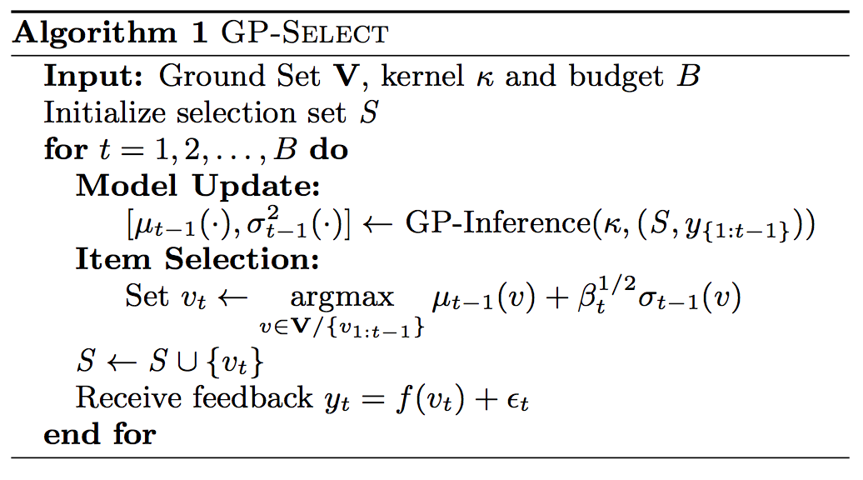
GP-Select
[Vanchinathan et al., 2015]
Learn posterior
Trades off exploration exploitation
Ask user feedback
Exploration: select items with high-variance
Exploitation: select items with high-value

Slide 89
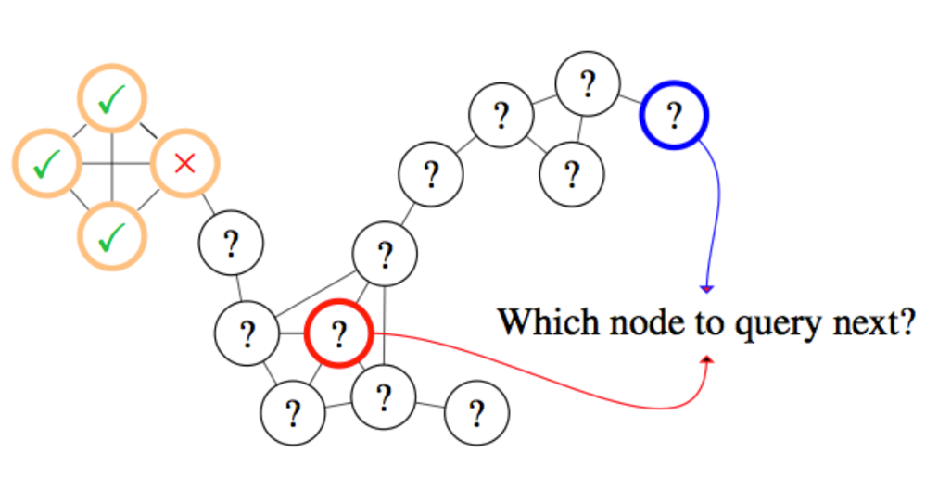
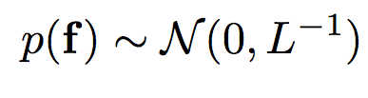
Active learning on graphs – which prior?
[Ma et al., 2015]
Idea: Use the graph structure to infer the node classes
Use graph Laplacian as prior
$L = D–A$, A is the adjacency matrix
Laplacian: higher probability of having the same class if two nodes are connected

Slide 90



Explore-by-Example: AIDE
[Dimitriadou et al., 2015]
Relevance Feedback
Relevant Samples
Irrelevant Samples
Data
Classification
User
Model
Samples
User
Model
Query Formulation
Space Exploration
SQL
Sampling
queries
Data Extraction
Query

Slide 91
The AIDE algorithm
[Dimitriadou et al., 2015]
Divide the space into d-dimensional cubes
Find the sample points in the cubes (medoids)
Train the classifier
Refine the training sampling from neighbors of misclassified points
Boundary refinement

Slide 92
Classification & Query Formulation
[Dimitriadou et al., 2015]
Sample | Red | Green | Relevant
Object A | 13.67 | 12.34 | Yes
Object B | 15.32 | 14.50 | No
.. | .. | .. | ...
Object X | 14.21 | 13.57 | Yes
red
red>14.82
red<=14.82
Irrelevant
red
red>=13.55
red<13.55
green
Irrelevant
green>13.74
green<=13.74
Decision Tree Classifier
Irrelevant
Relevant
SELECT * FROM galaxy WHERE red<= 14.82 AND red>= 13.5 AND green<=13.74

Slide 93
Misclassified Sample Exploitation
[Dimitriadou et al., 2015]
Sampling
Areas
x
√
x
x
x
√
√
√
√
√
√
√
√
x
x
x
x
x
Red wavelength
x
x
x
√
x
√
x
x
x
x
Green Wavelength

Slide 94
Clustering-based Sampling
[Dimitriadou et al., 2015]
x
√
√
x
√
√
x
x
√
√
√
√
Idea: Use a k-medoid approach to find sampling areas
√
√
√
√
x
x
√
√
√
x
Clusters-Sampling
Areas
Red wavelength
x
√
√
Green Wavelength
94
94

Slide 95

Where we are
Relational databases
Machine learning
Textual data
Graphs and networks
Challenges and Remarks

Slide 96
Example-based methods
Query suggestion using examples
Reverse engineering queries
Entity extraction by example text
Web table completion using examples
Search by example
Community-based Node-retrieval
Entity Search
Path and SPARQL queries
Graph structures as Examples

Slide 97
Example-based methods: takeaways
Complex search space
Exact and approximate
Interactivity can improve the quality
Limited to query inference
Allows serendipitous search
Easier document finding
Speed up entity matching
Exploit locality
Entity attributes are expressive
Reverse engineering: good approximations
Large result-sets require ranking
Relational
Textual
Graph

Slide 98
The use of examples
Examples can ease data exploration
… reduce need for complex queries / simplify user input
… require no schema knowledge
… allow uncertainity in search conditions
… require little data analytics expertise

Slide 99

Where should we invest time
Machine learning
Approximate
Methods
User models
Scalability

Slide 100
ADOPT HETEROGENEITY
Need for solutions that operate across different models operate on heterogeneous datastores

Slide 101
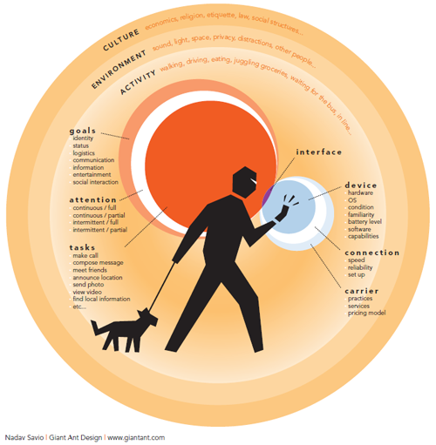
PERSONALIZATION
better understand user needs
Meta-data and User Profiles
exploit query log, prior searches, user context
“The Context of Mobile Interaction”
– Nadav Savio

Slide 102

DEMOCRATIZATION easy access to data tools that work on commodity hardware, mobile devices data-exploration for everyday use-cases

Slide 103

INTERACTIVITY gradually understand user need
ADAPTIVITY build indexes and data structures on-the-go

Slide 104

NATARUAL
LANGUAGE
INTERFACE
flexible, vague,
imprecise input
exploration through
conversation

Slide 105
Example is always more efficacious than precept
Samuel Johnson, Rasselas (1759), Chapter 29.
“New Trends on Exploratory Methods for Data Analytics.”
Davide Mottin, Matteo Lissandrini, Yannis Velegrakis, Themis Palpanas.
Proceedings of the Conference in Very Large Databases (PVLDB), 10(12), 2017
Slides: http://j.mp/DataExplore

Slide 106
Acknowledgments
We would like to thank the authors of the papers who kindly provided us the slides
Angela Bonifati, Radu Ciucianu, Marcelo Arenas, Gonzalo Diaz, Egor Kostylev, Yaacov Weiss, Sarah Cohen, Fotis Psallidas, Li Hao, Chan Chee Yong, Ilaria Bordino, Mohamed Yakout, Kris Ganjam, Kaushik Chakrabati, Thibault Sellam, Rohit Singh, Maeda Hanafi, Marcin Sydow, Mingzhu Zhu, Yoshiharu Ishikawa, Daniel Deutch, Nandish Jayaram, Bryan Perozzi, Kiriaki Dimitriadou, Yifei Ma, Natali Ruchansky, Quoc Trung Tran, Hastagiri Prakash Vanchinathan

Slide 107
References
M. Arenas, G. I. Diaz, and E. V. Kostylev. Reverse engineering sparql queries. WWW, 2016.
Agichtein, E. and Gravano, L. Snowball: Extracting relations from large plain-text collections. ICDL, 2000.
A.Bonifati, R.Ciucanu,and A.Lemay. Learning path queries on graph databases. EDBT, 2015.
A. Bonifati, R. Ciucanu, and S. Staworko. Learning join queries from user examples. TODS, 2016.
A. Bonifati, U. Comignani, E. Coquery, and R. Thion. Interactive mapping specification with exemplar tuples. SIGMOD, 2017.
I. Bordino, G. De Francisci Morales, I. Weber, and F. Bonchi. From machu picchu to rafting the urubamba river: anticipating information needs via the entity-query graph. WSDM, 2013.
D. Deutch and A. Gilad. Qplain: Query by explanation. ICDE, 2016.

Slide 108
References
G. Diaz, M. Arenas, and M. Benedikt. Sparqlbye: Querying rdf data by example. PVLDB, 2016.
K. Dimitriadou, O. Papaemmanouil, and Y. Diao. Explore-by-example: An automatic query steering framework for interactive data exploration. In SIGMOD, 2014.
B. Eravci and H. Ferhatosmanoglu. Diversity based relevance feedback for time series search. PVLDB, 2013.
A. Gionis, M. Mathioudakis, and A. Ukkonen. Bump hunting in the dark: Local discrepancy maximization on graphs. ICDE, 2015.
M. F. Hanafi, A. Abouzied, L. Chiticariu, and Y. Li. Synthesizing extraction rules from user examples with seer. SIGMOD, 2017.
Y. Ishikawa, R. Subramanya, and C. Faloutsos. Mindreader: Querying databases through multiple examples. VLDB, 1998.
N. Jayaram, A. Khan, C. Li, X. Yan, and R. Elmasri. Querying knowledge graphs by example entity tuples. TKDE, 2015.

Slide 109
References
H. Li, C.-Y. Chan, and D. Maier. Query from examples: An iterative, data-driven approach to query construction. PVLDB, 2015.
Y. Ma, T.-K. Huang, and J. G. Schneider. Active search and bandits on graphs using sigma-optimality. UAI, 2015.
S. Metzger, R. Schenkel, and M. Sydow. Qbees: query by entity examples. CIKM, 2013.
D. Mottin, M. Lissandrini, Y. Velegrakis, and T. Palpanas. Searching with xq: the exemplar query search engine. SIGMOD, 2014.
D. Mottin, M. Lissandrini, Y. Velegrakis, and T. Palpanas. Exemplar queries: a new way of searching. VLDB J., 2016.
B. Perozzi, L. Akoglu, P. Iglesias Sa ́nchez, and E. Müller. Focused clustering and outlier detection in large attributed graphs. KDD, 2014.

Slide 110
References
F. Psallidas, B. Ding, K. Chakrabarti, and S. Chaudhuri. S4: Top-k spreadsheet-style search for query discovery. SIGMOD, 2015.
R. Rolim, G. Soares, L. D’Antoni, O. Polozov, S. Gulwani, R. Gheyi, R. Suzuki, and B. Hartmann. Learning syntactic program transformations from examples. ICSE, 2017.
N. Ruchansky, F. Bonchi, D. García-Soriano, F. Gullo, and N. Kourtellis. The minimum wiener connector problem. SIGMOD, 2015.
T. Sellam and M. Kersten. Cluster-driven navigation of the query space. TKDE, 2016.
Y. Shen, K. Chakrabarti, S. Chaudhuri, B. Ding, and L. Novik. Discovering queries based on example tuples. SIGMOD, 2014.
R. Singh. Blinkfill: Semi-supervised programming by example for syntactic string transformations. PVLDB, 2016.
G. Sobczak, M. Chochół, R. Schenkel, and M. Sydow. iqbees: Towards interactive semantic entity search based on maximal aspects. Foundations of Intelligent Systems, 2015.

Slide 111
References
Y. Su, S. Yang, H. Sun, M. Srivatsa, S. Kase, M. Vanni, and X. Yan. Exploiting relevance feedback in knowledge graph search. KDD, 2015.
Q. T. Tran, C.-Y. Chan, and S. Parthasarathy. Query reverse engineering. VLDB J., 2014.
H. P. Vanchinathan, A. Marfurt, C.-A. Robelin, D. Koss- mann, and A. Krause. Discovering valuable items from massive data. In KDD, 2015.
C.Wang, A.Cheung, and R.Bodik. Interactive query synthesis from input-output examples. In SIGMOD, 2017.
C. Wang, A. Cheung, and R. Bodik. Synthesizing highly expressive sql queries from input-output examples. In PLDI, 2017.
Y. Y. Weiss and S. Cohen. Reverse engineering spj-queries from examples. SIGMOD, 2017.
M. Yakout, K. Ganjam, K. Chakrabarti, and S. Chaudhuri. Infogather: Entity augmentation and attribute discovery by holistic matching with web tables. SIGMOD, 2012.
M. Zhu and Y.-F. B. Wu. Search by multiple examples. WSDM, 2014.
M. M. Zloof. Query by example. AFIPS NCC, 1975.

