Slide 1



The Quest for F a s t e r
ANN Vector Search
Manos Chatzakis, Francesca Del Gaudio, Sophia Sideri, Themis Palpanas
LIPADE, Université Paris Cité

Slide 2
Vector
represented as N d-dimensional array
dimensionality d
x₁
x₂
…
x_{d}
x_{i} is a real number

Slide 3
Vector Collections
represented as N d-dimensional arrays
dimensionality d
v₁
x₁
x₂
…
x_{d}
v₂
number of
vectors N
dataset
…
v_{N}

Slide 4
sequences
text
images
video
graphs
molecules
...

Slide 5
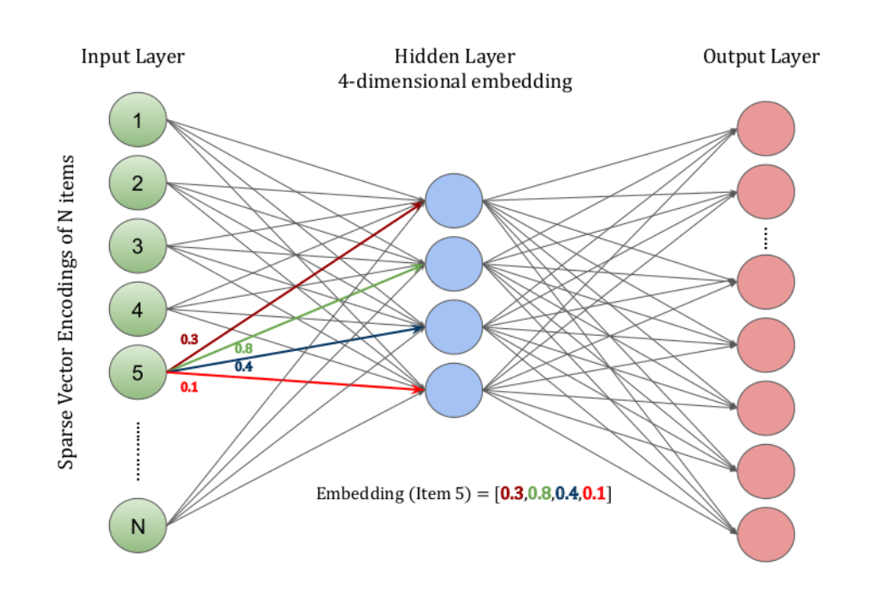
sequences
text
images
video
graphs
molecules
...

Slide 6

sequences
text
images
video
graphs
molecules
...

Slide 7
sequences
text
images
video
graphs
molecules
...
deep embeddings
high-d vectors learned using a DNN

Slide 8
image retrieval
recommendations
entity matching
fraud detection
drug discovery
retrieval augmented generation (RAG)
…
sequences
text
images
video
graphs
molecules
...
deep embeddings
high-d vectors learned using a DNN

Slide 9
Vector Search
find similar vectors, based on some distance function
popular distance functions (similarity/dissimilarity)
  Euclidean (L2)
  cosine similarity
  inner-product
Euclidean is equivalent to cosine similarity and maximum inner-product (under some non-restrictive vector transformations)
types of similarity search
  ε-range
  Nearest Neighbor (NN)

Slide 10
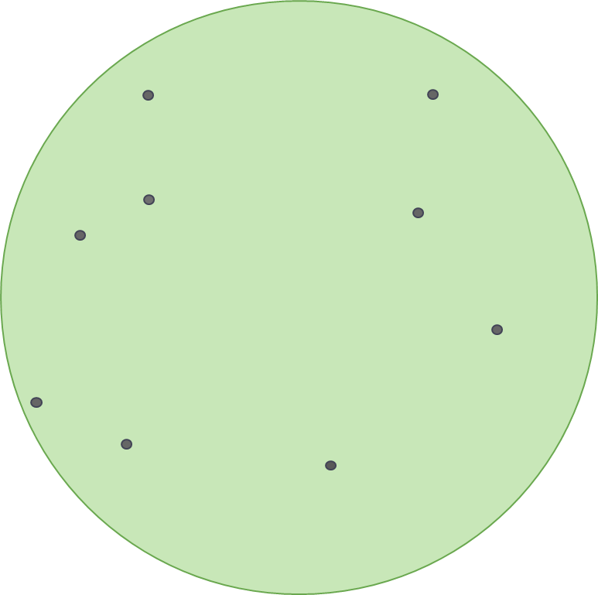
Vector Nearest Neighbor Search
Echihabi et al. “New Trends in High-D Vector Similarity Search: AI-driven, Progressive, and Distributed” PVLDB 2021

Slide 11
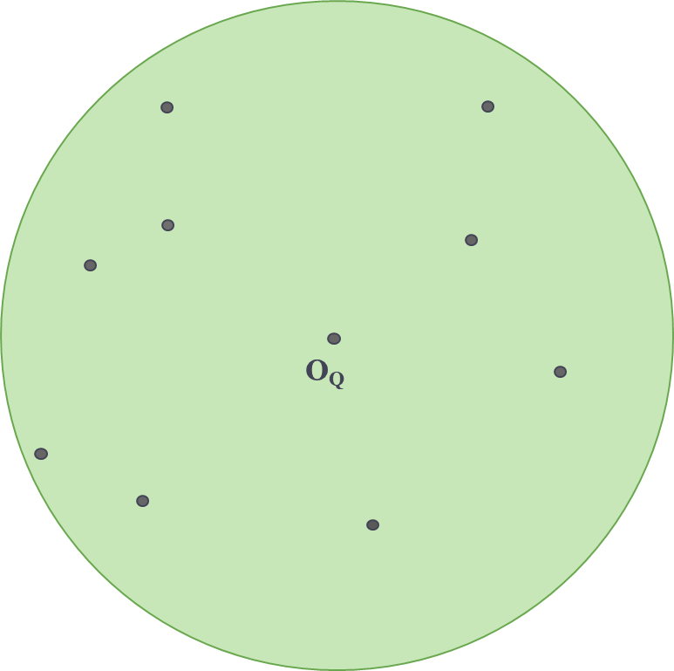
Vector Nearest Neighbor Search
Echihabi et al. “New Trends in High-D Vector Similarity Search: AI-driven, Progressive, and Distributed” PVLDB 2021

Slide 12
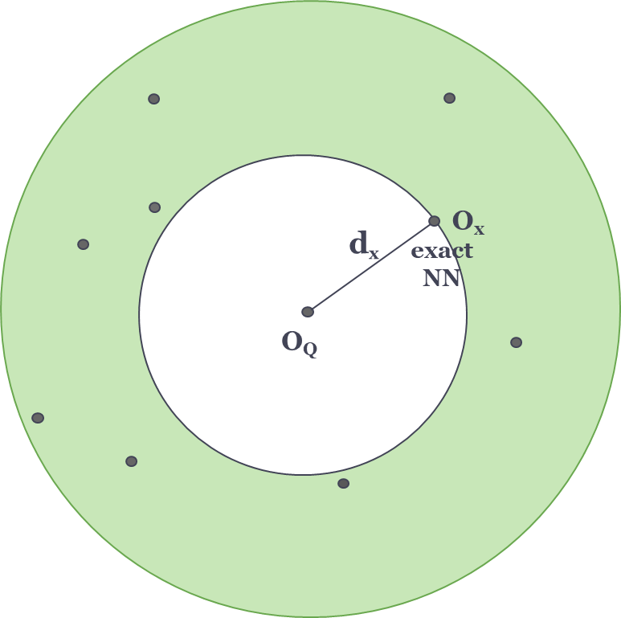
Vector Nearest Neighbor Search
Echihabi et al. “New Trends in High-D Vector Similarity Search: AI-driven, Progressive, and Distributed” PVLDB 2021
Prob( d_{x} = min{d_{i}} ) = 1
result is exact NN

Slide 13
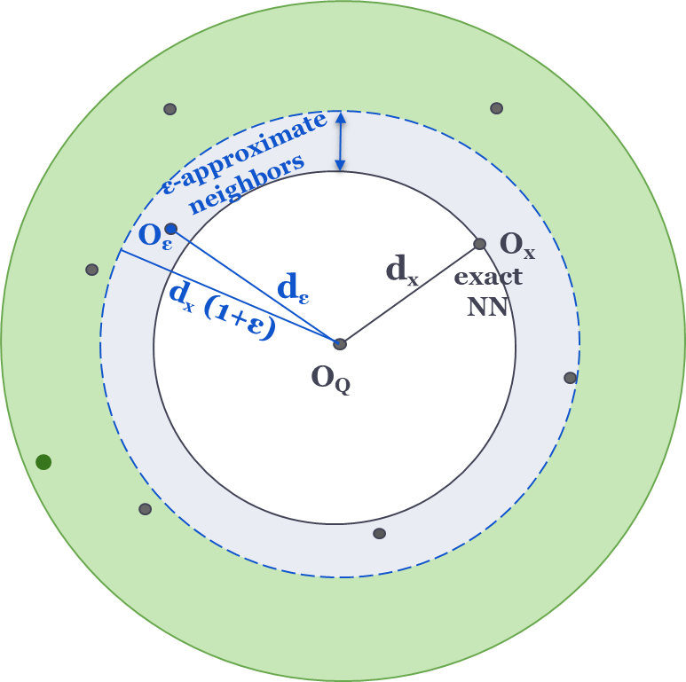
Vector Nearest Neighbor Search
Echihabi et al. “New Trends in High-D Vector Similarity Search: AI-driven, Progressive, and Distributed” PVLDB 2021
Prob(d_{ε} <= d_{x} (1+ε)) = 1
result within (1+ ε) of exact NN with probability 1
Prob( d_{x} = min{d_{i}} ) = 1
result is exact NN

Slide 14
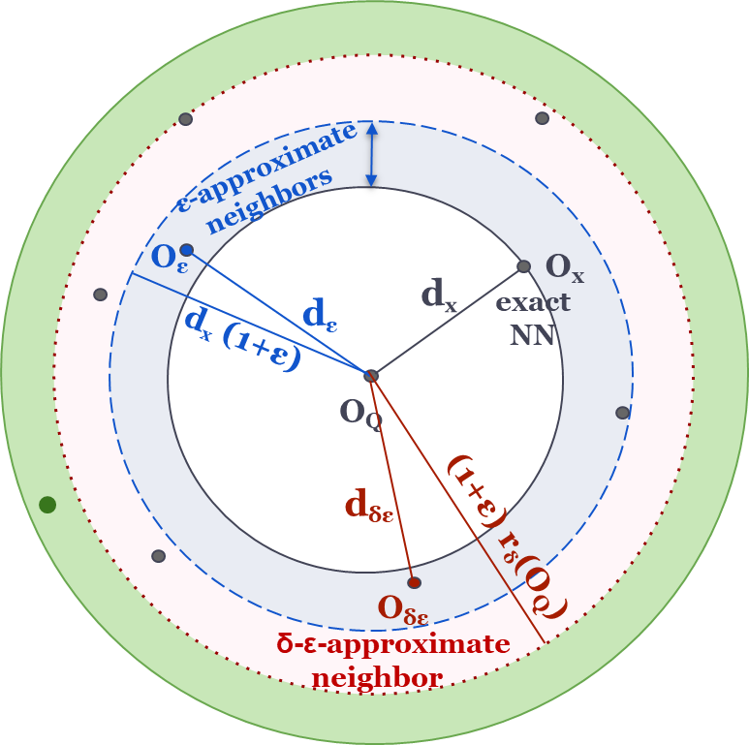
Vector Nearest Neighbor Search
Echihabi et al. “New Trends in High-D Vector Similarity Search: AI-driven, Progressive, and Distributed” PVLDB 2021
Prob(d_{ε} <= d_{x} (1+ε)) = 1
result within (1+ ε) of exact NN with probability 1
Prob( d_{x} = min{d_{i}} ) = 1
result is exact NN
Prob(d_{ε} <= d_{x} (1+ε)) >= δ
result within (1+ ε) of exact NN with probability at least δ

Slide 15
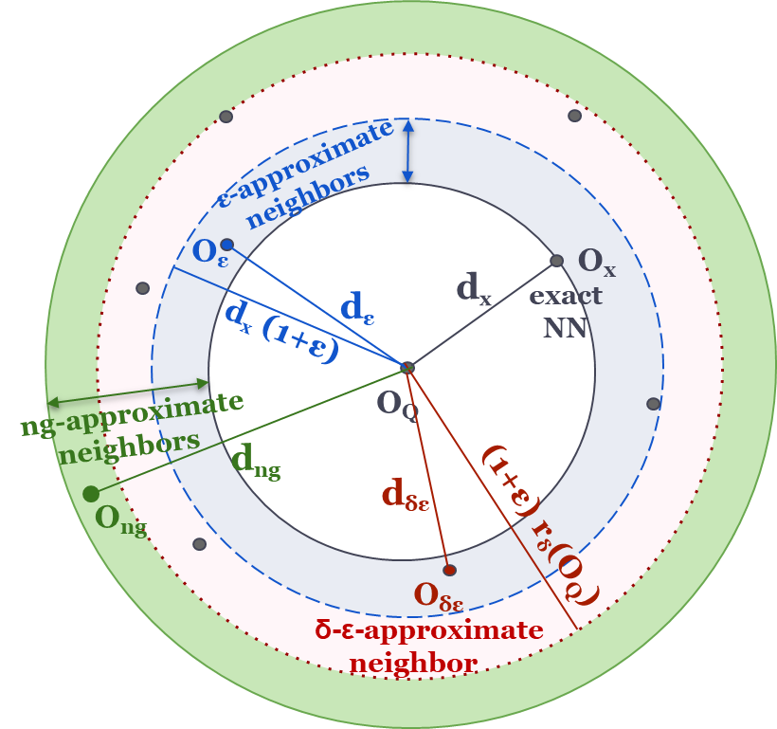
Vector Nearest Neighbor Search
Echihabi et al. “New Trends in High-D Vector Similarity Search: AI-driven, Progressive, and Distributed” PVLDB 2021
Prob(d_{ε} <= d_{x} (1+ε)) = 1
result within (1+ ε) of exact NN with probability 1
Prob( d_{x} = min{d_{i}} ) = 1
result is exact NN
Prob(d_{ng} <>= ?) = ?
result within ? of exact NN
Prob(d_{ε} <= d_{x} (1+ε)) >= δ
result within (1+ ε) of exact NN with probability at least δ

Slide 16
Vector Nearest Neighbor Search
Echihabi et al. “New Trends in High-D Vector Similarity Search: AI-driven, Progressive, and Distributed” PVLDB 2021
Prob(d_{ε} <= d_{x} (1+ε)) = 1
result within (1+ ε) of exact NN with probability 1
Prob( d_{x} = min{d_{i}} ) = 1
result is exact NN
Prob(d_{ng} <>= ?) = ?
result within ? of exact NN
Prob(d_{ε} <= d_{x} (1+ε)) >= δ
result within (1+ ε) of exact NN with probability at least δ
recall is the number of returned answers that are correct
(part of the groundtruth)

Slide 17
Vector Nearest Neighbor Search
Echihabi et al. “New Trends in High-D Vector Similarity Search: AI-driven, Progressive, and Distributed” PVLDB 2021
Prob(d_{ε} <= d_{x} (1+ε)) = 1
result within (1+ ε) of exact NN with probability 1
Prob( d_{x} = min{d_{i}} ) = 1
result is exact NN
Prob(d_{ng} <>= ?) = ?
result within ? of exact NN
Prob(d_{ε} <= d_{x} (1+ε)) >= δ
result within (1+ ε) of exact NN with probability at least δ
ng-approximate NN search

Slide 18
Vector Nearest Neighbor Search
Echihabi et al. “New Trends in High-D Vector Similarity Search: AI-driven, Progressive, and Distributed” PVLDB 2021
Prob(d_{ε} <= d_{x} (1+ε)) = 1
result within (1+ ε) of exact NN with probability 1
Prob( d_{x} = min{d_{i}} ) = 1
result is exact NN
Prob(d_{ng} <>= ?) = ?
result within ? of exact NN
Prob(d_{ε} <= d_{x} (1+ε)) >= δ
result within (1+ ε) of exact NN with probability at least δ
ng-approximate NN search
Approximate NN Search (ANNS)

Slide 19
Vector Nearest Neighbor Search
Echihabi et al. “New Trends in High-D Vector Similarity Search: AI-driven, Progressive, and Distributed” PVLDB 2021
Prob(d_{ε} <= d_{x} (1+ε)) = 1
result within (1+ ε) of exact NN with probability 1
Prob( d_{x} = min{d_{i}} ) = 1
result is exact NN
Prob(d_{ng} <>= ?) = ?
result within ? of exact NN
Prob(d_{ε} <= d_{x} (1+ε)) >= δ
result within (1+ ε) of exact NN with probability at least δ
ng-approximate NN search
Approximate NN Search (ANNS)
vector search

Slide 20
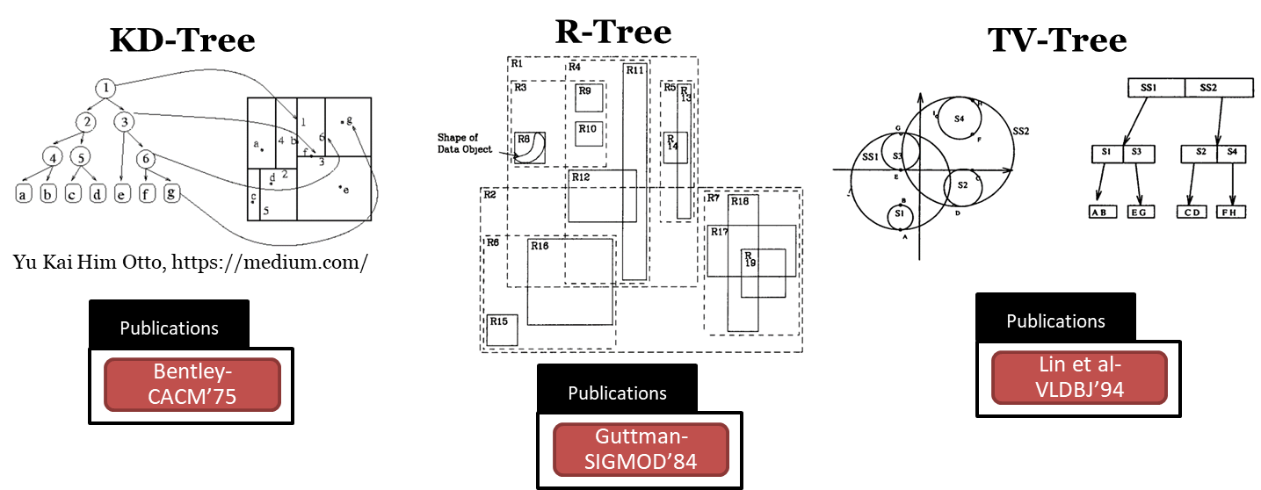
A Brief History of Vector Similarity Search

Slide 21
A Brief History of Vector Similarity Search
1975

Slide 22
A Brief History of Vector Similarity Search
1980’s

Slide 23
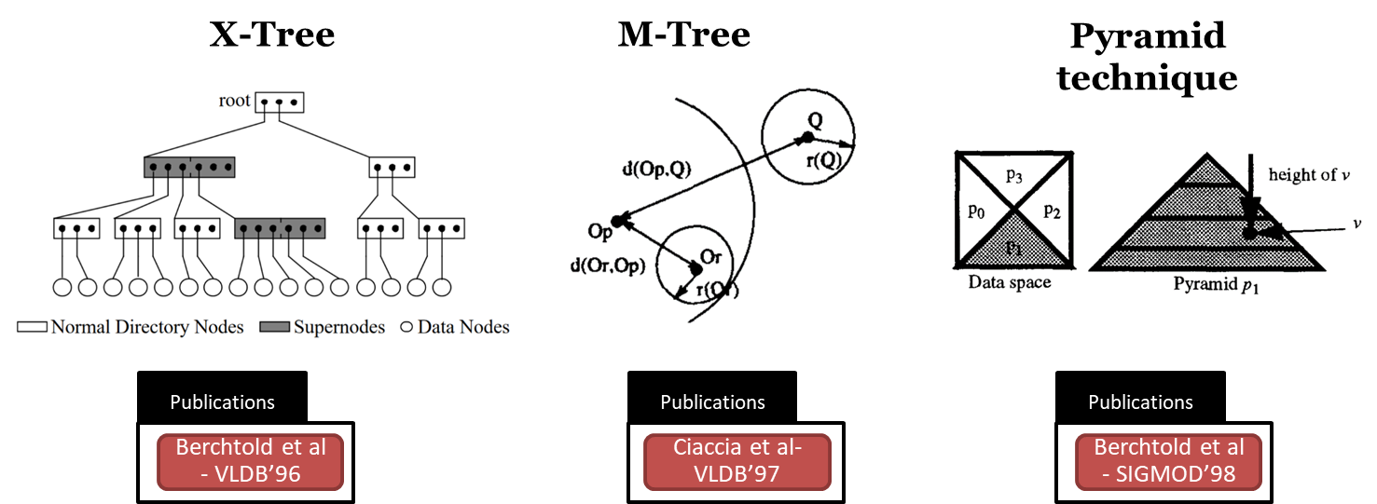
A Brief History of Vector Similarity Search
1990’s

Slide 24
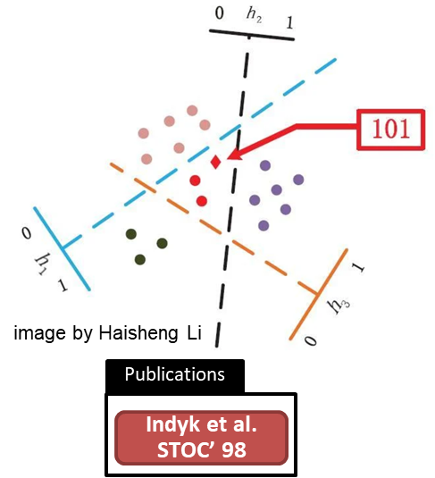
A Brief History of Vector Similarity Search
LSH
1990’s

Slide 25
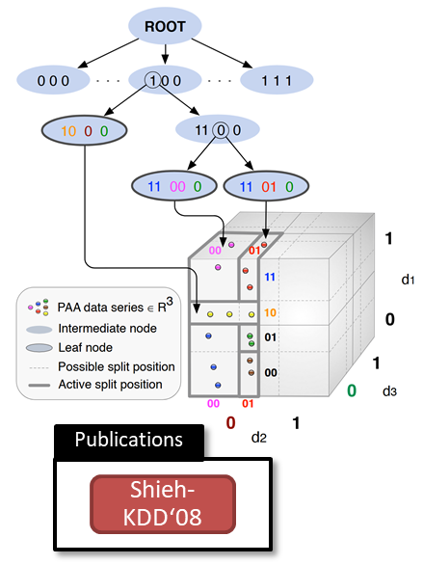
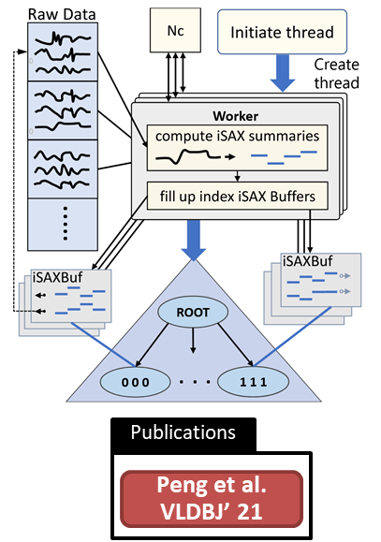
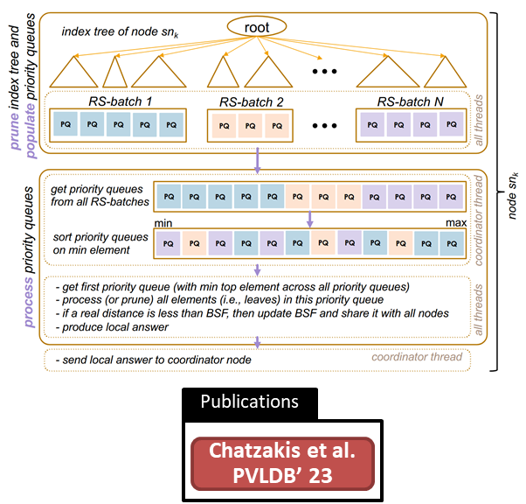
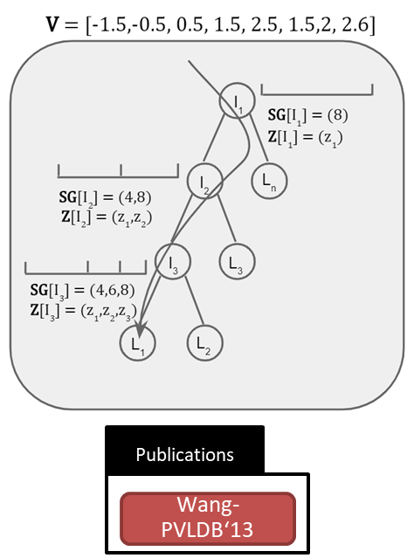
A Brief History of Vector Similarity Search
LSH
iSAX
DSTREE
MESSI
Odyssey
2010’s

Slide 26
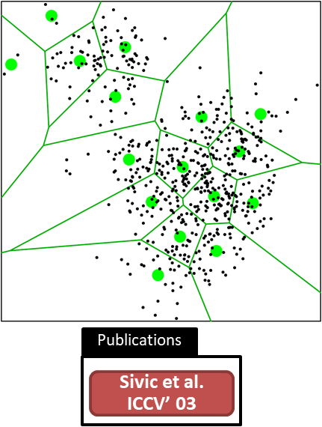
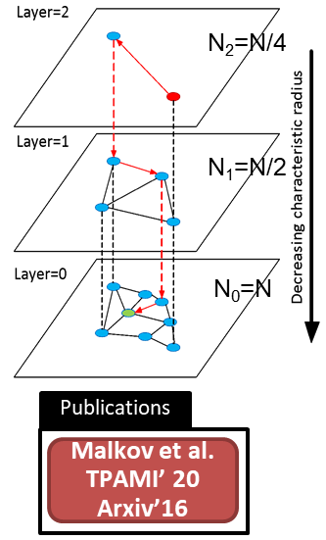
A Brief History of Vector Similarity Search
LSH
iSAX
DSTREE
MESSI
Odyssey
IVF
HNSW
late 2010’s

Slide 27
A Brief History of Vector Similarity Search
LSH
iSAX
DSTREE
MESSI
Odyssey
IVF
HNSW

Slide 28
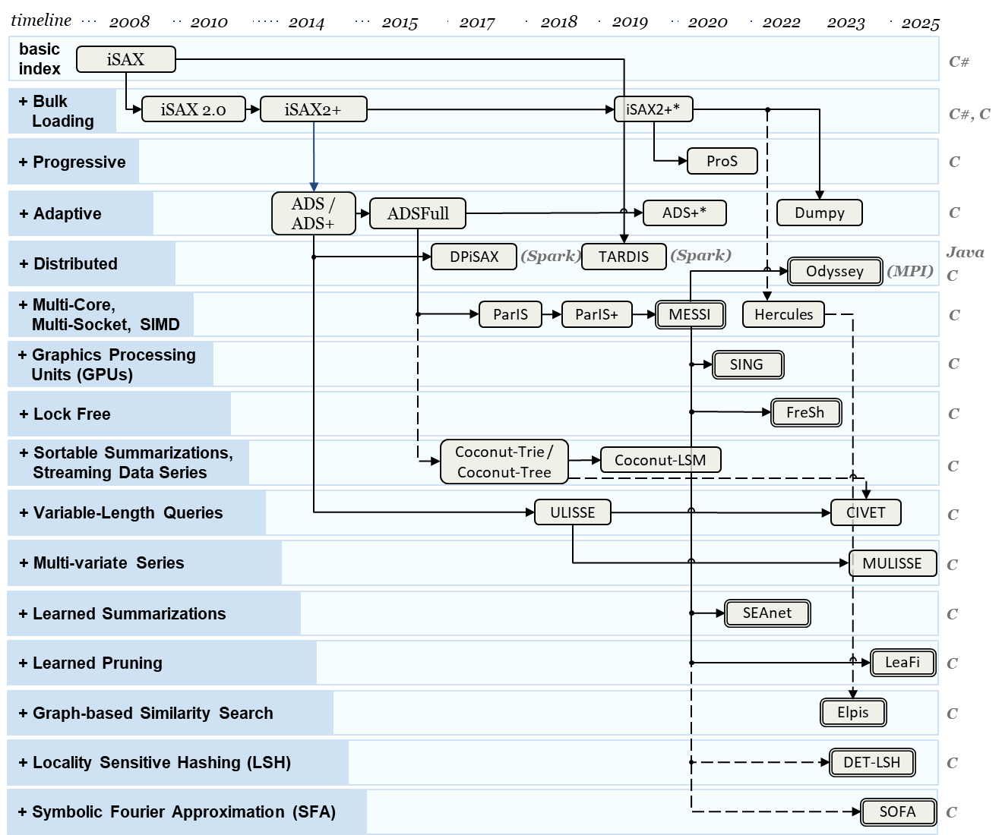

Slide 29
Wei et al. “DET-LSH: A Locality-Sensitive Hashing Scheme with Dynamic Encoding Tree for Approximate Nearest Neighbor Search” PVLDB 2024
DET-LSH hybrid solution
δ-ε-approximate
iSAX + LSH

Slide 30
Azizi et al. “ELPIS: Graph-Based Similarity Search for Scalable Data Science” PVLDB 2023
ELPIS
ng-approximate
DSTREE + HNSW

Slide 31
Echihabi et al. “ProS: data series progressive k-NN similarity search and classification with probabilistic quality guarantees” VLDBJ 2023
ProS
progressive query answering
useful for ANNS early termination

Slide 32

arriving soon

Slide 33

DaiSy library
for Fast Exact
Similarity Search
arriving soon

Slide 34
Vector Similarity Search Communities
high-d vector similarity search relevant to many communities
data management information retrieval / text search parallel and distributed computing | time series machine learning / deep learning computer architecture

Slide 35


Vector Similarity Search Communities
high-d vector similarity search relevant to many communities
cross-fertilization of ideas is useful
bringing together these communities
  IEEE Bulletin on Data Engineering Special Issues: High-Dimensional Vector Similarity Search
data management information retrieval / text search parallel and distributed computing | time series machine learning / deep learning computer architecture
September 2023
From Time Series to Vector Databases
September 2024
Role of Machine Learning and Future Perspectives

Slide 36
Vector Approximate NN Search (ANNS)
[ng-approximate search]
[vector search]
we focus on approximate NN search with no guarantees
study solutions based on:
  k-NN-Graphs
  Inverted Files

Slide 37
Vector Search with kNN-Graph Indexes
Malkov et al. "Efficient and robust approximate nearest neighbor search using hierarchical navigable small world graphs." PAMI 2018.
Fu et al. "Fast approximate nearest neighbor search with the navigating spreading-out graph." PVLDB 2017.
Subramanya et al. "Diskann: Fast accurate billion-point nearest neighbor search on a single node." NeurIPS 2019.
Create a proximity graph index over the vector collections
Greedy search from entry point with effort ef
Variations:
  HNSW: Hierarchical
  Vamana: Relaxed edge pruning
  NSG: Optimized search pruning
ANN(q, k, ef=3)
q
1-NN
Entry
point

Slide 38
Vector Search with Inverted File (IVF) Indexes
Douze, Matthijs et al. "The faiss library." IEEE Big Data 2025.
Google Research. “Announcing ScaNN: Efficient Vector Similarity Search.” Google Research Blog 2020.
Partition the dataset using clustering with nlist centroids
Visit the closest nprobe partitions of a query
Variations:
  FAISS-IVF: Efficient IVF implementation
  ScaNN: Hierarchical IVF, optimizations in vector assignment
ANN(q, k, nprobe=2)
nlist=5 → P₁ – P₅ with centroids C₁– C₅
C₄
C₅
C₁
C₃
C₂

Slide 39
Vector Search Resources
comparative evaluations
  Echihabi et al. “Return of the Lernaean Hydra: Experimental Evaluation of Data Series Approximate Similarity Search” PVLDB 2019
  Azizi et al. “Graph-Based Vector Search: An Experimental Evaluation of the State-of-the-Art” SIGMOD 2025
  Kang et al. “BigVectorBench: Heterogeneous Data Embedding and Compound Queries are Essential in Evaluating Vector Databases” PVLDB 2025
  Big-ANN Benchmark <https://big-ann-benchmarks.com/>
surveys
  Wang et al. “Graph- and Tree-based Indexes for High-dimensional Vector Similarity Search: Analyses, Comparisons, and Future Directions” IEEE Data Eng. Bull. 2023
  Pan et al. “Survey of Vector Database Management Systems” VLDBJ 2024
tutorials
  Qin et al. “High-Dimensional Similarity Qyery Processing for Data Science” KDD 2021
  Chronis et al. “Filtered Vector Search: State-of-the-art and Research Opportunities” VLDB 2025

Slide 40
Outline of this Tutorial
Parallel and Distributed ANNS
  exploit available hardware

Slide 41
Outline of this Tutorial
Parallel and Distributed ANNS
  exploit available hardware
Streaming ANNS
  employ incremental solutions

Slide 42
Outline of this Tutorial
Parallel and Distributed ANNS
  exploit available hardware
Streaming ANNS
  employ incremental solutions
Early Termination ANNS
  avoid wasted effort

Slide 43
Outline of this Tutorial
Parallel and Distributed ANNS
  exploit available hardware
Streaming ANNS
  employ incremental solutions
Early Termination ANNS
  avoid wasted effort
Quality Evaluation of ANNS
  select right measures

Slide 44
Parallel and Distributed Vector Search
Many thanks to Peng et al. (iQAN), Azizi et al. (ELPIS), Deng et al. (Pyramid), Dang et al. (BatANN), Adams et al. (SPIRE), Zhi et al. (CoTra), Li et al. (Tagore), Xu et al. (Harmony), Mohoney et al. (Quake), Zhang et al. (Auncel), Gottesbüren et al. (Graph Partitioning), who provided supporting material for this part of the tutorial.

Slide 45
Outline
Parallel Vector Search
Goals and Challenges
Parallelism for Fast Index Construction
Parallelism for Low Latency Query Answering

Slide 46
Outline
Parallel Vector Search
Goals and Challenges
Parallelism for Fast Index Construction
Parallelism for Low Latency Query Answering
Distributed Vector Search
Goals and Challenges
k-NN Graph-based Distributed Systems Overview
IVF-Based Distributed Systems Overview

Slide 47
Parallel Vector Search
Sequential vector search fails to saturate modern hardware, underutilizes cores and vector units, and quickly becomes memory-bound as dataset size grows.

Slide 48
Parallel Vector Search
Sequential vector search fails to saturate modern hardware, underutilizes cores and vector units, and quickly becomes memory-bound as dataset size grows.
Exploiting multi-core CPUs and GPUs through parallel execution increase throughput, reduce tail latency, and fully utilize available hardware resources.

Slide 49
Parallel Vector Search
Sequential vector search fails to saturate modern hardware, underutilizes cores and vector units, and quickly becomes memory-bound as dataset size grows.
Exploiting multi-core CPUs and GPUs through parallel execution increase throughput, reduce tail latency, and fully utilize available hardware resources.
Parallel execution introduces synchronization overhead, contention on shared index structures, load imbalance across threads, and cache/NUMA locality issues.

Slide 50
Parallel Vector Search - ELPIS [1/3]
Azizi et al. “ELPIS: Graph-Based Similarity Search for Scalable Data Science”. VLDB 2023
Goal: Decrease build indexing time and reach good throughput using parallelism in both build indexing in-memory ng-approximate vector search.

Slide 51
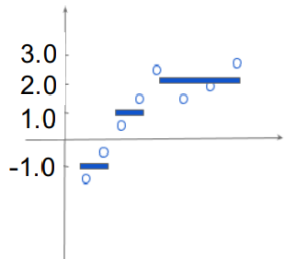
Parallel Vector Search - ELPIS [1/3]
Azizi et al. “ELPIS: Graph-Based Similarity Search for Scalable Data Science”. VLDB 2023
Goal: Decrease build indexing time and reach good throughput using parallelism in both build indexing in-memory ng-approximate vector search.
Contributions: Hybrid solution that combines a shallow tree at the top with a knn-graph, inside each leaf and uses EAPCA data series summarization.
-0.25, 0.54
0.45, 1.24
Root
|____________|
V = {-1.5,-0.5,0.5,1.5,2.5,1.5,2,2.6}
-0.25, 0.10
0.45, 0.93
-0.22, 0.54
0.48, 1.24
I1
L4
|____________|
|____________|
-0.25, -0.15
0.45, 0.71
I2
L1
0.11, 0.31
1.23, 1.32
-0.31, -0.11
0.44, 0.54
|____________|
|________|_______|
L2
L3
EAPCA(V) = {[-1,0.5],[1,0.5],[2.15,0.44]}
0.26, 0.31
1.23, 1.26
-0.31, -0.27
0.49, 0.54
0.11, 0.28
1.28, 1.32
-0.28, -0.11
0.44, 0.53
|________|_______|
|________|_______|

Slide 52
Parallel Vector Search - ELPIS [2/3]
Azizi et al. “ELPIS: Graph-Based Similarity Search for Scalable Data Science”. VLDB 2023
Build Index: concurrently constructs graphs using nw1 workers, with each worker building HNSW graph within each leaf in parallel using nw2 workers.
Q
-0.25, 0.54
0.45, 1.24
-0.25, 0.54
0.45, 1.24
Root
|____________|
-0.25, 0.10
0.45, 0.93
-0.22, 0.54
0.48, 1.24
I1
L4
|____________|
|____________|
-0.25, -0.15
0.45, 0.71
I2
L1
0.11, 0.31
1.23, 1.32
-0.31, -0.11
0.44, 0.54
|____________|
|________|_______|
L2
L3
0.26, 0.31
1.23, 1.26
-0.31, -0.27
0.49, 0.54
0.11, 0.28
1.28, 1.32
-0.28, -0.11
0.44, 0.53
|________|_______|
|________|_______|
dist(8,Q)
dist(20,Q)
dist(19,Q)
dist(8,Q)
dist(18,Q)
dist(20,Q)
C_NN_{L1}
dist(19,Q)
dist(18,Q)
C_NN_{L3}
dist(8,Q)
dist(20,Q)
L (Beam width)
dist(19,Q)
dist(18,Q)
C_NN_{L2}

Slide 53
Parallel Vector Search - ELPIS [2/3]
Azizi et al. “ELPIS: Graph-Based Similarity Search for Scalable Data Science”. VLDB 2023
Build Index: concurrently constructs graphs using nw1 workers, with each worker building HNSW graph within each leaf in parallel using nw2 workers.
Q
Query Answering: selects up to (nprobes - 1) additional leaves, and nw worker explore them in parallel.
-0.25, 0.54
0.45, 1.24
-0.25, 0.54
0.45, 1.24
Root
|____________|
-0.25, 0.10
0.45, 0.93
-0.22, 0.54
0.48, 1.24
I1
L4
|____________|
|____________|
-0.25, -0.15
0.45, 0.71
I2
L1
0.11, 0.31
1.23, 1.32
-0.31, -0.11
0.44, 0.54
|____________|
|________|_______|
L2
L3
0.26, 0.31
1.23, 1.26
-0.31, -0.27
0.49, 0.54
0.11, 0.28
1.28, 1.32
-0.28, -0.11
0.44, 0.53
|________|_______|
|________|_______|
dist(8,Q)
dist(20,Q)
dist(19,Q)
dist(8,Q)
dist(18,Q)
dist(20,Q)
C_NN_{L1}
dist(19,Q)
dist(18,Q)
C_NN_{L3}
dist(8,Q)
dist(20,Q)
L (Beam width)
dist(19,Q)
dist(18,Q)
C_NN_{L2}

Slide 54
Parallel Vector Search - ELPIS [2/3]
Azizi et al. “ELPIS: Graph-Based Similarity Search for Scalable Data Science”. VLDB 2023
Build Index: concurrently constructs graphs using nw1 workers, with each worker building HNSW graph within each leaf in parallel using nw2 workers.
Q
Query Answering: selects up to (nprobes - 1) additional leaves, and nw worker explore them in parallel.
-0.25, 0.54
0.45, 1.24
-0.25, 0.54
0.45, 1.24
Root
|____________|
-0.25, 0.10
0.45, 0.93
-0.22, 0.54
0.48, 1.24
I1
L4
|____________|
|____________|
-0.25, -0.15
0.45, 0.71
I2
L1
0.11, 0.31
1.23, 1.32
-0.31, -0.11
0.44, 0.54
|____________|
|________|_______|
L2
L3
0.26, 0.31
1.23, 1.26
-0.31, -0.27
0.49, 0.54
0.11, 0.28
1.28, 1.32
-0.28, -0.11
0.44, 0.53
|________|_______|
|________|_______|
dist(8,Q)
up to 4x faster in index building
up to 10x faster in query answering
dist(20,Q)
dist(19,Q)
dist(8,Q)
dist(18,Q)
dist(20,Q)
C_NN_{L1}
dist(19,Q)
dist(18,Q)
C_NN_{L3}
dist(8,Q)
dist(20,Q)
L (Beam width)
dist(19,Q)
dist(18,Q)
C_NN_{L2}

Slide 55
Parallel Vector Search - ELPIS [2/3]
Azizi et al. “ELPIS: Graph-Based Similarity Search for Scalable Data Science”. VLDB 2023
Build Index: concurrently constructs graphs using nw1 workers, with each worker building HNSW graph within each leaf in parallel using nw2 workers.
Q
Query Answering: selects up to (nprobes - 1) additional leaves, and nw worker explore them in parallel.
-0.25, 0.54
0.45, 1.24
-0.25, 0.54
0.45, 1.24
Root
|____________|
-0.25, 0.10
0.45, 0.93
-0.22, 0.54
0.48, 1.24
I1
L4
|____________|
|____________|
-0.25, -0.15
0.45, 0.71
I2
L1
0.11, 0.31
1.23, 1.32
-0.31, -0.11
0.44, 0.54
|____________|
|________|_______|
L2
L3
0.26, 0.31
1.23, 1.26
-0.31, -0.27
0.49, 0.54
0.11, 0.28
1.28, 1.32
-0.28, -0.11
0.44, 0.53
|________|_______|
|________|_______|
dist(8,Q)
up to 4x faster in index building
up to 10x faster in query answering
dist(20,Q)
dist(19,Q)
dist(8,Q)
dist(18,Q)
dist(20,Q)
C_NN_{L1}
dist(19,Q)
dist(18,Q)
C_NN_{L3}
sensitive to number of clusters.
dist(8,Q)
dist(20,Q)
L (Beam width)
dist(19,Q)
dist(18,Q)
C_NN_{L2}

Slide 56
Parallel Vector Search - ELPIS [3/3]
Li et al. “Scalable Graph Indexing using GPUs for Approximate Nearest Neighbor Search”. ACM Manag. Data 2025.
Dobson et al. “ParlayANN: Scalable and Deterministic Parallel Graph-Based Approximate Nearest Neighbor Search”. PPoPP 2023
Related Systems
ParlayANN: It’s a parallel and deterministic framework for graph-based ANNS. It introduces techniques such as prefix-doubling batch insertion that builds the graph incrementally in exponentially growing batches.
Tagore: It’s a fast library accelerated by GPUs for graph indexing. It introduces GNN-Descent, a GPU-specific algorithm for eﬃcient k-Nearest Neighbor (k-NN) graph initialization made by a two-phase descent procedure.

Slide 57
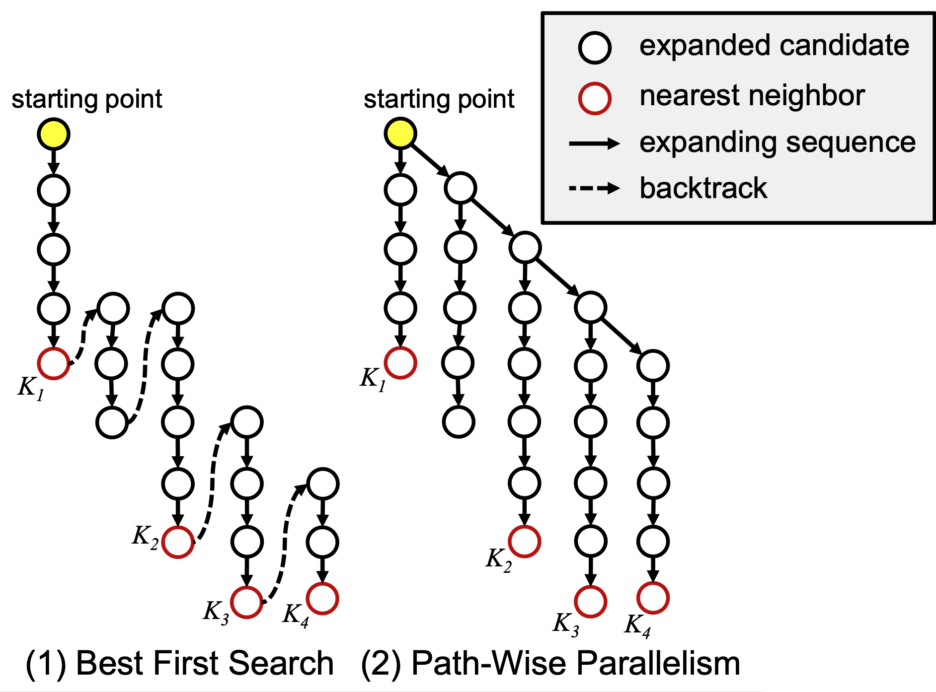
Parallel Vector Search - iQAN
Peng et al. “iQAN: Fast and Accurate Vector Search with Efficient Intra-Query Parallelism on Multi-Core Architectures”. PPoPP 2023.
Goal: Given a graph index, how to reduce search latency of a single query by parallelizing Best First Search?

Slide 58
Parallel Vector Search - iQAN
Peng et al. “iQAN: Fast and Accurate Vector Search with Efficient Intra-Query Parallelism on Multi-Core Architectures”. PPoPP 2023.
Goal: Given a graph index, how to reduce search latency of a single query by parallelizing Best First Search?
Contribution: Path-Wise Parallelism in contrast to Edge-Wise Parallelism.

Slide 59
Parallel Vector Search - iQAN
Peng et al. “iQAN: Fast and Accurate Vector Search with Efficient Intra-Query Parallelism on Multi-Core Architectures”. PPoPP 2023
Goal: Given a graph index, how to reduce search latency of a single query by parallelizing Best First Search?
Contribution: Path-Wise Parallelism in contrast to Edge-Wise Parallelism.
Reduces iterations depths for convergence.

Slide 60
Parallel Vector Search - iQAN
Peng et al. “iQAN: Fast and Accurate Vector Search with Efficient Intra-Query Parallelism on Multi-Core Architectures”. PPoPP 2023
Goal: Given a graph index, how to reduce search latency of a single query by parallelizing Best First Search?
Contribution: Path-Wise Parallelism in contrast to Edge-Wise Parallelism.
Reduces iterations depths for convergence.
Increases distance computations: unnecessary expansions.

Slide 61
Parallel Vector Search - iQAN
Peng et al. “iQAN: Fast and Accurate Vector Search with Efficient Intra-Query Parallelism on Multi-Core Architectures”. PPoPP 2023
Douze et al. The Faiss Library. arXiv 2023.
Goal: Given a graph index, how to reduce search latency of a single query by parallelizing Best First Search?
Contribution: Path-Wise Parallelism in contrast to Edge-Wise Parallelism.
Reduces iterations depths for convergence.
Increases distance computations: unnecessary expansions.
Related Systems
FAISS GPU: The core contribution is a highly optimized in-register k-selection algorithm (WarpSelect).

Slide 62
Parallel Vector Search - Quake
Mohoney et al. “Quake: adaptive indexing for vector search.” OSDI 2025.
Goal: An adaptive approach that exploits NUMA processors for low latency.
NUMA-aware data placement.
Partitions are distributed across NUMA nodes and bound to specific cores.

Slide 63
Parallel Vector Search - Quake
Mohoney et al. “Quake: adaptive indexing for vector search.” OSDI 2025.
Goal: An adaptive approach that exploits NUMA processors for low latency.
NUMA-aware data placement.
Partitions are distributed across NUMA nodes and bound to specific cores.
NUMA-aware Work Scheduling.
Queries are scheduled to threads based on partition locality.

Slide 64
Parallel Vector Search - Quake
Mohoney et al. “Quake: adaptive indexing for vector search.” OSDI 2025.
Goal: An adaptive approach that exploits NUMA processors for low latency.
NUMA-aware data placement.
Partitions are distributed across NUMA nodes and bound to specific cores.
NUMA-aware Work Scheduling.
Queries are scheduled to threads based on partition locality.
NUMA-aware query execution with APS.
Worker threads scan local partitions while a coordinator merges results and estimates recall.

Slide 65
Parallel Vector Search - Quake
Mohoney et al. “Quake: adaptive indexing for vector search.” OSDI 2025.
Goal: An adaptive approach that exploits NUMA processors for low latency.
NUMA-aware data placement.
Partitions are distributed across NUMA nodes and bound to specific cores.
NUMA-aware Work Scheduling.
Queries are scheduled to threads based on partition locality.
NUMA-aware query execution with APS.
Worker threads scan local partitions while a coordinator merges results and estimates recall.
Minimizes remote memory accesses via data-local execution.

Slide 66
Parallel Vector Search - Quake
Mohoney et al. “Quake: adaptive indexing for vector search.” OSDI 2025.
Goal: An adaptive approach that exploits NUMA processors for low latency.
NUMA-aware data placement.
Partitions are distributed across NUMA nodes and bound to specific cores.
NUMA-aware Work Scheduling.
Queries are scheduled to threads based on partition locality.
NUMA-aware query execution with APS.
Worker threads scan local partitions while a coordinator merges results and estimates recall.
Minimizes remote memory accesses via data-local execution.
NUMA cores imbalance in case of skewed workloads.

Slide 67
Distributed Vector Search
The rapid growth of high-dimensional vector datasets make single-machine processing insufficient.

Slide 68
Distributed Vector Search
The rapid growth of high-dimensional vector datasets make single-machine processing insufficient.
Single-node systems are constrained by memory capacity, memory bandwidth, and core-level parallelism.

Slide 69
Distributed Vector Search
The rapid growth of high-dimensional vector datasets make single-machine processing insufficient.
Single-node systems are constrained by memory capacity, memory bandwidth, and core-level parallelism.
Partitioning vectors across nodes introduces trade-offs between load balance, recall, and communication overhead.

Slide 70

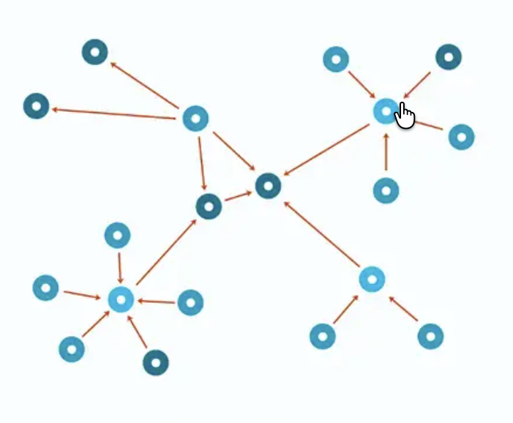
Distributed Vector Search
The rapid growth of high-dimensional vector datasets make single-machine processing insufficient.
Single-node systems are constrained by memory capacity, memory bandwidth, and core-level parallelism.
Partitioning vectors across nodes introduces trade-offs between load balance, recall, and communication overhead.
k-NN Graph

Slide 71
Distributed Vector Search
The rapid growth of high-dimensional vector datasets make single-machine processing insufficient.
Single-node systems are constrained by memory capacity, memory bandwidth, and core-level parallelism.
Partitioning vectors across nodes introduces trade-offs between load balance, recall, and communication overhead.
k-NN Graph
P1

Slide 72
Distributed Vector Search
The rapid growth of high-dimensional vector datasets make single-machine processing insufficient.
Single-node systems are constrained by memory capacity, memory bandwidth, and core-level parallelism.
Partitioning vectors across nodes introduces trade-offs between load balance, recall, and communication overhead.
k-NN Graph
P1
P2

Slide 73
Distributed Vector Search
The rapid growth of high-dimensional vector datasets make single-machine processing insufficient.
Single-node systems are constrained by memory capacity, memory bandwidth, and core-level parallelism.
Partitioning vectors across nodes introduces trade-offs between load balance, recall, and communication overhead.
k-NN Graph
P1
P2
P3

Slide 74
Distributed Vector Search
The rapid growth of high-dimensional vector datasets make single-machine processing insufficient.
Single-node systems are constrained by memory capacity, memory bandwidth, and core-level parallelism.
Partitioning vectors across nodes introduces trade-offs between load balance, recall, and communication overhead.
k-NN Graph
P1
P2
P3
P4

Slide 75
Distributed Vector Search
The rapid growth of high-dimensional vector datasets make single-machine processing insufficient.
Single-node systems are constrained by memory capacity, memory bandwidth, and core-level parallelism.
Partitioning vectors across nodes introduces trade-offs between load balance, recall, and communication overhead.
k-NN Graph
P1
P2
P3
P4

Slide 76
Distributed Vector Search
The rapid growth of high-dimensional vector datasets make single-machine processing insufficient.
Single-node systems are constrained by memory capacity, memory bandwidth, and core-level parallelism.
Partitioning vectors across nodes introduces trade-offs between load balance, recall, and communication overhead.
k-NN Graph
P1
Query 3-NN
P2
P3
P4

Slide 77
Distributed Vector Search
The rapid growth of high-dimensional vector datasets make single-machine processing insufficient.
Single-node systems are constrained by memory capacity, memory bandwidth, and core-level parallelism.
Partitioning vectors across nodes introduces trade-offs between load balance, recall, and communication overhead.
k-NN Graph
P1
Query 3-NN
P2
P3
P4

Slide 78
Distributed Vector Search
The rapid growth of high-dimensional vector datasets make single-machine processing insufficient.
Single-node systems are constrained by memory capacity, memory bandwidth, and core-level parallelism.
Partitioning vectors across nodes introduces trade-offs between load balance, recall, and communication overhead.
k-NN Graph
P1
Query 3-NN
P2
P3
P4

Slide 79
Distributed Vector Search
The rapid growth of high-dimensional vector datasets make single-machine processing insufficient.
Single-node systems are constrained by memory capacity, memory bandwidth, and core-level parallelism.
Partitioning vectors across nodes introduces trade-offs between load balance, recall, and communication overhead.
k-NN Graph
P1
Query 3-NN
P2
To reach high recall, we may need to search in multiple nodes.
P3
P4

Slide 80
Distributed Vector Search
The rapid growth of high-dimensional vector datasets make single-machine processing insufficient.
Single-node systems are constrained by memory capacity, memory bandwidth, and core-level parallelism.
Partitioning vectors across nodes introduces trade-offs between load balance, recall, and communication overhead.
k-NN Graph
We need replication.

Slide 81
Distributed Vector Search
The rapid growth of high-dimensional vector datasets make single-machine processing insufficient.
Single-node systems are constrained by memory capacity, memory bandwidth, and core-level parallelism.
Partitioning vectors across nodes introduces trade-offs between load balance, recall, and communication overhead.
k-NN Graph
We need replication.
P1

Slide 82
Distributed Vector Search
The rapid growth of high-dimensional vector datasets make single-machine processing insufficient.
Single-node systems are constrained by memory capacity, memory bandwidth, and core-level parallelism.
Partitioning vectors across nodes introduces trade-offs between load balance, recall, and communication overhead.
k-NN Graph
We need replication.
P1
P2

Slide 83
Distributed Vector Search
The rapid growth of high-dimensional vector datasets make single-machine processing insufficient.
Single-node systems are constrained by memory capacity, memory bandwidth, and core-level parallelism.
Partitioning vectors across nodes introduces trade-offs between load balance, recall, and communication overhead.
k-NN Graph
We need replication.
P1
P2
P3

Slide 84
Distributed Vector Search
The rapid growth of high-dimensional vector datasets make single-machine processing insufficient.
Single-node systems are constrained by memory capacity, memory bandwidth, and core-level parallelism.
Partitioning vectors across nodes introduces trade-offs between load balance, recall, and communication overhead.
k-NN Graph
We need replication.
P1
P2
P3
P4

Slide 85
Distributed Vector Search
The rapid growth of high-dimensional vector datasets make single-machine processing insufficient.
Single-node systems are constrained by memory capacity, memory bandwidth, and core-level parallelism.
Partitioning vectors across nodes introduces trade-offs between load balance, recall, and communication overhead.
k-NN Graph
We need replication.
P1
P2
P3
P4

Slide 86
Distributed Vector Search
The rapid growth of high-dimensional vector datasets make single-machine processing insufficient.
Single-node systems are constrained by memory capacity, memory bandwidth, and core-level parallelism.
Partitioning vectors across nodes introduces trade-offs between load balance, recall, and communication overhead.
k-NN Graph
P1
Query 3-NN
Query answered by searching only in P2!
P2
P3
P4

Slide 87
Distributed Vector Search - CoTra [1/3]
Zhi et al. “Towards Efficient and Scalable Distributed Vector Search with RDMA”. arXiv 2025
Goal: Resolve the tension between computation and communication to achieve near-linear scalability.

Slide 88
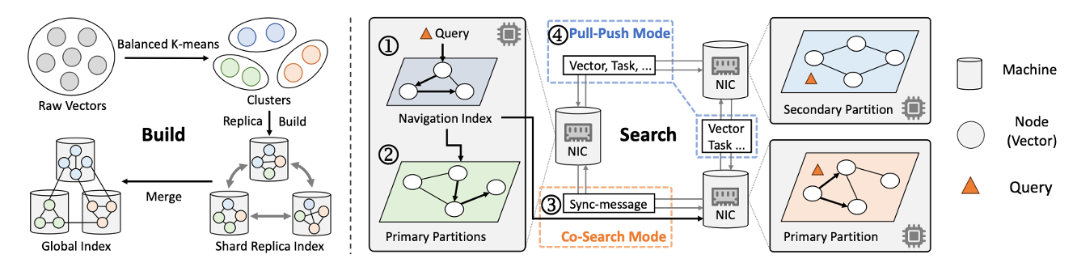
Distributed Vector Search - CoTra [1/3]
Zhi et al. “Towards Efficient and Scalable Distributed Vector Search with RDMA”. arXiv 2025
Goal: Resolve the tension between computation and communication to achieve near-linear scalability.
Contributions:
Collaborative Search: Differentiated execution modes (Co-Search & Push-Pull).

Slide 89
Distributed Vector Search - CoTra [1/3]
Zhi et al. “Towards Efficient and Scalable Distributed Vector Search with RDMA”. arXiv 2025
Goal: Resolve the tension between computation and communication to achieve near-linear scalability.
Contributions:
Collaborative Search: Differentiated execution modes (Co-Search & Push-Pull).
RDMA Integration: Low-latency, high-throughput communication.

Slide 90
Distributed Vector Search - CoTra [2/3]
Zhi et al. “Towards Efficient and Scalable Distributed Vector Search with RDMA”. arXiv 2025
Partitioning & Navigation
Balanced K-means Partitioning: Each machine keeps a similar number of vectors and the adjacency lists of these vectors in the graph index.

Slide 91
Distributed Vector Search - CoTra [2/3]
Zhi et al. “Towards Efficient and Scalable Distributed Vector Search with RDMA”. arXiv 2025
Partitioning & Navigation
Balanced K-means Partitioning: Each machine keeps a similar number of vectors and the adjacency lists of these vectors in the graph index.
Navigation Index: A small sample (e.g., 1%) of the dataset is used to build a replicated navigation index (proximity graph). Quickly identifies "Primary" vs. "Secondary" partitions for each query.

Slide 92
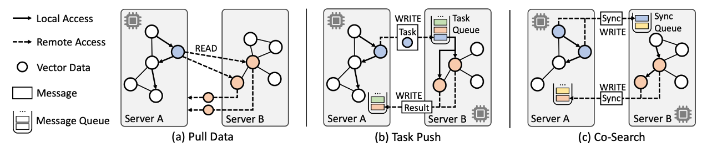
Distributed Vector Search - CoTra [3/3]
Zhi et al. “Towards Efficient and Scalable Distributed Vector Search with RDMA”. arXiv 2025
Collaborative Traversal
Co-Search Mode (Primary Partitions): Machines hosting many relevant vectors run local search.

Slide 93
Distributed Vector Search - CoTra [3/3]
Zhi et al. “Towards Efficient and Scalable Distributed Vector Search with RDMA”. arXiv 2025
Collaborative Traversal
Co-Search Mode (Primary Partitions): Machines hosting many relevant vectors run local search.
Pull-Push Mode (Secondary Partitions): Machines hosting few relevant vectors act as "workers."

Slide 94
Distributed Vector Search - CoTra [3/3]
Zhi et al. “Towards Efficient and Scalable Distributed Vector Search with RDMA”. arXiv 2025
Collaborative Traversal
Co-Search Mode (Primary Partitions): Machines hosting many relevant vectors run local search.
Pull-Push Mode (Secondary Partitions): Machines hosting few relevant vectors act as "workers."
Near-Linear Scalability

Slide 95
Distributed Vector Search - CoTra [3/3]
Zhi et al. “Towards Efficient and Scalable Distributed Vector Search with RDMA”. arXiv 2025
Collaborative Traversal
Co-Search Mode (Primary Partitions): Machines hosting many relevant vectors run local search.
Pull-Push Mode (Secondary Partitions): Machines hosting few relevant vectors act as "workers."
Near-Linear Scalability
RDMA is expensive!

Slide 96
Distributed Vector Search - CoTra [3/3]
Zhi et al. “Towards Efficient and Scalable Distributed Vector Search with RDMA”. arXiv 2025
Dang et al. “Pyramid: A General Framework for Distributed Similarity Search on Large-Scale Dataset”. IEEE Big Data 2019.
Collaborative Traversal
Co-Search Mode (Primary Partitions): Machines hosting many relevant vectors run local search.
Pull-Push Mode (Secondary Partitions): Machines hosting few relevant vectors act as "workers."
Near-Linear Scalability
RDMA is expensive!
Related Systems
Pyramid: It constructs a small meta-HNSW over centroids.

Slide 97
Distributed Vector Search - Graph Partitioning [1/3]
Gottesbüren et al. “Unleashing Graph Partitioning for Large-Scale Nearest Neighbor Search.” VLDB 2025.
Goal: Fast approximate k-NN graph construction based on recursive clustering.
Identify a straightforward way to partition global graph.

Slide 98
Distributed Vector Search - Graph Partitioning [1/3]
Gottesbüren et al. “Unleashing Graph Partitioning for Large-Scale Nearest Neighbor Search.” VLDB 2025.
Goal: Fast approximate k-NN graph construction based on recursive clustering.
Identify a straightforward way to partition global graph.
Contributions: Partitioning via Dense ball clusters algorithm. Routing via Hierarchical K-Means-based Routing (KRT) or Locality Sensitive Hashing-based Routing (HRT).

Slide 99
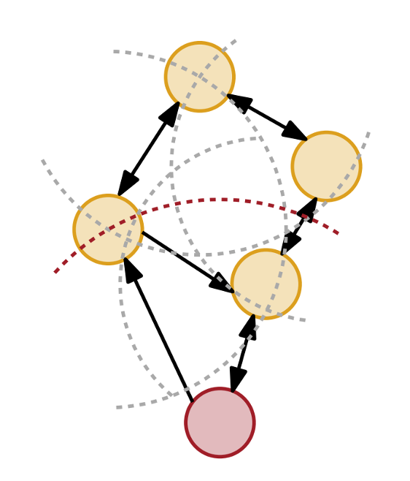
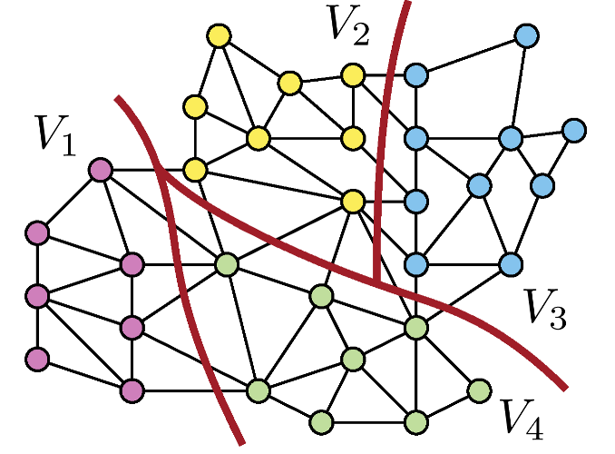
Distributed Vector Search - Graph Partitioning [1/3]
Gottesbüren et al. “Unleashing Graph Partitioning for Large-Scale Nearest Neighbor Search.” VLDB 2025.
Goal: Fast approximate k-NN graph construction based on recursive clustering.
Identify a straightforward way to partition global graph.
Contributions: Partitioning via Dense ball clusters algorithm. Routing via Hierarchical K-Means-based Routing (KRT) or Locality Sensitive Hashing-based Routing (HRT).
Minimize cut edges corresponds to concentrating neighbors in the same shard

Slide 100
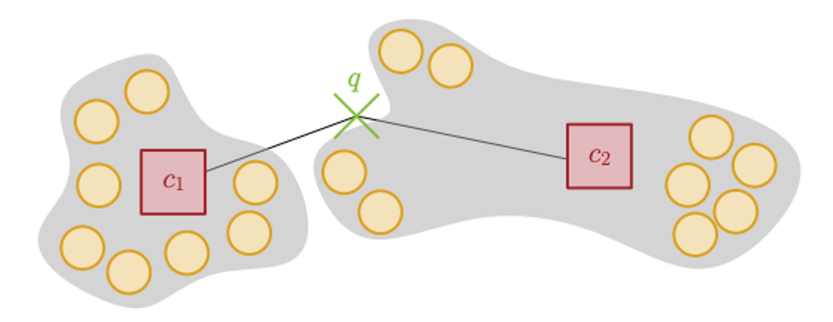
Distributed Vector Search - Graph Partitioning [2/3]
Gottesbüren et al. “Unleashing Graph Partitioning for Large-Scale Nearest Neighbor Search.” VLDB 2025.
Each shard is summarized by multiple coarse representatives. A compact routing index is built from all representatives.

Slide 101
Distributed Vector Search - Graph Partitioning [2/3]
Gottesbüren et al. “Unleashing Graph Partitioning for Large-Scale Nearest Neighbor Search.” VLDB 2025.
Each shard is summarized by multiple coarse representatives. A compact routing index is built from all representatives.
KRT Routing. Hierarchical k-means applied within each shard to build the routing index.

Slide 102
Distributed Vector Search - Graph Partitioning [2/3]
Gottesbüren et al. “Unleashing Graph Partitioning for Large-Scale Nearest Neighbor Search.” VLDB 2025.
Each shard is summarized by multiple coarse representatives. A compact routing index is built from all representatives.
KRT Routing. Hierarchical k-means applied within each shard to build the routing index.
HRT Routing. Based on LSH, the routing index is built by uniformly sampling m data points.

Slide 103
Distributed Vector Search - Graph Partitioning [2/3]
Gottesbüren et al. “Unleashing Graph Partitioning for Large-Scale Nearest Neighbor Search.” VLDB 2025.
Each shard is summarized by multiple coarse representatives. A compact routing index is built from all representatives.
KRT Routing. Hierarchical k-means applied within each shard to build the routing index.
HRT Routing. Based on LSH, the routing index is built by uniformly sampling m data points.
Global Graph building and fast routing.

Slide 104
Distributed Vector Search - Graph Partitioning [2/3]
Gottesbüren et al. “Unleashing Graph Partitioning for Large-Scale Nearest Neighbor Search.” VLDB 2025.
Each shard is summarized by multiple coarse representatives. A compact routing index is built from all representatives.
KRT Routing. Hierarchical k-means applied within each shard to build the routing index.
HRT Routing. Based on LSH, the routing index is built by uniformly sampling m data points.
Global Graph building and fast routing.
Partitioning time is 3x slower.

Slide 105
Distributed Vector Search - Graph Partitioning [3/3]
Dang et al.”Passing the Baton: High Throughput Distributed Disk-Based Vector Search with BatANN”. arXiv 2025.
Adams et al. “DistributedANN: Efficient Scaling of a Single DiskANN Graph Across Thousands of Computers”. arXiv 2025.
Xu et al. “Scalable Distributed Vector Search via Accuracy Preserving Index Construction”. arXiv 2025.
Related Systems
BatANN: Uses Graph Partitioning. Its core innovation is an asynchronous state-passing mechanism: it transfers the entire beam-search state to the destination server.
DISTRIBUTEDANN: It scales a single global DISKANN graph across thousands of machines by treating a distributed key-value store as a large shared disk.
SPIRE: Builds a multi-level hierarchical index by recursively clustering centroids until the top level fits within a single machine’s memory. During query answering, the system performs a top-down traversal.

Slide 106
Distributed Vector Search - IVF Systems
Zhang et al. “Fast, Approximate Vector Queries on Very Large Unstructured Datasets”. NSDI 2023.
Xu et al. “Harmony: A Scalable Distributed Vector Database for High-Throughput Approximate Nearest Neighbor Search”. ACM Manag. Data 2025.
Auncel
Provides bounded error or bounded latency guarantees.
Its core innovation is a query-aware, whitebox Error–Latency Profile (ELP).
Harmony
Builds a standard running k-means.
It then distributes the index using a multi-granularity layout: clusters are sharded across machines (vector-based partition), and each vector is further split by dimension (dimension-based partition).

Slide 107
Summary of the main Parallel and Distributed Systems
Parallel Method | Index | Hardware | Optimization Target
ELPIS [1] | Tree / k-NN Graph | CPU | Throughput
iQAN [2] | k-NN Graph | CPU | Latency
Tagore [3] | k-NN Graph | GPU | Indexing
Quake [4] | IVF | CPU | Latency
ParlayANN [5] | k-NN Graph | CPU | Throughput
FAISS [6] | IVF | GPU | Throughput
Distributed Method | Index | Storage | Optimization Target
BatANN [7] | k-NN Graph | On-disk | Throughput
Graph Partitioning [14] | k-NN Graph | In-memory | Throughput
SPIRE [8] | k-NN Graph | Both | Throughput
Auncel [9] | IVF | In-memory | Latency
Pyramid [10] | k-NN Graph | In-memory | Throughput
DistributedANN [11] | k-NN Graph | Both | Latency
Harmony [12] | IVF | In-memory | Throughput
CoTra [13] | K-NN Graph | In-memory | Latency

Slide 108
Open problems and future directions
Indexing building: partitioning which preserves locality
Query processing: avoid making all machines to be involved
Hybrid Search: Combined vector similarity and scalar/attribute filtering in distributed environments.
Still no support for streaming settings in distributed vector search.

Slide 109
Streaming Vector Search
Many thanks to Lu et al. (VectraFlow), Singh et al. (FreshDiskANN), Xu et al. (IP-DiskANN), Zhang et al. (CleANN), Gong et al. (VStream), who provided supporting material for this part of the tutorial

Slide 110
Motivation
Vectors are no longer static
Frequent and massive amounts of:
  Insertions
  Deletions
  Updates
Static ANN indexes assume offline construction

Slide 111
Motivation
Vectors are no longer static
Frequent and massive amounts of:
  Insertions
  Deletions
  Updates
Static ANN indexes assume offline construction
Static ANN ≠ Dynamic Workloads

Slide 112
Outline
Operations & Update models
Approaches:
  Batched Approaches
  K-NN Graph Approaches
  IVF Approaches
  Other Systems
Open Problems

Slide 113
Operations
Operation | Challenges
Insert | Graph connectivity/centroid staleness
Delete | “Broken” edges / imbalance of distribution
Update | Data drift

Slide 114
Operations
Operation | Challenges
Insert | Graph connectivity/centroid staleness
Delete | “Broken” edges / imbalance of distribution
Update | Data drift
Maintaining index quality under updates is hard

Slide 115
Four update models [1/3]
Granularity:
Batched
Incremental
vs
Materialization:
In-place
Out of place
vs

Slide 116
Four update models [1/3]
Granularity:
Batched
Incremental
vs
Materialization:
In-place
Out of place
vs
Whether updates happen one-by-one or in batches, and whether index changes happen in the index itself or in a secondary data structure

Slide 117
Four update models [1/3] - Granularity
Data Streams
Stream processing
…
insert
Incremental
…
delete
Index
…
update

Slide 118
Four update models [1/3] - Granularity
Data Streams
Stream processing
…
insert
Incremental
…
delete
insert
Index
…
update

Slide 119
Four update models [1/3] - Granularity
Data Streams
Stream processing
…
insert
Incremental
…
delete
insert
Index
…
update

Slide 120
Four update models [1/3] - Granularity
Data Streams
Stream processing
…
insert
Incremental
…
delete
Index
…
update

Slide 121
Four update models [1/3] - Granularity
Data Streams
Stream processing
…
insert
Incremental
…
delete
delete
Index
…
update

Slide 122
Four update models [1/3] - Granularity
Data Streams
Stream processing
…
insert
Incremental
…
delete
delete
Index
…
update

Slide 123
Four update models [1/3] - Granularity
Data Streams
Stream processing
…
insert
Incremental
…
delete
Index
…
update

Slide 124
Four update models [1/3] - Granularity
Data Streams
Stream processing
…
insert
data processed as it arrives in (near) real-time
Incremental
…
delete
Index
…
update

Slide 125
Four update models [1/3] - Granularity
Data Streams
Stream processing
…
insert
data processed as it arrives in (near) real-time
Incremental
…
delete
Index
…
update
Data Streams
Stream processing
…
insert
Batched
…
delete
Index
…
update

Slide 126

Four update models [1/3] - Granularity
Data Streams
Stream processing
…
insert
data processed as it arrives in (near) real-time
Incremental
…
delete
Index
…
update
Data Streams
Stream processing
…
insert
wait
Batched
…
delete
insert
Index
…
update

Slide 127
Four update models [1/3] - Granularity
Data Streams
Stream processing
…
insert
data processed as it arrives in (near) real-time
Incremental
…
delete
Index
…
update
Data Streams
Stream processing
…
insert
wait
Batched
…
delete
delete
insert
Index
…
update

Slide 128
Four update models [1/3] - Granularity
Data Streams
Stream processing
…
insert
data processed as it arrives in (near) real-time
Incremental
…
delete
Index
…
update
Data Streams
Stream processing
…
insert
wait
Batched
…
delete
delete
delete
insert
Index
…
update

Slide 129
Four update models [1/3] - Granularity
Data Streams
Stream processing
…
insert
data processed as it arrives in (near) real-time
Incremental
…
delete
Index
…
update
Data Streams
Stream processing
…
insert
Batched
…
delete
delete
delete
insert
Index
…
update
consolidation!

Slide 130
Four update models [1/3] - Granularity
Data Streams
Stream processing
…
insert
data processed as it arrives in (near) real-time
Incremental
…
delete
Index
…
update
Data Streams
Stream processing
…
insert
Batched
…
delete
delete
delete
insert
Index
…
update

Slide 131
Four update models [1/3] - Granularity
Data Streams
Stream processing
…
insert
data processed as it arrives in (near) real-time
Incremental
…
delete
Index
…
update
Data Streams
Stream processing
…
insert
Batched
…
delete
Index
…
update

Slide 132
Four update models [1/3] - Granularity
Data Streams
Stream processing
…
insert
data processed as it arrives in (near) real-time
Incremental
…
delete
Index
…
update
process large amounts of data
Data Streams
Stream processing
…
insert
Batched
…
delete
Index
…
update

Slide 133
Four update models [2/3] - Materialization
Data Streams
Stream processing
…
insert
In-place
…
delete
Index
…
update

Slide 134
Four update models [2/3] - Materialization
Data Streams
Stream processing
…
insert
In-place
…
delete
insert
Index
…
update

Slide 135
Four update models [2/3] - Materialization
Data Streams
Stream processing
…
insert
In-place
…
delete
insert
Index
…
update

Slide 136
Four update models [2/3] - Materialization
Data Streams
Stream processing
…
insert
In-place
…
delete
Index
…
update

Slide 137
Four update models [2/3] - Materialization
Data Streams
Stream processing
…
insert
In-place
…
delete
delete
Index
…
update

Slide 138
Four update models [2/3] - Materialization
Data Streams
Stream processing
…
insert
In-place
…
delete
delete
Index
…
update

Slide 139
Four update models [2/3] - Materialization
Data Streams
Stream processing
…
insert
In-place
…
delete
Index
…
update

Slide 140
Four update models [2/3] - Materialization
Data Streams
Stream processing
…
insert
In-place
…
delete
direct changes in the index
Index
…
update

Slide 141
Four update models [2/3] - Materialization
Data Streams
Stream processing
…
insert
In-place
…
delete
direct changes in the index
Index
…
update
Stream processing
…
insert
…
Out of place
delete
delete
Index
…
update
Aux. Data Structure

Slide 142
Four update models [2/3] - Materialization
Data Streams
Stream processing
…
insert
In-place
…
delete
direct changes in the index
Index
…
update
Stream processing
…
insert
…
Out of place
delete
delete
Index
…
update
Aux. Data Structure

Slide 143
Four update models [2/3] - Materialization
Data Streams
Stream processing
…
insert
In-place
…
delete
direct changes in the index
Index
…
update
Stream processing
…
insert
…
Out of place
delete
Index
…
update
delete
Aux. Data Structure

Slide 144
Four update models [2/3] - Materialization
Data Streams
Stream processing
…
insert
In-place
…
delete
direct changes in the index
Index
…
update
Stream processing
…
insert
…
Out of place
delete
Index
…
update
delete
deleted vectors first marked in the index
then removed at a later point
Aux. Data Structure

Slide 145
Four update models [2/3] - Materialization
Data Streams
Stream processing
…
insert
In-place
…
delete
direct changes in the index
Index
…
update
Stream processing
…
insert
…
Out of place
delete
insert
Index
…
update
delete
Aux. Data Structure

Slide 146
Four update models [2/3] - Materialization
Data Streams
Stream processing
…
insert
In-place
…
delete
direct changes in the index
Index
…
update
Stream processing
…
insert
…
Out of place
delete
insert
Index
…
update
delete
Aux. Data Structure

Slide 147
Four update models [2/3] - Materialization
Data Streams
Stream processing
…
insert
In-place
…
delete
direct changes in the index
Index
…
update
Stream processing
…
insert
…
Out of place
delete
insert
Index
…
update
delete
Aux. Data Structure

Slide 148
Four update models [2/3] - Materialization
Data Streams
Stream processing
…
insert
In-place
…
delete
direct changes in the index
Index
…
update
Stream processing
…
insert
…
Out of place
delete
Index
…
update
delete
Aux. Data Structure

Slide 149
Four update models [2/3] - Materialization
Data Streams
Stream processing
…
insert
In-place
…
delete
direct changes in the index
Index
…
update
Stream processing
…
insert
…
Out of place
delete
delete
Index
…
update
delete
Aux. Data Structure

Slide 150
Four update models [2/3] - Materialization
Data Streams
Stream processing
…
insert
In-place
…
delete
direct changes in the index
Index
…
update
Stream processing
…
insert
…
Out of place
delete
delete
Index
…
update
delete
Aux. Data Structure

Slide 151
Four update models [2/3] - Materialization
Data Streams
Stream processing
…
insert
In-place
…
delete
direct changes in the index
Index
…
update
Stream processing
…
insert
…
Out of place
delete
Index
…
update
delete
delete
Aux. Data Structure

Slide 152
Four update models [2/3] - Materialization
Data Streams
Stream processing
…
insert
In-place
…
delete
direct changes in the index
Index
…
update
Stream processing
…
insert
…
Out of place
delete
update
Index
…
update
delete
delete
Aux. Data Structure

Slide 153
Four update models [2/3] - Materialization
Data Streams
Stream processing
…
insert
In-place
…
delete
direct changes in the index
Index
…
update
Stream processing
…
insert
update = deletion + insertion
…
insert
Out of place
delete
delete
Index
…
update
delete
delete
Aux. Data Structure

Slide 154
Four update models [2/3] - Materialization
Data Streams
Stream processing
…
insert
In-place
…
delete
direct changes in the index
Index
…
update
Stream processing
…
insert
…
insert
Out of place
delete
Index
…
update
delete
delete
delete
Aux. Data Structure

Slide 155
Four update models [2/3] - Materialization
Data Streams
Stream processing
…
insert
In-place
…
delete
direct changes in the index
Index
…
update
Stream processing
…
insert
…
insert
Out of place
delete
Index
…
update
delete
delete
delete
Aux. Data Structure

Slide 156
Four update models [2/3] - Materialization
Data Streams
Stream processing
…
insert
In-place
…
delete
direct changes in the index
Index
…
update
Stream processing
…
insert
…
Out of place
delete
Index
…
update
delete
delete
delete
Aux. Data Structure

Slide 157
Four update models [2/3] - Materialization
Data Streams
Stream processing
…
insert
In-place
…
delete
direct changes in the index
Index
…
update
Stream processing
…
insert
…
Out of place
delete
consolidation!
Index
…
update
delete
delete
delete
deleted vectors removed from the index
Aux. Data Structure

Slide 158
Four update models [2/3] - Materialization
Data Streams
Stream processing
…
insert
In-place
…
delete
direct changes in the index
Index
…
update
Stream processing
…
insert
…
Out of place
delete
Index
…
update
Aux. Data Structure

Slide 159
Four update models [2/3] - Materialization
Data Streams
Stream processing
…
insert
In-place
…
delete
direct changes in the index
Index
…
update
changes stored in an auxiliary data structure
Stream processing
…
insert
…
Out of place
delete
Index
…
update
Aux. Data Structure

Slide 160
Four update models [2/3] - Materialization
Data Streams
Stream processing
…
insert
In-place
…
delete
direct changes in the index
Index
…
update
changes stored in an auxiliary data structure
Stream processing
…
insert
delete list
delete list
…
Out of place
delete
insert list
Index
…
update
Aux. Data Structure

Slide 161
Four update models [2/3]
Batched
Accumulate updates
Periodic rebuild
High quality
High latency
Incremental
Immediate visibility
Local rebuilds
Low latency
Risk of index degradation
Data Streams
Stream processing
Data Streams
Stream processing
…
insert
…
insert
Batched
…
delete
delete
insert
insert
Incremental
…
delete
insert
…
Index
…
Index
update
update

Slide 162
Four update models [2/3]
Batched
Accumulate updates
Periodic rebuild
High quality
High latency
Incremental
Immediate visibility
Local rebuilds
Low latency
Risk of index degradation
Data Streams
Stream processing
Data Streams
Stream processing
…
insert
…
insert
Batched
…
delete
delete
insert
insert
Incremental
…
delete
insert
…
Index
…
Index
update
update
Latency vs Recall (Freshness) Tradeoff

Slide 163
Four update models [3/3]
In-place
Direct modifications on the index
Immediate visibility of updates
Memory efficient
Complex concurrency
Out of place
Updates stored separately
Periodic merge into main index
Simpler consistency
Higher memory usage
Data Streams
Stream processing
Stream processing
…
insert
…
insert
…
In-place
…
delete
Out of place
delete
…
Index
…
Index
update
update
delete
delete
delete
Aux. Index

Slide 164
Four update models [3/3]
In-place
Direct modifications on the index
Immediate visibility of updates
Memory efficient
Complex concurrency
Out of place
Updates stored separately
Periodic merge into main index
Simpler consistency
Higher memory usage
Data Streams
Stream processing
Stream processing
…
insert
…
insert
…
In-place
…
delete
Out of place
delete
…
Index
…
Index
update
update
delete
delete
delete
Aux. Index
Memory vs Latency Tradeoff

Slide 165
Batched approaches

Slide 166
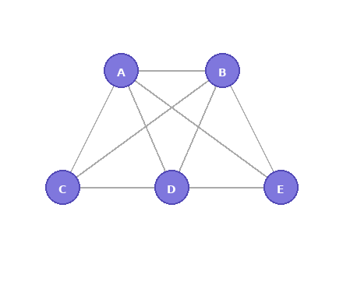
DEG [1/1]
Hezel et al. "Fast Approximate Nearest Neighbor Search with a Dynamic Exploration Graph using Continuous Refinement" arXiv 2023
Existing graph indexes are not dynamic, or lack connectivity guarantees
Guaranteed connectivity via Eulerian graph property
Incremental construction by replacing existing edges (no rebuild needed)
Dynamic edge optimization: continuously swaps edges to minimize average neighbor distance
for degre=4

Slide 167
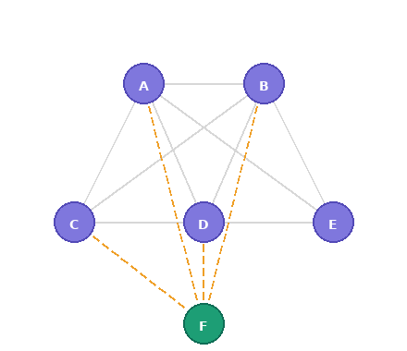
DEG [1/1]
Hezel et al. "Fast Approximate Nearest Neighbor Search with a Dynamic Exploration Graph using Continuous Refinement" arXiv 2023
Existing graph indexes are not dynamic, or lack connectivity guarantees
Guaranteed connectivity via Eulerian graph property
Incremental construction by replacing existing edges (no rebuild needed)
Dynamic edge optimization: continuously swaps edges to minimize average neighbor distance
for degre=4

Slide 168
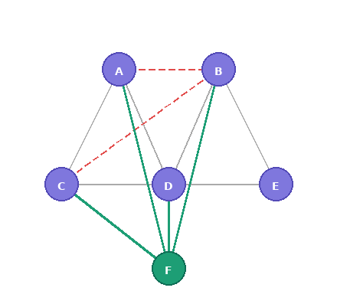
DEG [1/1]
Hezel et al. "Fast Approximate Nearest Neighbor Search with a Dynamic Exploration Graph using Continuous Refinement" arXiv 2023
Existing graph indexes are not dynamic, or lack connectivity guarantees
Guaranteed connectivity via Eulerian graph property
Incremental construction by replacing existing edges (no rebuild needed)
Dynamic edge optimization: continuously swaps edges to minimize average neighbor distance
for degre=4

Slide 169
DEG [1/1]
Hezel et al. "Fast Approximate Nearest Neighbor Search with a Dynamic Exploration Graph using Continuous Refinement" arXiv 2023
Existing graph indexes are not dynamic, or lack connectivity guarantees
Guaranteed connectivity via Eulerian graph property
Incremental construction by replacing existing edges (no rebuild needed)
Dynamic edge optimization: continuously swaps edges to minimize average neighbor distance
Results: 15–50% faster than HNSW at high recall
for degre=4

Slide 170
DEG [1/1]
Hezel et al. "Fast Approximate Nearest Neighbor Search with a Dynamic Exploration Graph using Continuous Refinement" arXiv 2023
Existing graph indexes are not dynamic, or lack connectivity guarantees
Guaranteed connectivity via Eulerian graph property
Incremental construction by replacing existing edges (no rebuild needed)
Dynamic edge optimization: continuously swaps edges to minimize average neighbor distance
Results: 15–50% faster than HNSW at high recall
No deletion support yet
for degre=4

Slide 171
SVS [1/1]
Aguerrebere et al. "Similarity Search in the Blink of an Eye with Compressed Indices" VLDB 2023
Graph-based search is memory-bandwidth limited; existing compression (PQ) requires keeping full-precision vectors for re-ranking, defeating the purpose of compression.
Locally-adaptive Vector Quantization (LVQ): per-vector scaling + scalar quantization
Two-level quantization (LVQ-B1×B2) for residuals to recover accuracy

Slide 172
SVS [1/1]
Aguerrebere et al. "Similarity Search in the Blink of an Eye with Compressed Indices" VLDB 2023
Graph-based search is memory-bandwidth limited; existing compression (PQ) requires keeping full-precision vectors for re-ranking, defeating the purpose of compression.
Locally-adaptive Vector Quantization (LVQ): per-vector scaling + scalar quantization
Two-level quantization (LVQ-B1×B2) for residuals to recover accuracy
Up to 20.7× throughput over FAISS-IVFPQfs; up to 3× memory reduction; 33× multi-thread scaling
Static/batch workloads

Slide 173
K-NN Graph approaches

Slide 174
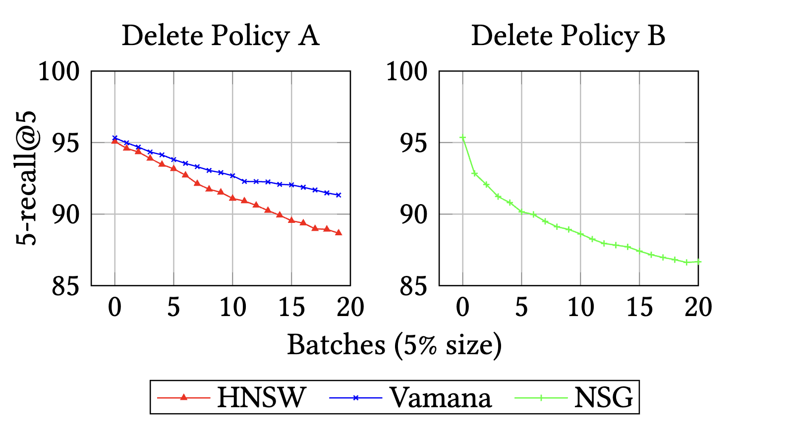
FreshDiskANN [1/4]
Singh et al. "FreshDiskANN: A Fast and Accurate Graph-Based ANN Index for Streaming Similarity Search" arXiv 2021
Motivation: Deletes are hard
HNSW, NSG, and Vamana
Delete Policy A → Remove all edges
Delete Policy B → Remove all edges
Add all in/out pairs and prune

Slide 175
FreshDiskANN [1/4]
Singh et al. "FreshDiskANN: A Fast and Accurate Graph-Based ANN Index for Streaming Similarity Search" arXiv 2021
Motivation: Deletes are hard
HNSW, NSG, and Vamana
Delete Policy A → Remove all edges
Delete Policy B → Remove all edges
Add all in/out pairs and prune
This graph becomes sparse!

Slide 176
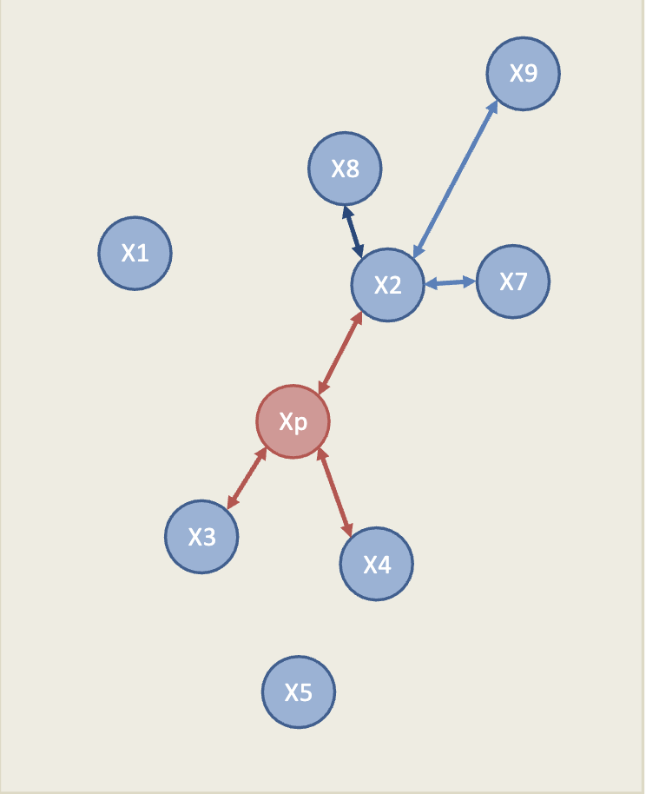
FreshDiskANN [2/4]
Singh et al. "FreshDiskANN: A Fast and Accurate Graph-Based ANN Index for Streaming Similarity Search" arXiv 2021
Insert
Query Nearest Neighbors: {X1, X2, X3, X4, X5}
Xp

Slide 177
FreshDiskANN [2/4]
Singh et al. "FreshDiskANN: A Fast and Accurate Graph-Based ANN Index for Streaming Similarity Search" arXiv 2021
Insert
Query Nearest Neighbors: {X1, X2, X3, X4, X5}
Xp

Slide 178
FreshDiskANN [2/4]
Singh et al. "FreshDiskANN: A Fast and Accurate Graph-Based ANN Index for Streaming Similarity Search" arXiv 2021
Insert
Query Nearest Neighbors: {X1, X2, X3, X4, X5}
Find Candidate Out-Neighbors: {X2, X3, X4}
Xp

Slide 179
FreshDiskANN [2/4]
Singh et al. "FreshDiskANN: A Fast and Accurate Graph-Based ANN Index for Streaming Similarity Search" arXiv 2021
Insert
Query Nearest Neighbors: {X1, X2, X3, X4, X5}
Find Candidate Out-Neighbors: {X2, X3, X4}
Add Bi-Directional Edges: (Xp <-> X2),
(Xp <-> X3), (Xp <-> X4)
Xp

Slide 180
FreshDiskANN [2/4]
Singh et al. "FreshDiskANN: A Fast and Accurate Graph-Based ANN Index for Streaming Similarity Search" arXiv 2021
Insert
Query Nearest Neighbors: {X1, X2, X3, X4, X5}
Find Candidate Out-Neighbors: {X2, X3, X4}
Add Bi-Directional Edges: (Xp <-> X2),
(Xp <-> X3), (Xp <-> X4)
Concurrency Control with lock
Xp

Slide 181
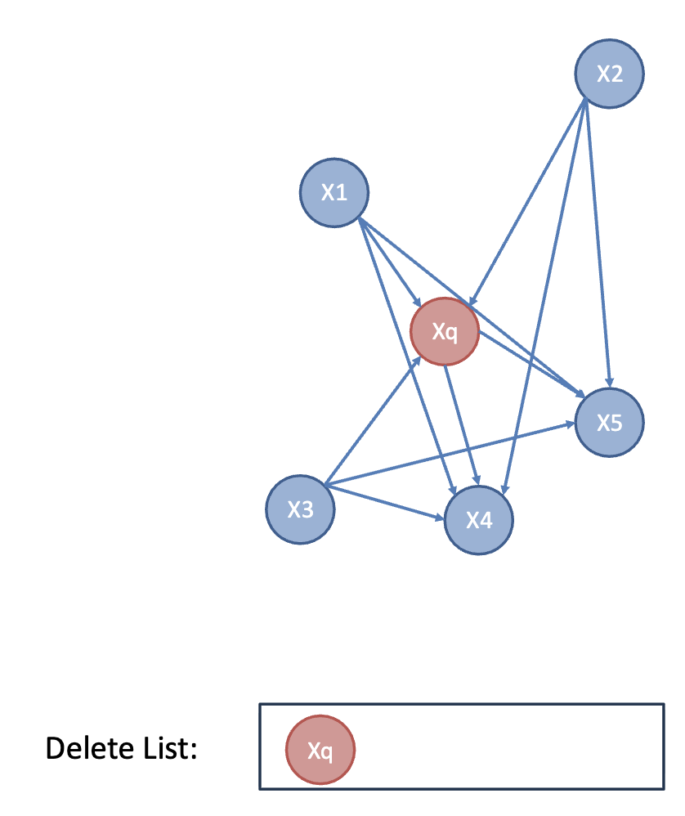
FreshDiskANN [3/4]
Singh et al. "FreshDiskANN: A Fast and Accurate Graph-Based ANN Index for Streaming Similarity Search" arXiv 2021
Update
Lazy Deletion:
  Stay there with In-neighbours (X1, X2)
  and out-neighbours (X3, X4, X5)
  Add to Delete List
Search Adjustments:
  Filter result with Delete List
Delete Consolidation
  Batch update
  Delete node / add edges
  Prune

Slide 182
IP-DiskANN [1/2]
Xu et al. "In-place Updates of a Graph Index for Streaming Approximate Nearest Neighbor Search" arXiv 2025
Handles deletions without batch consolidation
FreshDiskANN accumulates deletions and consolidates periodically,
causing latency spikes and resource overheads
IP-DiskANN processes every insertion and deletion in-place, maintaining a single live graph at all times
IP-DiskANN vs FreshDiskANN
35% faster deletions and recall improvement

Slide 183
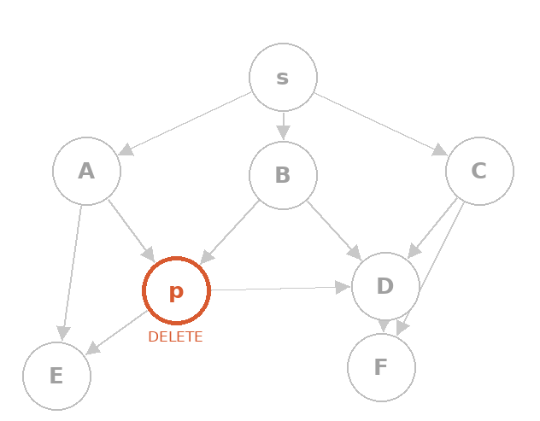
IP-DiskANN [2/2]
Xu et al. "In-place Updates of a Graph Index for Streaming Approximate Nearest Neighbor Search" arXiv 2025
GreedySearch with P as query

Slide 184
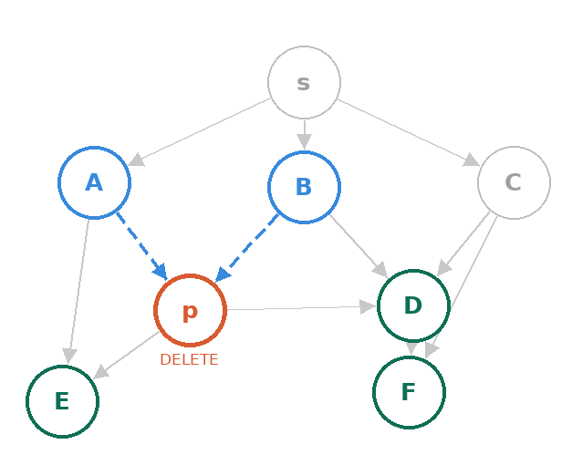
IP-DiskANN [2/2]
Xu et al. "In-place Updates of a Graph Index for Streaming Approximate Nearest Neighbor Search" arXiv 2025
GreedySearch with P as query
Find approximate in-neighbors: {A, B}

Slide 185
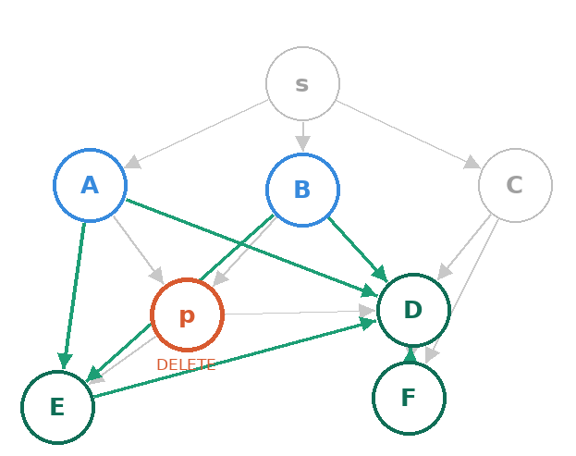
IP-DiskANN [2/2]
Xu et al. "In-place Updates of a Graph Index for Streaming Approximate Nearest Neighbor Search" arXiv 2025
GreedySearch with P as query
Find approximate in-neighbors: {A, B}
Rewire in-neighbors: add closest Candidates {D, E, F} to each {A, B}
Rewire out-neighbors: for each w in Nout(p), find nodes near w and add edge → w

Slide 186
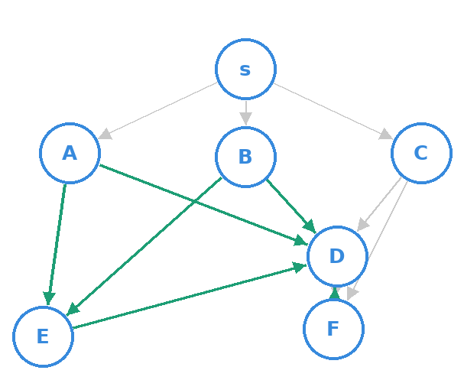
IP-DiskANN [2/2]
Xu et al. "In-place Updates of a Graph Index for Streaming Approximate Nearest Neighbor Search" arXiv 2025
GreedySearch with P as query
Find approximate in-neighbors: {A, B}
Rewire in-neighbors: add closest Candidates {D, E, F} to each {A, B}
Rewire out-neighbors: for each w in Nout(p), find nodes near w and add edge → w
Remove p immediately

Slide 187
CleANN [1/3]
Zhang et al. "CleANN: Efficient Full Dynamism in Graph-based Approximate Nearest Neighbor Search" arXiv 2025
Problem with existing systems:
FreshDiskANN: periodic global consolidation → throughput spikes
IP-DiskANN: in-place deletions but no concurrency
Both suffer from insertion robustness
CleANN's solution:
Bridge Building: adds "shortcut" edges during search tree traversal
On-the-fly Consolidation: cleanup triggered by query traffic, not batch scans
Semi-Lazy Cleaning: deleted nodes recycled after C consolidations, no full cleanup needed

Slide 188
CleANN [1/3]
Zhang et al. "CleANN: Efficient Full Dynamism in Graph-based Approximate Nearest Neighbor Search" arXiv 2025
Problem with existing systems:
FreshDiskANN: periodic global consolidation → throughput spikes
IP-DiskANN: in-place deletions but no concurrency
Both suffer from insertion robustness
CleANN's solution:
Bridge Building: adds "shortcut" edges during search tree traversal
On-the-fly Consolidation: cleanup triggered by query traffic, not batch scans
Semi-Lazy Cleaning: deleted nodes recycled after C consolidations, no full cleanup needed
CleANN vs FreshDiskANN: 7–1200x throughput, similar recall
CleANN vs IP-DiskANN: 3x update throughput, 1.5x search throughput (single thread)
explore how the parameter selection affects performance

Slide 189
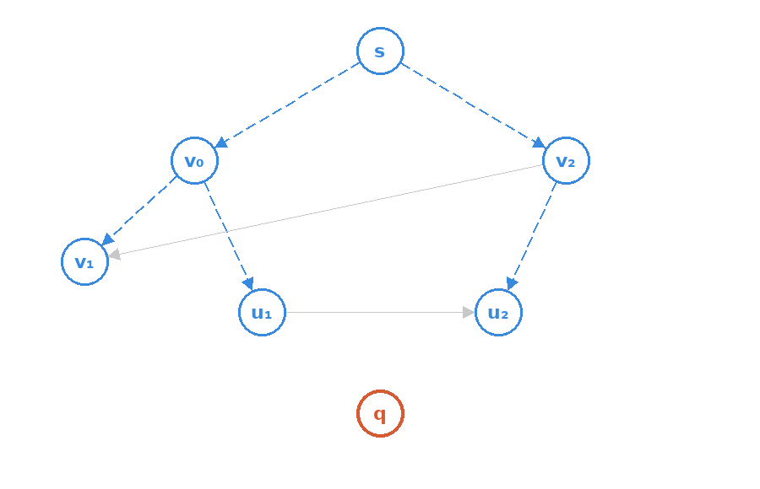
CleANN [2/3] - Insert
Zhang et al. "CleANN: Efficient Full Dynamism in Graph-based Approximate Nearest Neighbor Search" arXiv 2025
GreedySearch with q as query

Slide 190
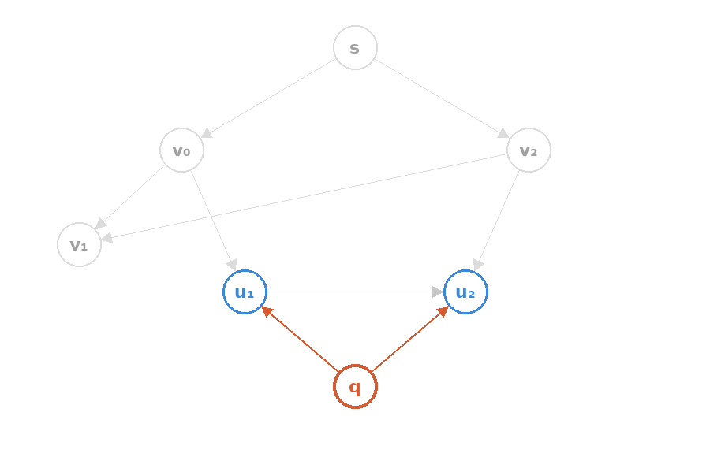
CleANN [2/3] - Insert
Zhang et al. "CleANN: Efficient Full Dynamism in Graph-based Approximate Nearest Neighbor Search" arXiv 2025
GreedySearch with q as query
Find ANN: {u₁, u₂}; q is connected.

Slide 191
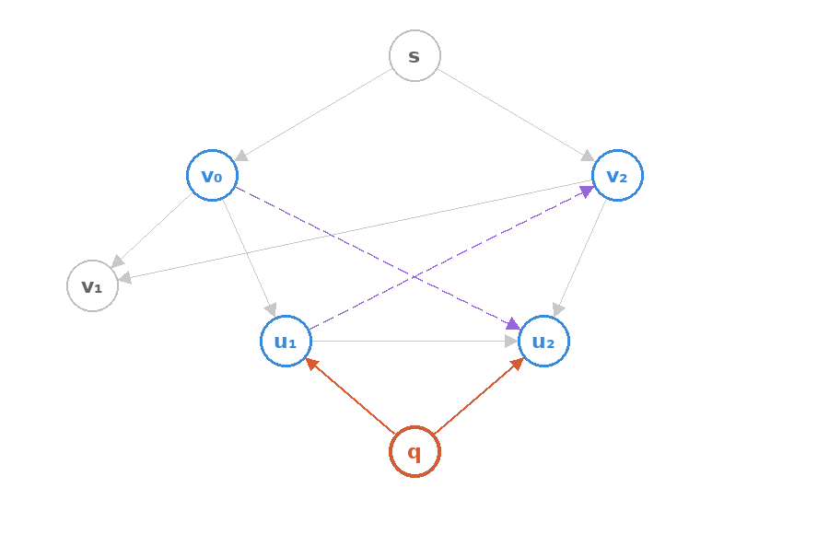
CleANN [2/3] - Insert
Zhang et al. "CleANN: Efficient Full Dynamism in Graph-based Approximate Nearest Neighbor Search" arXiv 2025
GreedySearch with q as query
Find ANN: {u₁, u₂}; q is connected.
Find bridge candidates {v₀↔u₂, u₁↔v₂}

Slide 192
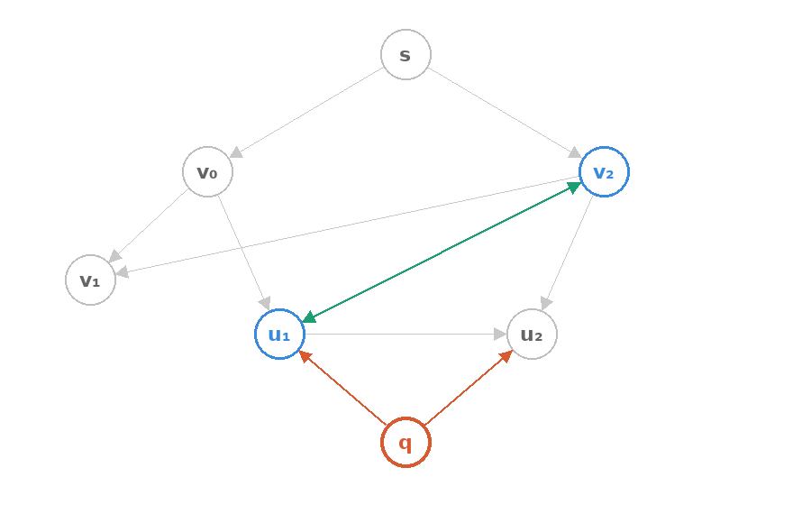
CleANN [2/3] - Insert
Zhang et al. "CleANN: Efficient Full Dynamism in Graph-based Approximate Nearest Neighbor Search" arXiv 2025
GreedySearch with q as query
Find ANN: {u₁, u₂}; q is connected.
Find bridge candidates {v₀↔u₂, u₁↔v₂}
v₀→u₂ is pruned; bridge edge u₁↔v₂ is added, improving navigability.

Slide 193
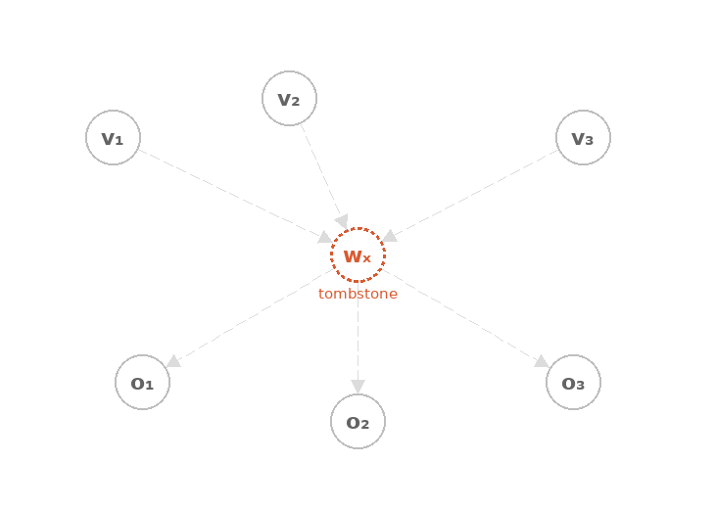
CleANN [3/3] - Delete
Zhang et al. "CleANN: Efficient Full Dynamism in Graph-based Approximate Nearest Neighbor Search" arXiv 2025
x is deleted — wₓ becomes a tombstone, queries still traverse it but filter it out.

Slide 194
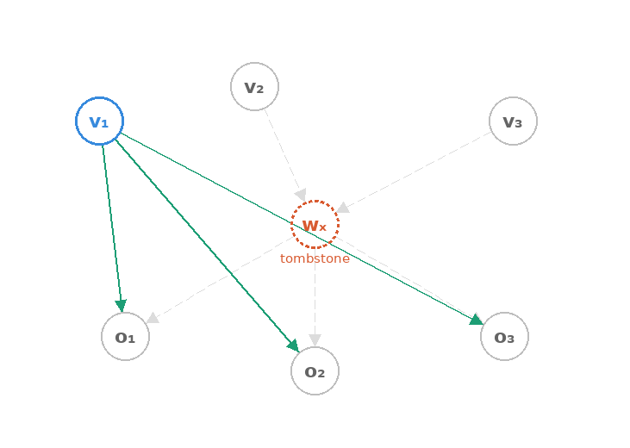
CleANN [3/3] - Delete
Zhang et al. "CleANN: Efficient Full Dynamism in Graph-based Approximate Nearest Neighbor Search" arXiv 2025
x is deleted — wₓ becomes a tombstone, queries still traverse it but filter it out.
A search traverses v₁ → wₓ; v₁ immediately consolidates, absorbing {o₁, o₂, o₃} into N(v₁). Edge v₁→wₓ removed.

Slide 195
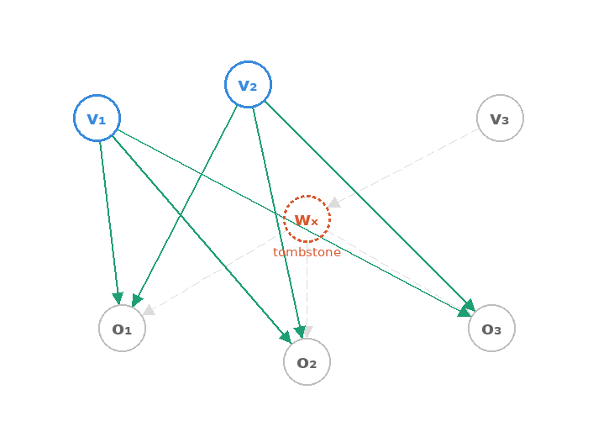
CleANN [3/3] - Delete
Zhang et al. "CleANN: Efficient Full Dynamism in Graph-based Approximate Nearest Neighbor Search" arXiv 2025
x is deleted — wₓ becomes a tombstone, queries still traverse it but filter it out.
A search traverses v₁ → wₓ; v₁ immediately consolidates, absorbing {o₁, o₂, o₃} into N(v₁). Edge v₁→wₓ removed.
v₂ also consolidates with wₓ. H(wₓ) hits threshold C=2 → wₓ marked replaceable.

Slide 196
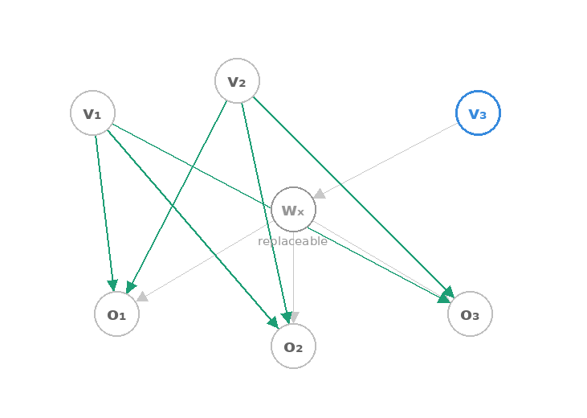
CleANN [3/3] - Delete
Zhang et al. "CleANN: Efficient Full Dynamism in Graph-based Approximate Nearest Neighbor Search" arXiv 2025
x is deleted — wₓ becomes a tombstone, queries still traverse it but filter it out.
A search traverses v₁ → wₓ; v₁ immediately consolidates, absorbing {o₁, o₂, o₃} into N(v₁). Edge v₁→wₓ removed.
v₂ also consolidates with wₓ. H(wₓ) hits threshold C=2 → wₓ marked replaceable.

Slide 197
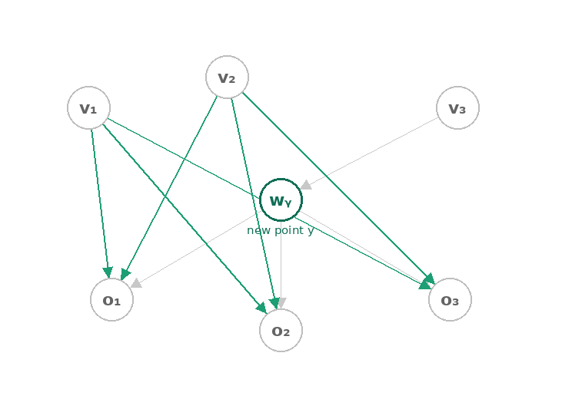
CleANN [3/3] - Delete
Zhang et al. "CleANN: Efficient Full Dynamism in Graph-based Approximate Nearest Neighbor Search" arXiv 2025
x is deleted — wₓ becomes a tombstone, queries still traverse it but filter it out.
A search traverses v₁ → wₓ; v₁ immediately consolidates, absorbing {o₁, o₂, o₃} into N(v₁). Edge v₁→wₓ removed.
v₂ also consolidates with wₓ. H(wₓ) hits threshold C=2 → wₓ marked replaceable.
New point y reuses wₓ's slot (now wᵧ).

Slide 198
IVF approaches

Slide 199
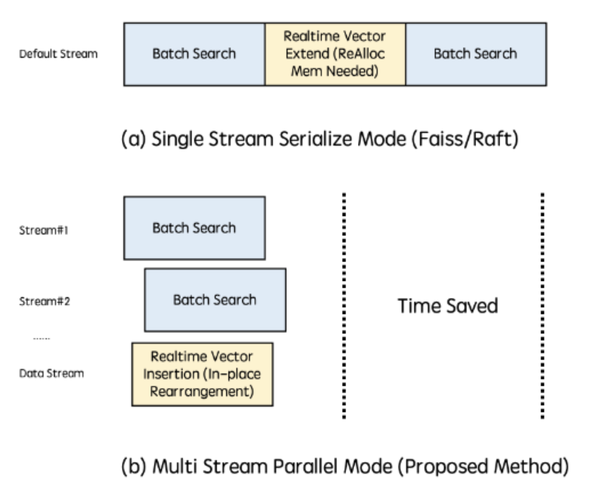
RTAMS-GANNS [1/1]
Sun et al. "A Real-Time Adaptive Multi-Stream GPU System for Online Approximate Nearest Neighborhood Search" CIKM 2024
Fixes real-time insertion on GPUs with two ideas:
Memory blocks: instead of one big array, memory is pre-split into small linked blocks — new vectors claim the next free block
Multi-stream execution: search queries each get their own stream, all run in parallel
Result: 40–80% lower latency, deployed live at Xiaohongshu serving 100M+ users daily
Only for IVF

Slide 200
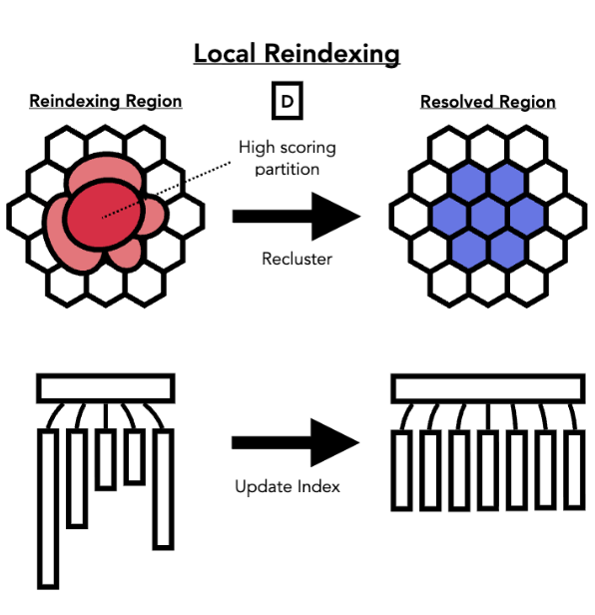
Streaming for IVF [1/2] - Ada-IVF
Mohoney et al. "Incremental IVF Index Maintenance for Streaming Vector Search" arXiv 2024
Problem: Centroids become outdated as distribution shifts

Slide 201
Streaming for IVF [1/2] - Ada-IVF
Mohoney et al. "Incremental IVF Index Maintenance for Streaming Vector Search" arXiv 2024
Problem: Centroids become outdated as distribution shifts
Can be sensitive to distribution shift

Slide 202
Streaming for IVF [1/2] - Ada-IVF
Mohoney et al. "Incremental IVF Index Maintenance for Streaming Vector Search" arXiv 2024
Problem: Centroids become outdated as distribution shifts
Can be sensitive to distribution shift
Local updates for IVF

Slide 203
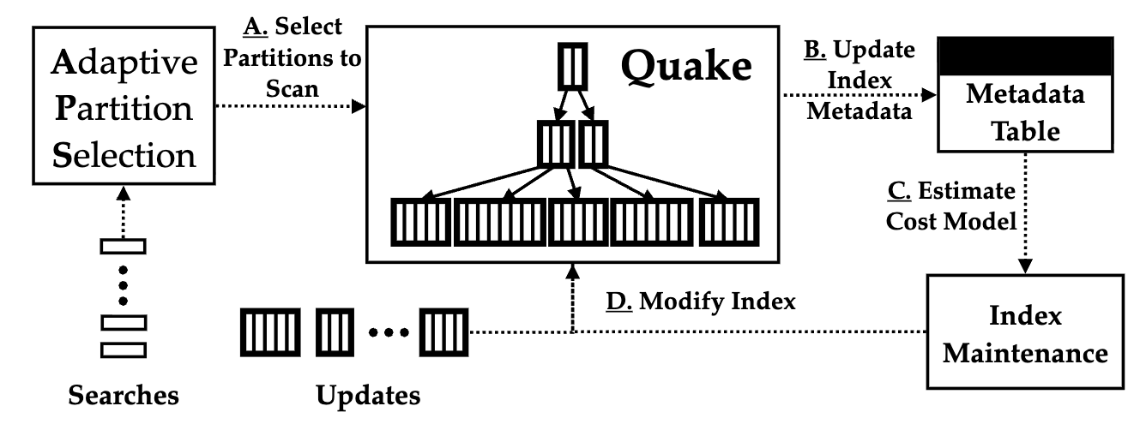
Streaming for IVF [2/2] - Quake
Mohoney et al. "Quake: Adaptive Indexing for Vector Search" OSDI 2025
Problem: Data is usually dynamic & skewed

Slide 204
Streaming for IVF [2/2] - Quake
Mohoney et al. "Quake: Adaptive Indexing for Vector Search" OSDI 2025
Problem: Data is usually dynamic & skewed

Slide 205
Streaming for IVF [2/2] - Quake
Mohoney et al. "Quake: Adaptive Indexing for Vector Search" OSDI 2025
Problem: Data is usually dynamic & skewed

Slide 206
Streaming for IVF [2/2] - Quake
Mohoney et al. "Quake: Adaptive Indexing for Vector Search" OSDI 2025
Problem: Data is usually dynamic & skewed

Slide 207
Streaming for IVF [2/2] - Quake
Mohoney et al. "Quake: Adaptive Indexing for Vector Search" OSDI 2025
Adaptive maintenance guided by cost model
Problem: Data is usually dynamic & skewed

Slide 208
Streaming for IVF [2/2] - Quake
Mohoney et al. "Quake: Adaptive Indexing for Vector Search" OSDI 2025
Adaptive maintenance guided by cost model
explore how searches, updates & maintenance can run in parallel
Problem: Data is usually dynamic & skewed

Slide 209
Other Systems

Slide 210
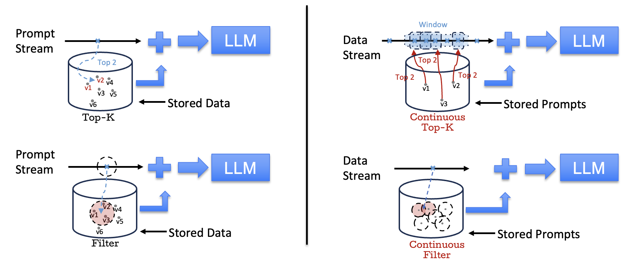
VectraFlow [1/2]
Lu et al. "VectraFlow: Integrating Vectors into Stream Processing" CIDR 2025
Traditional RAG
Continuous RAG

Slide 211
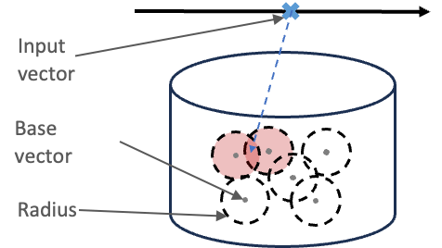
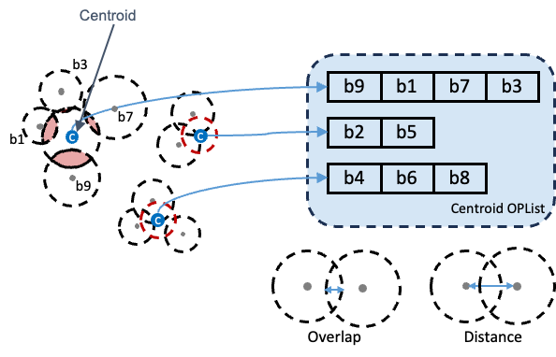
VectraFlow [2/2]- iV-Filter
Lu et al. "VectraFlow: Integrating Vectors into Stream Processing" CIDR 2025
Continuous prompts as base vectors
Each base vector has a radius
  Similarity threshold
Selects input vectors that fall within the radii of base vectors
OPList (Overlapped Partition List):
OPList: list of base vectors that overlap with the given base vector
Centroid OPList: cluster base vectors and assign a radius + OPList to each centroid

Slide 212

SPFresh [1/1]
Xu et al. "SPFresh: Incremental In-Place Update for Billion-Scale Vector Search" SOSP 2023
Problem: Existing systems avoid in-place updates, accumulate changes in secondary index and periodically rebuild entire index globally.
This rebuild for DiskANN is expensive as it requires more than a day for a 1-billion vector index.
SPFresh:
Uses LIRE protocol
Split/merge partitions locally and reassign only the vectors at the boundaries

Slide 213
SPFresh [1/1]
Xu et al. "SPFresh: Incremental In-Place Update for Billion-Scale Vector Search" SOSP 2023
Problem: Existing systems avoid in-place updates, accumulate changes in secondary index and periodically rebuild entire index globally.
This rebuild for DiskANN is expensive as it requires more than a day for a 1-billion vector index.
SPFresh:
Uses LIRE protocol
Split/merge partitions locally and reassign only the vectors at the boundaries
Works with cluster-based indexes

Slide 214
SPFresh [1/1]
Xu et al. "SPFresh: Incremental In-Place Update for Billion-Scale Vector Search" SOSP 2023
Problem: Existing systems avoid in-place updates, accumulate changes in secondary index and periodically rebuild entire index globally.
This rebuild for DiskANN is expensive as it requires more than a day for a 1-billion vector index.
SPFresh:
Uses LIRE protocol
Split/merge partitions locally and reassign only the vectors at the boundaries
Works with cluster-based indexes
No global rebuilds

Slide 215

VStream [1/4]
Gong et al. "VStream: A Distributed Streaming Vector Search System" VLDB 2025
Existing vector DBs operate as external services detached from streaming engines.

Slide 216

VStream [2/4]
Gong et al. "VStream: A Distributed Streaming Vector Search System" VLDB 2025
Dynamic partitioner: LSH + space-filling curves groups similar vectors in the same partition → queries skip irrelevant partitions

Slide 217
VStream [3/4]
Gong et al. "VStream: A Distributed Streaming Vector Search System" VLDB 2025
Dynamic partitioner: LSH + space-filling curves groups similar vectors in the same partition → queries skip irrelevant partitions
Hierarchical storage: 4 levels, recent data stays at top

Slide 218
VStream [4/4]
Gong et al. "VStream: A Distributed Streaming Vector Search System" VLDB 2025
Dynamic partitioner: LSH + space-filling curves groups similar vectors in the same partition → queries skip irrelevant partitions
Hierarchical storage: 4 levels, recent data stays at top
Hot-cold separation: scores data segments by access frequency, search hits, and freshness

Slide 219
Summary of the approaches
Method | Index | updates | hardware | execution
FreshDiskANN | k-NN Graph | incremental | CPU | parallel
SPFresh | k-NN Graph | incremental | CPU | parallel
CleANN | k-NN Graph | incremental | CPU | parallel
IP-DiskANN | k-NN Graph | incremental | CPU | parallel
Ada-IVF | IVF | incremental | CPU | parallel
RTAMS-GANNS | IVF | incremental | GPU | parallel
Quake | IVF | batched | CPU | parallel
VectraFlow | OPList | batched | CPU | parallel
DEG | k-NN Graph | batched | CPU | parallel
SVS | k-NN Graph | batched | CPU | parallel
VStream | k-NN Graph / IVF | incremental | CPU | parallel & distributed

Slide 220
Open Problems

Slide 221
Evaluation Gap
*batched approach
Method
FreshDiskANN
SPFresh
CleANN
IP-DiskANN
Ada-IVF
RTAMS-GANNS
Quake*
VectraFlow*
DEG*
SVS*
Vstream
compares to
Rebuild DiskANN* & Modified SPANN
Modified FreshDiskANN (without the consolidation) & Rebuild DiskANN*
Rebuild DiskANN* & HNSW*
LIRE, Rebuild IVF*, Frozen IVF
Modified Faiss* & Raft*
Faiss-IVF*, DeDrift, SCANN, Faiss-HNSW*, Rebuild DiskANN*
Brute Force & HNSW*
Milvus, ChromaDB, Qdrant

Slide 222
Evaluation Gap
*batched approach
Method
FreshDiskANN
SPFresh
CleANN
IP-DiskANN
Ada-IVF
RTAMS-GANNS
Quake*
VectraFlow*
DEG*
SVS*
Vstream
compares to
Rebuild DiskANN* & Modified SPANN
Modified FreshDiskANN (without the consolidation) & Rebuild DiskANN*
Rebuild DiskANN* & HNSW*
LIRE, Rebuild IVF*, Frozen IVF
Modified Faiss* & Raft*
Faiss-IVF*, DeDrift, SCANN, Faiss-HNSW*, Rebuild DiskANN*
Brute Force & HNSW*
No standard evaluation for streaming vector search
Milvus, ChromaDB, Qdrant

Slide 223
What Would a Streaming ANNS Benchmark Should include?
Workload Mix:
Configurable insert/delete ratio
Skewed vs uniform access patterns
Freshness Metric:
Time-to-visibility: how quickly a newly inserted vector becomes searchable
Staleness: what fraction of results are from deleted vectors
Scale:
Million to billion vectors
real-world vs synthetic datasets
What's missing today:
No standard benchmark all aforementioned
Each paper defines its own workload, making comparisons very hard
Simhadri, Harsha Vardhan, et al. Results of the Big ANN: NeurIPS'23 competition.

Slide 224
Future directions
Comparative evaluation between streaming methods
Standardize datasets, streaming workloads, metrics
Maintaining index quality under updates
Handling distribution drift
Hybrid update strategies

Slide 225
Early Termination
Many thanks to Conglong Li et al. (LAET), Sonia Horchidan et al. (ConANN), Chao Zhang et al. (Ada-ef), who provided supporting material

Slide 226
Problems with current vector search applications
All queries are processed with the same search hyperparameters

Slide 227
Problems with current vector search applications
All queries are processed with the same search hyperparameters
Hyperparameter setting is challenging
  Recall vs speed tradeoff → extensive tuning
  Mapping hyperparameters to average recall

Slide 228
Problems with current vector search applications
All queries are processed with the same search hyperparameters
Hyperparameter setting is challenging
  Recall vs speed tradeoff → extensive tuning
  Mapping hyperparameters to average recall
Suboptimal results for individual queries

Slide 229

Problems with current vector search applications
All queries are processed with the same search hyperparameters
Hyperparameter setting is challenging
  Recall vs speed tradeoff → extensive tuning
  Mapping hyperparameters to average recall
Suboptimal results for individual queries
HNSW (ef=750), DEEP100M, 1000 queries, avg. recall=0.95

Slide 230
Problems with current vector search applications
All queries are processed with the same search hyperparameters
Hyperparameter setting is challenging
  Recall vs speed tradeoff → extensive tuning
  Mapping hyperparameters to average recall
Suboptimal results for individual queries
  hard queries might undershoot (low recall) → inaccurate results!
HNSW (ef=750), DEEP100M, 1000 queries, avg. recall=0.95

Slide 231
Problems with current vector search applications
All queries are processed with the same search hyperparameters
Hyperparameter setting is challenging
  Recall vs speed tradeoff → extensive tuning
  Mapping hyperparameters to average recall
Suboptimal results for individual queries
  hard queries might undershoot (low recall) → inaccurate results!
  easy queries might overshoot (slow processing) → wasted effort, monetary costs!
HNSW (ef=750), DEEP100M, 1000 queries, avg. recall=0.95

Slide 232
Vector search with declarative recall
Adaptive search
  Adaptively deliver the defined target recall for queries individually
  Higher effort for hard queries, lower effort for easy queries
Transition to declarative recall interface
ANN(q, k, parameters) → ANN(q, k, R_{target})

Slide 233
Vector search with declarative recall
Adaptive search
  Adaptively deliver the defined target recall for queries individually
  Higher effort for hard queries, lower effort for easy queries
Transition to declarative recall interface
ANN(q, k, parameters) → ANN(q, k, R_{target})

Slide 234
Declarative recall through early termination
Search behaviors are very different between different queries!

Slide 235

Declarative recall through early termination
Search behaviors are very different between different queries!

Slide 236
Declarative recall through early termination
Search behaviors are very different between different queries!
Wasted effort

Slide 237

Declarative recall through early termination
Search behaviors are very different between different queries!
Wasted effort

Slide 238
Declarative recall through early termination
Search behaviors are very different between different queries!
Wasted effort

Slide 239

Declarative recall through early termination
Search behaviors are very different between different queries!
Wasted effort

Slide 240
Declarative recall through early termination
Search behaviors are very different between different queries!
Wasted effort
Different queries, different recalls, different points in time → adaptive search!

Slide 241
SPANN (IVF)
Chen et al. "Spann: Highly-efficient billion-scale approximate nearest neighborhood search." NeurIPS 2021
Adaptively terminate when the current partition is too far away from the query
  Use distance of query to first centroid for reference

Slide 242
SPANN (IVF)
Chen et al. "Spann: Highly-efficient billion-scale approximate nearest neighborhood search." NeurIPS 2021
Adaptively terminate when the current partition is too far away from the query
  Use distance of query to first centroid for reference
Early terminate when
dist_{q→Ci} > ( 1 + error ) dist_{q→C1}

Slide 243
SPANN (IVF)
Chen et al. "Spann: Highly-efficient billion-scale approximate nearest neighborhood search." NeurIPS 2021
Adaptively terminate when the current partition is too far away from the query
  Use distance of query to first centroid for reference
Early terminate when
dist_{q→Ci} > ( 1 + error ) dist_{q→C1}
Tune for each recall target!

Slide 244
SPANN (IVF)
Chen et al. "Spann: Highly-efficient billion-scale approximate nearest neighborhood search." NeurIPS 2021
Adaptively terminate when the current partition is too far away from the query
  Use distance of query to first centroid for reference
Early terminate when
dist_{q→Ci} > ( 1 + error ) dist_{q→C1}
IVF partitions P₁ – P₅ with centroids C₁– C₅
C₄
C₅
C₁
C₃
Tune for each recall target!
C₂

Slide 245
SPANN (IVF)
Chen et al. "Spann: Highly-efficient billion-scale approximate nearest neighborhood search." NeurIPS 2021
ANN(q, k, 0.80) → error=0.9
Adaptively terminate when the current partition is too far away from the query
  Use distance of query to first centroid for reference
Early terminate when
dist_{q→Ci} > ( 1 + error ) dist_{q→C1}
IVF partitions P₁ – P₅ with centroids C₁– C₅
C₄
C₅
C₁
C₃
q
Tune for each recall target!
C₂

Slide 246
SPANN (IVF)
Chen et al. "Spann: Highly-efficient billion-scale approximate nearest neighborhood search." NeurIPS 2021
ANN(q, k, 0.80) → error=0.9
Adaptively terminate when the current partition is too far away from the query
  Use distance of query to first centroid for reference
Early terminate when
dist_{q→Ci} > ( 1 + error ) dist_{q→C1}
IVF partitions P₁ – P₅ with centroids C₁– C₅
C₄
C₅
C₁
C₃
0.1
q
Tune for each recall target!
C₂

Slide 247
SPANN (IVF)
Chen et al. "Spann: Highly-efficient billion-scale approximate nearest neighborhood search." NeurIPS 2021
ANN(q, k, 0.80) → error=0.9
Adaptively terminate when the current partition is too far away from the query
  Use distance of query to first centroid for reference
Early terminate when
dist_{q→Ci} > ( 1 + error ) dist_{q→C1}
IVF partitions P₁ – P₅ with centroids C₁– C₅
C₄
C₅
C₁
C₃
0.1
q
Tune for each recall target!
C₂

Slide 248
SPANN (IVF)
Chen et al. "Spann: Highly-efficient billion-scale approximate nearest neighborhood search." NeurIPS 2021
ANN(q, k, 0.80) → error=0.9
Adaptively terminate when the current partition is too far away from the query
  Use distance of query to first centroid for reference
Early terminate when
dist_{q→Ci} > ( 1 + error ) dist_{q→C1}
IVF partitions P₁ – P₅ with centroids C₁– C₅
C₄
C₅
C₁
C₃
0.1
q
0.15
Tune for each recall target!
C₂

Slide 249
SPANN (IVF)
Chen et al. "Spann: Highly-efficient billion-scale approximate nearest neighborhood search." NeurIPS 2021
ANN(q, k, 0.80) → error=0.9
Adaptively terminate when the current partition is too far away from the query
  Use distance of query to first centroid for reference
Early terminate when
dist_{q→Ci} > ( 1 + error ) dist_{q→C1}
IVF partitions P₁ – P₅ with centroids C₁– C₅
C₄
C₅
C₁
C₃
0.1
q
0.15
Tune for each recall target!
C₂

Slide 250
SPANN (IVF)
Chen et al. "Spann: Highly-efficient billion-scale approximate nearest neighborhood search." NeurIPS 2021
ANN(q, k, 0.80) → error=0.9
Adaptively terminate when the current partition is too far away from the query
  Use distance of query to first centroid for reference
Early terminate when
dist_{q→Ci} > ( 1 + error ) dist_{q→C1}
IVF partitions P₁ – P₅ with centroids C₁– C₅
C₄
C₅
C₁
C₃
0.1
q
0.18
0.15
Tune for each recall target!
C₂

Slide 251
SPANN (IVF)
Chen et al. "Spann: Highly-efficient billion-scale approximate nearest neighborhood search." NeurIPS 2021
ANN(q, k, 0.80) → error=0.9
Adaptively terminate when the current partition is too far away from the query
  Use distance of query to first centroid for reference
Early terminate when
dist_{q→Ci} > ( 1 + error ) dist_{q→C1}
IVF partitions P₁ – P₅ with centroids C₁– C₅
C₄
C₅
C₁
C₃
0.1
q
0.18
0.15
Tune for each recall target!
C₂

Slide 252
SPANN (IVF)
Chen et al. "Spann: Highly-efficient billion-scale approximate nearest neighborhood search." NeurIPS 2021
ANN(q, k, 0.80) → error=0.9
Adaptively terminate when the current partition is too far away from the query
  Use distance of query to first centroid for reference
Early terminate when
dist_{q→Ci} > ( 1 + error ) dist_{q→C1}
IVF partitions P₁ – P₅ with centroids C₁– C₅
C₄
C₅
0.19
C₁
C₃
0.1
q
0.18
0.15
Tune for each recall target!
C₂

Slide 253
SPANN (IVF)
Chen et al. "Spann: Highly-efficient billion-scale approximate nearest neighborhood search." NeurIPS 2021
ANN(q, k, 0.80) → error=0.9
Adaptively terminate when the current partition is too far away from the query
  Use distance of query to first centroid for reference
Early terminate when
dist_{q→Ci} > ( 1 + error ) dist_{q→C1}
IVF partitions P₁ – P₅ with centroids C₁– C₅
C₄
C₅
0.19
C₁
C₃
0.1
q
0.18
0.15
Tune for each recall target!
C₂

Slide 254
SPANN (IVF)
Chen et al. "Spann: Highly-efficient billion-scale approximate nearest neighborhood search." NeurIPS 2021
ANN(q, k, 0.80) → error=0.9
Adaptively terminate when the current partition is too far away from the query
  Use distance of query to first centroid for reference
Early terminate when
dist_{q→Ci} > ( 1 + error ) dist_{q→C1}
IVF partitions P₁ – P₅ with centroids C₁– C₅
C₄
C₅
0.19
C₁
C₃
0.3
0.1
q
0.18
0.15
Tune for each recall target!
C₂

Slide 255
SPANN (IVF)
Chen et al. "Spann: Highly-efficient billion-scale approximate nearest neighborhood search." NeurIPS 2021
ANN(q, k, 0.80) → error=0.9
Adaptively terminate when the current partition is too far away from the query
  Use distance of query to first centroid for reference
Early terminate when
dist_{q→Ci} > ( 1 + error ) dist_{q→C1}
IVF partitions P₁ – P₅ with centroids C₁– C₅
C₄
C₅
0.19
C₁
C₃
0.3
0.1
q
0.18
0.15
Tune for each recall target!
C₂

Slide 256
SPANN (IVF)
Chen et al. "Spann: Highly-efficient billion-scale approximate nearest neighborhood search." NeurIPS 2021
ANN(q, k, 0.80) → error=0.9
Adaptively terminate when the current partition is too far away from the query
  Use distance of query to first centroid for reference
Early terminate when
dist_{q→Ci} > ( 1 + error ) dist_{q→C1}
IVF partitions P₁ – P₅ with centroids C₁– C₅
C₄
C₅
Stop!
0.19
C₁
C₃
0.3
0.1
q
0.18
0.15
Tune for each recall target!
C₂

Slide 257
SPANN (IVF)
Chen et al. "Spann: Highly-efficient billion-scale approximate nearest neighborhood search." NeurIPS 2021
ANN(q, k, 0.80) → error=0.9
Adaptively terminate when the current partition is too far away from the query
  Use distance of query to first centroid for reference
Early terminate when
dist_{q→Ci} > ( 1 + error ) dist_{q→C1}
IVF partitions P₁ – P₅ with centroids C₁– C₅
C₄
C₅
Stop!
0.19
C₁
C₃
0.3
0.1
q
0.18
0.15
Tune for each recall target!
C₂
Rule based
Extension to kNN-graphs
Optimized error tuning

Slide 258
Quake (IVF)
Mohoney et al. "Quake: Adaptive Indexing for Vector Search" OSDI 2025.
Estimate the recall each IVF partition contributes
  Volume overlap between the hypersphere of query and k-th nn (ρ_{k}) and each partition P_{i}
Recall_{Pi} = Vol(B(q, ρ_{k}) ∩ P_{i}) ) / Vol(B(q, ρ_{k}))

Slide 259
Quake (IVF)
Mohoney et al. "Quake: Adaptive Indexing for Vector Search" OSDI 2025.
Estimate the recall each IVF partition contributes
  Volume overlap between the hypersphere of query and k-th nn (ρ_{k}) and each partition P_{i}
Recall_{Pi} = Vol(B(q, ρ_{k}) ∩ P_{i}) ) / Vol(B(q, ρ_{k}))
Visit each partition under target recall is reached
  After each partition, each Recall_{Pi} is re-evaluated based on the updated k-th nn

Slide 260
Quake (IVF)
Mohoney et al. "Quake: Adaptive Indexing for Vector Search" OSDI 2025.
Estimate the recall each IVF partition contributes
  Volume overlap between the hypersphere of query and k-th nn (ρ_{k}) and each partition P_{i}
Recall_{Pi} = Vol(B(q, ρ_{k}) ∩ P_{i}) ) / Vol(B(q, ρ_{k}))
Visit each partition under target recall is reached
  After each partition, each Recall_{Pi} is re-evaluated based on the updated k-th nn
IVF partitions P₁ – P₅ with centroids C₁– C₅
C₄
C₅
C₁
C₃
C₂

Slide 261
Quake (IVF)
Mohoney et al. "Quake: Adaptive Indexing for Vector Search" OSDI 2025.
ANN(q, k, 0.70)
Estimate the recall each IVF partition contributes
  Volume overlap between the hypersphere of query and k-th nn (ρ_{k}) and each partition P_{i}
Recall_{Pi} = Vol(B(q, ρ_{k}) ∩ P_{i}) ) / Vol(B(q, ρ_{k}))
Visit each partition under target recall is reached
  After each partition, each Recall_{Pi} is re-evaluated based on the updated k-th nn
IVF partitions P₁ – P₅ with centroids C₁– C₅
C₄
C₅
C₁
C₃
C₂

Slide 262
Quake (IVF)
Mohoney et al. "Quake: Adaptive Indexing for Vector Search" OSDI 2025.
ANN(q, k, 0.70)
Estimate the recall each IVF partition contributes
  Volume overlap between the hypersphere of query and k-th nn (ρ_{k}) and each partition P_{i}
Recall_{Pi} = Vol(B(q, ρ_{k}) ∩ P_{i}) ) / Vol(B(q, ρ_{k}))
Visit each partition under target recall is reached
  After each partition, each Recall_{Pi} is re-evaluated based on the updated k-th nn
IVF partitions P₁ – P₅ with centroids C₁– C₅
C₄
C₅
C₁
C₃
B(q, ρ_{k})
C₂
After searching 2 partitions:

Slide 263
Quake (IVF)
Mohoney et al. "Quake: Adaptive Indexing for Vector Search" OSDI 2025.
ANN(q, k, 0.70)
Estimate the recall each IVF partition contributes
  Volume overlap between the hypersphere of query and k-th nn (ρ_{k}) and each partition P_{i}
Recall_{Pi} = Vol(B(q, ρ_{k}) ∩ P_{i}) ) / Vol(B(q, ρ_{k}))
Visit each partition under target recall is reached
  After each partition, each Recall_{Pi} is re-evaluated based on the updated k-th nn
IVF partitions P₁ – P₅ with centroids C₁– C₅
C₄
C₅
C₁
C₃
0.55
B(q, ρ_{k})
C₂
After searching 2 partitions:

Slide 264
Quake (IVF)
Mohoney et al. "Quake: Adaptive Indexing for Vector Search" OSDI 2025.
ANN(q, k, 0.70)
Estimate the recall each IVF partition contributes
  Volume overlap between the hypersphere of query and k-th nn (ρ_{k}) and each partition P_{i}
Recall_{Pi} = Vol(B(q, ρ_{k}) ∩ P_{i}) ) / Vol(B(q, ρ_{k}))
Visit each partition under target recall is reached
  After each partition, each Recall_{Pi} is re-evaluated based on the updated k-th nn
IVF partitions P₁ – P₅ with centroids C₁– C₅
C₄
C₅
C₁
C₃
0.55
B(q, ρ_{k})
0.15
C₂
After searching 2 partitions:

Slide 265
Quake (IVF)
Mohoney et al. "Quake: Adaptive Indexing for Vector Search" OSDI 2025.
ANN(q, k, 0.70)
Estimate the recall each IVF partition contributes
  Volume overlap between the hypersphere of query and k-th nn (ρ_{k}) and each partition P_{i}
Recall_{Pi} = Vol(B(q, ρ_{k}) ∩ P_{i}) ) / Vol(B(q, ρ_{k}))
Visit each partition under target recall is reached
  After each partition, each Recall_{Pi} is re-evaluated based on the updated k-th nn
IVF partitions P₁ – P₅ with centroids C₁– C₅
C₄
C₅
C₁
C₃
0.55
B(q, ρ_{k})
0.30
0.15
C₂
After searching 2 partitions:

Slide 266
Quake (IVF)
Mohoney et al. "Quake: Adaptive Indexing for Vector Search" OSDI 2025.
ANN(q, k, 0.70)
Estimate the recall each IVF partition contributes
  Volume overlap between the hypersphere of query and k-th nn (ρ_{k}) and each partition P_{i}
Recall_{Pi} = Vol(B(q, ρ_{k}) ∩ P_{i}) ) / Vol(B(q, ρ_{k}))
Visit each partition under target recall is reached
  After each partition, each Recall_{Pi} is re-evaluated based on the updated k-th nn
IVF partitions P₁ – P₅ with centroids C₁– C₅
C₄
C₅
C₁
C₃
0.55
B(q, ρ_{k})
0.30
0.15
C₂
After searching 2 partitions:
Estimated recall = 0.55 + 0.15 = 0.70 → Terminate!

Slide 267
Quake (IVF)
Mohoney et al. "Quake: Adaptive Indexing for Vector Search" OSDI 2025.
ANN(q, k, 0.70)
Estimate the recall each IVF partition contributes
  Volume overlap between the hypersphere of query and k-th nn (ρ_{k}) and each partition P_{i}
Recall_{Pi} = Vol(B(q, ρ_{k}) ∩ P_{i}) ) / Vol(B(q, ρ_{k}))
Visit each partition under target recall is reached
  After each partition, each Recall_{Pi} is re-evaluated based on the updated k-th nn
IVF partitions P₁ – P₅ with centroids C₁– C₅
C₄
C₅
C₁
C₃
0.55
B(q, ρ_{k})
0.30
0.15
C₂
Independent of dataset
Lightweight setup
Extension to kNN-graphs
After searching 2 partitions:
Estimated recall = 0.55 + 0.15 = 0.70 → Terminate!

Slide 268
ConANN (IVF)
Horchidan et al. “ConANN: Conformal Approximate Nearest Neighbor Search” PVLDB 2026.
Terminates the search using a global conformal-calibrated threshold λ that guarantees reaching target recall in expectation.

Slide 269
ConANN (IVF)
Horchidan et al. “ConANN: Conformal Approximate Nearest Neighbor Search” PVLDB 2026.
Terminates the search using a global conformal-calibrated threshold λ that guarantees reaching target recall in expectation.
  Terminate once k_{th} distance after processing a partition is k_{th} ≤ λ

Slide 270
ConANN (IVF)
Horchidan et al. “ConANN: Conformal Approximate Nearest Neighbor Search” PVLDB 2026.
Terminates the search using a global conformal-calibrated threshold λ that guarantees reaching target recall in expectation.
  Terminate once k_{th} distance after processing a partition is k_{th} ≤ λ
Conformal Risk Control (CRC)
  Find the minimum λ so that the expectation of recall across the queries of workload is 𝔼[R] ≥ R_{target}
In the original paper False Negative Rate is used as FNR = 1 - R_{target}

Slide 271
ConANN (IVF)
Horchidan et al. “ConANN: Conformal Approximate Nearest Neighbor Search” PVLDB 2026.
Terminates the search using a global conformal-calibrated threshold λ that guarantees reaching target recall in expectation.
  Terminate once k_{th} distance after processing a partition is k_{th} ≤ λ
Conformal Risk Control (CRC)
  Find the minimum λ so that the expectation of recall across the queries of workload is 𝔼[R] ≥ R_{target}
IVF partitions P₁ – P₅ with centroids C₁– C₅
C₄
C₅
C₁
C₃
C₂
In the original paper False Negative Rate is used as FNR = 1 - R_{target}

Slide 272
ConANN (IVF)
Horchidan et al. “ConANN: Conformal Approximate Nearest Neighbor Search” PVLDB 2026.
ANN(q, k, 0.80) → λ=0.1
Terminates the search using a global conformal-calibrated threshold λ that guarantees reaching target recall in expectation.
  Terminate once k_{th} distance after processing a partition is k_{th} ≤ λ
Conformal Risk Control (CRC)
  Find the minimum λ so that the expectation of recall across the queries of workload is 𝔼[R] ≥ R_{target}
IVF partitions P₁ – P₅ with centroids C₁– C₅
C₄
C₅
C₁
C₃
C₂
In the original paper False Negative Rate is used as FNR = 1 - R_{target}

Slide 273
ConANN (IVF)
Horchidan et al. “ConANN: Conformal Approximate Nearest Neighbor Search” PVLDB 2026.
ANN(q, k, 0.80) → λ=0.1
Terminates the search using a global conformal-calibrated threshold λ that guarantees reaching target recall in expectation.
  Terminate once k_{th} distance after processing a partition is k_{th} ≤ λ
Conformal Risk Control (CRC)
  Find the minimum λ so that the expectation of recall across the queries of workload is 𝔼[R] ≥ R_{target}
IVF partitions P₁ – P₅ with centroids C₁– C₅
C₄
C₅
C₁
C₃
C₂
In the original paper False Negative Rate is used as FNR = 1 - R_{target}

Slide 274
ConANN (IVF)
Horchidan et al. “ConANN: Conformal Approximate Nearest Neighbor Search” PVLDB 2026.
ANN(q, k, 0.80) → λ=0.1
Terminates the search using a global conformal-calibrated threshold λ that guarantees reaching target recall in expectation.
  Terminate once k_{th} distance after processing a partition is k_{th} ≤ λ
Conformal Risk Control (CRC)
  Find the minimum λ so that the expectation of recall across the queries of workload is 𝔼[R] ≥ R_{target}
IVF partitions P₁ – P₅ with centroids C₁– C₅
C₄
C₅
C₁
C₃
k_{th}= 0 .15
C₂
In the original paper False Negative Rate is used as FNR = 1 - R_{target}

Slide 275
ConANN (IVF)
Horchidan et al. “ConANN: Conformal Approximate Nearest Neighbor Search” PVLDB 2026.
ANN(q, k, 0.80) → λ=0.1
Terminates the search using a global conformal-calibrated threshold λ that guarantees reaching target recall in expectation.
  Terminate once k_{th} distance after processing a partition is k_{th} ≤ λ
Conformal Risk Control (CRC)
  Find the minimum λ so that the expectation of recall across the queries of workload is 𝔼[R] ≥ R_{target}
IVF partitions P₁ – P₅ with centroids C₁– C₅
C₄
C₅
C₁
C₃
k_{th}= 0 .15
C₂
In the original paper False Negative Rate is used as FNR = 1 - R_{target}

Slide 276
ConANN (IVF)
Horchidan et al. “ConANN: Conformal Approximate Nearest Neighbor Search” PVLDB 2026.
ANN(q, k, 0.80) → λ=0.1
Terminates the search using a global conformal-calibrated threshold λ that guarantees reaching target recall in expectation.
  Terminate once k_{th} distance after processing a partition is k_{th} ≤ λ
Conformal Risk Control (CRC)
  Find the minimum λ so that the expectation of recall across the queries of workload is 𝔼[R] ≥ R_{target}
IVF partitions P₁ – P₅ with centroids C₁– C₅
C₄
C₅
C₁
C₃
k_{th}= 0 .15
k_{th}= 0 .11
C₂
In the original paper False Negative Rate is used as FNR = 1 - R_{target}

Slide 277
ConANN (IVF)
Horchidan et al. “ConANN: Conformal Approximate Nearest Neighbor Search” PVLDB 2026.
ANN(q, k, 0.80) → λ=0.1
Terminates the search using a global conformal-calibrated threshold λ that guarantees reaching target recall in expectation.
  Terminate once k_{th} distance after processing a partition is k_{th} ≤ λ
Conformal Risk Control (CRC)
  Find the minimum λ so that the expectation of recall across the queries of workload is 𝔼[R] ≥ R_{target}
IVF partitions P₁ – P₅ with centroids C₁– C₅
C₄
C₅
C₁
C₃
k_{th}= 0 .15
k_{th}= 0 .11
C₂
In the original paper False Negative Rate is used as FNR = 1 - R_{target}

Slide 278
ConANN (IVF)
Horchidan et al. “ConANN: Conformal Approximate Nearest Neighbor Search” PVLDB 2026.
ANN(q, k, 0.80) → λ=0.1
Terminates the search using a global conformal-calibrated threshold λ that guarantees reaching target recall in expectation.
  Terminate once k_{th} distance after processing a partition is k_{th} ≤ λ
Conformal Risk Control (CRC)
  Find the minimum λ so that the expectation of recall across the queries of workload is 𝔼[R] ≥ R_{target}
IVF partitions P₁ – P₅ with centroids C₁– C₅
C₄
C₅
C₁
C₃
k_{th}= 0 .15
k_{th}= 0 .08
k_{th}= 0 .11
C₂
In the original paper False Negative Rate is used as FNR = 1 - R_{target}

Slide 279
ConANN (IVF)
Horchidan et al. “ConANN: Conformal Approximate Nearest Neighbor Search” PVLDB 2026.
ANN(q, k, 0.80) → λ=0.1
Terminates the search using a global conformal-calibrated threshold λ that guarantees reaching target recall in expectation.
  Terminate once k_{th} distance after processing a partition is k_{th} ≤ λ
Conformal Risk Control (CRC)
  Find the minimum λ so that the expectation of recall across the queries of workload is 𝔼[R] ≥ R_{target}
IVF partitions P₁ – P₅ with centroids C₁– C₅
C₄
Terminate after processing P₃!
C₅
C₁
C₃
k_{th}= 0 .15
k_{th}= 0 .08
k_{th}= 0 .11
C₂
In the original paper False Negative Rate is used as FNR = 1 - R_{target}

Slide 280
ConANN (IVF)
Horchidan et al. “ConANN: Conformal Approximate Nearest Neighbor Search” PVLDB 2026.
ANN(q, k, 0.80) → λ=0.1
Terminates the search using a global conformal-calibrated threshold λ that guarantees reaching target recall in expectation.
  Terminate once k_{th} distance after processing a partition is k_{th} ≤ λ
Conformal Risk Control (CRC)
  Find the minimum λ so that the expectation of recall across the queries of workload is 𝔼[R] ≥ R_{target}
IVF partitions P₁ – P₅ with centroids C₁– C₅
C₄
Terminate after processing P₃!
C₅
C₁
C₃
k_{th}= 0 .15
k_{th}= 0 .08
k_{th}= 0 .11
C₂
Extension to kNN-graphs
Per-query guarantees
Comparison with other approaches
Conformal Guarantees
In the original paper False Negative Rate is used as FNR = 1 - R_{target}

Slide 281
Ada-ef (HNSW, Inner Product)
Zhang et al. "Distribution-Aware Exploration for Adaptive HNSW Search." SIGMOD 2026.
Preliminary search → Predict ef (HNSW)

Slide 282

Ada-ef (HNSW, Inner Product)
Zhang et al. "Distribution-Aware Exploration for Adaptive HNSW Search." SIGMOD 2026.
Preliminary search → Predict ef (HNSW)
Inner product: distances of query to the dataset are normally distributed
GLOVE query distances to all dataset vectors

Slide 283
Ada-ef (HNSW, Inner Product)
Zhang et al. "Distribution-Aware Exploration for Adaptive HNSW Search." SIGMOD 2026.
Preliminary search → Predict ef (HNSW)
Inner product: distances of query to the dataset are normally distributed
Preliminary search: find neighbor distances in the
  leftmost tail → easier query, small ef, higher score
GLOVE query distances to all dataset vectors
small ef

Slide 284
Ada-ef (HNSW, Inner Product)
Zhang et al. "Distribution-Aware Exploration for Adaptive HNSW Search." SIGMOD 2026.
Preliminary search → Predict ef (HNSW)
Inner product: distances of query to the dataset are normally distributed
Preliminary search: find neighbor distances in the
  leftmost tail → easier query, small ef, higher score
  rightmost tail → harder query, large ef, lower score
GLOVE query distances to all dataset vectors
small ef
large ef

Slide 285
Ada-ef (HNSW, Inner Product)
Zhang et al. "Distribution-Aware Exploration for Adaptive HNSW Search." SIGMOD 2026.
Offline

Slide 286
Ada-ef (HNSW, Inner Product)
Zhang et al. "Distribution-Aware Exploration for Adaptive HNSW Search." SIGMOD 2026.
Offline
Precompute dataset’s covariance & mean

Slide 287

Ada-ef (HNSW, Inner Product)
Zhang et al. "Distribution-Aware Exploration for Adaptive HNSW Search." SIGMOD 2026.
Offline
Precompute dataset’s covariance & mean
Precompute score table
(200 queries)
Score → [ef, recall]

Slide 288
Ada-ef (HNSW, Inner Product)
Zhang et al. "Distribution-Aware Exploration for Adaptive HNSW Search." SIGMOD 2026.
Offline
Precompute dataset’s covariance & mean
Precompute score table
(200 queries)
Score → [ef, recall]
Online
ANN(q, k, 0.80)

Slide 289
Ada-ef (HNSW, Inner Product)
Zhang et al. "Distribution-Aware Exploration for Adaptive HNSW Search." SIGMOD 2026.
Offline
Precompute dataset’s covariance & mean
Precompute score table
(200 queries)
Score → [ef, recall]
Online
Preliminary Search
Gather distances after 2-hops of HNSW search
D = [...]
ANN(q, k, 0.80)

Slide 290
Ada-ef (HNSW, Inner Product)
Zhang et al. "Distribution-Aware Exploration for Adaptive HNSW Search." SIGMOD 2026.
Offline
Precompute dataset’s covariance & mean
Precompute score table
(200 queries)
Score → [ef, recall]
Online
Preliminary Search
Gather distances after 2-hops of HNSW search
D = [...]
Estimate distance distribution of query
Compute hardness score (e.g., score=53)
ANN(q, k, 0.80)

Slide 291
Ada-ef (HNSW, Inner Product)
Zhang et al. "Distribution-Aware Exploration for Adaptive HNSW Search." SIGMOD 2026.
Offline
Precompute dataset’s covariance & mean
Precompute score table
(200 queries)
Score → [ef, recall]
Online
Preliminary Search
Gather distances after 2-hops of HNSW search
D = [...]
Estimate distance distribution of query
Compute hardness score (e.g., score=53)
ANN(q, k, 0.80)

Slide 292
Ada-ef (HNSW, Inner Product)
Zhang et al. "Distribution-Aware Exploration for Adaptive HNSW Search." SIGMOD 2026.
Offline
Precompute dataset’s covariance & mean
Precompute score table
(200 queries)
Score → [ef, recall]
Online
Preliminary Search
Gather distances after 2-hops of HNSW search
D = [...]
Estimate distance distribution of query
Compute hardness score (e.g., score=53)
ANN(q, k, 0.80)

Slide 293
Ada-ef (HNSW, Inner Product)
Zhang et al. "Distribution-Aware Exploration for Adaptive HNSW Search." SIGMOD 2026.
Offline
Precompute dataset’s covariance & mean
Precompute score table
(200 queries)
Score → [ef, recall]
Online
Preliminary Search
Gather distances after 2-hops of HNSW search
D = [...]
Estimate distance distribution of query
Compute hardness score (e.g., score=53)
ANN(q, k, 0.80)
ef=100

Slide 294
Ada-ef (HNSW, Inner Product)
Zhang et al. "Distribution-Aware Exploration for Adaptive HNSW Search." SIGMOD 2026.
Offline
How to compute the score?
1. Estimate distance distribution of query
Precompute dataset’s covariance & mean
Precompute score table
(200 queries)
Score → [ef, recal]
Online
Preliminary Search
Gather distances after 2-hops of HNSW search
D = [...]
Estimate distance distribution of query
Compute hardness score (e.g., score=53)
ANN(q, k, 0.80)
ef=100

Slide 295
Ada-ef (HNSW, Inner Product)
Zhang et al. "Distribution-Aware Exploration for Adaptive HNSW Search." SIGMOD 2026.
Offline
How to compute the score?
1. Estimate distance distribution of query
Precompute dataset’s covariance & mean
Precompute score table
(200 queries)
Score → [ef, recal]
Online
Preliminary Search
Gather distances after 2-hops of HNSW search
D = [...]
Estimate distance distribution of query
Compute hardness score (e.g., score=53)
ANN(q, k, 0.80)
ef=100

Slide 296
Ada-ef (HNSW, Inner Product)
Zhang et al. "Distribution-Aware Exploration for Adaptive HNSW Search." SIGMOD 2026.
Offline
How to compute the score?
1. Estimate distance distribution of query
2. Discretize in 1000 buckets (0.1 percentile each)
Precompute dataset’s covariance & mean
Precompute score table
(200 queries)
Score → [ef, recal]
Online
…
Preliminary Search
Gather distances after 2-hops of HNSW search
D = [...]
Estimate distance distribution of query
Compute hardness score (e.g., score=53)
ANN(q, k, 0.80)
ef=100

Slide 297
Ada-ef (HNSW, Inner Product)
Zhang et al. "Distribution-Aware Exploration for Adaptive HNSW Search." SIGMOD 2026.
Offline
How to compute the score?
1. Estimate distance distribution of query
2. Discretize in 1000 buckets (0.1 percentile each)
3. Assign score of exponential decay in each bucket w_{i}=100e^{-i+1}
Precompute dataset’s covariance & mean
Precompute score table
(200 queries)
Score → [ef, recal]
Online
100%
37%
16%
…
0.01%
Preliminary Search
Gather distances after 2-hops of HNSW search
D = [...]
Estimate distance distribution of query
Compute hardness score (e.g., score=53)
ANN(q, k, 0.80)
ef=100

Slide 298
Ada-ef (HNSW, Inner Product)
Zhang et al. "Distribution-Aware Exploration for Adaptive HNSW Search." SIGMOD 2026.
Offline
How to compute the score?
1. Estimate distance distribution of query
2. Discretize in 1000 buckets (0.1 percentile each)
3. Assign score of exponential decay in each bucket w_{i}=100e^{-i+1}
4. Allocate the |D| distances found in the buckets
Precompute dataset’s covariance & mean
Precompute score table
(200 queries)
Score → [ef, recal]
Online
100%
37%
16%
…
0.01%
Preliminary Search
Gather distances after 2-hops of HNSW search
D = [...]
Estimate distance distribution of query
Compute hardness score (e.g., score=53)
ANN(q, k, 0.80)
ef=100

Slide 299

Ada-ef (HNSW, Inner Product)
Zhang et al. "Distribution-Aware Exploration for Adaptive HNSW Search." SIGMOD 2026.
Offline
How to compute the score?
1. Estimate distance distribution of query
2. Discretize in 1000 buckets (0.1 percentile each)
3. Assign score of exponential decay in each bucket w_{i}=100e^{-i+1}
4. Allocate the |D| distances found in the buckets
5. Compute score as weighted average
Precompute dataset’s covariance & mean
Precompute score table
(200 queries)
Score → [ef, recal]
Online
100%
37%
16%
…
0.01%
Preliminary Search
Gather distances after 2-hops of HNSW search
D = [...]
Estimate distance distribution of query
Compute hardness score (e.g., score=53)
ANN(q, k, 0.80)
ef=100

Slide 300
Ada-ef (HNSW, Inner Product)
Zhang et al. "Distribution-Aware Exploration for Adaptive HNSW Search." SIGMOD 2026.
Offline
How to compute the score?
1. Estimate distance distribution of query
2. Discretize in 1000 buckets (0.1 percentile each)
3. Assign score of exponential decay in each bucket w_{i}=100e^{-i+1}
4. Allocate the |D| distances found in the buckets
5. Compute score as weighted average
Precompute dataset’s covariance & mean
Precompute score table
(200 queries)
Score → [ef, recal]
Online
100%
37%
16%
…
0.01%
Preliminary Search
Gather distances after 2-hops of HNSW search
D = [...]
Estimate distance distribution of query
Compute hardness score (e.g., score=53)
ANN(q, k, 0.80)
ef=100
Rule based
Lightweight setup
Extension for L2
Extension to IVF

Slide 301
LAET (HNSW & IVF)
Li et al. "Learned adaptive early termination for approximate nearest neighbor search." SIGMOD 2021.
Preliminary search → predict number of distance calcs. (ndc) to be performed

Slide 302
LAET (HNSW & IVF)
Li et al. "Learned adaptive early termination for approximate nearest neighbor search." SIGMOD 2021.
Preliminary search → predict number of distance calcs. (ndc) to be performed
Index | Feature
Both | Query dimensions Distance to 1st nearest neighbor (D₁) Distance to 10th nearest neighbor (D₁₀)
HNSW | Distance to first node in the base layer (D_{start}) D₁ / D_{start} D₁₀ / D_{start}
IVF | dist_{q→Ci} / dist_{q→C1} with i in {10, 20, …, 100} D₁ / D₁₀ D₁ / dist_{q→C1}

Slide 303
LAET (HNSW & IVF)
Li et al. "Learned adaptive early termination for approximate nearest neighbor search." SIGMOD 2021.
Preliminary search → predict number of distance calcs. (ndc) to be performed
1 per query, after ?? NDC in preliminary search
Index | Feature
Both | Query dimensions Distance to 1st nearest neighbor (D₁) Distance to 10th nearest neighbor (D₁₀)
HNSW | Distance to first node in the base layer (D_{start}) D₁ / D_{start} D₁₀ / D_{start}
IVF | dist_{q→Ci} / dist_{q→C1} with i in {10, 20, …, 100} D₁ / D₁₀ D₁ / dist_{q→C1}

Slide 304
LAET (HNSW & IVF)
Li et al. "Learned adaptive early termination for approximate nearest neighbor search." SIGMOD 2021.
Preliminary search → predict number of distance calcs. (ndc) to be performed
1 per query, after ?? NDC in preliminary search
Index | Feature
Both | Query dimensions Distance to 1st nearest neighbor (D₁) Distance to 10th nearest neighbor (D₁₀)
HNSW | Distance to first node in the base layer (D_{start}) D₁ / D_{start} D₁₀ / D_{start}
IVF | dist_{q→Ci} / dist_{q→C1} with i in {10, 20, …, 100} D₁ / D₁₀ D₁ / dist_{q→C1}
NDC_{maxRecall}

Slide 305
LAET (HNSW & IVF)
Li et al. "Learned adaptive early termination for approximate nearest neighbor search." SIGMOD 2021.
Preliminary search → predict number of distance calcs. (ndc) to be performed
1 per query, after ?? NDC in preliminary search
Index | Feature
Both | Query dimensions Distance to 1st nearest neighbor (D₁) Distance to 10th nearest neighbor (D₁₀)
HNSW | Distance to first node in the base layer (D_{start}) D₁ / D_{start} D₁₀ / D_{start}
IVF | dist_{q→Ci} / dist_{q→C1} with i in {10, 20, …, 100} D₁ / D₁₀ D₁ / dist_{q→C1}
GBDT Predictor
multiplier
NDC_{maxRecall}

Slide 306
LAET (HNSW & IVF)
Li et al. "Learned adaptive early termination for approximate nearest neighbor search." SIGMOD 2021.
Preliminary search → predict number of distance calcs. (ndc) to be performed
1 per query, after ?? NDC in preliminary search
Index | Feature
Both | Query dimensions Distance to 1st nearest neighbor (D₁) Distance to 10th nearest neighbor (D₁₀)
HNSW | Distance to first node in the base layer (D_{start}) D₁ / D_{start} D₁₀ / D_{start}
IVF | dist_{q→Ci} / dist_{q→C1} with i in {10, 20, …, 100} D₁ / D₁₀ D₁ / dist_{q→C1}
GBDT Predictor
multiplier
NDC_{maxRecall}
Tune for each recall target!

Slide 307
LAET (HNSW & IVF)
Li et al. "Learned adaptive early termination for approximate nearest neighbor search." SIGMOD 2021.
Preliminary search → predict number of distance calcs. (ndc) to be performed
ANN(q1, k, 0.80)
1 per query, after ?? NDC in preliminary search
Index | Feature
Both | Query dimensions Distance to 1st nearest neighbor (D₁) Distance to 10th nearest neighbor (D₁₀)
HNSW | Distance to first node in the base layer (D_{start}) D₁ / D_{start} D₁₀ / D_{start}
IVF | dist_{q→Ci} / dist_{q→C1} with i in {10, 20, …, 100} D₁ / D₁₀ D₁ / dist_{q→C1}
GBDT Predictor
multiplier
NDC_{maxRecall}
Tune for each recall target!

Slide 308
LAET (HNSW & IVF)
Li et al. "Learned adaptive early termination for approximate nearest neighbor search." SIGMOD 2021.
Preliminary search → predict number of distance calcs. (ndc) to be performed
ANN(q1, k, 0.80)
1 per query, after ?? NDC in preliminary search
Index | Feature
Both | Query dimensions Distance to 1st nearest neighbor (D₁) Distance to 10th nearest neighbor (D₁₀)
HNSW | Distance to first node in the base layer (D_{start}) D₁ / D_{start} D₁₀ / D_{start}
IVF | dist_{q→Ci} / dist_{q→C1} with i in {10, 20, …, 100} D₁ / D₁₀ D₁ / dist_{q→C1}
Preliminary search
GBDT Predictor
multiplier
NDC_{maxRecall}
Tune for each recall target!

Slide 309
LAET (HNSW & IVF)
Li et al. "Learned adaptive early termination for approximate nearest neighbor search." SIGMOD 2021.
Preliminary search → predict number of distance calcs. (ndc) to be performed
ANN(q1, k, 0.80)
1 per query, after ?? NDC in preliminary search
[input] → prediction * multiplier → 1000 NDC
Index | Feature
Both | Query dimensions Distance to 1st nearest neighbor (D₁) Distance to 10th nearest neighbor (D₁₀)
HNSW | Distance to first node in the base layer (D_{start}) D₁ / D_{start} D₁₀ / D_{start}
IVF | dist_{q→Ci} / dist_{q→C1} with i in {10, 20, …, 100} D₁ / D₁₀ D₁ / dist_{q→C1}
Preliminary search
GBDT Predictor
multiplier
NDC_{maxRecall}
Tune for each recall target!

Slide 310
LAET (HNSW & IVF)
Li et al. "Learned adaptive early termination for approximate nearest neighbor search." SIGMOD 2021.
Preliminary search → predict number of distance calcs. (ndc) to be performed
ANN(q1, k, 0.80)
Early termination: 1000 NDC performed
1 per query, after ?? NDC in preliminary search
[input] → prediction * multiplier → 1000 NDC
Index | Feature
Both | Query dimensions Distance to 1st nearest neighbor (D₁) Distance to 10th nearest neighbor (D₁₀)
HNSW | Distance to first node in the base layer (D_{start}) D₁ / D_{start} D₁₀ / D_{start}
IVF | dist_{q→Ci} / dist_{q→C1} with i in {10, 20, …, 100} D₁ / D₁₀ D₁ / dist_{q→C1}
Preliminary search
GBDT Predictor
multiplier
NDC_{maxRecall}
Tune for each recall target!

Slide 311
LAET (HNSW & IVF)
Li et al. "Learned adaptive early termination for approximate nearest neighbor search." SIGMOD 2021.
Preliminary search → predict number of distance calcs. (ndc) to be performed
ANN(q1, k, 0.80)
Early termination: 1000 NDC performed
1 per query, after ?? NDC in preliminary search
[input] → prediction * multiplier → 1000 NDC
Index | Feature
Both | Query dimensions Distance to 1st nearest neighbor (D₁) Distance to 10th nearest neighbor (D₁₀)
HNSW | Distance to first node in the base layer (D_{start}) D₁ / D_{start} D₁₀ / D_{start}
IVF | dist_{q→Ci} / dist_{q→C1} with i in {10, 20, …, 100} D₁ / D₁₀ D₁ / dist_{q→C1}
Preliminary search
GBDT Predictor
multiplier
NDC_{maxRecall}
Tune for each recall target!
Generalizable to different indexes!
Optimization of tuning for preliminary amount of search and multiplier

Slide 312
DARTH (HNSW & IVF)
Chatzakis et al. "Darth: Declarative recall through early termination for approximate nearest neighbor search." SIGMOD 2026.
Predict the recall of a query any time during the search

Slide 313
DARTH (HNSW & IVF)
Chatzakis et al. "Darth: Declarative recall through early termination for approximate nearest neighbor search." SIGMOD 2026.
Predict the recall of a query any time during the search
Type | Feature (IVF)
Index | nstep/npartition ndis ninserts
NN Dist | firstNN closestNN furthestNN currPartitionDist
NN Stats | Avg, var Med, perc25 perc75

Slide 314
DARTH (HNSW & IVF)
Chatzakis et al. "Darth: Declarative recall through early termination for approximate nearest neighbor search." SIGMOD 2026.
Predict the recall of a query any time during the search
many samples per query
Type | Feature (IVF)
Index | nstep/npartition ndis ninserts
NN Dist | firstNN closestNN furthestNN currPartitionDist
NN Stats | Avg, var Med, perc25 perc75

Slide 315
DARTH (HNSW & IVF)
Chatzakis et al. "Darth: Declarative recall through early termination for approximate nearest neighbor search." SIGMOD 2026.
Predict the recall of a query any time during the search
many samples per query
Type | Feature (IVF)
Index | nstep/npartition ndis ninserts
NN Dist | firstNN closestNN furthestNN currPartitionDist
NN Stats | Avg, var Med, perc25 perc75
Current Recall

Slide 316
DARTH (HNSW & IVF)
Chatzakis et al. "Darth: Declarative recall through early termination for approximate nearest neighbor search." SIGMOD 2026.
Predict the recall of a query any time during the search
many samples per query
Type | Feature (IVF)
Index | nstep/npartition ndis ninserts
NN Dist | firstNN closestNN furthestNN currPartitionDist
NN Stats | Avg, var Med, perc25 perc75
GBDT Recall Predictor
Trained in seconds for 100Ms samples
Inference in 0.03ms
Current Recall

Slide 317
DARTH (HNSW & IVF)
Chatzakis et al. "Darth: Declarative recall through early termination for approximate nearest neighbor search." SIGMOD 2026.
Predict the recall of a query any time during the search
many samples per query
Type | Feature (IVF)
Index | nstep/npartition ndis ninserts
NN Dist | firstNN closestNN furthestNN currPartitionDist
NN Stats | Avg, var Med, perc25 perc75
GBDT Recall Predictor
Trained in seconds for 100Ms samples
Inference in 0.03ms
Current Recall

Slide 318
DARTH (HNSW & IVF)
Chatzakis et al. "Darth: Declarative recall through early termination for approximate nearest neighbor search." SIGMOD 2026.
Predict the recall of a query any time during the search
ANN(q1, k, 0.80)
many samples per query
Type | Feature (IVF)
Index | nstep/npartition ndis ninserts
NN Dist | firstNN closestNN furthestNN currPartitionDist
NN Stats | Avg, var Med, perc25 perc75
GBDT Recall Predictor
Trained in seconds for 100Ms samples
Inference in 0.03ms
Current Recall

Slide 319
DARTH (HNSW & IVF)
Chatzakis et al. "Darth: Declarative recall through early termination for approximate nearest neighbor search." SIGMOD 2026.
Predict the recall of a query any time during the search
ANN(q1, k, 0.80)
many samples per query
Type | Feature (IVF)
Index | nstep/npartition ndis ninserts
NN Dist | firstNN closestNN furthestNN currPartitionDist
NN Stats | Avg, var Med, perc25 perc75
[input] → predictor → 0.26
GBDT Recall Predictor
Trained in seconds for 100Ms samples
Inference in 0.03ms
Current Recall

Slide 320
DARTH (HNSW & IVF)
Chatzakis et al. "Darth: Declarative recall through early termination for approximate nearest neighbor search." SIGMOD 2026.
Predict the recall of a query any time during the search
ANN(q1, k, 0.80)
many samples per query
Type | Feature (IVF)
Index | nstep/npartition ndis ninserts
NN Dist | firstNN closestNN furthestNN currPartitionDist
NN Stats | Avg, var Med, perc25 perc75
[input] → predictor → 0.63
[input] → predictor → 0.26
GBDT Recall Predictor
Trained in seconds for 100Ms samples
Inference in 0.03ms
Current Recall

Slide 321
DARTH (HNSW & IVF)
Chatzakis et al. "Darth: Declarative recall through early termination for approximate nearest neighbor search." SIGMOD 2026.
Predict the recall of a query any time during the search
ANN(q1, k, 0.80)
many samples per query
[input] → predictor → 0.82
Type | Feature (IVF)
Index | nstep/npartition ndis ninserts
NN Dist | firstNN closestNN furthestNN currPartitionDist
NN Stats | Avg, var Med, perc25 perc75
[input] → predictor → 0.63
[input] → predictor → 0.26
GBDT Recall Predictor
Trained in seconds for 100Ms samples
Inference in 0.03ms
Current Recall

Slide 322
DARTH (HNSW & IVF)
Chatzakis et al. "Darth: Declarative recall through early termination for approximate nearest neighbor search." SIGMOD 2026.
Predict the recall of a query any time during the search
ANN(q1, k, 0.80)
~4x speedup!
many samples per query
[input] → predictor → 0.82: Early termination!
Type | Feature (IVF)
Index | nstep/npartition ndis ninserts
NN Dist | firstNN closestNN furthestNN currPartitionDist
NN Stats | Avg, var Med, perc25 perc75
[input] → predictor → 0.63
[input] → predictor → 0.26
GBDT Recall Predictor
Trained in seconds for 100Ms samples
Inference in 0.03ms
Current Recall

Slide 323

DARTH (HNSW & IVF)
Chatzakis et al. "Darth: Declarative recall through early termination for approximate nearest neighbor search." SIGMOD 2026.
Predict the recall of a query any time during the search
ANN(q1, k, 0.80)
~4x speedup!
many samples per query
[input] → predictor → 0.82: Early termination!
Type | Feature (IVF)
Index | nstep/npartition ndis ninserts
NN Dist | firstNN closestNN furthestNN currPartitionDist
NN Stats | Avg, var Med, perc25 perc75
[input] → predictor → 0.63
[input] → predictor → 0.26
GBDT Recall Predictor
Trained in seconds for 100Ms samples
Inference in 0.03ms
Current Recall
Adopted by

Slide 324
DARTH (HNSW & IVF)
Chatzakis et al. "Darth: Declarative recall through early termination for approximate nearest neighbor search." SIGMOD 2026.
Predict the recall of a query any time during the search
ANN(q1, k, 0.80)
~4x speedup!
many samples per query
[input] → predictor → 0.82: Early termination!
Type | Feature (IVF)
Index | nstep/npartition ndis ninserts
NN Dist | firstNN closestNN furthestNN currPartitionDist
NN Stats | Avg, var Med, perc25 perc75
[input] → predictor → 0.63
[input] → predictor → 0.26
GBDT Recall Predictor
Trained in seconds for 100Ms samples
Inference in 0.03ms
Current Recall
Generalizable to different indexes!
Heuristics instead of tuning!
Adopted by
Optimization for the amount of training samples

Slide 325
DARTH (HNSW & IVF)
Chatzakis et al. "Darth: Declarative recall through early termination for approximate nearest neighbor search." SIGMOD 2026.
Predict the recall of a query any time during the search
ANN(q1, k, 0.80)
~4x speedup!
many samples per query
[input] → predictor → 0.82: Early termination!
Type | Feature (IVF)
Index | nstep/npartition ndis ninserts
NN Dist | firstNN closestNN furthestNN currPartitionDist
NN Stats | Avg, var Med, perc25 perc75
[input] → predictor → 0.63
[input] → predictor → 0.26
GBDT Recall Predictor
Trained in seconds for 100Ms samples
Inference in 0.03ms
Current Recall
Most methods require GroundTruths (GT) for training
GT calculation can be super fast with DaiSy!
Generalizable to different indexes!
Heuristics instead of tuning!
Adopted by
Optimization for the amount of training samples

Slide 326
The list goes on!
Zhang et al. “Fast, Approximate Vector Queries on Very Large Unstructured Datasets” NSDI 2023
Zheng et al. "Learned probing cardinality estimation for high-dimensional approximate NN search." ICDE 2023.
Zeng et al. "Lira: A learning-based query-aware partition framework for large-scale ann search." WebConf 2025.
Teofili et al. "Patience in proximity: a simple early termination strategy for HNSW graph traversal in approximate K-nearest neighbor search." ECIR 2025.
Busolin et al. "Early exit strategies for approximate k-nn search in dense retrieval." ICIKM 2024.
Auncel (IVF): Estimate the recall of each IVF partition using geometric features
PCE-IVFPQ (IVF): Estimate a minimum nprobe for a target recall
LIRA (IVF): Predict the probability a partition contains a groundtruth
  Tunable probability threshold → target recall
PiP (HNSW) & PatEE (IVF): Terminate based on the change rate of the identified nearest neighbors (Patience)

Slide 327
Open problems and future directions
Method | Index | Compares to
LAET (2021) | HNSW & IVF | BSL
SPANN (2021) | IVF | BSL
PatEE (2024) | IVF | LAET, BSL
PCE-IVFPQ (2023) | IVF | BSL
Auncel (2023) | IVF | LAET, BSL
LIRA (2025) | IVF | BSL
Quake (2025) | IVF | Auncel, SPANN, LAET
PiP (2025) | HSNW | BSL
DARTH (2025) | HNSW & IVF | LAET, BSL
Ada-ef (2025) | HNSW | DARTH, LAET, BSL
ConANN (2025) | IVF | BSL
Comparative evaluation between early termination methods
  All of the methods compare to plain search with tuning (BSL)
  Combinations?

Slide 328
Open problems and future directions
Method | Index | Compares to
LAET (2021) | HNSW & IVF | BSL
SPANN (2021) | IVF | BSL
PatEE (2024) | IVF | LAET, BSL
PCE-IVFPQ (2023) | IVF | BSL
Auncel (2023) | IVF | LAET, BSL
LIRA (2025) | IVF | BSL
Quake (2025) | IVF | Auncel, SPANN, LAET
PiP (2025) | HSNW | BSL
DARTH (2025) | HNSW & IVF | LAET, BSL
Ada-ef (2025) | HNSW | DARTH, LAET, BSL
ConANN (2025) | IVF | BSL
Comparative evaluation between early termination methods
  All of the methods compare to plain search with tuning (BSL)
  Combinations?
Extensions to filtered vector search
  Difficult to capture the search behavior
Extensions to streaming
  Quake, Ada-ef already support that!

Slide 329
Vector Search Quality Evaluation

Slide 330

Pitfalls of vector search evaluation
Vector search is mainly evaluated using average recall over a query workload
  ANN benchmarks → y axis: QPS, x axis: Avg. recall

Slide 331
Pitfalls of vector search evaluation
Vector search is mainly evaluated using average recall over a query workload
  ANN benchmarks → y axis: QPS, x axis: Avg. recall

Slide 332
Pitfalls of vector search evaluation
Vector search is mainly evaluated using average recall over a query workload
  ANN benchmarks → y axis: QPS, x axis: Avg. recall
Average recall can be misleading
HNSW (ef=750), DEEP100M, 1000 queries, avg. recall=0.95

Slide 333
Pitfalls of vector search evaluation
Vector search is mainly evaluated using average recall over a query workload
  ANN benchmarks → y axis: QPS, x axis: Avg. recall
Average recall can be misleading
  Recall distributions
  P95,99 percentiles
  Worst errors
  Queries under target
HNSW (ef=750), DEEP100M, 1000 queries, avg. recall=0.95

Slide 334
Beyond Recall
Chatzakis et al. "Darth: Declarative recall through early termination for approximate nearest neighbor search." SIGMOD 2026.
Patella et al. “The many facets of approximate similarity search”, SISAP 2008.
Recall measure has drawbacks
  It evaluates the result quality as binary decisions
  A retrieved vector is either a hit or not
  Semantic search: Non-gt results might still be relevant!

Slide 335

Beyond Recall
Chatzakis et al. "Darth: Declarative recall through early termination for approximate nearest neighbor search." SIGMOD 2026.
Patella et al. “The many facets of approximate similarity search”, SISAP 2008.
Recall measure has drawbacks
  It evaluates the result quality as binary decisions
  A retrieved vector is either a hit or not
  Semantic search: Non-gt results might still be relevant!
Alg. A and Alg. B have same recall, but Alg. A has better semantic results!
  Relative Distance Error (RDE) captures this!

Slide 336

Beyond Recall
Chatzakis et al. "Darth: Declarative recall through early termination for approximate nearest neighbor search." SIGMOD 2026.
Patella et al. “The many facets of approximate similarity search”, SISAP 2008.
Recall measure has drawbacks
  It evaluates the result quality as binary decisions
  A retrieved vector is either a hit or not
  Semantic search: Non-gt results might still be relevant!
Alg. A and Alg. B have same recall, but Alg. A has better semantic results!
  Relative Distance Error (RDE) captures this!
  The IR community has proposed such measures many years ago!
  SISAP 2008, Patella et al.: The Many Facets of Approximate Similarity Search
We should consider additional measures beyond recall!

Slide 337
Remarks on query hardness
Query hardness corresponds to the effort needed to reach a recall target

Slide 338
Remarks on query hardness
Wang et al. "Steiner-Hardness: A Query Hardness Measure for Graph-Based ANN Indexes." PVLDB 2025.
Query hardness corresponds to the effort needed to reach a recall target
Measure | Description
LID | Intrinsic query hardness based on the distribution of GT nn distances for a given query. (higher is harder)
RC | Closeness of the k-th distance of the query to the average distance of the k-nn (lower is harder)
…
Steiner-hardness | Difficulty of reaching the true nn of query in a graph index (higher is harder)

Slide 339


Remarks on query hardness
Wang et al. "Steiner-Hardness: A Query Hardness Measure for Graph-Based ANN Indexes." PVLDB 2025.
Ceccarello et al. "Evaluating and generating query workloads for high dimensional vector similarity search." SIGKDD 2025.
Zoumpatianos et al. "Query workloads for data series indexes." SIGKDD 2015.
Query hardness corresponds to the effort needed to reach a recall target
Measure | Description
LID | Intrinsic query hardness based on the distribution of GT nn distances for a given query. (higher is harder)
RC | Closeness of the k-th distance of the query to the average distance of the k-nn (lower is harder)
…
Steiner-hardness | Difficulty of reaching the true nn of query in a graph index (higher is harder)

Slide 340
Towards better evaluation suites
Measure | Description | Range | Improvement
Recall | proportion of GTs retrieved over k | 0 → 1 | Higher is better

Slide 341
Towards better evaluation suites
Measure | Description | Range | Improvement
Recall | proportion of GTs retrieved over k | 0 → 1 | Higher is better
RDE | deviation of retrieved distances to GT distances | ∞ → 0 | Lower is better

Slide 342
Towards better evaluation suites
Measure | Description | Range | Improvement
Recall | proportion of GTs retrieved over k | 0 → 1 | Higher is better
RDE | deviation of retrieved distances to GT distances | ∞ → 0 | Lower is better
RQUT | Ratio of the Queries that fall Under the recall Target | 1 → 0 | Lower is better

Slide 343
Towards better evaluation suites
Measure | Description | Range | Improvement
Recall | proportion of GTs retrieved over k | 0 → 1 | Higher is better
RDE | deviation of retrieved distances to GT distances | ∞ → 0 | Lower is better
RQUT | Ratio of the Queries that fall Under the recall Target | 1 → 0 | Lower is better
Worst Errors | recall deviation of the queries that fell under the recall target | 1 → 0 | Lower is better

Slide 344
Towards better evaluation suites
Measure | Description | Range | Improvement
Recall | proportion of GTs retrieved over k | 0 → 1 | Higher is better
RDE | deviation of retrieved distances to GT distances | ∞ → 0 | Lower is better
RQUT | Ratio of the Queries that fall Under the recall Target | 1 → 0 | Lower is better
Worst Errors | recall deviation of the queries that fell under the recall target | 1 → 0 | Lower is better
Query Hardness | Hardness measures of the queries of the workload (LID, RC, Steiner, …) | - | -

Slide 345
Concluding Remarks
Parallel and Distributed Vector Search
  Still no solutions that probe only one shard
  Still communication required. Advanced components that leverage this overhead are expensive
  Hybrid search as future direction
Streaming
  No single winner, each approach tackles a different problem
  Index quality under updates is an open problem
  Lack of a standard benchmarks
Early termination enables adaptive vector search
  Comparative evaluations, filtered vector search, streaming
Vector search quality comparison should go beyond average recall

Slide 346
Acknowledgements
We thank the authors for providing us the material and slides of their work.

Slide 347
References [1/4]
[1] Azizi et al. ELPIS: Graph-Based Similarity Search for Scalable Data Science. VLDB 2023
[2] Peng et al. iQAN: Fast and Accurate Vector Search with Efficient Intra-Query Parallelism on Multi-Core Architectures. PPoPP 2023.
[3] Li et al. Scalable Graph Indexing using GPUs for Approximate Nearest Neighbor Search. ACM Manag. Data 2025.
[4] Mohoney et al. Quake: Adaptive Indexing for Vector Search. OSDI 2025.
[5] Dobson et al. ParlayANN: Scalable and Deterministic Parallel Graph-Based Approximate Nearest Neighbor Search. PPoPP 2023.
[6] Douze et al. The Faiss Library. arXive 2025.
[7] Dang et al. Passing the Baton: High Throughput Distributed Disk-Based
Vector Search with BatANN. arXiv 2025.
[8] Xu et al. Scalable Distributed Vector Search via Accuracy Preserving Index Construction. arXiv 2025.
[9] Zhang et al. Fast, Approximate Vector Queries on Very Large Unstructured Datasets. NSDI 2023.
[10] Deng et al. Pyramid: A General Framework for Distributed Similarity Search on Large-Scale Datasets. IEEE Big Data 2019.
[11] Adams et al. DistributedANN: Efficient Scaling of a Single DiskANN Graph Across Thousands of Computers. arXiv 2025.
[12] Xu et al. Harmony: A Scalable Distributed Vector Database for High-Throughput Approximate Nearest Neighbor Search. ACM Manag. Data 2025.
[13] Zhi et al. Towards Efficient and Scalable Distributed Vector Search with RDMA. arXiv 2025.
[14] Gottesbüren et al. Unleashing Graph Partitioning for Large-Scale Nearest Neighbor Search. VLDB 2025.

Slide 348
References [2/4]
[15] Singh et al. "FreshDiskANN: A Fast and Accurate Graph-Based ANN Index for Streaming Similarity Search" arXiv 2021
[16] Xu et al. "In-place Updates of a Graph Index for Streaming Approximate Nearest Neighbor Search" arXiv 2025
[17] Zhang et al. "CleANN: Efficient Full Dynamism in Graph-based Approximate Nearest Neighbor Search" arXiv 2025
[18] Xu et al. "SPFresh: Incremental In-Place Update for Billion-Scale Vector Search" SOSP 2023
[19] Mohoney et al. "Incremental IVF Index Maintenance for Streaming Vector Search" arXiv 2024
[20] Mohoney et al. "Quake: Adaptive Indexing for Vector Search" OSDI 2025
[21] Lu et al. "VectraFlow: Integrating Vectors into Stream Processing" CIDR 2025
[22] Sun et al. "A Real-Time Adaptive Multi-Stream GPU System for Online Approximate Nearest Neighborhood Search" CIKM 2024
[23] Gong et al. "VStream: A Distributed Streaming Vector Search System" VLDB 2025
[24] Hezel et al. "Fast Approximate Nearest Neighbor Search with a Dynamic Exploration Graph using Continuous Refinement" arXiv 2023
[25] Aguerrebere et al. "Similarity Search in the Blink of an Eye with Compressed Indices" VLDB 2023

Slide 349
References [3/4]
[26] Chen et al. "Spann: Highly-efficient billion-scale approximate nearest neighborhood search." NeurIPS 2021
[27] Horchidan et al. “ConANN: Conformal Approximate Nearest Neighbor Search” PVLDB 2026.
[28] Zhang et al. "Distribution-Aware Exploration for Adaptive HNSW Search." SIGMOD 2026.
[29] Li et al. "Learned adaptive early termination for approximate nearest neighbor search." SIGMOD 2021.
[30] Chatzakis et al. "Darth: Declarative recall through early termination for approximate nearest neighbor search." SIGMOD 2026.
[31] Zhang et al. “Fast, Approximate Vector Queries on Very Large Unstructured Datasets” NSDI 2023.
[32] Zheng et al. "Learned probing cardinality estimation for high-dimensional approximate NN search." ICDE 2023.
[33] Zeng et al. "Lira: A learning-based query-aware partition framework for large-scale ann search." WebConf 2025.
[34] Teofili et al. "Patience in proximity: a simple early termination strategy for HNSW graph traversal in approximate K-nearest neighbor search" ECIR 2025.
[35] Busolin et al. "Early exit strategies for approximate k-nn search in dense retrieval." ICIKM 2024.
[36] Patella et al. “The many facets of approximate similarity search” SISAP 2008.

Slide 350
References [4/4]
[37] Wang et al. "Steiner-Hardness: A Query Hardness Measure for Graph-Based ANN Indexes." PVLDB 2025.
[38] Ceccarello et al. "Evaluating and generating query workloads for high dimensional vector similarity search." SIGKDD 2025.
[39] Zoumpatianos et al. "Query workloads for data series indexes." SIGKDD 2015.
[40] Echihabi et al. “New Trends in High-D Vector Similarity Search: AI-driven, Progressive, and Distributed” PVLDB 2021.
[41] Wei et al. “DET-LSH: A Locality-Sensitive Hashing Scheme with Dynamic Encoding Tree for Approximate Nearest Neighbor Search” PVLDB 2024
[42] Azizi et al. “ELPIS: Graph-Based Similarity Search for Scalable Data Science” PVLDB 2023
[43] Echihabi et al. “ProS: data series progressive k-NN similarity search and classification with probabilistic quality guarantees” VLDBJ 2023
[44] Malkov et al. "Efficient and robust approximate nearest neighbor search using hierarchical navigable small world graphs." PAMI 2018.
[45] Fu et al. "Fast approximate nearest neighbor search with the navigating spreading-out graph." PVLDB 2017.
[46] Subramanya et al. "Diskann: Fast accurate billion-point nearest neighbor search on a single node." NeurIPS 2019.
[47] Douze, Matthijs et al. "The faiss library." IEEE Big Data 2025.
[48] Google Research. “Announcing ScaNN: Efficient Vector Similarity Search.” Google Research Blog 2020.

Slide 351









Thank you!
Questions?
‹#›

