Slide 1
Example-based exploration: exploring knowledge through examples
Matteo Lissandrini (Aalborg University), Yannis Velegrakis (Utrecht University)
Davide Mottin (Aarhus University), Themis Palpanas (University of Paris)
Notes:
Example from real life. Intro to data exploration

Slide 2
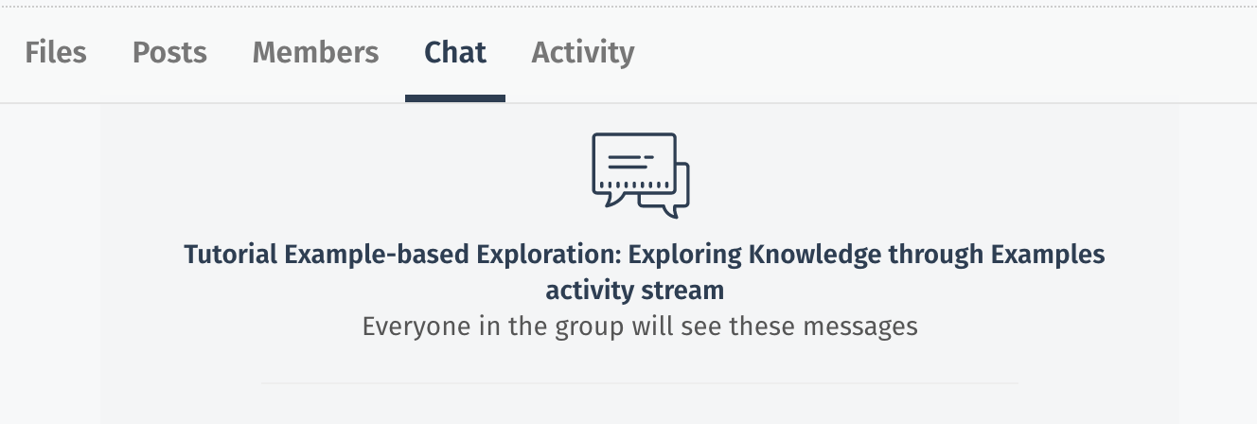
You can use the MiTeam chat
for questions
Tutorial Slides and Other Material
https://data-exploration.ml/eswc2020.html
M. Lissandrini, D. Mottin, T. Palpanas, Y. Velegrakis

Slide 3
M. Lissandrini, D. Mottin, T. Palpanas, Y. Velegrakis

Slide 4
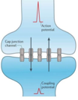

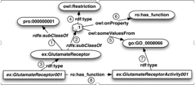
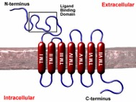
Traditional Data Management Systems
rdf:Type=GlutamateReceptor
ro:has_function=ex:GlutamateReceptorActivity001
Data
M. Lissandrini, D. Mottin, T. Palpanas, Y. Velegrakis
Notes:
Good Knowledge of the database
Certain that this query is what they want
They know how to formulate the query
Users know what they are looking for and the system tries to produce the right answer
We have the resources to devote to it
Assumptions valid for many applications today … but not all
But as the users become less technically expert, the data more and more complex and the search more and more interdisciplinary, the traditional query model is becoming harder and harder to use.

Slide 5

Modern Data Management Systems
Not clear what we are looking for
I would like to find acquisitions
like the one of
YouTube by Google
Big Data
M. Lissandrini, D. Mottin, T. Palpanas, Y. Velegrakis
Notes:
Building more dynamic data driven systems … this model is of the past. The requirements for the systems of the present are much different than those. Looking at an inventory database for a pattern is much different than a transaction

Slide 6

Exploration
We know where we start we don’t know what we’ll find

Slide 7
Exploration
Traditional
On data
M. Lissandrini, D. Mottin, T. Palpanas, Y. Velegrakis
Notes:
You know that something is interesting ONLY when you see it
This model has been transferred from real life to data
And is the same as in Internet search we do today

Slide 8
Data exploration
Visualization
Cleaning and profiling
Analysis
Interactions
Architectures
M. Lissandrini, D. Mottin, T. Palpanas, Y. Velegrakis
Notes:
Such Novel requirements have led to rethinking of data management systems across the whle stack

Slide 9
Data exploration software
Trifacta: data preparation
Tableau: analysis and statistics
OpenRefine: data preparation and cleanup
M. Lissandrini, D. Mottin, T. Palpanas, Y. Velegrakis

Slide 10
Traditional data exploration methods
[Idreos et al., 2015]
Efficiently extracting knowledge from data
even if we do not know exactly what we are looking for
SELECT avg(system-stars)
FROM Universe
WHERE system-stars > 10
GROUP BY galaxy
Not easy for novices
M. Lissandrini, D. Mottin, T. Palpanas, Y. Velegrakis

Slide 11
Modern Data Management Systems
How do we describe what we are looking for?
I would like to find acquisitions
like the one of
YouTube by Google
Query???
Big Data
M. Lissandrini, D. Mottin, T. Palpanas, Y. Velegrakis
Notes:
Building more dynamic data driven systems … this model is of the past. The requirements for the systems of the present are much different than those. Looking at an inventory database for a pattern is much different than a transaction

Slide 12
Declarative Exploratory methods
SELECT g.galaxy_name, SUM(s.stars) as st_s
FROM Universe.Galaxy AS g
JOIN Universe.Systems AS s
ON g.galaxy_name = s.galaxy_name
WHERE
g.st_s > 100B
AND diameter > 100k AND diameter > 180k
AND has_black_hole = TRUE
GROUP BY g.galaxy_name
SELECT galaxy_name
FROM Universe.Galaxy
Simple query (exploratory)
Complex query
(for data experts)
Over generic
100 billions results
Specific
Few results
M. Lissandrini, D. Mottin, T. Palpanas, Y. Velegrakis

Slide 13
Examples as Exploratory Methods
Example is always more efficacious than precept
Samuel Johnson, Rasselas (1759), Chapter 29.
Is there a galaxy like this?
Answers
M. Lissandrini, D. Mottin, T. Palpanas, Y. Velegrakis

Slide 14
Tutorial’s goals
Techniques, Algorithms, Applications for using Examples to support Exploratory Search
Exploratory methods using examples
Algorithms for retrieving data without using query languages
Interactive methods and user-in-the-loop feedback
Machine learning for adaptive, online methods
But NOT
Declarative query methods
User interfaces and visualization
Optimizations for fast data access
Dynamic data
M. Lissandrini, D. Mottin, T. Palpanas, Y. Velegrakis
Notes:
Exploration is a journey and we accompany the user in this journey

Slide 15
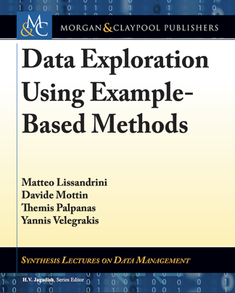

Our book on Example-based methods
M. Lissandrini, D. Mottin, T. Palpanas, Y. Velegrakis

Slide 16
Historical perspective: Query-by-example
[Zloof et al. 1975]
Specify a query by example tables, or skeletons.
Name | Stars | Diameter | Black_hole | Color | Life
P._ | > 10B | >100k | TRUE | * | *
* | * | <180k | * | * | *
Incomplete values
Unspecified values
Value conditions
Intuitive interface for simple queries
SQL not required
Restricted to SQL syntax but not explicitly
Not example-based
M. Lissandrini, D. Mottin, T. Palpanas, Y. Velegrakis

Slide 17
Similarities are the key …
If we knew how similar each item is with respect to any other for each user, we would know the answer to
Is there a galaxy like this?
M. Lissandrini, D. Mottin, T. Palpanas, Y. Velegrakis

Slide 18
Similarities are the key …
We define:
  A universe $𝒰$ of items
  A similarity among items $∼$
  A set of input examples $ℰ$
  A set of output user desired answers $𝒜$
M. Lissandrini, D. Mottin, T. Palpanas, Y. Velegrakis

Slide 19
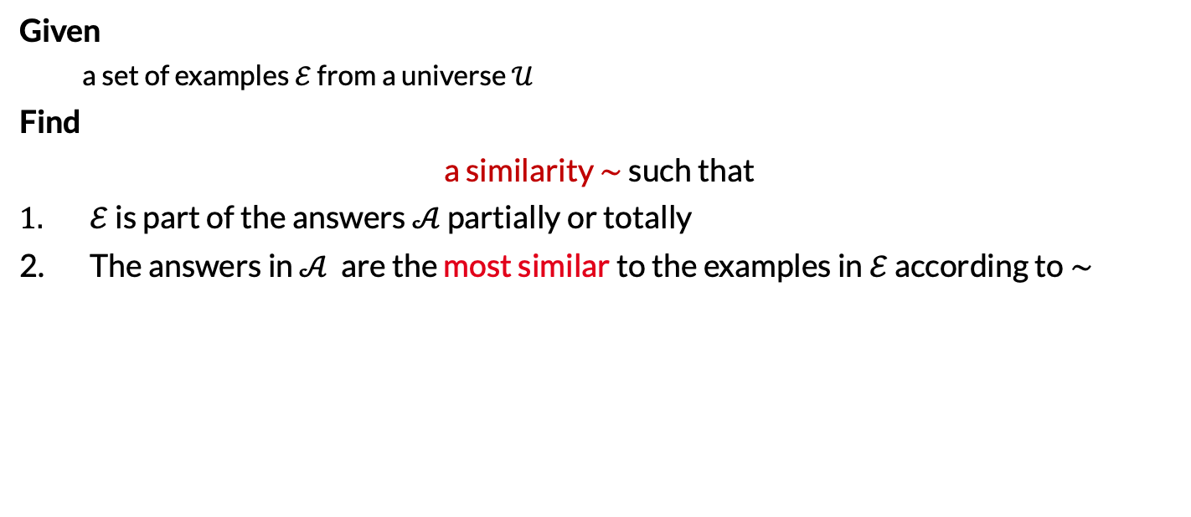
The example-based problem
Given
  a set of examples $ℰ$ from a universe $𝒰$
Find
a similarity $∼$ such that
$ℰ$ is part of the answers $𝒜$ partially or totally
The answers in $𝒜$ are the most similar to the examples in $ℰ$ according to $∼$
How do we find $∼$ for each user?
Do we need to know exactly $∼$?
M. Lissandrini, D. Mottin, T. Palpanas, Y. Velegrakis

Slide 20
Example-based methods
M. Lissandrini, D. Mottin, T. Palpanas, Y. Velegrakis

Slide 21
Example-based methods
Reverse engineering queries
Example-driven schema mapping
Interactive data repairing
Entity extraction by example text
Web table completion using examples
Search by example
Community-based Node-retrieval
Entity Search
Path and SPARQL queries
Graph structures as Examples
Relational
Textual
Graph
M. Lissandrini, D. Mottin, T. Palpanas, Y. Velegrakis

Slide 22
Tutorial structure
Relational databases
Machine learning
Textual data
Graph and networks
Challenges and Remarks
M. Lissandrini, D. Mottin, T. Palpanas, Y. Velegrakis
Notes:
Intro – 10
Relational – 20
Textual – 55 (include 1 demo)
- 5 min questions
Graph – 55 (include 1 demo)
Machine Learning - 20
Conclusions - 10
- 5 min questions

Slide 23
Where we are
Relational databases
Machine learning
Textual data
Graphs and networks
Challenges and Remarks
M. Lissandrini, D. Mottin, T. Palpanas, Y. Velegrakis

Slide 24
Searching for …
M. Lissandrini, D. Mottin, T. Palpanas, Y. Velegrakis

Slide 25
Reverse engineering queries (REQ)
Given a set of examples, find the query that generated that set of tuples
Example tuples
SELECT g.galaxy_name, SUM(s.stars) AS st_s
FROM Universe.Galaxy AS g
JOIN Universe.System AS s
ON g.galaxy_name = s.galaxy_name
WHERE
g.st_s > 100B
AND diameter > 100k AND diameter > 180k
AND has_black_hole = TRUE
GROUP BY g.galaxy_name
SELECT galaxy_name
FROM Universe.Galaxy
How do you find such queries?
M. Lissandrini, D. Mottin, T. Palpanas, Y. Velegrakis

Slide 26
Query by Output – TALOS (classification-based)
[Tran et al. 2013]
Main idea: Find the set of queries that exactly return a set of examples
Query Q
Query
Results
Query by Output
Reverse engineered
Queries Q’
Two queries Q and Q’ are instance equivalent on a database D, if the results of Q are the same of the results of Q’
M. Lissandrini, D. Mottin, T. Palpanas, Y. Velegrakis
Notes:
Characteristic case

Slide 27
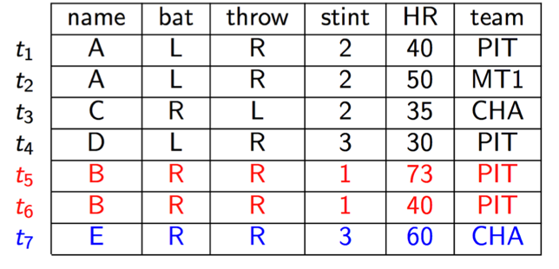

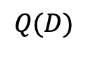
How many reverse engineered queries?
Master
weight
$$Q(D)$$
What queries generated Q(D)?
Q1 = SELECT name, team FROM Master WHERE bat = ’R’ AND throw = ’R’
Instance
Equivalent
Queries
Q2 = SELECT name, team FROM Master WHERE bat = ’R’ AND weight $>$ 35
Q3 = SELECT name, team FROM Master WHERE bat = ’R’ AND stint <> 2
…
M. Lissandrini, D. Mottin, T. Palpanas, Y. Velegrakis
Notes:
Here is an example

Slide 28
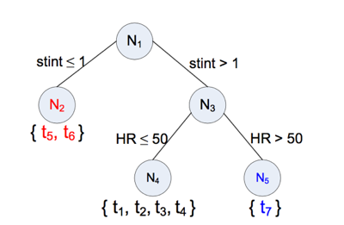
TALOS
B | PIT
E | CHA
[Tran et al. 2013]
Idea: treat the problem as a binary classification
X
X
X
Strict: all tuples must be captured
At-Least-one: one tuple for example must be captured
X
$$Gini\left(S_{1},S_{2}\right)=\frac{\left(\left|S_{1}\right|Gini\left(S_{1}\right)+{|S}_{2} | Gini\left(S_{2}\right)\right)}{\left|S_{1}\right|+\left|S_{2}\right|}$$
Decision tree
Notes:
F_i is the fraction of tuples belonging to class I (posdsitive or negative)
The S is an attribute-valuespecification pair.
The Gini(S1,S2) gives you the goodness of the split
In each iteration, examine non pure attributes (not those with standard value) and dicede which one is best to split (attribute and value)

Slide 29
How complex is exact REQ?
[Weiss et al., 2017]
Relational Operators:
Database $D$
$σ$ selection $\{=,≠,≥,≤\}$
$π$ projection
$⋈$ natural join
$Q$ such that results contain
All positive examples
No negative example
$E^{+}$ Positive examples
$E^{−}$ Negative examples
REQ
How difficult is to find:
A bounded size Q? an unbounded Q?
M. Lissandrini, D. Mottin, T. Palpanas, Y. Velegrakis

Slide 30
Complexity - No parameters
[Weiss et al., 2017]
Operator | Unbounded Queries | Bounded Queries
$$π$$ | P | P
$$⋈$$ | P | NPC
$$σ$$ | P | NPC
$$σ,⋈$$ | P | NPC
$$π,σ$$ | NPC | NPC
$$σ,⋈$$ | DP | DP
$$π,σ,⋈$$ | DP | DP
Only projections: Easy
Unbounded selections: Easy
Bounded selections: HARD
Combination of operators: HARD!!!
Reduction from SAT
M. Lissandrini, D. Mottin, T. Palpanas, Y. Velegrakis

Slide 31
Unbounded Select
[Weiss et al., 2017]
A | B | C | D | E
1 | 2 | 3 | 4 | 5
1 | 3 | 2 | 3 | 4
2 | 4 | 4 | 1 | 3
5 | 3 | 2 | 4 | 2
4 | 2 | 3 | 1 | 2
2 | 2 | 4 | 3 | 2
1 | 1 | 2 | 1 | 5
1 | 5 | 4 | 2 | 3
Possible queries?
☑
☒
A = 1 AND
B ≥ 1 AND B ≤ 5 AND
☒
C ≥ 2 AND C ≤ 4 AND
D ≥ 1 AND D ≤ 4 AND D ≠ 3
☑
E ≥ 3 AND E ≤ 5 AND E ≠ 4
☑
M. Lissandrini, D. Mottin, T. Palpanas, Y. Velegrakis

Slide 32
Bounded select
Reduction from
Set Cover
NP-C
INPUT: Database D, Examples E, Query size k
OUTPUT: Does there exist a query satisfying D and E, of size at most k?
U = {1,2,3,4,5} S = { {1,2,3}, {2,4}, {3,4}, {4,5} }
S
S
S
S
1
2
3
4
☒
1
0
0
0
☒
1
1
0
0
☒
1
0
1
0
☒
0
1
1
1
☒
0
0
0
1
☑
1
1
1
1
M. Lissandrini, D. Mottin, T. Palpanas, Y. Velegrakis

Slide 33
Minimal Project Join REQ
[Shen et al., 2014]
Main idea: Find the set of queries that approximately return a set of examples
Partial query table
Minimal PJ
Queries Q’
 | A | B | C
1 | Mike | ThinkPad | Office
2 | Mary | iPad
3 | Bob |  | Dropbox
valid: every tuple is present in query results
minimal: any removal in query tree gets to an invalid query
M. Lissandrini, D. Mottin, T. Palpanas, Y. Velegrakis

Slide 34
Candidate Query Generation
[Shen et al., 2014]
  Use candidate network generation algorithm (Hristidis 2002)
 | A | B | C
1 | Mike | ThinkPad | Office
2 | Mary | iPad
3 | Bob |  | Dropbox
CQ₁
Sales
CQ₂
Owner
CQ₃
Owner
A
B
C
A
B
C
A
B
Generate join tree $J$
Generate mapping $φ$
Check minimal:
  - Every leaf node contains a column that is mapped by an input column
Customer
Device
App
Employee
Device
App
Employee
Device
C
ESR
CQ₄
Owner
CQ₅
Owner
C
B
A
B
App
Device
Employee
Device
App
ESR
C
A
ESR
Employee
M. Lissandrini, D. Mottin, T. Palpanas, Y. Velegrakis

Slide 35
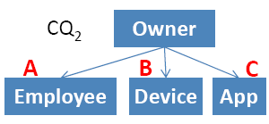
Validity verification
[Shen et al., 2014]
Naïve: check all candidate queries singularly if they return ALL examples
Candidate query
Better: exploit substructures in candidate queries for pruning
Substructures
Sub 1
Owner
Best: adaptively select the substructures to have the min number of evaluations
Sub 1 fails => $CQ_{2}$ invalid
A
B
Employee
Device
NP-hard
Owner
Sub 1 fails =>
Sub 2 fails
Sub 2
A
B
C
Employee
Device
App
M. Lissandrini, D. Mottin, T. Palpanas, Y. Velegrakis

Slide 36
Minimal Project Join REQ
[Psallidas et al., 2015]
Main idea: Allow missing rows/columns and rank the k best queries
Output: Top-k PJ Queries
Sales
Products
Customers
Partial query table
S4
Name
First Name
Last Name
Sales
 | A | B | C
1 | John | Smith | Xbox
2 | Jill | Hans | Surface
Products
Customers
Name
Last Name
City
Name
M. Lissandrini, D. Mottin, T. Palpanas, Y. Velegrakis

Slide 37
Ranking score
[Psallidas et al., 2015]
Linear combination of row score and column score
$α=1$ penalizes missing rows
$α=0$ penalizes missing columns
(Overlapping with the example table)
$$\frac{α∗score_{row}\left(Q\right)+\left(1−α\right)∗score_{col}\left(Q\right)}{\left|Q\right|}$$
Row score
Sales
Sales
 |  |  | Row Score
John | Smith | Xbox | 3 | 3
Jill | Hans | Surface | 2 | 1
 |  |  | 5 | 4
Products
Customers
Products
Customers
City
Name | First Name | Last Name
Xbox | John | Smith
iPhone | Michael | Douglas
Surface | Jill | Johnson
Name | City Name | Last Name
Xbox | St. John | Smith
iPhone | Montpellier | Douglas
Surface | Redmond | Johnson
Column score
Sales
Sales
 | John | Smith | Xbox
 | Jill | Hans | Surface
Column Score | 2 | 1 | 2 | 5
 | 2 | 1 | 1 | 4
Products
Customers
Products
Customers
Name
First Name
Last Name
City
Xbox
iPhone
Surface
John
Jill
Michael
Smith
Johnson
Douglas
Name
City Name
Last Name
Xbox
iPhone
Surface
St. John
Montpellier
Redmond
Smith
Johnson
Douglas
M. Lissandrini, D. Mottin, T. Palpanas, Y. Velegrakis

Slide 38

Interactive REQ – Query from Examples (cost model)
[Li et al., 2015]
Main idea: Interactively remove candidate queries proposing a new set of query results from a modified database
Modified database and results
Query
Results
REQ
Database
Refinement
Reverse engineered
Queries Q’
M. Lissandrini, D. Mottin, T. Palpanas, Y. Velegrakis

Slide 39

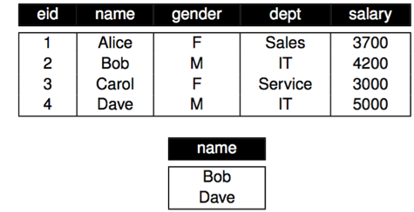
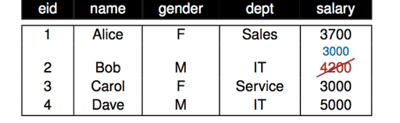
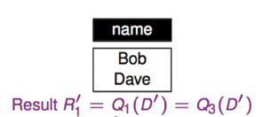
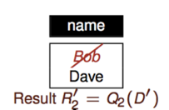
Database Refinement
[Li et al., 2015]
Results
Database
Refinement
REQs =
$Q_{1}=σ_{gender=M}\left(D\right)$
$Q_{2}=σ_{salary>3700}\left(D\right)$
$Q_{3}=σ_{dept=IT}\left(D\right)$
M. Lissandrini, D. Mottin, T. Palpanas, Y. Velegrakis

Slide 40
Cost model
[Li et al., 2015]
Number of modified tables
Number of new result sets
Choice to go with the max tuples modified
$$cost\left(D^{′}\right)=edit\left(D,D^{′}\right)+β⋅n+\sum_{i=1}^{k}{edit\left(R,R_{i}\right)+N⋅\frac{edit\left(D,D^{′}\right)}{μ}+β+\frac{2}{k}\sum_{i=1}^{k}{edit(R,R_{i})}}$$
Effort to examine D’
Effort to examine new results
DB cost
Results cost
Current cost
Residual cost
Main idea: Find a refined db D’ and results $R_{1}, …R_{k}$with:
Minimum number of results k
Minimum differences i the database
The query are balanced (less interactions)
M. Lissandrini, D. Mottin, T. Palpanas, Y. Velegrakis

Slide 41
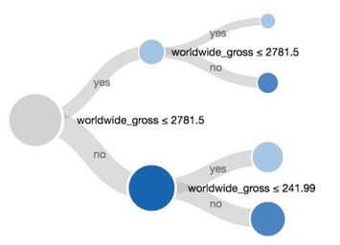
Examples for query suggestion: Blaeu (Clustering)
[Sellam et al., 2016]
Main idea: Allow interactive navigation of the query space in a hierarchy
Query Results
or Query
Blaeu
Query navigations
M. Lissandrini, D. Mottin, T. Palpanas, Y. Velegrakis

Slide 42
Examples for query suggestion: Blaeu
[Sellam et al., 2016]
Query results
Given a result of an example query Q, explore the data through data maps = partitions
Attribute 2
Output: Set of query refinements
Attribute 1
Problem: User utility is unknown
$$u:DB→\left\{−1,1\right\}, U\left(Q\right)=\sum_{t∈Q}{u(t)}$$
Cluster analysis for result exploration
Zoom and projection operations
User model
User utility
M. Lissandrini, D. Mottin, T. Palpanas, Y. Velegrakis

Slide 43
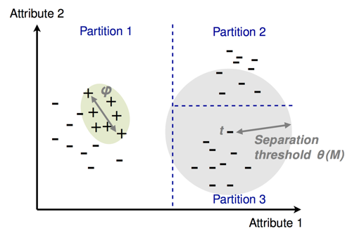
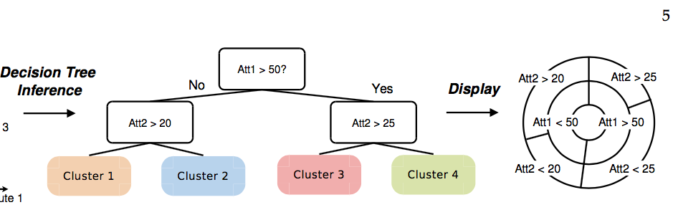
Examples for query suggestion: Blaeu
[Sellam et al., 2016]
$$u:DB→\left\{−1,1\right\}, U\left(C\right)=\sum_{t∈C}{u(t)}$$
Find the partition $𝒞=\left\{C_{1},…,C_{n}\right\}$ of the results of Q such that exists $C_{j}∈𝒞:U\left(C_{j}\right)>U(Q)$
Unknown User utility
Solution: interesting tuples are close to each other
within a maximum separation threshold $θ(𝒞)$
Detect clusters
(k-medoid)
Organize clusters
(decision tree)
Inference
M. Lissandrini, D. Mottin, T. Palpanas, Y. Velegrakis

Slide 44
Searching for …
M. Lissandrini, D. Mottin, T. Palpanas, Y. Velegrakis

Slide 45
Data Cleaning
tid | Date | Molecule | Laboratory | Quantity
t1 | 11 Nov | C₁₆H₁₆Cl | Austin | 200
t2 | 12 Nov | statin | Austin | 100
t3 | 12 Nov | C₂₄H₇₅S₆ | N.Y. | 100
t4 | 12 Nov | statin | Boston | 200
t5 | 13 Nov | statin | Austin | 200
t6 | 15 Nov | C₁₇H₂₀N | Dubai | 1000
Often data have redundancy, wrong values, and missing values
Different values can represent the same object (e.g., N.Y. and New York)
Values can be simply wrong
Data cleaning refers to ways of making the data consistent and correct
tid | Date | Molecule | Laboratory | Quantity
t1 | 11 Nov | C₁₆H₁₆Cl | Austin | 200
t2 | 12 Nov | C₂₂H₂₈F | Austin | 100
t3 | 12 Nov | C₂₄H₇₅S₆ | New York | 100
t4 | 12 Nov | statin | Boston | 200
t5 | 13 Nov | C₂₂H₂₈F | Austin | 200
t6 | 15 Nov | C₁₇H₂₀N | Dubai | 100
M. Lissandrini, D. Mottin, T. Palpanas, Y. Velegrakis

Slide 46
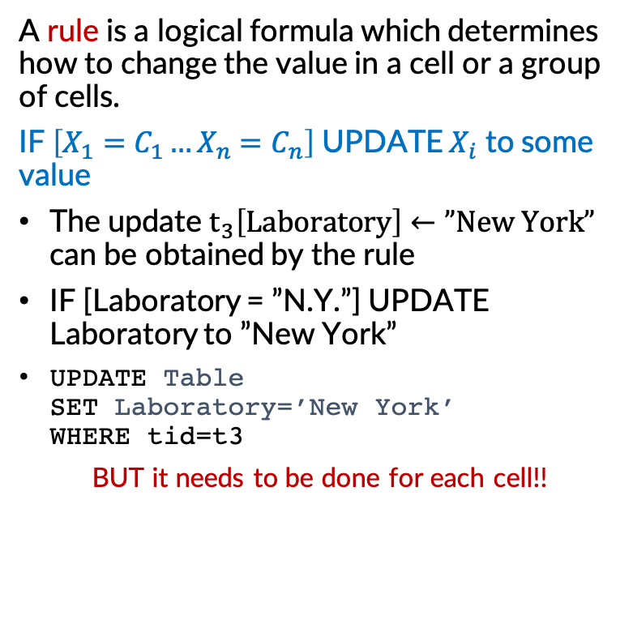
Data repairing: rules
[He, J. et al. 2016]
A rule is a logical formula which determines how to change the value in a cell or a group of cells.
IF $\left[X_{1}=C_{1}…X_{n}=C_{n}\right]$ UPDATE $X_{i}$ to some value
The update $t_{3}\left[Laboratory\right]←”New York”$ can be obtained by the rule
IF [Laboratory = ”N.Y.”] UPDATE Laboratory to ”New York”
UPDATE Table
SET Laboratory=’New York’
WHERE tid=t3
BUT it needs to be done for each cell!!
tid | Date | Molecule | Laboratory | Quantity
t1 | 11 Nov | C₁₆H₁₆Cl | Austin | 200
t2 | 12 Nov | statin | Austin | 100
t3 | 12 Nov | C₂₄H₇₅S₆ | N.Y. | 100
t4 | 12 Nov | statin | Boston | 200
t5 | 13 Nov | statin | Austin | 200
t6 | 15 Nov | C₁₇H₂₀N | Dubai | 1000
tid | Date | Molecule | Laboratory | Quantity
t1 | 11 Nov | C₁₆H₁₆Cl | Austin | 200
t2 | 12 Nov | C₂₂H₂₈F | Austin | 100
t3 | 12 Nov | C₂₄H₇₅S₆ | New York | 100
t4 | 12 Nov | statin | Boston | 200
t5 | 13 Nov | C₂₂H₂₈F | Austin | 200
t6 | 15 Nov | C₁₇H₂₀N | Dubai | 100
M. Lissandrini, D. Mottin, T. Palpanas, Y. Velegrakis

Slide 47
Discovering rules
[He, J. et al. 2016]
UPDATES:
𝚫₁: t3[Laboratory] ← “New York”
𝚫₂: t6[Quantity] ← 100
𝚫₃: t2[Molecule] ← “C₂₂H₂₈F”
tid | Date | Molecule | Laboratory | Quantity
t1 | 11 Nov | C₁₆H₁₆Cl | Austin | 200
t2 | 12 Nov | C₂₂H₂₈F | Austin | 100
t3 | 12 Nov | C₂₄H₇₅S₆ | New York | 100
t4 | 12 Nov | statin | Boston | 200
t5 | 13 Nov | C₂₂H₂₈F | Austin | 200
t6 | 15 Nov | C₁₇H₂₀N | Dubai | 100
Some rules for 𝚫₁:
Change all Laboratory values to “New York” (t1 – t6)
Reformatting all “N.Y” to “New York”(t3)
Some rules for 𝚫₂:
Update the quantity to 100 if the molecule is C₁₇H₂₀N and the date is 15 Nov (t6)
Some rules for 𝚫₃:
Update to “C₂₂H₂₈F” if molecule is statin (t2,t4,t5)
Update to “C₂₂H₂₈F” if molecule is statin and Laboratory Austin (t2,t5)
Update to “C₂₂H₂₈F” if molecule is statin and lab is Austin and date is 12 Nov and quantity is 100 (t2)
M. Lissandrini, D. Mottin, T. Palpanas, Y. Velegrakis

Slide 48
Interactive data cleaning: problem
User validates rules, but has no capacity to validate all rules for each update.
Budget Repair Problem: Given a set 𝒬 of rules, a table T and a budget B, find B rules from 𝒬 to maximize the number of repairs over T
Budget repair problem is an online problem
Corresponding offline problem is: given as input 𝒬 rules where validity of each rule is known, select B rules from 𝒬 to maximize the number of repairs over T. (NP-Hard)
M. Lissandrini, D. Mottin, T. Palpanas, Y. Velegrakis

Slide 49
Rule lattice
tid | Date | Molecule | Laboratory | Quantity
t2 | 12 Nov | statin→C₂₂H₂₈F | Austin | 100
More specific
DMLQ(1)
Number of tuples affected
DML (1)
DMQ (1)
DLQ (1)
MLQ (1)
DM (1)
DL (1)
DQ (2)
ML (2)
MQ (1)
LQ (1)
D (3)
M (3)
L (3)
Q (2)
12 Nov
statin
Austin
100
More general
∅ (6)
M. Lissandrini, D. Mottin, T. Palpanas, Y. Velegrakis

Slide 50
Lattice pruning
If Q is valid, Q’ is also valid if Q’ ≼ Q
If Q is invalid, Q’’ is also invalid if Q ≼ Q’’
If Q is valid, all Q’ such that Q’ ≼ Q are valid.
If Q is invalid, all Q’’ such that Q ≼ Q’’ are invalid.
M. Lissandrini, D. Mottin, T. Palpanas, Y. Velegrakis

Slide 51
Lattice pruning
DMLQ(1)
DML (1)
DMQ (1)
DLQ (1)
MLQ (1)
DM (1)
DL (1)
DQ (2)
ML (2)
MQ (1)
LQ (1)
D (3)
M (3)
L (3)
Q (2)
12 Nov
statin
Austin
100
∅ (6)
M. Lissandrini, D. Mottin, T. Palpanas, Y. Velegrakis

Slide 52
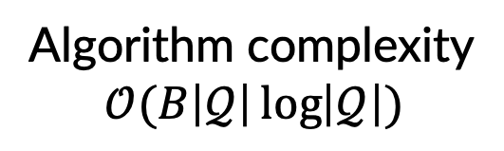
Dive search
Binary Search over the lattice ,ordering with #affected tuples
If T → BinarySearch(Q⋀)
If F → BinarySearch(Q ⋁)
BinarySearch()
Q1
Q2
Algorithm complexity
$$𝒪(B\left|𝒬\right|\log\left|𝒬\right|)$$
BinarySearch()
M. Lissandrini, D. Mottin, T. Palpanas, Y. Velegrakis

Slide 53
Searching for …
M. Lissandrini, D. Mottin, T. Palpanas, Y. Velegrakis

Slide 54


Schema mapping
Schema mapping finds a way to represent items on one database to items on another database
Finds a mapping $Σ$ between two schemas such that a query on one database can be converted to a query on the other database
Schema mappings in $Σ$ are rules in first-order logic that specifies the relationships between schema S and T
$$∀x∀y S\left(x,y\right)∧U\left(x,z\right)→∃v T\left(v,y\right)∧T′(v,z)$$
$$Σ$$
Schema
Source S
Target T
I
J
Database
M. Lissandrini, D. Mottin, T. Palpanas, Y. Velegrakis

Slide 55
A Data Exchange Example
[Popa et al. 2001]
S: Rcd
projects: Set of
project: Rcd
name
status
grants: Set of
grant: Rcd
gid
project
recipient
manager
supervisor
contacts: Set of
contact: Rcd
cid
email
phone
companies: Set of
company: Rcd
name
official
Projects
T: Rcd
projects: Set of
project: Rcd
code
funds: Set of
fund: Rcd
fid
finId
finances: Set of
finance: Rcd
finId
mPhone
company
companies: Set of
company: Rcd
coid
name
code: E-services
Funds
fid | finId
g3 | ???
code: PIX
Funds
fid | finId
g1 | ???
g2 | ???
Target instance
Finances
finId | mPhone | company
??? | 3608679 | ???
??? | 3608776 | ???
??? | 3608600 | ???
Companies
coid | name
??? | AT&T
??? | Lucent
project(na,st), grant(gid,na,re,ma,su), contact(ma,em,ph) →
project(na,FUND), fund(gid,finId), finance (finId,ph,company),
company(company, name)
M. Lissandrini, D. Mottin, T. Palpanas, Y. Velegrakis

Slide 56
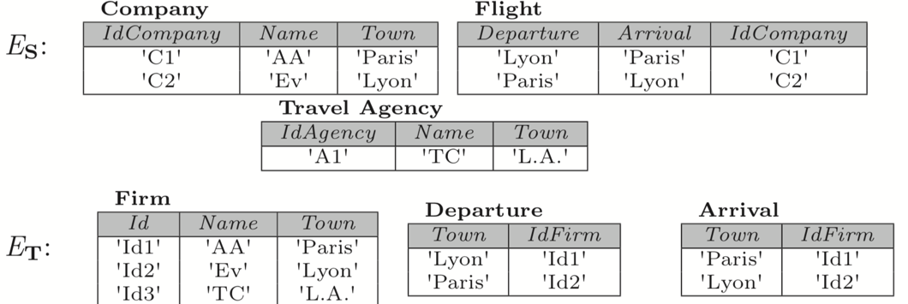
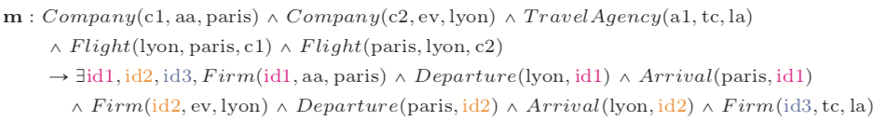
Mapping generation
[Bonifati et al. 2017]
M. Lissandrini, D. Mottin, T. Palpanas, Y. Velegrakis

Slide 57
Interactive Mapping
[Bonifati et al. 2017]
M. Lissandrini, D. Mottin, T. Palpanas, Y. Velegrakis

Slide 58
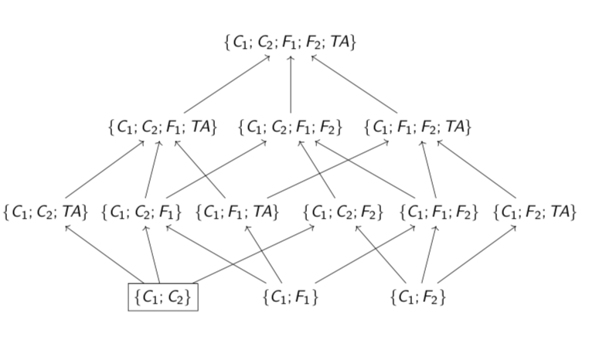
Atom Refinement
Ask the user and refine the left part of the rule
Are the tuples Company(c1,aa,paris); Company (c2, ev, lyon) enough to produce Firm(id, aa, Paris); Departure (Lyon, id); Arrival(Paris, id)?
M. Lissandrini, D. Mottin, T. Palpanas, Y. Velegrakis

Slide 59
Atom Refinement
Ask the user and refine the left part of the rule
Are the tuples Company(c1,aa,paris); Flight (lyon, paris, c1) enough to produce Firm(id, aa, Paris); Departure (Lyon, id); Arrival(Paris, id)?
M. Lissandrini, D. Mottin, T. Palpanas, Y. Velegrakis

Slide 60
Where we are
Relational databases
Machine learning
Textual data
Graphs and networks
Challenges and Remarks

Slide 61

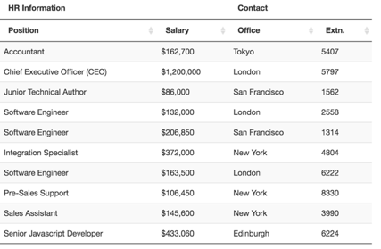
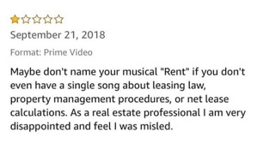
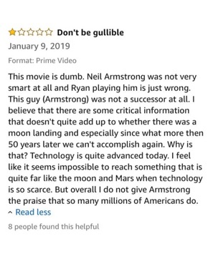
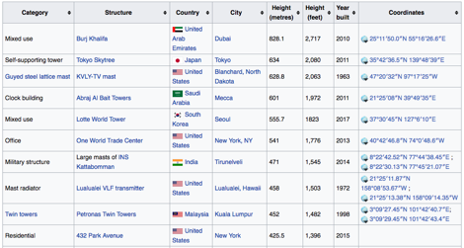

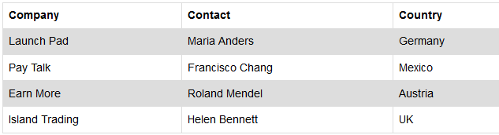
SIMILARITY for
TEXTUAL DATA
Unstructured
Semi-Structured

Slide 62
Documents
Semi-Structured
information
SEARCHING FOR
BY LOOKING AT
Words
Meta-Data
Words
Web-Tables
Text Classifier
[Liu et al. ’03
Zhang and Lee’09,
Zhu et al.’13]
Citation Graph
Navigation
[El-Arini et al.’11
Jia and Saule’17]
Regular Expressions
[Agichtein et al.’00]
Entity Mentions
[Wang et al.’15]
APPLYING
Topic Models
[Zhu and Wu. ’14]
Annotations
[Hanafi et al.’17]
Segmentation
[Papadimitriou et al. ’17]
Entity Linking
[Bordino et al. ’13]
Entity Extraction
[Ritter et al.’15]
Schema Matching
[Yakout et al.’18]
PRODUCES
Documents/Citations/Queries recommendations
Relation Extraction
Document Matching
Entity Augmentation
Concept Expansion
M. Lissandrini, D. Mottin, T. Palpanas, Y. Velegrakis

Slide 63

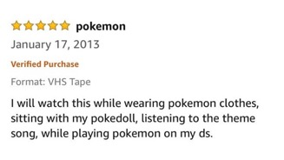
Document Search
Keyword Queries
& Relevance
Keyword query: search text with text
  “Action movie with magic”
Search documents containing those exact words
… a live action movie…
…. there is plenty of action…
… packed with action…
… Magic Mike is comedy movie …
… in Harry Potter magic is everywhere..
Is this enough?
Identify “relevant words”
and “relevant documents”
M. Lissandrini, D. Mottin, T. Palpanas, Y. Velegrakis

Slide 64
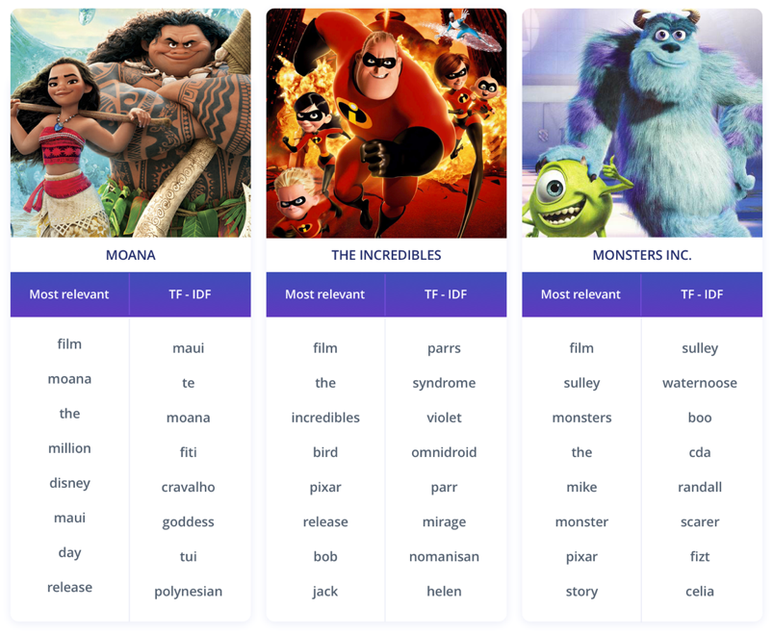
Document Search
Relevant Keywords
https://www.kdnuggets.com/2018/08/wtf-tf-idf.html
Relevance: which keywords are more helpful in describing the content of the document?
Relevance ≠ Frequency
Term-frequency: how many times the term appears in the document
Document-frequency: In how many documents the term appears
What keywords are more likely to be used
to describe the document we want
and not other documents
Frequent
Frequent
Frequent
FEW SELECTED KEYWORDS
IN THE USER QUERY
What keywords to choose?
TF-IDF: Term Frequency
Inverse Document Frequency
M. Lissandrini, D. Mottin, T. Palpanas, Y. Velegrakis

Slide 65


TRADITIONAL
SEARCH
EXPLORATORY
SEARCH
M. Lissandrini, D. Mottin, T. Palpanas, Y. Velegrakis

Slide 66
Documents
Semi-Structured
information
SEARCHING FOR
BY LOOKING AT
Words
Meta-Data
Words
Web-Tables
Text Classifier
[Liu et al. ’03
Zhang and Lee’09,
Zhu et al.’13]
Citation Graph
Navigation
[El-Arini et al.’11
Jia and Saule’17]
Regular Expressions
[Agichtein et al.’00]
Entity Mentions
[Wang et al.’15]
APPLYING
Topic Models
[Zhu and Wu. ’14]
Annotations
[Hanafi et al.’17]
Segmentation
[Papadimitriou et al. ’17]
Entity Linking
[Bordino et al. ’13]
Entity Extraction
[Ritter et al.’15]
Schema Matching
[Yakout et al.’18]
PRODUCES
Documents/Citations/Queries recommendations
Relation Extraction
Document Matching
Entity Augmentation
Concept Expansion
M. Lissandrini, D. Mottin, T. Palpanas, Y. Velegrakis

Slide 67
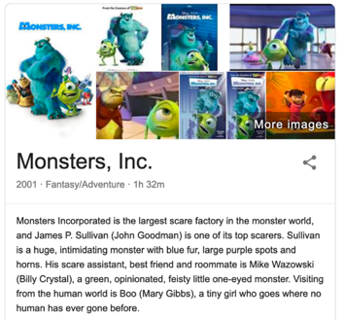
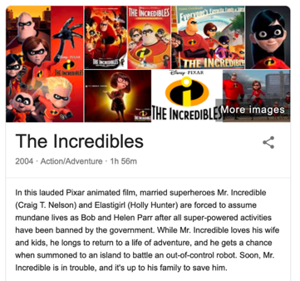
Documents as Examples
Exemplar documents
Liu et al. [2003]
Find me movies like these:
Set of exemplar documents
rather than a set of keywords.
Identify what makes them special, i.e., relevant
An entire document may contain more information!
It also contains more noise
Example-based Document Search
Given a corpus of documents D,
and a small set of relevant documents (D_{rel}),
identify a set of answer documents D_{A}
such that D_{rel} ⊆ D_{A} ⊆ D.
PROBLEM:MISSING NEGATIVE CLASS
Few positive examples and
a large set of unknown.
What features can discriminate relevant and irrelevant?
Would be better to have some negative examples
Model as a classification problem!
M. Lissandrini, D. Mottin, T. Palpanas, Y. Velegrakis

Slide 68
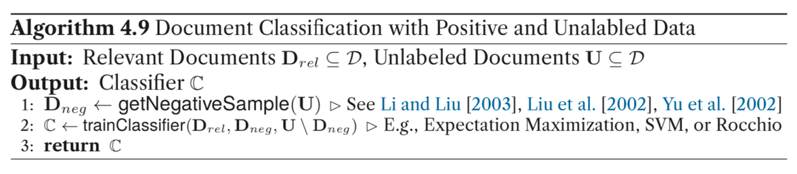
Text Classifiers
Using Positive and Unlabeled Examples
Liu et al. [2003]
Positive Unlabeled learning
a corpus of documents D,
2 Classes: relevant ⊤ & irrelevant ⊥
relevant documents (D_{rel})
  ∀d ∈ D_{rel}. class(d) = ⊤
Unlabeled documents U = D − D_{rel}
Goal:
train a classifier C : D → {⊤, ⊥},
to predict class(u) ∀ u ∈ U.
Missing:
To train C we need examples
for the negative class ⊥
M. Lissandrini, D. Mottin, T. Palpanas, Y. Velegrakis

Slide 69
Inferring Negative Examples (I)
Assign a label to Unlabeled data: how to determine a negative sample set without asking the user
Liu et al. [2003]
Goal:
Determine set of elements to be regarded as reliable negatives (RN)
4 Alternative approaches
Naïve Bayes (McCallum et al. [1998])
  All unlabeled data are assumed negatives
  NB-Classifier estimates P(c|d) based on on P(w|c) with c ∈ {⊤, ⊥} , d ∈ D, and words w ∈W
The Rocchio technique (Raskutti et al. [2002])
  ∀d ∈ D d⃗ is the TF-IDF vector representation
  Build prototype vectors ⃗c_{T} for documents in D_{rel}
  and ⃗c ⊥ for documents in U
  Compare each ∀d ∈ U with ⃗c_{T} and ⃗c ⊥
  assign the class of the most similar vector
Train a “simplistic” classifier
M. Lissandrini, D. Mottin, T. Palpanas, Y. Velegrakis

Slide 70
Inferring Negative Examples (II)
Assign a label to Unlabeled data: how to determine a negative sample set without asking the user
Liu et al. [2003]
Goal:
Determine set of elements to be regarded as reliable negatives (RN)
4 Alternative approaches
The Spy technique (Liu et al. [2002])
  Extract a sample S from the positive example
  Merge S in U (deploy the spies!)
  Build NB classifier with EM
  Determine threshold t such that all spies are correctly classified
  Document above the threshold are considered negative
1-DNF* technique (Yu et al. [2002]).
*Disjunctive Normal Form
  Positive Example Based Learning
  Get words W_{f} ⊂ W. freq(w, D_{rel})/|D_{rel}| > freq(w, U)/|U|
  Remove from U all documents containing any word in W_{f}
Train a “simplistic” classifier
D_{rel}
U
RN
M. Lissandrini, D. Mottin, T. Palpanas, Y. Velegrakis

Slide 71
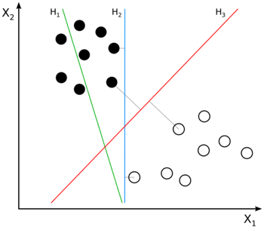
Training the Expert Classifier
Exploit the partial-supervision
Liu et al. [2003]
Expert Classifier
Builds on the result of the first step to train a much more sophisticated and precise classifier.
1-shot approach
  Use D_{rel} and RN and train a classifier (SVM or EM)
Iterative approach
  Use D_{rel} and RN and train a classifier C_{i}
  Use C_{i} and extract new negative documents Q
  Add Q to RN, train a new classifier C_{i+1}
  Continue until no more negative documents are retrieved
[Optionally] evaluate the last trained classifier over D_{rel} and discard it if it performs poorly
(Danger:Concept Drift)
Methods perform poorly when the initial set of documents is very small
The Rocchio approach + EM is best for this case
Advanced models with TF-IDF or Topic models
Zhu et al. [2013] - Zhu and Wu [2014]
Beware of Class Imbalance!
SMOTE: Synthetic Minority Over-sampling Technique
M. Lissandrini, D. Mottin, T. Palpanas, Y. Velegrakis

Slide 72
Document Segmentation
Intention-based relatedness
Papadimitriou et al. [2017]
Extra RAID disk drives seem to be the solution to my problem but does adding RAID drives requires a reformat and rebuild of the system to improve performance?
Model documents as Composite Objects
Do not perform matching across the posts as a whole but across fragments of them that are written for the same intention
Doc C
My boss gave me yesterday an HP Pavilion computer with Intel Matrix Storage System, a 320GB drive and Linux pre-installed. I am thinking to add an extra disk drive using a RAID 0 or 1. Can I do it without having to rebuild the entire system? I have already looked at the HP official web site for how to use a JBOD. But I have not found anything related to it.
Intuition:
Different parts of the document
Have different Purposes:
Provide background information
Describe Problem
Ask question…
I have an HP system with a RAID 0 controller and 4 disks in form of a JBOD. I would like to install Hadoop with a replication 4 HDFS and only 320GB of disk space used from every disc. Do you know whether it would perform ok or whether the partial use of the disk would degrade performance. Friends have downloaded the Cloudera distribution but it didn’t work. It stopped since the web site was suggesting to have 1TB disks. I am asking because I do not want to install Linux and then realize that my hardware configuration is not the right one.
Doc B
My HP Pavilion stops working after 15 min of activity. I called our technical department but no luck. Despite the many calls, I did not manage to find a person with adequate knowledge to find out what is wrong. All they said is bring it to up and we will see, which frustrated me. At the end I had the brilliant idea to move it to a cooler place and voila. No more problems.
Doc A
Doc D
M. Lissandrini, D. Mottin, T. Palpanas, Y. Velegrakis

Slide 73
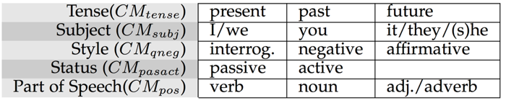
Segmentation
Boundaries
Papadimitriou et al. [2017]
Communication means & Text Features
Use text characteristics and identify points in which a significant variation of these characteristics occurs, and place a segmentation border there.
Good border
Not good border
segment 2
b₁
b₂
b₃
s _{i-2}
s _{i-1}
s _{i}
s _{i+1}
Bottom-up approach
Start with single words as segments
Compute a Diversity Index in each segment
Merge segments with low diversity
segment 1
M. Lissandrini, D. Mottin, T. Palpanas, Y. Velegrakis

Slide 74
Intention Clustering & Matching
Matching among segments with the same intention
Papadimitriou et al. [2017]
Friends have downloaded the Cloudera distribution but it didn’t work. It stopped since the web site was suggesting to have 1TB disks.
Clusters are based on intentions
I am thinking to add an extra disk drive using a RAID 0 or 1. Can I do it without having to rebuild the entire system?
C3
Given a document dq,
the system will segment dq ,
identify for each segment the segments in the same cluster
aggregate the similarity of those segments into a score for each document.
Do you know whetherit would perform ok or whether the partial use of the disk would degrade performance.
Despite the many calls, I did not manage to find a person with adequate knowledge to find out what is wrong.
Explore based on related topics
linked to common goals
C1
I am asking because I do not want to install Linux and then realize that my hardware configuration is not the right one.
All they said is bring it to up and we will see, which frustrated me. At the end I had the brilliant idea to move it to a cooler place and voila. No more problems.
C2
I have already looked at the HP official web site for how to use a JBOD. But I have not found anything related to it.
My HP Pavilion stops working after 15 min of activity. I called our technical department but no luck.
I have an HP system with a RAID 0 controller and 4 disks in form of a JBOD. I would like to install Hadoop with a replication 4 HDFS and only 320GB of disk space used from every disc.
My boss gave me yesterday an HP Pavilion computer with Intel Matrix Storage System, a 320GB drive and Linux pre-installed.
Extra RAID disk drives seem to be the solution to my problem but does adding RAID drives requires a reformat and rebuild of the system to improve performance?
M. Lissandrini, D. Mottin, T. Palpanas, Y. Velegrakis

Slide 75

Nilesh Dalvi
Fast Algorithms for Mining Association Rules in Large Databases
Management of probabilistic data: foundations and challenges
Rakesh Agrawal
Efficient Query Evaluation on Probabilistic Databases
Privacy-Preserving Data Publishing
Dan Suciu
Privacy-preserving data mining
The boundary between privacy and utility in data publishing
Privacy preserving OLAP
Sungho Hong
Vibhor Rastogi
Ramakrishnan Srikant
Dilys Thomas
Document Networks
https://www.microsoft.com/en-us/research/project/microsoft-academic-graph/

Slide 76
Influence in Citation Networks
Document relevance based on influence
El-Arini and Guestrin [2011]
Jia and Saule [2017]
Rakesh Agrawal
Citation Network
Nodes are Authors and Papers
Edges are Authorship and Citations
Influence is based on connecting Paths
Privacy-preserving data mining
Ramakrishnan Srikant
The boundary between privacy and utility in data publishing
Advance Models
El-Arini and Guestrin [2011] :
  Condition influence on topics
  Iterate for each topic T: Select topic T, keep only papers relevant for T, compute connecting Paths.
  Weight edges with Influence-Probability
Jia and Saule [2017]
  Enrich graph with Keywords & Venues
Just looking at citations
and co-citations is not sufficient.
Dan Suciu
Start from a known document
Explore new related topics, authors, venues…
M. Lissandrini, D. Mottin, T. Palpanas, Y. Velegrakis

Slide 77
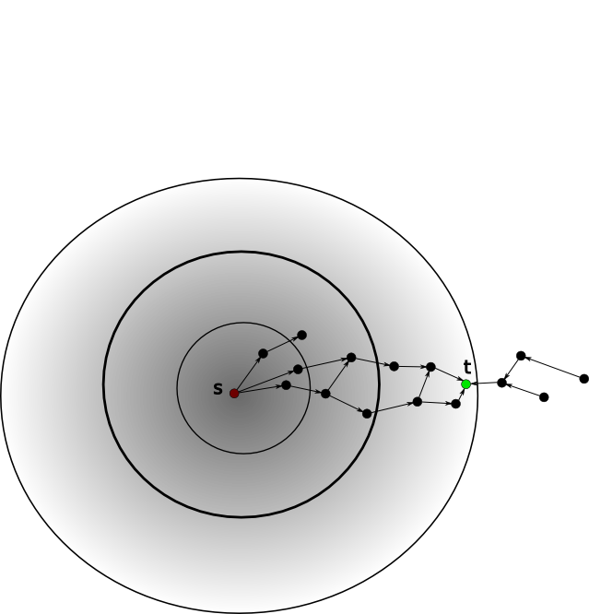
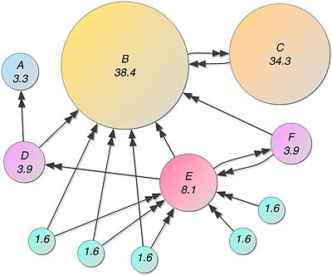
Traverse (Document) Networks
How to navigate links and connections
https://en.wikipedia.org/wiki/PageRank
SublinearAlgorithms for Personalized PageRank, with Applications – Ashish Goel et al
El-Arini and Guestrin [2011]
Jia and Saule [2017]
Personalized Page Rank
Start from seed nodes, i.e. the documents D_{rel}
Navigate towards locally connected nodes
Example based Exploration implies locality
Global Page Rank
Personalized Page Rank
CHALLENGE:
Identify meaningful transition probabilities
Starting from a random node, traversing randomly, random restart point anywhere in the graph
Starting from a limited set of nodes, traversing randomly,
restart point is one in the initial set.
Bound not to travel too far
E.g., El-Arini and Guestrin [2011]
M. Lissandrini, D. Mottin, T. Palpanas, Y. Velegrakis

Slide 78
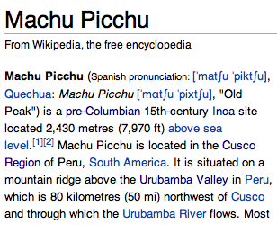

Serendipitous Search
Enhance document links with Entities and Query-logs
Bordino et al. [2013]
Francisco Pizarro
Rafting excursion
Amazon river
...
America
Peru
Query
Logs
Machu Picchu
Serenditpity
Related topics potentially
come to mind after consulting the page.
Input: Query/Document
Output: Queries
Connected entities
rafting excursion down the urubamba river
el dorado temple of sun
indios quechuas
map of peru
sapa inca
Serendipitous
Search
Exploit “lateral connections” in User Search Behaviors
Searches related to Document content
Document
M. Lissandrini, D. Mottin, T. Palpanas, Y. Velegrakis

Slide 79
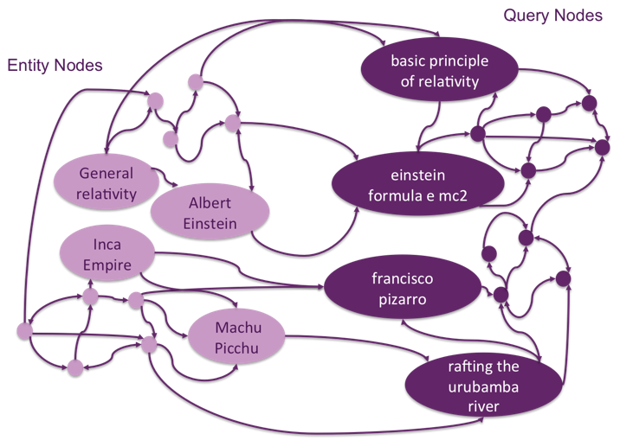


Entity Query Graph
Entity-Query graph from queries to entities and back
Bordino et al. [2013]
EQGraph Weighted Edges
1. query to query:
2. entity to query
3. entity to entity
Queries in the same session
Frequency-based approach
The more queries entities share the higher the probability
Personalized PageRank
to score suggested queries
M. Lissandrini, D. Mottin, T. Palpanas, Y. Velegrakis
Based on query to query edges

Slide 80
Documents
Semi-Structured
information
SEARCHING FOR
BY LOOKING AT
Words
Meta-Data
Words
Web-Tables
Text Classifier
[Liu et al. ’03
Zhang and Lee’09,
Zhu et al.’13]
Citation Graph
Navigation
[El-Arini et al.’11
Jia and Saule’17]
Regular Expressions
[Agichtein et al.’00]
Entity Mentions
[Wang et al.’15]
APPLYING
Topic Models
[Zhu and Wu. ’14]
Annotations
[Hanafi et al.’17]
Segmentation
[Papadimitriou et al. ’17]
Entity Linking
[Bordino et al. ’13]
Entity Extraction
[Ritter et al.’15]
Schema Matching
[Yakout et al.’18]
PRODUCES
Documents/Citations/Queries recommendations
Relation Extraction
Document Matching
Entity Augmentation
Concept Expansion
M. Lissandrini, D. Mottin, T. Palpanas, Y. Velegrakis

Slide 81
Other Related Works
Query by Document,
Yin Yang, with Nick Koudas and Dimitris Papadias
A Lattice-Based Approach to Query-by-Example Spoken Document Retrieval,
Tee Kiah Chia et al.
From Query-By-Keyword to Query-By-Example: LinkedIn Talent Search Approach,
Viet Ha-Thuc, et al

Slide 82
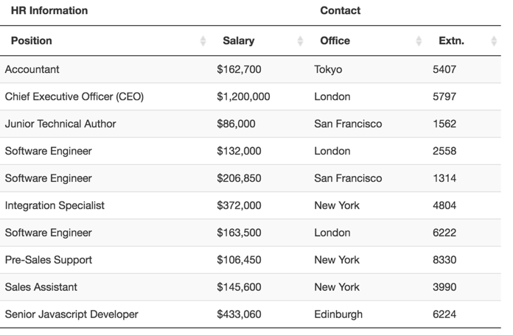
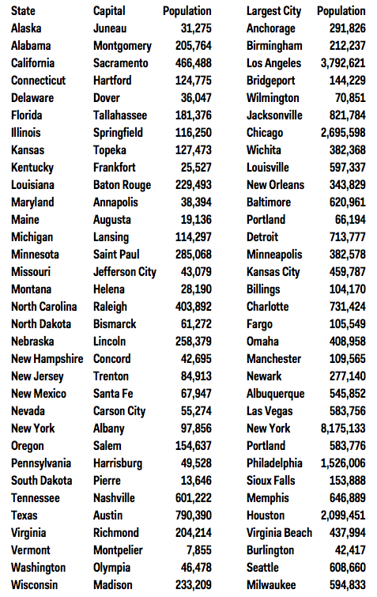

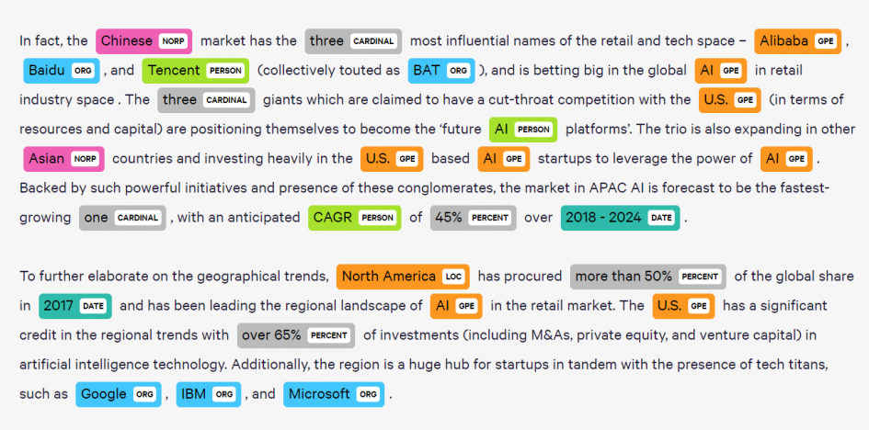
Entity Mentions
&Web-Tables
Documents & semi-structured information

Slide 83
Entity-relation tuples
Example-based extraction of Entity mentions and Relations
Brin [1998]
Agichtein and Gravano [2000]
Search for Information WITHIN Documents
Explore new Entities
and new ways to express relations
Works bests with Binary relation
Can work with multiple mentions:
Bob born in U.S.A. in 1978
1. Example
❬ Google ; Menlo Park ❭
2. Match
Google founded in Menlo Park…
3. Extract Pattern
… [X] founded in [Y] …
4. Extract New Mentions & Patterns
Apple founded in Coupertino …
Apple headquarters in Coupertino
Exemplar Tuples
Find Occurences of Exemplar Tuples
Generate
New Exemplar Tuples
Snowball
Tag Entities
Augment Table
Generate Extaction Patterns
Goal: Enrich a list of Entity-relationships data
M. Lissandrini, D. Mottin, T. Palpanas, Y. Velegrakis

Slide 84
Entity-relation tuples
Example-based extraction of Entity mentions and Relations
Brin [1998]
Agichtein and Gravano [2000]
How to validate the new rules extracted automatically?
This approach has
no “human in the loop”
Compare extracted rules with known tuples: confidence of R is based on how many known tuples extracts
Exemplar Tuples
Find Occurences of Exemplar Tuples
Generate
New Exemplar Tuples
Snowball
Tag Entities
Compare extracted tuples with known rules: confidence of T is based on how many known rules also extract T
Augment Table
Generate Extaction Patterns
New extracted Rules and Tuples should be supported by known information
M. Lissandrini, D. Mottin, T. Palpanas, Y. Velegrakis

Slide 85
IN MY DEFENSE
I WAS LEFT UNSUPERVISED

Slide 86
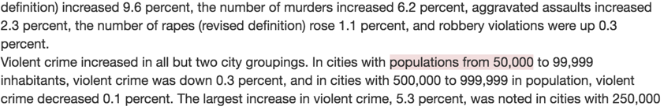
Entity-extraction by Example
Learn extraction rules from example
Hanafi et al., [2017]
Allow to match from text
both Positive and Negative examples
Goal: Supervised Extraction
SEER
Output: Extraction rules
P: Percentage = 1.0
= 1.0
D: {5, 6} = 0.4
D: {percent, %} = 0.4
= 0.4
R: [0-9]+ = 0.2
D: {percent, %} = 0.4
= 0.3
M. Lissandrini, D. Mottin, T. Palpanas, Y. Velegrakis

Slide 87
Matching Rules
From string tokens to “semantics”
Hanafi et al., [2017]
Intuition: Exploit a vocabulary of simple specialized patters with known semantics
Example:
5 percent up in Dubai
5
P: Number
percent
L: ‘percent’
Each rule has a “class”
and a preference score
P: Integer
R: [A-Za-z]+
…
L: ‘5’
T: 0-1
R: [0-9]+
Token gap
Literal
Pre-builts
≺
≺
Regex
Dictionary
Each token may have
different candidate
“matching rules”
≺
≺
Dubai
:
T: 0-1
L: ‘Dubai’
P: City
0
1
M. Lissandrini, D. Mottin, T. Palpanas, Y. Velegrakis

Slide 88
Merging Rules
Reconcile multiple interpretations
Hanafi et al., [2017]
Example:
5 percent
Example:
6 %
Tokens:
Tokens:
5
percent
6
%
5
percent
6
%
Tree:
Tree:
P: Percentage = 1.0
P: Percentage = 1.0
P: Percentage = 1.0
P: Percentage = 1.0
L: ‘%’ = 0.4
L: ‘%’ = 0.4
L: ‘percent’ = 0.4
L: ‘percent’ = 0.4
R: symbols = 0.2
L: ‘6’ = 0.4
R: symbols = 0.2
L: ‘5’ = 0.4
L: ‘6’ = 0.4
L: ‘5’ = 0.4
R: [A-Za-z]+ = 0.2
R: [A-Za-z]+ = 0.2
L: ‘%’ = 0.4
R: [0-9]+ = 0.2
L: ‘%’ = 0.4
L: ‘percent’ = 0.4
R: [0-9]+ = 0.2
R: [0-9]+ = 0.2
L: ‘percent’ = 0.4
R: [0-9]+ = 0.2
R: symbols = 0.2
R: [A-Za-z]+ = 0.2
R: symbols = 0.2
Rule:
R: [A-Za-z]+ = 0.2
Rule:
Rule:
R: [0-9]+ = 0.2
L: ‘percent’ = 0.4
Rule:
R: [0-9]+ = 0.2
L: ‘percent’ = 0.4
R: [0-9]+ = 0.2
L: ‘%’ = 0.4
R: [0-9]+ = 0.2
L: ‘%’ = 0.4
Intersection:
[5 percent, 6%]
Consider also Negative Examples
to prune candidates
P: Percentage = 1.0
L: {'5', '6'} = 0.4
L: {percent, %} = 0.4
R: [0-9]+ = 0.2
L: {percent, %} = 0.4
M. Lissandrini, D. Mottin, T. Palpanas, Y. Velegrakis

Slide 89

https://vimeo.com/208729128

Slide 90
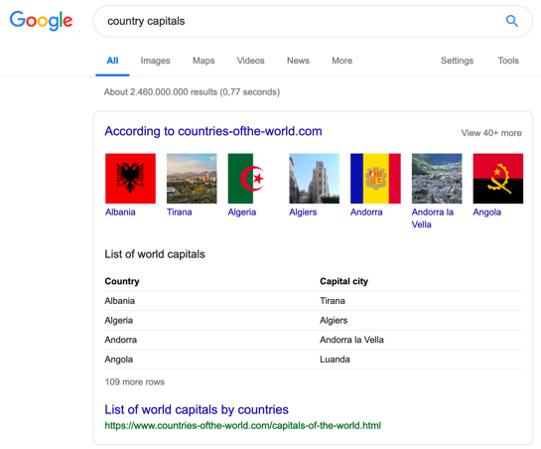
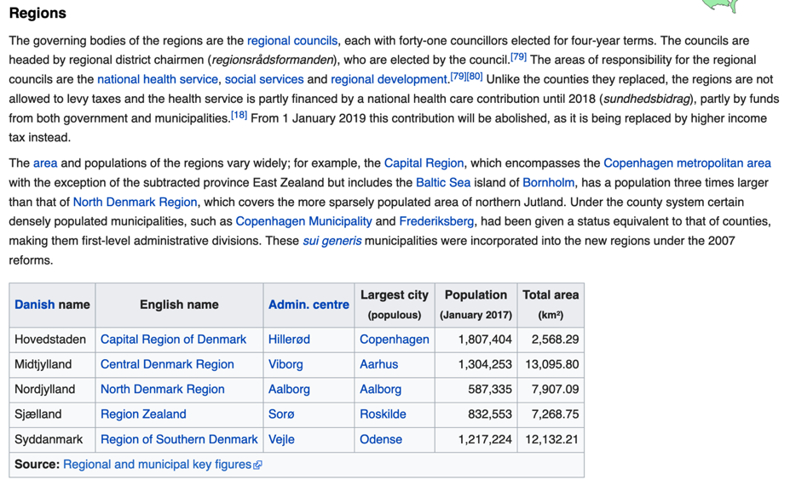
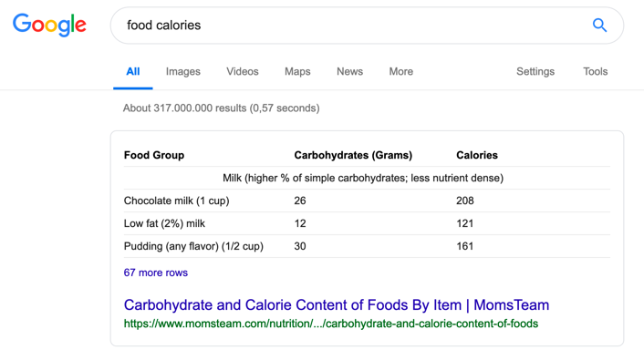
Web Tables
Semi-structured data on the web
https://en.wikipedia.org/wiki/Denmark#Regions
Web Table Extraction, Retrieval, and Augmentation: A Survey.
Shuo Zhang and Krisztian Balog. 2020.
https://doi.org/10.1145/3372117
M. Lissandrini, D. Mottin, T. Palpanas, Y. Velegrakis

Slide 91
Entity List Expansion
Augmentation: identify entities to complete the list
Wang et al. [2015]
Goal: Given some seed entity mentions, retrieve more entities of the same type
Input: Incomplete list + Keyword query
Retrieve tables from pages based on the keyword query
Assign Score to tables based on relevance
Extract entity mentions from tables
Analyze Entity mention co-occurrence
Pick ”co-occurring” Entities
IT Company
Dell
IBM
Lenovo
….?
Incomplete
table
Problem: entities may appear together for different reasons
Google
Accenture
0.4
Score Propagation
IT Company
Dell
IBM
Lenovo
Apple
Samsung
HP
Acer
Facebook
Augmented
table
Dell
0.3
Problem: Here PPR Causes concept drift
IBM
HP
0.5
Bipartite-graph
0.6
Heuristic Propagation
M. Lissandrini, D. Mottin, T. Palpanas, Y. Velegrakis

Slide 92
Web-Table Completion
Identify relevant content, retrieve missing information
Yakout et al. [2012]
Goal: Retrieve missing attribute values
Intuition: If there is a structure, we can match it!
Model | Brand
S80 | Nikon
Easyshare CD44 | Kodak
DSC W570 | Sony
Optio E60 | Pentax
Part No | Mfg
DSC W570 | Sony
T1460 | Benq
Optio E60 | Pentax
S8100 | Nikon
Web tables
Part No | Mfg
DSC W570 | Sony
T1460 | Benq
Optio E60 | Pentax
S8100 | Nikon
Model | Brand
S80 | Benq
A10
GX-1S
T1460
Model | Brand
S80 | Benq
A10 | Innostream
GX-1S | Samsung
T1460 | Benq
InfoGather
Problem: entities may appear together for different reasons
Incomplete table
Complete table
Extra Input: table header
target attribute name or example of completing attribute
M. Lissandrini, D. Mottin, T. Palpanas, Y. Velegrakis

Slide 93
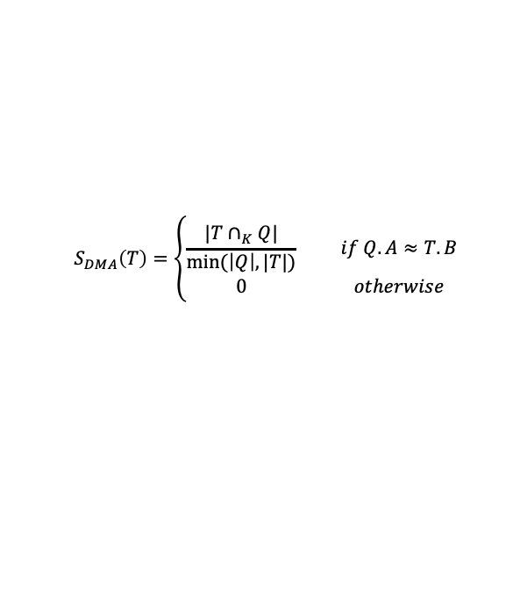
Table Correlation Graph
Schema matching for web-page and web-tables
Binary-relations only
Yakout et al. [2012]
Goal: Retrieve missing attribute values
Determine Table Match
Direct Match between Q(K,A) and T(K,B)
K=entity names in a column
A,B = attribute column name (header)
Can use approximate matching and thesaurus
$$S_{DMA}\left(T\right)=\left\{\begin{matrix}\frac{|T∩_{K}Q|}{min(\left|Q\right|, |T|)} & & if Q.A≈T.B \\ 0 & & otherwise\end{matrix}\right.$$
Problem: considers only direct links between Q and T
M. Lissandrini, D. Mottin, T. Palpanas, Y. Velegrakis

Slide 94
Table Correlation Graph
Schema matching for web-page and web-tables
Binary-relations only
Yakout et al. [2012]
Goal: Retrieve missing attribute values
Determine Table Match
Holistic Match
Assign Direct Match Score from Query to Tables
Scores >0 are starting nodes
Use classifier to add weight to other table pairs
Build Classifier using
  Context similarity
  Table-to-content similarity
  URL similarity
  Tuples Similarity
  the model predicts the match between
  two tables with a probability
Use starting node and execute PPR
Use PPR scores to rank matching tables
0.1
0.1
0.3
0.7
0.2
0.2
Overcomes problems due to poor matching with the query
0.1
0.2
0.1
0.5
M. Lissandrini, D. Mottin, T. Palpanas, Y. Velegrakis

Slide 95
Documents
Semi-Structured
information
SEARCHING FOR
BY LOOKING AT
Words
Meta-Data
Words
Web-Tables
Text Classifier
[Liu et al. ’03
Zhang and Lee’09,
Zhu et al.’13]
Citation Graph
Navigation
[El-Arini et al.’11
Jia and Saule’17]
Regular Expressions
[Agichtein et al.’00]
Entity Mentions
[Wang et al.’15]
APPLYING
Topic Models
[Zhu and Wu. ’14]
Annotations
[Hanafi et al.’17]
Segmentation
[Papadimitriou et al. ’17]
Entity Linking
[Bordino et al. ’13]
Entity Extraction
[Ritter et al.’15]
Schema Matching
[Yakout et al.’18]
PRODUCES
Documents/Citations/Queries recommendations
Relation Extraction
Document Matching
Entity Augmentation
Concept Expansion
M. Lissandrini, D. Mottin, T. Palpanas, Y. Velegrakis

Slide 96
Where we are
Relational databases
Machine learning
Textual data
Graphs and networks
Challenges and Remarks
M. Lissandrini, D. Mottin, T. Palpanas, Y. Velegrakis

Slide 97
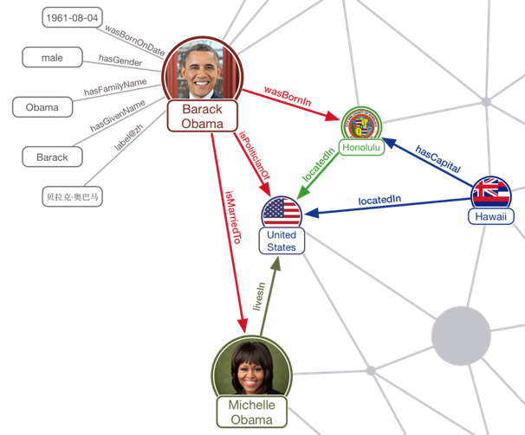
Graphs are Everywhere
Knowledge
Graph
Protein Interaction Network
Road
Network
Social
Network
M. Lissandrini, D. Mottin, T. Palpanas, Y. Velegrakis

Slide 98
Graphs
Connected Data
A graph is a graph is a graph
Fact Graph
Ontology Tree
Arnold Schwarzenegger
is A
Person
Edge-labelled
Multigraphs
G: ⟨V, E, L, 𝓁⟩
Attributes:
V/E:<key,value>
actedIN
is A
subClassOf
Terminator
Actor
Release | 1984
Budget | $6.4M
Length | 1h 48m
RDF
(subject,predicate,object)
(Arnold_Schwarzenegger,isA,Person)
(Actor, subClassOf, Person)
(Arnold_Schwarzenegger, actedIn, Terminator)
The Structure of the Graph
Is as important as the Data-values
M. Lissandrini, D. Mottin, T. Palpanas, Y. Velegrakis

Slide 99
Exemplar Queries
Example-driven graph search
Mottin et al. [2014,2016]
Nodes/Entities
Edges/Facts
Structures
Input: $Qe$, an example element of interest
Output: set of elements in the desired result set
Exemplar Query Evaluation
evaluate $Qe$ in a database D, finding a sample S
find the set of elements A similar to S given a similarity relation
[OPTIONAL] return only the subset A^{R} that are relevant
Usually requires an intermediate step:
User input (keywords) → Element in the graph
M. Lissandrini, D. Mottin, T. Palpanas, Y. Velegrakis

Slide 100
SIMILARITY for
GRAPHS
Nodes
Structures
Connectivity
Properties
Queries
(Edge-)Labels
CHALLENGE: DISCOVER USER PREFERENCE
CHALLENGE: EFFICIENT SEARCH

Slide 101
Nodes
Structures
SEARCHING FOR
BY LOOKING AT
Connectivity
Properties
Queries
(Edge-)Labels
Mediator Nodes
[Gionis et al. ‘15
Ruchansky et al.’15]
Similar Entities
[Metzger et al.’13,
Sobczak et al.’15]
Path Queries
[Bonifati et al.’15]
Entity Tuples
[Jayaram et al.’15]
PRODUCES
Similar
Structures
[Mottin et al.’14,
Xie et al.’17,
Lissandrini et al. ’18 & ‘20]
Clusters
[Perozzi et al.’14,
Kloumann et al. 14]
SPARQL
[Arenas et al.’16]
M. Lissandrini, D. Mottin, T. Palpanas, Y. Velegrakis

Slide 102

Seed Set Expansion
Nodes connected by a community
Kloumann and Kleinberg [2014]
Given a graph G, and a set of query nodes VQ⊆VG,
retrieve all other nodes VC⊆VG,
where C is a community in G, and VQ⊆VC.
Solution: PPR
Communities can be extremely large
Identify “central nodes”
or “the core subgraph”
M. Lissandrini, D. Mottin, T. Palpanas, Y. Velegrakis

Slide 103
The Minimum Wiener Connector Problem
Ruchansky et al. [2015]
Model: Unlabeled Undirected Graph
Query: A set of Nodes Q
Similarity: Shortest-Path distance
Output: A Set of Connector Nodes H
“explains” connections in Q
Case: Infected Patients
→ Culprit/Other Infected
Connectors:
Nodes with HIGH closeness
to ALL the inputs
Case: Target Audience
→ Influencers
Similar to a Steiner-Tree but
overall pairwise distances are optimized
M. Lissandrini, D. Mottin, T. Palpanas, Y. Velegrakis

Slide 104
The Minimum Wiener Connector Problem
Ruchansky et al. [2015]
Sometimes The Best Solution is
NOT A Tree
Model: Unlabeled Undirected Graph
Query: A set of Nodes Q
Similarity: Shortest-Path distance
Output: A Set of Connector Nodes H
“explains” connections in Q
W=1+2+1 =4
NP-Hard
W=1+1+1 = 3
minimize the sum of pairwise shortest-path-distances
between nodes in the connector H
d(u, v) is the shortest-path distance
Called: Wiener Index.
tradeoff between size
and average distance
M. Lissandrini, D. Mottin, T. Palpanas, Y. Velegrakis

Slide 105
Approximate minimum Wiener Index Connector
Ruchansky et al. [2015]
Approximated with
Edge-Weighted SteinerTree
CHOOSE r ∈ Q & λ ∈ [1, log_{(1+β)} |V| ]
All Pairwise Distances
Enumerate Candidate Solutions
for r ∈ Q & λ
and keep best tree
Distances from a root r
Measure distance in H (i.e., subgraph-induced)
Precomputed distance in G
r
Edge Weights
w(u, v) =
M. Lissandrini, D. Mottin, T. Palpanas, Y. Velegrakis
Notes:
Every edge encodes how much the shortest path from r is getting “worse”

Slide 106
Focused Clustering and Outlier Detection
Similarity based on attributes
Perozzi et al. [2014]
PhD
NYC
English
Google
College
Paris
Dutch
Google
PhD
NYC
Greek
SAP
Model: Unlabeled Undirected Graph with Node Attributes
Query: A set of Nodes Q
Similarity: To Be Inferred
based on Attribute Values & Connectivity
Output: Clusters of Nodes: Dense & Coherent
+ Outliers
College
NYC
English
Google
PhD
NYC
Italian
IBM
Case: Target Users → Community with same interests
PhD
NYC
French
SAP
Case: Products→ Co-purchased products with similar features
M. Lissandrini, D. Mottin, T. Palpanas, Y. Velegrakis

Slide 107

Focused Clustering
Infer User Focus
Perozzi et al. [2014]
PhD
NYC
English
Google
TASK: Infer “FOCUS” , important attributes
attribute weights β
1. Set of similar pairs, PS (from Q)
2. Set of dissimilar pairs, PD (random sample)
3. Learn a distance metric between PS and PD
( Distance Metric Learning, inverse Mahalanobis distance: Xing, et al 2002)
PhD
NYC
Greek
SAP
College
Paris
Dutch
Google
PhD
NYC
English
Google
PhD
NYC
French
SAP
0.5
0.5
0
0
Weak Ties
College
NYC
English
Google
PhD
NYC
Italian
IBM
Similar Attributes
=
Stronger Connection
PhD
NYC
French
SAP
M. Lissandrini, D. Mottin, T. Palpanas, Y. Velegrakis

Slide 108
Focused Clustering
Prune the Graph and keep dense communities
Perozzi et al. [2014]
LOCAL
clusters
TASK: Extract Clusters on Focused Graph
attribute weights β → Edge Weight
1. Find Starting Set of Small Candidate Clusters
1.a Drop low-weight edges
1.b Extract Strongly Connected Component C_{1,} C_{2, …}
2. Grow Clusters around Candidates
2.a Compute conductance of C: φ^{(w)} (C, G)
2.b Select node to add to C’: best improvement to ∆φ^{(w)} (C,C’) (greedy)
2.c Prune Underperforming nodes
3. Detect Outliers: High unweighted conductance
w.r.t. low weighted conductance
?
Seed
Weighted Conductance:
ratio between the weighted sum of edges
crossing the boundaries of the cluster
and the weighted sum of those residing within it.
Performant Strategy:
Start with local solution and expand around them to avoid complete scans of the graph
M. Lissandrini, D. Mottin, T. Palpanas, Y. Velegrakis

Slide 109

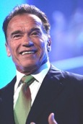
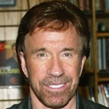







iQBEES: Entity Search by Example
Knowledge Graph Search
Metzger et al. [2013]
Sobczak et al. [2015]
Entity 1:
?
Entity 2:
Model: Knowledge Graph (Edge-labels)
Query: A set of Entities Q
Similarity: Shared semantic properties
Output: A Set of Similar Entities (ranked)
?
?
Case: Products→ Products with similar aspects
Case: KG Exploration→ Related Entities
M. Lissandrini, D. Mottin, T. Palpanas, Y. Velegrakis

Slide 110








Maximal Aspects
Selecting Features of Entity Similarity
Metzger et al. [2013]
Sobczak et al. [2015]
Is not maximal if
Adding any aspect
→ E(A)={Arnold}
?x sport BodyBuilding
?x type AmericanActor
Include
Typical Types
?x type AmericanActor
?x governorOf California
1. Prune
generic
aspects
?x hasHeight 1.88m
Use most Specific Type
?x type Entity
2. Rank
Set of
aspects
?x type AmericanActor
REPEATABLE
Update Q
?x actedIn TheExpendables
?x type ActionActor
M. Lissandrini, D. Mottin, T. Palpanas, Y. Velegrakis

Slide 111
SIMILARITY for
GRAPHS
Nodes
Structures
✓
✓
Connectivity
Properties
Queries
(Edge-)Labels
Queries can retrieve
both Nodes and Structures

Slide 112
Nodes
Structures
SEARCHING FOR
BY LOOKING AT
Connectivity
Properties
Queries
(Edge-)Labels
Mediator Nodes
[Gionis et al. ‘15
Ruchansky et al.’15]
Similar Entities
[Metzger et al.’13,
Sobczak et al.’15]
Path Queries
[Bonifati et al.’15]
Entity Tuples
[Jayaram et al.’15]
PRODUCES
Similar
Structures
[Mottin et al.’14,
Xie et al.’17,
Lissandrini et al. ’18 & ‘20]
Clusters
[Perozzi et al.’14,
Kloumann et al. 14]
SPARQL
[Arenas et al.’16]
M. Lissandrini, D. Mottin, T. Palpanas, Y. Velegrakis

Slide 113

Learning Path Queries on Graphs
Queries from Examples
Bonifati et al. [2015]
Tram
✓
+
Negative Examples to disambiguate intention
X
Model: Edge Labeled Graph
Query: 2 sets of Entities Q⁺ , Q⁻
Similarity: Common Path Query (RegExp)
(bus|tram)*+ Cinema
Output: Set of Nodes satisfying paths for Q⁺
but not paths for Q⁻
Tram
Tram
Tram
Bus
Bus
^{Positive, Negative}
+
Walk
✓
-
Walk
Shop
Cinema
Walk
S₁
Shop
X
C₁
Case: Proteins→ Similar interactions/co-expression
MONADIC: only starting nodes
extensible to
BINARY/ N-ARY : path from X to Y
Case: Tasks Initiator→ Similar Processes/Behaviours
M. Lissandrini, D. Mottin, T. Palpanas, Y. Velegrakis

Slide 114
Learnability of Path Queries
When is possible and How
Bonifati et al. [2015]
Sometimes Positive & Negative Examples
Cannot be reconciled!
Consistency Check:
PSPACE-complete
Query: 2 sets of Entities Q⁺ , Q⁻
Consistency:
Select Smallest Consistent Path
Loops cause infinite paths? Fix Maximal Length K
When to use Kleene star * ?
Generalize SCP
  Construct Prefix Tree Acceptor
  Generalize into DFA with Merge
Enumerate Paths
Up to Fixed distance
For paths of Length N
K = 2 ⅹ N +1
C | ( A﹒B﹒C) → ( A﹒B)*﹒C
Can be INTERACTIVE! The system presents to the user nodes to label as Positive/Negative
PTA
DFA
M. Lissandrini, D. Mottin, T. Palpanas, Y. Velegrakis

Slide 115
Reverse engineering SPARQL queries
Knowledge Graph Search
Arenas et al. [2016]
?
Mexico
Spanish
Model: Knowledge Graph (Edge-labels)
Query: Set of Answers
Similarity: common AND/OPT/FILTER query
Output: a SPARQL query / query results
→ Not Graphs but Tuples (of Nodes?)
Haiti
Jamaica
?
English
 | ?e1 | ?e2
M1 | Mexico | Spanish
M2 | Haiti
M3 | Jamaica | English
Case: Open Data→ Query Unknown Schema
Case: Novice User → Avoid SPARQL
MATCH (?X, is_a, Country)
OPT (?X, has_language, ?Y)
M. Lissandrini, D. Mottin, T. Palpanas, Y. Velegrakis

Slide 116


Complex SPARQL queries
A quick-peek to the complex pattern queries
https://www.stardog.com/blog/7-steps-to-fast-sparql-queries/
https://medium.com/wallscope/constructing-sparql-queries-ca63b8b9ac02
?
Variables start with
M. Lissandrini, D. Mottin, T. Palpanas, Y. Velegrakis
Notes:
Draw the pattern matched by this query

Slide 117





Reverse engineering SPARQL queries
Challenges and Complexity
Arenas et al. [2016]
Enumerate all possible
SPARQL queries satisfied
by the mappings
Query: Set of Variable Mappings
 | ?X | ?Y | ?Z
M1 | John
M2 | Mary | mary@email.eu
M3 | Lucy |  | Roses Street
INTRACTABLE
Build tree-shaped
SPARQL queries IMPLIED
by the mappings
Incomplete Mappings are treated as OPTIONAL
Typical of RDF queries
M. Lissandrini, D. Mottin, T. Palpanas, Y. Velegrakis

Slide 118







Reverse engineering SPARQL queries
Challenges and Complexity
Arenas et al. [2016]
3 Instantiations:
Only Positive Examples
Positive & Negative
Exact Result only
Query: Set of Variable Mappings Ω
{M1,M2,M3,M4}
M1
M2
M3
M4
{M2,M4}
{M3,M4}
{M4}
M1
M2
M3
M4
Greedy: keep just enough to cover all variables
M. Lissandrini, D. Mottin, T. Palpanas, Y. Velegrakis

Slide 119

Nodes
Structures
SEARCHING FOR
BY LOOKING AT
Connectivity
Properties
Queries
(Edge-)Labels
Mediator Nodes
[Gionis et al. ‘15
Ruchansky et al.’15]
Similar Entities
[Metzger et al.’13,
Sobczak et al.’15]
Path Queries
[Bonifati et al.’15]
Entity Tuples
[Jayaram et al.’15]
PRODUCES
Similar
Structures
[Mottin et al.’14,
Xie et al.’17,
Lissandrini et al. ’18 & ‘20]
Clusters
[Perozzi et al.’14,
Kloumann et al. 14]
SPARQL
[Arenas et al.’16]
M. Lissandrini, D. Mottin, T. Palpanas, Y. Velegrakis

Slide 120
Graph Exemplar Queries
Search for Structures
Mottin et al. [2016]
Query:
Model: Knowledge Graph
Query: Example Structure
Similarity: Isomorphism/Simulation
Output: A set of Sub-Graphs
S
A1
A2
Knowledge
Graph
Case: Rich Schema → Find complex structures
M. Lissandrini, D. Mottin, T. Palpanas, Y. Velegrakis

Slide 121
Graph Query by Example(GQBE)
Search for example Tuples
Jayaram et al. [2015]
Model: Knowledge Graph
Query: Entity Tuples
Similarity: ~Isomorphism
Output: A set of Tuples
Q = (Google, S. Mateo)
Results =
(Yahoo, S. Clara)
(CBS, New York)
In GQBE Input is a set of (disconnected) entity mention tuples
Case: Known Entities+Uknown Connections → Find Complex Connections
M. Lissandrini, D. Mottin, T. Palpanas, Y. Velegrakis

Slide 122

GQBE: Maximum Query Graph
Understand the connections implied by the tuples
Jayaram et al. [2015]
Find the maximum query graph
  Graph with M edges having the maximum weight
Answers subgraph-isomorphic to the query graph
Return top-k
Q = (v₁,v₂)
0.1
0.2
0.1
z
NP-hard
v₁
0.4
u₂
0.7
0.1
0.8
0.5
0.3
Answer score:
Sum of query graph weights
Similarity match between edges in the answer and the query (shared nodes take extra credit)
v₂
u₁
0.5
Maximum Query Graph
Answer graph
M. Lissandrini, D. Mottin, T. Palpanas, Y. Velegrakis

Slide 123
GQBE: Multiple Query Tuples
Understand the connections implied by the tuples
Jayaram et al. [2015]
Find answers using a lattice obtained removing edges from the union graph
GQBE finds answers for multiple query tuples
Compute a re-weighted union graph of the individual query graphs
Maximum
Query Graph
is Very Large
Subgraphs of
Maximum
Query graph
v₁
v₂
v₁
v₂
v₁
v₂
v₁
v₂
v₁
v₂
Preserve the query connectivity
Full process
M. Lissandrini, D. Mottin, T. Palpanas, Y. Velegrakis

Slide 124
Graph Isomorphism vs. Simulation Variants
Structural Congruence/Similarity
Isomorphism requires an bijective function
Simulation requires only a surjective relation
Preserves only Parent → Child relationships
Example of Simulating (G1∼ {G2,G3,G4}) and Strong-simulating Graphs (G1≈G2)
Strong simulation: Capturing topology in graph pattern matching
– Shuai Ma et al., 2014
Strong Simulation preserves close connectivity
M. Lissandrini, D. Mottin, T. Palpanas, Y. Velegrakis

Slide 125
Computing Exemplar Queries (i)
Fast Structure Matching
Mottin et al. [2016]
NP-complete
(subgraph isomorphism)
Reduce Search Space:
Removes nodes that cannot be part of a solution
$O\left({\left|V\right|}^{4}\right)$(simulation)
Exact Pruning technique:
Compute the neighbor labels of each node
Prune nodes not matching query nodes neighborhood labels
Apply iteratively on the query nodes
  $$W_{n,a,i}=\left\{n_{1} | l\left(n_{1},n_{2}\right)=a∨∈N_{i−1}\left(n\right)\right\}$$
v
A
A
A
X
B
B
B
A
Q
u
Sample
A1
B
neighborhood (v) = {(B,1)}
$⊈$
neighborhood (u) = {(A,1)}
A2
No Match
Labels at distance 1
M. Lissandrini, D. Mottin, T. Palpanas, Y. Velegrakis

Slide 126
Computing Exemplar Queries (ii)
Prune Irrelevant Answers
Mottin et al. [2016]
NP-complete
(subgraph isomorphism)
Reduce Search Space:
Removes nodes that are likely to be less relevant
$O\left({\left|V\right|}^{4}\right)$(simulation)
Approximation:
Nodes closed to the sample are more important
Use Personalized PageRank with a weighted matrix
Weight edges: frequency of the edge-label
v
Sample
A1
A2
M. Lissandrini, D. Mottin, T. Palpanas, Y. Velegrakis
D. Mottin, M. Lissandrini, T. Palpanas, Y. Velegrakis

Slide 127
Ranking Results
Score Relevance of Answers
Mottin et al. [2016]
Combination of two factors
Structural: similarity of two nodes in terms of neighbor relationships
Distance-based: the PageRank already computed
User Query
Google
Yahoo!
CBS
S
A1
A2
M. Lissandrini, D. Mottin, T. Palpanas, Y. Velegrakis

Slide 128













Search with Multiple Examples
Combining partial answers
Lissandrini et al. [2018]
  Multiple Simple Examples
  Each Example describes an Aspect
  Results are Combinations of aspects
  Results have possibly Multiple Structures
actor
director
actor
spouse
spouse
spouse
actor
director
director
Case: Unknown Structures → Find Complex Connections with Simpler Components
M. Lissandrini, D. Mottin, T. Palpanas, Y. Velegrakis

Slide 129

Search Framework
Pruning and Partial matching
Lissandrini et al. [2018]
S3
S1
S2
Exploit Localized Search
M. Lissandrini, D. Mottin, T. Palpanas, Y. Velegrakis

Slide 130
Fast Candidate Region Search
Reducing the search space
Lissandrini et al. [2018]
Identify SEED:
S3
S1
S2
With cardinality Estimation
Select SINGLE NODE
With neighborhood-mapping
EXPAND around each seed:
Retrieve candidate Regions
DISCARD incomplete regions
With neighborhood-mapping & before graph-search
M. Lissandrini, D. Mottin, T. Palpanas, Y. Velegrakis

Slide 131















Solution: Interactive Suggestion System
Lissandrini et al. [2020]
member
profession
won
profession
invented
works in
has advisor
✓
User Interaction
Narrow the options
Select suggestion
Focused Expansions
education
title
advisee
married
has advisor
✓
✓
Notes:
We propose to provide a solution that will guide our exploration interactively
This would be similar to the autocomplete suggestions for keywords queries in popular search engines
For instance, the user can explore some entity properties,
Like in this case assume the user is looking for information about famous scientist starting from Einstein and looking for information about Einstein academic education
[]
and after selecting among the options some relationships of interest
[]
the system would provide some more appropriate suggestions
[]
Through this process the user would acquire more relevant knowledge and at the same time refine their query

Slide 132
Suggesting Expansions
Lissandrini et al. [2020]
Americas
DATABASE
The User Search
contains
contains
Argentina
U.S.A.
President_of
President_of
President_of
President_of
Ronald Reagan
U.S.A.
Juan Perón
Barack
Obama
Ronald Reagan
married_with
married_with
married_with
married_with
Which Expansion to Suggest?
Has_child
Party
Eva
Perón
Michelle
Obama
Nancy Reagan
Republican
Jane Wyman
Ronald Reagan
Party
Republican
acted_in
acted_in
acted_in
acted_in
Has_child
The Prodigal Woman
Natasha
Obama
Night Into Morning
Law and Order
Pollyanna
Ronald Reagan
Acted_in
Law and Order
Rank Expansions
Approach:
Rank Edges based
on Label characteristics
contains
Americas
U.S.A.
. . .
Notes:
Therefore, in practice, given as input the current user query -- for instance an edge,
we aim at suggesting a set of query expansions in the form of more related edges
This requires us to compute a ranking of all the edges that can be used as expansions

Slide 133

Pseudo Relevance Feedback for Document Search
Lissandrini et al. [2020]
Keyword Query
--- --
---- ----
--- --------------
-------
--- --
---- ----
--- -----
---------
-------
--- --
---- ----
--- -----
“w₁ w₂ w₃”
--- --
---- ----
--- --------------
-------
--- --
---- ----
--- -----
---------
-------
--- --
---- ----
--- -----
Extract “new”
keywords
w_{x} w_{y} w_{z}
Search “relevant”
documents
--- --
---- ----
--- --------------
-------
--- --
---- ----
--- -----
---------
-------
--- --
---- ----
--- -----
Expand
query
--- --
---- ----
--- --------------
-------
--- --
---- ----
--- -----
---------
-------
--- --
---- ----
--- -----
Pseudo-Relevant Set
“w₁ w₂ w₃
w_{x} w_{y} w_{z}”
Query
PRS
--- --
---- ----
--- --------------
-------
--- --
---- ----
--- -----
---------
-------
--- --
---- ----
--- -----
--- --
---- ----
--- --------------
-------
--- --
---- ----
--- -----
---------
-------
--- --
---- ----
--- --
---- ----
--- --------------
-------
--- --
---- ----
--- -----
---------
-------
--- --
Search “new”
documents
--- --
---- ----
--- --------------
-------
--- --
---- ----
--- -----
---------
-------
--- --
Notes:
In classical document search, we start from the current keyword query and we search a set of matching documents that we assume to be relevant, hence called the pseudo-relevane set,
then from these documents we extract a set of new keywords, not appearing in the query
These keyword are used as query expansion in order to search for more relevant documents
Therefore the relevant of an expansion query is based in part on the the co-occurrence of keywords in the query
And in part on the freqeuency of in the pseudo-relevant sete

Slide 134



Pseudo Relevance Feedback Models
Lissandrini et al. [2020]
Maximum Likelihood Estimation
PRS
KL-Divergence
2 Models of Estimation
MLE & KL-Divergence
Notes:
There exists then two models for estimating the relevance of an expansion given the frequency in the pseudo-relevance set.
We could apply the maximum likelihood estimation model, which favors expansions that are frequent both in the graph and in the pseudo-relevance set
Or we could employ the KeyEll divergence to favor expansions that are unexpectedly frequent in the pseudo relevant set

Slide 135
Bag Model for Graphs
Lissandrini et al. [2020]
The User Search
President_of
Ronald Reagan
U.S.A.
Americas
contains
DATABASE
contains
contains
Argentina
U.S.A.
President_of
How can we convert to
the document model?
President_of
President_of
President_of
President_of
Juan Perón
Barack
Obama
Ronald Reagan
married_with
married_with
married_with
married_with
married_with
married_with
Lives_in
The Bag-of-Labels Model
Has_child
Lives_in
Eva
Perón
Michelle
Obama
Nancy Reagan
California
Jane Wyman
President_of, contains, married_with,
married_with, acted_in, lives_in
acted_in
Has_child
acted_in
acted_in
acted_in
The Prodigal Woman
Natasha
Obama
Night Into Morning
Law and Order
Pollyanna
Graphs can be modeled as Bag of Words
Describes MORE than what is in the query
Notes:
To effectively apply these models to graph search we require an appropriate way to model the graph structure.
Here we propose what we call a bag-of-labels
[]
That is we translate edges labels in the graph to bag of words where each edge type is a word.
Moreover with this model we describe the query itself but also all the edges that are around the query

Slide 136

https://www.youtube.com/watch?v=A1_dKvX5ZRk

Slide 137
Nodes
Structures
SEARCHING FOR
BY LOOKING AT
Connectivity
Properties
Queries
(Edge-)Labels
Mediator Nodes
[Gionis et al. ‘15
Ruchansky et al.’15]
Similar Entities
[Metzger et al.’13,
Sobczak et al.’15]
Path Queries
[Bonifati et al.’15]
Entity Tuples
[Jayaram et al.’15]
PRODUCES
Similar
Structures
[Mottin et al.’14,
Xie et al.’17,
Lissandrini et al’18]
Clusters
[Perozzi et al.’14,
Kloumann et al. 14]
SPARQL
[Arenas et al.’16]
Few Approaches accept User Feedback
M. Lissandrini, D. Mottin, T. Palpanas, Y. Velegrakis

Slide 138
Where we are
Relational databases
Machine
learning
Textual data
Graphs and networks
Challenges and Remarks
M. Lissandrini, D. Mottin, T. Palpanas, Y. Velegrakis

Slide 139
How ML fits the Big Picture
M. Lissandrini, D. Mottin, T. Palpanas, Y. Velegrakis

Slide 140
Interactive exploration of datasets
Main idea: Learn the items to show online as more points are acquired
Two ways of learning: passive and active
items
REQUESTS
USER INPUT
RESPONDS
To USER INPUT
Learn
v
items
Is t or ?
v
t
Learn
Passive
Active
M. Lissandrini, D. Mottin, T. Palpanas, Y. Velegrakis

Slide 141
MindReader
[Ishikawa et al., 1999]
Main idea: learn an implicit query from user examples and optional scores
Searching “mildly overweighted” patients
Weight
The doctor selects examples by browsing patient database
The examples have “oblique” correlation
We can “guess” the implied query
q
: good
: very good
Height
M. Lissandrini, D. Mottin, T. Palpanas, Y. Velegrakis

Slide 142
Learning an ellipsoid distance
[Ishikawa et al., 1999]
Weighted distance matrix
Euclidean
q
$D\left(x,q\right)={\left(x−q\right)}^{⊤}M(x−q)$
Implicit query
$$D\left(x,q\right)=\sum_{j}^{n}{\sum_{k}^{n}{m_{jk}(x_{j}−q_{j})(x_{k}−q_{k})}}$$
weighted
Euclidean
q
Learn the query minimizing the penalty = weighted sum of distances between query point and sample vectors
generalized
ellipsoid distance
$$minimize \sum_{i}{{\left(x_{i}−q\right)}^{⊤}M(x_{i}−q)}$$
$subject to\det\left(M\right)=1$
q
M. Lissandrini, D. Mottin, T. Palpanas, Y. Velegrakis

Slide 143
Learning the distance
[Ishikawa et al., 1999]
Query point is moved towards “good” examples — Rocchio formula in IR
Q₀: query point
: retrieved data
: relevance judgments
Q₁: new query point
Q₁
Q₀
Learning can be done online!!!
M. Lissandrini, D. Mottin, T. Palpanas, Y. Velegrakis

Slide 144



Explore-by-Example: AIDE
[Dimitriadou et al., 2014,2016]
Relevance Feedback
Relevant Samples
Irrelevant Samples
Data
Classification
User
Model
Samples
User
Model
Query Formulation
D-dimensional
Space Exploration
SQL
Sampling
queries
Data Extraction
Query
M. Lissandrini, D. Mottin, T. Palpanas, Y. Velegrakis

Slide 145
The AIDE algorithm
[Dimitriadou et al., 2014, 2016]
Divide the space into d-dimensional cubes
Find the sample points in the cubes (medoids)
Train the classifier
Refine the training sampling from neighbors of misclassified points
Boundary refinement
?
M. Lissandrini, D. Mottin, T. Palpanas, Y. Velegrakis

Slide 146
Classification & Query Formulation
[Dimitriadou et al., 2014, 2016]
Sample | Red | Green | Relevant
Object A | 13.67 | 12.34 | Yes
Object B | 15.32 | 14.50 | No
.. | .. | .. | ...
Object X | 14.21 | 13.57 | Yes
red
red>14.82
red<=14.82
Irrelevant
red
red>=13.55
red<13.55
green
Irrelevant
green>13.74
green<=13.74
Decision Tree Classifier
Irrelevant
Relevant
SELECT * FROM galaxy WHERE red<= 14.82 AND red>= 13.5 AND green<=13.74
M. Lissandrini, D. Mottin, T. Palpanas, Y. Velegrakis

Slide 147
Misclassified Sample Exploitation
[Dimitriadou et al., 2014,2016]
Sampling
Areas
x
√
x
x
x
√
√
√
√
√
√
√
√
x
x
x
x
x
Predicted Area
Red wavelength
x
x
x
√
x
√
x
x
x
x
Green Wavelength
M. Lissandrini, D. Mottin, T. Palpanas, Y. Velegrakis

Slide 148
Clustering-based Sampling
[Dimitriadou et al., 2014,2016]
x
√
√
x
√
√
x
x
√
√
√
√
Idea: Use a k-medoid approach to find sampling areas
√
√
√
√
x
x
√
√
√
x
Clusters-Sampling
Areas
Red wavelength
x
Iterative approach:
How many samples does it take to reach the desired result?
√
√
Green Wavelength
M. Lissandrini, D. Mottin, T. Palpanas, Y. Velegrakis

Slide 149
Active learning for online query systems
[Vanchinathan et al., 2015]
Main idea: the system “queries” the user to understand their preferences
Get item
System
Ask user
preference
Learn unknown preferences and minimize the number of questions to the user
M. Lissandrini, D. Mottin, T. Palpanas, Y. Velegrakis

Slide 150
Learning unknown preferences
[Vanchinathan et al., 2015]
Problem: Find a set S that maximize the unknown user preference within a budget (e.g., number of interactions)
User preferences
S (intended user set)
$$\arg{\max{\sum_{v∈S}{pref(v)}}}$$
$$subject to Cost\left(S\right)≤budget$$
Cost for the set S
M. Lissandrini, D. Mottin, T. Palpanas, Y. Velegrakis

Slide 151

A step back …
Learning from an unknown environment …

Slide 152
Multi-armed bandits
Maximize the reward by successively playing gamble machines (the ‘arms’ of the bandits)
Invented in early 1950s by Robbins for decision making under uncertainty when the environment is unknown
The reward is unknown ahead of time
…
Reward $X_{1}$
Reward $X_{2}$
Reward $X_{3}$
M. Lissandrini, D. Mottin, T. Palpanas, Y. Velegrakis

Slide 153
Multi-armed bandits
Reward = random variable $X_{i,n} ; 1 ≤ i ≤ K, n ≥ 1$
𝑖 = index of the gambling machine
𝑛 = number of plays
$μ_{i}$ = expected reward of machine 𝑖.
A policy, or allocation strategy 𝐴 is an algorithm that chooses the next machine to play based on the sequence of past plays and obtained rewards.
M. Lissandrini, D. Mottin, T. Palpanas, Y. Velegrakis

Slide 154

Exploration vs Exploitation
https://lilianweng.github.io/lil-log/2018/01/23/the-multi-armed-bandit-problem-and-its-solutions.html
M. Lissandrini, D. Mottin, T. Palpanas, Y. Velegrakis

Slide 155
Greedy: A pure exploitation algorithm
Choose the machine with current best expected reward
Exploitation vs exploration dilemma: Should you exploit the information you’ve learned or explore new options in the hope of greater payoff?
In the greedy case, the balance is completely towards exploitation
Yet, only exploitation will not lead to a good solution
M. Lissandrini, D. Mottin, T. Palpanas, Y. Velegrakis

Slide 156
Quality measure - Regret
Total expected regret (after T plays):
$$R_{T} =μ^{∗}⋅T−\sum_{i=1}^{K}{μ_{j}⋅𝔼}[N_{i,T}]$$
$μ^{∗}$: highest expected reward
$𝔼[N_{i,T}]$: expected number of times machine i is played
M. Lissandrini, D. Mottin, T. Palpanas, Y. Velegrakis

Slide 157

An optimistic view
M. Lissandrini, D. Mottin, T. Palpanas, Y. Velegrakis

Slide 158


Upper confidence bound (UCB) algorithm
Optimistic estimate of the mean of arm = ‘largest value it could plausibly be’
Pull at each time $t$ the arm with the maximum probability of being the best
Repeat until the budget (number of steps T) is depleted
$n_{j}$: number of times the arm j has been pulled
Balance exploration and exploitation: The uncertainty diminishes as the time passes
$$\frac{1}{n_{j}}\sum_{s=1}^{n_{j}}{X_{j,s}}+\sqrt{\frac{2\log\left(1/t\right)}{n_{j}}}$$
M. Lissandrini, D. Mottin, T. Palpanas, Y. Velegrakis

Slide 159
Back to our problem

Slide 160
Modeling the same problem as a Multi-Armed Bandit
Sampling
Areas as Arms
√
√
√
x
√
√
x
√
x
√
x
x
Red wavelength
Discrete Search Space
Vs
Continuous Space?
x
x
√
x
√
x
x
Green Wavelength
M. Lissandrini, D. Mottin, T. Palpanas, Y. Velegrakis

Slide 161

Background: Gaussian processes
[Bishop et al., 2006]
Idea: Model the user preferences as a Gaussian Process
A Gaussian Process (GP) is an infinite set of variables, any subset of this is Gaussian
$$P\left(f | Σ,μ\right)={\left|2πΣ\right|}^{\frac{1}{2}}\exp{(−\frac{1}{2}{\left(f−μ\right)}^{⊤}Σ^{−1}}(f−μ))$$
Gaussian prior
Specified only by mean and covariance
Given observations ${\left\{x,y\right\}}_{i=1}^{n}$ over an unknown function f drawn from a Gaussian prior, the posterior is Gaussian
$$P\left(f | y\right)∝\int{dx P(f,x,y)}$$
M. Lissandrini, D. Mottin, T. Palpanas, Y. Velegrakis

Slide 162

GP-Select
[Vanchinathan et al., 2015]
Learn posterior
Trades off exploration exploitation
Ask user feedback
Exploration: select items with high-variance
Exploitation: select items with high-value
M. Lissandrini, D. Mottin, T. Palpanas, Y. Velegrakis

Slide 163


Active learning on graphs – which prior?
[Ma et al., 2015]
Idea: Use the graph structure to infer the node classes
Use graph Laplacian as prior
$L = D–A$, A is the adjacency matrix
Laplacian: higher probability of having the same class if two nodes are connected
M. Lissandrini, D. Mottin, T. Palpanas, Y. Velegrakis

Slide 164



Where could Active learning help?
Reverse engineering queries and rules
Interactive Refinement of example tuples
Learning the most probable queries from their results
Graph exploration
Summarization of knowledge graphs with preferences
Seed set expansion
Recommendation of relevant nodes
Text processing
Fast entity matching
Advertising based on documents search

Slide 165
Example-based methods
NEW GOAL: Learn ~ Interactively!
M. Lissandrini, D. Mottin, T. Palpanas, Y. Velegrakis

Slide 166
MAB: good resources
Books and surveys
http://slivkins.com/work/MAB-book.pdf
http://downloads.tor-lattimore.com/book.pdf
http://sbubeck.com/SurveyBCB12.pdf
Tutorials
Lattimore - AAAI 2018: part 1 - part 2
Tutorial on bayesian optimization of expensive cost functions
Blog on bandits: http://banditalgs.com/
M. Lissandrini, D. Mottin, T. Palpanas, Y. Velegrakis

Slide 167
Where we are
Relational databases
Machine learning
Textual data
Graphs and networks
Challenges and Remarks
M. Lissandrini, D. Mottin, T. Palpanas, Y. Velegrakis

Slide 168
Big data – Easy value?
M. Lissandrini, D. Mottin, T. Palpanas, Y. Velegrakis

Slide 169
Exploration
We know where we start we don’t know what we’ll find

Slide 170


Traditional Search Methods are not Enough
We need Specialized Methods for Data Exploration
From broad views
to Detailed view
From exploration as
select count(*)
to find what is interesting
From Exact Search
based on explicit conditions
to Exploratory Search
based on Implicit needs
M. Lissandrini, D. Mottin, T. Palpanas, Y. Velegrakis

Slide 171
Similarities are the key …
Is there a galaxy like this?
M. Lissandrini, D. Mottin, T. Palpanas, Y. Velegrakis

Slide 172
Example-based methods: All You Need is …
M. Lissandrini, D. Mottin, T. Palpanas, Y. Velegrakis

Slide 173
Example-based methods
Reverse engineering queries
Example-driven schema mapping
Interactive data repairing
Search documents by example
Entity extraction by example text
Web table completion using examples
Community-based Node-retrieval
Entity Search
Path and SPARQL queries
Graph structures as Examples
Relational
Textual
Graph

Slide 174
Example-based methods: takeaways
Complex search space
Exact and approximate
Interactivity can improve the quality
Limited to query inference
Allows serendipitous search
Easier document finding
Speed up entity matching
Extract semi-structure data
Heterogenous Structures
Exploit locality
Entity attributes are expressive
Large result-sets require ranking
Relational
Textual
Graph

Slide 175
The use of examples
Examples can ease data exploration
… reduce need for complex queries / simplify user input
… require no schema knowledge
… allow uncertainity in search conditions
… require little data analytics expertise
M. Lissandrini, D. Mottin, T. Palpanas, Y. Velegrakis

Slide 176


Slide 177
Acknowledgments
We would like to thank the authors of the papers
who kindly provided us the slides and materials
Angela Bonifati, Radu Ciucianu, Marcelo Arenas, Gonzalo Diaz, Egor Kostylev, Yaacov Weiss, Sarah Cohen, Fotis Psallidas, Li Hao, Chan Chee Yong, Ilaria Bordino, Mohamed Yakout, Kris Ganjam, Kaushik Chakrabati, Thibault Sellam, Rohit Singh, Maeda Hanafi, Dmitri Kalashnikov, Marcin Sydow, Mingzhu Zhu, Yoshiharu Ishikawa, Daniel Deutch, Nandish Jayaram, Paolo Papotti, Bryan Perozzi, Kiriaki Dimitriadou, Yifei Ma, Natali Ruchansky, Quoc Trung Tran, Hastagiri Prakash Vanchinathan
… and many others (see references)
M. Lissandrini, D. Mottin, T. Palpanas, Y. Velegrakis

Slide 178

Where should we invest time?
Machine learning
Approximate
Methods
User models
Scalability
M. Lissandrini, D. Mottin, T. Palpanas, Y. Velegrakis

Slide 179
Where should we invest time?
Machine learning
Learn from Examples
… Similarity Measures: are often “fuzzy” and “implicit”
… New representations of the search space
Challenge: Scale! Exploration of large search spaces
M. Lissandrini, D. Mottin, T. Palpanas, Y. Velegrakis

Slide 180
Where should we invest time?
Machine learning
User models
Learn from Examples
… Similarity Measures to represent User Interests
… User-centric, dynamic, Exploration-strategies: learn as you go
Challenge: Distinct User have Different Goals! Explore in different ways
  We need more data!
M. Lissandrini, D. Mottin, T. Palpanas, Y. Velegrakis

Slide 181
Where should we invest time?
Scalability
Scale Example-based search
… Huge search space, dynamic data, variety of data models
… Exploration is Interactive, requires Interactive response time
Adaptive Data-structures, localized access, flexible schema, incremental index
M. Lissandrini, D. Mottin, T. Palpanas, Y. Velegrakis

Slide 182
Where should we invest time?
Scalability
Approximate
Methods
Scale Example-based search
… An approximate answer now is better than a precise answer in 1hour
… Approximate answers can provide insights without being accurate
Exploratory queries retrieve large resultsets: the user needs only a glimpse to figure out
if they are moving in the right direction!
M. Lissandrini, D. Mottin, T. Palpanas, Y. Velegrakis

Slide 183
Features of Exploratory Search Systems
[White and Roth, 2009]
Support querying and rapid query refinement:
Offer facets and metadata-based result filtering
Leverage search context
Example-driven
visualizations, summarizations, and explanations
paired with methods to suggest further example-based explorations.
Support learning and understanding
Via Interactivity
& Personalization!
M. Lissandrini, D. Mottin, T. Palpanas, Y. Velegrakis
Notes:
Note that the two are tightly connected: during interaction with the user, the system can improve and learn more about the user needs, henceforth, enabling better personal- ization.

Slide 184
Interactive Example Based Exploration System?
Requires:
Fast Query Processing
Avoid the full recomputation of a query
Limit the computation to only a sample
Adaptive query executions
Adaptive data-structures and indexes,
Automatic Result Analysis
Automatically identify peculiar characteristics,
Data-summarization techniques Learn user interests automatically
Dynamic
User
Profile
M. Lissandrini, D. Mottin, T. Palpanas, Y. Velegrakis

Slide 185
ADOPT HETEROGENEITY
Need for solutions that operate across different models operate on heterogeneous datastores dataset search
Data Lakes?? better
Semantic Data Lakes??
M. Lissandrini, D. Mottin, T. Palpanas, Y. Velegrakis

Slide 186

DEMOCRATIZATION easy access to data
Tools that work on commodity hardware, mobile devices
Data-exploration for everyday use-cases
Users want back the control on their data

Slide 187

NATARUAL
LANGUAGE
INTERFACE
flexible, vague,
imprecise input
Exploration through
conversation
Understand the user
Intention & context

Slide 188

Example is always more efficacious than precept
Samuel Johnson, Rasselas (1759), Chapter 29.
“New Trends on Exploratory Methods for Data Analytics.” PVLDB, 2017.
“Data Exploration Using Example-Based Methods.” M&C, 2018.
“Exploring the Data Wilderness through Examples.” SIGMOD, 2019.
“Example-driven Search: a New Frontier for Exploratory Search.” SIGIR 2019
Slides: https://data-exploration.ml/eswc2020.html

Slide 189


Slide 190
References
M. Arenas, G. I. Diaz, and E. V. Kostylev. Reverse engineering sparql queries. WWW, 2016.
Agichtein, E. and Gravano, L. Snowball: Extracting relations from large plain-text collections. ICDL, 2000.
A.Bonifati, R.Ciucanu,and A.Lemay. Learning path queries on graph databases. EDBT, 2015.
A. Bonifati, R. Ciucanu, and S. Staworko. Learning join queries from user examples. TODS, 2016.
A. Bonifati, U. Comignani, E. Coquery, and R. Thion. Interactive mapping specification with exemplar tuples. SIGMOD, 2017.
I. Bordino, G. De Francisci Morales, I. Weber, and F. Bonchi. From machu picchu to rafting the urubamba river: anticipating information needs via the entity-query graph. WSDM, 2013.
D. Deutch and A. Gilad. Qplain: Query by explanation. ICDE, 2016.
M. Lissandrini, D. Mottin, T. Palpanas, Y. Velegrakis

Slide 191
References
G. Diaz, M. Arenas, and M. Benedikt. Sparqlbye: Querying rdf data by example. PVLDB, 2016.
K. Dimitriadou, O. Papaemmanouil, and Y. Diao. Explore-by-example: An automatic query steering framework for interactive data exploration. In SIGMOD, 2014.
B. Eravci and H. Ferhatosmanoglu. Diversity based relevance feedback for time series search. PVLDB, 2013.
A. Gionis, M. Mathioudakis, and A. Ukkonen. Bump hunting in the dark: Local discrepancy maximization on graphs. ICDE, 2015.
M. F. Hanafi, A. Abouzied, L. Chiticariu, and Y. Li. Synthesizing extraction rules from user examples with seer. SIGMOD, 2017.
He, J., Veltri, E., Santoro, D., Li, G., Mecca, G., Papotti, P. and Tang, N. Interactive and deterministic data cleaning. SIGMOD, 2016.
Y. Ishikawa, R. Subramanya, and C. Faloutsos. Mindreader: Querying databases through multiple examples. VLDB, 1998.
N. Jayaram, A. Khan, C. Li, X. Yan, and R. Elmasri. Querying knowledge graphs by example entity tuples. TKDE, 2015.
M. Lissandrini, D. Mottin, T. Palpanas, Y. Velegrakis

Slide 192
References
H. Li, C.-Y. Chan, and D. Maier. Query from examples: An iterative, data-driven approach to query construction. PVLDB, 2015.
M. Lissandrini, D. Mottin, Y. Velegrakis, T. Palpanas. Multi-Example Search in Rich Information Graphs ICDE 2018
M. Lissandrini, D. Mottin, T. Palpanas, Y. Velegrakis. Graph-Query Suggestions for Knowledge Graph Exploration. WWW 2020
Y. Ma, T.-K. Huang, and J. G. Schneider. Active search and bandits on graphs using sigma-optimality. UAI, 2015.
S. Metzger, R. Schenkel, and M. Sydow. Qbees: query by entity examples. CIKM, 2013.
D. Mottin, M. Lissandrini, Y. Velegrakis, and T. Palpanas. Searching with xq: the exemplar query search engine. SIGMOD, 2014.
D. Mottin, M. Lissandrini, Y. Velegrakis, and T. Palpanas. Exemplar queries: a new way of searching. VLDB J., 2016.
B. Perozzi, L. Akoglu, P. Iglesias Sanchez, and E. Müller. Focused clustering and outlier detection in large attributed graphs. KDD, 2014.
M. Lissandrini, D. Mottin, T. Palpanas, Y. Velegrakis

Slide 193
References
F. Psallidas, B. Ding, K. Chakrabarti, and S. Chaudhuri. S4: Top-k spreadsheet-style search for query discovery. SIGMOD, 2015.
R. Rolim, G. Soares, L. D’Antoni, O. Polozov, S. Gulwani, R. Gheyi, R. Suzuki, and B. Hartmann. Learning syntactic program transformations from examples. ICSE, 2017.
N. Ruchansky, F. Bonchi, D. García-Soriano, F. Gullo, and N. Kourtellis. The minimum wiener connector problem. SIGMOD, 2015.
T. Sellam and M. Kersten. Cluster-driven navigation of the query space. TKDE, 2016.
Y. Shen, K. Chakrabarti, S. Chaudhuri, B. Ding, and L. Novik. Discovering queries based on example tuples. SIGMOD, 2014.
R. Singh. Blinkfill: Semi-supervised programming by example for syntactic string transformations. PVLDB, 2016.
G. Sobczak, M. Chochół, R. Schenkel, and M. Sydow. iqbees: Towards interactive semantic entity search based on maximal aspects. Foundations of Intelligent Systems, 2015.
M. Lissandrini, D. Mottin, T. Palpanas, Y. Velegrakis

Slide 194
References
Y. Su, S. Yang, H. Sun, M. Srivatsa, S. Kase, M. Vanni, and X. Yan. Exploiting relevance feedback in knowledge graph search. KDD, 2015.
Q. T. Tran, C.-Y. Chan, and S. Parthasarathy. Query reverse engineering. VLDB J., 2014.
H. P. Vanchinathan, A. Marfurt, C.-A. Robelin, D. Koss- mann, and A. Krause. Discovering valuable items from massive data. In KDD, 2015.
C.Wang, A.Cheung, and R.Bodik. Interactive query synthesis from input-output examples. In SIGMOD, 2017.
C. Wang, A. Cheung, and R. Bodik. Synthesizing highly expressive sql queries from input-output examples. In PLDI, 2017.
Y. Y. Weiss and S. Cohen. Reverse engineering spj-queries from examples. SIGMOD, 2017.
M. Yakout, K. Ganjam, K. Chakrabarti, and S. Chaudhuri. Infogather: Entity augmentation and attribute discovery by holistic matching with web tables. SIGMOD, 2012.
M. Zhu and Y.-F. B. Wu. Search by multiple examples. WSDM, 2014.
M. M. Zloof. Query by example. AFIPS NCC, 1975.
M. Lissandrini, D. Mottin, T. Palpanas, Y. Velegrakis

