Slide 1






High-Dimensional Similarity Search
for Scalable Data Science
Karima Echihabi Kostas Zoumpatianos Themis Palpanas
Mohammed VI Snowflake Computing University of Paris &
Polytechnic University work done while at French University Institute (IUF)
Harvard University &
University of Paris
International Conference on Data Engineering (ICDE), April 2021

Slide 2
Questions This Tutorial Answers
how important is high-dimensional data nowadays?
what types of analyses are performed on high-d data?
how can we speed up such an analysis?
what are the different kinds of similarity search?
what are the state-of-the-art high-d similarity search methods?
how do methods designed for data series compare to those designed for general high-d vector similarity search?
what are the open research problems in this area?
what are the connections to deep learning?

Slide 3
Acknowledgements
thanks for slides to
  Michail Vlachos
  Eamonn Keogh
  Panagiotis Papapetrou
  George Kollios
  Dimitrios Gunopulos
  Christos Faloutsos
  Panos Karras
  Peng Wang
  Liang Zhang
  Reza Akbarinia
  Marco Patella
  Wei Wang
  Yury Malkov
  Matthijs Douze
  Cong Fu
  Arnab Bhattacharya
  Qiang Huang
  Artem Babenko
  David Lowe

Slide 4
Introduction, Motivation

Slide 5




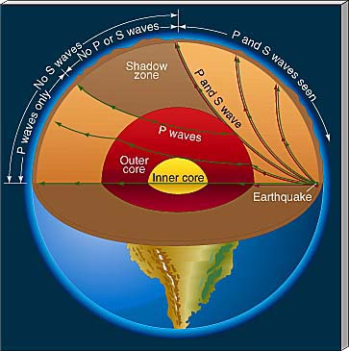
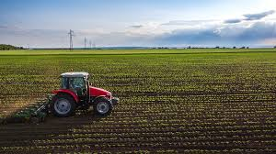
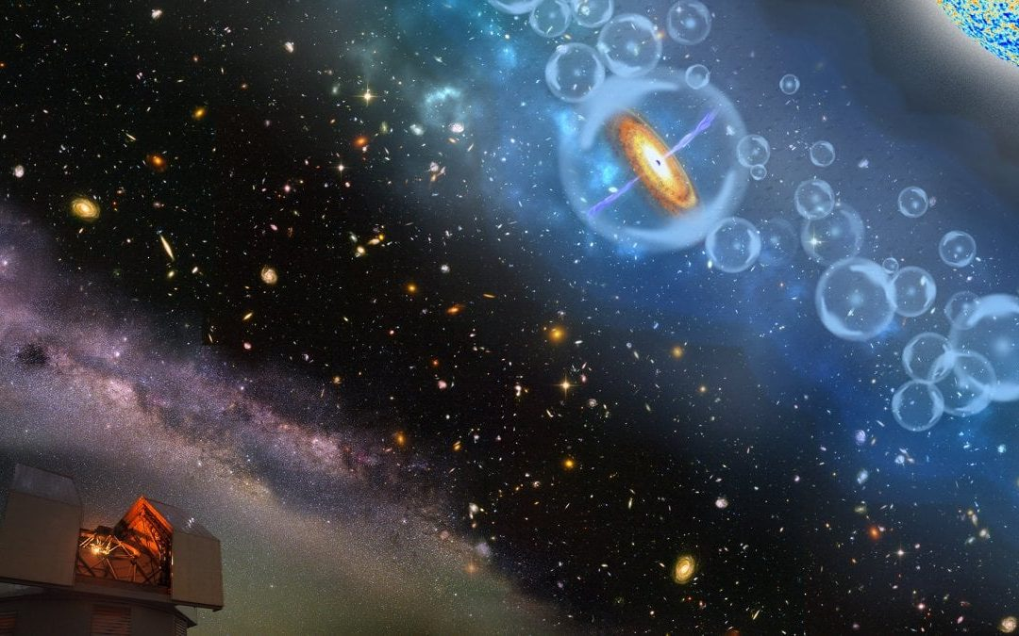


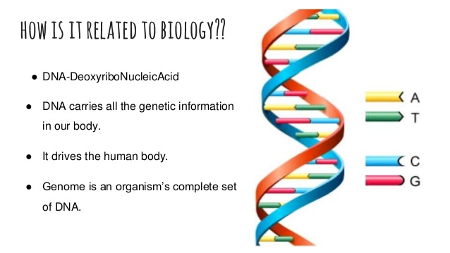


High-d data is everywhere
Finance
Paleontology
Manufacturing
Aviation
Agriculture
Astronomy
Criminology
Seismology
Neuroscience
Medicine
Biology
Echihabi, Zoumpatianos, Palpanas - ICDE 2021

Slide 6

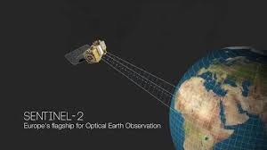

High-d collections are massive
≈ 500 ZB per year
≈ 130 TB
> 40 PB per day
> 5 TB per day
> 500 TB per day
1 PB = 1 thousand TB
1 ZB = 1 billion TB
Echihabi, Zoumpatianos, Palpanas - ICDE 2021

Slide 7
Popular High-d data
Echihabi, Zoumpatianos, Palpanas - ICDE 2021

Slide 8
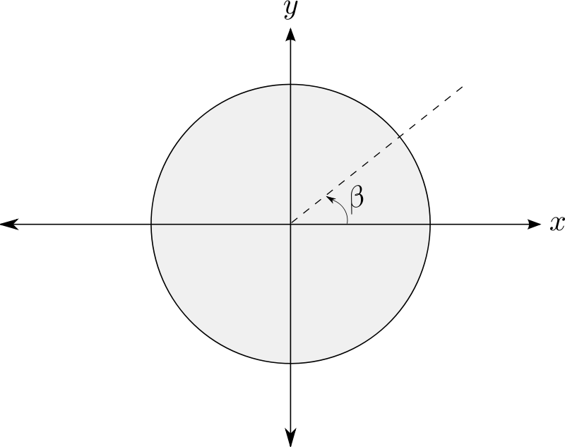


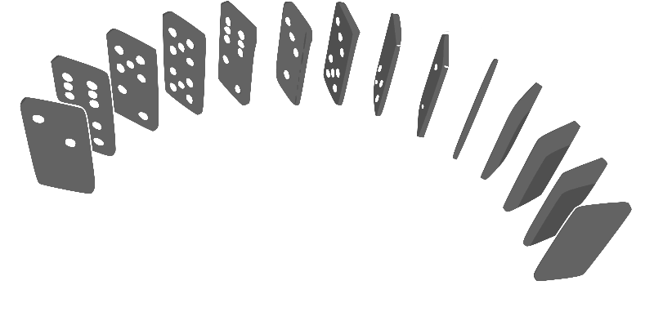
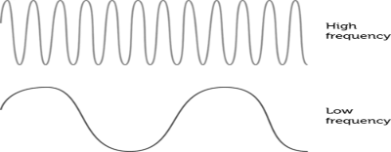
Popular High-d data
Data series
A collection of points ordered over a dimension
Angle
Time
Mass
Frequency
Position
Echihabi, Zoumpatianos, Palpanas - ICDE 2021

Slide 9
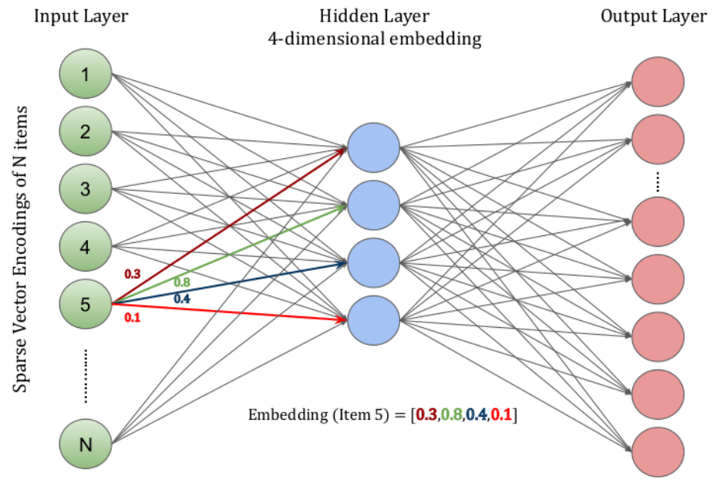
Popular High-d data
Data series
A collection of points ordered over a dimension
Deep Embeddings
A low-d vector learned from data using a DNN
Angle
Time
Mass
Frequency
Position
Echihabi, Zoumpatianos, Palpanas - ICDE 2021

Slide 10
Popular High-d data
Data series
A collection of points ordered over a dimension
Deep Embeddings
A low-d vector learned from data using a DNN
Angle
Time
Mass
Frequency
Position
embedded
text, images, video, graphs, etc.
Echihabi, Zoumpatianos, Palpanas - ICDE 2021

Slide 11
Popular High-d data
Data series
A collection of points ordered over a dimension
Deep Embeddings
A low-d vector learned from data using a DNN
Angle
Time
Mass
Frequency
Position
embedded
text, images, video, graphs, etc.
High-d data -> High-d vector
Echihabi, Zoumpatianos, Palpanas - ICDE 2021

Slide 12

Extracting value requires analytics
Classification
Classification
Predictive Maintenance
Notes:
Similarity-based classification (e.g., k-NN Classifier) is used in a variety of domains. Examples: Image classification, Document classification, Predictive maintenance, protein classification in bioinformatics and remote sensing

Slide 13

Extracting value requires analytics
Clustering
Classification
Classification
Predictive Maintenance
Notes:
Similarity search has been used for clustering by finding the k closest neighbors around a given point

Slide 14

Extracting value requires analytics
Clustering
Recommendation
Classification
Classification
Predictive Maintenance
Notes:
Similarity search is used in recommender systems to predict the interest of a user for a new item. Item embeddings are learned from user-item interactions, and used to recommend movies and products. Recommender systems are also used in other settings, for example In precision agriculture: recommend a fertilizer for a given crop or a crop for a given soil.
Item embeddings are learned from user-item interactions, and used to recommend products. For example, if we think a Similarity search is used in recommender systems to predict the interest of a user for a new item. Item embeddings are learned from user-item interactions, and used to recommend movies [27] and products [78].Netflix user as a set of movies that they liked, then you can identify Netflix users that have the same taste in movies, then use one user’s opinion to recommend a movie to the other. Alternatively, a new movie is recommended to a user if it is similar to the set of movies previously liked by this user.

Slide 15

Extracting value requires analytics
Clustering
Recommendation
Classification
Outlier Detection
Classification
Predictive Maintenance
Notes:
Techniques based on similarity search define outliers as the items with the largest distance to their NNs, and have been applied to find land mines in satellite images and discords in data series, and intrusion detection in cybersecurity.

Slide 16
Extracting value requires analytics
Clustering
Recommendation
Classification
Outlier Detection
Classification
Similarity Search
Predictive Maintenance
Notes:
In fact similarity search is also used in a variety of other applications. In particular in information retrieval for finding similar multimedia objects and copy detection in document, and video collections. Also in software engineering where code embeddings have been proposed to represent arbitrary snippets of code, and can be used to predict software dependencies and code clones.

Slide 17
Extracting value requires analytics
Clustering
Recommendation
Classification
Outlier Detection
Classification
Similarity Search
Predictive Maintenance
Data Cleaning
Data Integration
Notes:
Similarity search is used by data integration tools to facilitate a variety of tasks. Among others, it is used over tuple embeddings for entity resolution, and over schema embeddings for data discovery.

Slide 18
Extracting value requires analytics
Clustering
Recommendation
HARD, because of very high dimensionality:
each high-d point has 100s-1000s of dimensions!
Classification
Outlier Detection
Classification
Classification
Similarity Search
Predictive Maintenance
Data Cleaning
Data Integration

Slide 19
Extracting value requires analytics
Clustering
Recommendation
HARD, because of very high dimensionality:
each high-d point has 100s-1000s of dimensions!
Classification
Outlier Detection
Classification
Similarity Search
even HARDER, because of very large size:
millions to billions of high-d points (multi-TBs)!
Predictive Maintenance
Data Cleaning
Data Integration
Notes:
8 mins so far

Slide 20
High-d Similarity Search

Slide 21
High-d Similarity Search
Problem Variations

Slide 22
Problem Variations
Series

Slide 23
Problem Variations
Series
8
Univariate
each point represents one value (e.g., temperature)

Slide 24
Problem Variations
86
29
Series
8
6
Univariate
each point represents one value (e.g., temperature)
Multivariate
each point represents many values (e.g., temperature, humidity, pressure, wind, etc.)

Slide 25
Problem Variations
86
29
Series
8
6
Univariate
each point represents one value (e.g., temperature)
Multivariate
each point represents many values (e.g., temperature, humidity, pressure, wind, etc.)

Slide 26
Problem Variations
Publications
  Ding-PVLDB‘08
  Paparrizos-SIGMOD’20
Data Series Distance Measures
similarity search is based on measuring distance between sequences
dozens of distance measures have been proposed
  lock-step
    Minkowski, Manhattan, Euclidean, Maximum, DISSIM, …
  sliding
    Normalized Cross-Correlation, SBD, …
  elastic
    DTW, LCSS, MSM, EDR, ERP, Swale, …
  kernel-based
    KDTW, GAK, SINK, …
  embedding
    GRAIL, RWS, SPIRAL, …
Notes:
There is an abundance of data series distance measures and their effectiveness has been evaluated in two main studies. One dating over a decade ago and a more recent one.

Slide 27
Problem Variations
Publications
  Ding-PVLDB‘08
  Paparrizos-SIGMOD’20
Data Series Distance Measures
similarity search is based on measuring distance between sequences
dozens of distance measures have been proposed
  lock-step
    Minkowski, Manhattan, Euclidean, Maximum, DISSIM, …
  sliding
    Normalized Cross-Correlation, SBD, …
  elastic
    DTW, LCSS, MSM, EDR, ERP, Swale, …
  kernel-based
    KDTW, GAK, SINK, …
  embedding
    GRAIL, RWS, SPIRAL, …
Notes:
In the next coming slides, we will describe four popular distance measures: ED, NCC, DTW and LCSS

Slide 28
Problem Variations
High-d Vectors Distance Measures
similarity search is based on measuring distance between vectors
A variety of distance measures have been proposed
  L_{p} distances (0<p≤2, ∞), (Euclidean for p = 2)
  Cosine distance
  Correlation
  Hamming distance
  …
Notes:
While comparing two binary strings of equal length, Hamming distance is the number of bit positions in which the two bits are different

Slide 29
Problem Variations
High-d Vectors Distance Measures
similarity search is based on measuring distance between vectors
A variety of distance measures have been proposed
  L_{p} distances (0<p≤2, ∞), (Euclidean for p = 2)
  Cosine distance
  Correlation
  Hamming distance
  …
Notes:
While comparing two binary strings of equal length, Hamming distance is the number of bit positions in which the two bits are different

Slide 30
Euclidean Distance
v₂
v₁

Slide 31
Euclidean Distance
v₂
v₁

Slide 32
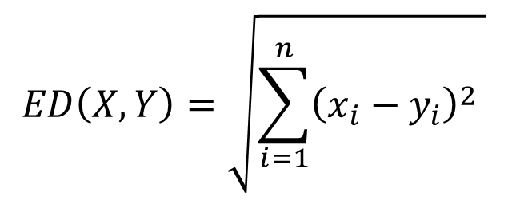
Euclidean Distance
Euclidean distance
  pair-wise point distance
v₂
v₁

Slide 33
Similarity Matching
Fast Euclidean Distance
similarity matching requires many distance computations
  can significantly slow down processing
    because of large number of data series in the collection
    because of high dimensionality of each data series

Slide 34
Similarity Matching
Fast Euclidean Distance
similarity matching requires many distance computations
  can significantly slow down processing
    because of large number of data series in the collection
    because of high dimensionality of each data series
in case of Euclidean Distance, we can speedup processing by
  smart implementation of distance function
  early abandoning

Slide 35
Similarity Matching
Fast Euclidean Distance
similarity matching requires many distance computations
  can significantly slow down processing
    because of large number of data series in the collection
    because of high dimensionality of each data series
in case of Euclidean Distance, we can speedup processing by
  smart implementation of distance function
  early abandoning
result in considerable performance improvement

Slide 36

Similarity Matching
Fast Euclidean Distance
Publications
  Keogh-
  DMKD’03
smart implementation of distance function
$$ED\left(X,Y\right)=\sqrt{\sum_{i=1}^{n}{{\left(x_{i}−y_{i}\right)}^{2}} }$$

Slide 37
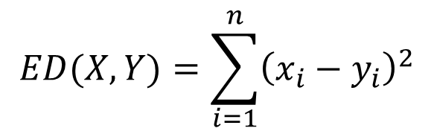
Similarity Matching
Fast Euclidean Distance
Publications
  Keogh-
  DMKD’03
smart implementation of distance function
  do not compute the square root (of the Euclidean Distance)
$$ED(X,Y)=\sum_{i=1}^{n}{{\left(x_{i}−y_{i}\right)}^{2}}$$

Slide 38
Similarity Matching
Fast Euclidean Distance
Publications
  Keogh-
  DMKD’03
smart implementation of distance function
  do not compute the square root (of the Euclidean Distance)
does not alter the results
saves precious CPU cycles
$$ED(X,Y)=\sum_{i=1}^{n}{{\left(x_{i}−y_{i}\right)}^{2}}$$
Notes:
n is the length of the data series

Slide 39
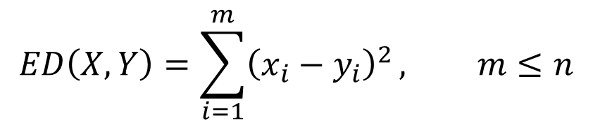
Similarity Matching
Fast Euclidean Distance
Publications
  Keogh-
  DMKD’03
early abandoning
  stop the distance computation as soon as it exceeds the value of bsf
$$ED\left(X,Y\right)=\sum_{i=1}^{m}{{\left(x_{i}−y_{i}\right)}^{2}}, m≤n$$

Slide 40
Similarity Matching
Fast Euclidean Distance
Publications
  Keogh-
  DMKD’03
early abandoning
  stop the distance computation as soon as it exceeds the value of bsf
does not alter the results
avoids useless computations
$$ED\left(X,Y\right)=\sum_{i=1}^{m}{{\left(x_{i}−y_{i}\right)}^{2}}, m≤n$$

Slide 41
Correlation
measures the degree of relationship between data series
  indicates the degree and direction of relationship
direction of change
  positive correlation
    values of two data series change in same direction
  negative correlation
    values of two data series change in opposite directions
linear correlation
  amount of change in one data series bears constant ratio of change in the other data series
useful in several applications
Notes:
Cross-correlation dates back in the 1700s but has become popular after the invention of Fast Fourier Transform (FFT) which dramatically reduced its computational cost. It is a fundamental operation in signal processing, deep neural networks and data series analytics.

Slide 42
Correlation
measures the degree of relationship between data series
  indicates the degree and direction of relationship
direction of change
  positive correlation
    values of two data series change in same direction
  negative correlation
    values of two data series change in opposite directions
linear correlation
  amount of change in one data series bears constant ratio of change in the other data series
useful in several applications

Slide 43
Correlation
measures the degree of relationship between data series
  indicates the degree and direction of relationship
direction of change
  positive correlation
    values of two data series change in same direction
  negative correlation
    values of two data series change in opposite directions
linear correlation
  amount of change in one data series bears constant ratio of change in the other data series
useful in several applications

Slide 44
Correlation
measures the degree of relationship between data series
  indicates the degree and direction of relationship
direction of change
  positive correlation
    values of two data series change in same direction
  negative correlation
    values of two data series change in opposite directions
linear correlation
  amount of change in one data series bears constant ratio of change in the other data series
useful in several applications

Slide 45
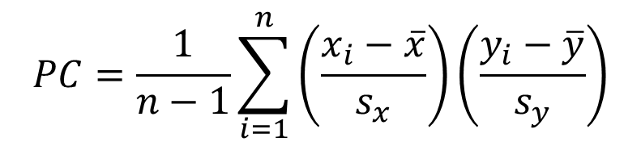
Pearson’s Correlation Coefficient
used to see linear dependency between values of data series of equal length, n

Slide 46
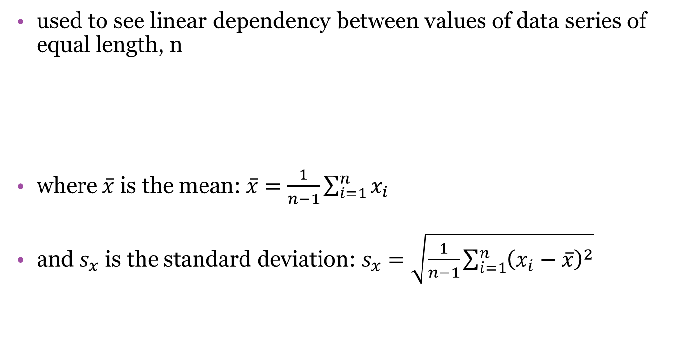
Pearson’s Correlation Coefficient

Slide 47
Pearson’s Correlation Coefficient
used to see linear dependency between values of data series of equal length, n
takes values in [-1,1]
  0 – no correlation
  -1, 1 – inverse/direct correlation
there is a statistical test connected to PC, where null hypothesis is the no correlation case (correlation coefficient = 0)
  test is used to ensure that the correlation similarity is not caused by a random process

Slide 48
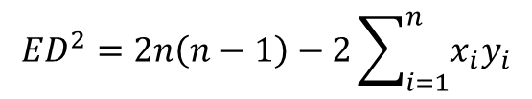
PC and ED
Euclidean distance:
In case of Z-normalized data series (mean = 0, stddev = 1):
and
so the following formula is true:
direct connection between ED and PC for Z-normalized data series
  if ED is calculated for normalized data series, it can be directly used to calculate the p-value for statistical test of Pearson’s correlation instead of actual PC value.
$${ED}^{2}=2n\left(n−1\right)−2\sum_{i=1}^{n}{x_{i}y_{i}}$$

Slide 49
Distance Measures:
LCSS against Euclidean, DTW
Euclidean
  rigid
Notes:
ED is widely used because it is simple to computer and parameter-free, but it is quite rigid because th ith point of one time series is compared with the ith point of another.
due to itED is quit

Slide 50
Distance Measures:
LCSS against Euclidean, DTW
Euclidean
  rigid
Dynamic Time Warping (DTW)
  allows local scaling
Notes:
So to allow local scaling, elastic measures have been proposed elastic measures which create a non-linear mapping between time series by comparing one-to-many points;. The most widely used is DTW.

Slide 51
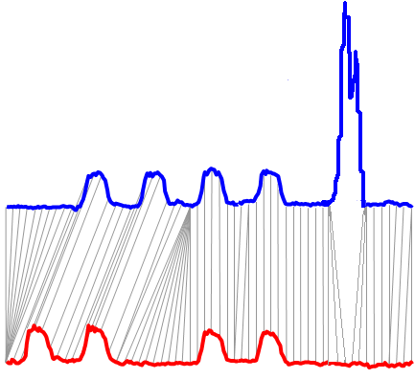
Distance Measures:
LCSS against Euclidean, DTW
Euclidean
  rigid
Dynamic Time Warping (DTW)
  allows local scaling
Longest Common SubSequence (LCSS)
  allows local scaling
  ignores outliers
Notes:
And LCSS which improves upon DTW by ignoring outliers.

Slide 52
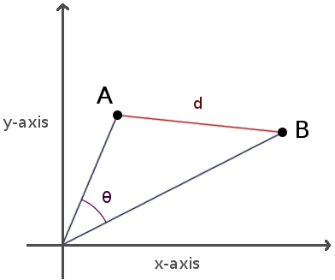
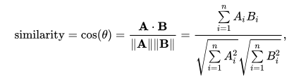
Distance Measures:
Cosine Distance
  Cosine distance = 1 - cosine similarity
Notes:
Cosine similarity is a measure of similarity between two non-zero vectors of an inner product space. It is defined to equal the cosine of the angle between them, which is also the same as the inner product of the same vectors normalized to both have length 1. Cosine similarity is generally used as a metric for measuring distance when the magnitude of the vectors does not matter.
The term cosine distance is often used for the complement in positive space. It is important to note, however, that this is not a proper distance metric as it does not have the triangle inequality property.

Slide 53
Problem Variations
Queries
Whole matching
Entire query
Entire candidate
Whole matching
Entire query
Entire candidate

Slide 54
Problem Variations
Queries
Whole matching
Entire query
Entire candidate
Subsequence matching
Entire query
A subsequence of a candidate

Slide 55
Problem Variations
Queries
Nearest Neighbor (1NN)
k-Nearest Neighbor (kNN)
Farthest Neighbor
epsilon-Range
and more…

Slide 56
Similarity Matching
given a data series collection D and a query data series q, return the data series from D that are the most similar to q
  there exist different flavors of this basic operation
basis for most data series analysis tasks

Slide 57
Similarity Matching
Nearest Neighbor (NN) Search
given a data series collection D and a query data series q, return the data series from D that has the smallest distance to q

Slide 58
Similarity Matching
Nearest Neighbor (NN) Search
given a data series collection D and a query data series q, return the data series from D that has the smallest distance to q
result set contains one data series

Slide 59

Similarity Matching
Nearest Neighbor (NN) Search
serial scan
  compute the distance between q and every d_{i} $∈$ D
  return d_{i} with the smallest distance to q

Slide 60

Similarity Matching
Nearest Neighbor (NN) Search
serial scan
  bsf = Inf // best so far distance
  for every d_{i} $∈$ D
    compute distance, dist, between d_{i} and q
    if this dist less than bsf then bsf=dist
  return d_{i} corresponding to bsf

Slide 61
Similarity Matching k-Nearest Neighbors (kNN) Search
given a data series collection D and a query data series q, return the k data series from D that have the k smallest distances to q

Slide 62
Similarity Matching k-Nearest Neighbors (kNN) Search
given a data series collection D and a query data series q, return the k data series from D that have the k smallest distances to q
result set contains k data series

Slide 63

Similarity Matching k-Nearest Neighbors (kNN) Search
serial scan
  compute the distance between q and every d_{i} $∈$ D
  return the k d_{i} with the k smallest distances to q

Slide 64
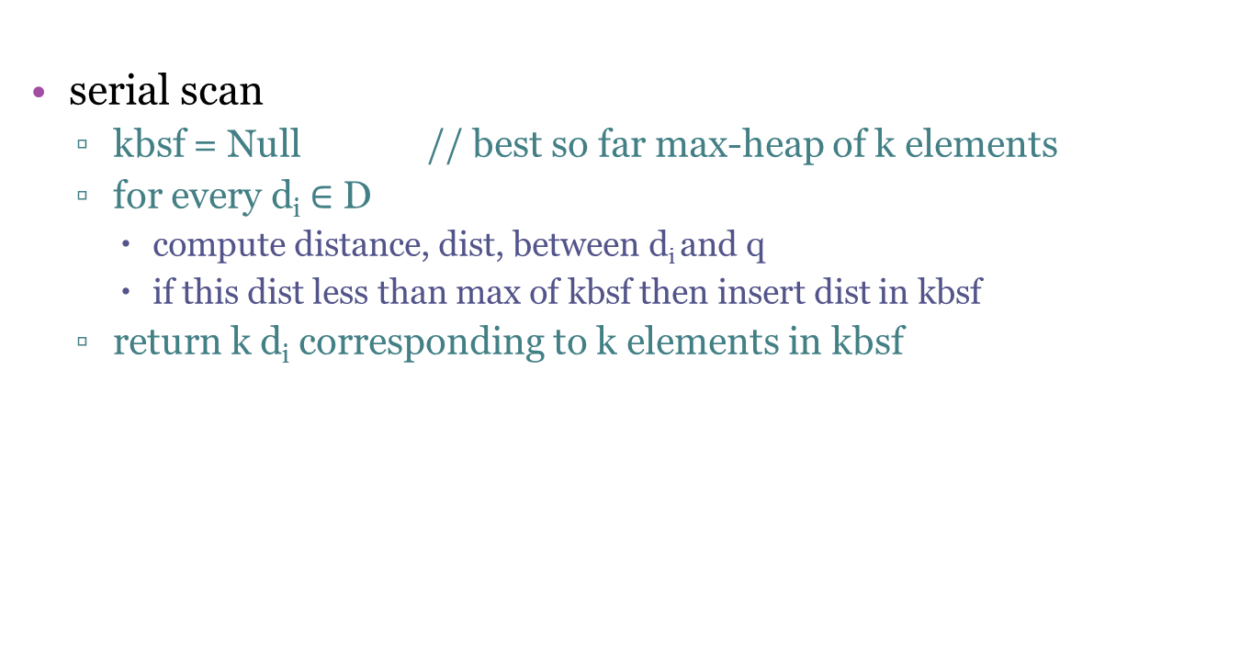
Similarity Matching k-Nearest Neighbors (kNN) Search
serial scan
  kbsf = Null // best so far max-heap of k elements
  for every d_{i} $∈$ D
    compute distance, dist, between d_{i} and q
    if this dist less than max of kbsf then insert dist in kbsf
  return k d_{i} corresponding to k elements in kbsf

Slide 65


Similarity Matching
$ε$-Range Search
given a data series collection D and a query data series q, return all data series from D that are within distance $ε$from q

Slide 66

Similarity Matching
$ε$-Range Search
given a data series collection D and a query data series q, return all data series from D that are within distance $ε$from q
result set contains [?] data series

Slide 67

Similarity Matching
$ε$-Range Search
serial scan
  compute the distance between q and every d_{i} $∈$ D
  return all d_{i} with distance less than $ε$ to q

Slide 68
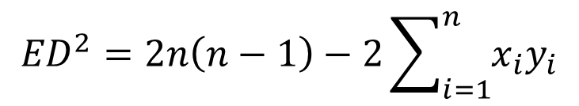
Similarity Matching
$ε$-Range Search
serial scan
  res = {} // empty result set
  for every d_{i} $∈$ D
    compute distance, dist, between d_{i} and q
    if this dist less than $ε$then insert dist in res
  return all d_{i} corresponding to elements in res

Slide 69
Problem Variations
Queries
Nearest Neighbor (1NN)
k-Nearest Neighbor (kNN)
Farthest Neighbor
epsilon-Range
And more…

Slide 70
Nearest Neighbor (NN) Queries…
Publications
  Echihabi et al.
  PVLDB‘19

Slide 71
Nearest Neighbor (NN) Queries…
Publications
  Echihabi et al.
  PVLDB‘19
O_{Q}

Slide 72
Nearest Neighbor (NN) Queries…
Publications
  Echihabi et al.
  PVLDB‘19
Prob( d_{x} = min{d_{i}} ) = 1
result is exact NN
O_{x}
d_{x}
exact
NN
O_{Q}

Slide 73
Nearest Neighbor (NN) Queries…
Publications
  Echihabi et al.
  PVLDB‘19
Prob( d_{x} = min{d_{i}} ) = 1
result is exact NN
O_{x}
d_{x}
exact
NN
O_{Q}
Notes:
…hard, especially when this NN is in a dense area of the space

Slide 74
Nearest Neighbor (NN) Queries…
Publications
  Echihabi et al.
  PVLDB‘19
Prob( d_{x} = min{d_{i}} ) = 1
result is exact NN
O_{x}
d_{x}
exact
NN
ng-approximate
neighbors
O_{Q}
d_{ng}
Prob(d_{ng} <>= ?) = ?
result within ? of exact NN
O_{ng}

Slide 75
Nearest Neighbor (NN) Queries…
Publications
  Echihabi et al.
  PVLDB‘19
Prob(d_{ε} <= d_{x} (1+ε)) = 1
result within (1+ ε) of exact NN with probability 1
Prob( d_{x} = min{d_{i}} ) = 1
result is exact NN
ε-approximate
neighbors
O_{ε}
O_{x}
d_{x}
d_{ε}
exact
NN
d_{x} (1+ε)
ng-approximate
neighbors
O_{Q}
d_{ng}
Prob(d_{ng} <>= ?) = ?
result within ? of exact NN
O_{ng}

Slide 76
Nearest Neighbor (NN) Queries…
Publications
  Echihabi et al.
  PVLDB‘19
Prob(d_{ε} <= d_{x} (1+ε)) = 1
result within (1+ ε) of exact NN with probability 1
Prob( d_{x} = min{d_{i}} ) = 1
result is exact NN
ε-approximate
neighbors
O_{ε}
O_{x}
d_{x}
d_{ε}
exact
NN
d_{x} (1+ε)
ng-approximate
neighbors
O_{Q}
d_{ng}
Prob(d_{ng} <>= ?) = ?
result within ? of exact NN
d_{δε}
O_{ng}
O_{δε}
δ-ε-approximate
neighbor
Prob(d_{ε} <= d_{x} (1+ε)) >= δ
result within (1+ ε) of exact NN with probability at least δ

Slide 77
Nearest Neighbor (NN) Queries…
Publications
  Echihabi et al.
  PVLDB‘19
Prob(d_{ε} <= d_{x} (1+ε)) = 1
result within (1+ ε) of exact NN with probability 1
Prob( d_{x} = min{d_{i}} ) = 1
result is exact NN
ε-approximate
neighbors
O_{ε}
O_{x}
d_{x}
d_{ε}
exact
NN
d_{x} (1+ε)
ng-approximate
neighbors
O_{Q}
d_{ng}
Prob(d_{ng} <>= ?) = ?
result within ? of exact NN
d_{δε}
O_{ng}
(1+ε) r_{δ}(O_{Q})
O_{δε}
δ-ε-approximate
neighbor
Prob(d_{ε} <= d_{x} (1+ε)) >= δ
result within (1+ ε) of exact NN with probability at least δ
Notes:
The radius of the pink ribbon serves as a stopping condition. Once an algorithm thinks that it has found a point within the pink hypersphere, it stops with the probabilistic guarantee delta that this point is an epsilon-approximate neighbor

Slide 78
Meaningfulness of NN queries in high-d spaces
Publications
  Beyer et al.
  ICDT‘99
  Aggarwal et al.
  ICDT‘01
Some studies have argued that NN search is not meaningful for a number of high dimensional datasets due to the concentration of distances.
  However, these conclusions were based on over-restrictive assumptions such as:
    data being identical and independently distributed (i.i.d.) in each dimension
    dimensionality being the only factor determining meaningfulness
    an asymptotic analysis of dimensionality growing to infinity
Other studies have shown that high-dimensional NN search is meaningful for:
  non-i.i.d data
  data with low intrinsic dimensionality
  for a variety of real world datasets
  He et al.
  ICML‘12

Slide 79
High-d Similarity Search
Process

Slide 80

Similarity Search Process
Data Loading Procedure
Query Answering Procedure
Raw data
Notes:
The query answering process consists of two main procedures:

Slide 81
Similarity Search Process
Data Loading Procedure
Query Answering Procedure
Raw data
Data Series
Database/
Indexing
Data
data-to-query time
Notes:
For big data exploration, it is prohibitive to rely to full sequential scans for every single query, and therefore, indexing is required to reduce the data to query time.

Slide 82

Similarity Search Process
Data Loading Procedure
Query Answering Procedure
Raw data
Data Series
Database/
Indexing
Queries
Data
Answers
data-to-query time
query answering time
Notes:
Once an index is built and loaded, it is also important to answer queries efficiently.

Slide 83
Similarity Search Process
Data Loading Procedure
Query Answering Procedure
Raw data
Data Series
Database/
Indexing
Queries
Data
Answers
data-to-query time
query answering time
these times are big!

Slide 84
Similarity Search Process
Data Loading Procedure
Query Answering Procedure
Raw data
Data Series
Database/
Indexing
Queries
Data
Answers
data-to-query time
query answering time
we need solutions
for both problems!

Slide 85
Questions?

Slide 86
Data Series Similarity Search

Slide 87
Outline
Pre-processing Tasks
Classes of Methods
State-of-the-art Techniques
New extensions

Slide 88
Data Series Similarity Search
Pre-processing Tasks

Slide 89
Pre-Processing z-Normalization
data series encode trends
usually interested in identifying similar trends

Slide 90
Pre-Processing z-Normalization
data series encode trends
usually interested in identifying similar trends
but absolute values may mask this similarity

Slide 91
Pre-Processing z-Normalization
two data series with similar trends
v₂
v₁
sequence dimension

Slide 92
Pre-Processing z-Normalization
two data series with similar trends
but large distance…
v₂
v₁

Slide 93
Pre-Processing z-Normalization
zero mean
  compute the mean of the sequence
  subtract the mean from every value of the sequence
v₂
v₁

Slide 94
Pre-Processing z-Normalization
zero mean
  compute the mean of the sequence
  subtract the mean from every value of the sequence

Slide 95
Pre-Processing z-Normalization
zero mean
  compute the mean of the sequence
  subtract the mean from every value of the sequence

Slide 96
Pre-Processing z-Normalization
zero mean
  compute the mean of the sequence
  subtract the mean from every value of the sequence

Slide 97
Pre-Processing z-Normalization
zero mean
standard deviation one
  compute the standard deviation of the sequence
  divide every value of the sequence by the stddev

Slide 98
Pre-Processing z-Normalization
zero mean
standard deviation one
  compute the standard deviation of the sequence
  divide every value of the sequence by the stddev

Slide 99
Pre-Processing z-Normalization
zero mean
standard deviation one
  compute the standard deviation of the sequence
  divide every value of the sequence by the stddev

Slide 100
Pre-Processing z-Normalization
zero mean
standard deviation one

Slide 101
Pre-Processing z-Normalization
when to z-normalize
  interested in trends

Slide 102
Pre-Processing z-Normalization
when to z-normalize
  interested in trends
when not to z-normalize
  interested in absolute values

Slide 103
aabbbccb
0
20
40
60
80
100
120
0
20
40
60
80
100
120
0
20
40
60
80
100
120
0
20
40
60
80
100
120
0
20
40
60
80
100
120
0
20
40
60
80
100
120
a
a
b
b
b
c
c
b
DFT
DWT
PAA
APCA
PLA
SAX
for a complete and detailed presentation, see tutorial:
Chan & Fu. ICDE 1999
Morinaka,
Yoshikawa, Amagasa, & Uemura, PAKDD 2001
Agrawal, Faloutsos, &. Swami. FODO 1993
Faloutsos, Ranganathan, & Manolopoulos. SIGMOD 1994
Keogh, Chakrabarti, Pazzani & Mehrotra KAIS 2000
Yi & Faloutsos VLDB 2000
Keogh, Chakrabarti, Pazzani & Mehrotra SIGMOD 2001
Publications
  Keogh -
  KDD‘04

Slide 104
Comparison of Representations
which representation is the best?

Slide 105
Comparison of Representations
which representation is the best?
depends on data characteristics
  periodic, smooth, spiky, …

Slide 106
Comparison of Representations
Publications
  Palpanas et al.
  ICDE’04
  Palpanas et al.
  TKDE’08
  Shieh et al.
  KDD’08
which representation is the best?
depends on data characteristics
  periodic, smooth, spiky, …
overall (averaged over many diverse datasets, using same memory budget), when measuring reconstruction error (RMSE)
  no big differences among methods
  DFT, PAA, DWT (Haar), iSAX slightly better
should also take into account other factors
  visualization, indexable, ...

Slide 107
Data Series Similarity Search
Common Framework

Slide 108
GEMINI Framework
Publications
  Faloutsos-
  SIGMOD’94
Raw data: original full-dimensional space
Summarization: reduced dimensionality space
Searching in original space costly
Searching in reduced space faster:
  Less data, indexing techniques available, lower bounding
Lower bounding enables us to
  prune search space: throw away data series based on reduced dimensionality representation
  guarantee correctness of answer
    no false negatives
    false positives filtered out based on raw data

Slide 109
GEMINI Framework
Publications
  Faloutsos-
  SIGMOD’94
GEMINI Solution: Quick filter-and-refine:
extract m features (numbers, e.g., average)
map to point in m-dimensional feature space
organize points
retrieve the answer using a NN query
discard false positives

Slide 110
GEMINI: contractiveness
Publications
  Faloutsos-
  SIGMOD’94
GEMINI works when:
D_{feature}(F(x), F(y)) <= D(x, y)
Note that, the closer the feature distance to the actual one, the better

Slide 111
Data Series Similarity Search
Classes of Methods

Slide 112
Similarity Matching
Serial Scan
Q
Q
Q
The summary of Q is compared to the summary of each candidate
Memory
Disk
C_{x}
C_{x}
C_{x}
Q is compared to each raw candidate in the dataset before returning the answer C_{x}
Q is compared to a raw candidate only if
its summary cannot be pruned
Q is compared to a raw candidate only if
its corresponding leaf cannot be pruned
(a) Serial scan
Answering a similarity search query using different access paths

Slide 113
Similarity Matching
Serial Scan
bsf = +ꝏ
Q
Q
Q
The summary of Q is compared to the summary of each candidate
Memory
Disk
C_{x}
C_{x}
C_{x}
Q is compared to each raw candidate in the dataset before returning the answer C_{x}
Q is compared to a raw candidate only if
its summary cannot be pruned
Q is compared to a raw candidate only if
its corresponding leaf cannot be pruned
(a) Serial scan
Answering a similarity search query using different access paths

Slide 114
Similarity Matching
Serial Scan
bsf = d(Q, C₁)
Q
Q
Q
The summary of Q is compared to the summary of each candidate
Memory
Disk
C_{x}
C_{x}
C_{x}
Q is compared to each raw candidate in the dataset before returning the answer C_{x}
Q is compared to a raw candidate only if
its summary cannot be pruned
Q is compared to a raw candidate only if
its corresponding leaf cannot be pruned
(a) Serial scan
Answering a similarity search query using different access paths

Slide 115
Similarity Matching
Serial Scan
bsf = d(Q, C₁)
Q
Q
Q
The summary of Q is compared to the summary of each candidate
Memory
Disk
C_{x}
C_{x}
C_{x}
Q is compared to each raw candidate in the dataset before returning the answer C_{x}
Q is compared to a raw candidate only if
its summary cannot be pruned
Q is compared to a raw candidate only if
its corresponding leaf cannot be pruned
(a) Serial scan
Answering a similarity search query using different access paths

Slide 116
Similarity Matching
Serial Scan
bsf = d(Q, C_{x})
Q
Q
Q
The summary of Q is compared to the summary of each candidate
Memory
Disk
C_{x}
C_{x}
C_{x}
Q is compared to each raw candidate in the dataset before returning the answer C_{x}
Q is compared to a raw candidate only if
its summary cannot be pruned
Q is compared to a raw candidate only if
its corresponding leaf cannot be pruned
(a) Serial scan
Answering a similarity search query using different access paths

Slide 117
Similarity Matching
Serial Scan
bsf = d(Q, C_{x})
Q
Q
Q
The summary of Q is compared to the summary of each candidate
Memory
Disk
C_{x}
C_{x}
C_{x}
Q is compared to each raw candidate in the dataset before returning the answer C_{x}
Q is compared to a raw candidate only if
its summary cannot be pruned
Q is compared to a raw candidate only if
its corresponding leaf cannot be pruned
(a) Serial scan
Answering a similarity search query using different access paths

Slide 118
Similarity Matching
Serial Scan
Q
Q
Q
Memory
Disk
C_{x}
C_{x}
C_{x}
Q is compared to each raw candidate in the dataset before returning the answer C_{x}
Q is compared to a raw candidate only if
its corresponding leaf cannot be pruned
(a) Serial scan
(b) Skip-sequential scan
Answering a similarity search query using different access paths

Slide 119


Similarity Matching
Serial Scan
Q
Q
Q
Memory
Disk
C_{x}
C_{x}
C_{x}
Q is compared to each raw candidate in the dataset before returning the answer C_{x}
Q is compared to a raw candidate only if
its corresponding leaf cannot be pruned
(a) Serial scan
(b) Skip-sequential scan
Answering a similarity search query using different access paths

Slide 120
Indexes vs. Scans
Q
Q
Q
Memory
Disk
C_{x}
C_{x}
C_{x}
Q is compared to each raw candidate in the dataset before returning the answer C_{x}
Q is compared to a raw candidate only if
its corresponding leaf cannot be pruned
(a) Serial scan
(b) Skip-sequential scan
Answering a similarity search query using different access paths

Slide 121
Indexes vs. Scans
Q
Q
Q
Memory
Disk
C_{x}
C_{x}
C_{x}
Q is compared to each raw candidate in the dataset before returning the answer C_{x}
Q is compared to a raw candidate only if
its corresponding leaf cannot be pruned
(a) Serial scan
(b) Skip-sequential scan
Answering a similarity search query using different access paths

Slide 122
bsf = +ꝏ
lb_{cur} = +ꝏ
Q
Q
Q
Publications
lower-bounding (lb) property:
d_{lb}(Q’, C_{i}’) <= d(Q, C_{i})
  Faloutsos-
  SIGMOD’94
Memory
Disk
C_{x}
C_{x}
C_{x}
Q is compared to each raw candidate in the dataset before returning the answer C_{x}
Q is compared to a raw candidate only if
its corresponding leaf cannot be pruned
(a) Serial scan
(b) Skip-sequential scan
Answering a similarity search query using different access paths

Slide 123
Indexes vs. Scans
bsf = +ꝏ
lb_{cur} = d_{lb}(Q’,C₁’)
Q
Q
Q
The summary of Q (Q’) is compared to the summary of each candidate
Memory
Disk
C_{x}
C_{x}
C_{x}
Q is compared to each raw candidate in the dataset before returning the answer C_{x}
Q is compared to a raw candidate only if
its corresponding leaf cannot be pruned
(a) Serial scan
(b) Skip-sequential scan
Answering a similarity search query using different access paths

Slide 124
Indexes vs. Scans
bsf = +ꝏ
lb_{cur} = d_{lb}(Q’,C₁’) < bsf
Q
Q
Q
The summary of Q (Q’) is compared to the summary of each candidate
Memory
Disk
C_{x}
C_{x}
C_{x}
Q is compared to each raw candidate in the dataset before returning the answer C_{x}
Q is compared to a raw candidate only if
its corresponding leaf cannot be pruned
(a) Serial scan
(b) Skip-sequential scan
Answering a similarity search query using different access paths

Slide 125
Indexes vs. Scans
bsf = +ꝏ
lb_{cur} = d_{lb}(Q’,C₁’) < bsf
Q
Q
Q
The summary of Q (Q’) is compared to the summary of each candidate
Memory
Disk
C_{x}
C_{x}
C_{x}
Q is compared to each raw candidate in the dataset before returning the answer C_{x}
Q is compared to a raw candidate only if
its summary cannot be pruned
Q is compared to a raw candidate only if
its corresponding leaf cannot be pruned
(a) Serial scan
(b) Skip-sequential scan
Answering a similarity search query using different access paths

Slide 126
Indexes vs. Scans
bsf = d(Q,C₁)
lb_{cur} = d_{lb}(Q’,C₁’) < bsf
Q
Q
Q
The summary of Q (Q’) is compared to the summary of each candidate
Memory
Disk
C_{x}
C_{x}
C_{x}
Q is compared to each raw candidate in the dataset before returning the answer C_{x}
Q is compared to a raw candidate only if
its summary cannot be pruned
Q is compared to a raw candidate only if
its corresponding leaf cannot be pruned
(a) Serial scan
(b) Skip-sequential scan
Answering a similarity search query using different access paths

Slide 127
Indexes vs. Scans
bsf = d(Q,C₁)
lb_{cur} = d_{lb}(Q’,C₂’)
Q
Q
Q
The summary of Q (Q’) is compared to the summary of each candidate
Memory
Disk
C_{x}
C_{x}
C_{x}
Q is compared to each raw candidate in the dataset before returning the answer C_{x}
Q is compared to a raw candidate only if
its summary cannot be pruned
Q is compared to a raw candidate only if
its corresponding leaf cannot be pruned
(a) Serial scan
(b) Skip-sequential scan
Answering a similarity search query using different access paths

Slide 128
Indexes vs. Scans
bsf = d(Q,C₁)
lb_{cur} = d_{lb}(Q’,C₂’) >= bsf
Q
Q
Q
The summary of Q (Q’) is compared to the summary of each candidate
Memory
Disk
C_{x}
C_{x}
C_{x}
Q is compared to each raw candidate in the dataset before returning the answer C_{x}
Q is compared to a raw candidate only if
its summary cannot be pruned
Q is compared to a raw candidate only if
its corresponding leaf cannot be pruned
(a) Serial scan
(b) Skip-sequential scan
Answering a similarity search query using different access paths

Slide 129
Indexes vs. Scans
bsf = d(Q,C₁)
lb_{cur} = d_{lb}(Q’,C₂’) >= bsf
Q
Q
Q
The summary of Q (Q’) is compared to the summary of each candidate
Memory
Disk
C_{x}
C_{x}
C_{x}
Q is compared to each raw candidate in the dataset before returning the answer C_{x}
Q is compared to a raw candidate only if
its summary cannot be pruned
Q is compared to a raw candidate only if
its corresponding leaf cannot be pruned
(a) Serial scan
(b) Skip-sequential scan
Answering a similarity search query using different access paths

Slide 130
Indexes vs. Scans
bsf = d(Q,C₁)
lb_{cur} = d_{lb}(Q’,C₂’) >= bsf
d(Q,C₂) >=
Q
LB Property
Q
Q
The summary of Q (Q’) is compared to the summary of each candidate
Memory
Disk
C_{x}
C_{x}
C_{x}
Q is compared to each raw candidate in the dataset before returning the answer C_{x}
Q is compared to a raw candidate only if
its summary cannot be pruned
Q is compared to a raw candidate only if
its corresponding leaf cannot be pruned
(a) Serial scan
(b) Skip-sequential scan
Answering a similarity search query using different access paths

Slide 131
Indexes vs. Scans
bsf = d(Q,C₁)
lb_{cur} = d_{lb}(Q’,C₂’) >= bsf
d(Q,C₂) >=
Q
LB Property
Q
Q
The summary of Q (Q’) is compared to the summary of each candidate
prune C₂
Memory
Disk
C_{x}
C_{x}
C_{x}
Q is compared to each raw candidate in the dataset before returning the answer C_{x}
Q is compared to a raw candidate only if
its summary cannot be pruned
Q is compared to a raw candidate only if
its corresponding leaf cannot be pruned
(a) Serial scan
(b) Skip-sequential scan
Answering a similarity search query using different access paths

Slide 132
Indexes vs. Scans
bsf = d(Q,C₁)
lb_{cur} = d_{lb}(Q’,C_{x}’)
Q
Q
Q
The summary of Q (Q’) is compared to the summary of each candidate
Memory
Disk
C_{x}
C_{x}
C_{x}
Q is compared to each raw candidate in the dataset before returning the answer C_{x}
Q is compared to a raw candidate only if
its summary cannot be pruned
Q is compared to a raw candidate only if
its corresponding leaf cannot be pruned
(a) Serial scan
(b) Skip-sequential scan
Answering a similarity search query using different access paths

Slide 133
Indexes vs. Scans
bsf = d(Q,C₁)
lb_{cur} = d_{lb}(Q’,C_{x}’) < bsf
Q
Q
Q
The summary of Q (Q’) is compared to the summary of each candidate
Memory
Disk
C_{x}
C_{x}
C_{x}
Q is compared to each raw candidate in the dataset before returning the answer C_{x}
Q is compared to a raw candidate only if
its summary cannot be pruned
Q is compared to a raw candidate only if
its corresponding leaf cannot be pruned
(a) Serial scan
(b) Skip-sequential scan
Answering a similarity search query using different access paths

Slide 134
Indexes vs. Scans
bsf = d(Q,C_{x})
lb_{cur} = d_{lb}(Q’,C_{x}’) < bsf
Q
Q
Q
The summary of Q (Q’) is compared to the summary of each candidate
Memory
Disk
C_{x}
C_{x}
C_{x}
Q is compared to each raw candidate in the dataset before returning the answer C_{x}
Q is compared to a raw candidate only if
its summary cannot be pruned
Q is compared to a raw candidate only if
its corresponding leaf cannot be pruned
(a) Serial scan
(b) Skip-sequential scan
Answering a similarity search query using different access paths

Slide 135
Indexes vs. Scans
bsf = d(Q,C_{x})
lb_{cur} = d_{lb}(Q’,C_{n}’) < bsf
Q
Q
Q
The summary of Q (Q’) is compared to the summary of each candidate
Memory
Disk
C_{x}
C_{x}
C_{x}
Q is compared to each raw candidate in the dataset before returning the answer C_{x}
Q is compared to a raw candidate only if
its summary cannot be pruned
Q is compared to a raw candidate only if
its corresponding leaf cannot be pruned
(a) Serial scan
(b) Skip-sequential scan
Answering a similarity search query using different access paths

Slide 136
Indexes vs. Scans
Q
Q
Q
The summary of Q (Q’) is compared to the summary of each candidate
Memory
Disk
C_{x}
C_{x}
C_{x}
Q is compared to each raw candidate in the dataset before returning the answer C_{x}
Q is compared to a raw candidate only if
its summary cannot be pruned
Q is compared to a raw candidate only if
its corresponding leaf cannot be pruned
(a) Serial scan
(b) Skip-sequential scan
Answering a similarity search query using different access paths

Slide 137
Indexes vs. Scans
Q
Q
Q
The summary of Q (Q’) is compared to the summary of each candidate
1
2
3
4
5
Memory
1
2
Disk
C_{x}
C_{x}
C_{x}
Q is compared to each raw candidate in the dataset before returning the answer C_{x}
Q is compared to a raw candidate only if
its summary cannot be pruned
(a) Serial scan
(b) Skip-sequential scan
(c) Tree-based index
Answering a similarity search query using different access paths

Slide 138
Indexes vs. Scans
bsf = +ꝏ
Q
Q
Q
The summary of Q (Q’) is compared to the summary of each candidate
1
2
3
4
5
Memory
1
2
Disk
C_{x}
C_{x}
C_{x}
Q is compared to each raw candidate in the dataset before returning the answer C_{x}
Q is compared to a raw candidate only if
its summary cannot be pruned
(a) Serial scan
(b) Skip-sequential scan
(c) Tree-based index
Answering a similarity search query using different access paths

Slide 139
Indexes vs. Scans
bsf = +ꝏ
Q
Q
Q
The summary of Q (Q’) is compared to the summary of each candidate
1
2
3
4
5
Memory
1
2
Disk
C_{x}
C_{x}
C_{x}
Q is compared to each raw candidate in the dataset before returning the answer C_{x}
Q is compared to a raw candidate only if
its summary cannot be pruned
(a) Serial scan
(b) Skip-sequential scan
(c) Tree-based index
Answering a similarity search query using different access paths

Slide 140
Indexes vs. Scans
bsf = d(Q,C₃)
Q
Q
Q
The summary of Q (Q’) is compared to the summary of each candidate
1
2
3
4
5
Memory
1
2
Disk
C_{x}
C_{x}
C_{x}
Q is compared to each raw candidate in the dataset before returning the answer C_{x}
Q is compared to a raw candidate only if
its summary cannot be pruned
(a) Serial scan
(b) Skip-sequential scan
(c) Tree-based index
Answering a similarity search query using different access paths

Slide 141
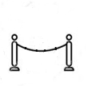
Indexes vs. Scans
1
bsf = d(Q,C₃)
Queue
Q
Q
Q
The summary of Q (Q’) is compared to the summary of each candidate
1
2
3
4
5
Memory
1
2
Disk
C_{x}
C_{x}
C_{x}
Q is compared to each raw candidate in the dataset before returning the answer C_{x}
Q is compared to a raw candidate only if
its summary cannot be pruned
(a) Serial scan
(b) Skip-sequential scan
(c) Tree-based index
Answering a similarity search query using different access paths

Slide 142
Indexes vs. Scans
bsf = d(Q,C₃)
lb_{cur} = d_{lb}(Q’, )
Queue
Queue
1
Q
Q
Q
The summary of Q (Q’) is compared to the summary of each candidate
1
2
3
4
5
Memory
1
2
Disk
C_{x}
C_{x}
C_{x}
Q is compared to each raw candidate in the dataset before returning the answer C_{x}
Q is compared to a raw candidate only if
its summary cannot be pruned
(a) Serial scan
(b) Skip-sequential scan
(c) Tree-based index
Answering a similarity search query using different access paths

Slide 143
Indexes vs. Scans
bsf = d(Q,C₃)
lb_{cur} = d_{lb}(Q’, ) < bsf
Queue
Queue
1
Q
Q
Q
The summary of Q (Q’) is compared to the summary of each candidate
1
2
3
4
5
Memory
1
2
Disk
C_{x}
C_{x}
C_{x}
Q is compared to each raw candidate in the dataset before returning the answer C_{x}
Q is compared to a raw candidate only if
its summary cannot be pruned
(a) Serial scan
(b) Skip-sequential scan
(c) Tree-based index
Answering a similarity search query using different access paths

Slide 144
Indexes vs. Scans
3
2
bsf = d(Q,C₃)
lb_{cur} = d_{lb}(Q’, ) < bsf
Queue
Queue
1
Q
Q
Q
The summary of Q (Q’) is compared to the summary of each candidate
1
2
3
4
5
Memory
1
2
Disk
C_{x}
C_{x}
C_{x}
Q is compared to each raw candidate in the dataset before returning the answer C_{x}
Q is compared to a raw candidate only if
its summary cannot be pruned
(a) Serial scan
(b) Skip-sequential scan
(c) Tree-based index
Answering a similarity search query using different access paths

Slide 145
Indexes vs. Scans
3
bsf = d(Q,C₃)
lb_{cur} = d_{lb}(Q’, )
Queue
2
Q
Q
Q
The summary of Q (Q’) is compared to the summary of each candidate
1
2
3
4
5
Memory
1
2
Disk
C_{x}
C_{x}
C_{x}
Q is compared to each raw candidate in the dataset before returning the answer C_{x}
Q is compared to a raw candidate only if
its summary cannot be pruned
(a) Serial scan
(b) Skip-sequential scan
(c) Tree-based index
Answering a similarity search query using different access paths

Slide 146
Indexes vs. Scans
3
bsf = d(Q,C₃)
lb_{cur} = d_{lb}(Q’, ) < bsf
Queue
2
Q
Q
Q
The summary of Q (Q’) is compared to the summary of each candidate
1
2
3
4
5
Memory
1
2
Disk
C_{x}
C_{x}
C_{x}
Q is compared to each raw candidate in the dataset before returning the answer C_{x}
Q is compared to a raw candidate only if
its summary cannot be pruned
(a) Serial scan
(b) Skip-sequential scan
(c) Tree-based index
Answering a similarity search query using different access paths

Slide 147
Indexes vs. Scans
3
4
5
bsf = d(Q,C₃)
lb_{cur} = d_{lb}(Q’, ) < bsf
Queue
2
Q
Q
Q
The summary of Q (Q’) is compared to the summary of each candidate
1
2
3
4
5
Memory
1
2
Disk
C_{x}
C_{x}
C_{x}
Q is compared to each raw candidate in the dataset before returning the answer C_{x}
Q is compared to a raw candidate only if
its summary cannot be pruned
(a) Serial scan
(b) Skip-sequential scan
(c) Tree-based index
Answering a similarity search query using different access paths

Slide 148
Indexes vs. Scans
3
4
bsf = d(Q,C₃)
lb_{cur} = d_{lb}(Q’, )
Queue
5
Q
Q
Q
The summary of Q (Q’) is compared to the summary of each candidate
1
2
3
4
5
Memory
1
2
Disk
C_{x}
C_{x}
C_{x}
Q is compared to each raw candidate in the dataset before returning the answer C_{x}
Q is compared to a raw candidate only if
its summary cannot be pruned
(a) Serial scan
(b) Skip-sequential scan
(c) Tree-based index
Answering a similarity search query using different access paths

Slide 149
Indexes vs. Scans
3
4
bsf = d(Q,C₃)
lb_{cur} = d_{lb}(Q’, ) < bsf
Queue
5
Q
Q
Q
The summary of Q (Q’) is compared to the summary of each candidate
1
2
3
4
5
Memory
1
2
Disk
C_{x}
C_{x}
C_{x}
Q is compared to each raw candidate in the dataset before returning the answer C_{x}
Q is compared to a raw candidate only if
its summary cannot be pruned
(a) Serial scan
(b) Skip-sequential scan
(c) Tree-based index
Answering a similarity search query using different access paths

Slide 150
Indexes vs. Scans
3
4
2
bsf = d(Q,C₃)
lb_{cur} = d_{lb}(Q’, ) < bsf
Queue
5
Q
Q
Q
The summary of Q (Q’) is compared to the summary of each candidate
1
2
3
4
5
Memory
1
2
Disk
C_{x}
C_{x}
C_{x}
Q is compared to each raw candidate in the dataset before returning the answer C_{x}
Q is compared to a raw candidate only if
its summary cannot be pruned
(a) Serial scan
(b) Skip-sequential scan
(c) Tree-based index
Answering a similarity search query using different access paths

Slide 151
Indexes vs. Scans
3
4
bsf = d(Q,C₃)
lb_{cur} = d_{lb}(Q’, )
Queue
2
Q
Q
Q
The summary of Q (Q’) is compared to the summary of each candidate
1
2
3
4
5
Memory
1
2
Disk
C_{x}
C_{x}
C_{x}
Q is compared to each raw candidate in the dataset before returning the answer C_{x}
Q is compared to a raw candidate only if
its summary cannot be pruned
(a) Serial scan
(b) Skip-sequential scan
(c) Tree-based index
Answering a similarity search query using different access paths

Slide 152
Indexes vs. Scans
3
4
bsf = d(Q,C₃)
lb_{cur} = d_{lb}(Q’, ) < bsf
Queue
2
Q
Q
Q
The summary of Q (Q’) is compared to the summary of each candidate
1
2
3
4
5
Memory
1
2
Disk
C_{x}
C_{x}
C_{x}
Q is compared to each raw candidate in the dataset before returning the answer C_{x}
Q is compared to a raw candidate only if
its summary cannot be pruned
(a) Serial scan
(b) Skip-sequential scan
(c) Tree-based index
Answering a similarity search query using different access paths

Slide 153
Indexes vs. Scans
3
4
bsf = d(Q,C₃)
lb_{cur} = d_{lb}(Q’, ) < bsf
Queue
2
Q
Q
Q
The summary of Q (Q’) is compared to the summary of each candidate
1
2
3
4
5
Memory
1
2
Disk
C_{x}
C_{x}
C_{x}
Q is compared to each raw candidate in the dataset before returning the answer C_{x}
Q is compared to a raw candidate only if
its summary cannot be pruned
(a) Serial scan
(b) Skip-sequential scan
(c) Tree-based index
Answering a similarity search query using different access paths

Slide 154
Indexes vs. Scans
3
4
bsf = d(Q,C_{x})
lb_{cur} = d_{lb}(Q’, ) < bsf
Queue
2
Q
Q
Q
The summary of Q (Q’) is compared to the summary of each candidate
1
2
3
4
5
Memory
1
2
Disk
C_{x}
C_{x}
C_{x}
Q is compared to each raw candidate in the dataset before returning the answer C_{x}
Q is compared to a raw candidate only if
its summary cannot be pruned
(a) Serial scan
(b) Skip-sequential scan
(c) Tree-based index
Answering a similarity search query using different access paths

Slide 155
Indexes vs. Scans
3
bsf = d(Q,C_{x})
lb_{cur} = d_{lb}(Q’, )
Queue
4
Q
Q
Q
The summary of Q (Q’) is compared to the summary of each candidate
1
2
3
4
5
Memory
1
2
Disk
C_{x}
C_{x}
C_{x}
Q is compared to each raw candidate in the dataset before returning the answer C_{x}
Q is compared to a raw candidate only if
its summary cannot be pruned
(a) Serial scan
(b) Skip-sequential scan
(c) Tree-based index
Answering a similarity search query using different access paths

Slide 156
Indexes vs. Scans
3
bsf = d(Q,C_{x})
lb_{cur} = d_{lb}(Q’, ) > bsf
Queue
4
Q
Q
Q
LB Property
The summary of Q (Q’) is compared to the summary of each candidate
1
prune
4
2
3
4
5
Memory
1
2
Disk
C_{x}
C_{x}
C_{x}
Q is compared to each raw candidate in the dataset before returning the answer C_{x}
Q is compared to a raw candidate only if
its summary cannot be pruned
(a) Serial scan
(b) Skip-sequential scan
(c) Tree-based index
Answering a similarity search query using different access paths

Slide 157

Indexes vs. Scans
3
bsf = d(Q,C_{x})
lb_{cur} = d_{lb}(Q’, ) > bsf
Queue
4
Q
Q
Q
The summary of Q (Q’) is compared to the summary of each candidate
1
2
3
4
5
Memory
1
2
Disk
C_{x}
C_{x}
C_{x}
Q is compared to each raw candidate in the dataset before returning the answer C_{x}
Q is compared to a raw candidate only if
its summary cannot be pruned
(a) Serial scan
(b) Skip-sequential scan
(c) Tree-based index
Answering a similarity search query using different access paths

Slide 158
Indexes vs. Scans
3
bsf = d(Q,C_{x})
lb_{cur} = d_{lb}(Q’, ) > bsf
Queue
4
Q
Q
Q
The summary of Q (Q’) is compared to the summary of each candidate
1
2
3
4
5
Memory
1
2
Disk
C_{x}
C_{x}
C_{x}
Q is compared to each raw candidate in the dataset before returning the answer C_{x}
Q is compared to a raw candidate only if
its summary cannot be pruned
(a) Serial scan
(b) Skip-sequential scan
(c) Tree-based index
Answering a similarity search query using different access paths

Slide 159
Similarity Search
Data Series Extensions

Slide 160

Access Paths
O_{Q}
O_{Q}
O_{Q}
The summary of O_{Q} (O_{Q}’) is compared to the summary of each candidate
1
2
3
4
Memory
1
2
Disk
O_{x}
O_{x}
O_{x}
O_{Q} is compared to each raw candidate in the dataset before returning the answer O_{x}
O_{Q} is compared to a raw candidate only if
its summary cannot be pruned
(a) Serial scan
(b) Skip-sequential scan
(c) Tree-based index
Answering a similarity search query using different access paths

Slide 161
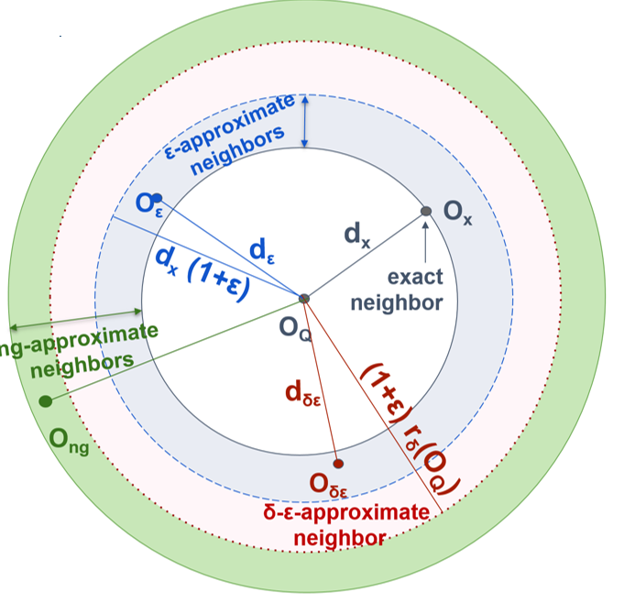
Extensions: Skip-Sequential Scans
bsf = d(O_{Q},O₁)
lb_{cur} = d_{lb}(O_{Q}’, O_{x}’) < bsf
P{d_{ε} <= d_{x} (1+ε)} >= δ
Result is within
distance (1+ ε) of
the exact answer with probability at least δ
O_{Q}
The summary of O_{Q} (O_{Q}’) is compared to the summary of each candidate
Memory
Disk
O_{x}

Slide 162
Extensions: Skip-Sequential Scans
bsf = d(O_{Q},O₁)
lb_{cur} = d_{lb}(O_{Q}’, O_{x}’) < bsf
lb_{cur} = d_{lb}(O_{Q}’, O_{x}’) < (1+ε) bsf
P{d_{ε} <= d_{x} (1+ε)} >= δ
Result is within
distance (1+ ε) of
the exact answer with probability at least δ
O_{Q}
The summary of O_{Q} (O_{Q}’) is compared to the summary of each candidate
Memory
Disk
O_{x}

Slide 163
Extensions: Skip-Sequential Scans
bsf = d(O_{Q},O₁)
P{d_{ε} <= d_{x} (1+ε) = δ
Result is within
distance (1+ ε) of
the exact answer with probability at least δ
O_{Q}
The summary of O_{Q} (O_{Q}’) is compared to the summary of each candidate
Memory
Disk
O_{x}

Slide 164

Extensions: Skip-Sequential Scans
bsf = d(O_{Q},O₁)
If bsf <=
(1+ε) r_{δ}(O_{Q})
P{d_{ε} <= d_{x} (1+ε)} >= δ
Result is within
distance (1+ ε) of
the exact answer
with probability at
least δ
O_{Q}
The summary of O_{Q} (O_{Q}’) is compared to the summary of each candidate
Memory
Disk
O_{x}

Slide 165
Extensions: Indexes
bsf = d(O_{Q},O₃)
lb_{cur} = d_{lb}(O_{Q}’, ) < bsf
1
P{d_{ε} <= d_{x} (1+ε)} >= δ
Result is within
distance (1+ ε) of
the exact answer with probability at least δ
Q
1
2
3
4
Memory
1
2
Disk
O_{x}

Slide 166
Extensions: Indexes
bsf = d(O_{Q},O₃)
lb_{cur} = d_{lb}(O_{Q}’, ) < bsf
lb_{cur} = d_{lb}(O_{Q}’, ) < (1+ε) bsf
1
Q
1
P{d_{ε} <= d_{x} (1+ε)} >= δ
Result is within
distance (1+ ε) of
the exact answer with probability at least δ
1
2
3
4
Memory
1
2
Disk
O_{x}

Slide 167
Extensions: Indexes
bsf = d(O_{Q},O₃)
lb_{cur} = d_{lb}(O_{Q}’, ) < bsf
lb_{cur} = d_{lb}(O_{Q}’, ) < (1+ε) bsf
1
Q
1
P{d_{ε} <= d_{x} (1+ε)} >= δ
Result is within
distance (1+ ε) of
the exact answer with probability at least δ
1
2
3
4
Memory
1
2
Disk
O_{x}

Slide 168
Extensions: Indexes
bsf = d(O_{Q},O₃)
If bsf <=
(1+ε) r_{δ}(O_{Q})
P{d_{ε} <= d_{x} (1+ε)} >= δ
Result is within
distance (1+ ε) of
the exact answer
with probability at
least δ
Q
1
2
3
4
Memory
1
2
Disk
O_{x}

Slide 169
Questions?

Slide 170
Data Series Similarity Search
State-of-the-Art Methods

Slide 171
Data Series Similarity Search
State-of-the-Art Methods
Publications
  Echihabi-
  EDBT‘21
for a more complete and detailed presentation, see tutorial:
Karima Echihabi, Kostas Zoumpatianos, Themis Palpanas. Big Sequence Management: Scaling Up and Out. EDBT 2021
http://helios.mi.parisdescartes.fr/~themisp/publications.html#tutorials

Slide 172
iSAX Summarization
3
2
A data series T
1
indexable Symbolic Aggregate approXimation (SAX)
  (1) Represent data series T of length n with w segments using Piecewise Aggregate Approximation (PAA)
0
-1
-2
-3
0
4
8
12
16

Slide 173
iSAX Summarization
3
2
A data series T
1
indexable Symbolic Aggregate approXimation (SAX)
  (1) Represent data series T of length n with w segments using Piecewise Aggregate Approximation (PAA)
    T typically normalized to μ = 0, σ = 1
    PAA(T,w) =
    where
0
-1
-2
-3
0
4
8
12
16
3
2
PAA(T,4)
1
0
-1
-2
-3
0
4
8
12
16

Slide 174
iSAX Summarization
3
2
A data series T
1
indexable Symbolic Aggregate approXimation (SAX)
  (1) Represent data series T of length n with w segments using Piecewise Aggregate Approximation (PAA)
    T typically normalized to μ = 0, σ = 1
    PAA(T,w) =
    where
  (2) Discretize into a vector of symbols
    Breakpoints map to small alphabet a of symbols
0
-1
-2
-3
0
4
8
12
16
3
2
PAA(T,4)
1
0
-1
-2
-3
0
4
8
12
16
3
2
iSAX(T,4,4)
1
00
01
0
10
-1
11
-2
-3
0
4
8
12
16

Slide 175
iSAX Summarization iSAX Summarization
Publications
  Shieh-
  KDD‘08
based on iSAX representation, which offers a bit-aware, quantized, multi-resolution representation with variable granularity
= { 6, 6, 3, 0} = {110 ,110 ,0111 ,000} = { 3, 3, 1, 0} = {11 ,11 ,011 ,00 } = { 1, 1, 0, 0} = {1 ,1 ,0 ,0 }
Notes:
The isax-based indexes use the isax summarization that we described earlier.
As we mentioned, the isax summarization is bitwise, and allows us to represent different segments of the same series with a different number of bits.
This is what enables a small memory footprint, a hierarchical organization of the series in the form of a tree, and fast, bitwise operations for the traversal of this tree index

Slide 176
iSAX Index Family
non-balanced tree-based index with non-overlapping regions, and controlled fan-out rate
  base cardinality b (optional), segments w, threshold th
  hierarchically subdivides SAX space until num. entries ≤ th

Slide 177
iSAX Index Family
non-balanced tree-based index with non-overlapping regions, and controlled fan-out rate
  base cardinality b (optional), segments w, threshold th
  hierarchically subdivides SAX space until num. entries ≤ th
e.g., th=4, w=4, b=1
1 1 1 0
1 1 1 0
1 1 1 0
1 1 1 0

Slide 178
iSAX Index Family
non-balanced tree-based index with non-overlapping regions, and controlled fan-out rate
  base cardinality b (optional), segments w, threshold th
  hierarchically subdivides SAX space until num. entries ≤ th
e.g., th=4, w=4, b=1
1 1 1 0
Insert:
1 1 1 0
1 1 1 0
1 1 1 0
1 1 1 0

Slide 179
iSAX Index Family
non-balanced tree-based index with non-overlapping regions, and controlled fan-out rate
  base cardinality b (optional), segments w, threshold th
  hierarchically subdivides SAX space until num. entries ≤ th
e.g., th=4, w=4, b=1
1 1 10 0
1 1 10 0
1 1 1 0
1 1 11 0
1 1 11 0
1 1 11 0

Slide 180
iSAX Index Family
non-balanced tree-based index with non-overlapping regions, and controlled fan-out rate
  base cardinality b (optional), segments w, threshold th
  hierarchically subdivides SAX space until num. entries ≤ th

Slide 181
iSAX Index Family
non-balanced tree-based index with non-overlapping regions, and controlled fan-out rate
  base cardinality b (optional), segments w, threshold th
  hierarchically subdivides SAX space until num. entries ≤ th

Slide 182
iSAX Index Family
non-balanced tree-based index with non-overlapping regions, and controlled fan-out rate
  base cardinality b (optional), segments w, threshold th
  hierarchically subdivides SAX space until num. entries ≤ th

Slide 183
iSAX Index Family
non-balanced tree-based index with non-overlapping regions, and controlled fan-out rate
  base cardinality b (optional), segments w, threshold th
  hierarchically subdivides SAX space until num. entries ≤ th
Approximate Search
  Match iSAX representation at each level
Exact Search
  Leverage approximate search
  Prune search space
    Lower bounding distance

Slide 184
iSAX
Publications
  Shieh-
  KDD‘08
ROOT
0 0 0 0
. . .
1 1 1 0
. . .
1 1 1 1
1 1 1 1
1
0
1 1 1 1
1 1 1 0
0
1
1 1 1 0
1 1 1 0
0
184
Notes:
This slide shows an example of an isax index.
Each inner node contains the isax summarization of all series below that subtree.
Leaf nodes also contain (or point to) the raw data values, so that we can remove false positives during query answering, and get exact, correct answers for similarity search.
Leaves have a fixed capacity; once this is exceeded, we have to split a leaf in two children, by selecting one of the segments and augmenting by one the number of bits for representing this segment.
Note also that the root of the index has more than two children: it can have up to 2^w children (if the corresponding series exist in the dataset), where w is the number of segments.
The isax index is built top-down, and is a non-balanced tree.

Slide 185
R
iSAX2+
Publications
  Camerra-
  ICDM‘10
FBL
z
  Camerra-
  KAIS‘14
L1
I2
I1
L5
L6
I3
L4
L7
L8
LBL
b
c
main memory
disk
b
a
c
a
y
x
Notes:
The isax2+ index is newer version of the isax index that supports bulk loading.
The main ideas are the following:
First, it gathers in main memory as many series from the input as possible that will end up in the same leaf, and then issues sequential disk writes to materialize the corresponding leaves.
Second, it handles separately the summarizations and the raw data of each series, so that operations are executed faster, using only the necessary data.
And third, it applies an optimistic policy, assuming that the first leaf each series gets into will never split.
These strategies result in isax2+ building almost an order of magnitude faster than the simple isax index (for large sequence collections).

Slide 186
ADS+
Publications
  Zoumbatianos-SIGMOD‘14
  Zoumbatianos-PVLDB‘15
  Zoumbatianos-VLDBJ‘16
novel paradigm for building a data series index
  does not build entire index and then answer queries
  starts answering queries by building the part of the index needed by those queries
still guarantees correct answers
intuition for proposed solution
  builds index using only iSAX summaries; uses large leaf size
  postpones leaf materialization to query time
    only materialize (at query time) leaves needed by queries
  parts that are queried more are refined more
    use smaller leaf sizes (reduced leaf materialization and query answering costs)
Notes:
The Adaptive Data Series index (ADS+), is an adaptive version of isax2+.
It represents a novel paradigm for building a data series index, by starting to answer similarity search queries before the entire index has been built, while still guaranteeing correct results.
This leads to a significant performance improvement (up to 7x faster) for the time we need to answer the very first query using the index.
The main idea is to build a high-level in-memory index using only the isax summarizations and very large leaf sizes, and then refine the leaves and bring in their raw data only when accessed by some query.

Slide 187
Query #1
ROOT
Publications
  Zoumbatianos-SIGMOD‘14
FBL
  Zoumbatianos-PVLDB‘15
I1
I2
  Zoumbatianos-VLDBJ‘16
LBL
L1
L2
L4
L5
RAM
Raw data
DISK
TOO BIG!
PARTIAL
PARTIAL
PARTIAL
PARTIAL
Notes:
This slide shows the ADS index when we have finished the first phase, and are ready to answer queries.
The leaves are large, and point to the raw data in the original file on disk, which permits us to finish this phase quickly.

Slide 188
Query #1
ROOT
Publications
  Zoumbatianos-SIGMOD‘14
FBL
  Zoumbatianos-PVLDB‘15
I1
I2
Adaptive split
  Zoumbatianos-VLDBJ‘16
LBL
I3
L4
L5
L2
L4
L5
RAM
Raw data
DISK
PARTIAL
PARTIAL
PARTIAL
PARTIAL
PARTIAL
Create a smaller leaf
Notes:
In order to answer the query fast, we further split the leaves needed by the query, until they become small enough, so that we can afford to pay the cost of reading the corresponding raw data, bringing them in the index, and materializing the leaf with the raw data.

Slide 189
ROOT
Publications
  Zoumbatianos-SIGMOD‘14
FBL
  Zoumbatianos-PVLDB‘15
I1
I2
  Zoumbatianos-VLDBJ‘16
I3
LBL
L4
L5
L2
L4
L5
RAM
Raw data
DISK
FULL
PARTIAL
PARTIAL
PARTIAL
PARTIAL
Notes:
This approach ensures that the next time a query will need this leaf, it will already contain the raw data, and the query will execute much faster.
Moreover, we do not need to spend time and effort to build parts of the index that will never be queried, and overall, we end up answering queries much faster than other approaches.

Slide 190
ADS Index creation
Notes:
This is Breakdown of time consumption in creation of indexing.

Slide 191
ADS Index creation
~60% of time spent in CPU: potential for improvement!
Notes:
We can see that 60% of time is CPU time. We concentrate on how to reduce that.

Slide 192
Parallelization/Distribution
Publications
  Yagoubi-ICDM‘17
  Yagoubi-TKDE’18
  Lavchenko-KAIS’20
DPiSAX: current solution for distributed processing (Spark)
  balances work of different worker nodes
Notes:
In terms of distribution and parallelization, DPiSAX is an extension of isax2+ that operates on the Spark distributed platform.

Slide 193
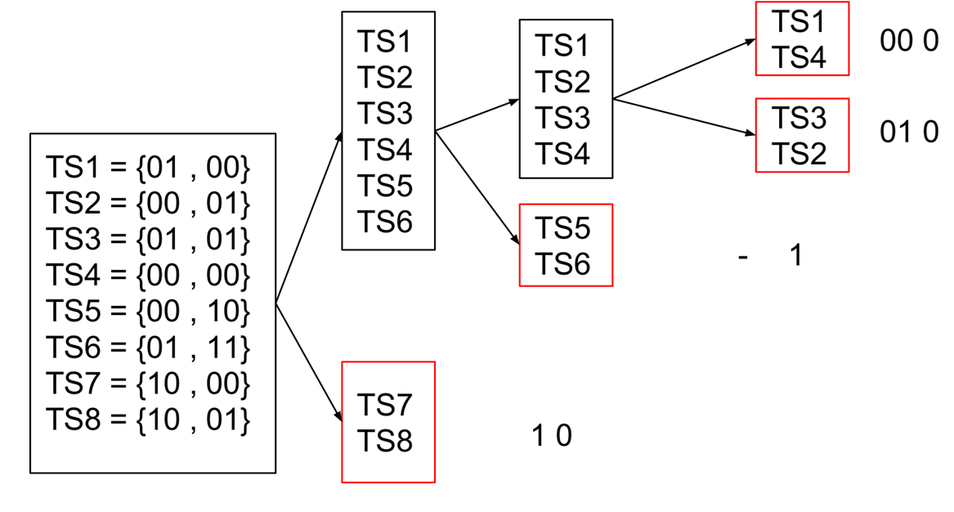
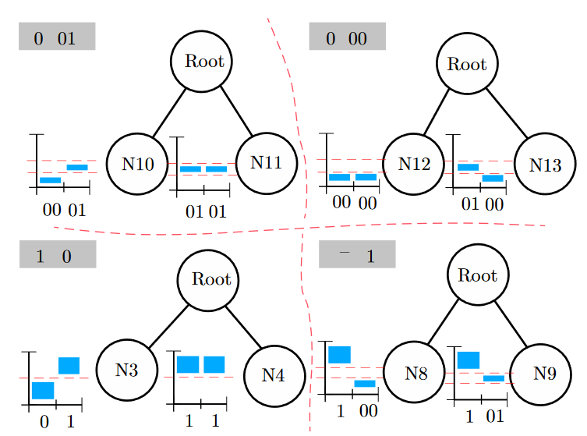
Parallelization/Distribution
Publications
  Yagoubi-ICDM‘17
  Yagoubi-TKDE’18
  Lavchenko-KAIS’20
DPiSAX: current solution for distributed processing (Spark)
  balances work of different worker nodes
  performs 2 orders of magnitude faster than centralized solution
Notes:
DpiSAX uses the isax summarization to effectively balance the workload of each node in the Spark cluster, before actually building the index.

Slide 194
Parallelization/Distribution
Publications
  Yagoubi-ICDM‘17
  Yagoubi-TKDE’18
  Lavchenko-KAIS’20
DPiSAX: current solution for distributed processing (Spark)
  balances work of different worker nodes
  performs 2 orders of magnitude faster than centralized solution
Notes:
This results in batch query answering 2 orders of magnitude faster than centralized approaches.

Slide 195
Parallelization/Distribution
Publications
  Yagoubi-ICDM‘17
  Yagoubi-TKDE’18
  Lavchenko-KAIS’20
DPiSAX: current solution for distributed processing (Spark)
  balances work of different worker nodes
  performs 2 orders of magnitude faster than centralized solution
ParIS+: current solution for modern hardware
  completely masks out the CPU cost
  Peng-BigData’18
  Peng-
  TKDE’21
Notes:
Following DPiSAX, specialized isax-based indexes for modern hardware were proposed.
ParIS is the current state of the art index for disk-based data that exploits the SIMD (single instruction multiple data), multi-core, and multi-socket architectures of modern hardware.

Slide 196
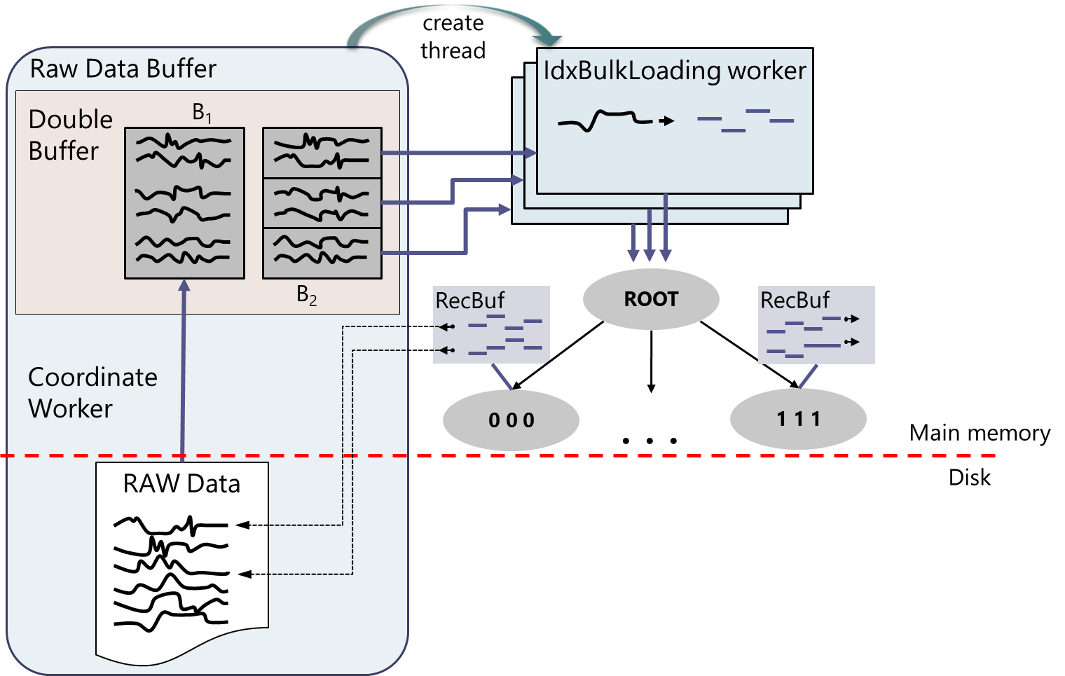
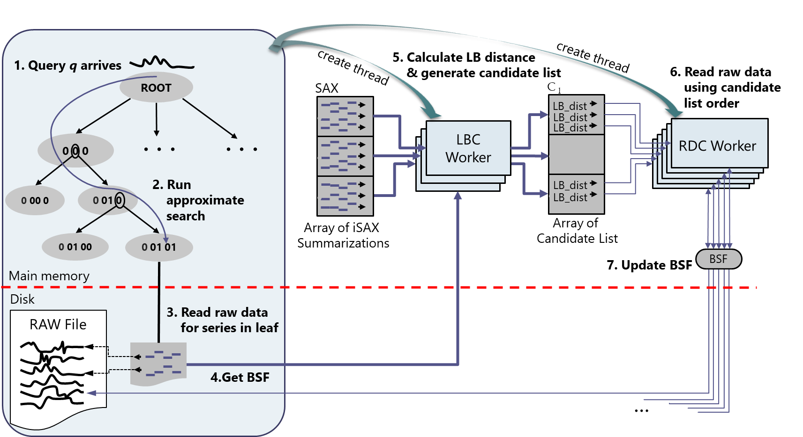
Parallelization/Distribution
Publications
  Yagoubi-ICDM‘17
  Yagoubi-TKDE’18
  Lavchenko-KAIS’20
DPiSAX: current solution for distributed processing (Spark)
  balances work of different worker nodes
  performs 2 orders of magnitude faster than centralized solution
ParIS: current solution for modern hardware
  completely masks out the CPU cost
  Peng-BigData’18
  Peng-
  TKDE’21
Notes:
Its design ensures that the CPU cost is entirely masked under the disk I/O cost.
This is true for both spinning disks and SSDs, and it seems that it will continue to be true as these storage technologies improve.

Slide 197
Parallelization/Distribution
Publications
  Yagoubi-ICDM‘17
  Yagoubi-TKDE’18
  Lavchenko-KAIS’20
DPiSAX: current solution for distributed processing (Spark)
  balances work of different worker nodes
  performs 2 orders of magnitude faster than centralized solution
ParIS+: current solution for modern hardware
  masks out the CPU cost
  answers exact queries in the order of a few secs
    3 orders of magnitude faster then single-core solutions
  Peng-BigData’18
  Peng-
  TKDE’21
Notes:
ParIS results in query answering up to 3 orders of magnitude faster than single core solutions, which has interesting implications for complex analytics tasks, as well.

Slide 198
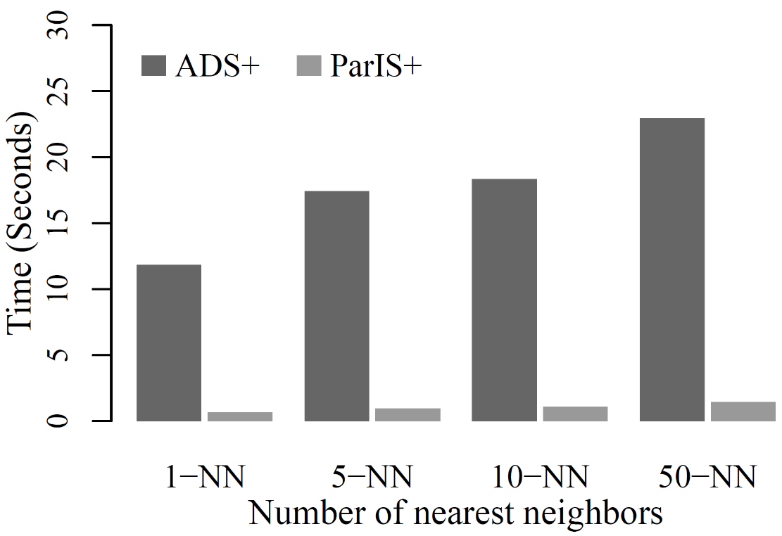
Parallelization/Distribution
Publications
  Yagoubi-ICDM‘17
  Yagoubi-TKDE’18
  Lavchenko-KAIS’20
DPiSAX: current solution for distributed processing (Spark)
  balances work of different worker nodes
  performs 2 orders of magnitude faster than centralized solution
ParIS+: current solution for modern hardware
  masks out the CPU cost
  answers exact queries in the order of a few secs
    3 orders of magnitude faster then single-core solutions
  Peng-BigData’18
  Peng-
  TKDE’21
k-NN Classification
Notes:
For example, this graph shows the time to classify a single object using k-NN classification on a 100GB dataset.

Slide 199
Parallelization/Distribution
Publications
  Yagoubi-ICDM‘17
  Yagoubi-TKDE’18
  Lavchenko-KAIS’20
DPiSAX: current solution for distributed processing (Spark)
  balances work of different worker nodes
  performs 2 orders of magnitude faster than centralized solution
ParIS+: current solution for modern hardware
  masks out the CPU cost
  answers exact queries in the order of a few secs
    3 orders of magnitude faster then single-core solutions
  Peng-BigData’18
  Peng-
  TKDE’21
k-NN Classification
18x faster
Notes:
When using the same hardware and data, ParIS is 18x faster than ADS+ on this task.

Slide 200
Parallelization/Distribution
Publications
  Yagoubi-ICDM‘17
  Yagoubi-TKDE’18
  Lavchenko-KAIS’20
DPiSAX: current solution for distributed processing (Spark)
  balances work of different worker nodes
  performs 2 orders of magnitude faster than centralized solution
ParIS: current solution for modern hardware
  masks out the CPU cost
  answers exact queries in the order of a few secs
    3 orders of magnitude faster then single-core solutions
  Peng-BigData’18
  Peng-
  TKDE’21
k-NN Classification
classifying 100K objects using a 100GB dataset goes down from several days to few hours!
18x faster
Notes:
This means that classification time for 100K objects goes from several days down to a few hours, all while using the same hardware.

Slide 201
Parallelization/Distribution
Publications
  Yagoubi-ICDM‘17
  Yagoubi-TKDE’18
  Lavchenko-KAIS’20
DPiSAX: current solution for distributed processing (Spark)
  balances work of different worker nodes
  performs 2 orders of magnitude faster than centralized solution
ParIS+: current single-node parallel solution
  masks out the CPU cost
  answers exact queries in the order of a few secs
    >1 order of magnitude faster then single-core solutions
MESSI: current single-node parallel solution + in-memory data
  answers exact queries at interactive speeds: ~50msec on 100GB
  Peng-BigData’18
  Peng-
  TKDE’21
  Peng-
  ICDE’20
  Peng-
  VLDBJ’21
Notes:
MESSI is an extension of ParIS for memory-resident data.
This index takes advantage of the fact that random accesses in main memory are fast, so it uses tree traversals more aggressively than ParIS for its query answering algorithm.

Slide 202
Parallelization/Distribution
Publications
  Yagoubi-ICDM‘17
  Yagoubi-TKDE’18
  Lavchenko-KAIS’20
DPiSAX: current solution for distributed processing (Spark)
  balances work of different worker nodes
  performs 2 orders of magnitude faster than centralized solution
ParIS+: current single-node parallel solution
  masks out the CPU cost
  answers exact queries in the order of a few secs
    >1 order of magnitude faster then single-core solutions
MESSI: current single-node parallel solution + in-memory data
  answers exact queries at interactive speeds: ~50msec on 100GB
SING: current single-node parallel solution + GPU + in-memory data
  answers exact queries at interactive speeds: ~32msec on 100GB
  Peng-BigData’18
  Peng-
  TKDE’21
  Peng-
  ICDE’20
  Peng-
  VLDBJ’21
  Peng-
  ICDE’21
Notes:
Finally, SING is an extension of MESSI that also takes advantage of GPU processors for similarity search query answering of memory-resident data.
SING achieves interactive query answering times for exact similarity search over 100GB sequence collections, taking a mere 32msec per query.

Slide 203
Extensions…
Publications
  Kondylakis-PVLDB‘18
  Kondylakis-SIGMOD’19
Coconut: current solution for limited memory devices
and streaming time series
  bottom-up, succinct index construction based on sortable summarizations
Notes:
Following isax2+ and ADS+, several other isax-based indexes were developed.
Coconut is the current state of the art index for limited memory devices (where the memory is significantly smaller than the dataset size), and is the first scalable data series index that is built bottom-up.

Slide 204
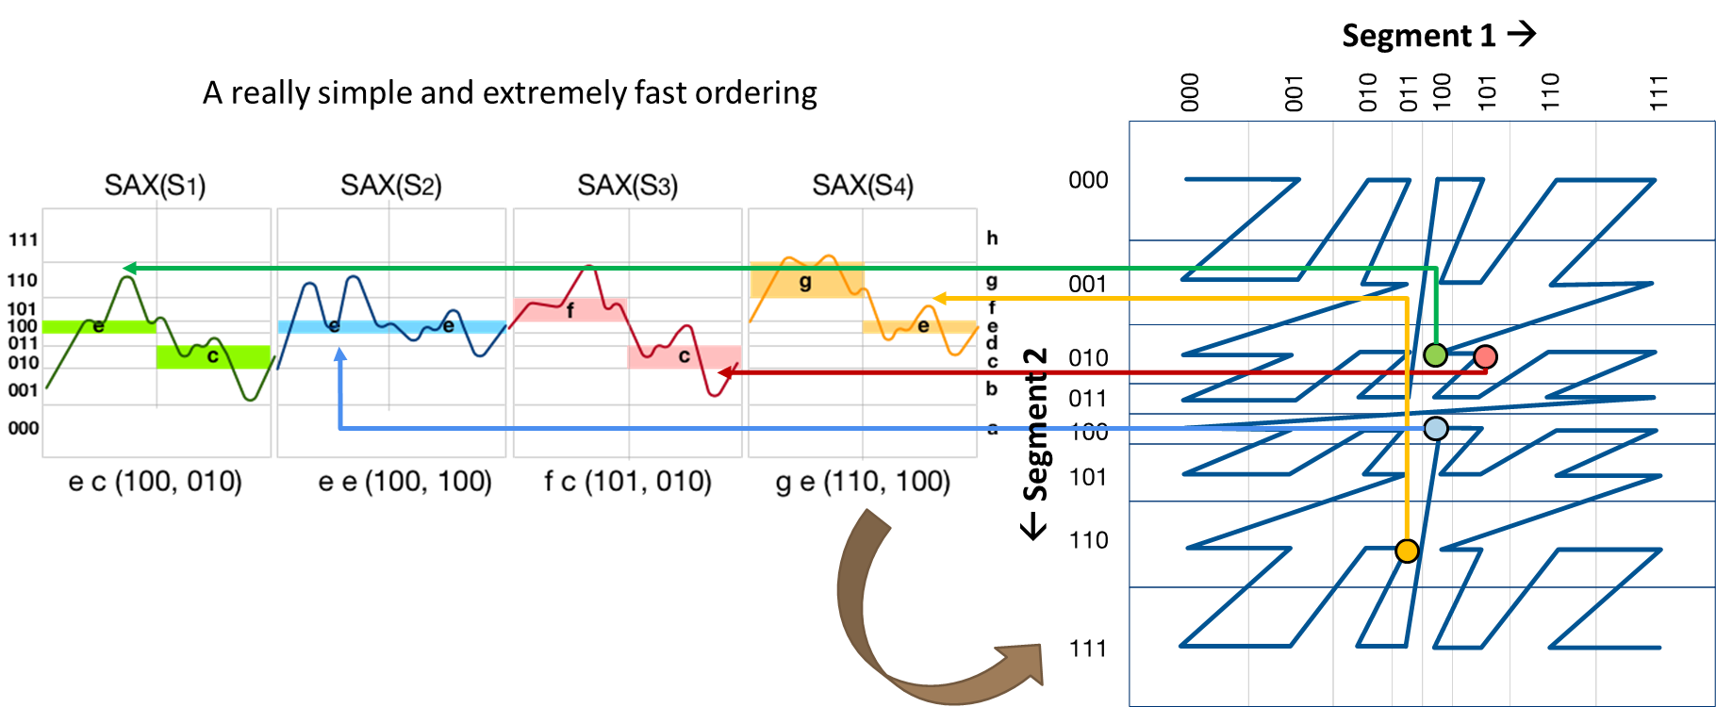
Extensions…
Publications
  Kondylakis-PVLDB‘18
  Kondylakis-SIGMOD’19
Coconut: current solution for limited memory devices
and streaming time series
  bottom-up, succinct index construction based on sortable summarizations
Notes:
This is made possible thanks to InvSax, an isax summarization that is sortable.
Note that sorting sequences, or their summarizations is not straight-forward.
For example, two sequences may be similar in the first few points, but different in the rest.
This means that a sorted order should take into account all the points of the sequence, in order to place close to each other in the sorted order two sequences that have a low distance between them.
Coconut proposes such a solution using a space-filling curve on the embedded space of the isax summarizations of the series.

Slide 205
Extensions…
Publications
  Kondylakis-PVLDB‘18
  Kondylakis-SIGMOD’19
Coconut: current solution for limited memory devices
and streaming time series
  bottom-up, succinct index construction based on sortable summarizations
  outperforms state-of-the-art in terms of index space, index construction time, and query answering time
Notes:
This results in an index that can be built bottom-up, bulk loaded, and densely packed.
Moreover, we can use traditional single-dimensional indexes to do that, such as a B+-tree.

Slide 206
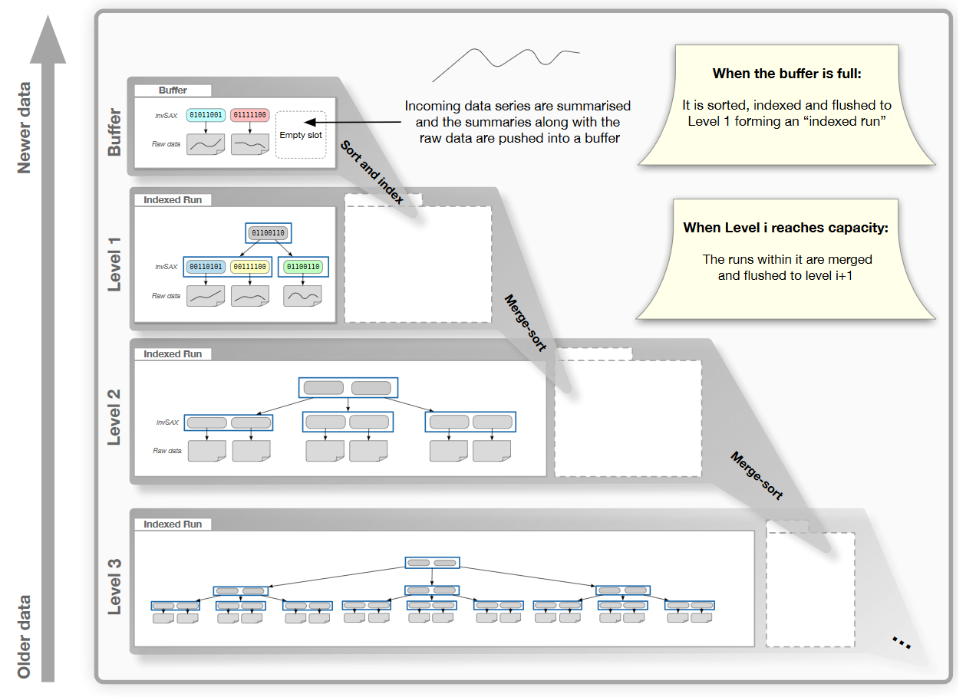
Extensions…
Coconut-LSM
Publications
  Kondylakis-PVLDB‘18
  Kondylakis-SIGMOD’19
  Kondylakis-VLDBJ’20
Notes:
Coconut has also been extended to operate with LSM-trees, which are adapted to online operation.
Coconut-LSM is the first data series indexing solution for similarity search in streaming time series.

Slide 207
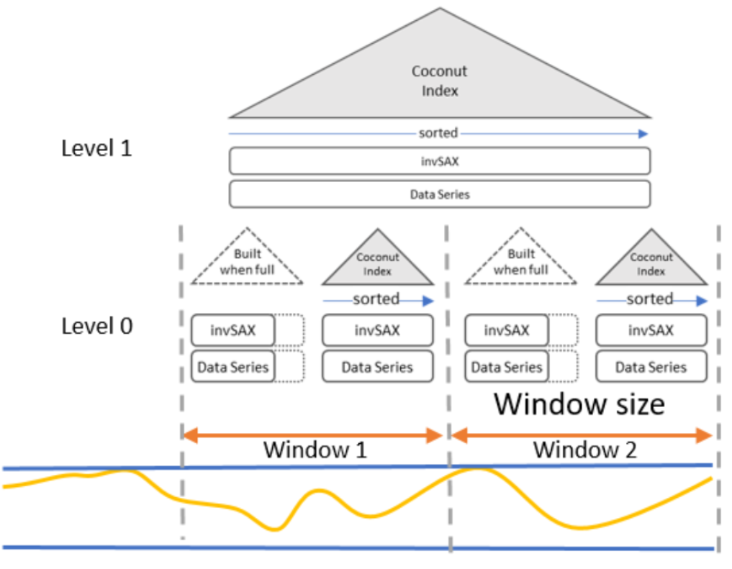
Extensions…
Coconut-LSM
Publications
  Kondylakis-PVLDB‘18
  Kondylakis-SIGMOD’19
  Kondylakis-VLDBJ’20
Notes:
It allows users to efficiently index and answer similarity search queries for ad-hoc windows in the past.
For example, find sequences similar to this pattern that have occurred in the stream during last week, or last August.

Slide 208
Extensions…
Publications
  Kondylakis-PVLDB‘18
  Kondylakis-SIGMOD’19
  Kondylakis-VLDBJ’20
Coconut: current solution for limited memory devices
and streaming time series
  bottom-up, succinct index construction based on sortable summarizations
  outperforms state-of-the-art in terms of index space, index construction time, and query answering time
ULISSE: current solution for variable-length queries
  single-index support of queries of variable lengths
  Linardi-ICDE’18
  Linardi-PVLDB‘19
  Linardi-VLDBJ‘20
Notes:
ULISSE is a single index that can support variable-length similarity search queries, for a wide range of lengths, ranging from a few hundred to a few thousand of points.

Slide 209
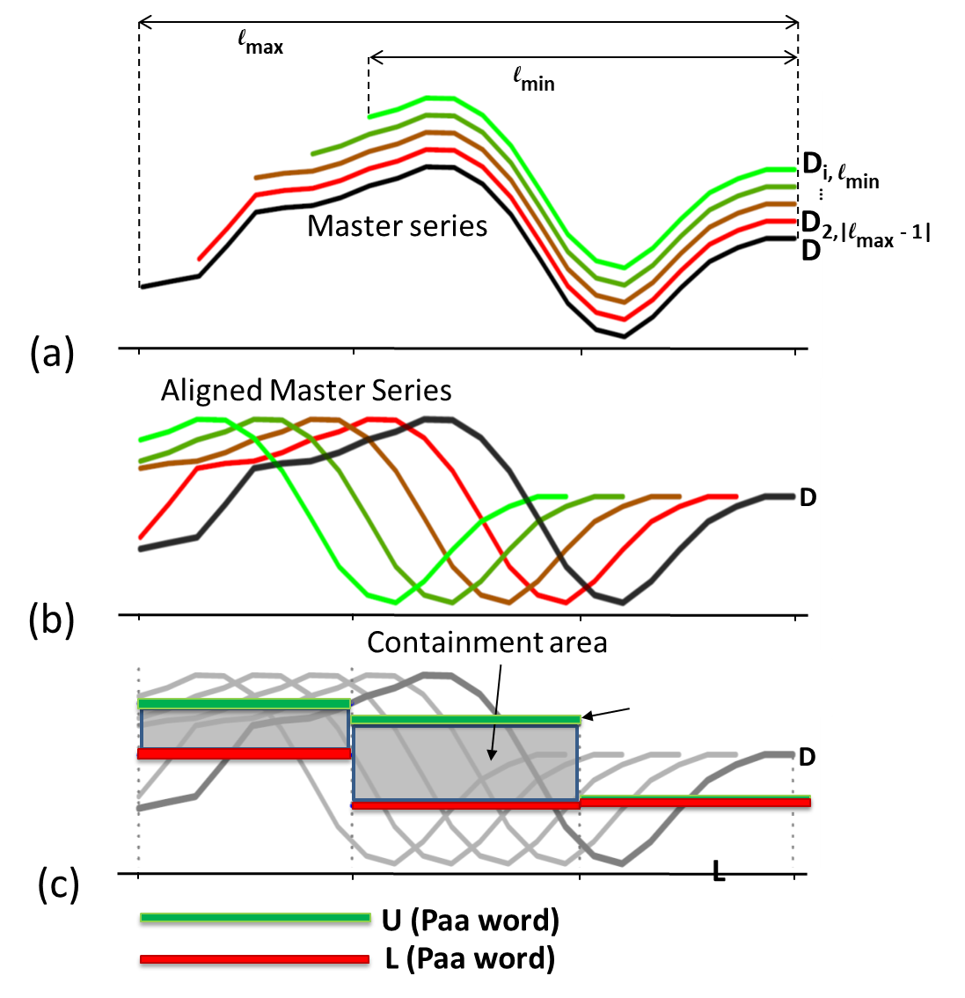
Extensions…
Publications
  Kondylakis-PVLDB‘18
  Kondylakis-SIGMOD’19
  Kondylakis-VLDBJ’20
Coconut: current solution for limited memory devices
and streaming time series
  bottom-up, succinct index construction based on sortable summarizations
  outperforms state-of-the-art in terms of index space, index construction time, and query answering time
ULISSE: current solution for variable-length queries
  single-index support of queries of variable lengths
  Linardi-ICDE’18
  Linardi-PVLDB‘19
  Linardi-VLDBJ‘20
Notes:
The idea of ULISSE is that indexes many subsequences of a series.
Conceptually what it does, is that it considers each individual subsequence, it groups them, and computes an envelope representation that contains them all.
Then, each node in the index stores the isax summarization of the envelope of all these subsequences.

Slide 210
Extensions…
Publications
  Kondylakis-PVLDB‘18
  Kondylakis-SIGMOD’19
  Kondylakis-VLDBJ’20
Coconut: current solution for limited memory devices
and streaming time series
  bottom-up, succinct index construction based on sortable summarizations
  outperforms state-of-the-art in terms of index space, index construction time, and query answering time
ULISSE: current solution for variable-length queries
  single-index support of queries of variable lengths
  orders of magnitude faster than competing approaches
  Linardi-ICDE’18
  Linardi-PVLDB‘19
  Linardi-VLDBJ‘20
Notes:
This enables ULISSE to answer variable-length queries orders of magnitude faster than other approaches.

Slide 211
iSAX Index Family
Publications
  Palpanas-ISIP‘19
timeline
2008
2010
2014
2015
2017
2018
2019
2020
basic
index
iSAX
C#
+ Bulk
Loading
iSAX 2.0
iSAX2+
iSAX2+*
C#, C
+ Adaptive
ADS / ADS+
ADSFull
ADS+*
C
+ Distributed
DPiSAX
Java
(Spark)
+ Multi-Core,
Multi-Socket, SIMD
ParIS
ParIS+
MESSI
C
+ Graphics Processing
Units (GPUs)
SING
C
+ Sortable Summarizations,
Streaming Data Series
Coconut-Trie / Coconut-Tree
Coconut-LSM
C
+ Variable-Length Queries
ULISSE
C
Timeline depicted on top; implementation languages marked on the right. Solid arrows denote inheritance of index design; dashed arrows denote inheritance of some of the design features; two new versions of iSAX2+/ADS+ marked with asterisk support approximate similarity search with deterministic and probabilistic quality guarantees.
Notes:
This slide summarizes the isax family of indexes, with a timeline from left to right, and the different functionalities that are supported vertically.
The arrows indicate which design each index inherits.
Note that all these indexes support both the Euclidean and DTW distances on z- and non z-normalized data, as well as all variations of similarity search queries that we have discussed: both exact and approximate similarity search, with and without quality guarantees.

Slide 212
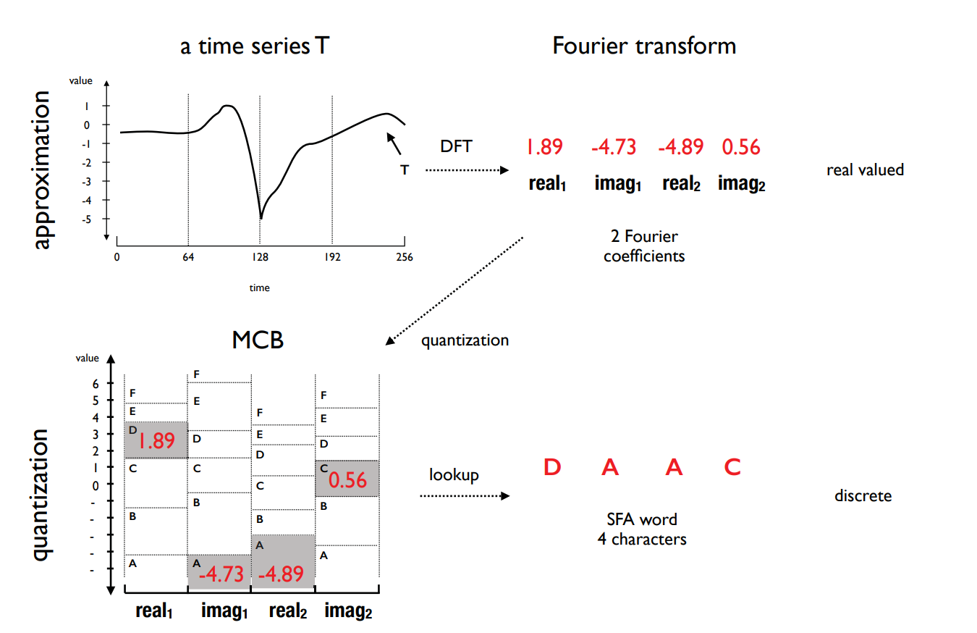
Symbolic Fourier Approximation (SFA)
Summarization
Publications
  Schafer-ICDE‘12
The SFA representation*
*https://www2.informatik.hu-berlin.de/~schaefpa/talks/scalable_classification.pptx
Notes:
The symbolic time series representation Symbolic Fourier Approximation (SFA) represents each real-valued time series by a string. SFA is composed of approximation using the Fourier transform and quantization using a technique called Multiple Coefficient Binning (MCB)

Slide 213
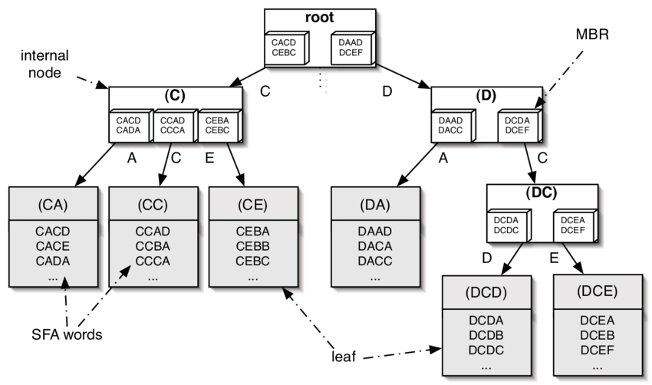
SFA
Indexing
Publications
  Schafer-ICDE‘12
The SFA Trie*
*https://www2.informatik.hu-berlin.de/~schaefpa/talks/scalable_classification.pptx
Notes:
Since symbolic representations are essentially a character string, they can be used with string algorithms and data structures such prefix tries, bag-of-words, Markov models, or string-matching.

Slide 214
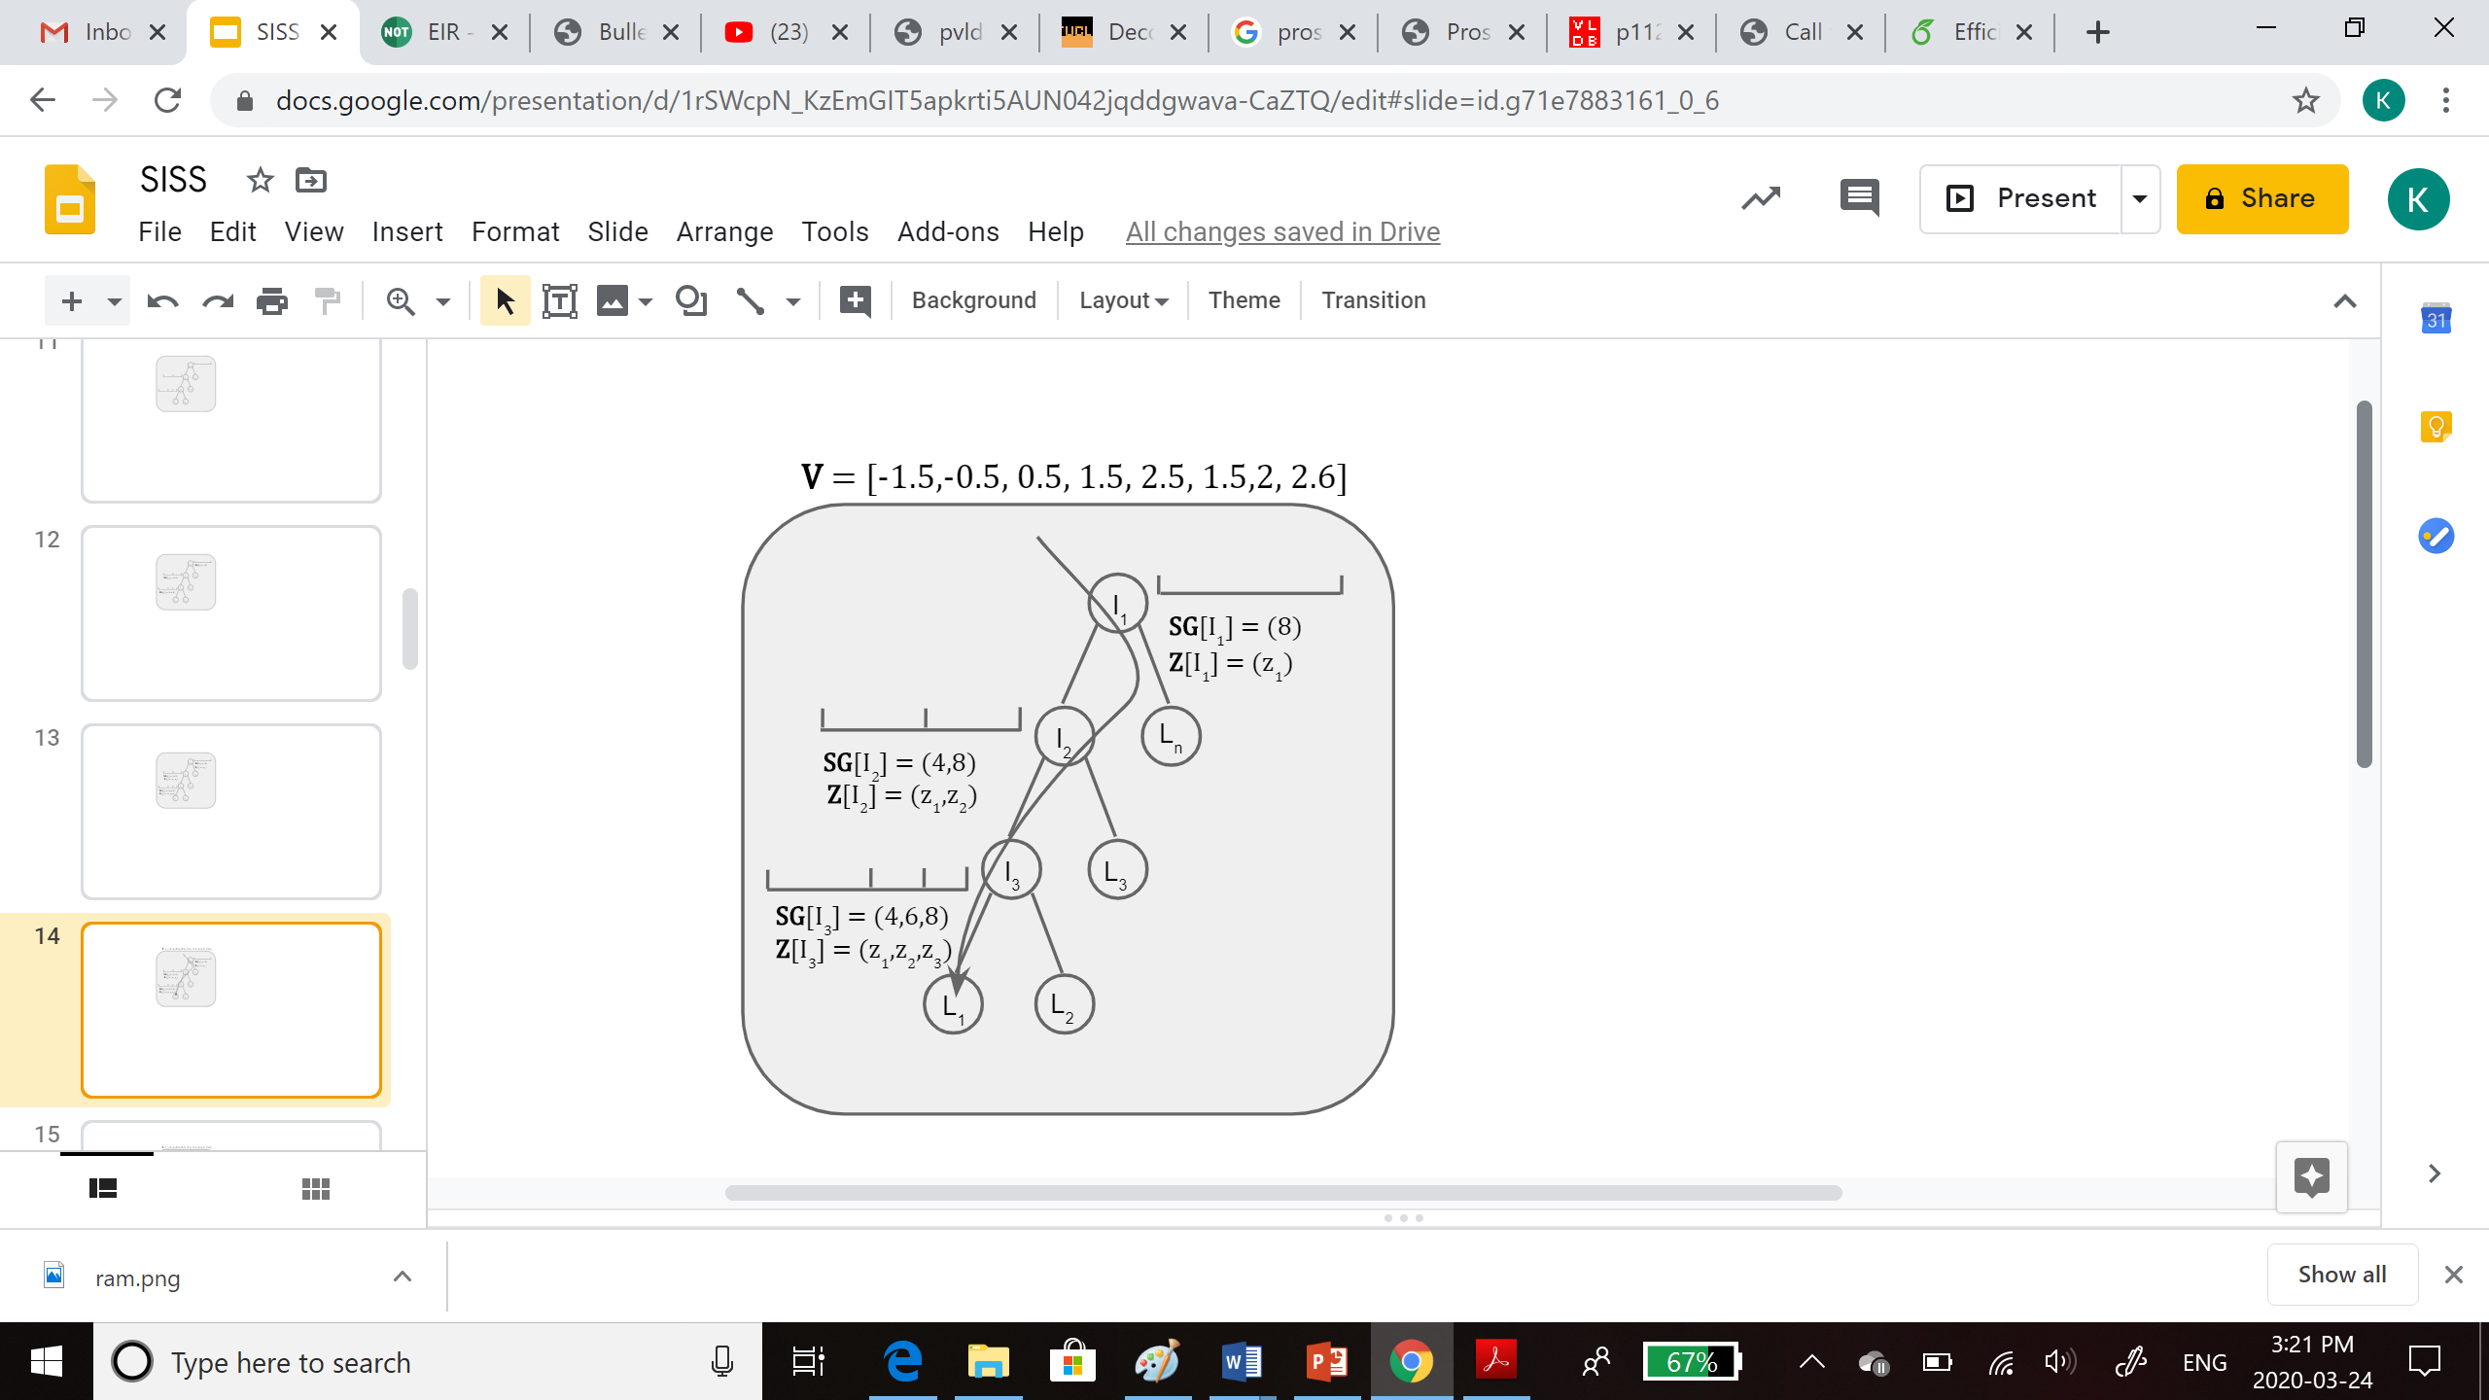
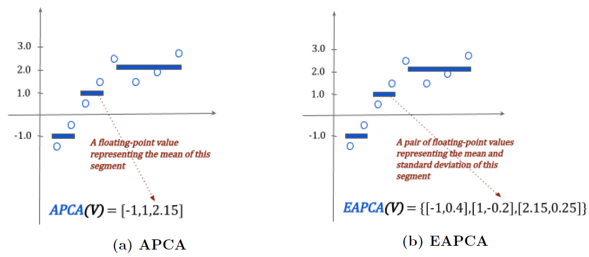
DSTree
Summarization
Publications
  Wang-PVLDB‘13
Intertwined with indexing
The APCA and EAPCA representations

Slide 215
DSTree
Indexing
Publications
  Wang-PVLDB‘13
Each node contains
# vectors
segmentation SG
synopsis Z
Each Leaf node also :
stores its raw
vectors in a separate
disk file

Slide 216
ParSketch
Publications
  Cole et al.
  KDD‘05
  Yagoubi et al.
  DMKD‘18
solution for distributed processing (Spark)
  represents data series using sketches
    using a set of random vectors (Johnson-Lindenstrauss lemma)

Slide 217










ParSketch
Publications
  Cole et al.
  KDD‘05
  Yagoubi et al.
  DMKD‘18
solution for distributed processing (Spark)
  represents data series using sketches
    using a set of random vectors (Johnson-Lindenstrauss lemma)

Slide 218
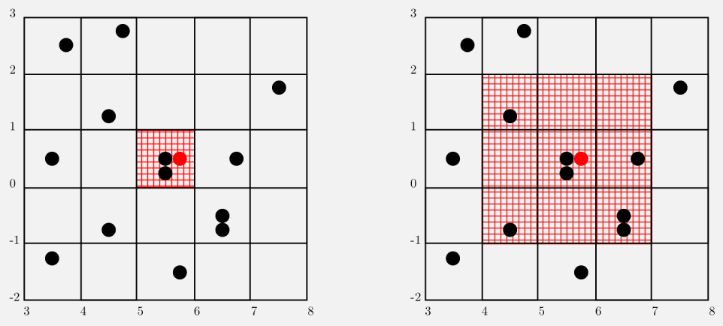
ParSketch
Publications
  Cole et al.
  KDD‘05
  Yagoubi et al.
  DMKD‘18
solution for distributed processing (Spark)
  represents data series using sketches
    using a set of random vectors (Johnson-Lindenstrauss lemma)
  define groups of dimensions in sketches
  store the values of each group in a grid (in parallel)
    each grid is kept by a node
node 1
node 2

Slide 219
ParSketch
Publications
  Cole et al.
  KDD‘05
  Yagoubi et al.
  DMKD‘18
solution for distributed processing (Spark)
  represents data series using sketches
    using a set of random vectors (Johnson-Lindenstrauss lemma)
  define groups of dimensions in sketches
  store the values of each group in a grid (in parallel)
    each grid is kept by a node
  for ng-approximate query answering (originally proposed for ε-range queries)
    find in the grids time series that are close to the query
    finally, check the real similarity of candidates to find the results
  performs well for high-frequency series
node 1
node 2

Slide 220
Publications
  Zhang-ICDE‘19
other techniques, not covered here:
  TARDIS
  KV-Match
  L-Match
  Wu-
  ICDE‘19
  Feng-
  IEEE Access‘20

Slide 221
Publications
  Zhang-ICDE‘19
other techniques, not covered here:
  TARDIS
  KV-Match
  L-Match
for a more complete and detailed presentation, see tutorial:
  Karima Echihabi, Kostas Zoumpatianos, Themis Palpanas. Big Sequence Management: Scaling Up and Out. EDBT 2021
  Wu-
  ICDE‘19
  Feng-
  IEEE Access‘20
  Echihabi-
  EDBT‘21

Slide 222
Questions?

Slide 223
High-d Vector Similarity Search
State-of-the-Art Methods

Slide 224
High-d Vector Similarity Search Methods
Tree-Based Methods
Hash-Based Methods
Quantization-Based Methods
Graph-Based Methods

Slide 225
High-d Vector Similarity Search
State-of-the-Art Methods
Tree-Based Methods

Slide 226
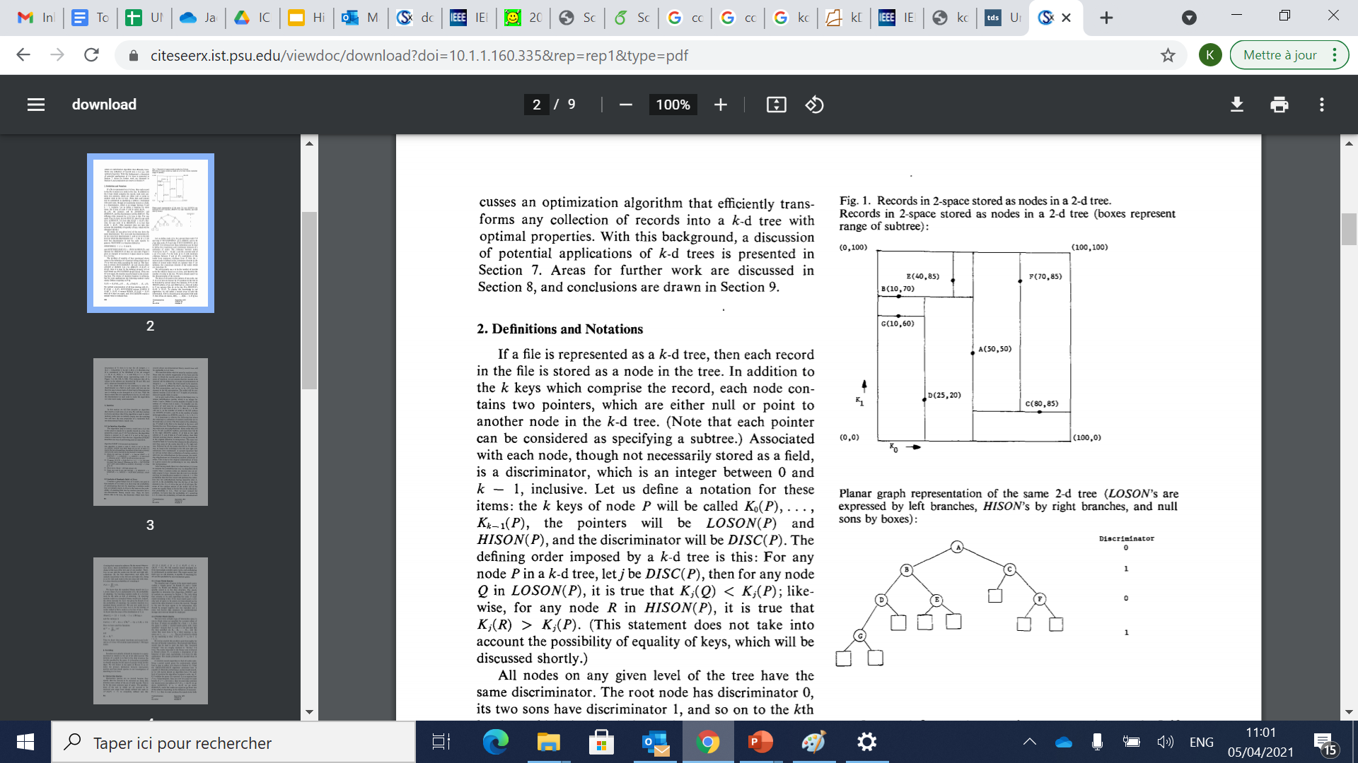
KD-tree
Publications
  Bentley
  CACM’75
Solution for exact kNN search
Notes:
The KD-tree was introduced by Bentley as a generalisation of a binary tree to high dimensions..
The difference is that each level of the tree branches based on a particular dimension associated with that level.
The k-d tree is a partition of the space into hyper-rectangular cells, based on a set of data points (Bentley, 1975).
The root of the tree is a single cell corresponding to the entire space. A coordinate direction is chosen, and the cell is
split at the median of the data along this direction (Figure 1, left). The process is then recursed on the two newly created
cells, and continues until all leaf cells contain at most some predetermined number n0 of points. When there are n data points,
the depth of the tree is at most about log(n/no). Given a k-d tree built from data points S, there are several ways to answer a nearest neighbor query q. The quickest and dirtiest of these is to move q down the tree to its appropriate leaf cell, and then return the nearest neighbor in that cell

Slide 227
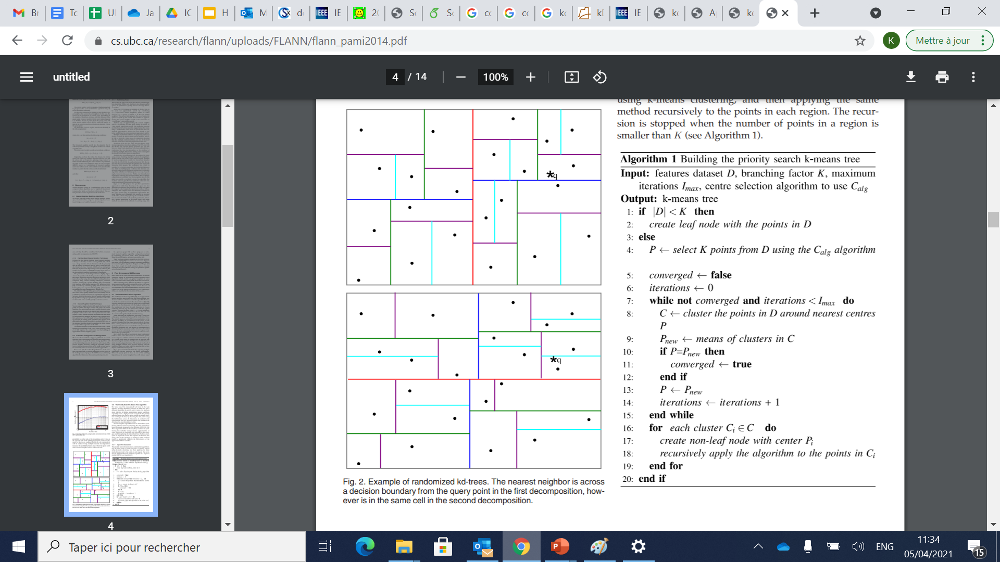
Randomized KD-tree
Publications
  Silpa-Anan
  CVPR’08
Solution for ng-approximate kNN search
  Multiple randomized kd-trees with a small set of dimensions with highest variance
  Concurrent search on the forest of kd-trees
Figure from Muja et al. VISAPP’’09
    Example of randomized kd-trees. The nearest neighbor is across a decision boundary from the query point in the first decomposition, however is in the same cell in the second decomposition.
Notes:
Although KD-trees are relatively effective and efficient in low dimensions, their efficiency diminishes for high dimensional data. Silpa-Anan and Hartley presented the idea of multiple randomized k-d trees. The trees are built in a similar manner to the classic k-d tree, with the difference that where the classic kd-tree algorithm splits data on the dimension with the highest variance, for the randomized k-d trees the split dimension is chosen randomly from the top ND dimensions with the highest variance.
When searching the randomized k-d forest, a single priority queue is maintained across all the randomized trees. The priority queue is ordered by increasing distance to the decision boundary of each branch in the queue, so the search will explore first the closest leaves from all the trees.
Once a data point has been examined (compared to the query point) inside a tree, it is marked in order to not be reexamined in another tree. The degree of approximation is determined by the maximum number of leaves to be visited (across all trees), returning the best nearest neighbor candidates found up to that point

Slide 228

Flann
Publications
  Muja et al.
  VISAPP’09
Solution for ng-approximate kNN search
  Randomized kd-tree
  Hierarchical k-means
    Projections of priority search k-means trees constructed using different branching factors: 4, 32, 128
Notes:
Muja and Lowe proposed a method called hierarchical k-means trees and identified that the latter in addition to the randomized kd-trees discussed earlier are the two best algorithms for KNN querying: randomized k-d trees and hierarchical k-means trees. They also presented an algorithm that selects optimum parameters for the algorithms in terms of speed and accuracy criteria.
They propose the priority search k-means, which compared to the kd-tre variants, uses a different choice for defining how the tree should branch. The trees are constructed by hierarchical clustering, recursively at each level clustering the data points into k disjoint groups. Where the branching factor k determines whether a flat or deep tree is built.
The clustering of the data points is done using the full distance across all dimensions, in contrast to the (randomized) k-d tree algorithm which only partitions the data based on one dimension at a time.

Slide 229
MTree
Publications
  Ciaccia et al.
  VLDB’97
d≡L₂
  Ciaccia et al.
  ICDE’00
C
A B
A
E
B
C D E F
F
D
Solution for exact and δ-ε-approximate kNN search
Each node N of the tree has an associated region, Reg(N), defined as
Reg(N) = {p: p ∈U , d(p,v_{N}) ≤ r_{N}}
where:
  v_{N} (the “center”) is also called a routing object, and
  r_{N} is called the (covering) radius of the region
The set of indexed points p that are reachable from node N are guaranteed to have d(p,v_{N}) ≤ r_{N}
Slide by M. Patella.
Notes:
The Mtree is a solution for similarity search in the metric space. It was first proposed for exact search then extended to support also d-e-approximate search.
It is based on a recursive bottom-up aggregation of objects based on regions. The regions can overlap. Each node can contain up to C entries, but not less than c ≤ 0.5*C. The root makes an exception

Slide 230
MTree
Publications
  Ciaccia et al.
  VLDB’97
  Ciaccia et al.
  ICDE’00
Each node N stores a variable number of entries
Leaf node:
An entry E has the form E=(ObjFeatures,distP,TID), where
  ObjFeatures are the feature values of the indexed object
  distP is the distance between the object and its parent routing object (i.e, the routing object of node N)
Internal node:
E=(RoutingObjFeatures,CoveringRadius,distP,PID), where
  RoutingObjFeatures are the feature values of the routing object
  CoveringRadius is the radius of the region
  distP is the distance between the routing object and its parent routing object (undefined for entries in the root node)
Slides by M. Patella.

Slide 231
Mtree- Fast pruning based on distP
Publications
  Ciaccia et al.
  VLDB’97
Pre-computed distances distP are exploited during query execution to save distance computations
Let v_{P} be the parent (routing) object of v_{N}
When we come to consider the entry of v_{N}, we
  have already computed the distance d(q,v_{P}) between the query and its parent
  know the distance d(v_{P},v_{N})
  Ciaccia et al.
  ICDE’00
From the triangle inequality it is:
d(q,v_{N}) ≥ |d(q,v_{P}) - d(v_{P},v_{N})|
Thus we can prune node N
without computing d(q,v_{N}) if
|d(q,v_{P}) - d(v_{P},v_{N})| > r_{N} + r
v_{P}
d(q,v_{P})
d(v_{P},v_{N})
q
v_{N}
r
r_{N}
Consider a range query {p: d(p,q) ≤ r}

Slide 232

HD-Index
Publications
  Arora et al.
  PVLDB‘18
Solution for ng-approximate kNN search
  Index creation
    Dimensions are partitioned
    For each partition, a space-filling (Hilbert) curve is passed
    Hilbert keys are indexed using a modified B+-tree
    Reference objects are chosen
    Leaves of B+-trees contain distance to reference objects in the
    full-dimensional space
    Modified B+-trees are called Reference Distance B+-trees (RDB-trees)
    Collection of RDB-trees form High-Dimensional Index (HD-Index)
Slide by A. Bhattacharya

Slide 233

HD-Index
Publications
  Arora et al.
  PVLDB‘18
Solution for ng-approximate kNN search
  Query answering
    Query Q partitioned into same subspaces
    For each RDB-tree, initial search retrieves α candidates
      α/2 on each side of the query Hilbert key
    Candidates are refined successively to β and γ candidates using triangular and Ptolemaic inequalities
    Collection of all such candidates form the final candidate set of size κ
    Exact distance computations are done with these κ candidates to return top-k
Slide by A. Bhattacharya

Slide 234
High-d Vector Similarity Search
State-of-the-Art Methods
Hash-Based Methods

Slide 235
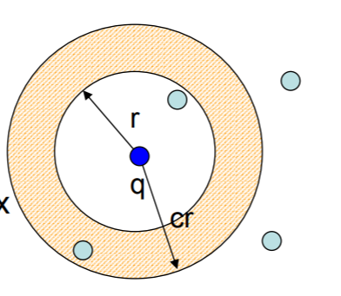
Locality Sensitive Hashing (LSH)
Publications
  Indyk et al.
  STOC’98
Solution for δ-ε-approximate kNN search δ < 1
Random projections into a lower dimensional space using hashing
Probability of collisions increases with locality
c-Approximate r-Near Neighbor: build data structure which, for any query q:
  If there is a point p ∈P, ||p-q|| ≤ r Then return p’ ∈ P, ||p-q|| ≤ c r
c-approximate nearest neighbor reduces to c-approximate near neighbor
  Enumerate all approximate near neighbors
Find a vector in a preprocessed set S ⊆ {0, 1} d that has minimum Hamming distance to a query vector y ∈ {0, 1} d
(r₁, r₂, p₁, p₂)-sensitive [IM98]
Pr[ h(x) = h(y) ] ≥ p₁ , if dist(x, y) ≤ r₁
Pr[ h(x) = h(y) ] ≤ p₂ , if dist(x, y) ≥ r₂
Notes:
The LSH family encompasses a class of randomized algorithms that solve the δ-ǫ-approximate nearest neighbor problem in sub-linear time, for δ < 1. The main intuition is that two points that are nearby in a high dimensional space, will remain nearby when projected to a lower dimensional space.

Slide 236
Locality Sensitive Hashing (LSH)
Publications
  Andoni et al.
  CACM’08
A large family
  Different distance measures:
    Hamming distance
    L_{p} (0 < p ≤ 2): use p-stable distribution to generate the projection vector
    Angular distance (simHash)
    Jaccard distance (minhash)
  Tighter Theoretical Bounds
  Better query efficiency/smaller index size
Notes:
There exist many variants of LSH, either proposing different hash functions to support particular similarity measures [29, 51, 36, 61], or improving the theoretical bounds on query accuracy (i.e., δ or ǫ), query efficiency or the index size [98, 120, 109, 100, 61, 115, 142, 71] [99].

Slide 237
Probabilistic Mapping
d dims
m dims
P
𝜋(O) = [h₁(O), h₂(O), …, h_{m}(O)]
𝜋(P)
Probabilistic, linear mapping from the original space to the projected space
hat about the distances (wrt Q or 𝜋(Q)) in these two spaces?
Slide by W. Wang

Slide 238
Probabilistic Mapping
d dims
m dims
𝜋(Q)
P
𝜋(O) = [h₁(O), h₂(O), …, h_{m}(O)]
ProjDist(P)
Dist(P)
𝜋(P)
Q
Probabilistic, linear mapping from the original space to the projected space
What about the distances (wrt Q or 𝜋(Q)) in these two spaces?
Slide by W. Wang

Slide 239
Probabilistic Distance Tracking Property of the Mapping
d dims
m dims
𝜋(Q)
P
𝜋(O) = [h₁(O), h₂(O), …, h_{m}(O)]
ProjDist(P)
Dist(P)
𝜋(P)
Q
LSH provides a probabilistic distance-preserving mapping between the two spaces
Johnson & Lindenstrauss Lemma [JL84] only works for L2 and induces a method that requires more space than LSH [AIR18]
Slide by W. Wang

Slide 240
Probabilistic Distance Tracking Property of the Mapping
Publications
  Sun et al.
  PVLDB’ 14
d dims
m dims
𝜋(Q)
P
𝜋(O) = [h₁(O), h₂(O), …, h_{m}(O)]
ProjDist(P)
Dist(P)
𝜋(P)
Q
ProjDist(P)² ~ Dist(P)² * χ²_{m}
  ProjDist(P)² can be computed (incrementally) from h_{i}(P) and h_{i}(Q) due to the linearity of the hash function
  Can be generalized to other p-stable LSH functions
Slide by W. Wang
Notes:
this work, we select SRS [142] and QALSH [71] to represent the class of LSH techniques because they are considered the state-of-the-art in terms of footprint and accuracy, respectively.
LSH provides a probabilistic distance-preserving mapping between the two spaces. Sun et al. proposed a technique called SRS which
SRS answers δǫ-approximate queries using an index that is linear in size to the dataset size, while empirically outperforming other LSH methods (with size super-linear to the dataset size

Slide 241
SRS
Publications
  Sun et al.
  PVLDB’ 14
d dims
m dims
𝜋(Q)
P
𝜋(O) = [h₁(O), h₂(O), …, h_{m}(O)]
ProjDist(P)
Dist(P)
𝜋(P)
Q
ProjDist(P)² ~ Dist(P)² * χ²_{m}
Given that ProjDist(P) ≤ r, what can we infer about Dist(P)?
  If Dist(P) ≤ R, then Pr[ ProjDist(P) ≤ r ] ≥ Ψ_{m}( (r/R)² )
  If Dist(P) > cR, then Pr[ ProjDist(P) ≤ r ] ≤ Ψ_{m}( (r/cR)² ) = t
  (some probability) at most O(tn) points with ProjDist ≤ R
  (constant probability) one of the O(tn) points has Dist ≤ R
This solves the so-called (R, c)-NN queries ➔ returns a c² ANN
Using another algorithm & proof ➔ returns a c-ANN
Slide by W. Wang
Notes:
We will describe in more detail, three LSH methods: SRS, QALSH and VHP because they are considered the state-of-the-art in terms of footprint, efficiency or accuracy.
LSH provides a probabilistic distance-preserving mapping between the two spaces. Sun et al. proposed a technique called SRS which exploits a very interesting property: the pair-wise distance in the projected space (called projected distance) over that in the original high-dimensional space follows a known distribution (chi-square).
SRS answers δǫ-approximate queries using an index that is linear in the dataset size, by performing an incremental exact top-k NN search in the projected space.

Slide 242
C2LSH/QALSH
Publications
  Huang et al.
  PVLDB’ 15
  Gan et al.
  SIGMOD’12
d dims
m dims
𝜋(Q)
P
𝜋(O) = [h₁(O), h₂(O), …, h_{m}(O)]
ProjDist(P)
Dist(P)
𝜋(P)
Q
Collision wrt w: if |h_{i}(P) – h_{i}(Q)| ≤ w
Given that P’s #collision ≥ 𝛼m, what can we infer about Dist(P)?
  If Dist(P) ≤ R, then Pr[ #collision ≥ 𝛼m ] ≥ 𝛾₁
  If Dist(P) > cR, then Pr[ #collision ≥ 𝛼m ] ≤ 𝛾₂
  (some probability) at most O(𝛾₂*n) points with #collision ≥ 𝛼m
  (constant probability) one of the O(𝛾₂*n) points has #collision ≥ 𝛼m
Slide by W. Wang
Notes:
While SRS makes inference on the real distance based on the projected distance, QALSH and C2LSH rely on the number of collisions to infer information about the real distances.

Slide 243













Query-oblivious LSH functions
Publications
  Huang et al.
  PVLDB’15
The query-oblivious LSH functions for Euclidean distance:
  $$h_{\vec{a},b}\left(o\right)=\left\lfloor \frac{\vec{a}⋅\vec{o}+b}{w}\right\rfloor$$
$$y$$
Query-Oblivious Bucket Partition:
  Buckets are statically determined before any query arrives;
  Use the origin (i.e., “0”) as anchor;
  If $h_{\vec{a},b}\left(o\right)=h_{\vec{a},b}\left(q\right)$, we say $o$ and $q$ collide under $h_{\vec{a},b}\left(⋅\right)$.
$$o$$
$$\vec{a}$$
random projection
$$w$$
$$w$$
$$\vec{a}⋅\vec{o}+b$$
$$w$$
$$\vec{a}⋅\vec{o}$$
random shift $b$
$$0$$
$$x$$
Slide by Q. Huang
Notes:
QALSH is a query-aware LSH technique that partitions points into buckets using the query as anchor. Other LSH methods typically partition data points before a query arrives, using a random projection followed by a random shift.

Slide 244








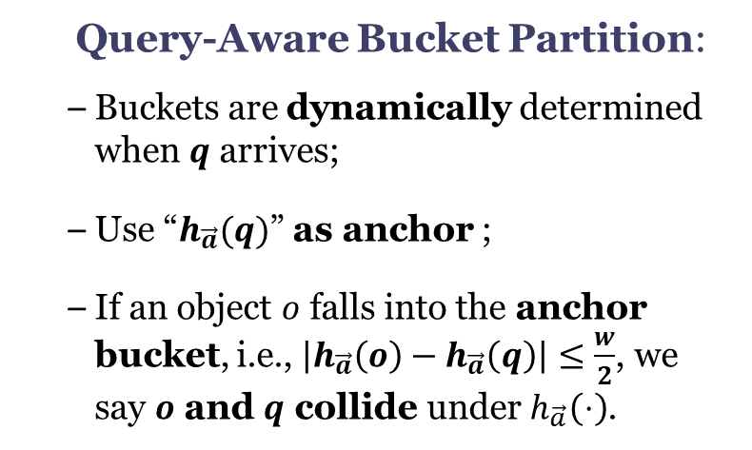

QALSH
Publications
  Huang et al.
  PVLDB’ 15
Query-aware LSH function = random projection + query-aware bucket partition
$$h_{\vec{a}}\left(o\right)=\vec{a}⋅\vec{o}$$
$$y$$
Query-Aware Bucket Partition:
  Buckets are dynamically determined when $q$ arrives;
  Use “$h_{\vec{a}}(q)$” as anchor ;
  If an object $o$ falls into the anchor bucket, i.e., $\left|h_{\vec{a}}\left(o\right)−h_{\vec{a}}\left(q\right)\right|≤\frac{w}{2}$, we say $o$ and $q$ collide under $h_{\vec{a}}\left(⋅\right)$.
$$q$$
random projection
$$\vec{a}$$
$$o_{1}$$
$$w/2$$
$$h_{\vec{a}}(o_{2})$$
$$w/2$$
$$h_{\vec{a}}(q)$$
$$o_{2}$$
$$h_{\vec{a}}(o_{1})$$
$$0$$
$$x$$
Slide by Q. Huang
Notes:
QALSH, does not perform the second step until a query arrives, thus improving the likelihood that points similar to the query are mapped to the same bucket.

Slide 245
VHP
Publications
  Lu et al.
  PVLDB’ 20
Solution for δ-ε-approximate kNN search
  Indexing:
    Store LSH projections with independent
    B+ trees.
  Querying
    Impose a virtual hypersphere in the original high-d space
    Keep enlarging the virtual hypersphere to accommodate more candidate until the success probability is met
Slide by W. Wang
Notes:
Another method by Lu et al. stores LSH projections with independent B+ tree. During querying, it imposes a virtual hypersphere, centered at the query, in the original feature space and only examine points inside the hypersphere. To represent this virtual hypersphere, it uses multiple physical hyperspheres with different radii in corresponding projection subspaces. This results in better efficiency-accuracy tradeoffs.

Slide 246
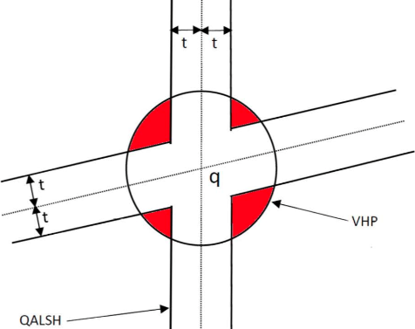
Some Comparisons
Publications
  Huang et al.
  PVLDB’ 15
Candidate Conditions
Method | Collision Count | (Observed) Distance | Max Candidates
SRS | = m | ≤ r | T
QALSH | ≥ 𝛼m | n/a | 𝛽n
VHP | ≥ i (i = 1, 2, …, m) | ≤ l_{i} | 𝛽n
SRS
VHP
Candidate Regions
VHP = SRS ∩ QALSH
Slide by W. Wang
Notes:
Let’s look at a comparison between SRS/QALSH and the VHP.
An illustrative example of the search spaces of virtual sphere partitioning and collision-threshold-based filtering. The dimensionality d of the feature space is 2, the number of hash functions m is 2 and the collision threshold L is set to 1. The search window is of size 2t. The crossroadlike region is the search space of collision-threshold-based filtering, which is irregular and unbounded. Points in this region are estimated to be the NNs by QALSH. In contrast, virtual sphere partitioning imposes a virtual hypersphere in the feature space, which is isotropic and bounded. Points whose distances to q are less than the radius of the hypersphere (in estimation) are regarded as candidates.

Slide 247
High-d Vector Similarity Search
State-of-the-Art Methods
Quantization-Based Methods

Slide 248
VA-file
Publications
A solution for exact kNN search
The basic idea of the VA-file is to speed-up the sequential scan by exploiting a “Vector Approximation”
Each dimension of the data space is partitioned into 2^{bi} intervals using b_{i} bits
  E.g.: the 1st coordinate uses 2 bits, which leads to the intervals 00,01,10, and 11
Thus, each coordinate of a point (vector) requires now b_{i} bits instead of 32
The VA-file stores, for each point of the dataset, its approximation, which is a vector of ∑_{i=1,D} b_{i} bits
  Blott et. al
  VLDB’98
p3
11
10
01
00
 | 00 | 01 | 10 | 11
Feature values
VA-file
p1
p1 | 0.1 0.6
p2 | 0.7 0.4
p3 | 0.9 0.3
p1 | 00 10
p2 | 10 01
p3 | 11 11
Data space
p2
Slides by M. Patella.

Slide 249
VA-file
Publications
Query processing with the VA-file is based on a filter & refine approach
For simplicity, consider a range query
Filter: the VA file is accessed and only the points in the regions that intersect the query region are kept
Refine: the feature vectors are retrieved and an exact check is made
  Blott et. al
  VLDB’98
r
q
actual results
false drops
excluded points
Slides by M. Patella.

Slide 250
VA+file
Publications
  Ferhatosmanoglu
  et al.
  CIKM’00
Solution for exact kNN search
An improvement of the VA-file method:
  Does not assume that neighboring dimensions are uncorrelated
  Decorrelates the data using KLT
  Allocates bits per dimension in a non-uniform fashion
  Partitions each dimension using k-means instead of equi-depth
Notes:
While both methods create a filter file containing quantization-based approximations of the high dimensional data, and share the same exact search algorithm, the VA+file does not assume that neighboring points (dimensions) in the feature vector are uncorrelated. It thus improves the accuracy of the approximations by allocating bits per dimension in a non-uniform fashion, and partitioning each dimension using a k-means (instead of an equi-depth approach).

Slide 251
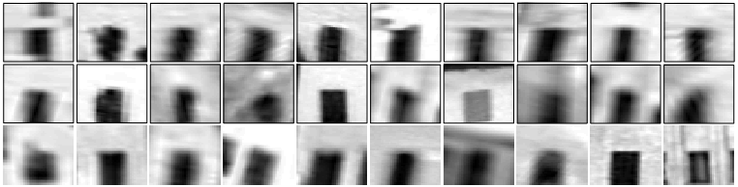


The Inverted Index
Publications
  Sivic et al.
  ICCV’ 03
"Visual word"
Visual codebook
Slide by A. Babenko
Notes:
Quantization is a lossy compression process that maps a set of infinite numbers to a finite set of codewords that together constitute the codebook.
A popular quantization-based technique is the inverted index which splits the feature space into Voronoi regions for a set of K-Means centroids.
The codebook consists of the set of centroids.

Slide 252


Querying the Inverted Index
Publications
Query:
  Sivic et al.
  ICCV’ 03
Have to consider several words for best accuracy
Want to use as big codebook as possible
Want to spend as little time as possible for matching to codebooks
conflict
Slide by A. Babenko
Notes:
During search, only the closest regions are investigated for a particular query. We show two example queries, one in blue and one in red. The lists returned by the inverted index (left) contain 45 and 62 words respectively (circled). Note that when a query lies near a space partition boundary (as happens most often in high dimensions) the resulting list is heavily “skewed” and may not contain many of the nearest neighbors.

Slide 253



Product Quantization
Publications
  Jegou et al.
  TPAMI’ 11
Split vector into correlated subvectors
use separate small codebook for each chunk
Quantization vs. Product quantization:
For a budget of 4 bytes per descriptor:
Can use a single codebook with 1 billion codewords many minutes 128GB
Can use 4 different codebooks with 256 codewords each < 1 millisecond 32KB
IVFADC+ variants (state-of-the-art for billion scale datasets) =
inverted index for indexing + product quantization for reranking
Slide by A. Babenko
Notes:
A scalar quantizer operates on the individual dimensions of a vector independently, whereas a vector quantizer considers the vector as a whole (leveraging the correlation between dimensions [66]). The size k of a codebook increases exponentially with the number of bits allocated for each code. A product quantizer [74] splits the original vector of dimension d into m smaller subvectors, on which a lower-complexity vector quantization is performed. The codebook then consists of the cartesian product of the codebooks of the m subquantizers. Scalar and vector quantization are special cases of product quantization, where m is equal to d and 1, respectively.

Slide 254


The Inverted Multi-Index
Publications
  Babenko et al.
  TPAMI’ 12
Idea: use product quantization
for indexing
Main advantage:
For the same K, much finer subdivision achieved
Main problem:
Very non-uniform entry size distribution
Slide by A. Babenko
Notes:
Later a generalization of the inverted index structure was proposed by Babenko et al. This work introduced the inverted multi-index (IMI) that decomposes the feature space into several orthogonal subspaces and partitions each subspace into Voronoi regions independently. Then the Cartesian product of regions in each subspace forms the implicit partition of the whole feature space. In this example, the space is partitioned into two subspaces, with each subspace having its own codebook.
Due to a huge number of regions, the IMI space partition is very fine-grained, and each region contains only a few data points. Therefore, IMI forms accurate and concise candidate lists while being memory and runtime efficient.

Slide 255
Querying the Inverted Multi-Index
Publications
Input: query
Output: stream of entries
  Babenko et al.
  TPAMI’ 12
Answer to the query:
9
3
4
8
10
1
2
7
5
6
Slide by A. Babenko
Notes:
The Inverted Multi-Index uses a multi-sequence procedure that produces the sequence of regions that are closest to the particular query. By visiting more regions than in the inverted index, the resulting vector sets span the neighborhoods that are much less “skewed”.

Slide 256
High-d Vector Similarity Search
State-of-the-Art Methods
Graph-Based Methods

Slide 257
Conceptual Graphs
Voronoi/Delaunay Diagrams
kNN Graphs
Navigable Small World Graphs
Relative Neighborhood graphs
Notes:
State-of-the art graph-based similarity search algorithms exploit several graph models including the Delaunay graph, kNN graph, NSW graph and RNG graphs.
In the next slides we will describe each in mode detail.

Slide 258


The Delaunay Diagram
Publications
  Delaunay
  CSMN’ 39
Delaunay Diagram – Dual of Voronoi Diagram
The VD is constructed by decomposing the space using a finite number of points, called sites into regions, such that each site is associated to a region consisting of all points closer to it than to any other site.
The DT is the dual of the VD, contructed by connecting sites with an edge if their regions share a side.
Voronoi Diagram
Delaunay Diagram
Notes:
A VD is obtained when a given space is decomposed using a finite number of points, called sites, into regions such that each site is associated with a region consisting of all points that are closer to it than to any other site. The DT is the dual of the VD. It is constructed by connecting sites with an edge if their regions share a side.

Slide 259
kNN Graphs
Publications
  Anastasiu et al.
  CIKM’ 15
  Dong et al.
  WWW’ 11
Exact kNN graphs on n d-dimensional points:
  Each point in the space is considered a node
  A directed edge is added between nodes node A and B (A -=> B) if B is a k-nearest neighbor of A
  O(dn²)
  Example: L2knng
Approximate kNN Graphs:
  LSH
  Heuristics
    Example: NN-Descent: “a neighbor of a neighbor is also likely to be a neighbor”
Notes:
The NN descent graph is initialized by having each point randomly pick K neighbors. Then each point explores its current neighbors’ neighbors and updates its K-NN list if better ones are found. The algorithms stops when no further improvements can be made.

Slide 260

NSW Graphs
Publications
  Kleinberg
  STOC’ 00
Augment approximate kNN graphs with long range links:
  Milgram experiment
  Shorten the greedy algorithm path to log(N)
Notes:
Another popular Graph model is the NSW graph. NSW graphs are networks with logarithmic or polylogarithmic complexity of the greedy graph search. They are typically built on top of approximate kNN graphs adding long range links to shorten the greedy algorithm path down to log(N). The idea is inspired from the Milgram experiment which demonstrated that a social network exhibits the small-world phenomenon if, roughly speaking, any two individuals in the network are likely to be connected through a short sequence of intermediate acquaintances. This is also known as the 6 degrees of separation. Kleinberg (2000) gave formal support to this so-called “small world phenomenon” by using meshes augmented with long-range links chosen randomly according to harmonic distributions.
Backup text: Milgram's basic small-world experiment remains one of the most compelling ways to think about the problem. The goal of the experiment was to find short chains of acquaintances linking pairs of people in the United States who did not know one another. In a typical instance of the experiment, a source person in Nebraska would be given a letter to deliver to a target person in Massachusetts. The source would initially be told basic information about the target, including his address and occupation; the source would then be instructed to send the letter to someone she knew on a first-name basis in an effort to transmit the letter to the target as efficaciously as possible. Anyone subsequently receiving the letter would be given the same instructions, and the chain of communication would continue until the target was reached. Over many trials, the average number of intermediate steps in a successful chain was found to lie between five and six, a quantity that has since entered popular culture as the ``six degrees of separation'' principle

Slide 261

Relative Neighbourhood graph (RNG)
Publications
  Toussaint
  Pat. Recognit.’80
A superset of the minimal spanning tree (MST) and a subset of the Delaunay Diagram.
Two algorithms for obtaining the RNG of n points on the plane:
  An algorithm for 1-d space in 0(n2) time
  Another algorithm for d-dimensional spaces running in 0(n3).
An edge is constructed between two vertices if there is no vertex in the intersection of the two balls
Notes:
Toussaint has shown that the RNG is a special graph that is a superset of the MST and a subset of the DT. He proposed two algorithms for building an RNG. One in n square and the other in n cube, the latter supporting also d-dimensional data. RNGs adopt an interesting edge selection strategy to eliminate the longest edge in all the possible triangles on S. In fact, an edge is constructed between two vertices if there is no vertex in the intersection of the two balls around the vertices

Slide 262

HNSW
Publications
  Malkov et al.
  TPAMI’ 20
  Arxiv’16
In HNSW we split the graph into layers (fewer elements at higher levels)
Search starts for the top layer. Greedy routing at each level and descend to the next layer.
Maximum degree is capped while paths ~ log(N) → log(N) complexity scaling.
Incremental construction
N₂=N/4
N₁=N/2
N₀=N
Slides by Malkov
Notes:
The HNSW exploits RNG and NSW graphs, It splits the NSW graph into hierarchical layers which improves the search efficiency of NSW. Search starts at the top layer, which contains only the longest links, and proceeds down the hierarchy. HNSW is considered the state-of-the-art in ng-approximate search.

Slide 263

Navigating Speading-out Graph (NSG)
Publications
  Fu et al.
  PVLDB’ 19
RNGs do not guarantee monotonic search
  There exists at least one monotonic path. Following this path, the query can be approached with the distance decreasing monotonically
Propose a Monotonic RNG (MRNG)
Build an approximate kNN graph.
Find the Navigating Node. (All search will start with this fixed node – center of the graph ).
For each node p, find a relatively small candidate neighbour set. (sparse)
Select the edges for p according to the definition
of MRNG. (low complexity)
leverage Depth-First-Search tree (connectivity)
Slides by Fu

Slide 264
Questions?

Slide 265
Experimental Comparisons:
Similarity Search Methods

Slide 266
How do similarity search methods compare?
several methods proposed in last 3 decades by different communities
never carefully compared to one another
we now present results of extensive experimental comparison

Slide 267
Experimental Comparisons:
A Taxonomy

Slide 268
Methods
Publications
  Echihabi-PVLDB‘18
  Echihabi-PVLDB‘19
Similarity Search Methods

Slide 269
Methods
Publications
  Echihabi-PVLDB‘18
  Echihabi-PVLDB‘19
Similarity Search Methods
No guarantees
ng-Approximate

Slide 270
Methods
Publications
  Echihabi-PVLDB‘18
  Echihabi-PVLDB‘19
Similarity Search Methods
0 ⩽ δ ⩽ 1, ε ⩾ 0
δ,ε guarantees
No guarantees
δ-ε-Approximate*
ng-Approximate
* result is within distance
(1+ ε) of the exact answer
with probability δ

Slide 271
Methods
Publications
  Echihabi-PVLDB‘18
  Echihabi-PVLDB‘19
Similarity Search Methods
0 ⩽ δ ⩽ 1, ε ⩾ 0
δ,ε guarantees
No guarantees
δ-ε-Approximate*
ng-Approximate
δ < 1, ε guarantee
Probabilistic
* result is within distance
(1+ ε) of the exact answer
with probability δ

Slide 272
Methods
Publications
  Echihabi-PVLDB‘18
  Echihabi-PVLDB‘19
Similarity Search Methods
0 ⩽ δ ⩽ 1, ε ⩾ 0
δ,ε guarantees
No guarantees
δ-ε-Approximate*
ng-Approximate
δ < 1, ε guarantee
δ = 1, ε guarantee
Probabilistic
ε-Approximate
* result is within distance
(1+ ε) of the exact answer
with probability δ

Slide 273
Methods
Publications
  Echihabi-PVLDB‘18
  Echihabi-PVLDB‘19
Similarity Search Methods
0 ⩽ δ ⩽ 1, ε ⩾ 0
δ,ε guarantees
No guarantees
δ-ε-Approximate*
ng-Approximate
δ < 1, ε guarantee
δ = 1, ε guarantee
Probabilistic
ε-Approximate
δ = 1, ε = 0 guarantee
Exact
* result is within distance
(1+ ε) of the exact answer
with probability δ

Slide 274
Methods
Publications
  Echihabi-PVLDB‘18
Techniques for data Series
Techniques for High-D vectors
  Echihabi-PVLDB‘19
Similarity Search Methods
0 ⩽ δ ⩽ 1, ε ⩾ 0
δ,ε guarantees
No guarantees
δ-ε-Approximate*
ng-Approximate
δ < 1, ε guarantee
δ = 1, ε guarantee
Probabilistic
ε-Approximate
δ = 1, ε = 0 guarantee
Exact
ADS+ RTree
DSTree SFA
iSAX2+ Stepwise Mtree UCR-Suite
MASS VA+file
* result is within distance
(1+ ε) of the exact answer
with probability δ

Slide 275
Methods
Publications
  Echihabi-PVLDB‘18
Techniques for data Series
Techniques for High-D vectors
  Echihabi-PVLDB‘19
Similarity Search Methods
0 ⩽ δ ⩽ 1, ε ⩾ 0
δ,ε guarantees
No guarantees
δ-ε-Approximate*
ng-Approximate
δ < 1, ε guarantee
δ = 1, ε guarantee
ADS+ IMI
CK-Means iSAX2+[ ]
DSTree [ ] NSG
Flann SFA
HD-index VA+file[ ]
HNSW
Probabilistic
ε-Approximate
δ = 1, ε = 0 guarantee
Exact
ADS+ RTree
DSTree SFA
iSAX2+ Stepwise Mtree UCR-Suite
MASS VA+file
* result is within distance
(1+ ε) of the exact answer
with probability δ
extensions

Slide 276
Methods
Publications
  Echihabi-PVLDB‘18
Techniques for data Series
Techniques for High-D vectors
  Echihabi-PVLDB‘19
Similarity Search Methods
0 ⩽ δ ⩽ 1, ε ⩾ 0
δ,ε guarantees
No guarantees
δ-ε-Approximate*
ng-Approximate
δ < 1, ε guarantee
δ = 1, ε guarantee
ADS+ IMI
CK-Means iSAX2+[ ]
DSTree [ ] NSG
Flann SFA
HD-index VA+file[ ]
HNSW
Probabilistic
ε-Approximate
δ = 1, ε = 0 guarantee
ADS+[ ]
DSTree[ ]
iSAX2+ [ ]
Mtree
VA+file[ ]
Exact
ADS+ RTree
DSTree SFA
iSAX2+ Stepwise Mtree UCR-Suite
MASS VA+file
* result is within distance
(1+ ε) of the exact answer
with probability δ
extensions

Slide 277
Methods
Publications
  Echihabi-PVLDB‘18
Techniques for data Series
Techniques for High-D vectors
  Echihabi-PVLDB‘19
Similarity Search Methods
0 ⩽ δ ⩽ 1, ε ⩾ 0
δ,ε guarantees
No guarantees
δ-ε-Approximate*
ng-Approximate
δ < 1, ε guarantee
δ = 1, ε guarantee
ADS+ IMI
CK-Means iSAX2+[ ]
DSTree [ ] NSG
Flann SFA
HD-index VA+file[ ]
HNSW
Probabilistic
ε-Approximate
δ = 1, ε = 0 guarantee
ADS+[ ]
DSTree[ ]
iSAX2+ [ ]
Mtree
QALSH
SRS
VA+file[ ]
ADS+[ ]
DSTree[ ]
iSAX2+ [ ]
Mtree
VA+file[ ]
Exact
ADS+ RTree
DSTree SFA
iSAX2+ Stepwise Mtree UCR-Suite
MASS VA+file
* result is within distance
(1+ ε) of the exact answer
with probability δ
extensions

Slide 278
Experimental Comparisons:
Exact Query Answering

Slide 279
Experimental Framework
Publications
  Echihabi-PVLDB‘18
Hardware
  HDD and SSD
Datasets
  Synthetic (25GB to 1TB) and 4 real (100 GB)
Exact Query Workloads
  100 – 10,000 queries
Performance measures
  Time, #disk accesses, footprint, pruning, Tightness of Lower Bound (TLB), etc.
C/C++ methods (4 methods reimplemented from scratch)
Procedure:
  Step 1: Parametrization
  Step 2: Evaluation of individual methods
  Step 3: Comparison of best methods

Slide 280

Time for Indexing (Idx) vs. Dataset Size
RAM=75GB

Slide 281
Time for Indexing (Idx) vs. Dataset Size
RAM=75GB
ADS+ fastest

Slide 282
Time for Indexing (Idx) vs. Dataset Size
RAM=75GB
DSTree slowest
ADS+ fastest

Slide 283
Time for 100 Exact Queries vs. Dataset size
RAM=75GB

Slide 284
Time for 100 Exact Queries vs. Dataset size
RAM=75GB
In-memory:
VA+file fastest

Slide 285
Time for 100 Exact Queries vs. Dataset size
RAM=75GB
disk:
DSTree fastest
In-memory:
VA+file fastest

Slide 286
Time for Idx + 100 Exact Queries vs. Dataset size
RAM=75GB

Slide 287
Time for Idx + 100 Exact Queries vs. Dataset size
RAM=75GB
In-memory:
ADS+ fastest

Slide 288
Time for Idx + 100 Exact Queries vs. Dataset size
RAM=75GB
disk:
VA+file fastest
In-memory:
ADS+ fastest

Slide 289
Time for Idx + 10K Exact Queries vs. Dataset size

Slide 290
Time for Idx + 10K Exact Queries vs. Dataset size
In-memory:
VA+file fastest

Slide 291
Time for Idx + 10K Exact Queries vs. Dataset size
disk:
DSTree fastest
In-memory:
VA+file fastest

Slide 292

Time for Idx + 10K Exact Queries vs. Series Length
(Size = 100GB, Dimensions = 16)

Slide 293
Time for Idx + 10K Exact Queries vs. Series Length
Steady performance for most methods
(Size = 100GB, Dimensions = 16)

Slide 294
Time for Idx + 10K Exact Queries vs. Series Length
Steady performance for most methods
VA+file and ADS+ get faster with increasing length
(Size = 100GB, Dimensions = 16)

Slide 295
Unexpected Results
Publications
  Echihabi-PVLDB‘18
Some methods do not scale as expected (or not at all!)
Brought back to the spotlight two older methods VA+file and DSTree
  New reimplementations outperform by far the original ones
Optimal parameters for some methods are different from the ones reported in the original papers
Tightness of Lower Bound (TLB) does not always predict performance

Slide 296
TLB does not always predict performance
Publications
  Echihabi-PVLDB‘18

Slide 297
TLB does not always predict performance
Publications
  Echihabi-PVLDB‘18
The TLB measures the quality of a summarization (higher is better)

Slide 298

TLB does not always predict performance
Publications
  Echihabi-PVLDB‘18
The TLB measures the quality of a summarization (higher is better)
TLB $=\frac{dist(Query, candidate) in reduced space}{dist(Query, candidate) in original space}$

Slide 299
TLB does not always predict performance
Publications
  Echihabi-PVLDB‘18
The TLB measures the quality of a summarization (higher is better)
0 ≤
TLB $=\frac{dist(Query, candidate) in reduced space}{dist(Query, candidate) in original space}$
≤ 1
worst
best

Slide 300

TLB does not always predict performance
Publications
  Echihabi-PVLDB‘18
The TLB measures the quality of a summarization (higher is better)
0 ≤
TLB $=\frac{dist(Query, candidate) in reduced space}{dist(Query, candidate) in original space}$
≤ 1
worst
best
DSTree and iSAX2+ have similar TLB

Slide 301
TLB does not always predict performance
Publications
  Echihabi-PVLDB‘18
The TLB measures the quality of a summarization (higher is better)
0 ≤
TLB $=\frac{dist(Query, candidate) in reduced space}{dist(Query, candidate) in original space}$
≤ 1
worst
best
DSTree and iSAX2+ have similar TLB
YET
iSAX2+ 5x slower than
DSTree

Slide 302
TLB does not always predict performance
Publications
  Echihabi-PVLDB‘18
The TLB measures the quality of a summarization (higher is better)
0 ≤
TLB $=\frac{dist(Query, candidate) in reduced space}{dist(Query, candidate) in original space}$
≤ 1
worst
best
DSTree and iSAX2+ have similar TLB
YET
iSAX2+ 5x slower than
DSTree
No bias, same data and same implementation framework

Slide 303

Insights
Publications
  Echihabi-PVLDB‘18
Results are sensitive to:
  Parameter tuning
  Hardware setup
  Implementation
  Workload selection
Results identify methods that would benefit from modern hardware
Notes:
Hydra1: 8:30 mins

Slide 304


Publications
  Echihabi-PVLDB‘18
Recommendations
Scenario: Indexing and answering 10K exact queries on HDD
Notes:
Hydra1: 8:30 mins

Slide 305
Experimental Comparisons:
Approximate Query Answering

Slide 306
Experimental Framework
Publications
  Echihabi-PVLDB‘19
Datasets
  In-memory and disk-based datasets
  Synthetic data modeling financial time series
  Four real datasets from deep learning, computer vision, seismology, and neuroscience (25GB-250GB)
Query Workloads
  100 – 10,000 kNN queries k in [1,100]
  ng-approximate and δ-ε-approximate queries (exact queries used as yardstick)
C/C++ methods (3 methods reimplemented from scratch)
Performance measures
  Efficiency: time, throughput, #disk accesses, % of data accessed
  Accuracy: average recall, mean average precision, mean relative error
Procedure:
  Step 1: Parametrization
  Step 2: Evaluation of indexing/query answering scalability in-memory
  Step 3: Evaluation of indexing/query answering scalability on-disk
  Step 4: Additional experiments with best-performing methods on disk

Slide 307

Approximate Methods Covered in Study

Slide 308
Approximate Methods Covered in Study

Slide 309
Approximate Methods Covered in Study

Slide 310
Approximate Methods Covered in Study
Our extensions

Slide 311
Approximate Methods Covered in Study
Our extensions

Slide 312

Unexpected Results
New data series extensions are the overall winners even for general high-d vectors
  perform the best for approximate queries with probabilistic guarantees (δ-ε-approximate search), in-memory and on-disk
  perform the best for long vectors, in-memory and on-disk
  perform the best for disk-resident vectors
  are fastest at indexing and have the lowest footprint
Notes:
When do we talk about extensions??

Slide 313

Unexpected Results
New data series extensions are the overall winners even for general high-d vectors
  perform the best for approximate queries with probabilistic guarantees (δ-ε-approximate search), in-memory and on-disk
  perform the best for long vectors, in-memory and on-disk
  perform the best for disk-resident vectors
  are fastest at indexing and have the lowest footprint
best
Time
Accuracy

Slide 314
Unexpected Results
New data series extensions are the overall winners even for general high-d vectors
  perform the best for approximate queries with probabilistic guarantees (δ-ε-approximate search), in-memory and on-disk
  perform the best for long vectors, in-memory and on-disk
  perform the best for disk-resident vectors
  are fastest at indexing and have the lowest footprint
DSTree
iSAX2+

Slide 315


Unexpected Results
New data series extensions are the overall winners even for general high-d vectors
  perform the best for approximate queries with probabilistic guarantees (δ-ε-approximate search), in-memory and on-disk
  perform the best for long vectors, in-memory and on-disk
  perform the best for disk-resident vectors
  are fastest at indexing and have the lowest footprint
DSTree
iSAX2+
DSTree
iSAX2+
DSTree
iSAX2+

Slide 316

Unexpected Results
Our new extensions are the overall winners even for general high-d vectors
  perform the best for approximate queries with probabilistic guarantees (δ-ε-approximate search), in-memory and on-disk
  perform the best for long vectors, in-memory and on-disk
  perform the best for disk-resident vectors
  are fastest at indexing and have the lowest footprint

Slide 317
Unexpected Results
Our new extensions are the overall winners even for general high-d vectors
  perform the best for approximate queries with probabilistic guarantees (δ-ε-approximate search), in-memory and on-disk
  perform the best for long vectors, in-memory and on-disk
  perform the best for disk-resident vectors
  are fastest at indexing and have the lowest footprint
DSTree
iSAX2+
DSTree
iSAX2+
VA+file

Slide 318

Unexpected Results
Our new extensions are the overall winners even for general high-d vectors
  perform the best for approximate queries with probabilistic guarantees (δ-ε-approximate search), in-memory and on-disk
  perform the best for long vectors, in-memory and on-disk
  perform the best for disk-resident vectors
  are fastest at indexing and have the lowest footprint
DSTree
iSAX2+

Slide 319

Unexpected Results
New data series extensions are the overall winners even for general high-d vectors
  perform the best for approximate queries with probabilistic guarantees (δ-ε-approximate search), in-memory and on-disk
  perform the best for long vectors, in-memory and on-disk
  perform the best for disk-resident vectors
  are fastest at indexing and have the lowest footprint
iSAX2+
VA+file

Slide 320
Insights
Exciting research direction for approximate similarity search in high-d spaces:
  Currently two main groups of solutions exist:
  We show that it is possible to have efficient approximate algorithms with guarantees

Slide 321
Insights
Exciting research direction for approximate similarity search in high-d spaces:
  Currently two main groups of solutions exist:
  We show that it is possible to have efficient approximate algorithms with guarantees
approximate search solutions without guarantees relatively efficient | approximate search solutions with guarantees relatively slow

Slide 322
Insights
Exciting research direction for approximate similarity search in high-d spaces:
  Currently two main groups of solutions exist:
  We show that it is possible to have efficient approximate algorithms with guarantees
approximate search solutions without guarantees relatively efficient | approximate search solutions with guarantees relatively slow

Slide 323
Insights
Exciting research direction for approximate similarity search in high-d spaces:
  Currently two main groups of solutions exist:
  We show that it is possible to have efficient approximate algorithms with guarantees
approximate search solutions without guarantees relatively efficient | approximate search solutions with guarantees relatively slow

Slide 324
Insights
Approximate state-of-the-art techniques for high-d vectors are not practical:

Slide 325
Insights
Approximate state-of-the-art techniques for high-d vectors are not practical:
  LSH-based techniques
  slow, high-footprint, low accuracy (recall/MAP)

Slide 326
Insights
Approximate state-of-the-art techniques for high-d vectors are not practical:
  LSH-based techniques
  slow, high-footprint, low accuracy (recall/MAP)
  kNNG-based techniques
  slow indexing, difficult to tune, in-memory, no guarantees

Slide 327
Insights
Approximate state-of-the-art techniques for high-d vectors are not practical:
  LSH-based techniques
  slow, high-footprint, low accuracy (recall/MAP)
  kNNG-based techniques
  slow indexing, difficult to tune, in-memory, no guarantees
  Quantization-based techniques
  slow indexing, difficult to tune, no guarantees

Slide 328
Insights
Approximate state-of-the-art techniques for high-d vectors are not practical:
  LSH-based techniques
  slow, high-footprint, low accuracy (recall/MAP)
  kNNG-based techniques
  slow indexing, difficult to tune, in-memory, no guarantees
  Quantization-based techniques
  slow indexing, difficult to tune, no guarantees
All suffer a serious limitation: accuracy determined during index-building & query answering

Slide 329

Recommendations for approx. techniques
Data series approaches
are the overall winners!
The only exception is HNSW for in-memory
ng-approximate queries using an existing index

Slide 330

Recommendations
Scenario: Answering a query workload using an existing index
Notes:
Hydra2: 8:30 mins

Slide 331
Summary
Similarity search on data series/high-d vectors is an important problem
We conducted the first experimental comparison of both data series and high-d vector methods
  Demonstrated that data series methods dominate traditional high-d vector methods
  Described new methods that support approximate similarity search with guarantees
Methods and observations are applicable to high-d vectors in general!

Slide 332
Questions?

Slide 333
High-d Similarity Search: Challenges and Open Problems

Slide 334
Challenges and Open Problems
we are still far from having solved the problem
several challenges remain in terms of
  usability, ease of use
  scalability, distribution
  benchmarking
these challenges derive from modern data science applications

Slide 335
Challenges and Open Problems
Outline
benchmarking
interactive analytics
parallelization and distribution
deep learning

Slide 336





Massive High-d Data Collections
Publications
  Palpanas-SIGREC’19
NASA’s Solar Observatory
1.5 TB per day
Large Synoptic Survey Telescope (2019)
~30 TB per night
Human Genome project
130 TB
passenger aircrafts
20 TB per hour
data center and
services monitoring
2B data series
4M points/sec
Notes:
http://spacemath.gsfc.nasa.gov/news/6Page137.pdfhttp
://www.spacepolicyonline.com/images/stories/PSDS%20PB2%20Ivezik.pdf
AND THIS IS NOT ONLY IN NEUROSCIENCE

Slide 337
Challenges and Open Problems
Outline
benchmarking
interactive analytics
parallelization and distribution
deep learning

Slide 338

Previous Studies
evaluate performance of indexing methods using random queries
  chosen from the data (with/without noise)

Slide 339
Previous Studies
With or without noise
noise

Slide 340





Problem with
Random Queries
No control on their characteristics
We cannot properly evaluate summarizations and indexes
We need queries that cover the entire range
from easy to hard

Slide 341
Previous Workloads
Publications
  ZoumbatianosKDD ‘15
  ZoumbatianosTKDE ‘18
Most previous workloads are skewed to easy queries
64
256
1024
DNA

Slide 342
Previous Workloads
Publications
  ZoumbatianosKDD ‘15
  ZoumbatianosTKDE ‘18
Most previous workloads are skewed to easy queries
64
256
1024
DNA
EEG
Randomwalk

Slide 343





Benchmark Workloads
Publications
  ZoumbatianosKDD ‘15
  ZoumbatianosTKDE ‘18
If all queries are easy
all indexes look good
If all queries are hard
all indexes look bad
need methods for generating queries of varying hardness

Slide 344
Characterizing Queries
Publications
  ZoumbatianosKDD ‘15
  ZoumbatianosTKDE ‘18
Real Distance from query
P₄
MINDIST
query
Approximating distances using Lower Bounding functions on summarizations.
MINDIST
Lower Bound Distance from query

Slide 345
Publications
Densification Method:
Equi-densification
  ZoumbatianosKDD ‘15
  ZoumbatianosTKDE ‘18
New points
Original points
Distribute points such that:
The worse a summarization
the more data it checks
Equal number of points in every “zone”
MINDIST
Q₁

Slide 346
Experiments
Densification Methods
Publications
  ZoumbatianosKDD ‘15
  ZoumbatianosTKDE ‘18
Using all datasets of size 256 (100 queries for each dens. method), we measured the:
1-TLB: Summarization Error (0: perfect bound, 1: worst possible bound)
Minimum Effort for a set of summarizations using 8 – 64 bytes.
Normalized over SAX-64

Slide 347
Experiments
Densification Methods
Publications
  ZoumbatianosKDD ‘15
  ZoumbatianosTKDE ‘18
For equi-densification
normalized Effort is closer to the normalized Summarization Error
The worse a summarization the bigger effort it does

Slide 348



Summary
Publications
  ZoumbatianosKDD ‘15
  ZoumbatianosTKDE ‘18
Pros:
Theoretical background
Methodology for characterizing
NN queries for data series indexes
Nearest neighbor query workload generator
Designed to stress-test data series indexes
at varying levels of difficulty
Cons:
Time complexity
Need new approach to scale to very large datasets

Slide 349
Challenges and Open Problems
Outline
benchmarking
interactive analytics
parallelization and distribution
deep learning

Slide 350
Interactive Analytics?
analytics over high-d data is computationally expensive
  very high inherent complexity
may not always be possible to remove delays
  but could try to hide them!

Slide 351
Need for
Interactive Analytics
Publications
  Gogolou-BigVis‘19
interaction with users offers new opportunities
  progressive answers
    produce intermediate results
      iteratively converge to final, correct solution

Slide 352

Need for
Interactive Analytics
Publications
  Gogolou-BigVis‘19
interaction with users offers new opportunities
  progressive answers
    produce intermediate results
      iteratively converge to final, correct solution

Slide 353
Need for
Interactive Analytics
Publications
  Gogolou-BigVis‘19
interaction with users offers new opportunities
  progressive answers
    produce intermediate results
      iteratively converge to final, correct solution

Slide 354


Need for
Interactive Analytics
Publications
  Gogolou-BigVis‘19
interaction with users offers new opportunities
  progressive answers
    produce intermediate results
      iteratively converge to final, correct solution

Slide 355

Need for
Interactive Analytics
Publications
  Gogolou-BigVis‘19
  Gogolou-SIGMOD‘20
interaction with users offers new opportunities
  progressive answers
    produce intermediate results
      iteratively converge to final, correct solution
    provide bounds on the errors (of the intermediate results) along the way

Slide 356
Need for
Interactive Analytics
Publications
  Gogolou-BigVis‘19
  Gogolou-SIGMOD‘20
interaction with users offers new opportunities
  progressive answers
    produce intermediate results
      iteratively converge to final, correct solution
    provide bounds on the errors (of the intermediate results) along the way

Slide 357
Need for
Interactive Analytics
Publications
  Gogolou-BigVis‘19
  Gogolou-SIGMOD‘20
interaction with users offers new opportunities
  progressive answers
    produce intermediate results
      iteratively converge to final, correct solution
    provide bounds on the errors (of the intermediate results) along the way

Slide 358
Need for
Interactive Analytics
Publications
  Gogolou-BigVis‘19
  Gogolou-SIGMOD‘20
interaction with users offers new opportunities
  progressive answers
    produce intermediate results
      iteratively converge to final, correct solution
    provide bounds on the errors (of the intermediate results) along the way

Slide 359
Need for
Interactive Analytics
Publications
  Gogolou-BigVis‘19
  Gogolou-SIGMOD‘20
interaction with users offers new opportunities
  progressive answers
    produce intermediate results
      iteratively converge to final, correct solution
    provide bounds on the errors (of the intermediate results) along the way

Slide 360
Need for
Interactive Analytics
Publications
  Gogolou-BigVis‘19
  Gogolou-SIGMOD‘20
interaction with users offers new opportunities
  progressive answers
    produce intermediate results
      iteratively converge to final, correct solution
    provide bounds on the errors (of the intermediate results) along the way

Slide 361
Need for
Interactive Analytics
interaction with users offers new opportunities
  progressive answers
    produce intermediate results
      iteratively converge to final, correct solution
    provide bounds on the errors (of the intermediate results) along the way

Slide 362
Need for
Interactive Analytics
Publications
  Gogolou-Vis‘18
interaction with users offers new opportunities
  progressive answers
    produce intermediate results
      iteratively converge to final, correct solution
    provide bounds on the errors (of the intermediate results) along the way
several exciting research problems in intersection of visualization and data management
  frontend: HCI/visualizations for querying/results display
  backend: efficiently supporting these operations

Slide 363
Challenges and Open Problems
Outline
benchmarking
interactive analytics
parallelization and distribution
deep learning

Slide 364
Need for
Parallelization/Distribution
Publications
  Palpanas-HPCS’17
take advantage of all modern hardware opportunities!
  Single Instruction Multiple Data (SIMD)
    natural for data series operations
  multi-tier CPU caches
    design data structures aligned to cache lines
  multi-core and multi-socket architectures
    use parallelism inside each computation server
  Graphics Processing Units (GPUs)
    propose massively parallel techniques for GPUs
  new storage solutions: NVRAMs, FPGAs
    develop algorithms that take these new characteristics/tradeoffs into account
  compute clusters
    distribute operation over many machines

Slide 365
Need for
Parallelization/Distribution
Publications
  Palpanas-HPCS’17
further scale-up and scale-out possible!
  techniques inherently parallelizable
    across cores, across machines
need to
  propose methods for concurrent query answering
  combine multi-core and distributed methods
  examine FPGA and NVM technologies
more involved solutions required when optimizing for energy
  reducing execution time is relatively easy
  minimizing total work (energy) is more challenging

Slide 366
Challenges and Open Problems
Outline
benchmarking
interactive analytics
parallelization and distribution
deep learning

Slide 367
Connections to Deep Learning
data series indexing for deep embeddings

Slide 368
Connections to Deep Learning
data series indexing for deep embeddings
sequences
text
images
video
graphs
...

Slide 369
Connections to Deep Learning
data series indexing for deep embeddings
sequences
text
images
video
graphs
...

Slide 370
Connections to Deep Learning
data series indexing for deep embeddings
sequences
text
images
video
graphs
...
deep embeddings
high-d vectors learned using a DNN

Slide 371
Connections to Deep Learning
data series indexing for deep embeddings
  deep embeddings are high-d vectors
  data series techniques provide effective/scalable similarity search

Slide 372
Connections to Deep Learning
data series indexing for deep embeddings
  deep embeddings are high-d vectors
  data series techniques provide effective/scalable similarity search
deep learning for summarizing for high-d vectors
  Different summarization for different high-d data types
  eg, autoencoders can learn efficient data series summaries

Slide 373
Connections to Deep Learning
data series indexing for deep embeddings
  deep embeddings are high-d vectors
  data series techniques provide effective/scalable similarity search
deep learning for summarizing for high-d vectors
  Different summarization for different high-d data types
  eg, autoencoders can learn efficient data series summaries
deep learning for designing index data structures
  learn an index for similarity search

Slide 374
Connections to Deep Learning
data series indexing for deep embeddings
  deep embeddings are high-d vectors
  data series techniques provide effective/scalable similarity search
deep learning for summarizing for high-d vectors
  Different summarization for different high-d data types
  eg, autoencoders can learn efficient data series summaries
deep learning for designing index data structures
  learn an index for similarity search
deep learning for query optimization
  search space is vast
  learn optimization function

Slide 375
Overall Conclusions
High-d data is a very common data type
  across several different domains and applications

Slide 376
Overall Conclusions
High-d data is a very common data type
  across several different domains and applications
Complex analytics on high-d data are challenging
  have very high complexity
  efficiency comes from data series management/indexing techniques

Slide 377
Overall Conclusions
High-d data is a very common data type
  across several different domains and applications
Complex analytics on high-d data are challenging
  have very high complexity
  efficiency comes from data series management/indexing techniques
Several exciting research opportunities
Notes:
Challenges and open problems: 10 mins

Slide 378
thank you!
google: Karima Echihabi
Kostas Zoumpatianos
Themis Palpanas
visit: http://nestordb.com

Slide 379
References (chronological order)
Delaunay, Boris (1934). "Sur la sphère vide". Bulletin de l'Académie des Sciences de l'URSS, Classe des Sciences Mathématiques et Naturelles. 6: 793–800.
Ramer, U. (1972). An iterative procedure for the polygonal approximation of planar curves. Computer Graphics and Image Processing. 1: pp. 244-256.
Douglas, D. H. & Peucker, T. K.(1973). Algorithms for the Reduction of the Number of Points Required to Represent a Digitized Line or Its Caricature. Canadian Cartographer, Vol. 10, No. 2, December. pp. 112-122.
Duda, R. O. and Hart, P. E. 1973. Pattern Classification and Scene Analysis. Wiley, New York.
Jon Louis Bentley. 1975. Multidimensional binary search trees used for associative searching. Commun. ACM 18, 9 (Sept. 1975), 509–517.
Pavlidis, T. (1976). Waveform segmentation through functional approximation. IEEE Transactions on Computers.
Godfried T. Toussaint, The relative neighbourhood graph of a finite planar set, Pattern Recognition, Volume 12, Issue 4, 1980, Pages 261-268,
Ishijima, M., et al. (1983). Scan-Along Polygonal Approximation for Data Compression of Electrocardiograms. IEEE Transactions on Biomedical Engineering. BME-30(11):723-729.
N. Beckmann, H.-P. Kriegel, R. Schneider, and B. Seeger. The R*-tree: an efficient and robust access method for points and rectangles. In SIGMOD, pages 322–331, 1990.
C. Faloutsos, M. Ranganathan, & Y. Manolopoulos. Fast Subsequence Matching in Time-Series Databases. In Proc. ACM SIGMOD Int'l Conf. on Management of Data, pp 419–429, 1994.
McKee, J.J., Evans, N.E., & Owens, F.J. (1994). Efficient implementation of the Fan/SAPA-2 algorithm using fixed point arithmetic. Automedica. Vol. 16, pp 109-117.
Koski, A., Juhola, M. & Meriste, M. (1995). Syntactic Recognition of ECG Signals By Attributed Finite Automata. Pattern Recognition, 28 (12), pp. 1927-1940.
Seshadri P., Livny M. & Ramakrishnan R. (1995): SEQ: A Model for Sequence Databases. ICDE 1995: 232-239
Shatkay, H. (1995). Approximate Queries and Representations for Large Data Sequences. Technical Report cs-95-03, Department of Computer Science, Brown University.
Shatkay, H., & Zdonik, S. (1996). Approximate queries and representations for large data sequences. Proceedings of the 12th IEEE International Conference on Data Engineering. pp 546-553.
Vullings, H.J.L.M., Verhaegen, M.H.G. & Verbruggen H.B. (1997). ECG Segmentation Using Time-Warping. Proceedings of the 2nd International Symposium on Intelligent Data Analysis.

Slide 380
References (chronological order)
Keogh, E., & Smyth, P. (1997). A probabilistic approach to fast pattern matching in time series databases. Proceedings of the 3rd International Conference of Knowledge Discovery and Data Mining. pp 24-20.
P. Ciaccia, M. Patella, and P. Zezula. M-tree: An Efficient Access Method for Similarity Search in Metric Spaces. Proceedings of VLDB’97, pp 426–435.
Heckbert, P. S. & Garland, M. (1997). Survey of polygonal surface simplification algorithms, Multiresolution Surface Modeling Course. Proceedings of the 24th International Conference on Computer Graphics and Interactive Techniques.
Piotr Indyk, Rajeev Motwani. Approximate Nearest Neighbors: Towards Removing the Curse of Dimensionality. STOC 1998.
Qu, Y., Wang, C. & Wang, S. (1998). Supporting fast search in time series for movement patterns in multiples scales. Proceedings of the 7th International Conference on Information and Knowledge Management.
Keogh, E., & Pazzani, M. (1998). An enhanced representation of time series which allows fast and accurate classification, clustering and relevance feedback. Proceedings of the 4th International Conference of Knowledge Discovery and Data Mining. pp 239-241, AAAI Press.
Hunter, J. & McIntosh, N. (1999). Knowledge-based event detection in complex time series data. Artificial Intelligence in Medicine. pp. 271-280. Springer.
K. S. Beyer, J. Goldstein, R. Ramakrishnan, and U. Shaft. When is “‘nearest neighbor’” meaningful? In ICDT, 1999.
Keogh, E. & Pazzani, M. (1999). Relevance feedback retrieval of time series data. Proceedings of the 22th Annual International ACM-SIGIR Conference on Research and Development in Information Retrieval.
P. Ciaccia and M. Patella. PAC Nearest Neighbor Queries: Approximate and Controlled Search in HighDimensional and Metric Spaces. In ICDE, pages 244– 255, 2000.
H. Ferhatosmanoglu, E. Tuncel, D. Agrawal, and A. El Abbadi. Vector Approximation Based Indexing for Non-uniform High Dimensional Data Sets. In CIKM, pp 202–209, 2000.
J. Kleinberg. The Small-world Phenomenon: An Algorithmic Perspective. In Proceedings of the Thirty- second Annual ACM Symposium on Theory of Computing, STOC ’00, pages 163–170, New York, NY, USA, 2000. ACM

Slide 381
References (chronological order)
Lavrenko, V., Schmill, M., Lawrie, D., Ogilvie, P., Jensen, D., & Allan, J. (2000). Mining of Concurent Text and Time Series. Proceedings of the 6th International Conference on Knowledge Discovery and Data Mining. pp. 37-44.
Wang, C. & Wang, S. (2000). Supporting content-based searches on time Series via approximation. Proceedings of the 12th International Conference on Scientific and Statistical Database Management.
Keogh, E., Chu, S., Hart, D. & Pazzani, M. (2001). An Online Algorithm for Segmenting Time Series. In Proceedings of IEEE International Conference on Data Mining. pp 289-296.
C. C. Aggarwal, A. Hinneburg, and D. A. Keim. On the surprising behavior of distance metrics in high dimensional spaces. In ICDT, 2001
Ge, X. & Smyth P. (2001). Segmental Semi-Markov Models for Endpoint Detection in Plasma Etching. To appear in IEEE Transactions on Semiconductor Engineering.
Eamonn J. Keogh, Shruti Kasetty: On the Need for Time Series Data Mining Benchmarks: A Survey and Empirical Demonstration. Data Min. Knowl. Discov. 7(4): 349-371 (2003)
Sivic and Zisserman, "Video Google: a text retrieval approach to object matching in videos," Proceedings Ninth IEEE International Conference on Computer Vision, Nice, France, 2003, pp. 1470-1477 vol.2
T. Palpanas, M. Vlachos, E. Keogh, D. Gunopulos, W. Truppel (2004). Online Amnesic Approximation of Streaming Time Series. In ICDE . Boston, MA, USA, March 2004.
E. Keogh. Tutorial on Data Mining and Machine Learning in Time Series Databases. KDD 2004.
Richard Cole, Dennis E. Shasha, Xiaojian Zhao: Fast window correlations over uncooperative time series. KDD 2005: 743-749
Jessica Lin, Eamonn J. Keogh, Li Wei, Stefano Lonardi: Experiencing SAX: a novel symbolic representation of time series. Data Min. Knowl. Discov. 15(2): 107-144 (2007)
Jin Shieh, Eamonn J. Keogh: iSAX: indexing and mining terabyte sized time series. KDD 2008: 623-631
Themis Palpanas, Michail Vlachos, Eamonn J. Keogh, Dimitrios Gunopulos: Streaming Time Series Summarization Using User-Defined Amnesic Functions. IEEE Trans. Knowl. Data Eng. 20(7): 992-1006 (2008)
Hui Ding, Goce Trajcevski, Peter Scheuermann, Xiaoyue Wang, Eamonn J. Keogh: Querying and mining of time series data: experimental comparison of representations and distance measures. Proc. VLDB Endow. 1(2): 1542-1552 (2008)
Stephen Blott and Roger Weber. 2008. What's wrong with high-dimensional similarity search? Proc. VLDB Endow. 1, 1 (August 2008), 3.

Slide 382
References (chronological order)
C. Silpa-Anan and R. Hartley, "Optimised KD-trees for fast image descriptor matching," 2008 IEEE Conference on Computer Vision and Pattern Recognition, Anchorage, AK, USA, 2008, pp. 1-8
Alexandr Andoni and Piotr Indyk. 2008. Near-optimal hashing algorithms for approximate nearest neighbor in high dimensions. Commun. ACM 51, 1 (January 2008), 117–122.
M. Muja and D. G. Lowe. Fast approximate nearest neighbors with automatic algorithm configuration. In VISAPP International Conference on Computer Vision Theory and Applications, pages 331–340, 2009
Alessandro Camerra, Themis Palpanas, Jin Shieh, Eamonn J. Keogh: iSAX 2.0: Indexing and Mining One Billion Time Series. ICDM 2010: 58-67
S. Kashyap and P. Karras. Scalable kNN search on vertically stored time series. In KDD, pages 1334–1342 (2011)
Hervé Jégou, Matthijs Douze, Cordelia Schmid: Product Quantization for Nearest Neighbor Search. IEEE Trans. Pattern Anal. Mach. Intell. 33(1): 117-128 (2011)
Wei Dong, Charikar Moses, and Kai Li. 2011. Efficient k-nearest neighbor graph construction for generic similarity measures. In Proceedings of the 20th international conference on World wide web (WWW '11).
P. Schafer and M. Hogvist. Sfa: A symbolic fourier approximation and index for similarity search in high dimensional datasets. ICDE Conference 2012: 516–527
T. Rakthanmanon, B. J. L. Campana, A. Mueen, G. E. A. P. A. Batista, M. B. Westover, Q. Zhu, J. Zakaria, and E. J. Keogh. Searching and mining trillions of time series subsequences under dynamic time warping. In KDD, pages 262–270. ACM, 2012.
J. He, S. Kumar, and S.-F. Chang. On the difficulty of nearest neighbor search. In ICML, 2012.

Slide 383
References (chronological order)
Junhao Gan, Jianlin Feng, Qiong Fang, and Wilfred Ng. 2012. Locality-sensitive hashing scheme based on dynamic collision counting. In SIGMOD.
Babenko, Artem & Lempitsky, Victor. (2012). The Inverted Multi-Index. IEEE Transactions on Pattern Analysis and Machine Intelligence. 37. 3069-3076.
Y. Wang, P. Wang, J. Pei, W. Wang, and S. Huang. A data-adaptive and dynamic segmentation index for whole matching on time series. PVLDB, 6(10):793–804, 2013.
M. Norouzi and D. J. Fleet. Cartesian K-Means. In Proceedings of the 2013 IEEE Conference on Computer Vision and Pattern Recognition, CVPR ’13, pages 3017–3024, 2013
Alessandro Camerra, Jin Shieh, Themis Palpanas, Thanawin Rakthanmanon, Eamonn J. Keogh: Beyond one billion time series: indexing and mining very large time series collections with iSAX2+. Knowl. Inf. Syst. 39(1): 123-151 (2014)
Y. Sun, W. Wang, J. Qin, Y. Zhang, and X. Lin. SRS: Solving c-approximate Nearest Neighbor Queries in High Dimensional Euclidean Space with a Tiny Index. PVLDB, 8(1):1–12, 2014
Kostas Zoumpatianos, Stratos Idreos, Themis Palpanas: Indexing for interactive exploration of big data series. SIGMOD Conference 2014: 1555-1566
Y. Malkov, A. Ponomarenko, A. Logvinov, and V. Krylov. Approximate nearest neighbor algorithm based on navigable small world graphs. Information Systems (IS), 45:61 – 68, 2014.
NSW IS'14: Y. Malkov, A. Ponomarenko, A. Logvinov, and V. Krylov: Approximate nearest neighbor algorithm based on navigable small world graphs, Inf. Syst., vol. 45, pp. 61–68, 2014.
T. Ge, K. He, Q. Ke, and J. Sun. Optimized Product Quantization. IEEE Trans. Pattern Anal. Mach. Intell. (TPAMI), 36(4):744–755, Apr. 2014
A. Babenko and V. Lempitsky. The Inverted MultiIndex. IEEE Transactions on Pattern Analysis and Machine Intelligence (TPAMI), 37(6):1247–1260, June 2015.

Slide 384
References (chronological order)
Kostas Zoumpatianos, Stratos Idreos, Themis Palpanas: RINSE: Interactive Data Series Exploration with ADS+. Proc. VLDB Endow. 8(12): 1912-1915 (2015)
Kostas Zoumpatianos, Yin Lou, Themis Palpanas, Johannes Gehrke: Query Workloads for Data Series Indexes. KDD 2015: 1603-1612
Q. Huang, J. Feng, Y. Zhang, Q. Fang, and W. Ng. Query-aware Locality-sensitive Hashing for Approximate Nearest Neighbor Search. PVLDB, 9(1):1–12, 2015
David C. Anastasiu and George Karypis. 2015. L2Knng: Fast Exact K-Nearest Neighbor Graph Construction with L2-Norm Pruning. In CIKM ‘15.
Themis Palpanas: Big Sequence Management: A glimpse of the Past, the Present, and the Future. SOFSEM 2016: 63-80
Kostas Zoumpatianos, Stratos Idreos, Themis Palpanas: ADS: the adaptive data series index. VLDB J. 25(6): 843-866 (2016)
Y. A. Malkov and D. A. Yashunin. Efficient and robust approximate nearest neighbor search using Hierarchical Navigable Small World graphs. CoRR, abs/1603.09320, 2016
Djamel Edine Yagoubi, Reza Akbarinia, Florent Masseglia, Themis Palpanas: DPiSAX: Massively Distributed Partitioned iSAX. ICDM 2017: 1135-1140
A. Mueen, Y. Zhu, M. Yeh, K. Kamgar, K. Viswanathan, C. Gupta, and E. Keogh. The Fastest Similarity Search Algorithm for Time Series Subsequences under Euclidean Distance, August 2017. http://www.cs.unm.edu/~mueen/ FastestSimilaritySearch.html.
Katsiaryna Mirylenka, Michele Dallachiesa, Themis Palpanas: Correlation-Aware Distance Measures for Data Series. ICDE 2017: 502-505
Katsiaryna Mirylenka, Michele Dallachiesa, Themis Palpanas: Data Series Similarity Using Correlation-Aware Measures. SSDBM 2017: 11:1-11:12
Kostas Zoumpatianos, Themis Palpanas: Data Series Management: Fulfilling the Need for Big Sequence Analytics. ICDE 2018: 1677-1678
A. Arora, S. Sinha, P. Kumar, and A. Bhattacharya. HD-index: Pushing the Scalability-accuracy Boundary for Approximate kNN Search in High-dimensional Spaces. PVLDB, 11(8):906–919, 2018

Slide 385
References (chronological order)
Michele Linardi, Themis Palpanas: ULISSE: ULtra Compact Index for Variable-Length Similarity Search in Data Series. ICDE 2018: 1356-1359
J. Wang, T. Zhang, j. song, N. Sebe, and H. T. Shen. A survey on learning to hash. TPAMI, 40(4): 769-790 (2018).
Kostas Zoumpatianos, Yin Lou, Ioana Ileana, Themis Palpanas, Johannes Gehrke: Generating data series query workloads. VLDB J. 27(6): 823-846 (2018)
Haridimos Kondylakis, Niv Dayan, Kostas Zoumpatianos, Themis Palpanas: Coconut: A Scalable Bottom-Up Approach for Building Data Series Indexes. Proc. VLDB Endow. 11(6): 677-690 (2018)
Cagatay Turkay, Nicola Pezzotti, Carsten Binnig, Hendrik Strobelt, Barbara Hammer, Daniel A. Keim, Jean-Daniel Fekete, Themis Palpanas, Yunhai Wang, Florin Rusu: Progressive Data Science: Potential and Challenges. CoRR abs/1812.08032 (2018)
Michele Linardi, Themis Palpanas: Scalable, Variable-Length Similarity Search in Data Series: The ULISSE Approach. Proc. VLDB Endow. 11(13): 2236-2248 (2018)
Karima Echihabi, Kostas Zoumpatianos, Themis Palpanas, Houda Benbrahim: The Lernaean Hydra of Data Series Similarity Search: An Experimental Evaluation of the State of the Art. Proc. VLDB Endow. 12(2): 112-127 (2018)
Botao Peng, Panagiota Fatourou, Themis Palpanas: ParIS: The Next Destination for Fast Data Series Indexing and Query Answering. BigData 2018: 791-800
Akhil Arora, Sakshi Sinha, Piyush Kumar, Arnab Bhattacharya: HD-Index: Pushing the Scalability-Accuracy Boundary for Approximate kNN Search in High-Dimensional Spaces. PVLDB. 11(8): 906-919 (2018).
D.E. Yagoubi, R. Akbarinia, B. Kolev, O. Levchenko, F. Masseglia, P. Valduriez, D. Shasha. ParCorr: efficient parallel methods to identify similar time series pairs across sliding windows. Data Mining and Knowledge Discovery (DMKD), 2018
Haridimos Kondylakis, Niv Dayan, Kostas Zoumpatianos, Themis Palpanas: Coconut Palm: Static and Streaming Data Series Exploration Now in your Palm. SIGMOD Conference 2019: 1941-1944
Themis Palpanas, Volker Beckmann: Report on the First and Second Interdisciplinary Time Series Analysis Workshop (ITISA). SIGMOD Rec. 48(3): 36-40 (2019)

Slide 386
References (chronological order)
Oleksandra Levchenko, Boyan Kolev, Djamel Edine Yagoubi, Dennis E. Shasha, Themis Palpanas, Patrick Valduriez, Reza Akbarinia, Florent Masseglia: Distributed Algorithms to Find Similar Time Series. ECML/PKDD (3) 2019: 781-785
Haridimos Kondylakis, Niv Dayan, Kostas Zoumpatianos, Themis Palpanas: Coconut: sortable summarizations for scalable indexes over static and streaming data series. VLDB J. 28(6): 847-869 (2019)
Danila Piatov, Sven Helmer, Anton Dignös, Johann Gamper: Interactive and space-efficient multi-dimensional time series subsequence matching. Inf. Syst. 82: 121-135 (2019)
Karima Echihabi, Kostas Zoumpatianos, Themis Palpanas, Houda Benbrahim: Return of the Lernaean Hydra: Experimental Evaluation of Data Series Approximate Similarity Search. Proc. VLDB Endow. 13(3): 403-420 (2019)
C. Fu, C. Xiang, C. Wang, and D. Cai. Fast Approximate Nearest Neighbor Search with the Navigating Spreading-out Graph. PVLDB, 12(5):461–474, 2019.
Anna Gogolou, Theophanis Tsandilas, Themis Palpanas, Anastasia Bezerianos: Comparing Similarity Perception in Time Series Visualizations. IEEE Trans. Vis. Comput. Graph. 25(1): 523-533 (2019)
John Paparrizos, Michael J. Franklin: GRAIL: Efficient Time-Series Representation Learning. Proc. VLDB Endow. 12(11): 1762-1777 (2019)
Cong Fu, Chao Xiang, Changxu Wang, and Deng Cai. 2019. Fast approximate nearest neighbor search with the navigating spreading-out graph. Proc. VLDB Endow. 12, 5 (January 2019), 461–474.
Jiaye Wu, Peng Wang, Ningting Pan, Chen Wang, Wei Wang, Jianmin Wang: KV-Match: A Subsequence Matching Approach Supporting Normalization and Time Warping. ICDE 2019: 866-877
Liang Zhang, Noura Alghamdi, Mohamed Y. Eltabakh, Elke A. Rundensteiner: TARDIS: Distributed Indexing Framework for Big Time Series Data. ICDE 2019: 1202-1213
Anna Gogolou, Theophanis Tsandilas, Karima Echihabi, Anastasia Bezerianos, Themis Palpanas: Data Series Progressive Similarity Search with Probabilistic Quality Guarantees. SIGMOD Conference 2020: 1857-1873
Themis Palpanas. Evolution of a Data Series Index - The iSAX Family of Data Series Indexes. CCIS, 1197 (2020)
Djamel Edine Yagoubi, Reza Akbarinia, Florent Masseglia, Themis Palpanas: Massively Distributed Time Series Indexing and Querying. IEEE Trans. Knowl. Data Eng. 32(1): 108-120 (2020)

Slide 387
References (chronological order)
Botao Peng, Panagiota Fatourou, Themis Palpanas: MESSI: In-Memory Data Series Indexing. ICDE 2020: 337-348
Kefeng Feng, Peng Wang, Jiaye Wu, Wei Wang: L-Match: A Lightweight and Effective Subsequence Matching Approach. IEEE Access 8: 71572-71583 (2020)
Chen Wang, Xiangdong Huang, Jialin Qiao, Tian Jiang, Lei Rui, Jinrui Zhang, Rong Kang, Julian Feinauer, Kevin Mcgrail, Peng Wang, Diaohan Luo, Jun Yuan, Jianmin Wang, Jiaguang Sun: Apache IoTDB: Time-series database for Internet of Things. Proc. VLDB Endow. 13(12): 2901-2904 (2020)
Michele Linardi, Themis Palpanas. Scalable Data Series Subsequence Matching with ULISSE. VLDBJ 2020
John Paparrizos, Chunwei Liu, Aaron J. Elmore, Michael J. Franklin: Debunking Four Long-Standing Misconceptions of Time-Series Distance Measures. SIGMOD Conference 2020
Karima Echihabi, Kostas Zoumpatianos, and Themis Palpanas. Scalable Machine Learning on High-Dimensional Vectors: From Data Series to Deep Network Embeddings. In WIMS, 2020
Oleksandra Levchenko, Boyan Kolev, Djamel-Edine Yagoubi, Reza Akbarinia, Florent Masseflia, Themis Palpanas, Dennis Shasha, Patrick Valduriez. BestNeighbor: Efficient Evaluation of kNN Queries on Large Time Series Databases. Knowledge and Information Systems (KAIS), 2020
Kejing Lu, Hongya Wang, Wei Wang, Mineichi Kudo. VHP: Approximate Nearest Neighbor Search via Virtual Hypersphere Partitioning. PVLDB, 13(9): 1443-1455, 2020
Yury A. Malkov, D. A. Yashunin: Efficient and Robust Approximate Nearest Neighbor Search Using Hierarchical Navigable Small World Graphs. IEEE Trans. Pattern Anal. Mach. Intell. 42(4): 824-836 (2020)
Botao Peng, Panagiota Fatourou, Themis Palpanas. Paris+: Data series indexing on multi-core architectures. TKDE, 2021
Botao Peng, Panagiota Fatourou, Themis Palpanas. SING: Sequence Indexing Using GPUs. ICDE, 2021
Karima Echihabi, Kostas Zoumpatianos, Themis Palpanas. Big Sequence Management: Scaling Up and Out. EDBT 2021
Botao Peng, Panagiota Fatourou, Themis Palpanas. Fast Data Series Indexing for In-Memory Data. VLDBJ 2021

