Slide 1






New Trends in
High-D Vector Similarity Search
AI-driven, Progressive, and Distributed
Karima Echihabi Kostas Zoumpatianos Themis Palpanas
Mohammed VI Snowflake Computing University of Paris &
Polytechnic University work done while at French University Institute (IUF)
Harvard University &
University of Paris
International Conference on Very Large Data Bases (VLDB), August 2021

Slide 2
Questions This Tutorial Answers
how important are high-dimensional (high-d) data nowadays?
what types of analyses are performed on high-d data?
how can we speed up such analyses?
what are the different kinds of similarity search?
what are the state-of-the-art high-d similarity search methods?
how do methods designed for data series compare to those designed for general high-d vector similarity search?
how do similarity search techniques support interactivity?
how can AI help similarity search and vice versa?
which similarity search techniques exploit modern hardware and distribution?
what are the open research problems in this area?

Slide 3
Acknowledgements
thanks for slides to
  Michail Vlachos
  Eamonn Keogh
  Panagiotis Papapetrou
  George Kollios
  Dimitrios Gunopulos
  Christos Faloutsos
  Panos Karras
  Peng Wang
  Liang Zhang
  Reza Akbarinia
  Stanislav Morozov
  Sarath Shekkizhar
  Marco Patella
  Wei Wang
  Yury Malkov
  Matthijs Douze
  Cong Fu
  Arnab Bhattacharya
  Qiang Huang
  Artem Babenko
  David Lowe
  Walid Aref
  John Paparrizos
  Conglong Li
  Saravanan Thirumuruganathan

Slide 4
Introduction, Motivation

Slide 5

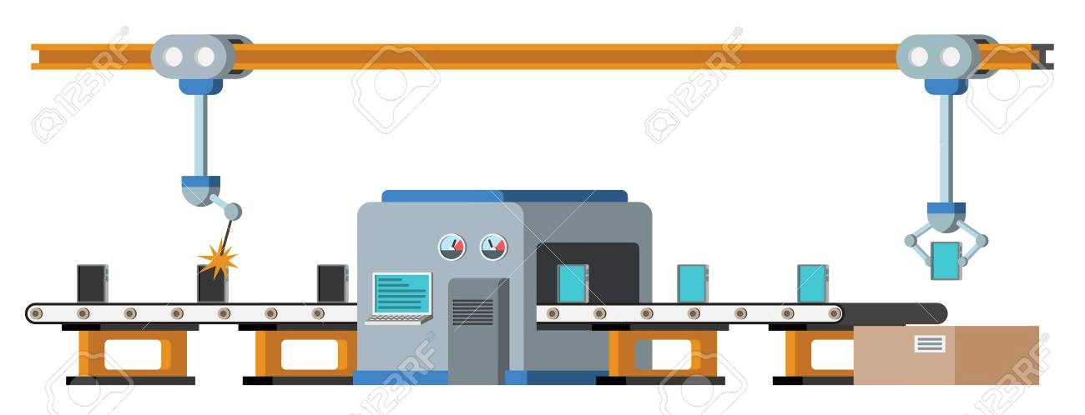


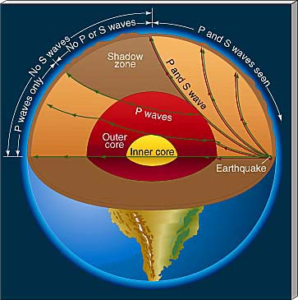
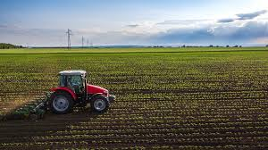
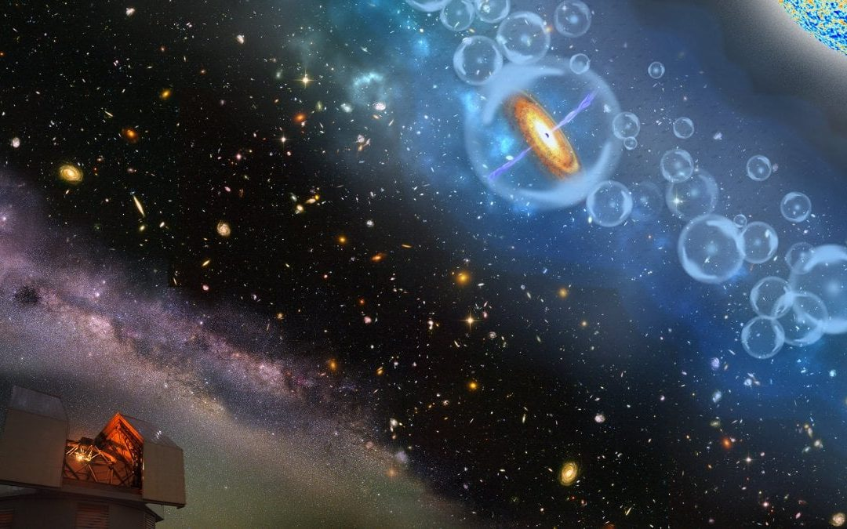


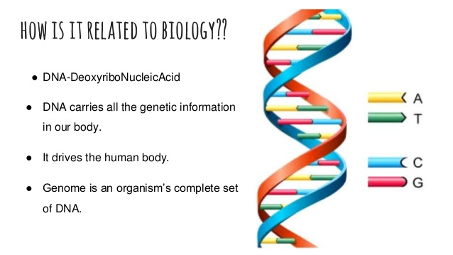


High-d data are everywhere
Finance
Paleontology
Manufacturing
Aviation
Agriculture
Astronomy
Criminology
Seismology
Neuroscience
Medicine
Biology

Slide 6
High-d data are everywhere
operation health monitoring
  classification, anomaly detection
data integration
  entity resolution, data discovery
recommender systems
  predict user interest
information retrieval
  similarity search
software engineering
  find software dependencies
cybersecurity
  network usage profiling, intrusion detection
…

Slide 7

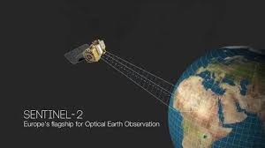

High-d collections are massive
≈ 500 ZB per year
≈ 130 TB
> 40 PB per day
> 5 TB per day
> 500 TB per day
1 PB = 1 thousand TB
1 ZB = 1 billion TB

Slide 8
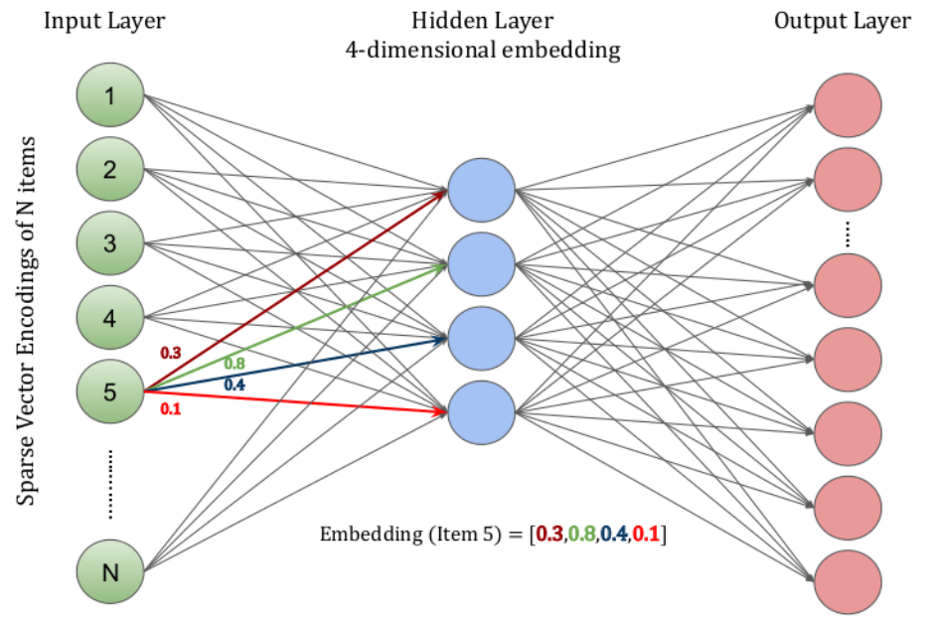
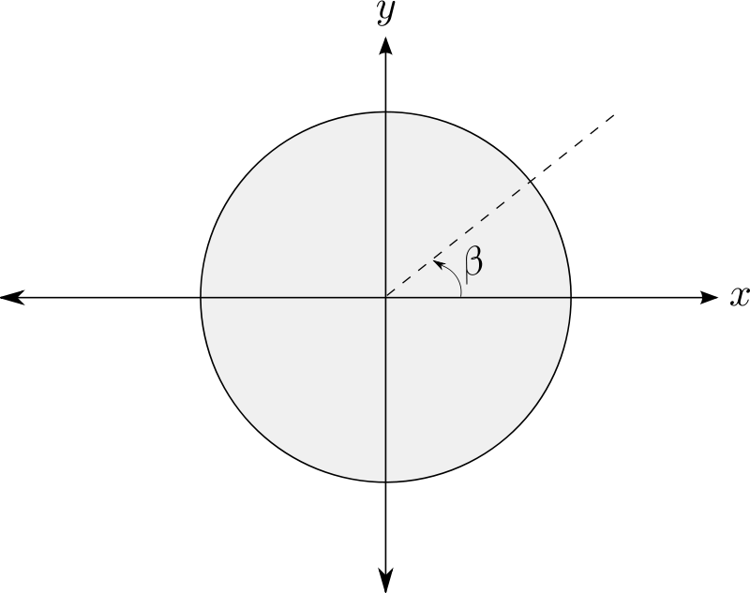


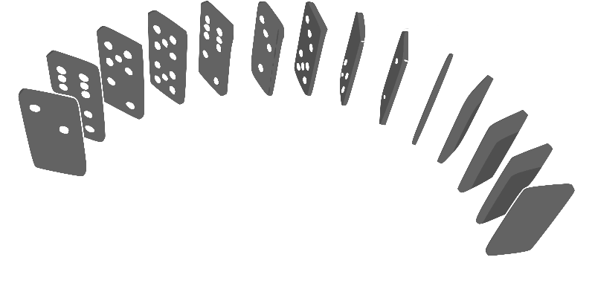
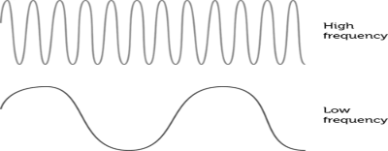
Popular High-d data
Data series
A collection of points ordered over a dimension
Deep Embeddings
A high-d vector learned from data using a DNN
Angle
Time
Mass
Frequency
Position
embedded
text, images, video, graphs, etc.
High-d data -> High-d vectors

Slide 9




Extracting value requires analytics
Clustering
Recommendation
Classification
Outlier Detection
Classification
Similarity Search
Predictive Maintenance
Data Cleaning
Data Integration
Notes:
Similarity search is used by data integration tools to facilitate a variety of tasks. Among others, it is used over tuple embeddings for entity resolution, and over schema embeddings for data discovery.

Slide 10
Extracting value requires analytics
Clustering
Recommendation
HARD, because of very high dimensionality:
each high-d vector has 100s-1000s of dimensions!
Classification
Outlier Detection
Classification
Similarity Search
even HARDER, because of very large size:
millions to billions of high-d vectors (multi-TBs)!
Predictive Maintenance
Data Cleaning
Data Integration

Slide 11
High-d Similarity Search

Slide 12
High-d Similarity Search
Problem Variations

Slide 13
Problem Variations
Series
86
29
8
6
Univariate
each point represents one value (e.g., temperature)
Multivariate
each point represents many values (e.g., temperature, humidity, pressure, wind, etc.)

Slide 14
Problem Variations
Series
86
29
8
6
Univariate
each point represents one value (e.g., temperature)
Multivariate
each point represents many values (e.g., temperature, humidity, pressure, wind, etc.)

Slide 15
Problem Variations
Publications
  Ding-PVLDB‘08
  Paparrizos-SIGMOD’20
Data Series Distance Measures
similarity search is based on measuring distance between sequences
dozens of distance measures have been proposed
  lock-step
    Minkowski, Manhattan, Euclidean, Maximum, DISSIM, …
  sliding
    Normalized Cross-Correlation, SBD, …
  elastic
    DTW, LCSS, MSM, EDR, ERP, Swale, …
  kernel-based
    KDTW, GAK, SINK, …
  embedding
    GRAIL, RWS, SPIRAL, SEAnet, …
Notes:
There is an abundance of data series distance measures and their effectiveness has been evaluated in two main studies. One dating over a decade ago and a more recent one.

Slide 16
Problem Variations
Publications
  Ding-PVLDB‘08
  Paparrizos-SIGMOD’20
Data Series Distance Measures
similarity search is based on measuring distance between sequences
dozens of distance measures have been proposed
  lock-step
    Minkowski, Manhattan, Euclidean, Maximum, DISSIM, …
  sliding
    Normalized Cross-Correlation, SBD, …
  elastic
    DTW, LCSS, MSM, EDR, ERP, Swale, …
  kernel-based
    KDTW, GAK, SINK, …
  embedding
    GRAIL, RWS, SPIRAL, SEAnet, …

Slide 17
Problem Variations
High-d Vectors Distance Measures
similarity search is based on measuring distance between vectors
A variety of distance measures have been proposed
  L_{p} distances (0<p≤2, ∞), (Euclidean for p = 2)
  Cosine distance
  Correlation
  Hamming distance
  …
Notes:
While comparing two binary strings of equal length, Hamming distance is the number of bit positions in which the two bits are different

Slide 18
Problem Variations
High-d Vectors Distance Measures
similarity search is based on measuring distance between vectors
A variety of distance measures have been proposed
  L_{p} distances (0<p≤2, ∞), (Euclidean for p = 2)
  Cosine distance
  Correlation
  Hamming distance
  …
Notes:
While comparing two binary strings of equal length, Hamming distance is the number of bit positions in which the two bits are different

Slide 19
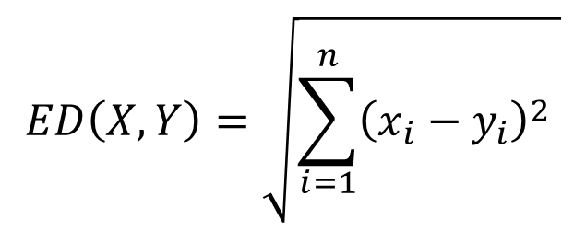
Euclidean Distance
Euclidean distance
  pair-wise point distance
v₂
v₁

Slide 20
Correlation
measures the degree of relationship between data series
  indicates the degree and direction of relationship
direction of change
  positive correlation
    values of two data series change in same direction
  negative correlation
    values of two data series change in opposite directions
linear correlation
  amount of change in one data series bears constant ratio of change in the other data series
useful in several applications

Slide 21
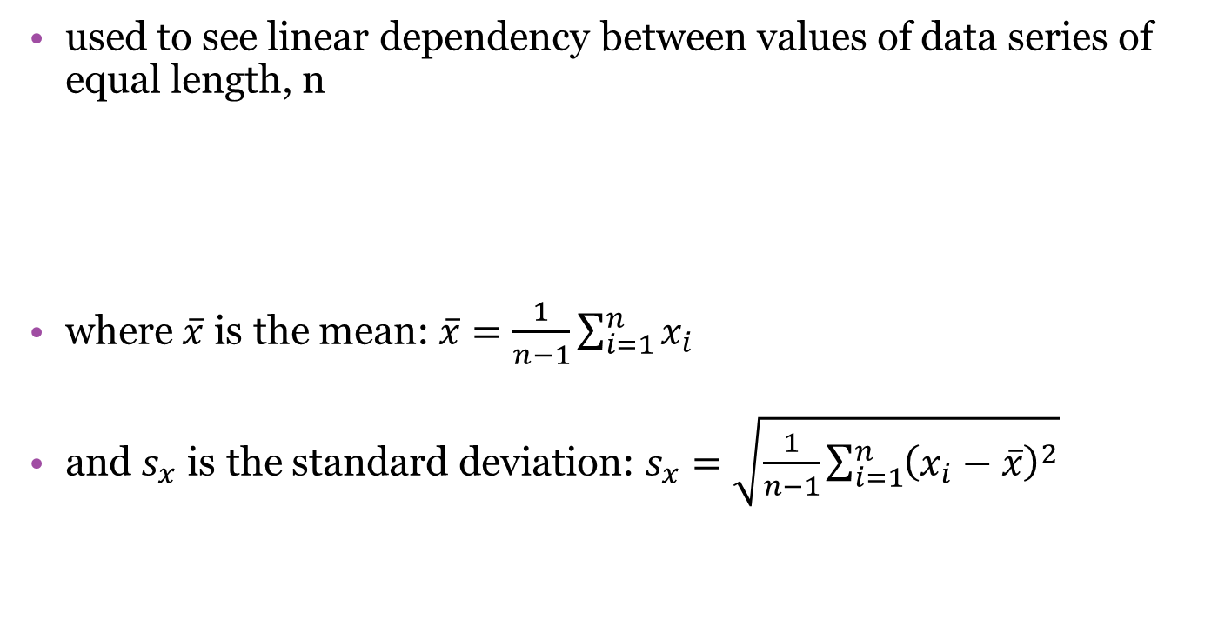
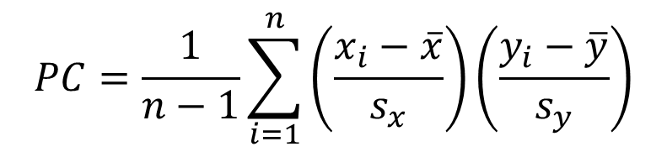
Pearson’s Correlation (PC) Coefficient

Slide 22
Pearson’s Correlation (PC) Coefficient
used to see linear dependency between values of data series of equal length, n
takes values in [-1,1]
  0 – no correlation
  -1, 1 – inverse/direct correlation
there is a statistical test connected to PC, where null hypothesis is the no correlation case (correlation coefficient = 0)
  test is used to ensure that the correlation similarity is not caused by a random process

Slide 23
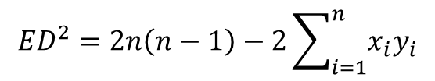
PC and ED
Euclidean distance:
In case of Z-normalized data series (mean = 0, stddev = 1):
and
so the following formula is true:
direct connection between ED and PC for Z-normalized data series
  if ED is calculated for normalized data series, it can be directly used to calculate the p-value for statistical test of Pearson’s correlation instead of actual PC value.
$${ED}^{2}=2n\left(n−1\right)−2\sum_{i=1}^{n}{x_{i}y_{i}}$$

Slide 24
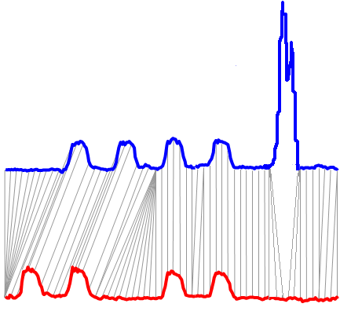
Distance Measures:
LCSS against Euclidean, DTW
Euclidean
  rigid
Dynamic Time Warping (DTW)
  allows local scaling
Longest Common SubSequence (LCSS)
  allows local scaling
  ignores outliers
Notes:
And LCSS which improves upon DTW by ignoring outliers.

Slide 25
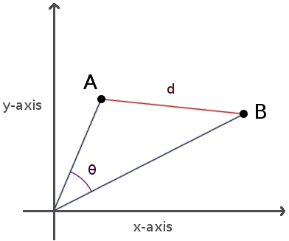
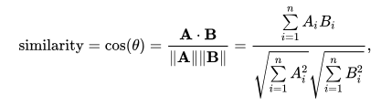
Distance Measures:
Cosine Distance
  Cosine distance = 1 - cosine similarity
  ED vs. Cosine similarity
    If A and B are normalized to unit length in L₂, the square of ED is proportional to the cosine distance:
    ||A||₂=||B||₂=1 →||A−B||₂=2−2cos(A,B)
Notes:
Cosine similarity is a measure of similarity between two non-zero vectors of an inner product space. It is defined to equal the cosine of the angle between them, which is also the same as the inner product of the same vectors normalized to both have length 1. Cosine similarity is generally used as a metric for measuring distance when the magnitude of the vectors does not matter.
The term cosine distance is often used for the complement in positive space. It is important to note, however, that this is not a proper distance metric as it does not have the triangle inequality property.

Slide 26
Problem Variations
Queries
Whole matching
Entire query
Entire candidate
Subsequence matching
Entire query
A subsequence of a candidate

Slide 27
Problem Variations
Queries
Nearest Neighbor (1NN)
k-Nearest Neighbor (kNN)
Farthest Neighbor
epsilon-Range
and more…

Slide 28
Nearest Neighbor (NN) Queries…
Publications
  Echihabi et al.
  PVLDB‘19

Slide 29
Nearest Neighbor (NN) Queries…
Publications
  Echihabi et al.
  PVLDB‘19
O_{Q}

Slide 30
Nearest Neighbor (NN) Queries…
Publications
  Echihabi et al.
  PVLDB‘19
Prob( d_{x} = min{d_{i}} ) = 1
result is exact NN
O_{x}
d_{x}
exact
NN
O_{Q}

Slide 31
Nearest Neighbor (NN) Queries…
Publications
  Echihabi et al.
  PVLDB‘19
Prob( d_{x} = min{d_{i}} ) = 1
result is exact NN
O_{x}
d_{x}
exact
NN
O_{Q}
Notes:
…hard, especially when this NN is in a dense area of the space

Slide 32
Nearest Neighbor (NN) Queries…
Publications
  Echihabi et al.
  PVLDB‘19
Prob( d_{x} = min{d_{i}} ) = 1
result is exact NN
O_{x}
d_{x}
exact
NN
ng-approximate
neighbors
O_{Q}
d_{ng}
Prob(d_{ng} <>= ?) = ?
result within ? of exact NN
O_{ng}

Slide 33
Nearest Neighbor (NN) Queries…
Publications
  Echihabi et al.
  PVLDB‘19
Prob(d_{ε} <= d_{x} (1+ε)) = 1
result within (1+ ε) of exact NN with probability 1
Prob( d_{x} = min{d_{i}} ) = 1
result is exact NN
ε-approximate
neighbors
O_{ε}
O_{x}
d_{x}
d_{ε}
exact
NN
d_{x} (1+ε)
ng-approximate
neighbors
O_{Q}
d_{ng}
Prob(d_{ng} <>= ?) = ?
result within ? of exact NN
O_{ng}

Slide 34
Nearest Neighbor (NN) Queries…
Publications
  Echihabi et al.
  PVLDB‘19
Prob(d_{ε} <= d_{x} (1+ε)) = 1
result within (1+ ε) of exact NN with probability 1
Prob( d_{x} = min{d_{i}} ) = 1
result is exact NN
ε-approximate
neighbors
O_{ε}
O_{x}
d_{x}
d_{ε}
exact
NN
d_{x} (1+ε)
ng-approximate
neighbors
O_{Q}
d_{ng}
Prob(d_{ng} <>= ?) = ?
result within ? of exact NN
d_{δε}
O_{ng}
O_{δε}
δ-ε-approximate
neighbor
Prob(d_{ε} <= d_{x} (1+ε)) >= δ
result within (1+ ε) of exact NN with probability at least δ

Slide 35
Nearest Neighbor (NN) Queries…
Publications
  Echihabi et al.
  PVLDB‘19
Prob(d_{ε} <= d_{x} (1+ε)) = 1
result within (1+ ε) of exact NN with probability 1
Prob( d_{x} = min{d_{i}} ) = 1
result is exact NN
ε-approximate
neighbors
O_{ε}
O_{x}
d_{x}
d_{ε}
exact
NN
d_{x} (1+ε)
ng-approximate
neighbors
O_{Q}
d_{ng}
Prob(d_{ng} <>= ?) = ?
result within ? of exact NN
d_{δε}
O_{ng}
(1+ε) r_{δ}(O_{Q})
O_{δε}
δ-ε-approximate
neighbor
Prob(d_{ε} <= d_{x} (1+ε)) >= δ
result within (1+ ε) of exact NN with probability at least δ
Notes:
The radius of the pink ribbon serves as a stopping condition. Once an algorithm thinks that it has found a point within the pink hypersphere, it stops with the probabilistic guarantee delta that this point is an epsilon-approximate neighbor

Slide 36
Maximum Inner Product Search (MIPS)
Problem Definition:
  Given a collection of candidate vectors S and a query Q , find a candidate vector C maximizing the inner product with the query: :
    Given S ⊂ R^{d} and Q ∈ R^{d} , C = argmax_{X∈S} Q^{T} X

Slide 37
Maximum Inner Product Search (MIPS)
Problem Definition:
  Given a collection of candidate vectors S and a query Q , find a candidate vector C maximizing the inner product with the query: :
    Given S ⊂ R^{d} and Q ∈ R^{d} , C = argmax_{X∈S} Q^{T} X
  MIPS is closely related to NN search:
    If ∥Q∥₂ = 1, ∥Q − X∥₂ = 1 + ∥X∥₂− 2Q^{T}X
  MIPS and NN search are equivalent when all vectors X in S have constant length c
  Otherwise, MIPS can be converted to NN search with ED or Cosine similarity [1][2][3]
[1] Anshumali Shrivastava and Ping Li. 2014a. Asymmetric LSH (ALSH) for Sublinear Time Maximum Inner Product Search (MIPS). In NIPS. 2321–2329.
[2] Yoram Bachrach, Yehuda Finkelstein, Ran Gilad-Bachrach, Liran Katzir, Noam Koenigstein, Nir Nice, and Ulrich Paquet. 2014. Speeding Up the Xbox Recommender System Using a Euclidean Transformation for Inner-product Spaces. In RecSys. 257–264.
[3] B. Neyshabur and N. Srebro. 2014. On Symmetric and Asymmetric LSHs for Inner Product Search. ArXiv e-prints (Oct. 2014).

Slide 38
High-d Similarity Search
Process

Slide 39

Similarity Search Process
Data Loading Procedure
Query Answering Procedure
Raw data
Notes:
The query answering process consists of two main procedures:

Slide 40
Similarity Search Process
Data Loading Procedure
Query Answering Procedure
Raw data
Data Series
Database/
Indexing
Data
data-to-query time
Notes:
For big data exploration, it is prohibitive to rely to full sequential scans for every single query, and therefore, indexing is required to reduce the data to query time.

Slide 41

Similarity Search Process
Data Loading Procedure
Query Answering Procedure
Raw data
Data Series
Database/
Indexing
Queries
Data
Answers
data-to-query time
query answering time
Notes:
Once an index is built and loaded, it is also important to answer queries efficiently.

Slide 42
Similarity Search Process
Data Loading Procedure
Query Answering Procedure
Raw data
Data Series
Database/
Indexing
Queries
Data
Answers
data-to-query time
query answering time
these times are big!

Slide 43
Similarity Search Process
Data Loading Procedure
Query Answering Procedure
Raw data
Data Series
Database/
Indexing
Queries
Data
Answers
data-to-query time
query answering time
we need solutions
for both problems!

Slide 44
Questions?

Slide 45
Data Series Similarity Search

Slide 46
aabbbccb
0
20
40
60
80
100
120
0
20
40
60
80
100
120
0
20
40
60
80
100
120
0
20
40
60
80
100
120
0
20
40
60
80
100
120
0
20
40
60
80
100
120
a
a
b
b
b
c
c
b
DFT
DWT
PAA
APCA
PLA
SAX
for a complete and detailed presentation, see tutorial:
Chan & Fu. ICDE 1999
Morinaka,
Yoshikawa, Amagasa, & Uemura, PAKDD 2001
Agrawal, Faloutsos, &. Swami. FODO 1993
Faloutsos, Ranganathan, & Manolopoulos. SIGMOD 1994
Keogh, Chakrabarti, Pazzani & Mehrotra KAIS 2000
Yi & Faloutsos VLDB 2000
Keogh, Chakrabarti, Pazzani & Mehrotra SIGMOD 2001
Publications
  Keogh -
  KDD‘04

Slide 47
Data Series Similarity Search
Classes of Methods

Slide 48
Similarity Matching
Serial Scan
Q
Q
Q
The summary of Q is compared to the summary of each candidate
Memory
Disk
C_{x}
C_{x}
C_{x}
Q is compared to each raw candidate in the dataset before returning the answer C_{x}
Q is compared to a raw candidate only if
its summary cannot be pruned
Q is compared to a raw candidate only if
its corresponding leaf cannot be pruned
(a) Serial scan
Answering a similarity search query using different access paths

Slide 49
Similarity Matching
Serial Scan
bsf = +ꝏ
Q
Q
Q
The summary of Q is compared to the summary of each candidate
Memory
Disk
C_{x}
C_{x}
C_{x}
Q is compared to each raw candidate in the dataset before returning the answer C_{x}
Q is compared to a raw candidate only if
its summary cannot be pruned
Q is compared to a raw candidate only if
its corresponding leaf cannot be pruned
(a) Serial scan
Answering a similarity search query using different access paths

Slide 50
Similarity Matching
Serial Scan
bsf = d(Q, C₁)
Q
Q
Q
The summary of Q is compared to the summary of each candidate
Memory
Disk
C_{x}
C_{x}
C_{x}
Q is compared to each raw candidate in the dataset before returning the answer C_{x}
Q is compared to a raw candidate only if
its summary cannot be pruned
Q is compared to a raw candidate only if
its corresponding leaf cannot be pruned
(a) Serial scan
Answering a similarity search query using different access paths

Slide 51
Similarity Matching
Serial Scan
bsf = d(Q, C₁)
Q
Q
Q
The summary of Q is compared to the summary of each candidate
Memory
Disk
C_{x}
C_{x}
C_{x}
Q is compared to each raw candidate in the dataset before returning the answer C_{x}
Q is compared to a raw candidate only if
its summary cannot be pruned
Q is compared to a raw candidate only if
its corresponding leaf cannot be pruned
(a) Serial scan
Answering a similarity search query using different access paths

Slide 52
Similarity Matching
Serial Scan
bsf = d(Q, C_{x})
Q
Q
Q
The summary of Q is compared to the summary of each candidate
Memory
Disk
C_{x}
C_{x}
C_{x}
Q is compared to each raw candidate in the dataset before returning the answer C_{x}
Q is compared to a raw candidate only if
its summary cannot be pruned
Q is compared to a raw candidate only if
its corresponding leaf cannot be pruned
(a) Serial scan
Answering a similarity search query using different access paths

Slide 53
Similarity Matching
Serial Scan
bsf = d(Q, C_{x})
Q
Q
Q
The summary of Q is compared to the summary of each candidate
Memory
Disk
C_{x}
C_{x}
C_{x}
Q is compared to each raw candidate in the dataset before returning the answer C_{x}
Q is compared to a raw candidate only if
its summary cannot be pruned
Q is compared to a raw candidate only if
its corresponding leaf cannot be pruned
(a) Serial scan
Answering a similarity search query using different access paths

Slide 54
Similarity Matching
Serial Scan
Q
Q
Q
Memory
Disk
C_{x}
C_{x}
C_{x}
Q is compared to each raw candidate in the dataset before returning the answer C_{x}
Q is compared to a raw candidate only if
its corresponding leaf cannot be pruned
(a) Serial scan
(b) Skip-sequential scan
Answering a similarity search query using different access paths

Slide 55


Similarity Matching
Serial Scan
Q
Q
Q
Memory
Disk
C_{x}
C_{x}
C_{x}
Q is compared to each raw candidate in the dataset before returning the answer C_{x}
Q is compared to a raw candidate only if
its corresponding leaf cannot be pruned
(a) Serial scan
(b) Skip-sequential scan
Answering a similarity search query using different access paths

Slide 56
Indexes vs. Scans
Q
Q
Q
Memory
Disk
C_{x}
C_{x}
C_{x}
Q is compared to each raw candidate in the dataset before returning the answer C_{x}
Q is compared to a raw candidate only if
its corresponding leaf cannot be pruned
(a) Serial scan
(b) Skip-sequential scan
Answering a similarity search query using different access paths

Slide 57
Indexes vs. Scans
Q
Q
Q
Memory
Disk
C_{x}
C_{x}
C_{x}
Q is compared to each raw candidate in the dataset before returning the answer C_{x}
Q is compared to a raw candidate only if
its corresponding leaf cannot be pruned
(a) Serial scan
(b) Skip-sequential scan
Answering a similarity search query using different access paths

Slide 58
bsf = +ꝏ
lb_{cur} = +ꝏ
Q
Q
Q
Publications
lower-bounding (lb) property:
d_{lb}(Q’, C_{i}’) <= d(Q, C_{i})
  Faloutsos-
  SIGMOD’94
Memory
Disk
C_{x}
C_{x}
C_{x}
Q is compared to each raw candidate in the dataset before returning the answer C_{x}
Q is compared to a raw candidate only if
its corresponding leaf cannot be pruned
(a) Serial scan
(b) Skip-sequential scan
Answering a similarity search query using different access paths

Slide 59
Indexes vs. Scans
bsf = +ꝏ
lb_{cur} = d_{lb}(Q’,C₁’)
Q
Q
Q
The summary of Q (Q’) is compared to the summary of each candidate
Memory
Disk
C_{x}
C_{x}
C_{x}
Q is compared to each raw candidate in the dataset before returning the answer C_{x}
Q is compared to a raw candidate only if
its corresponding leaf cannot be pruned
(a) Serial scan
(b) Skip-sequential scan
Answering a similarity search query using different access paths

Slide 60
Indexes vs. Scans
bsf = +ꝏ
lb_{cur} = d_{lb}(Q’,C₁’) < bsf
Q
Q
Q
The summary of Q (Q’) is compared to the summary of each candidate
Memory
Disk
C_{x}
C_{x}
C_{x}
Q is compared to each raw candidate in the dataset before returning the answer C_{x}
Q is compared to a raw candidate only if
its corresponding leaf cannot be pruned
(a) Serial scan
(b) Skip-sequential scan
Answering a similarity search query using different access paths

Slide 61
Indexes vs. Scans
bsf = +ꝏ
lb_{cur} = d_{lb}(Q’,C₁’) < bsf
Q
Q
Q
The summary of Q (Q’) is compared to the summary of each candidate
Memory
Disk
C_{x}
C_{x}
C_{x}
Q is compared to each raw candidate in the dataset before returning the answer C_{x}
Q is compared to a raw candidate only if
its summary cannot be pruned
Q is compared to a raw candidate only if
its corresponding leaf cannot be pruned
(a) Serial scan
(b) Skip-sequential scan
Answering a similarity search query using different access paths

Slide 62
Indexes vs. Scans
bsf = d(Q,C₁)
lb_{cur} = d_{lb}(Q’,C₁’) < bsf
Q
Q
Q
The summary of Q (Q’) is compared to the summary of each candidate
Memory
Disk
C_{x}
C_{x}
C_{x}
Q is compared to each raw candidate in the dataset before returning the answer C_{x}
Q is compared to a raw candidate only if
its summary cannot be pruned
Q is compared to a raw candidate only if
its corresponding leaf cannot be pruned
(a) Serial scan
(b) Skip-sequential scan
Answering a similarity search query using different access paths

Slide 63
Indexes vs. Scans
bsf = d(Q,C₁)
lb_{cur} = d_{lb}(Q’,C₂’)
Q
Q
Q
The summary of Q (Q’) is compared to the summary of each candidate
Memory
Disk
C_{x}
C_{x}
C_{x}
Q is compared to each raw candidate in the dataset before returning the answer C_{x}
Q is compared to a raw candidate only if
its summary cannot be pruned
Q is compared to a raw candidate only if
its corresponding leaf cannot be pruned
(a) Serial scan
(b) Skip-sequential scan
Answering a similarity search query using different access paths

Slide 64
Indexes vs. Scans
bsf = d(Q,C₁)
lb_{cur} = d_{lb}(Q’,C₂’) >= bsf
Q
Q
Q
The summary of Q (Q’) is compared to the summary of each candidate
Memory
Disk
C_{x}
C_{x}
C_{x}
Q is compared to each raw candidate in the dataset before returning the answer C_{x}
Q is compared to a raw candidate only if
its summary cannot be pruned
Q is compared to a raw candidate only if
its corresponding leaf cannot be pruned
(a) Serial scan
(b) Skip-sequential scan
Answering a similarity search query using different access paths

Slide 65
Indexes vs. Scans
bsf = d(Q,C₁)
lb_{cur} = d_{lb}(Q’,C₂’) >= bsf
Q
Q
Q
The summary of Q (Q’) is compared to the summary of each candidate
Memory
Disk
C_{x}
C_{x}
C_{x}
Q is compared to each raw candidate in the dataset before returning the answer C_{x}
Q is compared to a raw candidate only if
its summary cannot be pruned
Q is compared to a raw candidate only if
its corresponding leaf cannot be pruned
(a) Serial scan
(b) Skip-sequential scan
Answering a similarity search query using different access paths

Slide 66
Indexes vs. Scans
bsf = d(Q,C₁)
lb_{cur} = d_{lb}(Q’,C₂’) >= bsf
d(Q,C₂) >=
Q
LB Property
Q
Q
The summary of Q (Q’) is compared to the summary of each candidate
Memory
Disk
C_{x}
C_{x}
C_{x}
Q is compared to each raw candidate in the dataset before returning the answer C_{x}
Q is compared to a raw candidate only if
its summary cannot be pruned
Q is compared to a raw candidate only if
its corresponding leaf cannot be pruned
(a) Serial scan
(b) Skip-sequential scan
Answering a similarity search query using different access paths

Slide 67
Indexes vs. Scans
bsf = d(Q,C₁)
lb_{cur} = d_{lb}(Q’,C₂’) >= bsf
d(Q,C₂) >=
Q
LB Property
Q
Q
The summary of Q (Q’) is compared to the summary of each candidate
prune C₂
Memory
Disk
C_{x}
C_{x}
C_{x}
Q is compared to each raw candidate in the dataset before returning the answer C_{x}
Q is compared to a raw candidate only if
its summary cannot be pruned
Q is compared to a raw candidate only if
its corresponding leaf cannot be pruned
(a) Serial scan
(b) Skip-sequential scan
Answering a similarity search query using different access paths

Slide 68
Indexes vs. Scans
bsf = d(Q,C₁)
lb_{cur} = d_{lb}(Q’,C_{x}’)
Q
Q
Q
The summary of Q (Q’) is compared to the summary of each candidate
Memory
Disk
C_{x}
C_{x}
C_{x}
Q is compared to each raw candidate in the dataset before returning the answer C_{x}
Q is compared to a raw candidate only if
its summary cannot be pruned
Q is compared to a raw candidate only if
its corresponding leaf cannot be pruned
(a) Serial scan
(b) Skip-sequential scan
Answering a similarity search query using different access paths

Slide 69
Indexes vs. Scans
bsf = d(Q,C₁)
lb_{cur} = d_{lb}(Q’,C_{x}’) < bsf
Q
Q
Q
The summary of Q (Q’) is compared to the summary of each candidate
Memory
Disk
C_{x}
C_{x}
C_{x}
Q is compared to each raw candidate in the dataset before returning the answer C_{x}
Q is compared to a raw candidate only if
its summary cannot be pruned
Q is compared to a raw candidate only if
its corresponding leaf cannot be pruned
(a) Serial scan
(b) Skip-sequential scan
Answering a similarity search query using different access paths

Slide 70
Indexes vs. Scans
bsf = d(Q,C_{x})
lb_{cur} = d_{lb}(Q’,C_{x}’) < bsf
Q
Q
Q
The summary of Q (Q’) is compared to the summary of each candidate
Memory
Disk
C_{x}
C_{x}
C_{x}
Q is compared to each raw candidate in the dataset before returning the answer C_{x}
Q is compared to a raw candidate only if
its summary cannot be pruned
Q is compared to a raw candidate only if
its corresponding leaf cannot be pruned
(a) Serial scan
(b) Skip-sequential scan
Answering a similarity search query using different access paths

Slide 71
Indexes vs. Scans
bsf = d(Q,C_{x})
lb_{cur} = d_{lb}(Q’,C_{n}’) < bsf
Q
Q
Q
The summary of Q (Q’) is compared to the summary of each candidate
Memory
Disk
C_{x}
C_{x}
C_{x}
Q is compared to each raw candidate in the dataset before returning the answer C_{x}
Q is compared to a raw candidate only if
its summary cannot be pruned
Q is compared to a raw candidate only if
its corresponding leaf cannot be pruned
(a) Serial scan
(b) Skip-sequential scan
Answering a similarity search query using different access paths

Slide 72
Indexes vs. Scans
Q
Q
Q
The summary of Q (Q’) is compared to the summary of each candidate
Memory
Disk
C_{x}
C_{x}
C_{x}
Q is compared to each raw candidate in the dataset before returning the answer C_{x}
Q is compared to a raw candidate only if
its summary cannot be pruned
Q is compared to a raw candidate only if
its corresponding leaf cannot be pruned
(a) Serial scan
(b) Skip-sequential scan
Answering a similarity search query using different access paths

Slide 73
Indexes vs. Scans
Q
Q
Q
The summary of Q (Q’) is compared to the summary of each candidate
1
2
3
4
5
Memory
1
2
Disk
C_{x}
C_{x}
C_{x}
Q is compared to each raw candidate in the dataset before returning the answer C_{x}
Q is compared to a raw candidate only if
its summary cannot be pruned
(a) Serial scan
(b) Skip-sequential scan
(c) Tree-based index
Answering a similarity search query using different access paths

Slide 74
Indexes vs. Scans
bsf = +ꝏ
Q
Q
Q
The summary of Q (Q’) is compared to the summary of each candidate
1
2
3
4
5
Memory
1
2
Disk
C_{x}
C_{x}
C_{x}
Q is compared to each raw candidate in the dataset before returning the answer C_{x}
Q is compared to a raw candidate only if
its summary cannot be pruned
(a) Serial scan
(b) Skip-sequential scan
(c) Tree-based index
Answering a similarity search query using different access paths

Slide 75
Indexes vs. Scans
bsf = +ꝏ
Q
Q
Q
The summary of Q (Q’) is compared to the summary of each candidate
1
2
3
4
5
Memory
1
2
Disk
C_{x}
C_{x}
C_{x}
Q is compared to each raw candidate in the dataset before returning the answer C_{x}
Q is compared to a raw candidate only if
its summary cannot be pruned
(a) Serial scan
(b) Skip-sequential scan
(c) Tree-based index
Answering a similarity search query using different access paths

Slide 76
Indexes vs. Scans
bsf = d(Q,C₃)
Q
Q
Q
The summary of Q (Q’) is compared to the summary of each candidate
1
2
3
4
5
Memory
1
2
Disk
C_{x}
C_{x}
C_{x}
Q is compared to each raw candidate in the dataset before returning the answer C_{x}
Q is compared to a raw candidate only if
its summary cannot be pruned
(a) Serial scan
(b) Skip-sequential scan
(c) Tree-based index
Answering a similarity search query using different access paths

Slide 77
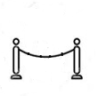
Indexes vs. Scans
1
bsf = d(Q,C₃)
Queue
Q
Q
Q
The summary of Q (Q’) is compared to the summary of each candidate
1
2
3
4
5
Memory
1
2
Disk
C_{x}
C_{x}
C_{x}
Q is compared to each raw candidate in the dataset before returning the answer C_{x}
Q is compared to a raw candidate only if
its summary cannot be pruned
(a) Serial scan
(b) Skip-sequential scan
(c) Tree-based index
Answering a similarity search query using different access paths

Slide 78
Indexes vs. Scans
bsf = d(Q,C₃)
lb_{cur} = d_{lb}(Q’, )
Queue
Queue
1
Q
Q
Q
The summary of Q (Q’) is compared to the summary of each candidate
1
2
3
4
5
Memory
1
2
Disk
C_{x}
C_{x}
C_{x}
Q is compared to each raw candidate in the dataset before returning the answer C_{x}
Q is compared to a raw candidate only if
its summary cannot be pruned
(a) Serial scan
(b) Skip-sequential scan
(c) Tree-based index
Answering a similarity search query using different access paths

Slide 79
Indexes vs. Scans
bsf = d(Q,C₃)
lb_{cur} = d_{lb}(Q’, ) < bsf
Queue
Queue
1
Q
Q
Q
The summary of Q (Q’) is compared to the summary of each candidate
1
2
3
4
5
Memory
1
2
Disk
C_{x}
C_{x}
C_{x}
Q is compared to each raw candidate in the dataset before returning the answer C_{x}
Q is compared to a raw candidate only if
its summary cannot be pruned
(a) Serial scan
(b) Skip-sequential scan
(c) Tree-based index
Answering a similarity search query using different access paths

Slide 80
Indexes vs. Scans
3
2
bsf = d(Q,C₃)
lb_{cur} = d_{lb}(Q’, ) < bsf
Queue
Queue
1
Q
Q
Q
The summary of Q (Q’) is compared to the summary of each candidate
1
2
3
4
5
Memory
1
2
Disk
C_{x}
C_{x}
C_{x}
Q is compared to each raw candidate in the dataset before returning the answer C_{x}
Q is compared to a raw candidate only if
its summary cannot be pruned
(a) Serial scan
(b) Skip-sequential scan
(c) Tree-based index
Answering a similarity search query using different access paths

Slide 81
Indexes vs. Scans
3
bsf = d(Q,C₃)
lb_{cur} = d_{lb}(Q’, )
Queue
2
Q
Q
Q
The summary of Q (Q’) is compared to the summary of each candidate
1
2
3
4
5
Memory
1
2
Disk
C_{x}
C_{x}
C_{x}
Q is compared to each raw candidate in the dataset before returning the answer C_{x}
Q is compared to a raw candidate only if
its summary cannot be pruned
(a) Serial scan
(b) Skip-sequential scan
(c) Tree-based index
Answering a similarity search query using different access paths

Slide 82
Indexes vs. Scans
3
bsf = d(Q,C₃)
lb_{cur} = d_{lb}(Q’, ) < bsf
Queue
2
Q
Q
Q
The summary of Q (Q’) is compared to the summary of each candidate
1
2
3
4
5
Memory
1
2
Disk
C_{x}
C_{x}
C_{x}
Q is compared to each raw candidate in the dataset before returning the answer C_{x}
Q is compared to a raw candidate only if
its summary cannot be pruned
(a) Serial scan
(b) Skip-sequential scan
(c) Tree-based index
Answering a similarity search query using different access paths

Slide 83
Indexes vs. Scans
3
4
5
bsf = d(Q,C₃)
lb_{cur} = d_{lb}(Q’, ) < bsf
Queue
2
Q
Q
Q
The summary of Q (Q’) is compared to the summary of each candidate
1
2
3
4
5
Memory
1
2
Disk
C_{x}
C_{x}
C_{x}
Q is compared to each raw candidate in the dataset before returning the answer C_{x}
Q is compared to a raw candidate only if
its summary cannot be pruned
(a) Serial scan
(b) Skip-sequential scan
(c) Tree-based index
Answering a similarity search query using different access paths

Slide 84
Indexes vs. Scans
3
4
bsf = d(Q,C₃)
lb_{cur} = d_{lb}(Q’, )
Queue
5
Q
Q
Q
The summary of Q (Q’) is compared to the summary of each candidate
1
2
3
4
5
Memory
1
2
Disk
C_{x}
C_{x}
C_{x}
Q is compared to each raw candidate in the dataset before returning the answer C_{x}
Q is compared to a raw candidate only if
its summary cannot be pruned
(a) Serial scan
(b) Skip-sequential scan
(c) Tree-based index
Answering a similarity search query using different access paths

Slide 85
Indexes vs. Scans
3
4
bsf = d(Q,C₃)
lb_{cur} = d_{lb}(Q’, ) < bsf
Queue
5
Q
Q
Q
The summary of Q (Q’) is compared to the summary of each candidate
1
2
3
4
5
Memory
1
2
Disk
C_{x}
C_{x}
C_{x}
Q is compared to each raw candidate in the dataset before returning the answer C_{x}
Q is compared to a raw candidate only if
its summary cannot be pruned
(a) Serial scan
(b) Skip-sequential scan
(c) Tree-based index
Answering a similarity search query using different access paths

Slide 86
Indexes vs. Scans
3
4
2
bsf = d(Q,C₃)
lb_{cur} = d_{lb}(Q’, ) < bsf
Queue
5
Q
Q
Q
The summary of Q (Q’) is compared to the summary of each candidate
1
2
3
4
5
Memory
1
2
Disk
C_{x}
C_{x}
C_{x}
Q is compared to each raw candidate in the dataset before returning the answer C_{x}
Q is compared to a raw candidate only if
its summary cannot be pruned
(a) Serial scan
(b) Skip-sequential scan
(c) Tree-based index
Answering a similarity search query using different access paths

Slide 87
Indexes vs. Scans
3
4
bsf = d(Q,C₃)
lb_{cur} = d_{lb}(Q’, )
Queue
2
Q
Q
Q
The summary of Q (Q’) is compared to the summary of each candidate
1
2
3
4
5
Memory
1
2
Disk
C_{x}
C_{x}
C_{x}
Q is compared to each raw candidate in the dataset before returning the answer C_{x}
Q is compared to a raw candidate only if
its summary cannot be pruned
(a) Serial scan
(b) Skip-sequential scan
(c) Tree-based index
Answering a similarity search query using different access paths

Slide 88
Indexes vs. Scans
3
4
bsf = d(Q,C₃)
lb_{cur} = d_{lb}(Q’, ) < bsf
Queue
2
Q
Q
Q
The summary of Q (Q’) is compared to the summary of each candidate
1
2
3
4
5
Memory
1
2
Disk
C_{x}
C_{x}
C_{x}
Q is compared to each raw candidate in the dataset before returning the answer C_{x}
Q is compared to a raw candidate only if
its summary cannot be pruned
(a) Serial scan
(b) Skip-sequential scan
(c) Tree-based index
Answering a similarity search query using different access paths

Slide 89
Indexes vs. Scans
3
4
bsf = d(Q,C₃)
lb_{cur} = d_{lb}(Q’, ) < bsf
Queue
2
Q
Q
Q
The summary of Q (Q’) is compared to the summary of each candidate
1
2
3
4
5
Memory
1
2
Disk
C_{x}
C_{x}
C_{x}
Q is compared to each raw candidate in the dataset before returning the answer C_{x}
Q is compared to a raw candidate only if
its summary cannot be pruned
(a) Serial scan
(b) Skip-sequential scan
(c) Tree-based index
Answering a similarity search query using different access paths

Slide 90
Indexes vs. Scans
3
4
bsf = d(Q,C_{x})
lb_{cur} = d_{lb}(Q’, ) < bsf
Queue
2
Q
Q
Q
The summary of Q (Q’) is compared to the summary of each candidate
1
2
3
4
5
Memory
1
2
Disk
C_{x}
C_{x}
C_{x}
Q is compared to each raw candidate in the dataset before returning the answer C_{x}
Q is compared to a raw candidate only if
its summary cannot be pruned
(a) Serial scan
(b) Skip-sequential scan
(c) Tree-based index
Answering a similarity search query using different access paths

Slide 91
Indexes vs. Scans
3
bsf = d(Q,C_{x})
lb_{cur} = d_{lb}(Q’, )
Queue
4
Q
Q
Q
The summary of Q (Q’) is compared to the summary of each candidate
1
2
3
4
5
Memory
1
2
Disk
C_{x}
C_{x}
C_{x}
Q is compared to each raw candidate in the dataset before returning the answer C_{x}
Q is compared to a raw candidate only if
its summary cannot be pruned
(a) Serial scan
(b) Skip-sequential scan
(c) Tree-based index
Answering a similarity search query using different access paths

Slide 92
Indexes vs. Scans
3
bsf = d(Q,C_{x})
lb_{cur} = d_{lb}(Q’, ) > bsf
Queue
4
Q
Q
Q
LB Property
The summary of Q (Q’) is compared to the summary of each candidate
1
prune
4
2
3
4
5
Memory
1
2
Disk
C_{x}
C_{x}
C_{x}
Q is compared to each raw candidate in the dataset before returning the answer C_{x}
Q is compared to a raw candidate only if
its summary cannot be pruned
(a) Serial scan
(b) Skip-sequential scan
(c) Tree-based index
Answering a similarity search query using different access paths

Slide 93

Indexes vs. Scans
3
bsf = d(Q,C_{x})
lb_{cur} = d_{lb}(Q’, ) > bsf
Queue
4
Q
Q
Q
The summary of Q (Q’) is compared to the summary of each candidate
1
2
3
4
5
Memory
1
2
Disk
C_{x}
C_{x}
C_{x}
Q is compared to each raw candidate in the dataset before returning the answer C_{x}
Q is compared to a raw candidate only if
its summary cannot be pruned
(a) Serial scan
(b) Skip-sequential scan
(c) Tree-based index
Answering a similarity search query using different access paths

Slide 94
Indexes vs. Scans
3
bsf = d(Q,C_{x})
lb_{cur} = d_{lb}(Q’, ) > bsf
Queue
4
Q
Q
Q
The summary of Q (Q’) is compared to the summary of each candidate
1
2
3
4
5
Memory
1
2
Disk
C_{x}
C_{x}
C_{x}
Q is compared to each raw candidate in the dataset before returning the answer C_{x}
Q is compared to a raw candidate only if
its summary cannot be pruned
(a) Serial scan
(b) Skip-sequential scan
(c) Tree-based index
Answering a similarity search query using different access paths

Slide 95
Similarity Search
Data Series Extensions

Slide 96

Access Paths
O_{Q}
O_{Q}
O_{Q}
The summary of O_{Q} (O_{Q}’) is compared to the summary of each candidate
1
2
3
4
Memory
1
2
Disk
O_{x}
O_{x}
O_{x}
O_{Q} is compared to each raw candidate in the dataset before returning the answer O_{x}
O_{Q} is compared to a raw candidate only if
its summary cannot be pruned
(a) Serial scan
(b) Skip-sequential scan
(c) Tree-based index
Answering a similarity search query using different access paths

Slide 97
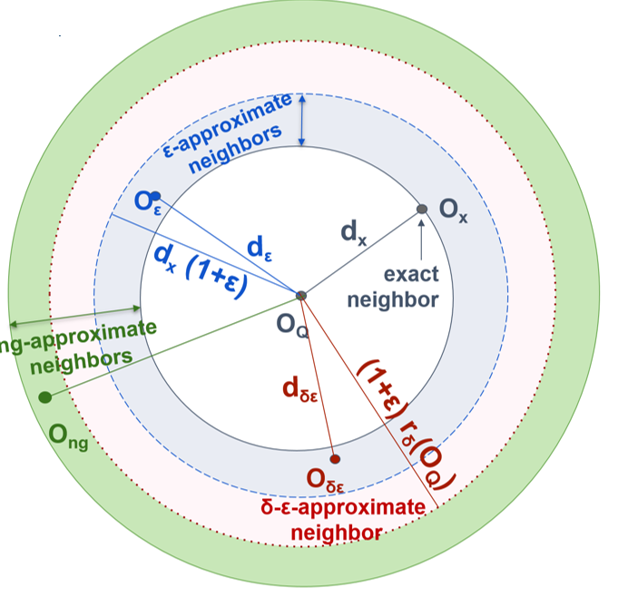
Extensions: Skip-Sequential Scans
bsf = d(O_{Q},O₁)
lb_{cur} = d_{lb}(O_{Q}’, O_{x}’) < bsf
P{d_{ε} <= d_{x} (1+ε)} >= δ
Result is within
distance (1+ ε) of
the exact answer with probability at least δ
O_{Q}
The summary of O_{Q} (O_{Q}’) is compared to the summary of each candidate
Memory
Disk
O_{x}

Slide 98
Extensions: Skip-Sequential Scans
bsf = d(O_{Q},O₁)
lb_{cur} = d_{lb}(O_{Q}’, O_{x}’) < bsf
lb_{cur} = d_{lb}(O_{Q}’, O_{x}’) < (1+ε) bsf
P{d_{ε} <= d_{x} (1+ε)} >= δ
Result is within
distance (1+ ε) of
the exact answer with probability at least δ
O_{Q}
The summary of O_{Q} (O_{Q}’) is compared to the summary of each candidate
Memory
Disk
O_{x}

Slide 99
Extensions: Skip-Sequential Scans
bsf = d(O_{Q},O₁)
P{d_{ε} <= d_{x} (1+ε) = δ
Result is within
distance (1+ ε) of
the exact answer with probability at least δ
O_{Q}
The summary of O_{Q} (O_{Q}’) is compared to the summary of each candidate
Memory
Disk
O_{x}

Slide 100

Extensions: Skip-Sequential Scans
bsf = d(O_{Q},O₁)
If bsf <=
(1+ε) r_{δ}(O_{Q})
P{d_{ε} <= d_{x} (1+ε)} >= δ
Result is within
distance (1+ ε) of
the exact answer
with probability at
least δ
O_{Q}
The summary of O_{Q} (O_{Q}’) is compared to the summary of each candidate
Memory
Disk
O_{x}

Slide 101
Extensions: Indexes
bsf = d(O_{Q},O₃)
lb_{cur} = d_{lb}(O_{Q}’, ) < bsf
1
P{d_{ε} <= d_{x} (1+ε)} >= δ
Result is within
distance (1+ ε) of
the exact answer with probability at least δ
Q
1
2
3
4
Memory
1
2
Disk
O_{x}

Slide 102
Extensions: Indexes
bsf = d(O_{Q},O₃)
lb_{cur} = d_{lb}(O_{Q}’, ) < bsf
lb_{cur} = d_{lb}(O_{Q}’, ) < (1+ε) bsf
1
Q
1
P{d_{ε} <= d_{x} (1+ε)} >= δ
Result is within
distance (1+ ε) of
the exact answer with probability at least δ
1
2
3
4
Memory
1
2
Disk
O_{x}

Slide 103
Extensions: Indexes
bsf = d(O_{Q},O₃)
lb_{cur} = d_{lb}(O_{Q}’, ) < bsf
lb_{cur} = d_{lb}(O_{Q}’, ) < (1+ε) bsf
1
Q
1
P{d_{ε} <= d_{x} (1+ε)} >= δ
Result is within
distance (1+ ε) of
the exact answer with probability at least δ
1
2
3
4
Memory
1
2
Disk
O_{x}

Slide 104
Extensions: Indexes
bsf = d(O_{Q},O₃)
If bsf <=
(1+ε) r_{δ}(O_{Q})
P{d_{ε} <= d_{x} (1+ε)} >= δ
Result is within
distance (1+ ε) of
the exact answer
with probability at
least δ
Q
1
2
3
4
Memory
1
2
Disk
O_{x}

Slide 105
Questions?

Slide 106
Data Series Similarity Search
State-of-the-Art Methods

Slide 107
Data Series Similarity Search
State-of-the-Art Methods
Publications
  Echihabi-
  EDBT‘21
for a more complete and detailed presentation, see tutorial:
Karima Echihabi, Kostas Zoumpatianos, Themis Palpanas. Big Sequence Management: Scaling Up and Out. EDBT 2021
http://helios.mi.parisdescartes.fr/~themisp/publications.html#tutorials

Slide 108
iSAX Summarization
3
2
A data series T
1
Symbolic Aggregate approXimation (SAX)
0
-1
-2
-3
0
4
8
12
16

Slide 109
iSAX Summarization
3
2
A data series T
1
Symbolic Aggregate approXimation (SAX)
  (1) Represent data series T of length n with w segments using Piecewise Aggregate Approximation (PAA)
    T typically normalized to μ = 0, σ = 1
    PAA(T,w) =
    where
0
-1
-2
-3
0
4
8
12
16
3
2
PAA(T,4)
1
0
-1
-2
-3
0
4
8
12
16

Slide 110
iSAX Summarization
3
2
A data series T
1
Symbolic Aggregate approXimation (SAX)
  (1) Represent data series T of length n with w segments using Piecewise Aggregate Approximation (PAA)
    T typically normalized to μ = 0, σ = 1
    PAA(T,w) =
    where
  (2) Discretize into a vector of symbols
    Breakpoints map to small alphabet a of symbols
0
-1
-2
-3
0
4
8
12
16
3
2
PAA(T,4)
1
0
-1
-2
-3
0
4
8
12
16
3
2
iSAX(T,4,4)
1
00
01
0
10
-1
11
-2
-3
0
4
8
12
16

Slide 111
iSAX Summarization
Publications
  Shieh-
  KDD‘08
iSAX representation offers a bit-aware, quantized, multi-resolution representation with variable granularity
= { 6, 6, 3, 0} = {110 ,110 ,0111 ,000} = { 3, 3, 1, 0} = {11 ,11 ,011 ,00 } = { 1, 1, 0, 0} = {1 ,1 ,0 ,0 }
Notes:
The isax-based indexes use the isax summarization that we described earlier.
As we mentioned, the isax summarization is bitwise, and allows us to represent different segments of the same series with a different number of bits.
This is what enables a small memory footprint, a hierarchical organization of the series in the form of a tree, and fast, bitwise operations for the traversal of this tree index

Slide 112
iSAX Index Family
non-balanced tree-based index with non-overlapping regions, and controlled fan-out rate
  base cardinality b (optional), segments w, threshold th
  hierarchically subdivides SAX space until num. entries ≤ th

Slide 113
iSAX Index Family
non-balanced tree-based index with non-overlapping regions, and controlled fan-out rate
  base cardinality b (optional), segments w, threshold th
  hierarchically subdivides SAX space until num. entries ≤ th
e.g., th=4, w=4, b=1
1 1 1 0
1 1 1 0
1 1 1 0
1 1 1 0

Slide 114
iSAX Index Family
non-balanced tree-based index with non-overlapping regions, and controlled fan-out rate
  base cardinality b (optional), segments w, threshold th
  hierarchically subdivides SAX space until num. entries ≤ th
e.g., th=4, w=4, b=1
1 1 1 0
Insert:
1 1 1 0
1 1 1 0
1 1 1 0
1 1 1 0

Slide 115
iSAX Index Family
non-balanced tree-based index with non-overlapping regions, and controlled fan-out rate
  base cardinality b (optional), segments w, threshold th
  hierarchically subdivides SAX space until num. entries ≤ th
e.g., th=4, w=4, b=1
1 1 10 0
1 1 10 0
1 1 1 0
1 1 11 0
1 1 11 0
1 1 11 0

Slide 116
iSAX Index Family
non-balanced tree-based index with non-overlapping regions, and controlled fan-out rate
  base cardinality b (optional), segments w, threshold th
  hierarchically subdivides SAX space until num. entries ≤ th

Slide 117
iSAX Index Family
non-balanced tree-based index with non-overlapping regions, and controlled fan-out rate
  base cardinality b (optional), segments w, threshold th
  hierarchically subdivides SAX space until num. entries ≤ th

Slide 118
iSAX Index Family
non-balanced tree-based index with non-overlapping regions, and controlled fan-out rate
  base cardinality b (optional), segments w, threshold th
  hierarchically subdivides SAX space until num. entries ≤ th

Slide 119
iSAX Index Family
non-balanced tree-based index with non-overlapping regions, and controlled fan-out rate
  base cardinality b (optional), segments w, threshold th
  hierarchically subdivides SAX space until num. entries ≤ th
Approximate Search
  Match iSAX representation at each level
Exact Search
  Leverage approximate search
  Prune search space
    Lower bounding distance

Slide 120
ADS+
Publications
  Zoumbatianos-SIGMOD‘14
  Zoumbatianos-PVLDB‘15
  Zoumbatianos-VLDBJ‘16
novel paradigm for building a data series index
  does not build entire index and then answer queries
  starts answering queries by building the part of the index needed by those queries
still guarantees correct answers
intuition for proposed solution
  builds index using only iSAX summaries; uses large leaf size
  postpones leaf materialization to query time
    only materialize (at query time) leaves needed by queries
  parts that are queried more are refined more
    use smaller leaf sizes (reduced leaf materialization and query answering costs)
Notes:
The Adaptive Data Series index (ADS+), is an adaptive version of isax2+.
It represents a novel paradigm for building a data series index, by starting to answer similarity search queries before the entire index has been built, while still guaranteeing correct results.
This leads to a significant performance improvement (up to 7x faster) for the time we need to answer the very first query using the index.
The main idea is to build a high-level in-memory index using only the isax summarizations and very large leaf sizes, and then refine the leaves and bring in their raw data only when accessed by some query.

Slide 121
Query #1
ROOT
Publications
  Zoumbatianos-SIGMOD‘14
FBL
  Zoumbatianos-PVLDB‘15
I1
I2
  Zoumbatianos-VLDBJ‘16
LBL
L1
L2
L4
L5
RAM
Raw data
DISK
TOO BIG!
PARTIAL
PARTIAL
PARTIAL
PARTIAL
Notes:
This slide shows the ADS index when we have finished the first phase, and are ready to answer queries.
The leaves are large, and point to the raw data in the original file on disk, which permits us to finish this phase quickly.

Slide 122
Query #1
ROOT
Publications
  Zoumbatianos-SIGMOD‘14
FBL
  Zoumbatianos-PVLDB‘15
I1
I2
Adaptive split
  Zoumbatianos-VLDBJ‘16
LBL
I3
L4
L5
L2
L4
L5
RAM
Raw data
DISK
PARTIAL
PARTIAL
PARTIAL
PARTIAL
PARTIAL
Create a smaller leaf
Notes:
In order to answer the query fast, we further split the leaves needed by the query, until they become small enough, so that we can afford to pay the cost of reading the corresponding raw data, bringing them in the index, and materializing the leaf with the raw data.

Slide 123
ROOT
Publications
  Zoumbatianos-SIGMOD‘14
FBL
  Zoumbatianos-PVLDB‘15
I1
I2
  Zoumbatianos-VLDBJ‘16
I3
LBL
L4
L5
L2
L4
L5
RAM
Raw data
DISK
FULL
PARTIAL
PARTIAL
PARTIAL
PARTIAL
Notes:
This approach ensures that the next time a query will need this leaf, it will already contain the raw data, and the query will execute much faster.
Moreover, we do not need to spend time and effort to build parts of the index that will never be queried, and overall, we end up answering queries much faster than other approaches.

Slide 124
ADS Index creation
~60% of time spent in CPU: potential for improvement!
Notes:
We can see that 60% of time is CPU time. We concentrate on how to reduce that.

Slide 125
Parallelization/Distribution
Publications
  Yagoubi-ICDM‘17
  Yagoubi-TKDE’18
DPiSAX: current solution for distributed processing (Spark)
  balances work of different worker nodes
  Lavchenko-KAIS’20
Notes:
In terms of distribution and parallelization, DPiSAX is an extension of isax2+ that operates on the Spark distributed platform.

Slide 126
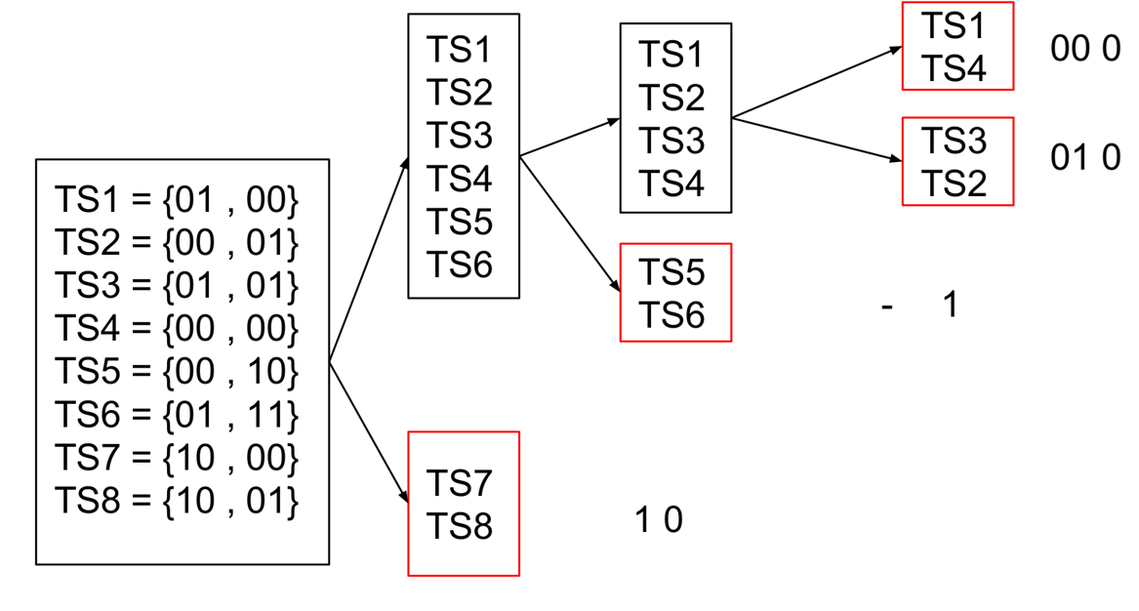
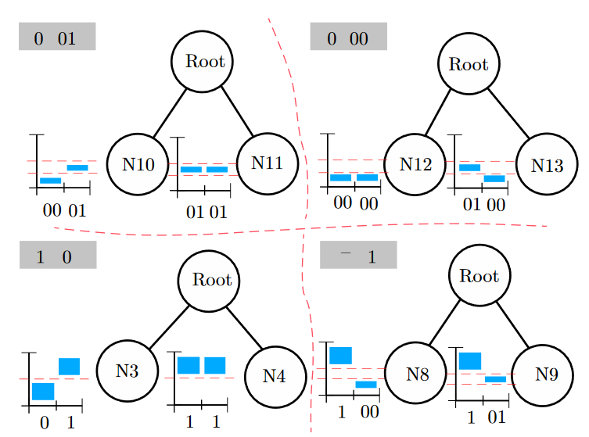
Parallelization/Distribution
Publications
  Yagoubi-ICDM‘17
  Yagoubi-TKDE’18
DPiSAX: current solution for distributed processing (Spark)
  balances work of different worker nodes
  Lavchenko-KAIS’20
Notes:
DpiSAX uses the isax summarization to effectively balance the workload of each node in the Spark cluster, before actually building the index.

Slide 127
Parallelization/Distribution
Publications
  Yagoubi-ICDM‘17
  Yagoubi-TKDE’18
DPiSAX: current solution for distributed processing (Spark)
  balances work of different worker nodes
  performs 2 orders of magnitude faster than centralized solution
  Lavchenko-KAIS’20
Notes:
This results in batch query answering 2 orders of magnitude faster than centralized approaches.

Slide 128
Parallelization/Distribution
Publications
  Yagoubi-ICDM‘17
  Yagoubi-TKDE’18
DPiSAX: current solution for distributed processing (Spark)
  balances work of different worker nodes
  performs 2 orders of magnitude faster than centralized solution
ParIS+: current solution for modern hardware
  completely masks out the CPU cost
  Lavchenko-KAIS’20
  Peng-BigData’18
  Peng-
  TKDE’21
Notes:
Following DPiSAX, specialized isax-based indexes for modern hardware were proposed.
ParIS is the current state of the art index for disk-based data that exploits the SIMD (single instruction multiple data), multi-core, and multi-socket architectures of modern hardware.

Slide 129
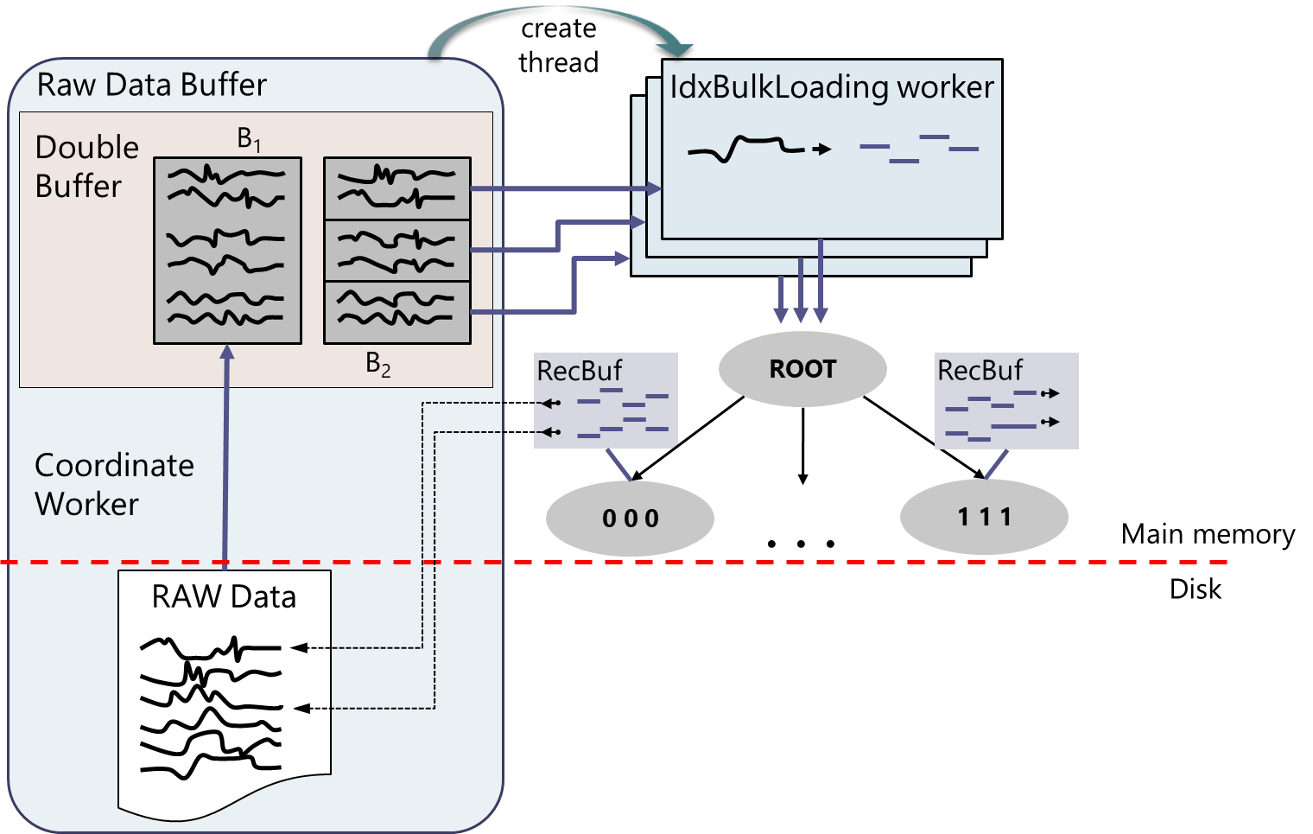
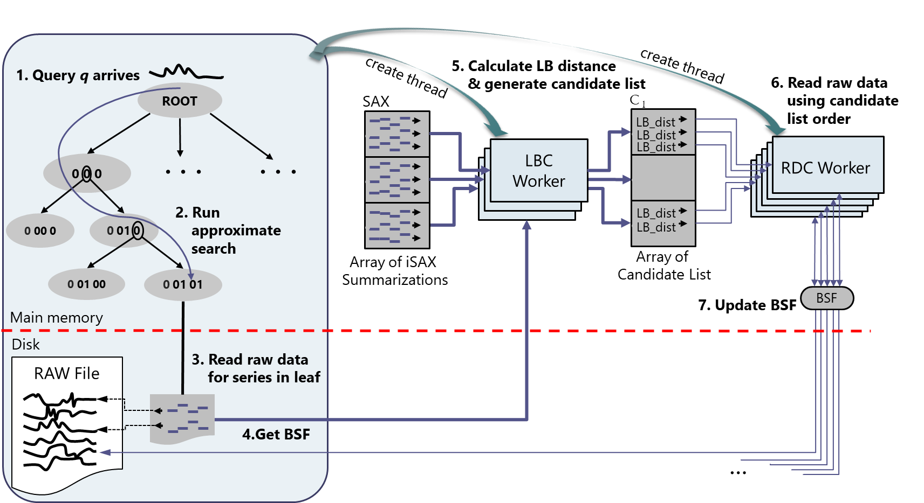
Parallelization/Distribution
Publications
  Yagoubi-ICDM‘17
  Yagoubi-TKDE’18
DPiSAX: current solution for distributed processing (Spark)
  balances work of different worker nodes
  performs 2 orders of magnitude faster than centralized solution
ParIS: current solution for modern hardware
  completely masks out the CPU cost
  Lavchenko-KAIS’20
  Peng-BigData’18
  Peng-
  TKDE’21
Notes:
Its design ensures that the CPU cost is entirely masked under the disk I/O cost.
This is true for both spinning disks and SSDs, and it seems that it will continue to be true as these storage technologies improve.

Slide 130
Parallelization/Distribution
Publications
  Yagoubi-ICDM‘17
  Yagoubi-TKDE’18
DPiSAX: current solution for distributed processing (Spark)
  balances work of different worker nodes
  performs 2 orders of magnitude faster than centralized solution
ParIS+: current solution for modern hardware
  masks out the CPU cost
  answers exact queries in the order of a few secs
    3 orders of magnitude faster then single-core solutions
  Lavchenko-KAIS’20
  Peng-BigData’18
  Peng-
  TKDE’21
Notes:
ParIS results in query answering up to 3 orders of magnitude faster than single core solutions, which has interesting implications for complex analytics tasks, as well.

Slide 131
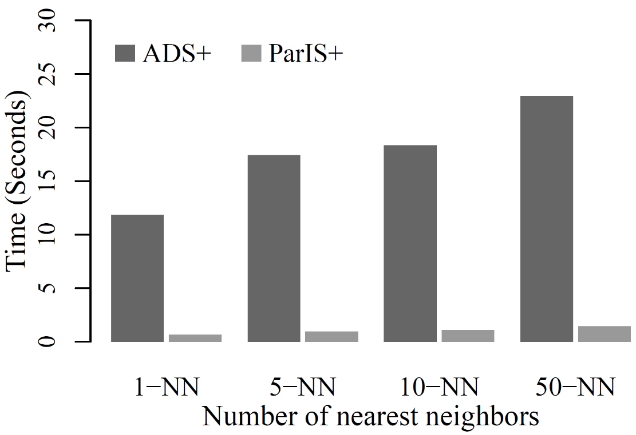
Parallelization/Distribution
Publications
  Yagoubi-ICDM‘17
  Yagoubi-TKDE’18
DPiSAX: current solution for distributed processing (Spark)
  balances work of different worker nodes
  performs 2 orders of magnitude faster than centralized solution
ParIS+: current solution for modern hardware
  masks out the CPU cost
  answers exact queries in the order of a few secs
    3 orders of magnitude faster then single-core solutions
  Lavchenko-KAIS’20
  Peng-BigData’18
  Peng-
  TKDE’21
k-NN Classification
18x faster
Notes:
When using the same hardware and data, ParIS is 18x faster than ADS+ on this task.

Slide 132
Parallelization/Distribution
Publications
  Yagoubi-ICDM‘17
  Yagoubi-TKDE’18
DPiSAX: current solution for distributed processing (Spark)
  balances work of different worker nodes
  performs 2 orders of magnitude faster than centralized solution
ParIS: current solution for modern hardware
  masks out the CPU cost
  answers exact queries in the order of a few secs
    3 orders of magnitude faster then single-core solutions
  Lavchenko-KAIS’20
  Peng-BigData’18
  Peng-
  TKDE’21
k-NN Classification
classifying 100K objects using a 100GB dataset goes down from several days to few hours!
18x faster
Notes:
This means that classification time for 100K objects goes from several days down to a few hours, all while using the same hardware.

Slide 133
Parallelization/Distribution
Publications
  Yagoubi-ICDM‘17
  Yagoubi-TKDE’18
DPiSAX: current solution for distributed processing (Spark)
  balances work of different worker nodes
  performs 2 orders of magnitude faster than centralized solution
ParIS+: current single-node parallel solution
  masks out the CPU cost
  answers exact queries in the order of a few secs
    >1 order of magnitude faster then single-core solutions
MESSI: current single-node parallel solution + in-memory data
  answers exact queries at interactive speeds: ~50msec on 100GB
  Lavchenko-KAIS’20
  Peng-BigData’18
  Peng-
  TKDE’21
  Peng-
  ICDE’20
  Peng-
  VLDBJ’21
Notes:
MESSI is an extension of ParIS for memory-resident data.
This index takes advantage of the fact that random accesses in main memory are fast, so it uses tree traversals more aggressively than ParIS for its query answering algorithm.

Slide 134
Parallelization/Distribution
Publications
  Yagoubi-ICDM‘17
  Yagoubi-TKDE’18
DPiSAX: current solution for distributed processing (Spark)
  balances work of different worker nodes
  performs 2 orders of magnitude faster than centralized solution
ParIS+: current single-node parallel solution
  masks out the CPU cost
  answers exact queries in the order of a few secs
    >1 order of magnitude faster then single-core solutions
MESSI: current single-node parallel solution + in-memory data
  answers exact queries at interactive speeds: ~50msec on 100GB
SING: current single-node parallel solution + GPU + in-memory data
  answers exact queries at interactive speeds: ~32msec on 100GB
  Lavchenko-KAIS’20
  Peng-BigData’18
  Peng-
  TKDE’21
  Peng-
  ICDE’20
  Peng-
  VLDBJ’21
  Peng-
  ICDE’21
Notes:
Finally, SING is an extension of MESSI that also takes advantage of GPU processors for similarity search query answering of memory-resident data.
SING achieves interactive query answering times for exact similarity search over 100GB sequence collections, taking a mere 32msec per query.

Slide 135
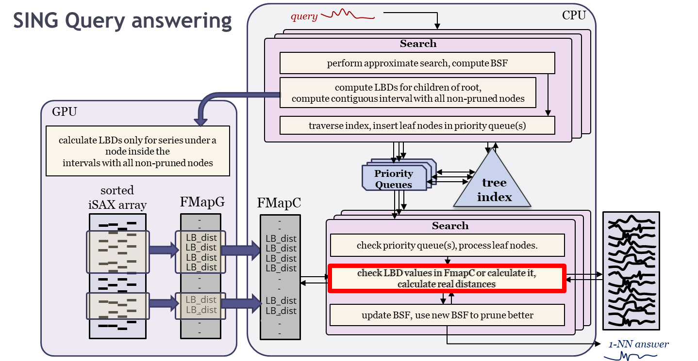
Parallelization/Distribution
Publications
  Yagoubi-ICDM‘17
  Yagoubi-TKDE’18
DPiSAX: current solution for distributed processing (Spark)
  balances work of different worker nodes
  performs 2 orders of magnitude faster than centralized solution
ParIS+: current single-node parallel solution
  masks out the CPU cost
  answers exact queries in the order of a few secs
    >1 order of magnitude faster then single-core solutions
MESSI: current single-node parallel solution + in-memory data
  answers exact queries at interactive speeds: ~50msec on 100GB
SING: current single-node parallel solution + GPU + in-memory data
  answers exact queries at interactive speeds: ~32msec on 100GB
  Lavchenko-KAIS’20
  Peng-BigData’18
  Peng-
  TKDE’21
  Peng-
  ICDE’20
  Peng-
  VLDBJ’21
  Peng-
  ICDE’21

Slide 136
iSAX Index Family
Publications
  Palpanas-ISIP‘19
timeline
2008
2010
2014
2015
2017
2018
2019
2020
basic
index
iSAX
C#
+ Bulk
Loading
iSAX 2.0
iSAX2+
iSAX2+*
C#, C
+ Adaptive
ADS / ADS+
ADSFull
ADS+*
C
+ Distributed
DPiSAX
Java
(Spark)
+ Multi-Core,
Multi-Socket, SIMD
ParIS
ParIS+
MESSI
C
+ Graphics Processing
Units (GPUs)
SING
C
+ Sortable Summarizations,
Streaming Data Series
Coconut-Trie / Coconut-Tree
Coconut-LSM
C
+ Variable-Length Queries
ULISSE
C
Timeline depicted on top; implementation languages marked on the right. Solid arrows denote inheritance of index design; dashed arrows denote inheritance of some of the design features; two new versions of iSAX2+/ADS+ marked with asterisk support approximate similarity search with deterministic and probabilistic quality guarantees.
Notes:
This slide summarizes the isax family of indexes, with a timeline from left to right, and the different functionalities that are supported vertically.
The arrows indicate which design each index inherits.
Note that all these indexes support both the Euclidean and DTW distances on z- and non z-normalized data, as well as all variations of similarity search queries that we have discussed: both exact and approximate similarity search, with and without quality guarantees.

Slide 137
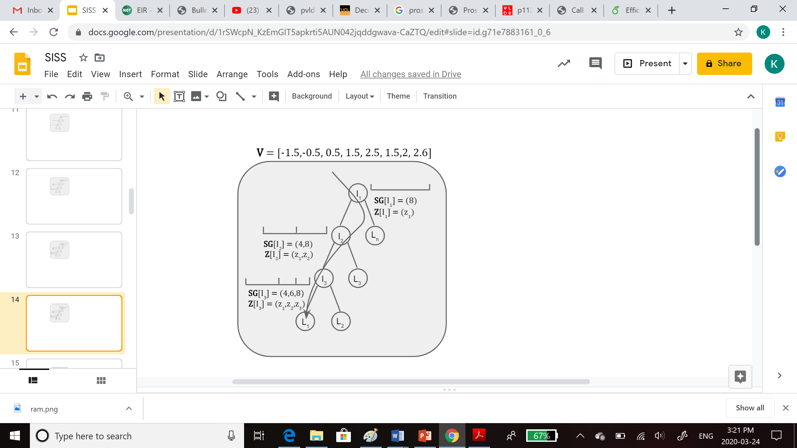
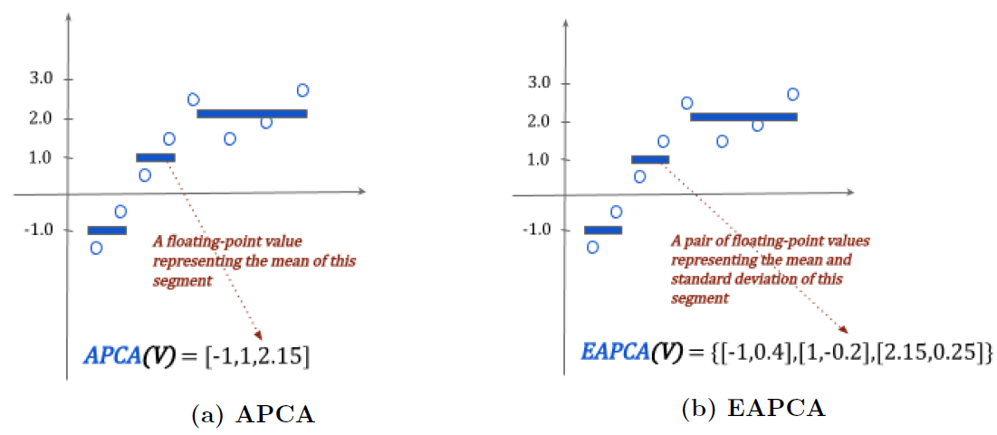
DSTree
Summarization
Publications
  Wang-PVLDB‘13
Intertwined with indexing
The APCA and EAPCA representations

Slide 138
DSTree
Indexing
Publications
  Wang-PVLDB‘13
Each node contains
# vectors
segmentation SG
synopsis Z
Each Leaf node also :
stores its raw
vectors in a separate
disk file

Slide 139










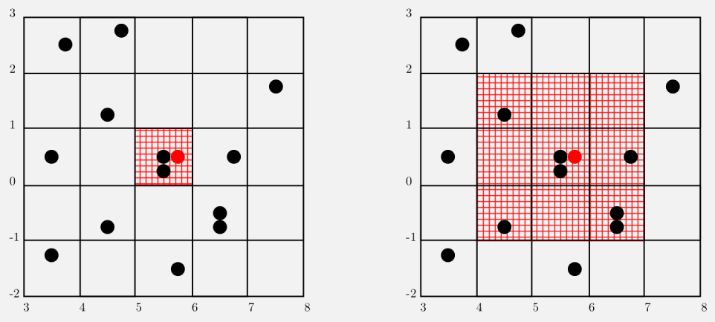
ParSketch
Publications
  Cole et al.
  KDD‘05
  Yagoubi et al.
  DMKD‘18
solution for distributed processing (Spark)
  represents data series using sketches
    using a set of random vectors (Johnson-Lindenstrauss lemma)
  define groups of dimensions in sketches
  store the values of each group in a grid (in parallel)
    each grid is kept by a node
  for ng-approximate query answering (originally proposed for ε-range queries)
    find in the grids time series that are close to the query
    finally, check the real similarity of candidates to find the results
  performs well for high-frequency series
node 1
node 2

Slide 140
Publications
  Zhang-ICDE‘19
other techniques, not covered here:
  TARDIS
  KV-Match (subsequence matching)
  L-Match (subsequence matching)
for a more complete and detailed presentation, see tutorial:
  Karima Echihabi, Kostas Zoumpatianos, Themis Palpanas. Big Sequence Management: Scaling Up and Out. EDBT 2021
  Wu-
  ICDE‘19
  Feng-
  IEEE Access‘20
  Echihabi-
  EDBT‘21

Slide 141
Questions?

Slide 142
High-d Vector Similarity Search
State-of-the-Art Methods

Slide 143
High-d Vector Similarity Search Methods
Tree-Based Methods
Hash-Based Methods
Quantization-Based Methods
Graph-Based Methods

Slide 144
High-d Vector Similarity Search
State-of-the-Art Methods
Tree-Based Methods

Slide 145
Tree-Based Methods
Publications
  Bentley
  CACM’75
A large body of work
Some representative methods:
  KD-tree
Notes:
The KD-tree was introduced by Bentley as a generalization of a binary tree to high dimensions.. The difference is that each level of the tree branches based on a particular dimension associated with that level.

Slide 146
Tree-Based Methods
Publications
  Bentley
  CACM’75
  Silpa-Anan
  CVPR’08
A large body of work
Some representative methods:
  KD-tree
  Randomized KD-tree
Notes:
Although KD-trees are relatively effective and efficient in low dimensions, their efficiency diminishes for high dimensional data. Silpa-Anan and Hartley presented the idea of multiple randomized k-d trees. The trees are built in a similar manner to the classic k-d tree, with the difference that where the classic kd-tree algorithm splits data on the dimension with the highest variance, for the randomized k-d trees the split dimension is chosen randomly from the top ND dimensions with the highest variance.

Slide 147
Tree-Based Methods
Publications
  Bentley
  CACM’75
  Silpa-Anan
  CVPR’08
A large body of work
Some representative methods:
  KD-tree
  Randomized KD-tree
  FLANN
  Muja et al.
  VISAPP’09
Notes:
Muja and Lowe proposed a method called hierarchical k-means trees and identified that the latter in addition to the randomized kd-trees discussed earlier are the two best algorithms for KNN querying: randomized k-d trees and hierarchical k-means trees. They also presented an algorithm that selects optimum parameters for the algorithms in terms of speed and accuracy criteria.

Slide 148
Tree-Based Methods
Publications
  Bentley
  CACM’75
  Silpa-Anan
  CVPR’08
A large body of work
Some representative methods:
  KD-tree
  Randomized KD-tree
  FLANN
  Mtree
  Muja et al.
  VISAPP’09
  Ciaccia et al.
  VLDB’97
  Ciaccia et al.
  ICDE’00
Notes:
The Mtree is a solution for similarity search in the metric space. It was first proposed for exact search then extended to support also d-e-approximate search.

Slide 149
Tree-Based Methods
Publications
  Bentley
  CACM’75
  Silpa-Anan
  CVPR’08
A large body of work
Some representative methods:
  KD-tree
  Randomized KD-tree
  FLANN
  Mtree
  HD-Index
  Muja et al.
  VISAPP’09
  Ciaccia et al.
  VLDB’97
  Ciaccia et al.
  ICDE’00
  Arora et al.
  PVLDB‘18
Notes:
The HD-Index is a solution for ng-approximate similarity search, HD-Index consists of a set of novel hierarchical structures called RDB-trees built on Hilbert keys of database objects. The leaves of the RDB-trees store distances of database objects to reference objects, thereby allowing efficient pruning using distance filters. In addition to triangular inequality, we also use Ptolemaic inequality to produce better lower bounds

Slide 150
Tree-Based Methods
Publications
  Bentley
  CACM’75
  Silpa-Anan
  CVPR’08
A large body of work
Some representative methods:
  KD-tree
  Randomized KD-tree
  FLANN
  Mtree
  HD-Index
for a more complete and detailed presentation, see tutorial:
  Karima Echihabi, Kostas Zoumpatianos, Themis Palpanas. High-Dimensional Similarity Search for Scalable Data Science. ICDE 2021
  Muja et al.
  VISAPP’09
  Ciaccia et al.
  VLDB’97
  Ciaccia et al.
  ICDE’00
  Arora et al.
  PVLDB‘18
  Echihabi et al.
  ICDE‘21
Notes:
The HD-Index is a solution for ng-approximate similarity search, HD-Index consists of a set of novel hierarchical structures called RDB-trees built on Hilbert keys of database objects. The leaves of the RDB-trees store distances of database objects to reference objects, thereby allowing efficient pruning using distance filters. In addition to triangular inequality, we also use Ptolemaic inequality to produce better lower bounds

Slide 151
High-d Vector Similarity Search
State-of-the-Art Methods
Hash-Based Methods

Slide 152
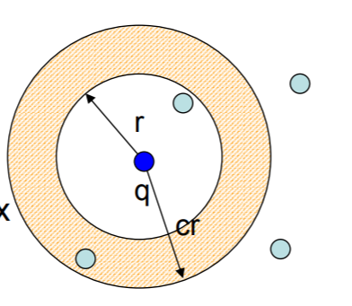
Locality Sensitive Hashing (LSH)
Publications
  Indyk et al.
  STOC’98
Solution for δ-ε-approximate kNN search δ < 1
Random projections into a lower dimensional space using hashing
Probability of collisions increases with locality
c-Approximate r-Near Neighbor: build data structure which, for any query q:
  If there is a point p ∈P, ||p-q|| ≤ r Then return p’ ∈ P, ||p-q|| ≤ c r
c-approximate nearest neighbor reduces to c-approximate near neighbor
  Enumerate all approximate near neighbors
Find a vector in a preprocessed set S ⊆ {0, 1} d that has minimum Hamming distance to a query vector y ∈ {0, 1} d
(r₁, r₂, p₁, p₂)-sensitive [IM98]
Pr[ h(x) = h(y) ] ≥ p₁ , if dist(x, y) ≤ r₁
Pr[ h(x) = h(y) ] ≤ p₂ , if dist(x, y) ≥ r₂
Notes:
The LSH family encompasses a class of randomized algorithms that solve the δ-ǫ-approximate nearest neighbor problem in sub-linear time, for δ < 1. The main intuition is that two points that are nearby in a high dimensional space, will remain nearby when projected to a lower dimensional space.

Slide 153
Locality Sensitive Hashing (LSH)
Publications
  Andoni et al.
  CACM’08
A large family
  Different distance measures:
    Hamming distance
    L_{p} (0 < p ≤ 2): use p-stable distribution to generate the projection vector
    Angular distance (simHash)
    Jaccard distance (minhash)
  Tighter Theoretical Bounds
  Better query efficiency/smaller index size
Notes:
There exist many variants of LSH, either proposing different hash functions to support particular similarity measures [29, 51, 36, 61], or improving the theoretical bounds on query accuracy (i.e., δ or ǫ), query efficiency or the index size [98, 120, 109, 100, 61, 115, 142, 71] [99].

Slide 154
Probabilistic Mapping
d dims
m dims
P
𝜋(O) = [h₁(O), h₂(O), …, h_{m}(O)]
𝜋(P)
Probabilistic, linear mapping from the original space to the projected space
Slide by W. Wang

Slide 155
Probabilistic Mapping
d dims
m dims
𝜋(Q)
P
𝜋(O) = [h₁(O), h₂(O), …, h_{m}(O)]
ProjDist(P)
Dist(P)
𝜋(P)
Q
Probabilistic, linear mapping from the original space to the projected space
What about the distances (wrt Q or 𝜋(Q)) in these two spaces?
Slide by W. Wang

Slide 156
SRS
Publications
  Sun et al.
  PVLDB’ 14
d dims
m dims
𝜋(Q)
𝜋(O) = [h₁(O), h₂(O), …, h_{m}(O)]
P
ProjDist(P)
Dist(P)
𝜋(P)
Q
ProjDist(P)² ~ Dist(P)² * χ²_{m}
Given that ProjDist(P) ≤ r, what can we infer about Dist(P)?
  If Dist(P) ≤ R, then Pr[ ProjDist(P) ≤ r ] ≥ Ψ_{m}( (r/R)² )
  If Dist(P) > cR, then Pr[ ProjDist(P) ≤ r ] ≤ Ψ_{m}( (r/cR)² ) = t
  (some probability) at most O(tn) points with ProjDist ≤ R
  (constant probability) one of the O(tn) points has Dist ≤ R
This solves the so-called (R, c)-NN queries ➔ returns a c² ANN
Using another algorithm & proof ➔ returns a c-ANN
Slide by W. Wang
Notes:
We will describe in more detail, three LSH methods: SRS, QALSH and VHP because they are considered the state-of-the-art in terms of footprint, efficiency or accuracy.
LSH provides a probabilistic distance-preserving mapping between the two spaces. Sun et al. proposed a technique called SRS which exploits a very interesting property: the pair-wise distance in the projected space (called projected distance) over that in the original high-dimensional space follows a known distribution (chi-square).
SRS answers δǫ-approximate queries using an index that is linear in the dataset size, by performing an incremental exact top-k NN search in the projected space.

Slide 157
C2LSH/QALSH
Publications
  Huang et al.
  PVLDB’ 15
  Gan et al.
  SIGMOD’12
d dims
m dims
𝜋(Q)
P
𝜋(O) = [h₁(O), h₂(O), …, h_{m}(O)]
ProjDist(P)
Dist(P)
𝜋(P)
Q
Collision wrt w: if |h_{i}(P) – h_{i}(Q)| ≤ w
Given that P’s #collision ≥ 𝛼m, what can we infer about Dist(P)?
  If Dist(P) ≤ R, then Pr[ #collision ≥ 𝛼m ] ≥ 𝛾₁
  If Dist(P) > cR, then Pr[ #collision ≥ 𝛼m ] ≤ 𝛾₂
  (some probability) at most O(𝛾₂*n) points with #collision ≥ 𝛼m
  (constant probability) one of the O(𝛾₂*n) points has #collision ≥ 𝛼m
Slide by W. Wang
Notes:
While SRS makes inference on the real distance based on the projected distance, QALSH and C2LSH rely on the number of collisions to infer information about the real distances.

Slide 158








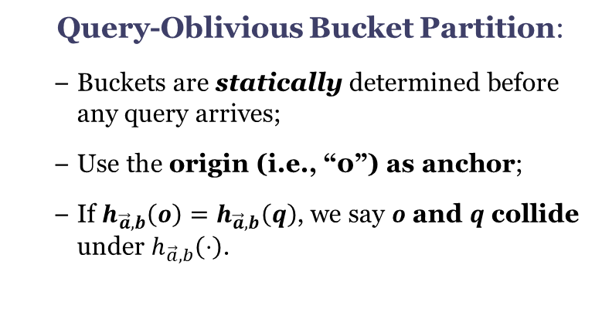




Query-oblivious LSH functions
Publications
  Huang et al.
  PVLDB’15
The query-oblivious LSH functions for Euclidean distance:
  $$h_{\vec{a},b}\left(o\right)=\left\lfloor \frac{\vec{a}⋅\vec{o}+b}{w}\right\rfloor$$
$$y$$
Query-Oblivious Bucket Partition:
  Buckets are statically determined before any query arrives;
  Use the origin (i.e., “0”) as anchor;
  If $h_{\vec{a},b}\left(o\right)=h_{\vec{a},b}\left(q\right)$, we say $o$ and $q$ collide under $h_{\vec{a},b}\left(⋅\right)$.
$$o$$
$$\vec{a}$$
random projection
$$w$$
$$w$$
$$\vec{a}⋅\vec{o}+b$$
$$w$$
$$\vec{a}⋅\vec{o}$$
random shift $b$
$$0$$
$$x$$
Slide by Q. Huang
Notes:
QALSH is a query-aware LSH technique that partitions points into buckets using the query as anchor. Other LSH methods typically partition data points before a query arrives, using a random projection followed by a random shift.

Slide 159


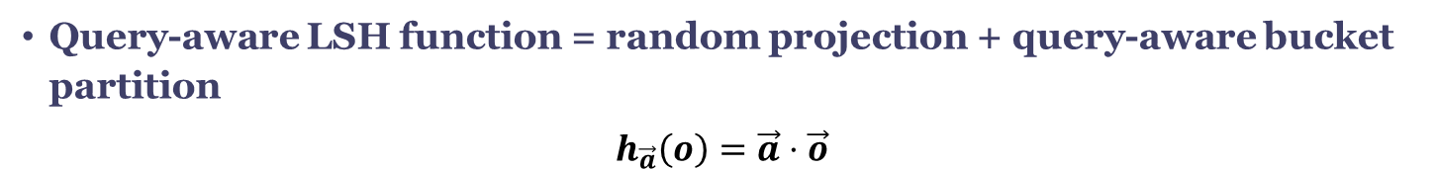





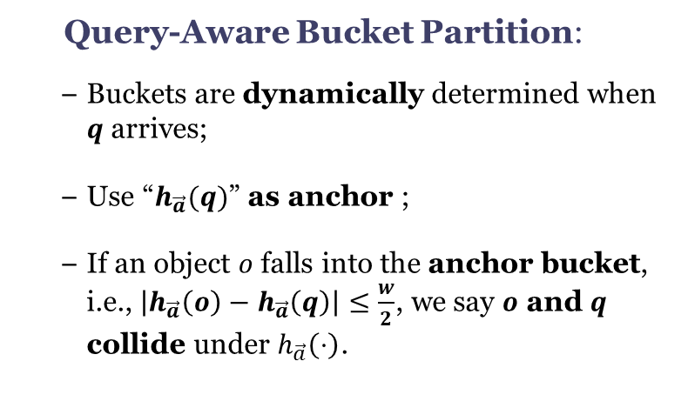

QALSH
Publications
  Huang et al.
  PVLDB’ 15
Query-aware LSH function = random projection + query-aware bucket partition
$$h_{\vec{a}}\left(o\right)=\vec{a}⋅\vec{o}$$
$$y$$
Query-Aware Bucket Partition:
  Buckets are dynamically determined when $q$ arrives;
  Use “$h_{\vec{a}}(q)$” as anchor ;
  If an object $o$ falls into the anchor bucket, i.e., $\left|h_{\vec{a}}\left(o\right)−h_{\vec{a}}\left(q\right)\right|≤\frac{w}{2}$, we say $o$ and $q$ collide under $h_{\vec{a}}\left(⋅\right)$.
$$q$$
random projection
$$\vec{a}$$
$$o_{1}$$
$$w/2$$
$$h_{\vec{a}}(o_{2})$$
$$w/2$$
$$h_{\vec{a}}(q)$$
$$o_{2}$$
$$h_{\vec{a}}(o_{1})$$
$$0$$
$$x$$
Slide by Q. Huang
Notes:
QALSH, does not perform the second step until a query arrives, thus improving the likelihood that points similar to the query are mapped to the same bucket.

Slide 160
VHP
Publications
  Lu et al.
  PVLDB’ 20
Solution for δ-ε-approximate kNN search
  Indexing:
    Store LSH projections with independent
    B+ trees.
  Querying
    Impose a virtual hypersphere in the original high-d space
    Keep enlarging the virtual hypersphere to accommodate more candidate until the success probability is met
Slide by W. Wang
Notes:
Another method by Lu et al. stores LSH projections with independent B+ tree. During querying, it imposes a virtual hypersphere, centered at the query, in the original feature space and only examine points inside the hypersphere. To represent this virtual hypersphere, it uses multiple physical hyperspheres with different radii in corresponding projection subspaces. This results in better efficiency-accuracy tradeoffs.

Slide 161
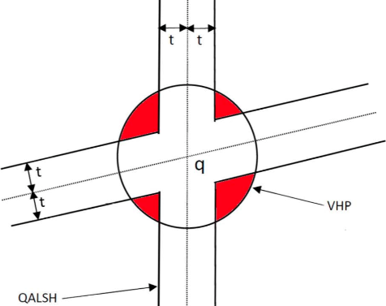
Some Comparisons
Publications
  Huang et al.
  PVLDB’ 15
Candidate Conditions
Method | Collision Count | (Observed) Distance | Max Candidates
SRS | = m | ≤ r | T
QALSH | ≥ 𝛼m | n/a | 𝛽n
VHP | ≥ i (i = 1, 2, …, m) | ≤ l_{i} | 𝛽n
SRS
VHP
Candidate Regions
VHP = SRS ∩ QALSH
Slide by W. Wang
Notes:
Let’s look at a comparison between SRS/QALSH and the VHP.
An illustrative example of the search spaces of virtual sphere partitioning and collision-threshold-based filtering. The dimensionality d of the feature space is 2, the number of hash functions m is 2 and the collision threshold L is set to 1. The search window is of size 2t. The crossroad-like region is the search space of collision-threshold-based filtering, which is irregular and unbounded. Points in this region are estimated to be the NNs by QALSH. In contrast, virtual sphere partitioning imposes a virtual hypersphere in the feature space, which is isotropic and bounded. Points whose distances to q are less than the radius of the hypersphere (in estimation) are regarded as candidates.

Slide 162
High-d Vector Similarity Search
State-of-the-Art Methods
Quantization-Based Methods

Slide 163
Quantization
A lossy compression process that maps a set of infinite numbers to a finite set of codewords that together constitute the codebook:
  Scalar Quantization
    Operates on the individual dimensions of the original vector independently
  Vector Quantization
    Considers the original vector as a whole
  Product Quantization
    Splits the original vector of dimension d into m smaller subvectors, on which a lower-complexity vector quantization is performed. The codebook consists of the cartesian product of the codebooks of the m subquantizers.
  Scalar and vector quantization are special cases of product quantization, where m is equal to d and 1, respectively

Slide 164
VA-file
Publications
A solution for exact kNN search
The basic idea of the VA-file is to speed-up the sequential scan by exploiting a “Vector Approximation”
Each dimension of the data space is partitioned into 2^{bi} intervals using b_{i} bits (scalar quantization)
  E.g.: the 1st coordinate uses 2 bits, which leads to the intervals 00,01,10, and 11
Thus, each coordinate of a point (vector) requires now b_{i} bits instead of 32
The VA-file stores, for each point of the dataset, its approximation, which is a vector of ∑_{i=1,D} b_{i} bits
  Blott et. al
  VLDB’98
p3
11
10
01
00
 | 00 | 01 | 10 | 11
Feature values
VA-file
p1
p1 | 0.1 0.6
p2 | 0.7 0.4
p3 | 0.9 0.3
p1 | 00 10
p2 | 10 01
p3 | 11 11
Data space
p2
Slides by M. Patella.

Slide 165
VA-file
Publications
Query processing with the VA-file is based on a filter & refine approach
For simplicity, consider a range query
Filter: the VA file is accessed and only the points in the regions that intersect the query region are kept
Refine: the feature vectors are retrieved and an exact check is made
  Blott et. al
  VLDB’98
r
q
actual results
false drops
excluded points
Slides by M. Patella.

Slide 166
VA+file
Publications
  Ferhatosmanoglu
  et al.
  CIKM’00
Solution for exact kNN search
An improvement of the VA-file method:
  Does not assume that neighboring dimensions are uncorrelated
  Decorrelates the data using KLT
  Allocates bits per dimension in a non-uniform fashion
  Partitions each dimension using k-means instead of equi-depth
Notes:
While both methods create a filter file containing quantization-based approximations of the high dimensional data, and share the same exact search algorithm, the VA+file does not assume that neighboring points (dimensions) in the feature vector are uncorrelated. It thus improves the accuracy of the approximations by allocating bits per dimension in a non-uniform fashion, and partitioning each dimension using a k-means (instead of an equi-depth approach).

Slide 167
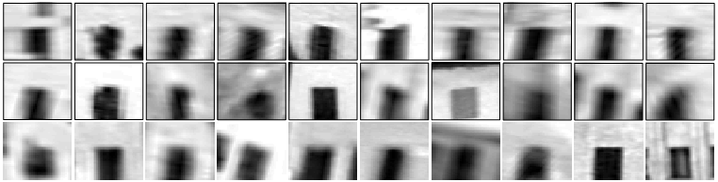
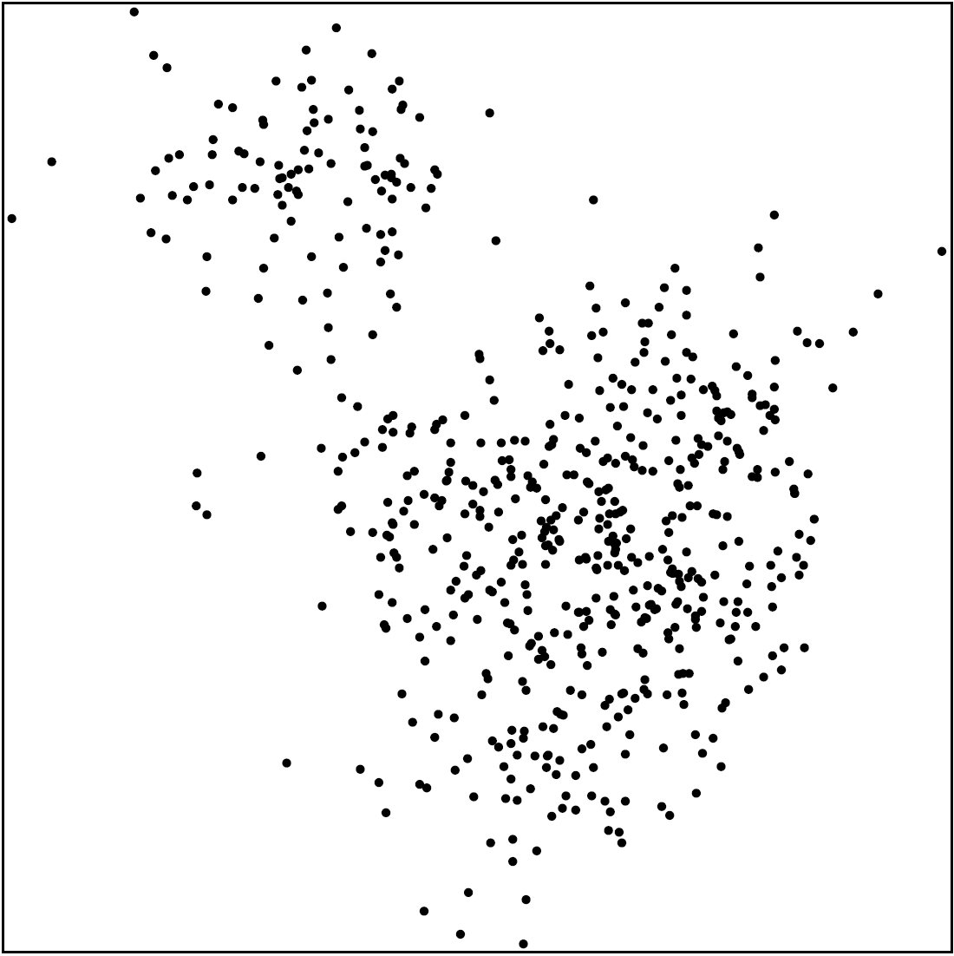
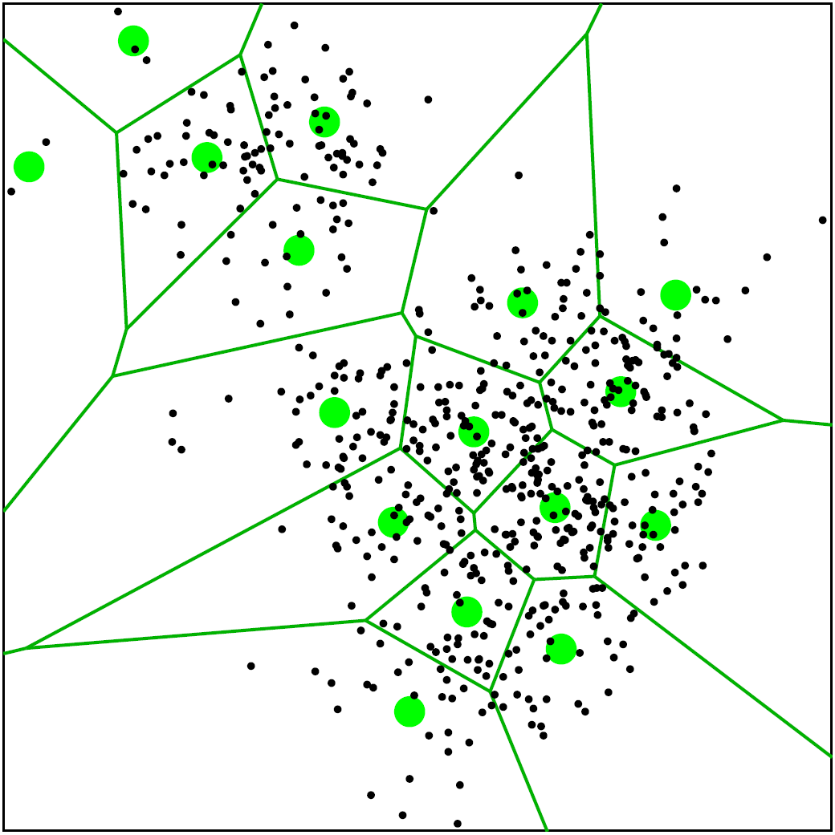
The Inverted Index
Publications
  Sivic et al.
  ICCV’ 03
"Visual word"
Visual codebook
Slide by A. Babenko
Notes:
We have seen the VA and VA+files which exploit scalar quantization. In this slide, we present the inverted index which exploits vector quantization.
A popular quantization-based technique is the inverted index which splits the feature space into Voronoi regions for a set of K-Means centroids.
The codebook consists of the set of centroids.

Slide 168
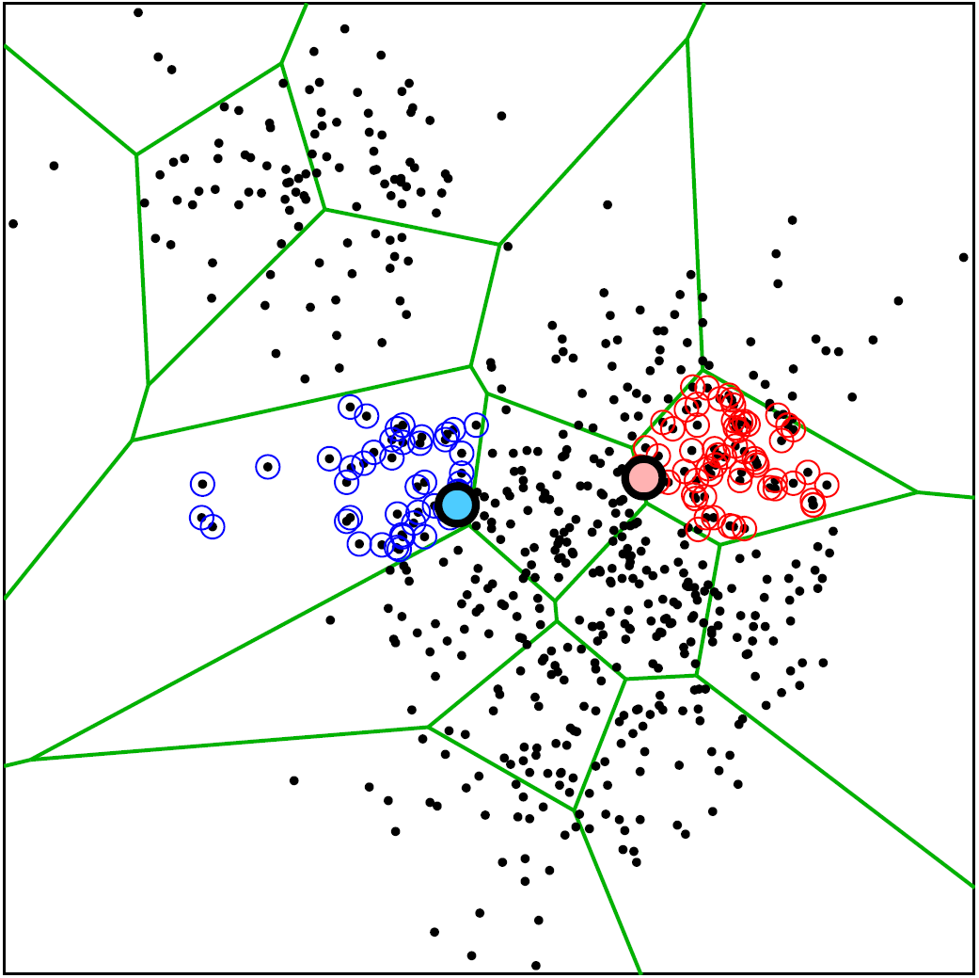
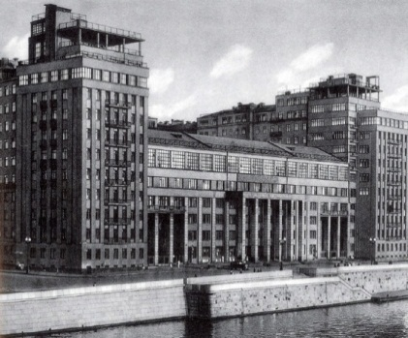
Querying the Inverted Index
Publications
Query:
  Sivic et al.
  ICCV’ 03
Have to consider several words for best accuracy
Want to use as big codebook as possible
Want to spend as little time as possible for matching to codebooks
conflict
Slide by A. Babenko
Notes:
During search, only the closest regions are investigated for a particular query. We show two example queries, one in blue and one in red. The lists returned by the inverted index (left) contain 45 and 62 words respectively (circled). Note that when a query lies near a space partition boundary (as happens most often in high dimensions) the resulting list is heavily “skewed” and may not contain many of the nearest neighbors.

Slide 169
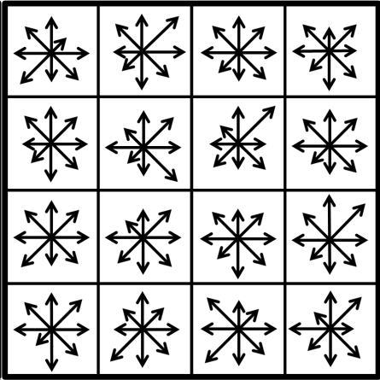
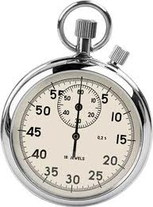

Product Quantization
Publications
  Jegou et al.
  TPAMI’ 11
Split vector into correlated subvectors
use separate small codebook for each chunk
Quantization vs. Product quantization:
For a budget of 4 bytes per descriptor:
Can use a single codebook with 1 billion codewords many minutes 128GB
Can use 4 different codebooks with 256 codewords each < 1 millisecond 32KB
IVFADC+ variants (state-of-the-art for billion scale datasets) =
inverted index for indexing + product quantization for reranking
Slide by A. Babenko
Notes:
A scalar quantizer operates on the individual dimensions of a vector independently, whereas a vector quantizer considers the vector as a whole (leveraging the correlation between dimensions [66]). The size k of a codebook increases exponentially with the number of bits allocated for each code. A product quantizer [74] splits the original vector of dimension d into m smaller subvectors, on which a lower-complexity vector quantization is performed. The codebook then consists of the cartesian product of the codebooks of the m subquantizers. Scalar and vector quantization are special cases of product quantization, where m is equal to d and 1, respectively.

Slide 170
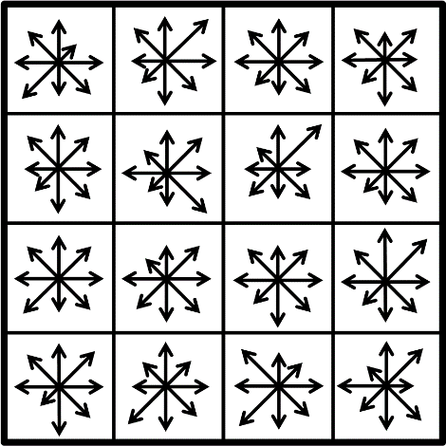
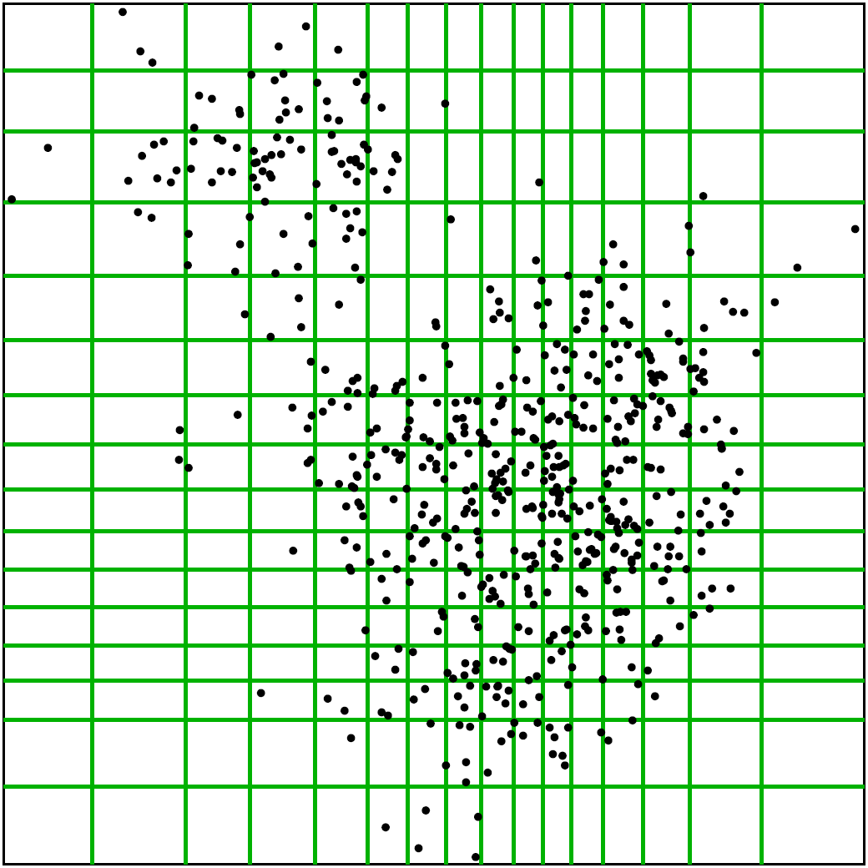
The Inverted Multi-Index
Publications
  Babenko et al.
  TPAMI’ 12
Idea: use product quantization
for indexing
Main advantage:
For the same K, much finer subdivision achieved
Main problem:
Very non-uniform entry size distribution
Slide by A. Babenko
Notes:
Later a generalization of the inverted index structure was proposed by Babenko et al. This work introduced the inverted multi-index (IMI) that decomposes the feature space into several orthogonal subspaces and partitions each subspace into Voronoi regions independently. Then the Cartesian product of regions in each subspace forms the implicit partition of the whole feature space. In this example, the space is partitioned into two subspaces, with each subspace having its own codebook.
Due to a huge number of regions, the IMI space partition is very fine-grained, and each region contains only a few data points. Therefore, IMI forms accurate and concise candidate lists while being memory and runtime efficient.

Slide 171
Querying the Inverted Multi-Index
Publications
Input: query
Output: stream of entries
  Babenko et al.
  TPAMI’ 12
Answer to the query:
9
3
4
8
10
1
2
7
5
6
Slide by A. Babenko
Notes:
The Inverted Multi-Index uses a multi-sequence procedure that produces the sequence of regions that are closest to the particular query. By visiting more regions than in the inverted index, the resulting vector sets span the neighborhoods that are much less “skewed”.

Slide 172
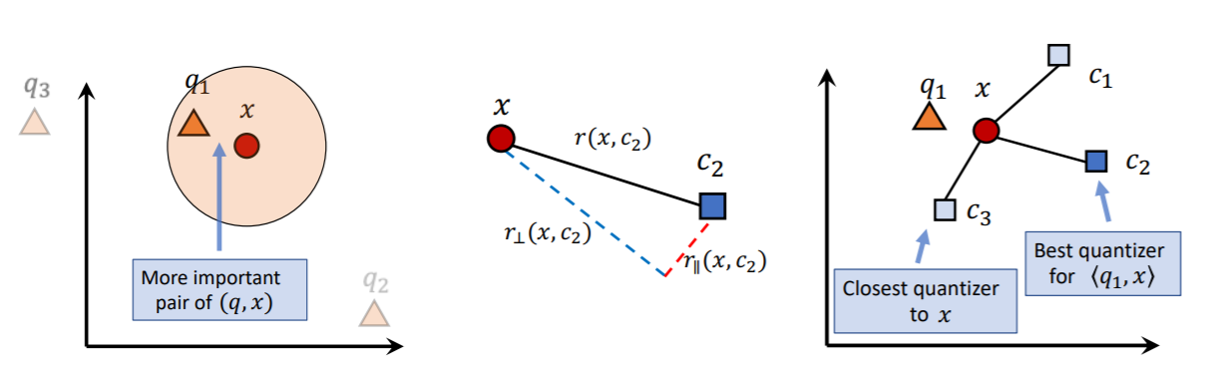
Google ScaNN
Publications
  Guo-ICML’20
Quantization-based similarity search using MIPS
  A novel score-aware loss function:
    The approximation error on the pairs which have a high inner product is far more important than that of pairs whose inner product is low.

Slide 173
Google ScaNN
Publications
  Guo-ICML’20
Quantization-based similarity search using MIPS
  A novel score-aware loss function:
    The approximation error on the pairs which have a high inner product is far more important than that of pairs whose inner product is low.

Slide 174
High-d Vector Similarity Search
State-of-the-Art Methods
Graph-Based Methods

Slide 175
Conceptual Graphs
Voronoi/Delaunay Diagrams
kNN Graphs
Navigable Small World Graphs
Relative Neighborhood graphs
Notes:
State-of-the art graph-based similarity search algorithms exploit several graph models including the Delaunay graph, kNN graph, NSW graph and RNG graphs.
In the next slides we will describe each in mode detail.

Slide 176
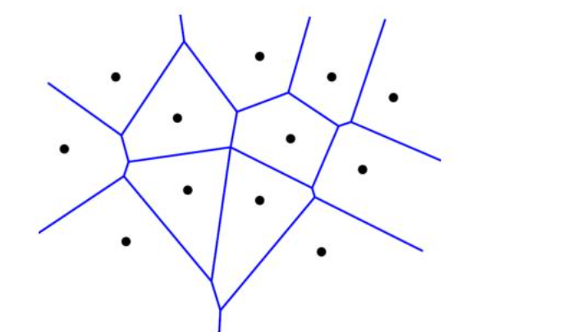
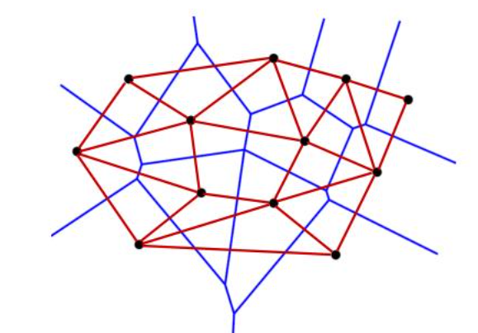
The Delaunay Diagram
Publications
  Delaunay
  CSMN’ 39
Delaunay Diagram – Dual of Voronoi Diagram
The VD is constructed by decomposing the space using a finite number of points, called sites into regions, such that each site is associated to a region consisting of all points closer to it than to any other site.
The DT is the dual of the VD, constructed by connecting sites with an edge if their regions share a side.
Voronoi Diagram
Delaunay Diagram
Notes:
A VD is obtained when a given space is decomposed using a finite number of points, called sites, into regions such that each site is associated with a region consisting of all points that are closer to it than to any other site. The DT is the dual of the VD. It is constructed by connecting sites with an edge if their regions share a side.

Slide 177
kNN Graphs
Publications
  Anastasiu et al.
  CIKM’ 15
  Dong et al.
  WWW’ 11
Exact kNN graphs on n d-dimensional points:
  Each point in the space is considered a node
  A directed edge is added between nodes node A and B (A -=> B) if B is a kNN of A
  O(dn²)
  Example: L2knng
Approximate kNN Graphs:
  LSH
  Heuristics
    Example: NN-Descent: “a neighbor of a neighbor is also likely to be a neighbor”
Notes:
The NN descent graph is initialized by having each point randomly pick K neighbors. Then each point explores its current neighbors’ neighbors and updates its K-NN list if better ones are found. The algorithms stops when no further improvements can be made.

Slide 178
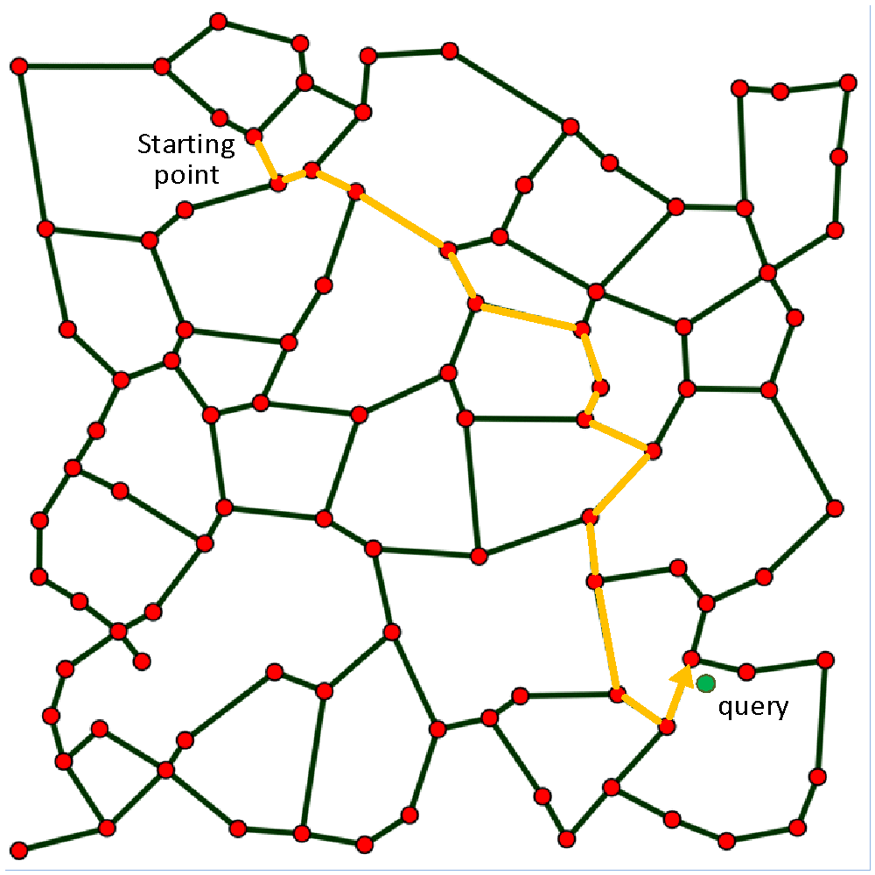
NSW Graphs
Publications
  Kleinberg
  STOC’ 00
Augment approximate kNN graphs with long range links:
  Milgram experiment
  Shorten the greedy algorithm path to log(N)
Notes:
Another popular Graph model is the NSW graph. NSW graphs are networks with logarithmic or polylogarithmic complexity of the greedy graph search. They are typically built on top of approximate kNN graphs adding long range links to shorten the greedy algorithm path down to log(N). The idea is inspired from the Milgram experiment which demonstrated that a social network exhibits the small-world phenomenon if, roughly speaking, any two individuals in the network are likely to be connected through a short sequence of intermediate acquaintances. This is also known as the 6 degrees of separation. Kleinberg (2000) gave formal support to this so-called “small world phenomenon” by using meshes augmented with long-range links chosen randomly according to harmonic distributions.
Backup text: Milgram's basic small-world experiment remains one of the most compelling ways to think about the problem. The goal of the experiment was to find short chains of acquaintances linking pairs of people in the United States who did not know one another. In a typical instance of the experiment, a source person in Nebraska would be given a letter to deliver to a target person in Massachusetts. The source would initially be told basic information about the target, including his address and occupation; the source would then be instructed to send the letter to someone she knew on a first-name basis in an effort to transmit the letter to the target as efficaciously as possible. Anyone subsequently receiving the letter would be given the same instructions, and the chain of communication would continue until the target was reached. Over many trials, the average number of intermediate steps in a successful chain was found to lie between five and six, a quantity that has since entered popular culture as the ``six degrees of separation'' principle

Slide 179
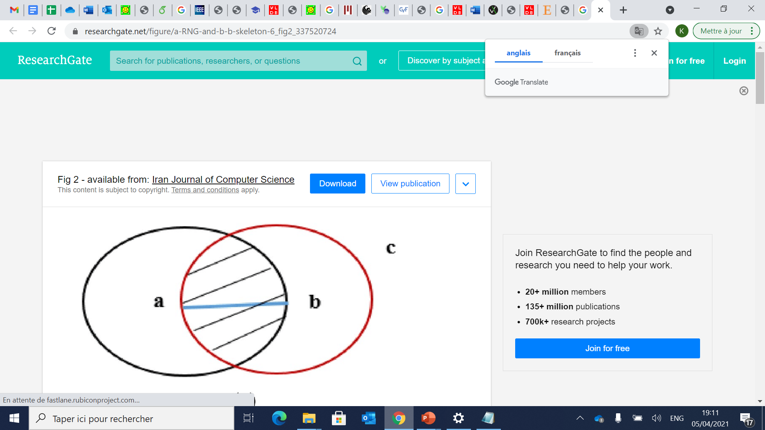
Relative Neighbourhood graph (RNG)
Publications
  Toussaint
  Pat. Recognit.’80
A superset of the minimal spanning tree (MST) and a subset of the Delaunay Diagram.
Two algorithms for obtaining the RNG of n points on the plane:
  An algorithm for 1-d space in 0(n2) time
  Another algorithm for d-dimensional spaces running in 0(n3).
An edge is constructed between two vertices if there is no vertex in the intersection of the two balls
Notes:
Toussaint has shown that the RNG is a special graph that is a superset of the MST and a subset of the DT. He proposed two algorithms for building an RNG. One in n square and the other in n cube, the latter supporting also d-dimensional data. RNGs adopt an interesting edge selection strategy to eliminate the longest edge in all the possible triangles on S. In fact, an edge is constructed between two vertices if there is no vertex in the intersection of the two balls around the vertices

Slide 180
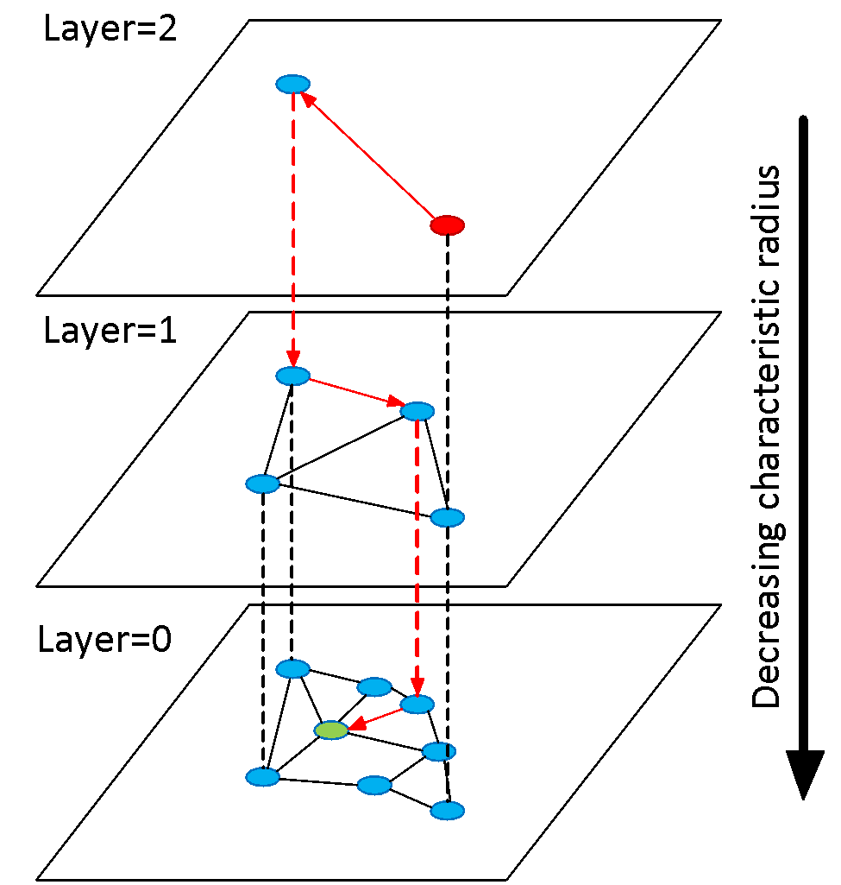
HNSW
Publications
  Malkov et al.
  TPAMI’ 20
  Arxiv’16
In HNSW we split the graph into layers (fewer elements at higher levels)
Search starts for the top layer. Greedy routing at each level and descend to the next layer.
Maximum degree is capped while paths ~ log(N) → log(N) complexity scaling.
Incremental construction
N₂=N/4
N₁=N/2
N₀=N
Slides by Malkov
Notes:
The HNSW exploits RNG and NSW graphs, It splits the NSW graph into hierarchical layers which improves the search efficiency of NSW. Search starts at the top layer, which contains only the longest links, and proceeds down the hierarchy. HNSW is considered the state-of-the-art in ng-approximate search.

Slide 181
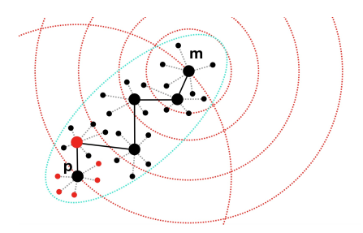
Navigating Speading-out Graph (NSG)
Publications
  Fu et al.
  PVLDB’ 19
RNGs do not guarantee monotonic search
  There exists at least one monotonic path. Following this path, the query can be approached with the distance decreasing monotonically
Propose a Monotonic RNG (MRNG)
Build an approximate kNN graph.
Find the Navigating Node. (All search will start with this fixed node – center of the graph ).
For each node p, find a relatively small candidate neighbour set. (sparse)
Select the edges for p according to the definition
of MRNG. (low complexity)
leverage Depth-First-Search tree (connectivity)
Slides by Fu

Slide 182
Other tutorials
for a more complete and detailed presentation, see tutorials:
  Jianbin Qin, Wei Wang, Chuan Xiao, Ying Zhang: Similarity Query Processing for High-Dimensional Data. PVLDB. 13(12): 3437-3440 (2020).
  Karima Echihabi, Kostas Zoumpatianos, Themis Palpanas. High-Dimensional Similarity Search for Scalable Data Science. ICDE 2021

Slide 183
High-d Vector Similarity Search
State-of-the-Art Methods
Modern Hardware
& Distribution
Notes:
We will discuss next high-d vector similarity search designed for modern hardware and distributed environments. We selected some of the key methods in this area although it is not clear how these methods compare to each other. This is still an open problem.

Slide 184
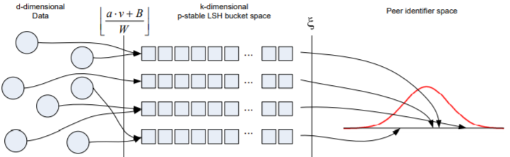
Distributed LSH
Publications
  Haghani-EDBT’09
A two-level mapping strategy
  Condition 1: assign buckets likely to hold similar data to the same peer.
  Condition 2: have a predictable output distribution which fosters fair load balancing.
Theoretical guarantees on locality preserving properties of the mapping
Significant improvement over state-of-the-art
Notes:
The figure shows an illustration of the overall mapping from the d-dimensional space, to the k-dimensional LSH buckets, to finally the peer identifier space using ξ. Different instances of the mapping function ξ come with different characteristics w.r.t. to load balancing and the ability to efficiently search the index. In terms of network bandwidth consumption and number of network hops, clearly, a mapping of all data to just one peer is optimal. Obviously, this mapping suffers from a huge load imbalance. The other extreme is to assign each hash bucket to a peer using a pseudo-uniform hash function that provides perfect load balancing but steals any control on grouping similar buckets on the same peer, therefore causing an excessive number of DHT lookups.
To capture the semantics of similar buckets, the intuition is that buckets likely to hold close data have small l1 distance to each other.
Streaming Similarity Search over one Billion Tweets using Parallel Locality-Sensitive Hashing
P. Haghani, S. Michel, and K. Aberer. Distributed similarity search in high dimensions using locality sensitive hashing. In EDBT, pages 744–755, 2009.

Slide 185
Layered LSH
Publications
  Bahmani-CIKM’12
One of the early works
Entropy-based LSH in Euclidean space
Apache Hadoop for disk-based version
Twitter storm for in-memory version
Theoretical guarantees
  Only for the single hash tables setting
Notes:
Both Hadoop and Storm process data in a distributed way. The main difference is that Storm can perform real-time processing of incoming data while Hadoop do batch processing with MapReduce jobs.

Slide 186
PLSH
Publications
  Sundaram-PVLDB’13
In-memory, multi-core, distributed LSH
  Designed for text data (angular distance)
Main idea
  Use a caching strategy to improve online index construction
  Insert-optimized delta tables to hold indexes of new data
    Merge periodically with main index structures
  Eliminate duplicate data using a bitmap-based strategy
  Model to predict performance
Experiments on a billion-tweet dataset on 100 nodes
  1-2.5 ms per query
  Streaming 100 millions of tweets per day

Slide 187
RDH
Publications
  Durmaz-PLR’19
Distributed similarity search for images
Main ideal:
  Randomly splits and distributes the dataset over compute nodes
  Each node builds an LSH index over its data subset
  Same hash functions used in all nodes
  No communication between nodes
  Network used to send hash functions and
8x faster (with 10 nodes) than state-of-the-art while maintaining similar accuracy

Slide 188
FAISS
Publications
  Johnson-ITBD’21
Facebook’s library for similarity search
  CPU and GPU implementations
FAISS GPU:
  Quantization-based inverted index
  kNN graph
Experiments
  Up to 8.5x faster than other GPU-based techniques
  5x-10x faster than corresponding CPU implementation on a single GPU
  Near linear speedup with multiple GPUs over a single GPU
  95 million images in 35 minutes, and of a graph connecting 1 billion vectors in less than 12 hours on 4 Maxwell Titan X GPUs

Slide 189
Questions?

Slide 190
Experimental Comparisons:
Similarity Search Methods

Slide 191
How do similarity search methods compare?
several methods proposed in last 3 decades by different communities
  never carefully compared to one another
we now present results of extensive experimental comparison

Slide 192
Experimental Comparisons:
A Taxonomy

Slide 193
Methods
Publications
  Echihabi-PVLDB‘18
  Echihabi-PVLDB‘19
Similarity Search Methods
Echihabi, Zoumpatianos, Palpanas - VLDB 2021

Slide 194
Methods
Publications
  Echihabi-PVLDB‘18
  Echihabi-PVLDB‘19
Similarity Search Methods
No guarantees
ng-Approximate
Echihabi, Zoumpatianos, Palpanas - VLDB 2021

Slide 195
Methods
Publications
  Echihabi-PVLDB‘18
  Echihabi-PVLDB‘19
Similarity Search Methods
0 ⩽ δ ⩽ 1, ε ⩾ 0
δ,ε guarantees
No guarantees
δ-ε-Approximate*
ng-Approximate
* result is within distance
(1+ ε) of the exact answer
with probability δ
Echihabi, Zoumpatianos, Palpanas - VLDB 2021

Slide 196
Methods
Publications
  Echihabi-PVLDB‘18
  Echihabi-PVLDB‘19
Similarity Search Methods
0 ⩽ δ ⩽ 1, ε ⩾ 0
δ,ε guarantees
No guarantees
δ-ε-Approximate*
ng-Approximate
δ < 1, ε guarantee
Probabilistic
* result is within distance
(1+ ε) of the exact answer
with probability δ
Echihabi, Zoumpatianos, Palpanas - VLDB 2021

Slide 197
Methods
Publications
  Echihabi-PVLDB‘18
  Echihabi-PVLDB‘19
Similarity Search Methods
0 ⩽ δ ⩽ 1, ε ⩾ 0
δ,ε guarantees
No guarantees
δ-ε-Approximate*
ng-Approximate
δ < 1, ε guarantee
δ = 1, ε guarantee
Probabilistic
ε-Approximate
* result is within distance
(1+ ε) of the exact answer
with probability δ
Echihabi, Zoumpatianos, Palpanas - VLDB 2021

Slide 198
Methods
Publications
  Echihabi-PVLDB‘18
  Echihabi-PVLDB‘19
Similarity Search Methods
0 ⩽ δ ⩽ 1, ε ⩾ 0
δ,ε guarantees
No guarantees
δ-ε-Approximate*
ng-Approximate
δ < 1, ε guarantee
δ = 1, ε guarantee
Probabilistic
ε-Approximate
δ = 1, ε = 0 guarantee
Exact
* result is within distance
(1+ ε) of the exact answer
with probability δ
Echihabi, Zoumpatianos, Palpanas - VLDB 2021

Slide 199
Methods
Publications
Techniques for data Series
Techniques for High-D vectors
  Echihabi-PVLDB‘18
  Echihabi-PVLDB‘19
Similarity Search Methods
0 ⩽ δ ⩽ 1, ε ⩾ 0
δ,ε guarantees
No guarantees
δ-ε-Approximate*
ng-Approximate
δ < 1, ε guarantee
δ = 1, ε guarantee
Probabilistic
ε-Approximate
δ = 1, ε = 0 guarantee
Exact
ADS+ RTree
DSTree SFA
iSAX2+ Stepwise Mtree UCR-Suite
MASS VA+file
* result is within distance
(1+ ε) of the exact answer
with probability δ
Echihabi, Zoumpatianos, Palpanas - VLDB 2021

Slide 200
Methods
Publications
Techniques for data Series
Techniques for High-D vectors
  Echihabi-PVLDB‘18
  Echihabi-PVLDB‘19
Similarity Search Methods
0 ⩽ δ ⩽ 1, ε ⩾ 0
δ,ε guarantees
No guarantees
δ-ε-Approximate*
ng-Approximate
δ < 1, ε guarantee
δ = 1, ε guarantee
ADS+ IMI
CK-Means iSAX2+[ ]
DSTree [ ] NSG
Flann SFA
HD-index VA+file[ ]
HNSW
Probabilistic
ε-Approximate
δ = 1, ε = 0 guarantee
Exact
ADS+ RTree
DSTree SFA
iSAX2+ Stepwise Mtree UCR-Suite
MASS VA+file
* result is within distance
(1+ ε) of the exact answer
with probability δ
extensions
Echihabi, Zoumpatianos, Palpanas - VLDB 2021

Slide 201
Methods
Publications
Techniques for data Series
Techniques for High-D vectors
  Echihabi-PVLDB‘18
  Echihabi-PVLDB‘19
Similarity Search Methods
0 ⩽ δ ⩽ 1, ε ⩾ 0
δ,ε guarantees
No guarantees
δ-ε-Approximate*
ng-Approximate
δ < 1, ε guarantee
δ = 1, ε guarantee
ADS+ IMI
CK-Means iSAX2+[ ]
DSTree [ ] NSG
Flann SFA
HD-index VA+file[ ]
HNSW
Probabilistic
ε-Approximate
δ = 1, ε = 0 guarantee
ADS+[ ]
DSTree[ ]
iSAX2+ [ ]
Mtree
VA+file[ ]
Exact
ADS+ RTree
DSTree SFA
iSAX2+ Stepwise Mtree UCR-Suite
MASS VA+file
* result is within distance
(1+ ε) of the exact answer
with probability δ
extensions
Echihabi, Zoumpatianos, Palpanas - VLDB 2021

Slide 202
Methods
Publications
Techniques for data Series
Techniques for High-D vectors
  Echihabi-PVLDB‘18
  Echihabi-PVLDB‘19
Similarity Search Methods
0 ⩽ δ ⩽ 1, ε ⩾ 0
δ,ε guarantees
No guarantees
δ-ε-Approximate*
ng-Approximate
δ < 1, ε guarantee
δ = 1, ε guarantee
ADS+ IMI
CK-Means iSAX2+[ ]
DSTree [ ] NSG
Flann SFA
HD-index VA+file[ ]
HNSW
Probabilistic
ε-Approximate
δ = 1, ε = 0 guarantee
ADS+[ ]
DSTree[ ]
iSAX2+ [ ]
Mtree
QALSH
SRS
VA+file[ ]
ADS+[ ]
DSTree[ ]
iSAX2+ [ ]
Mtree
VA+file[ ]
Exact
ADS+ RTree
DSTree SFA
iSAX2+ Stepwise Mtree UCR-Suite
MASS VA+file
* result is within distance
(1+ ε) of the exact answer
with probability δ
extensions
Echihabi, Zoumpatianos, Palpanas - VLDB 2021

Slide 203
Experimental Comparisons:
Exact Query Answering

Slide 204
Experimental Framework
Publications
  Echihabi-PVLDB‘18
Hardware
  HDD and SSD
Datasets
  Synthetic (25GB to 1TB) and 4 real (100 GB)
Exact Query Workloads
  100 – 10,000 queries
Performance measures
  Time, #disk accesses, footprint, pruning, Tightness of Lower Bound (TLB), etc.
C/C++ methods (4 methods reimplemented from scratch)
Procedure:
  Step 1: Parametrization
  Step 2: Evaluation of individual methods
  Step 3: Comparison of best methods
Echihabi, Zoumpatianos, Palpanas - VLDB 2021

Slide 205

RAM=75GB
Echihabi, Zoumpatianos, Palpanas - VLDB 2021

Slide 206
Time for Indexing (Idx) vs. Dataset Size
RAM=75GB
Echihabi, Zoumpatianos, Palpanas - VLDB 2021

Slide 207
Time for Indexing (Idx) vs. Dataset Size
RAM=75GB
ADS+ fastest
Echihabi, Zoumpatianos, Palpanas - VLDB 2021

Slide 208
Time for Indexing (Idx) vs. Dataset Size
RAM=75GB
DSTree slowest
ADS+ fastest
Echihabi, Zoumpatianos, Palpanas - VLDB 2021

Slide 209
Time for 100 Exact Queries vs. Dataset size
RAM=75GB
Echihabi, Zoumpatianos, Palpanas - VLDB 2021

Slide 210
Time for 100 Exact Queries vs. Dataset size
RAM=75GB
In-memory:
VA+file fastest
Echihabi, Zoumpatianos, Palpanas - VLDB 2021

Slide 211
Time for 100 Exact Queries vs. Dataset size
RAM=75GB
disk:
DSTree fastest
In-memory:
VA+file fastest
Echihabi, Zoumpatianos, Palpanas - VLDB 2021

Slide 212
Time for Idx + 100 Exact Queries vs. Dataset size
RAM=75GB
Echihabi, Zoumpatianos, Palpanas - VLDB 2021

Slide 213
Time for Idx + 100 Exact Queries vs. Dataset size
RAM=75GB
In-memory:
ADS+ fastest
Echihabi, Zoumpatianos, Palpanas - VLDB 2021

Slide 214
Time for Idx + 100 Exact Queries vs. Dataset size
RAM=75GB
disk:
VA+file fastest
In-memory:
ADS+ fastest
Echihabi, Zoumpatianos, Palpanas - VLDB 2021

Slide 215
Time for Idx + 10K Exact Queries vs. Dataset size
Echihabi, Zoumpatianos, Palpanas - VLDB 2021

Slide 216
Time for Idx + 10K Exact Queries vs. Dataset size
In-memory:
VA+file fastest
Echihabi, Zoumpatianos, Palpanas - VLDB 2021

Slide 217
Time for Idx + 10K Exact Queries vs. Dataset size
disk:
DSTree fastest
In-memory:
VA+file fastest
Echihabi, Zoumpatianos, Palpanas - VLDB 2021

Slide 218

Time for Idx + 10K Exact Queries vs. Series Length
(Size = 100GB, Dimensions = 16)
Echihabi, Zoumpatianos, Palpanas - VLDB 2021

Slide 219
Time for Idx + 10K Exact Queries vs. Series Length
Steady performance for most methods
(Size = 100GB, Dimensions = 16)
Echihabi, Zoumpatianos, Palpanas - VLDB 2021

Slide 220
Time for Idx + 10K Exact Queries vs. Series Length
Steady performance for most methods
VA+file and ADS+ get faster with increasing length
(Size = 100GB, Dimensions = 16)
Echihabi, Zoumpatianos, Palpanas - VLDB 2021

Slide 221


Publications
  Echihabi-PVLDB‘18
Recommendations
Scenario: Indexing and answering 10K exact queries on HDD

Slide 222
Unexpected Results
Publications
  Echihabi-PVLDB‘18
Some methods do not scale as expected (or not at all!)
Brought back to the spotlight two older methods VA+file and DSTree
  New reimplementations outperform by far the original ones
Optimal parameters for some methods are different from the ones reported in the original papers
Tightness of Lower Bound (TLB) does not always predict performance
Echihabi, Zoumpatianos, Palpanas - VLDB 2021

Slide 223
TLB does not always predict performance
Publications
  Echihabi-PVLDB‘18
Echihabi, Zoumpatianos, Palpanas - VLDB 2021

Slide 224
TLB does not always predict performance
Publications
  Echihabi-PVLDB‘18
The TLB measures the quality of a summarization (higher is better)
Echihabi, Zoumpatianos, Palpanas - VLDB 2021

Slide 225

TLB does not always predict performance
Publications
  Echihabi-PVLDB‘18
The TLB measures the quality of a summarization (higher is better)
TLB $=\frac{dist(Query, candidate) in reduced space}{dist(Query, candidate) in original space}$
Echihabi, Zoumpatianos, Palpanas - VLDB 2021

Slide 226
TLB does not always predict performance
Publications
  Echihabi-PVLDB‘18
The TLB measures the quality of a summarization (higher is better)
0 ≤
TLB $=\frac{dist(Query, candidate) in reduced space}{dist(Query, candidate) in original space}$
≤ 1
worst
best
Echihabi, Zoumpatianos, Palpanas - VLDB 2021

Slide 227

TLB does not always predict performance
Publications
  Echihabi-PVLDB‘18
The TLB measures the quality of a summarization (higher is better)
0 ≤
TLB $=\frac{dist(Query, candidate) in reduced space}{dist(Query, candidate) in original space}$
≤ 1
worst
best
DSTree and iSAX2+ have similar TLB
Echihabi, Zoumpatianos, Palpanas - VLDB 2021

Slide 228
TLB does not always predict performance
Publications
  Echihabi-PVLDB‘18
The TLB measures the quality of a summarization (higher is better)
0 ≤
TLB $=\frac{dist(Query, candidate) in reduced space}{dist(Query, candidate) in original space}$
≤ 1
worst
best
DSTree and iSAX2+ have similar TLB
YET
iSAX2+ 5x slower than
DSTree
Echihabi, Zoumpatianos, Palpanas - VLDB 2021

Slide 229
TLB does not always predict performance
Publications
  Echihabi-PVLDB‘18
The TLB measures the quality of a summarization (higher is better)
0 ≤
TLB $=\frac{dist(Query, candidate) in reduced space}{dist(Query, candidate) in original space}$
≤ 1
worst
best
DSTree and iSAX2+ have similar TLB
YET
iSAX2+ 5x slower than
DSTree
No bias, same data and same implementation framework
Echihabi, Zoumpatianos, Palpanas - VLDB 2021

Slide 230

Insights
Publications
  Echihabi-PVLDB‘18
Results are sensitive to:
  Parameter tuning
  Hardware setup
  Implementation
  Workload selection
Results identify methods that would benefit from modern hardware
Echihabi, Zoumpatianos, Palpanas - VLDB 2021

Slide 231
Experimental Comparisons:
Approximate Query Answering

Slide 232
Experimental Framework
Publications
  Echihabi-PVLDB‘19
Datasets
  In-memory and disk-based datasets
  Synthetic data modeling financial time series
  Four real datasets from deep learning, computer vision, seismology, and neuroscience (25GB-250GB)
Query Workloads
  100 – 10,000 kNN queries k in [1,100]
  ng-approximate and δ-ε-approximate queries (exact queries used as yardstick)
C/C++ methods (3 methods reimplemented from scratch)
Performance measures
  Efficiency: time, throughput, #disk accesses, % of data accessed
  Accuracy: average recall, mean average precision, mean relative error
Procedure:
  Step 1: Parametrization
  Step 2: Evaluation of indexing/query answering scalability in-memory
  Step 3: Evaluation of indexing/query answering scalability on-disk
  Step 4: Additional experiments with best-performing methods on disk
Echihabi, Zoumpatianos, Palpanas - VLDB 2021

Slide 233

Approximate Methods Covered in Study
Our extensions

Slide 234

Unexpected Results
New data series extensions are the overall winners even for general high-d vectors
  perform the best for approximate queries with probabilistic guarantees (δ-ε-approximate search), in-memory and on-disk
  perform the best for long vectors, in-memory and on-disk
  perform the best for disk-resident vectors
  are fastest at indexing and have the lowest footprint

Slide 235

Unexpected Results
New data series extensions are the overall winners even for general high-d vectors
  perform the best for approximate queries with probabilistic guarantees (δ-ε-approximate search), in-memory and on-disk
  perform the best for long vectors, in-memory and on-disk
  perform the best for disk-resident vectors
  are fastest at indexing and have the lowest footprint
best
Time
Accuracy

Slide 236
Unexpected Results
New data series extensions are the overall winners even for general high-d vectors
  perform the best for approximate queries with probabilistic guarantees (δ-ε-approximate search), in-memory and on-disk
  perform the best for long vectors, in-memory and on-disk
  perform the best for disk-resident vectors
  are fastest at indexing and have the lowest footprint
DSTree
iSAX2+

Slide 237


Unexpected Results
New data series extensions are the overall winners even for general high-d vectors
  perform the best for approximate queries with probabilistic guarantees (δ-ε-approximate search), in-memory and on-disk
  perform the best for long vectors, in-memory and on-disk
  perform the best for disk-resident vectors
  are fastest at indexing and have the lowest footprint
DSTree
iSAX2+
DSTree
iSAX2+
DSTree
iSAX2+

Slide 238

Unexpected Results
New data series extensions are the overall winners even for general high-d vectors
  perform the best for approximate queries with probabilistic guarantees (δ-ε-approximate search), in-memory and on-disk
  perform the best for long vectors, in-memory and on-disk
  perform the best for disk-resident vectors
  are fastest at indexing and have the lowest footprint

Slide 239
Unexpected Results
New data series extensions are the overall winners even for general high-d vectors
  perform the best for approximate queries with probabilistic guarantees (δ-ε-approximate search), in-memory and on-disk
  perform the best for long vectors, in-memory and on-disk
  perform the best for disk-resident vectors
  are fastest at indexing and have the lowest footprint
DSTree
iSAX2+
DSTree
iSAX2+
VA+file

Slide 240

Unexpected Results
New data series extensions are the overall winners even for general high-d vectors
  perform the best for approximate queries with probabilistic guarantees (δ-ε-approximate search), in-memory and on-disk
  perform the best for long vectors, in-memory and on-disk
  perform the best for disk-resident vectors
  are fastest at indexing and have the lowest footprint
DSTree
iSAX2+

Slide 241

Unexpected Results
New data series extensions are the overall winners even for general high-d vectors
  perform the best for approximate queries with probabilistic guarantees (δ-ε-approximate search), in-memory and on-disk
  perform the best for long vectors, in-memory and on-disk
  perform the best for disk-resident vectors
  are fastest at indexing and have the lowest footprint
iSAX2+
VA+file

Slide 242

Unexpected Results
New data series extensions are the overall winners even for general high-d vectors
  perform the best for approximate queries with probabilistic guarantees (δ-ε-approximate search), in-memory and on-disk
  perform the best for long vectors, in-memory and on-disk
  perform the best for disk-resident vectors
  are fastest at indexing and have the lowest footprint
iSAX2+
VA+file
DSTree
iSAX2+

Slide 243
Insights
Exciting research direction for approximate similarity search in high-d spaces:
  Currently two main groups of solutions exist:
  We show that it is possible to have efficient approximate algorithms with guarantees

Slide 244
Insights
Exciting research direction for approximate similarity search in high-d spaces:
  Currently two main groups of solutions exist:
  We show that it is possible to have efficient approximate algorithms with guarantees
approximate search solutions without guarantees relatively efficient | approximate search solutions with guarantees relatively slow

Slide 245
Insights
Exciting research direction for approximate similarity search in high-d spaces:
  Currently two main groups of solutions exist:
  We show that it is possible to have efficient approximate algorithms with guarantees
approximate search solutions without guarantees relatively efficient | approximate search solutions with guarantees relatively slow

Slide 246
Insights
Exciting research direction for approximate similarity search in high-d spaces:
  Currently two main groups of solutions exist:
  We show that it is possible to have efficient approximate algorithms with guarantees
approximate search solutions without guarantees relatively efficient | approximate search solutions with guarantees relatively slow

Slide 247
Insights
Approximate state-of-the-art techniques for high-d vectors are not practical:

Slide 248
Insights
Approximate state-of-the-art techniques for high-d vectors are not practical:
  LSH-based techniques
  slow, high-footprint, low accuracy (recall/MAP)
  kNNG-based techniques
  slow indexing, difficult to tune, in-memory, no guarantees
  Quantization-based techniques
  slow indexing, difficult to tune, no guarantees

Slide 249
Insights
Approximate state-of-the-art techniques for high-d vectors are not practical:
  LSH-based techniques
  slow, high-footprint, low accuracy (recall/MAP)
  kNNG-based techniques
  slow indexing, difficult to tune, in-memory, no guarantees
  Quantization-based techniques
  slow indexing, difficult to tune, no guarantees

Slide 250
Insights
Approximate state-of-the-art techniques for high-d vectors are not practical:
  LSH-based techniques
  slow, high-footprint, low accuracy (recall/MAP)
  kNNG-based techniques
  slow indexing, difficult to tune, in-memory, no guarantees
  Quantization-based techniques
  slow indexing, difficult to tune, no guarantees

Slide 251
Insights
Approximate state-of-the-art techniques for high-d vectors are not practical:
  LSH-based techniques
  slow, high-footprint, low accuracy (recall/MAP)
  kNNG-based techniques
  slow indexing, difficult to tune, in-memory, no guarantees
  Quantization-based techniques
  slow indexing, difficult to tune, no guarantees
All suffer a serious limitation:
accuracy determined during index-building & query answering

Slide 252

Recommendations for approx. techniques
Data series approaches
are the overall winners!
The only exception is HNSW for in-memory
ng-approximate queries using an existing index

Slide 253

Recommendations
Scenario: Answering a query workload using an existing index

Slide 254
Experimental evaluation of graph-based methods
Publications
  Wang-PVLDB’2021
A variety of evaluation criteria
  Indexing:
    Construction efficiency, index size, graph quality
  Search
    Efficiency, accuracy, candidate set size, query path length, memory overhead,
13 graph-based methods
8 real datasets and 12 synthetic datasets
  Largest contains 2M vectors
Echihabi, Zoumpatianos, Palpanas - VLDB 2021

Slide 255

Experimental evaluation of graph-based methods
Publications
  Wang-PVLDB’2021
Recommendations
Echihabi, Zoumpatianos, Palpanas - VLDB 2021

Slide 256
Questions?

Slide 257
Progressive Similarity Search

Slide 258
Interactive Analytics
exact
analytics over high-d data is computationally expensive
  very high inherent complexity
may not always be possible to remove delays
  but could try to hide them!

Slide 259
Need for Interactive Analytics
exact
interaction with users offers new opportunities
  progressive answers
    produce intermediate results
      iteratively converge to final, correct solution

Slide 260
Need for Interactive Analytics
exact
interaction with users offers new opportunities
  progressive answers
    produce intermediate results
      iteratively converge to final, correct solution
        Exact or approximate

Slide 261

Need for Interactive Analytics
Exact Search
Publications
  Gogolou-BigVis‘19
  Gogolou-SIGMOD‘20
interaction with users offers new opportunities
  progressive answers
    produce intermediate results
      iteratively converge to final, correct solution
      Tree-based indexes
Q
1
2
3
4
5
1
2
Notes:
It is interesting to report Intermediate results for the user because they are typically found long before the final answer is returned. Let’s see some numbers for real 100GB datasets, In this plot, the gray bars indicate the average time required for an algorithm to finish answering 100 exact queries on real datasets from three different domains: seismology, neuroscience and deep neural embeddings.
The blue bars indicate the average time it takes the algorithm to find the 1NN final answer.

Slide 262
Need for Interactive Analytics
Exact Search
Publications
  Gogolou-BigVis‘19
  Gogolou-SIGMOD‘20
interaction with users offers new opportunities
  progressive answers
    produce intermediate results
      iteratively converge to final, correct solution
      Tree-based indexes
Q
1
2
3
4
5
1
2
Notes:
We can observe that the algorithm spends a small fraction of its execution time finding the answer and most of time determining when to finish.

Slide 263


Need for Interactive Analytics
Exact Search
Publications
  Gogolou-BigVis‘19
  Gogolou-SIGMOD‘20
interaction with users offers new opportunities
  progressive answers
    produce intermediate results
      iteratively converge to final, correct solution
Notes:
The figure at the right presents the approximate results of the (iSAX2+) index for four example queries on a 100GB data series collection with seismic data. We show the evolution of the approximation error as a percentage of the exact 1-NN distance. We observe that the algorithm provides approximate answers within a few milliseconds, and those answers gradually converge to the exact answer, which is the distance of the query from the 1-NN.
Interestingly, the 1-NN is often found in less than 1 sec (e.g., see yellow line)
but it takes the search algorithm much longer to verify that there is no better answer and terminate.

Slide 264

Need for Interactive Analytics
Exact Search
Publications
  Gogolou-BigVis‘19
interaction with users offers new opportunities
  progressive answers
    produce intermediate results
      iteratively converge to final, correct solution
    provide bounds on the errors (of the intermediate results) along the way
  Gogolou-SIGMOD‘20
Notes:
A user launches a query Q

Slide 265
Need for Interactive Analytics
Exact Search
Publications
  Gogolou-BigVis‘19
interaction with users offers new opportunities
  progressive answers
    produce intermediate results
      iteratively converge to final, correct solution
    provide bounds on the errors (of the intermediate results) along the way
  Gogolou-SIGMOD‘20
Notes:
The algorithm returns progressive answers Si. The first answer is returned after 26 msecs.

Slide 266
Need for Interactive Analytics
Exact Search
Publications
  Gogolou-BigVis‘19
interaction with users offers new opportunities
  progressive answers
    produce intermediate results
      iteratively converge to final, correct solution
    provide bounds on the errors (of the intermediate results) along the way
  Gogolou-SIGMOD‘20
Notes:
The second answer S2 is found after 1.1 secs

Slide 267
Need for Interactive Analytics
Exact Search
Publications
  Gogolou-BigVis‘19
interaction with users offers new opportunities
  progressive answers
    produce intermediate results
      iteratively converge to final, correct solution
    provide bounds on the errors (of the intermediate results) along the way
  Gogolou-SIGMOD‘20
Notes:
The third answer S3 is found after 3.8 secs

Slide 268
Need for Interactive Analytics
Exact Search
Publications
  Gogolou-BigVis‘19
interaction with users offers new opportunities
  progressive answers
    produce intermediate results
      iteratively converge to final, correct solution
    provide bounds on the errors (of the intermediate results) along the way
  Gogolou-SIGMOD‘20
Notes:
The third answer S3 is found after 15.7 secs

Slide 269
Need for Interactive Analytics
Exact Search
Publications
  Gogolou-BigVis‘19
interaction with users offers new opportunities
  progressive answers
    produce intermediate results
      iteratively converge to final, correct solution
    provide bounds on the errors (of the intermediate results) along the way
  Gogolou-SIGMOD‘20
Notes:
The final answer is found after 75 secs.

Slide 270
Need for Interactive Analytics
Exact Search
Publications
  Gogolou-BigVis‘19
interaction with users offers new opportunities
  progressive answers
    produce intermediate results
      iteratively converge to final, correct solution
    provide bounds on the errors (of the intermediate results) along the way
  Gogolou-SIGMOD‘20
Notes:
Note that the algorithm has found the final answer early on. Therefore, a progressive algorithm should allow the user to decide when to stop the search based on some information about the progressive answer.

Slide 271
Contributions
271
Need for Interactive Analytics
Exact Search
Publications
  Gogolou-BigVis‘19
  Gogolou-SIGMOD‘20
Formalize data series progressive similarity search with probabilistic quality guarantees (wrt exact answers).
Propose statistical models (linear, quantile & logistic regression, and multivariate kernel density estimation) to support reliable progressive estimation with a small number of training queries.
Develop stopping criteria to stop a search long before normal query execution ends.

Slide 272

Time savings for 1NN queries
Need for Interactive Analytics
Exact Search
Publications
  Gogolou-BigVis‘19
  Gogolou-SIGMOD‘20
Early stopping when predicted probability that current answer is exact is higher than 1 - φ
(n_{r} = 100 training queries)
time savings up to 90%
Notes:
The time savings up to 90%

Slide 273
Time savings for 1NN queries
Need for Interactive Analytics
Exact Search
Publications
  Gogolou-BigVis‘19
  Gogolou-SIGMOD‘20
Early stopping when predicted probability that current answer is exact is higher than 1 - φ
(n_{r} = 100 training queries)
time savings up to 90%, with ~99% of the answers to be exact
Notes:
With about 99% of the answers to be exact.

Slide 274

Need for Interactive Analytics
Exact Search
Publications
  Echihabi-submitted’21
Time savings for kNN classification
time savings up to 95% with ~99% of the answers to be exact
Notes:
The models described in the last few slides can also be extended to kNN similarity search and kNN classification. The Figure presents results for the exact class probability criterion. The average ratio of exact answers is close to or higher than its nominal level of 95% (φc = :05) for most cases but deteriorates when k ≤ 3. The accuracy ratio is again high, ranging between 97% and 103%. Time savings are especially high for iSAX2+, greater than 65% and up to 95% for CBF3. Overall, these results demonstrate that our approach can achieve huge time improvement with no or with minimal cost in terms of classification accuracy.

Slide 275
275
Need for Interactive Analytics
Approximate Search
Publications
  Li-SIGMOD’20
interaction with users offers new opportunities
  progressive answers
    produce intermediate results
      iteratively converge to final, correct solution
      Inverted files
Inverted file index (IVF)
Slide by C. Li
Notes:
We covered ideas for progressive exact similarity search. We now discuss progressive approximate similarity search.
A recent work by Microsoft developed early termination conditions for approximate similarity search on two types of indexes.
Inverted file index, which groups database vectors into different clusters. When building the index, a list of cluster centroids is trained by K-means clustering, and each database vector is assigned to the cluster with the closest centroid. During searching, the index first computes the distance between the query and all cluster centroids, then evaluates the database vectors belonging to the top nearest clusters.
For inverted file index, there is a configuration that controls the number of nearest clusters to search for each query. Searching a larger number of clusters increase both the chance of finding the ground truth nearest neighbor and the search latency.

Slide 276
276
Need for Interactive Analytics
Approximate Search
Publications
  Li-SIGMOD’20
interaction with users offers new opportunities
  progressive answers
    produce intermediate results
      iteratively converge to final, correct solution
      Inverted files and graph-based indexes
Inverted file index (IVF)
HNSW
N₂=N/4
N₁=N/2
N₀=N
Slide by C. Li
Notes:
For graph-based indexes, where nodes are connected if they are neighbors to each other. Visiting a larger number of nodes increases the change to find the ground truth nearest neighbor and the search latency

Slide 277
Need for Interactive Analytics
Approximate Search
Publications
  Li-SIGMOD’20
Search termination condition varies greatly
  Inverted indexes: number of nearest clusters
  Graph-based indexes: Minimum number of distance evaluations.
Max =
606/367/169
for DEEP/SIFT/GIST
IVF index: CDF of min. termination conditions among queries.
DEEP10M and SIFT10M have 4000 clusters and GIST1M has 1000 clusters in total.
Slide by C. Li
Notes:
An important observation is that the minimum search termination conditions varies a lot among queries.
Th plot shows the CDF of the minimum termination conditions among all the queries. (animation) Most of the queries only need to search less than 10 clusters, (animation) while the remaining queries must search up to more than hundred clusters to find the ground truth nearest neighbor. Similar rends were observed for the graph-based index in terms of minimum number of distance evaluations.

Slide 278
Need for Interactive Analytics
Approximate Search
Publications
  Li-SIGMOD’20
Learned Adaptive Early Termination
At index construction:
At online search:
Query
Database vectors
Search small fixed amount
Build index
Query vector,
Interm. results,
Other features
Training vectors,
Interm. results,
Other features
Predict termination condition
Train model
Continue based on prediction
On average, end-to-end latency is improved by up to 7.1x under the same accuracy targets
Slide by C. Li
Notes:
Another important observation is that the intermediate search result after a certain amount of search is an important indicator of how much more search should be performed.
Based on these observations, a learned adaptive early termination condition is devised for individual queries.
During index construction, the index is built as the baseline approach, then gradient boosting decision tree models are trained to predict the search termination conditions using the training vectors, intermediate search results, and other features.
During search, for each query, first search a small fixed amount, then we make a prediction based on the intermediate result and other features. Finally we continue the search based on the predicted termination condition.
For the inverted file index, we build and train gradient boosting decision tree models to predict the min search termination condition represented as the number of nearest clusters to search for each query. The prediction model employs three kinds of features. First, we use the query vector as the feature. Then we use the distances between query and various nearest cluster centroids as the index structure features. The intuition is that if the query has shorter distance to cluster centroids, we probably want to search more clusters. We use the intermediate search results as the third kind of feature.

Slide 279
AI and Similarity Search

Slide 280
AI and Similarity Search
Representation Learning
  Learned hashing
  Learned quantization
  Learned summarizations for data series
Search and Indexing
  Learned indexes
  Similarity search on deep network embeddings

Slide 281
AI and Similarity Search
Representation Learning
Learned Hashing
  Prior works:
    Classical locality sensitive hashing. Typically data insensitive
h₁(O_{i})
h₂(O_{i})
h_{L}(O_{i})
…
…
…
…
O_{Q}
Each object O is mapped to a single bucket in each of the L hash tables using hash function h_{j}(O)
Notes:
During the search phase, a query object ( O_Q ) is also mapped to the L buckets using the same LSH functions. The cobjects that collide with O_Q selected as candidates, and then ranked according to their actual distance to q in order to find the k nearest objects.

Slide 282
AI and Similarity Search
Representation Learning
Publications
  Salakhutdinov-
  IJAR’09
  Weiss-NIPS’09
Learned Hashing
  Main goal: learn compact encodings that preserve similarity
  Early works: semantic hashing, spectral hashing
      Learn projection vectors instead of the random projections
  A large body of follow-up work on data-sensitive approaches
    http://cs.nju.edu.cn/lwj/slides/L2H.pdf
    https://learning2hash.github.io/
  Deep-learning approaches

Slide 283

AI and Similarity Search
Representation Learning
Publications
  Yang-TPAMI’18
  Krizhevsky-NIPS’2012
Deep-Learned Hashing
  Main Idea:
    Modify conventional DNN models (eg, AlexNet classification model) by replacing ouput layer with deep hashing modules
Notes:
Actually, these deep hashing models can be modified from any conventional deep model (for classification tasks, e.g., AlexNet.): (a) by replacing the output layer with various deep hashing modules (for the purpose of various loss functions, ensuring the binary outputs, etc.). In this example, we show the SSDH method which constructs hash functions as a latent layer with K units between the image representation layer and classification outputs in a convolutional neural network (CNN). SSDH takes inputs from images and learns image representations, binary codes, and classification through the optimization of an objective function that combines a classification loss with desirable properties of hash codes. The learned codes preserve the semantic similarity between images and are compact for image search.

Slide 284
AI and Similarity Search
Representation Learning
Publications
  Cai-Arxiv’17
  Luo-Arxiv’20
Deep-Learned Hashing
  Wang-TPAMI’18
Network | AE, CNN, GAN, Siamese/Triplets, Attention Networks, etc.
Loss Functions | Pair-wise similarity, multi-wise similarity, semantic similarity (label-based), quantization loss, regularization loss, etc.
Optimization | Backpropagation, relaxation, optimizing subproblems, continuation
Notes:
Loss functions typically contain the terms of similarity information. For example, the typical loss function is a pairwise loss, making similar input objects have similar hash codes (small hamming distance) and dissimilar input objects have dissimilar hash codes (large hamming distance). Multi-wise similarity preserving loss has been used, especially in triplet forms. Besides similarity information, the semantic (label) information has also been included in the design of deep-learned hashing loss function, which integrate the labels in a classification loss, along with a hashing loss.. Quantization loss (or reconstruction loss) penalizes the distance between the real-valued vector representing the original object and the learned encoding. Several regularization losses can be added to the loss function to prevent overfitting and increase the accuracy of the network.
The challenge for optimizing the neural network parameters is the vanishing gradient problem from the sign function which is used to obtain binary hash codes. First, most techniques proposed to solve the vanishing gradient problem rely on relaxation, i.e., during training, the sign function is replaced with a tanh or sigmoid, and later in the test phase apply sign function to obtain final binary codes. Second, some techniques rely on alternative optimization. For instance, by decomposing the problem into subproblems, using backprobagation for one problem and other optimization methods for the others (discrete cyclic coordinate descend a DSCD). The third method is named continuation which utilizes a smooth activation function y = tanh(βx) to approximate the discrete sign function by increasing β [55]. There are some other ways to solve this problem by changing the calculation and the propagation of gradients, e.g., Greedy Hash and Gradient Attention Network.

Slide 285

AI and Similarity Search
Representation Learning
Publications
  Li et al. –
  ICDE’20
Deep-Learned Hashing
  OPFA, NeOPFA: approximate NN search for disk-based data
    learn hashing (i.e., mapping) functions that map vectors to (lower dimensional) embeddings, preserving data locality
    build indexes (e.g.,. B+-trees) on lists of values of individual dimensions of the embeddings
    query answering makes bi-directional sequential access to each list, leading to sequential I/O
Slide by W. Wang

Slide 286
AI and Similarity Search
Representation Learning
Publications
  Cai-Arxiv’17
  Luo-Arxiv’20
Deep-Learned Hashing
  How do they compare?
    Evaluation Metrics: precision, recall, search time
  Conflicting results:
    [Luo-20]: Deep-learned hashing greatly outperforms traditional hashing methods (e.g., SDH and KSH) overall.
    [Cai17]: Deep-learned hashing is inferior to traditional hashing methods if the later exploit multiple hash tables.
  [Sablayrolles17]:
    Need better evaluation criteria: retrieval of unseen classes and transfer learning.
  Wang-TPAMI’18
  Sablayrolles-ICASSP’17
Notes:
Sablayrolles17 also demonstrated that a simple solution that encodes the output of a classifier outperforms the state-of-the-art. They argue that this is due to inadequate evaluation metrics. They propose two different protocols to evaluate hashing techniques where 75% of the classes are assumed to be known when learning the hashing function, and the 25% remaining classes are used to evaluate the encoding / hashing scheme. The first protocol is retrieval of unseen classes the second is transfer learning: a new classifier with the same structure as the top of the original CNN is trained with the 25% unseen classes.

Slide 287
AI and Similarity Search
Representation Learning
Publications
  Jegou et al.
  TPAMI’ 11
Learned Quantization
Techniques
  Prior works:
    Product Quantization
    Efficient search with
    lookup tables
Slide by A. Babenko
Notes:
Recall that the most popular quantization technique is PQ which decomposes the feature space into several orthogonal subspaces and partitions each subspace into Voronoi regions independently. Then the Cartesian product of regions in each subspace forms the implicit partition of the whole feature space. In this example, the space is partitioned into two subspaces, with each subspace having its own codebook
During search, the distance between the query and the candidate vectors are estimated from precomputed distances between codewords, stored in a lookup table.

Slide 288
AI and Similarity Search
Representation Learning
Publications
  Wang-CVPR’16
  Cao-AAAI’16
Learned Quantization
  Main goal: learn encodings that minimize quantization errors
  Early works:
    SQ learns features and quantization separately
      Exploits Semantic (label-based) loss.
    DQN learns them simulatenaneously
      First end-to-end model
      Combines a similarity-preserving loss and a product quantization loss.
      But DQN’s codebook is trained with k-means clustering.
  No exhaustive survey
  we will focus on state-of-the-art deep-learning approaches
Notes:
DQN alternates between learning PQ centroids using K-means on the embeddings space in an unsupervised fashion, and between learning the embedding using a CNN.

Slide 289
AI and Similarity Search
Representation Learning
Publications
  Klein-CVPR’19
Supervised Learned Quantization
  DPQ:
    Learns centroids and parameters end-to-end
    Learns a cascade of two fully-connected layers followed by a softmax layer to determine a soft codeword assignment.
    In contrast to original PQ, codeword assignment is no longer determined by distance between the original feature and codewords.
Notes:
DPQ: learns the centroids and the parameters of the CNN end-to-end, while optimizing the centroids explicitly to perform well on classification and retrieval tasks

Slide 290

AI and Similarity Search
Representation Learning
Publications
  Yu-ECCV’18
Supervised Learned Quantization
  PQN:
    Codewords are assigned based on similarity between the original features and codewords
    Less prone to over-fitting compared to DPQ due to the smaller number of parameters.
Notes:
The asymmetric triplet loss takes as input a triplet consisting of the CNN feature of an anchor image (I), the SPQ feature of a positive sample (I+) and the SPQ feature of a negative sample (I−). It it aims to increase the asymmetric similarity between the pairs of relevant images and decrease that of pairs consisting of irrelevant images.

Slide 291

AI and Similarity Search
Representation Learning
Publications
  Sablayrolles-ICLR’19
Unsupervised Learned Quantization
Catalyst-Lattice
  Idea: adapt the data to the quantizer rather than the opposite
    Train a neural network that maps input features to a uniform output distribution on a unit hypersphere, making high-dimensional indexing more accurate
Notes:
The method takes as input a set of samples from an unknown distribution. We learn a neural network that aims at preserving the neighborhood structure in the input space while best covering the output space (uniformly). This trade-off is controlled by a parameter λ. The case λ = 0 keeps the locality of the neighbors but does not cover the output space. On the opposite, when the loss degenerates to the differential entropic regularizer (λ → ∞), the neighbors are not maintained by the mapping. Intermediate values offer different trade-offs between neighbor fidelity and uniformity.

Slide 292


AI and Similarity Search
Representation Learning
Publications
  Morozov-ICCV’19
Unsupervised Learned Quantization
Unsupervised Neural Quantization (UNQ)
  Idea: train multi-layer encoder/decoder in end-to-end fashion in unsupervised setup
UNQ Training Loss:$L=L_{1}+αL_{2}+βL_{3}$
    $L_{1}$ – reconstruction loss
    $L_{2}$ – triplet loss in compressed domain
    $L_{3}$ – enforces diversity among codebooks
Slide by S. Morozov
Notes:
The encoder has M separate heads, corresponding to different codebooks Gumbel-Softmax trick to train discrete assignments.

Slide 293

AI and Similarity Search
Representation Learning
Publications
  Morozov-ICCV’19
Learned Quantization Techniques
Slide by S. Morozov
UNQ vs. Catalyst-Lattice[1] and LSQ[2]
[1] Alexandre Sablayrolles, Matthijs Douze, Cordelia Schmid and Hervé Jégou. Spreading vectors for similarity search. ICLR’19
[2] Julieta Martinez, Shobhit Zakhmi, Holger H. Hoos, and James J. Little. LSQ++: lower running time and higher recall in multi-codebook quantization, ECCV’2018
Slide by S. Morozov

Slide 294
AI and Similarity Search
Representation Learning for Data Series
learn compact similarity-preserving representations
use those for
  similarity search
  classification
  clustering
  …

Slide 295

AI and Similarity Search
Representation Learning for Data Series
Publications
  Paparrizos - PVLDB’19
GRAIL
  learns representations that preserve a user-defined comparison function
  for a given comparison function:
    extracts landmark series
    using clustering
    optimizes parameters
    exploits approximations
    for kernel methods to
    construct representations
    by expressing each series
    as a combination of the
    landmark series
Slide by J. Paparrizos
Notes:
GRAIL is a generic framework, which can learn data series representations that preserve a user-defined comparison function, eg, Euclidean or DTW distance.
GRAIL works as follows.
For a given comparison function, it extracts landmark series using clustering, it optimizes necessary parameters, and finally it exploits approximations for kernel methods to construct representations by expressing each series as a combination of the landmark series.

Slide 296

AI and Similarity Search
Representation Learning for Data Series
Publications
  Paparrizos - PVLDB’19
GRAIL
  uses the learned representations for querying, classification, clustering, …
Slide by J. Paparrizos
Notes:
We can then use the learned representations to perform tasks, such as similarity search, classification, clustering, and others, with accuracy equal or better than other state-of-the-art methods.

Slide 297
AI and Similarity Search
Representation Learning for Data Series
Publications
  Wang - KDD’21
Series Approximation Network (SEAnet)
  novel autoencoder architecture
  learns deep embedding approximations
  uses those for similarity search
Notes:
SEAnet is a recently proposed autoencoder architecture that learns deep embedding approximations of data series and high-d vectors, which can then be used for efficient similarity search.

Slide 298







AI and Similarity Search
Representation Learning for Data Series
Publications
  Wang - KDD’21
Series Approximation Network (SEAnet)
  novel autoencoder architecture
  learns deep embedding approximations
  uses those for similarity search
$$S_{1}$$
$$S_{3}$$
11
$$S_{1}=10$$
$$S_{3}=11$$
10
iSAX
index
$$S_{2}$$
01
Piecewise
aggregate
Symbolize
00
$$S_{2}=00$$
Series
PAA
$${SAX}_{PAA}$$
Notes:
Thus, instead of using the PAA representation in order to produce iSAX summaries that we can then index,

Slide 299





AI and Similarity Search
Representation Learning for Data Series
Publications
  Wang - KDD’21
Series Approximation Network (SEAnet)
  novel autoencoder architecture
  learns deep embedding approximations
  uses those for similarity search
$$e_{1}=11$$
11
$$e_{2}=10$$
$$\left[{e_{1},e_{2},e}_{3}\right]$$
10
iSAX
index
01
Encode
Symbolize
00
$$e_{3}=00$$
Series
DEA
$${SAX}_{DEA}$$
Notes:
we produce Deep Embedding Approximations using the SEAnet architecture, which can then be symbolized using iSAX, indexed, and queried.

Slide 300
AI and Similarity Search
Representation Learning for Data Series
Publications
  Wang - KDD’21
Series Approximation Network (SEAnet)
  is an exponentially dilated ResNet architecture + Sum of Squares regularization
  minimizes
    reconstruction error
    difference between distance of two vectors in embedded space and distance in original space
Notes:
SEAnet is an exponentially dilated ResNet architecture with a Sum of Squares regularization.
It minimizes the reconstruction error, as well as the difference between the distance of two vectors in the embedded space and the distance in the original space.

Slide 301


AI and Similarity Search
Representation Learning for Data Series
Publications
  Wang - KDD’21
Series Approximation Network (SEAnet)
  is an exponentially dilated ResNet architecture + Sum of Squares regularization
  minimizes
    reconstruction error
    difference between distance of two vectors in embedded space and distance in original space
better
better
Notes:
This leads to summarized spaces that better preserve the neighborhoods of each vector, and therefore lead to more accurate results for approximate similarity search than traditional techniques.

Slide 302
AI and Similarity Search
Search and Indexing
Search and Indexing
  Problem:
    High-d vector similarity search is hard
    Massive datasets and high dimensionality in 100s-1000s
    Sophisticated indexing structures and search algorithms
  Solutions:
    Learned Indexes
    Improve search efficiency using deep learning
    Indexing for learned embeddings

Slide 303
AI and Similarity Search
Search and Indexing
Publications
  Kraska-SIGMOD’18
  Al-Mamun-
  SIGSPATIAL’20
Learned Indexes:
  Main idea: replace an index with a learned model
      One-dimensional learned indexes
        Seminal work: The Case for Learned Indexes
      Multi-dimensional indexes
        Exhaustive tutorial on this topic at SIGSPATIAL’20: https://www.cs.purdue.edu/homes/aref/learned-indexes-tutorial.html
      Some initial attempts for similarity search
  Main challenges for multi-dimensional indexes:
    How to sort the data?
    How to correct prediction errors?
    Which ML model to choose?
    How to store the data?

Slide 304
Publications
AI and Similarity Search
Search and Indexing
RS^{[20]}
  Al-Mamun-
  SIGSPATIAL’20
One-d
RMI^{[22]}
CDF Shop^{[29]}
Pavo^{[44]}
Learned Indexes:
Immutable
Multi-d
SageDB^{[21]}
ZM-index^{[41]}
ML-index^{[3]}
Learned BF ^{[27]}
Flood^{[31]}
Tsunami^{[5]}
Case^{[32]}
Qd-tree^{[45]}
ALEX^{[4]}
MADEX^{[15]}
Acc
B+ Tree^{[26]}
SIndex^{[42]}
PGM^{[7]}
ASLM^{[25]}
Learning the Index
One-d
Fiting-tree^{[10]}
Doraemon^{[38]}
XIndex^{[39]}
BF-Sandwich^{[30]}
AIDEL^{[23]}
IFB-Tree^{[14]}
Hybrid-O^{[34]}
Drift Model^{[13]}
LEARNED INDEX
Fixed Data Layout
Mutable
Multi-d
Hands-off^{[16]}
SoftFunctional^{[11]}
One-d
Dynamic Data Layout
Multi-d
LISA^{[24]}
RSMI^{[33]}
Indexing
Learned
Models
SpatioTemporal
Handwritten Trie^{[22]}
Trie with HMM
Sequential
Music Retrieval^{[46]}
R-Tree with HMM
Benchmarking
One-d
SOSD^{[19]}
Benchmark^{[28]}
focus
updatable or static
fixed data layout or arranged by model
data type
model structure
Slide from W. Aref

Slide 305
Publications
AI and Similarity Search
Search and Indexing
  Davitkova-
  EDBT’20
Learned Indexes for similarity search:
  The ML-Index: A multidimensional, learned index for point, range and NN queries
Core Idea
ML-Index:
  Z/Morton order cannot be easily learned by ML models.
  Multi-dimensional data should be sorted in an order that can be easily learned.
  Partition and transform the data into one-dimensional values based on distribution-aware reference points.
  Combines the scaled ordering with ML models
Q
Key = dist(O1,Q) + offset1
1. Find the closest reference point Oi and calculate the scaled value.
O2
dist(O1,Q)
O1
ML Model
2.Model (key)🡪predicted position.
3. Local search
Efficient Scaling
Offset Method:
  m reference points Oi are chosen each can be thought as a centroid of the data partition Pi.
  The closest reference points of Oi are used to build the partition Pi.
  The minimal distance of a point to the reference points is dl
  Scaled value = offseti + dist(Oi, dl)
                For reference points O1, O2,…Om and their partitions P1,P2,…Pm,
      r: The maximal distance from Oj to the points in partition Pj
Position - error
Predicted position
Position + error
Query Processing (Point)
Slide from W. Aref

Slide 306
Publications
AI and Similarity Search
Search and Indexing
  Davitkova-
  EDBT’20
Learned Indexes for similarity search:
  The ML-Index: A multidimensional, learned index for point, range and NN queries
Core Idea
ML-Index:
  Z/Morton order cannot be easily learned by ML models.
  Multi-dimensional data should be sorted in an order that can be easily learned.
  Partition and transform the data into one-dimensional values based on distribution-aware reference points.
  Combines the scaled ordering with ML models
Q
Key = dist(O1,Q) + offset1
1. Find the closest reference point Oi and calculate the scaled value.
O2
dist(O1,Q)
O1
ML Model
2.Model (key)🡪predicted position.
3. Local search
Efficient Scaling
Offset Method:
  m reference points Oi are chosen each can be thought as a centroid of the data partition Pi.
  The closest reference points of Oi are used to build the partition Pi.
  The minimal distance of a point to the reference points is dl
  Scaled value = offseti + dist(Oi, dl)
                For reference points O1, O2,…Om and their partitions P1,P2,…Pm,
      r: The maximal distance from Oj to the points in partition Pj
Position - error
Predicted position
Position + error
Query Processing (Point)
Slide from W. Aref

Slide 307
AI and Similarity Search
Search and Indexing
307
Publications
  Qi-PVLDB’20
Learned Indexes for similarity search:
  Effectively Learning Spatial Indices
Motivation
Selecting grid resolution for Z-order for learned multi-dimensional index (e.g. ZM-Index[41]) is difficult:
  Large cells
    More false positives due to many points per cell
  Small cells
    Hard to learn due to uneven gaps in Cumulative Distribution Function (CDF)
Core Idea
Spatial index based on ordering the data points by a rank space-based transformation*
  Simplify the indexing functions to be learned
  M(search keys) disk block Ids (location)
For scaling to large datasets, proposes:
  Introduce a Recursive Spatial Model Index (RSMI) (in lieu of RMI)
Support point, window, and kNN queries
Support updates
Original Space
Rank Space
Easily Learnable
CDF
Slide from W. Aref

Slide 308
AI and Similarity Search
Search and Indexing
308
Publications
  Qi-PVLDB’20
Learned Indexes for similarity search:
  Effectively Learning Spatial Indices
RSMI
Recursive Spatial Model Index (RSMI):
  Recursively partitions a dataset
  Partitioning is learned over the distribution of data
Steps:
  Initially distribute the data into equal sized partitions
  Use a Space Filling Curve (SFC) to assign Ids to partitions
  Learn the partition Ids using a model M0,0
  Rearrange the data based on the prediction of M0,0
  Recursively repartition
    Until each partition can be learned with a simple model
2
3
p3
p4
0
1
p1
p2
Point | p1 | p2 | p3 | p4
Initial partition Id | 0 | 1 | 2 | 3
Model predicted Id | 0 | 1 | 3 | 3
Learned partition Id | 0 | 1 | 3 | 3
Discussion
  Window and kNN query results are highly accurate but not exact.
    i.e., over 87% across a variety of settings
    Separate mechanism has been proposed for exact answer.
  Does not support query for spatial objects with non-zero extent
Slide from W. Aref
308

Slide 309
AI and Similarity Search
Search and Indexing
Publications
  Echihabi-PVLDB’19
Indexing Deep Network Embeddings (DNE)
  Extensions to data series indexes outperform competitors
sequences
text
images
video
graphs
...
deep embeddings
high-d vectors learned using a DNN

Slide 310
AI and Similarity Search
Search and Indexing
Publications
  Echihabi-PVLDB’19
Indexing Deep Network Embeddings (DNE)
  Data series techniques provide effective/scalable similarity search over DNE
  They outperform hashing-based, quantization-based inverted indexes and kNN graphs on many scenarios
  Extensions to data series indexes outperform competitors
sequences
text
images
video
graphs
...
deep embeddings
high-d vectors learned using a DNN

Slide 311
High-d Similarity Search: Challenges and Open Problems

Slide 312
Challenges and Open Problems
we are still far from having solved the problem
several challenges remain in terms of
  usability, ease of use
  scalability, distribution
  benchmarking
these challenges derive from modern data science applications

Slide 313
Challenges and Open Problems
Outline
benchmarking
interactive analytics
parallelization and distribution
deep learning

Slide 314





Massive High-d Data Collections
Publications
  Palpanas-SIGREC’19
NASA’s Solar Observatory
1.5 TB per day
Large Synoptic Survey Telescope (2019)
~30 TB per night
Human Genome project
130 TB
passenger aircrafts
20 TB per hour
data center and
services monitoring
2B data series
4M points/sec

Slide 315
Challenges and Open Problems
Outline
benchmarking
interactive analytics
parallelization and distribution
deep learning

Slide 316

Previous Studies
evaluate performance of indexing methods using random queries
  chosen from the data (with/without noise)

Slide 317
Previous Studies
With or without noise
noise

Slide 318





Problem with
Random Queries
No control on their characteristics
We cannot properly evaluate summarizations and indexes
We need queries that cover the entire range
from easy to hard

Slide 319
Previous Workloads
Publications
  ZoumbatianosKDD’15
  ZoumbatianosTKDE’18
Most previous workloads are skewed to easy queries
64
256
1024
DNA

Slide 320
Previous Workloads
Publications
  ZoumbatianosKDD’15
  ZoumbatianosTKDE’18
Most previous workloads are skewed to easy queries
64
256
1024
DNA
EEG
Randomwalk

Slide 321





Benchmark Workloads
Publications
  ZoumbatianosKDD’15
  ZoumbatianosTKDE’18
If all queries are easy
all indexes look good
If all queries are hard
all indexes look bad
need methods for generating queries of varying hardness

Slide 322
Characterizing Queries
Publications
  ZoumbatianosKDD’15
  ZoumbatianosTKDE’18
Real Distance from query
P₄
MINDIST
query
Approximating distances using Lower Bounding functions on summarizations.
MINDIST
Lower Bound Distance from query

Slide 323
Publications
Densification Method:
Equi-densification
  ZoumbatianosKDD’15
  ZoumbatianosTKDE’18
New points
Original points
Distribute points such that:
The worse a summarization
the more data it checks
Equal number of points in every “zone”
MINDIST
Q₁

Slide 324
Experiments
Densification Methods
Publications
  ZoumbatianosKDD’15
  ZoumbatianosTKDE’18
Using all datasets of size 256 (100 queries for each dens. method), we measured the:
1-TLB: Summarization Error (0: perfect bound, 1: worst possible bound)
Minimum Effort for a set of summarizations using 8 – 64 bytes.
Normalized over SAX-64

Slide 325
Experiments
Densification Methods
Publications
  ZoumbatianosKDD’15
  ZoumbatianosTKDE’18
For equi-densification
normalized Effort is closer to the normalized Summarization Error
The worse a summarization the bigger effort it does

Slide 326



Summary
Publications
  ZoumbatianosKDD’15
  ZoumbatianosTKDE’18
Pros:
Theoretical background
Methodology for characterizing
NN queries for data series indexes
Nearest neighbor query workload generator
Designed to stress-test data series indexes
at varying levels of difficulty
Cons:
Time complexity
Need new approach to scale to very large datasets

Slide 327
Challenges and Open Problems
Outline
benchmarking
interactive analytics
parallelization and distribution
deep learning

Slide 328
Need for Interactive Analytics
interaction with users offers new opportunities
  progressive answers
    produce intermediate results
      iteratively converge to final, correct solution
    provide bounds on the errors (of the intermediate results) along the way
several exciting research problems in intersection of visualization and data management
  frontend: HCI/visualizations for querying/results display
  backend: efficiently supporting these operations

Slide 329
Challenges and Open Problems
Outline
benchmarking
interactive analytics
parallelization and distribution
deep learning

Slide 330
Need for
Parallelization/Distribution
Publications
  Palpanas-HPCS’17
take advantage of all modern hardware opportunities!
  Single Instruction Multiple Data (SIMD)
    natural for data series operations
  multi-tier CPU caches
    design data structures aligned to cache lines
  multi-core and multi-socket architectures
    use parallelism inside each computation server
  Graphics Processing Units (GPUs)
    propose massively parallel techniques for GPUs
  new storage solutions: NVRAMs, FPGAs
    develop algorithms that take these new characteristics/tradeoffs into account
  compute clusters
    distribute operation over many machines

Slide 331
Need for
Parallelization/Distribution
Publications
  Palpanas-HPCS’17
further scale-up and scale-out possible!
  techniques inherently parallelizable
    across cores, across machines
need to
  propose methods for concurrent query answering
  combine multi-core and distributed methods
  examine FPGA and NVM technologies
more involved solutions required when optimizing for energy
  reducing execution time is relatively easy
  minimizing total work (energy) is more challenging

Slide 332
Challenges and Open Problems
Outline
benchmarking
interactive analytics
parallelization and distribution
deep learning

Slide 333
Connections to Deep Learning
data series indexing for deep embeddings
  deep embeddings are high-d vectors
  data series techniques provide effective/scalable similarity search
deep learning for summarizing high-d vectors
  different representations for different high-d data types
  eg, autoencoders can learn efficient data series summaries

Slide 334
Connections to Deep Learning
data series indexing for deep embeddings
  deep embeddings are high-d vectors
  data series techniques provide effective/scalable similarity search
deep learning for summarizing high-d vectors
  different representations for different high-d data types
  eg, autoencoders can learn efficient data series summaries
deep learning for designing index data structures
  learn an index for similarity search

Slide 335
Connections to Deep Learning
data series indexing for deep embeddings
  deep embeddings are high-d vectors
  data series techniques provide effective/scalable similarity search
deep learning for summarizing high-d vectors
  different representations for different high-d data types
  eg, autoencoders can learn efficient data series summaries
deep learning for designing index data structures
  learn an index for similarity search
deep learning for query optimization
  search space is vast
  learn optimization function

Slide 336
Connections to Deep Learning
data series indexing for deep embeddings
  deep embeddings are high-d vectors
  data series techniques provide effective/scalable similarity search
deep learning for summarizing high-d vectors
  different representations for different high-d data types
  eg, autoencoders can learn efficient data series summaries
deep learning for designing index data structures
  learn an index for similarity search
deep learning for query optimization
  search space is vast
  learn optimization function
learning data distributions
  answer approximate aggregate queries
learning cardinality estimation
  estimate query answering cost
Publications
  Thirumuruganathan-ICDE’20
  Sun et al. –
  SIGMOD’21

Slide 337
Connections to Deep Learning
data series indexing for deep embeddings
  deep embeddings are high-d vectors
  data series techniques provide effective/scalable similarity search
deep learning for summarizing high-d vectors
  different representations for different high-d data types
  eg, autoencoders can learn efficient data series summaries
deep learning for designing index data structures
  learn an index for similarity search
deep learning for query optimization
  search space is vast
  learn optimization function
dimensionality of high-d vectors and overall dataset size are major challenges!
  transfer learning to play an important role

Slide 338
Overall Conclusions
High-d data is a very common data type
  across several different domains and applications
Complex analytics on high-d data are challenging
  have very high complexity

Slide 339
Overall Conclusions
High-d data is a very common data type
  across several different domains and applications
Complex analytics on high-d data are challenging
  have very high complexity
Data series indexing techniques provide state-of-the-art performance for
  exact similarity search
  approximate similarity search with quality guarantees
  disk-based datasets

Slide 340
Overall Conclusions
High-d data is a very common data type
  across several different domains and applications
Complex analytics on high-d data are challenging
  have very high complexity
Data series indexing techniques provide state-of-the-art performance for
  exact similarity search
  approximate similarity search with quality guarantees
  disk-based datasets
Several exciting research opportunities
  parallel, progressive, and deep learning techniques can lead to further performance improvements

Slide 341
thank you!
google: Karima Echihabi
Kostas Zoumpatianos
Themis Palpanas
visit: http://nestordb.com

Slide 342
References (chronological order)
Delaunay, Boris (1934). "Sur la sphère vide". Bulletin de l'Académie des Sciences de l'URSS, Classe des Sciences Mathématiques et Naturelles. 6: 793–800.
Ramer, U. (1972). An iterative procedure for the polygonal approximation of planar curves. Computer Graphics and Image Processing. 1: pp. 244-256.
Douglas, D. H. & Peucker, T. K.(1973). Algorithms for the Reduction of the Number of Points Required to Represent a Digitized Line or Its Caricature. Canadian Cartographer, Vol. 10, No. 2, December. pp. 112-122.
Duda, R. O. and Hart, P. E. 1973. Pattern Classification and Scene Analysis. Wiley, New York.
Jon Louis Bentley. 1975. Multidimensional binary search trees used for associative searching. Commun. ACM 18, 9 (Sept. 1975), 509–517.
Pavlidis, T. (1976). Waveform segmentation through functional approximation. IEEE Transactions on Computers.
Godfried T. Toussaint, The relative neighbourhood graph of a finite planar set, Pattern Recognition, Volume 12, Issue 4, 1980, Pages 261-268,
Ishijima, M., et al. (1983). Scan-Along Polygonal Approximation for Data Compression of Electrocardiograms. IEEE Transactions on Biomedical Engineering. BME-30(11):723-729.
N. Beckmann, H.-P. Kriegel, R. Schneider, and B. Seeger. The R*-tree: an efficient and robust access method for points and rectangles. In SIGMOD, pages 322–331, 1990.
C. Faloutsos, M. Ranganathan, & Y. Manolopoulos. Fast Subsequence Matching in Time-Series Databases. In Proc. ACM SIGMOD Int'l Conf. on Management of Data, pp 419–429, 1994.
McKee, J.J., Evans, N.E., & Owens, F.J. (1994). Efficient implementation of the Fan/SAPA-2 algorithm using fixed point arithmetic. Automedica. Vol. 16, pp 109-117.
Koski, A., Juhola, M. & Meriste, M. (1995). Syntactic Recognition of ECG Signals By Attributed Finite Automata. Pattern Recognition, 28 (12), pp. 1927-1940.
Seshadri P., Livny M. & Ramakrishnan R. (1995): SEQ: A Model for Sequence Databases. ICDE 1995: 232-239
Shatkay, H. (1995). Approximate Queries and Representations for Large Data Sequences. Technical Report cs-95-03, Department of Computer Science, Brown University.
Shatkay, H., & Zdonik, S. (1996). Approximate queries and representations for large data sequences. Proceedings of the 12th IEEE International Conference on Data Engineering. pp 546-553.
Vullings, H.J.L.M., Verhaegen, M.H.G. & Verbruggen H.B. (1997). ECG Segmentation Using Time-Warping. Proceedings of the 2nd International Symposium on Intelligent Data Analysis.

Slide 343
References (chronological order)
Keogh, E., & Smyth, P. (1997). A probabilistic approach to fast pattern matching in time series databases. Proceedings of the 3rd International Conference of Knowledge Discovery and Data Mining. pp 24-20.
P. Ciaccia, M. Patella, and P. Zezula. M-tree: An Efficient Access Method for Similarity Search in Metric Spaces. Proceedings of VLDB’97, pp 426–435.
Heckbert, P. S. & Garland, M. (1997). Survey of polygonal surface simplification algorithms, Multiresolution Surface Modeling Course. Proceedings of the 24th International Conference on Computer Graphics and Interactive Techniques.
Piotr Indyk, Rajeev Motwani. Approximate Nearest Neighbors: Towards Removing the Curse of Dimensionality. STOC 1998.
Qu, Y., Wang, C. & Wang, S. (1998). Supporting fast search in time series for movement patterns in multiples scales. Proceedings of the 7th International Conference on Information and Knowledge Management.
Keogh, E., & Pazzani, M. (1998). An enhanced representation of time series which allows fast and accurate classification, clustering and relevance feedback. Proceedings of the 4th International Conference of Knowledge Discovery and Data Mining. pp 239-241, AAAI Press.
Hunter, J. & McIntosh, N. (1999). Knowledge-based event detection in complex time series data. Artificial Intelligence in Medicine. pp. 271-280. Springer.
K. S. Beyer, J. Goldstein, R. Ramakrishnan, and U. Shaft. When is “‘nearest neighbor’” meaningful? In ICDT, 1999.
Keogh, E. & Pazzani, M. (1999). Relevance feedback retrieval of time series data. Proceedings of the 22th Annual International ACM-SIGIR Conference on Research and Development in Information Retrieval.
P. Ciaccia and M. Patella. PAC Nearest Neighbor Queries: Approximate and Controlled Search in HighDimensional and Metric Spaces. In ICDE, pages 244– 255, 2000.
H. Ferhatosmanoglu, E. Tuncel, D. Agrawal, and A. El Abbadi. Vector Approximation Based Indexing for Non-uniform High Dimensional Data Sets. In CIKM, pp 202–209, 2000.
J. Kleinberg. The Small-world Phenomenon: An Algorithmic Perspective. In Proceedings of the Thirty- second Annual ACM Symposium on Theory of Computing, STOC ’00, pages 163–170, New York, NY, USA, 2000. ACM

Slide 344
References (chronological order)
Lavrenko, V., Schmill, M., Lawrie, D., Ogilvie, P., Jensen, D., & Allan, J. (2000). Mining of Concurent Text and Time Series. Proceedings of the 6th International Conference on Knowledge Discovery and Data Mining. pp. 37-44.
Wang, C. & Wang, S. (2000). Supporting content-based searches on time Series via approximation. Proceedings of the 12th International Conference on Scientific and Statistical Database Management.
Keogh, E., Chu, S., Hart, D. & Pazzani, M. (2001). An Online Algorithm for Segmenting Time Series. In Proceedings of IEEE International Conference on Data Mining. pp 289-296.
C. C. Aggarwal, A. Hinneburg, and D. A. Keim. On the surprising behavior of distance metrics in high dimensional spaces. In ICDT, 2001
Ge, X. & Smyth P. (2001). Segmental Semi-Markov Models for Endpoint Detection in Plasma Etching. To appear in IEEE Transactions on Semiconductor Engineering.
Eamonn J. Keogh, Shruti Kasetty: On the Need for Time Series Data Mining Benchmarks: A Survey and Empirical Demonstration. Data Min. Knowl. Discov. 7(4): 349-371 (2003)
Sivic and Zisserman, "Video Google: a text retrieval approach to object matching in videos," Proceedings Ninth IEEE International Conference on Computer Vision, Nice, France, 2003, pp. 1470-1477 vol.2
T. Palpanas, M. Vlachos, E. Keogh, D. Gunopulos, W. Truppel (2004). Online Amnesic Approximation of Streaming Time Series. In ICDE . Boston, MA, USA, March 2004.
E. Keogh. Tutorial on Data Mining and Machine Learning in Time Series Databases. KDD 2004.
Richard Cole, Dennis E. Shasha, Xiaojian Zhao: Fast window correlations over uncooperative time series. KDD 2005: 743-749
Jessica Lin, Eamonn J. Keogh, Li Wei, Stefano Lonardi: Experiencing SAX: a novel symbolic representation of time series. Data Min. Knowl. Discov. 15(2): 107-144 (2007)
Jin Shieh, Eamonn J. Keogh: iSAX: indexing and mining terabyte sized time series. KDD 2008: 623-631
Themis Palpanas, Michail Vlachos, Eamonn J. Keogh, Dimitrios Gunopulos: Streaming Time Series Summarization Using User-Defined Amnesic Functions. IEEE Trans. Knowl. Data Eng. 20(7): 992-1006 (2008)
Hui Ding, Goce Trajcevski, Peter Scheuermann, Xiaoyue Wang, Eamonn J. Keogh: Querying and mining of time series data: experimental comparison of representations and distance measures. Proc. VLDB Endow. 1(2): 1542-1552 (2008)
Stephen Blott and Roger Weber. 2008. What's wrong with high-dimensional similarity search? Proc. VLDB Endow. 1, 1 (August 2008), 3.

Slide 345
References (chronological order)
C. Silpa-Anan and R. Hartley, "Optimised KD-trees for fast image descriptor matching," 2008 IEEE Conference on Computer Vision and Pattern Recognition, Anchorage, AK, USA, 2008, pp. 1-8
Alexandr Andoni and Piotr Indyk. 2008. Near-optimal hashing algorithms for approximate nearest neighbor in high dimensions. Commun. ACM 51, 1 (January 2008), 117–122.
M. Muja and D. G. Lowe. Fast approximate nearest neighbors with automatic algorithm configuration. In VISAPP International Conference on Computer Vision Theory and Applications, pages 331–340, 2009
R. Salakhutdinov and G. Hinton, “Semantic hashing,” International Journal of Approximate Reasoning, vol. 50, no. 7, pp. 969–978, 2009
Y. Weiss, A. Torralba, and R. Fergus, “Spectral hashing,” in Advances in neural information processing systems, 2009, pp. 1753–1760
P. Haghani, S. Michel, and K. Aberer. Distributed similarity search in high dimensions using locality sensitive hashing. In EDBT, pages 744–755, 2009.
Alessandro Camerra, Themis Palpanas, Jin Shieh, Eamonn J. Keogh: iSAX 2.0: Indexing and Mining One Billion Time Series. ICDM 2010: 58-67
S. Kashyap and P. Karras. Scalable kNN search on vertically stored time series. In KDD, pages 1334–1342 (2011)
Hervé Jégou, Matthijs Douze, Cordelia Schmid: Product Quantization for Nearest Neighbor Search. IEEE Trans. Pattern Anal. Mach. Intell. 33(1): 117-128 (2011)
Wei Dong, Charikar Moses, and Kai Li. 2011. Efficient k-nearest neighbor graph construction for generic similarity measures. In Proceedings of the 20th international conference on World wide web (WWW '11).
P. Schafer and M. Hogvist. Sfa: A symbolic fourier approximation and index for similarity search in high dimensional datasets. ICDE Conference 2012: 516–527
T. Rakthanmanon, B. J. L. Campana, A. Mueen, G. E. A. P. A. Batista, M. B. Westover, Q. Zhu, J. Zakaria, and E. J. Keogh. Searching and mining trillions of time series subsequences under dynamic time warping. In KDD, pages 262–270. ACM, 2012.
J. He, S. Kumar, and S.-F. Chang. On the difficulty of nearest neighbor search. In ICML, 2012.

Slide 346
References (chronological order)
A. Krizhevsky, I. Sutskever, and G. E. Hinton, “ImageNet classification with deep convolutional neural networks,” in NIPS, 2012, pp. 1106–1114.
Bahman Bahmani, Ashish Goel, Rajendra Shinde: Efficient distributed locality sensitive hashing, CIKM 2012: 2174-2178
Junhao Gan, Jianlin Feng, Qiong Fang, and Wilfred Ng. 2012. Locality-sensitive hashing scheme based on dynamic collision counting. In SIGMOD.
Babenko, Artem & Lempitsky, Victor. (2012). The Inverted Multi-Index. IEEE Transactions on Pattern Analysis and Machine Intelligence. 37. 3069-3076.
Y. Wang, P. Wang, J. Pei, W. Wang, and S. Huang. A data-adaptive and dynamic segmentation index for whole matching on time series. PVLDB, 6(10):793–804, 2013.
M. Norouzi and D. J. Fleet. Cartesian K-Means. In Proceedings of the 2013 IEEE Conference on Computer Vision and Pattern Recognition, CVPR ’13, pages 3017–3024, 2013
Narayanan Sundaram, Aizana Turmukhametova, Nadathur Satish, Todd Mostak, Piotr Indyk, Samuel Madden, Pradeep Dubey: Streaming Similarity Search over one Billion Tweets using Parallel Locality-Sensitive Hashing. Proc. VLDB Endow. 6(14): 1930-1941 (2013)
Alessandro Camerra, Jin Shieh, Themis Palpanas, Thanawin Rakthanmanon, Eamonn J. Keogh: Beyond one billion time series: indexing and mining very large time series collections with iSAX2+. Knowl. Inf. Syst. 39(1): 123-151 (2014)
Y. Sun, W. Wang, J. Qin, Y. Zhang, and X. Lin. SRS: Solving c-approximate Nearest Neighbor Queries in High Dimensional Euclidean Space with a Tiny Index. PVLDB, 8(1):1–12, 2014
Kostas Zoumpatianos, Stratos Idreos, Themis Palpanas: Indexing for interactive exploration of big data series. SIGMOD Conference 2014: 1555-1566
Y. Malkov, A. Ponomarenko, A. Logvinov, and V. Krylov. Approximate nearest neighbor algorithm based on navigable small world graphs. Information Systems (IS), 45:61 – 68, 2014.
NSW IS'14: Y. Malkov, A. Ponomarenko, A. Logvinov, and V. Krylov: Approximate nearest neighbor algorithm based on navigable small world graphs, Inf. Syst., vol. 45, pp. 61–68, 2014.

Slide 347
References (chronological order)
T. Ge, K. He, Q. Ke, and J. Sun. Optimized Product Quantization. IEEE Trans. Pattern Anal. Mach. Intell. (TPAMI), 36(4):744–755, Apr. 2014
A. Babenko and V. Lempitsky. The Inverted MultiIndex. IEEE Transactions on Pattern Analysis and Machine Intelligence (TPAMI), 37(6):1247–1260, June 2015.
Kostas Zoumpatianos, Stratos Idreos, Themis Palpanas: RINSE: Interactive Data Series Exploration with ADS+. Proc. VLDB Endow. 8(12): 1912-1915 (2015)
Kostas Zoumpatianos, Yin Lou, Themis Palpanas, Johannes Gehrke: Query Workloads for Data Series Indexes. KDD 2015: 1603-1612
Q. Huang, J. Feng, Y. Zhang, Q. Fang, and W. Ng. Query-aware Locality-sensitive Hashing for Approximate Nearest Neighbor Search. PVLDB, 9(1):1–12, 2015
David C. Anastasiu and George Karypis. 2015. L2Knng: Fast Exact K-Nearest Neighbor Graph Construction with L2-Norm Pruning. In CIKM ‘15.
Themis Palpanas: Big Sequence Management: A glimpse of the Past, the Present, and the Future. SOFSEM 2016: 63-80
Kostas Zoumpatianos, Stratos Idreos, Themis Palpanas: ADS: the adaptive data series index. VLDB J. 25(6): 843-866 (2016)
Y. A. Malkov and D. A. Yashunin. Efficient and robust approximate nearest neighbor search using Hierarchical Navigable Small World graphs. CoRR, abs/1603.09320, 2016
Xiaojuan Wang, Ting Zhang, Guo-Jun Qi, Jinhui Tang, Jingdong Wang: Supervised Quantization for Similarity Search. CVPR 2016: 2018-2026
Cao, Y., Long, M., Wang, J., Zhu, H., Wen, Q.: Deep quantization network for efficient image retrieval. In: AAAI (2016)
H. Liu, R. Wang, S. Shan and X. Chen, "Deep Supervised Hashing for Fast Image Retrieval," 2016 IEEE Conference on Computer Vision and Pattern Recognition (CVPR), 2016, pp. 2064-2072.
Djamel Edine Yagoubi, Reza Akbarinia, Florent Masseglia, Themis Palpanas: DPiSAX: Massively Distributed Partitioned iSAX. ICDM 2017: 1135-1140
A. Mueen, Y. Zhu, M. Yeh, K. Kamgar, K. Viswanathan, C. Gupta, and E. Keogh. The Fastest Similarity Search Algorithm for Time Series Subsequences under Euclidean Distance, August 2017. http://www.cs.unm.edu/~mueen/ FastestSimilaritySearch.html.

Slide 348
References (chronological order)
D. Cai, X. Gu, and C. Wang. A revisit on deep hashings for large-scale content based image retrieval, 2017.
Katsiaryna Mirylenka, Michele Dallachiesa, Themis Palpanas: Correlation-Aware Distance Measures for Data Series. ICDE 2017: 502-505
Katsiaryna Mirylenka, Michele Dallachiesa, Themis Palpanas: Data Series Similarity Using Correlation-Aware Measures. SSDBM 2017: 11:1-11:12
Kostas Zoumpatianos, Themis Palpanas: Data Series Management: Fulfilling the Need for Big Sequence Analytics. ICDE 2018: 1677-1678
A. Arora, S. Sinha, P. Kumar, and A. Bhattacharya. HD-index: Pushing the Scalability-accuracy Boundary for Approximate kNN Search in High-dimensional Spaces. PVLDB, 11(8):906–919, 2018
J. Wang, T. Zhang, j. song, N. Sebe, and H. T. Shen. 2018. A Survey on Learning to Hash. TPAMI 40, 4 (2018)
Michele Linardi, Themis Palpanas: ULISSE: ULtra Compact Index for Variable-Length Similarity Search in Data Series. ICDE 2018: 1356-1359
J. Wang, T. Zhang, j. song, N. Sebe, and H. T. Shen. A survey on learning to hash. TPAMI, 40(4): 769-790 (2018).
Kostas Zoumpatianos, Yin Lou, Ioana Ileana, Themis Palpanas, Johannes Gehrke: Generating data series query workloads. VLDB J. 27(6): 823-846 (2018)
Haridimos Kondylakis, Niv Dayan, Kostas Zoumpatianos, Themis Palpanas: Coconut: A Scalable Bottom-Up Approach for Building Data Series Indexes. Proc. VLDB Endow. 11(6): 677-690 (2018)
Cagatay Turkay, Nicola Pezzotti, Carsten Binnig, Hendrik Strobelt, Barbara Hammer, Daniel A. Keim, Jean-Daniel Fekete, Themis Palpanas, Yunhai Wang, Florin Rusu: Progressive Data Science: Potential and Challenges. CoRR abs/1812.08032 (2018)
Michele Linardi, Themis Palpanas: Scalable, Variable-Length Similarity Search in Data Series: The ULISSE Approach. Proc. VLDB Endow. 11(13): 2236-2248 (2018)
Tim Kraska, Alex Beutel, Ed H. Chi, Jeffrey Dean, Neoklis Polyzotis: The Case for Learned Index Structures. SIGMOD Conference 2018: 489-504.
H. Yang, K. Lin and C. Chen, "Supervised Learning of Semantics-Preserving Hash via Deep Convolutional Neural Networks," in IEEE Transactions on Pattern Analysis and Machine Intelligence, vol. 40, no. 2, pp. 437-451, 1 Feb. 2018.

Slide 349
References (chronological order)
Karima Echihabi, Kostas Zoumpatianos, Themis Palpanas, Houda Benbrahim: The Lernaean Hydra of Data Series Similarity Search: An Experimental Evaluation of the State of the Art. Proc. VLDB Endow. 12(2): 112-127 (2018)
Botao Peng, Panagiota Fatourou, Themis Palpanas: ParIS: The Next Destination for Fast Data Series Indexing and Query Answering. BigData 2018: 791-800
Akhil Arora, Sakshi Sinha, Piyush Kumar, Arnab Bhattacharya: HD-Index: Pushing the Scalability-Accuracy Boundary for Approximate kNN Search in High-Dimensional Spaces. PVLDB. 11(8): 906-919 (2018).
D.E. Yagoubi, R. Akbarinia, B. Kolev, O. Levchenko, F. Masseglia, P. Valduriez, D. Shasha. ParCorr: efficient parallel methods to identify similar time series pairs across sliding windows. Data Mining and Knowledge Discovery (DMKD), 2018
Tan Yu, et al. "Product quantization network for fast image retrieval." Proceedings of the European Conference on Computer Vision (ECCV). 2018.
Matsui, Yusuke, et al. "A survey of product quantization." ITE Transactions on Media Technology and Applications 6.1 (2018): 2-10.
Haridimos Kondylakis, Niv Dayan, Kostas Zoumpatianos, Themis Palpanas: Coconut Palm: Static and Streaming Data Series Exploration Now in your Palm. SIGMOD Conference 2019: 1941-1944
Themis Palpanas, Volker Beckmann: Report on the First and Second Interdisciplinary Time Series Analysis Workshop (ITISA). SIGMOD Rec. 48(3): 36-40 (2019)
S. Morozov and A. Babenko. Unsupervised neural quantization for compressed-domain similarity search. In ICCV, 2019.
Benjamin Klein, Lior Wolf: End-To-End Supervised Product Quantization for Image Search and Retrieval. CVPR 2019: 5041-5050
Alexandre Sablayrolles, Matthijs Douze, Cordelia Schmid, and Herve Jegou. Spreading vectors for similarity search., ICLR, 2019
Osman Durmaz and Hasan Sakir Bilge. 2019. Fast image similarity search by distributed locality sensitive hashing. Pattern Recognition Letters 128 (2019), 361–369

Slide 350
References (chronological order)
Oleksandra Levchenko, Boyan Kolev, Djamel Edine Yagoubi, Dennis E. Shasha, Themis Palpanas, Patrick Valduriez, Reza Akbarinia, Florent Masseglia: Distributed Algorithms to Find Similar Time Series. ECML/PKDD (3) 2019: 781-785
Haridimos Kondylakis, Niv Dayan, Kostas Zoumpatianos, Themis Palpanas: Coconut: sortable summarizations for scalable indexes over static and streaming data series. VLDB J. 28(6): 847-869 (2019)
Danila Piatov, Sven Helmer, Anton Dignös, Johann Gamper: Interactive and space-efficient multi-dimensional time series subsequence matching. Inf. Syst. 82: 121-135 (2019)
Karima Echihabi, Kostas Zoumpatianos, Themis Palpanas, Houda Benbrahim: Return of the Lernaean Hydra: Experimental Evaluation of Data Series Approximate Similarity Search. Proc. VLDB Endow. 13(3): 403-420 (2019)
Anna Gogolou, Theophanis Tsandilas, Themis Palpanas, Anastasia Bezerianos: Comparing Similarity Perception in Time Series Visualizations. IEEE Trans. Vis. Comput. Graph. 25(1): 523-533 (2019)
John Paparrizos, Michael J. Franklin: GRAIL: Efficient Time-Series Representation Learning. Proc. VLDB Endow. 12(11): 1762-1777 (2019)
Cong Fu, Chao Xiang, Changxu Wang, and Deng Cai. 2019. Fast approximate nearest neighbor search with the navigating spreading-out graph. Proc. VLDB Endow. 12, 5 (January 2019), 461–474.
Jiaye Wu, Peng Wang, Ningting Pan, Chen Wang, Wei Wang, Jianmin Wang: KV-Match: A Subsequence Matching Approach Supporting Normalization and Time Warping. ICDE 2019: 866-877
Liang Zhang, Noura Alghamdi, Mohamed Y. Eltabakh, Elke A. Rundensteiner: TARDIS: Distributed Indexing Framework for Big Time Series Data. ICDE 2019: 1202-1213

Slide 351
References (chronological order)
Conglong Li, Minjia Zhang, David G. Andersen, and Yuxiong He.Improving Approximate Nearest Neighbor Search through Learned Adaptive Early Termination. SIGMOD Conference 2020. 2539–2554. Anna Gogolou, Theophanis Tsandilas, Karima Echihabi, Anastasia Bezerianos, Themis Palpanas: Data Series Progressive Similarity Search with Probabilistic Quality Guarantees. SIGMOD Conference 2020: 1857-1873
Themis Palpanas. Evolution of a Data Series Index - The iSAX Family of Data Series Indexes. CCIS, 1197 (2020)
Xiao Luo, Chong Chen, Huasong Zhong, Hao Zhang, Minghua Deng, Jianqiang Huang, and Xiansheng Hua. 2020. A Survey on Deep Hashing Methods.
Abdullah Al-Mamun, Hao Wu, Walid G. Aref:A Tutorial on Learned Multi-dimensional Indexes. SIGSPATIAL/GIS 2020: 1-4
Angjela Davitkova, Evica Milchevski, and Sebastian Michel. 2020. The ML-Index:A Multidimensional, Learned Index for Point, Range, and Nearest-Neighbor Queries.. In EDBT. 407–410.
Jianzhong Qi, Guanli Liu, Christian S Jensen, and Lars Kulik. 2020. Effectively learning spatial indices. Proceedings of the VLDB Endowment13, 12 (2020), 2341–2354.
Djamel Edine Yagoubi, Reza Akbarinia, Florent Masseglia, Themis Palpanas: Massively Distributed Time Series Indexing and Querying. IEEE Trans. Knowl. Data Eng. 32(1): 108-120 (2020)
Botao Peng, Panagiota Fatourou, Themis Palpanas: MESSI: In-Memory Data Series Indexing. ICDE 2020: 337-348
Kefeng Feng, Peng Wang, Jiaye Wu, Wei Wang: L-Match: A Lightweight and Effective Subsequence Matching Approach. IEEE Access 8: 71572-71583 (2020)
Chen Wang, Xiangdong Huang, Jialin Qiao, Tian Jiang, Lei Rui, Jinrui Zhang, Rong Kang, Julian Feinauer, Kevin Mcgrail, Peng Wang, Diaohan Luo, Jun Yuan, Jianmin Wang, Jiaguang Sun: Apache IoTDB: Time-series database for Internet of Things. Proc. VLDB Endow. 13(12): 2901-2904 (2020)
Ruiqi Guo, Philip Sun, Erik Lindgren, Quan Geng, David Simcha, Felix Chern, Sanjiv Kumar: Accelerating Large- Scale Inference with Anisotropic Vector Quantization. ICML 2020: 3887-3896.
Jianbin Qin, Wei Wang, Chuan Xiao, Ying Zhang: Similarity Query Processing for High-Dimensional Data. Proc. VLDB Endow. 13(12): 3437-3440 (2020)

Slide 352
References (chronological order)
Mingjie Li, Ying Zhang, Yifang Sun, Wei Wang, Ivor W. Tsang, Xuemin Lin: I/O Efficient Approximate Nearest Neighbour Search based on Learned Functions. ICDE 2020: 289-300
Michele Linardi, Themis Palpanas. Scalable Data Series Subsequence Matching with ULISSE. VLDBJ 2020
John Paparrizos, Chunwei Liu, Aaron J. Elmore, Michael J. Franklin: Debunking Four Long-Standing Misconceptions of Time-Series Distance Measures. SIGMOD Conference 2020
Karima Echihabi, Kostas Zoumpatianos, and Themis Palpanas. Scalable Machine Learning on High-Dimensional Vectors: From Data Series to Deep Network Embeddings. In WIMS, 2020
Oleksandra Levchenko, Boyan Kolev, Djamel-Edine Yagoubi, Reza Akbarinia, Florent Masseflia, Themis Palpanas, Dennis Shasha, Patrick Valduriez. BestNeighbor: Efficient Evaluation of kNN Queries on Large Time Series Databases. Knowledge and Information Systems (KAIS), 2020
Kejing Lu, Hongya Wang, Wei Wang, Mineichi Kudo. VHP: Approximate Nearest Neighbor Search via Virtual Hypersphere Partitioning. PVLDB, 13(9): 1443-1455, 2020
Yury A. Malkov, D. A. Yashunin: Efficient and Robust Approximate Nearest Neighbor Search Using Hierarchical Navigable Small World Graphs. IEEE Trans. Pattern Anal. Mach. Intell. 42(4): 824-836 (2020)
Botao Peng, Panagiota Fatourou, Themis Palpanas. Paris+: Data series indexing on multi-core architectures. TKDE, 2021
Botao Peng, Panagiota Fatourou, Themis Palpanas. SING: Sequence Indexing Using GPUs. ICDE, 2021
Q. Wang and T. Palpanas. Deep Learning Embeddings for Data Series Similarity Search. In SIGKDD, 2021.
Karima Echihabi, Kostas Zoumpatianos, Themis Palpanas. Big Sequence Management: Scaling Up and Out. EDBT 2021
Botao Peng, Panagiota Fatourou, Themis Palpanas. Fast Data Series Indexing for In-Memory Data. VLDBJ 2021
Jeff Johnson, Matthijs Douze, Hervé Jégou: Billion-Scale Similarity Search with GPUs. IEEE Trans. Big Data 7(3): 535-547 (2021)
Mengzhao Wang, Xiaoliang Xu, Qiang Yue, Yuxiang Wang: A Comprehensive Survey and Experimental Comparison of Graph Based Approximate Nearest Neighbor Search. PVLDB, 2021.
Karima Echihabi, Kostas Zoumpatianos, Themis Palpanas. High-Dimensional Similarity Search for Scalable Data Science. ICDE 2021
Ji Sun, Guoliang Li, Nan Tang: Learned Cardinality Estimation for Similarity Queries. SIGMOD Conference 2021

