Slide 1







FreSh: A Lock-Free Data Series Index
Panagiota Fatourou | Eleftherios Kosmas | Themis Palpalanas | George Paterakis
ICS-FORTH & University of Crete | Hellenic Mediterranean University | LIPADE, Université Paris Cité & French University Institute (IUF) | ICS-FORTH & University of Crete
SRDS 2023

Slide 2
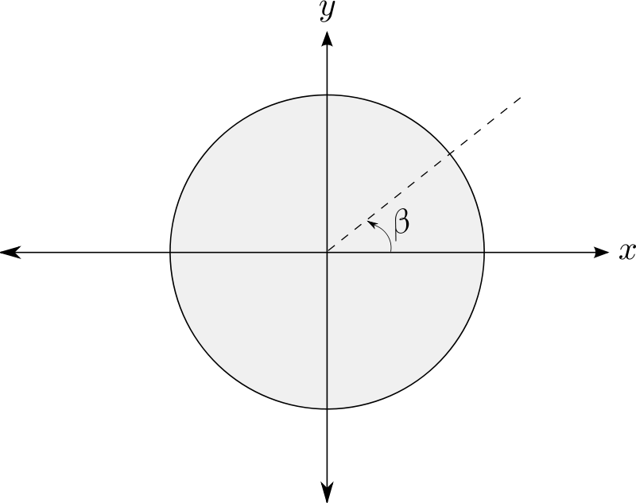


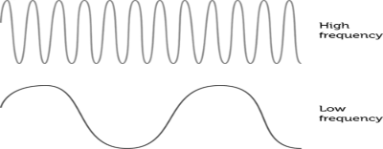

Data Series
Angle
Is a sequence of points ordered along some dimension
Processing
  Similarity search (based on a distance metric)
Challenges
  very large size of data series collections
  high dimensionality
Position
Mass
value
x₁
x₂
…
x_{n}
v₂
v₁
Frequency
Time
sequence dimension

Slide 3
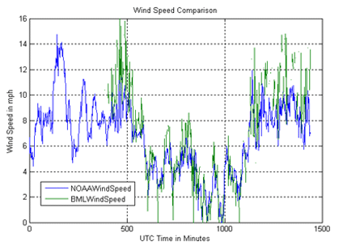
Data Series
Many applications
  Seismology, Meteorology, Oceanography, Astrophysics, Neuroscience, Biology
Average number of calls
Wind speed
From ocean observing node project, http://bml.ucdavis.edu/boon/wind.html

Slide 4
How Does a data series index work?
State-of-the art data series indexes are blocking
Raw Data Series
Final Answer set
query
summarized query
Verify against Raw Data Series
Raw Data Series
Summarized Data Series
Best So Far
(BSF)
Answer Superset

Slide 5
Blocking & Non-Blocking Algorithms
Blocking Algorithms
  Usually use locks.
Locks can lead to performance degradation
  If a thread holding the lock fails or experience delays , other threads are blocked.
Locks can also result in undesired behavior:
  Priority Inversion
  Convoying
Lock-free Algorithms
  Have some sort of helping mechanism.
  Expensive, difficult to design and implement.

Slide 6
Our Contributions
Develop RefreSh, a theoretical framework for supporting lock-freedom in a systematic way on top of highly-efficient data series indexes.
Develop FreSh, the first lock-free, iSAX-based data series index.
FreSh performs as efficient as the state-of-the-art blocking index.
FreSh outperforms by far lock-free implementations based on conventional approaches.
Introduce the traverse object for developing state-of-the-art data series indexes in a modular way.

Slide 7
Locality Awareness
To have good performance, state-of-the-art data-series indexes must respect a property, called locality awareness that we formalize.
Locality awareness has three principles:
  Data Locality.
  High Parallelism & Low Synchronization Cost.
  Load Balancing.

Slide 8
Locality aware data series index.
Threads
1st Stage of Index Construction
Summarized Data Series
1st Summarization Buffer
N^{th} Summarization Buffer
Raw Data Series
Split Raw data
1st _{part}
Insert
2st _{part}
Mth _{part}
Notes:
which splits its workload into disjoint parts
and assigns them to threads for processing

Slide 9
Locality aware data series index.
Threads
2st Stage of Index Construction
1st Summarization Buffer
N^{th} Summarization Buffer
1st Subtree
N^{th} Subtree
Insert
Notes:
which splits its workload into disjoint parts
and assigns them to threads for processing

Slide 10
Locality aware data series index.
Threads
Query Answering
BSF
Priority Queues
query
summarized query
Insert
1st Subtree
N^{th} Subtree

Slide 11
Locality aware data series index.
Threads
Query Answering
BSF
Priority Queues
query
summarized query
Calculate distances
Final Answer set
Insert
1st Subtree
N^{st} Subtree

Slide 12
RefreSh
Generic approach
Applicable to any blocking locality aware data series index
Ensures lock-freedom
In expeditive mode
(while not helped)
Acquire and process
parts stage
thread 1
Acquire parts
(one after the other
using a counter object)
Mark part as processed
(set d_{i})
thread 2
Process part
In standard mode
(if helped)
thread N
w₁
w₂
w₃
w_{k}
If no more parts to acquire go to helping phase
`
Workload
Helping stage
_{H1}
_{H2}
_{H3}
_{Hk}
Scan for unprocessed parts (read d₁,…,d_{k)}
_{D1}
_{D2}
_{D3}
_{Dk}
mark helped part as processed
(set d₃)
Help unprocessed parts in standard mode
Set helper flag of unprocessed part (set h₃)
For each
unprocessed part

Slide 13
RefreSh
We split workload into smaller chunks
We create flags for each chunk
W_{1.1}
W_{1.2}
W_{1.3}
W_{1.c}
H_{1.1}
H_{1.2}
H_{1.3}
H_{1.C}
_{H1}
D_{1.1}
D_{1.2}
D_{1.3}
D_{1.C}
_{D1}
In expeditive mode
(while not helped)
Acquire and process
parts stage
thread 1
Acquire parts
(one after the other
using a counter object)
Mark part as processed
(set d_{i})
thread 2
Process part
In standard mode
(if helped)
thread N
w₁
w₂
w₃
w_{k}
If no more parts to acquire, go to helping phase
`
Workload
Helping stage
_{H1}
_{H2}
_{H3}
_{Hk}
Scan for unprocessed parts (read d₁,…,d_{k)}
_{D1}
_{D2}
_{D3}
_{Dk}
mark helped part as processed
(set d₃)
Help unprocessed parts in standard mode
Set helper flag of unprocessed part (set h₃)
For each
unprocessed part

Slide 14
RefreSh
Acquire and process
parts stage
thread 1
Acquire parts
(one after the other
using a counter object)
Mark part as processed
(set d_{i})
thread 2
Process part
In expeditive mode
(while not helped)
thread N
In standard mode
(if helped)
If no more parts to acquire go to helping phase
`
Workload
W_{1.1}
W_{1.2}
W_{1.3}
W_{1.c}
W_{2.1}
W_{2.2}
W_{2.3}
W_{2.c}
W_{3.1}
W_{3.2}
W_{3.3}
W_{3.c}
W_{k.1}
W_{k.2}
W_{k.3}
Wk.c
Helping stage
H_{1.1}
H_{1.2}
H_{1.3}
H_{1.C}
_{H1}
H_{2.1}
H_{2.2}
H_{2.3}
H_{2.C}
_{H2}
H_{3.1}
H_{3.2}
H_{3.3}
H_{3.C}
_{H3}
H_{k.1}
H_{k.2}
H_{k.3}
H_{k.C}
_{Hk}
Scan for unprocessed parts (read d₁,…,d_{k)}
D_{1.1}
D_{1.2}
D_{1.3}
D_{1.C}
_{D1}
D_{2.1}
D_{2.2}
D_{2.3}
D_{2.C}
_{D2}
D_{3.1}
D_{3.2}
D_{3.3}
D_{3.C}
_{D3}
D_{k.1}
D_{k.2}
D_{k.3}
D_{k.C}
_{Dk}
mark helped part as processed
(set d₃)
Help unprocessed parts in standard mode
Set helper flag of unprocessed part (set h₃)
For each
unprocessed part

Slide 15
FreSh: Tree Construction
The root of the tree has a large number N of binary subtrees.
Each node stores a key, left and right pointers.
The leaves store additionally an array D.
ROOT
. . . . . . . . . .
1st
2nd
2^{w} -1
2^{w}
. . . .
0
k

Slide 16
FreSh: Tree Construction
When a leaf is full thread(s) attempt to split the leaf.
iSAX Buffer 1
ROOT
Some positions of the array may be empty.
Each leaf contains an announce array.
Each thread announce its operation before
acquire a position.
x
Id:0
.
.
Id:1 Id:2
Leaf helper exists
x
. . . .
⊥
⊥
⊥
⊥
⊥
1st
0
N
x
. . . .
0
k

Slide 17
FreSh: Tree Construction
When a leaf is full thread(s) attempt to split the leaf.
iSAX Buffer 1
ROOT
Some positions of the array may be empty.
Each leaf contains an announce array.
Each thread announce its operation before
acquire a position.
x
y
z
Id:0
.
.
Id:1 Id:2
l
x1
p
Leaf helper exists
⊥
⊥
x1
⊥
. . . .
⊥
1st
0
N
x
y
z
l
. . . .
p
0
k

Slide 18
FreSh: Tree Construction
The new leaves contains not only the elements found in D but also those in Announce.
x
y
z
l
. . . .
p
x1
. . . .
⊥
⊥
⊥
⊥
0
k
0
N
p
If x1 <= p
If x1 > p
. . . .
⊥
⊥
. . . .
⊥
⊥
⊥
⊥
⊥
⊥
⊥
⊥
0
0
N
N
. . . .
. . . .
l
p
x1
x
y
z
x1
0
0
k
k

Slide 19
FreSh: Tree Construction
Tree insert has to support also the expeditive and standard mode.
Expeditive Mode
Standard mode
iSAX Buffer 1
ROOT
Threads have to synchronize
in order to operate on
the data structure
Threads acquire a position
and pos and store it in D[pos]
Thread is safe to operate
on the data structure
.
.
Leaf helper exists
1st
. . . .
0
k

Slide 20
Introduction to traverse object
Each phase of a locality-aware data series index use the data (or part of them) produced by the previous stage.
The traverse object supports 2 operations:
  PUT(S, e, param), adds an element e in S
  TRAVERSE(S, f , param, del ), traverses S and applies the function f on each of the traversed elements

Slide 21
Traverse object
Each stage of a locality aware data series index can be represented with a Traverse object.
As a result we have four Traverse Objects.
  Buffer Creation (BC)
  Tree Population (TP)
  Pruning (PS)
  Refinement (RS)

Slide 22
Traverse object
1^{st Stage}
2^{nd Stage}
BC
TP
Function
Function
Rs
PS
4th Stage
3^{rd Stage}
Function
Function
1st Subtree
N^{th} Subtree
Final Answer

Slide 23
Performance Analysis
Setup
  2 Intel Xeon E5-2650 v4 2.2GHz CPUs with 12 cores each, 30MB L3 cache and 256GB of RAM.
Experiments
  We use both real and synthetic datasets.
  We measure time for each stage.
  We compare SOTA MESSI, an optimized MESSI and FreSh

Slide 24
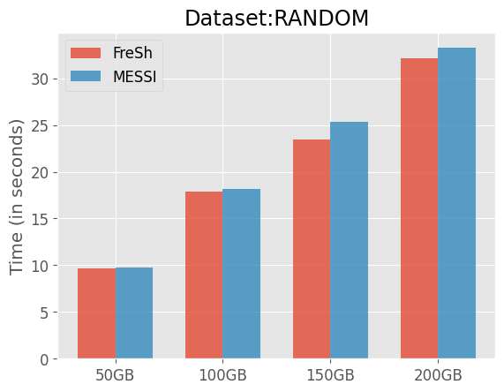
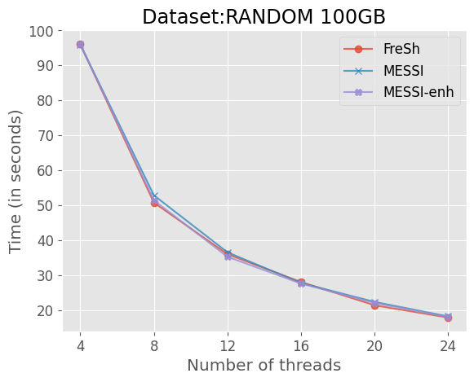
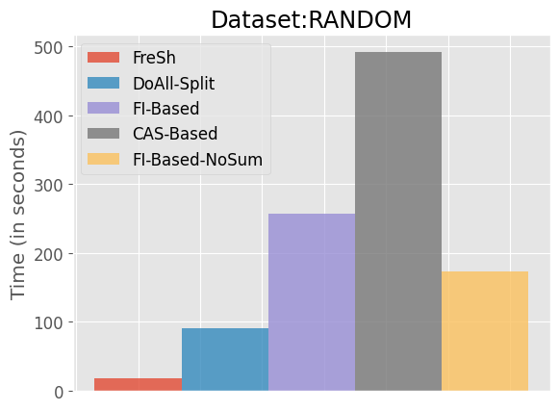
Performance Analysis
Total time
a) while dataset size increases
b) while number of threads increases
c) while using simple lock free techniques
FreSh exhibits performance as good as MESSI, while providing lock-freedom without overhead.

Slide 25
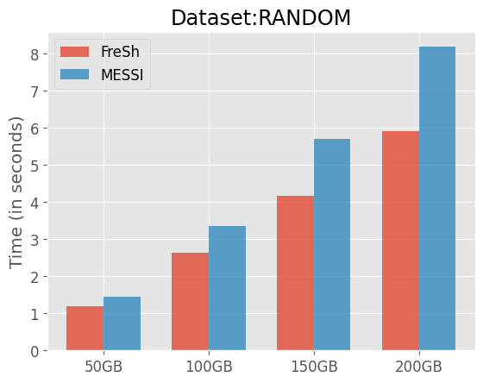
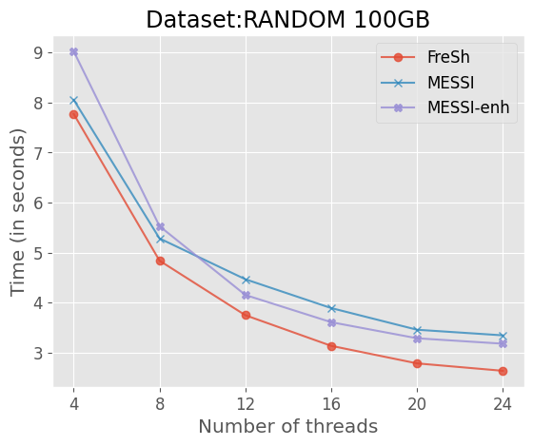
Performance Analysis
Tree index time:
a) while dataset size increases
b) while number of threads increases
FreSh implements a tree that supports multiple insert operations to concurrently update a leaf.

Slide 26
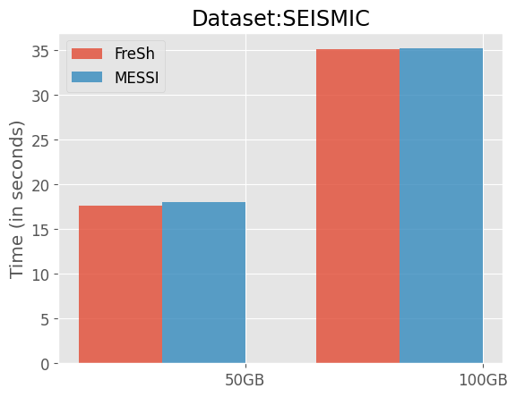
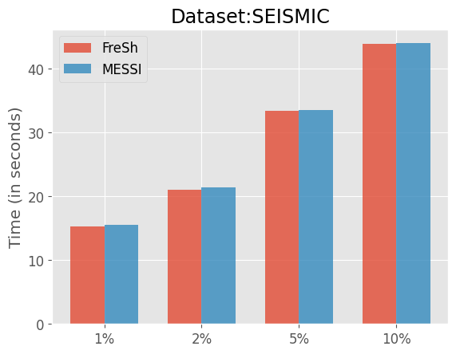
Performance Analysis
a) Total time: while dataset size increases
b) Query Answering: Increasing difficulty in queries
The performance of FreSh is also good with real datasets and challenging queries.

Slide 27
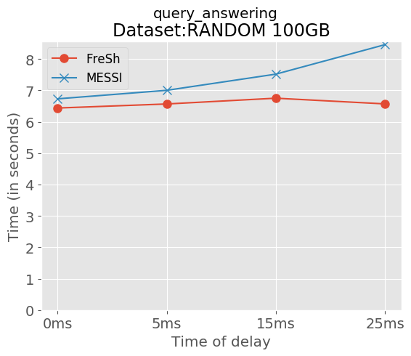
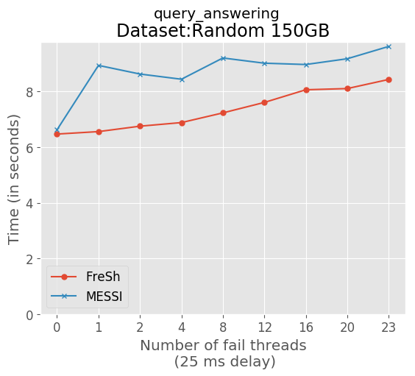
Performance Analysis
a) Increasing time of delay
b) Increasing number of delayed threads
FreSh maintains good performance on systems that may experience delays.

Slide 28
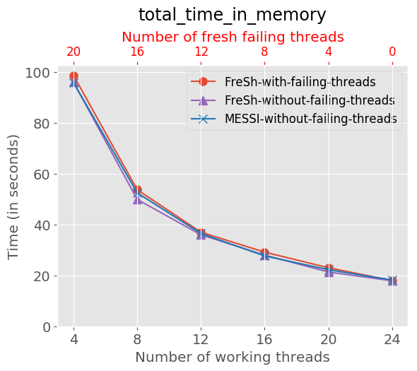
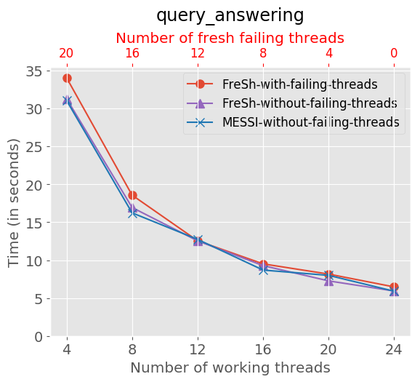
Performance Analysis
The performance of FreSh is maintained when the number of remaining
threads is equal to the number of working threads.

Slide 29
Conclusions
We developed and implemented FreSh the first lock-free data series index.
We designed Refresh , a framework for supporting lock-freedom in a systematic way on top of highly-efficient data series indexes.
We implemented a lock-free leaf-oriented tree data structure.
Results show that Refresh offers lock-freedom without overhead and that our lock-free leaf oriented tree enables higher parallelism and throughput.

